Slide 1

NPS and Its Alternatives

Slide 2
Table of Content
The actual framework and calculations description
The relevance of why we have selected this framework
Ease of using and handling WRT user and organization of this framework
Further questions to be asked to gain insights based on responses

Slide 3
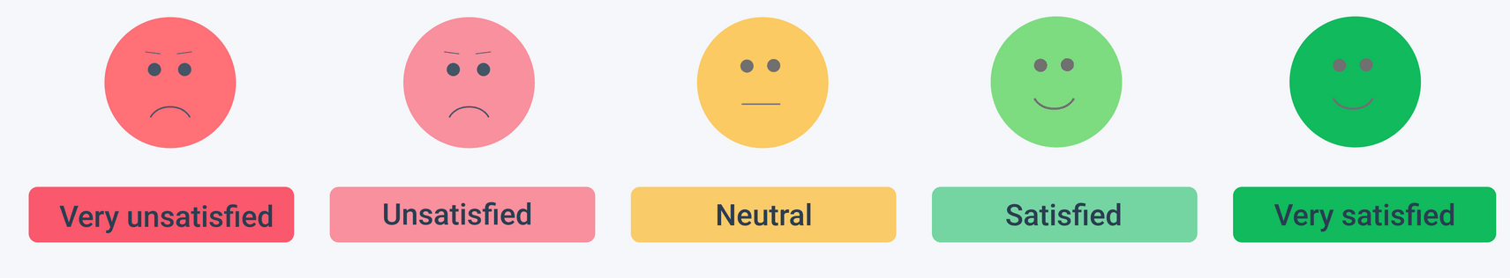
Customer Satisfaction Score (CSAT)
With a focus on customer satisfaction, the CSAT score centers around a single survey question:
“How satisfied were you with our service/product?”
Customers rank their level of satisfaction, usually on a scale from 1-5.
(Total number of 4 and 5 responses) ÷ (Total number of responses) x 100
Like NPS surveys, CSAT is easy to calculate and can be used to gauge satisfaction at different stages of the customer journey.
However, CSAT only explores satisfaction at that point in time, and doesn’t encompass customer loyalty.
Cons of CSAT:
It doesn't explain why customers were satisfied or unsatisfied with their experiences
Unable to predict future satisfaction levels.

Slide 4
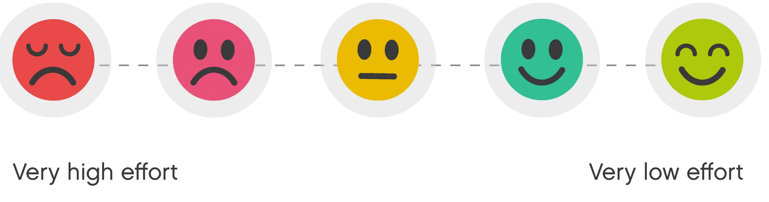
Customer Effort Score (CES)
CES ranks ease of use, a key factor to customer satisfaction, with a simple question:
“How much effort did it take to deal with us?”
Respondents rank the level of effort on a 1-5 scale.
(Total number of 4 and 5 responses) ÷ (Total number of responses) x 100
CES is easy to conduct and requires a straightforward calculation.
Its data can give businesses understanding behind feature adoption, potential problems to be addressed, and reasons for churn.
Also, like NPS and CSAT, CES survey questions should be supported with qualitative questions to get to the bottom of ‘why’ customers may feel a certain way.
Cons of CES:
It only lets you know if customers found a specific aspect of your business to be challenging, making it difficult to determine what made it difficult without asking follow-up questions to get more information.

Slide 5

Further findings
Technology: The degree to which the space is equipped with the right tools
calculation: average (from the ratings received from employees )
Measure the impact of workplace technology on your employee experience?
calculation: average (from the ratings received from employees )
Consider how well it embodies the characteristics of “frictionless technology”:
Is it mobile and cloud-based?
Intuitive?
Intelligent?
Secure?
Efficient?
Average service request response time
Employees' perception of technology mobility, ease of use, and efficiency

Slide 6
Further questions to gain insights based on responses.
How efficient is the service for you.
Would you like to tell us what is the shortcoming of our service/your expectations?
How satisfied are you with the response time of our service.
Would you like to share what we feature you need us to add in our service
Is our service easy to use

Slide 7
Why have we selected this set of framework?
Understanding customer experience about the service/product
Finding if customers are happy with Ultimatix services/product
Understanding areas of improvements in the services/product
Tracking customer's engagement (Loyalty) towards this service/product.
Gaining the insights on suggestions to improvise the product/service.

Slide 8
Ease of use of these frameworks
Like NPS this framework too consists of simple and lucid questions
This framework overcomes the shortcomings of NPS such as manipulative behaviour, anomalous behaviour and failure to find the actual reason for negative responses.

Slide 9
THANK YOU

