Slide 1
Alternative metric measurements of NPS

Slide 2
Table Of Content
Positive takeaways of NPS
Shortcomings of NPS
Alternative measurement metrics
Merits needed in Ideal Framework to measure Total Experience
Suitable Metrics
Why did we select CSAT and CES
NPS vs CSAT vs CES
Shortcomings of CSAT and CES WRT Ideal framework
How qualitative feedback questions are framed
Framed questions to gain qualitative feedback
References

Slide 3
Positive Takeaways from the Net Promoter Score
Simplicity at its Best
(there’s no doubt about the user-friendliness of NPS surveys. Customers love it because they are quick, short, and straightforward)
Employee Engagement Metric
(survey type helps you collect rich feedback about what drives employee engagement and what’s not)
The Loyalty Metric
(NPS plays a significant role in establishing word-of-mouth marketing and thus letting you analyze your customers’ loyalty)
Meet Your Brand Advocates
(You can understand who will be your brand advocate and promote or demote the product)
Quick Follow-Ups
(the NPS survey’s nature is quick, short, and straightforward)

Slide 4
Shortcomings of Net Promoter Score
Promoters, detractors and passive users are not well defined in NPS metrics
(I.e. The promoter can act as a detractor or a passive user as well & vice-a-versa is possible too)
NPS is not a suitable metric for measuring KPIs across internal products
(When there is not any involvement of any external users there is very little to no chance of referring the product to anyone else)
Net Promoter Score doesn’t pave a way to address employee issues
(NPS results don’t spell out the reasons for user's dissatisfaction towards the product/service)
The experience function somewhere remains unaddressed in the short run
(I.e., Experience is a combined key function of satisfaction, accessibility, usability and not loyalty alone)
The Net Promoter Score does not provide deep insights of the data
(Our aim of measuring total exp is to track the level of satisfaction and degree of serving the purpose for the user from the current services and in such case in-depth insights and data will help us to verify this)
The causes of shortfalls among services stays unknown
(Though NPS answers What part in the results , it fails to identify the Whys and Hows from the results)

Slide 5
Alternative Measurement Metrics
CSAT
Customer Satisfaction surveys are intuitive for everyone in the company to understand customer satisfaction
CES
Customer Effort Score explores how much effort a customer feels they had to put in to resolve an issue and is usually used to help customer service improve resolution times and provide higher-quality experiences.
Customer Churn
Customer churn is the percentage of customers that stopped using your product or service during a certain time frame.
Product engagement score (PES)
Product engagement score (PES) measures how engaged your customers are with your product, with a view that higher engagement means higher satisfaction levels.
Customer Health Score
Customer health score categorizes happy customers as healthy, and those who are struggling as unhealthy.
As we need metrics measurement for our internal product, metrics such as customer churn gets eliminated
Considering engagement of products, all employees use the services to accomplish their tasks
Our aim is to provide quality experience to fulfill their tasks in most efficient manner
By considering following requirements we found CSAT and CES relevant metrics for our product
To understand how much satisfied the user is with our service
To provide better experience to user as per their needs
To understand how much efforts does it take to use the service

Slide 6
Merits needed in Ideal Framework to measure Total Experience
Ease of use while measuring the score and calculating the results.
The questions included should draw out meaningful and active insights from respondents.
The framework should be capable of pointing out the positives as well as the negative points about current services/products.
It should also be able to track the various levels across satisfaction, ease of use, engagement, experience for user at the end of the survey.
The survey framework should ensure a holistic coverage of user's experiences across all the touchpoints within the service boundaries.

Slide 7
Suitable Metrics (Proposed to be used)
As we aim to provide value added service to our users the important factor is to understand users' satisfaction and ease of use of service
CSAT focuses on satisfaction whereas CES focuses on finding out effort needed to use the service
Customer Satisfaction Score (CSAT):
With a focus on customer satisfaction, the CSAT score centers around a single survey question:
“How satisfied were you with our service/product?”
Customers rank their level of satisfaction, usually on a scale from 1-5.
CSAT score of 75% or more is considered good and 80% or more is considered the gold standard.
Calculation of CSAT
(Total number of 4 and 5 responses) ÷ (Total number of responses) x 100
CSAT only explores satisfaction at that point in time and doesn’t encompass customer loyalty.
2. Customer Effort Score (CES)
CES ranks ease of use, a key factor to customer satisfaction, with a simple question:
“How much effort did it take to deal with us?”
Respondents rank the level of effort on a 1-5 scale.
There is no one universally accepted number that shows a good customer score, lesser the effort higher is the score
You can draw positive conclusions about the customer experience if the number stays around the higher end of the scale
Calculation of CES
(Total number of 4 and 5 responses) ÷ (Total number of responses) x 100
CES is easy to conduct and requires a straightforward calculation.

Slide 8
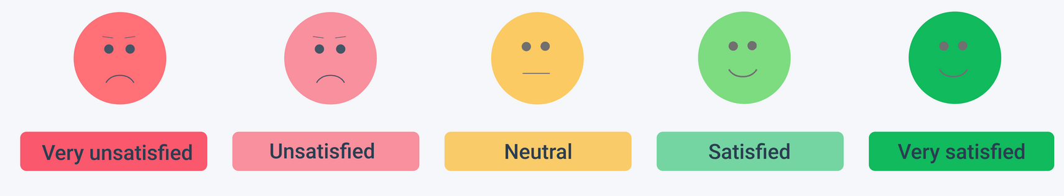
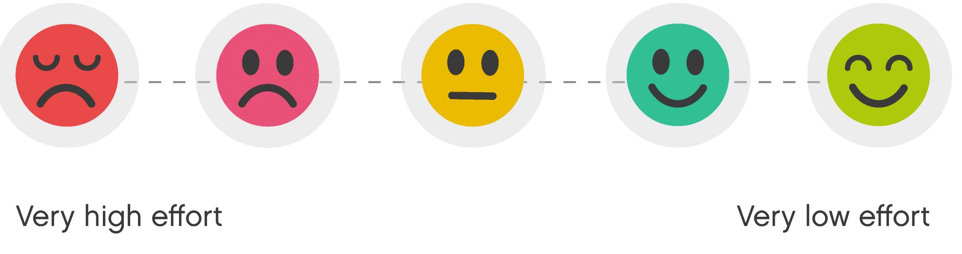
Why did we select CSAT and CES
To overcome the shortfalls of NPS and to have access to in-depth insights about the products and services offered under Ultimatix we have selected CSAT and CES as the metrics to measure user experience on behalf of following plus points they offer within the framework.
CSAT
Easy To complete the survey
Easy To Calculate Your Score
In-depth insights of customer experience
Helps improve overall quality of the product
Helps implement better solutions
Shorter and well-defined scale for understanding responses
Makes continuous improvement simple
Helps understand how internal changes impact customer satisfaction
Helps in better management of product
CES
Easy to implement survey
Easy To Calculate Your Score
Corrective actions can be taken by analyzing the responses
Useful in testing the effectiveness of service
Might help to uncover problems faced by user while using the service

Slide 9
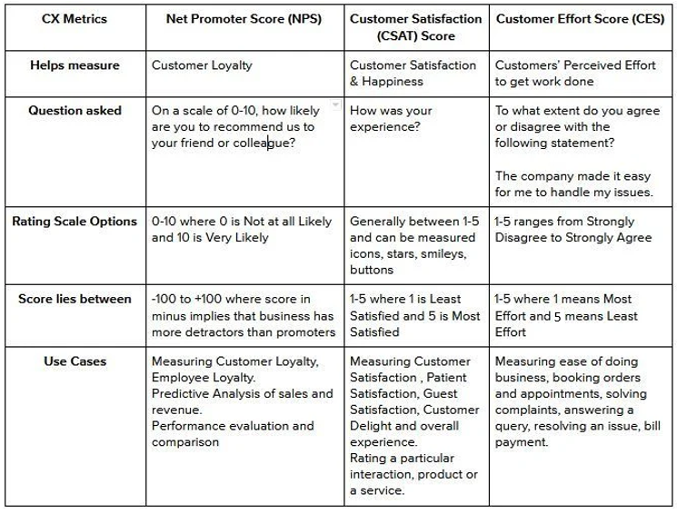
NPS vs CSAT vs CES

Slide 10
Shortcomings of CSAT and CES WRT Ideal framework
Shortcomings of CSAT:
Doesn't explain why customers were satisfied or unsatisfied with their experiences
Unable to predict future satisfaction levels
Shortcomings of CES:
Difficult to determine what made a specific aspect difficult to use for use
Insights about user's expectation from the service/product is not known
The scope of improvement for next cycles remains unclear

Slide 11
How and Why are qualitative feedback questions framed
On what basis qualitative feedback questions are framed
What are the use of features provided in those Ultimatix services
Who is the user of the service
How frequently is the service used
Who has the access to particular service
Why are the questions framed:
To understand the positives and negatives of the services at every touchpoint from users' perspective
To understand if the product/service is fulfilling the user's needs
To track if the product is matching the expectation of the user
To know the deep insights & full proof scores obtained from CSAT & CES
To fill the voids which remains after CSAT & CES surveys there is need to ask some qualitative and descriptive nature of questions along with so that to obtain meaningful conclusions and actionable plans at the end of the surveys.

Slide 12
Framed questions to gain qualitative feedback
Asking engaging questions to users will help understand their experience and support CSAT and CES scores​
Generalized Feedback Questions for qualitative data | Type of Question
Rate how efficient is the service for you | Rating based
Rate the response time of our service | Rating based
Rate how fast is the request acknowledged | Rating based
Rate the usefulness of this service | Rating based
Is this service easy to use | Yes/No
Would you like to tell us what is the shortcoming of our service/your expectations? | Descriptive & Optional
Would you like to share what we feature you need us to add in our service | Descriptive & Optional
Application Specific Questions | Application Type
Rate how satisfied are you with the learning material provided here | Learning Platforms
Rate how much this helped you maintain privacy | Privacy Maintenance Platforms
Is the tracking status updated regularly | Trackers
Is the information sufficient? | Refer / Process Information

Slide 13
Service based sample questions
Application Specific Questions (Timesheet)
Are the available features enough to cater user's requirement while accessing Timesheet?
If not what additional features will the user be willing to suggest for addition?
Does the user face any issue/complexity while filling the timesheet?
Are you easily able to modify the filled data for any correction purpose?
Is the time frame suitable within which you can enter the data for previous days?
Do the options available in the dropdown match with the work you do?
Do you face any issues while downloading the excel sheet for filled data?
Application Specific Questions (I evolve)
Are the courses and its content relevant for the user?
Is the course content up to date?
Is it easy to search for a particular course from the dashboard?
Does the certificate of completion immediately load up after course completion?
Is the interface easy to use for a new user?
Is the designation-compliance requirement data available to see on the platform?

Slide 14
Summary
The more satisfied customers you have, the more likely you are to increase your customer experience
To correct any customer satisfaction issues you first need to know what is going on, and ask what your customers need and expect from you
The CSAT is a simple yet powerful metric that helps you keep track of how happy your customers are in their interactions with your company
The survey responses can be used to enhance your products and services, and your overall customer experience
Customer recommendations are more powerful than ever in today’s world
Customers turn toward businesses that go beyond just satisfying them, but instead delight them
Putting user experience at the heart is what we are trying to bring up using these metrics

Slide 15
References
https://www.intotheminds.com/blog/en/disadvantages-net-promoter-score-nps/
https://hbr.org/2019/10/where-net-promoter-score-goes-wrong
https://trustmary.com/nps-net-promoter-score/alternatives-to-nps-net-promoter-score/
https://monkeylearn.com/csat/
https://elearningindustry.com/advertise/elearning-marketing-resources/blog/why-use-net-promoter-score

