Slide 1
CSE-5324 –Software Engineering Analysis and Design
MAV$HOP
TEAM-2-Smartinis
Iteration-3
Group Members:-
Neha Anil Shimpi (Team captain)
Sucharitha Cheenepalli
Akshat Ashwin Shah
Sushmitha Srinath Kenkare
Rupal Ravindra Godbole
Sai Sravanthi Podilli
Instructor: Dr. Michael F. Siok

Slide 2
Agenda
Project Description
Overall Technical Approach
Requirements
Use Cases
High Level Use Cases
Domain Diagram
Requirements Use Case Traceability Matrix
Increment matrix
Expanded Use Cases
Sequence Diagram
Domain Class Diagram
Demo
Task List
Summary

Slide 3
Project Description
Mav$hop is an app which will facilitate user within UTA to sell or buy items when moving in/moving out of the campus.
Mav$hop helps user to purchase and sell an item.
User who wishes to sell an item will post the product on the app with necessary details.
User who buys an item will have categories like furniture, kitchenware, electronic and more to select from and proceed for payment.

Slide 4
Overall Technical Approach
Requirement Analysis
Designing
Coding
Testing
Planning
Coding
Testing
Determining scope
Determining high level plan
Gathering business requirements
Performing detailed analysis.
Analyzing needs to ensure end systems meets expectation
Describe features and operations of the system.
Includes design documents
Actual code implementation.
Finding any issues in the end system.

Slide 5
Requirements
Req ID​ | Req Statement​ | Line Reference​
R1​ | The app shall allow the user to choose between login or register.​ | Derived​
R2​ | If the user wants to register, the app shall allow the user to enter details like first-name, last-name, email-id, password and address for the registration | 9,10,11​
R3​ | If the user selects to login, the app shall allow the users to login through authentication. ​ | 12​
R4​ | The app shall provide a reset password function for registered users.​ | 13​
R5​ | The app shall provide the user with list of categories.​ | 15-17​
R6​ | The app shall allow the user to select an item from the list.​ | Derived​
R7​ | The app shall allow the user to buy the item which he has selected. | 24,25​
R8​ | The app shall allow the user to enter payment details like card number, CVV, expiry date and name if willing to buy the item | 27​
R9​ | The app should check the card details provided by user and process the payment.​ | Derived​
R10​ | The app shall allow the user to sell the item after entering contact details, required information and uploadingappropriate images of the item.​ | 19-22​
R11​ | The app shall allow user to edit his personal details such as Phone number and Address n the profile section.​ | Derived​
R12​ | The app shall provide user with his purchase and selling history.​ | Derived​
R13​ | The app shall provide user to logout from application.​ | Derived​

Slide 6
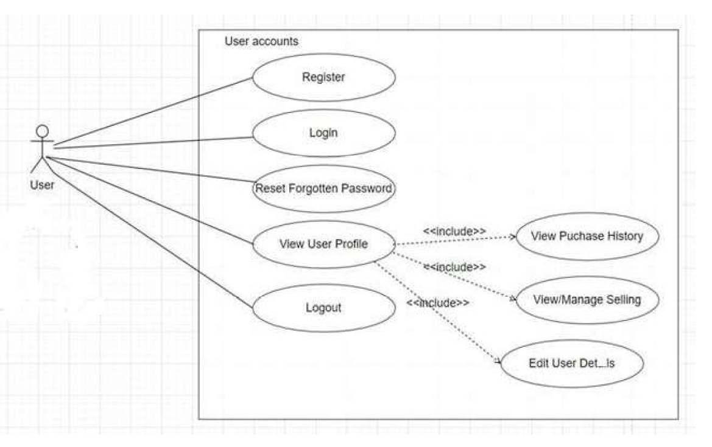
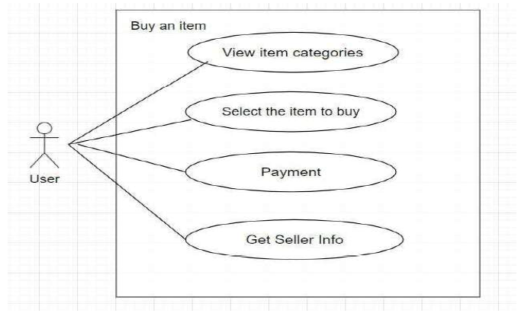
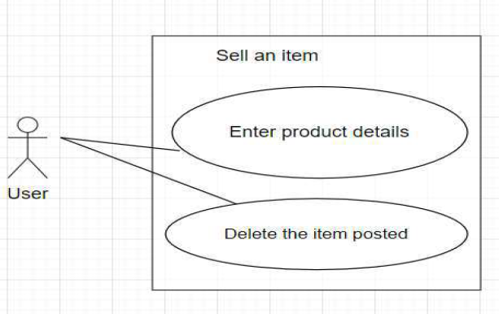
Use Cases
Use Case # ​ | Use Case Name ​
UC1 ​ | Register ​
UC2 ​ | Login ​
UC3 ​ | Select Item Category ​
UC3.1 ​ | View and Select the item to purchase from the listing
UC3.1.1 ​ | View Seller Information ​
UC3.1.2 ​ | Enter Payment Information and Pay ​
UC4 ​ | Enter Product Details ​
UC5 ​ | View User Profile ​
UC5.1 ​ | Edit User Details​
UC5.2​ | View Purchase History ​
UC5.3​ | View and Manage Selling ​
UC5.3.1​ | Delete Item from Listings ​
UC5.4​ | Logout ​
UC6​ | Reset Forgotten Password ​

Slide 7
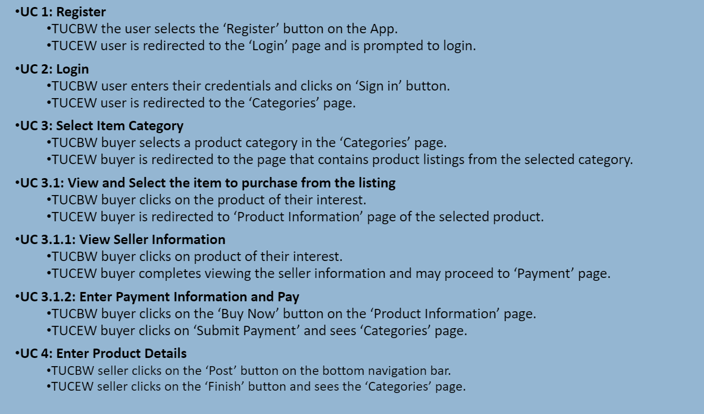
High Level Use Cases

Slide 8
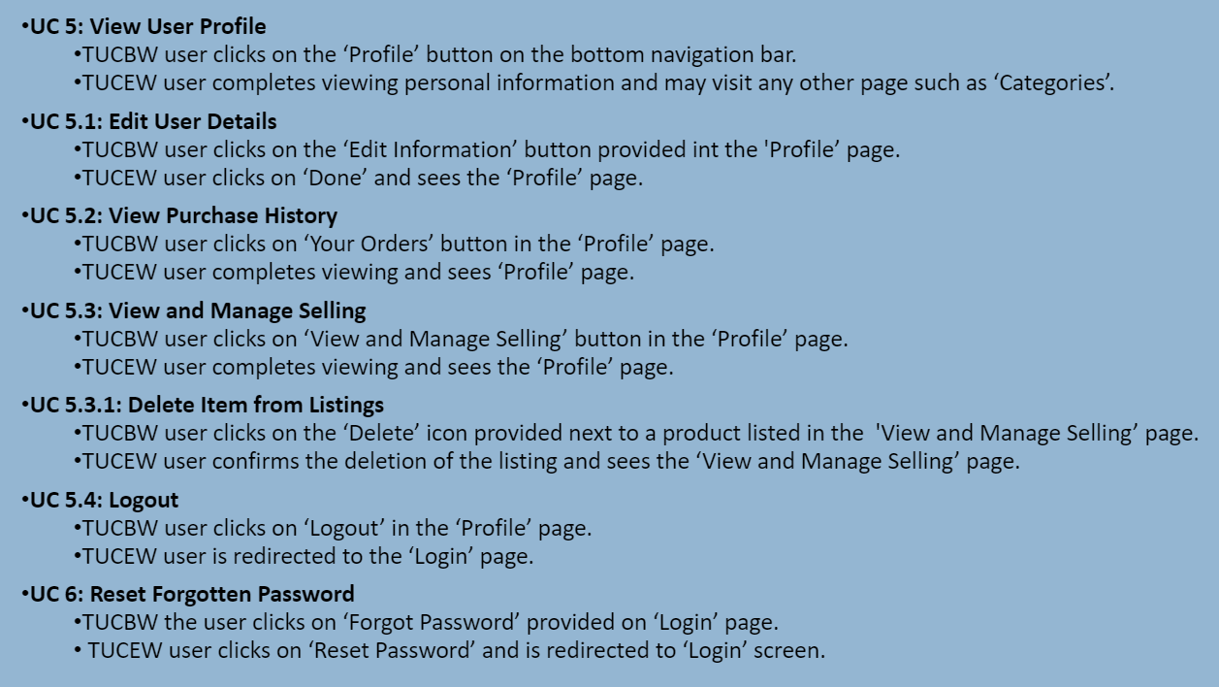
High Level Use Cases

Slide 9
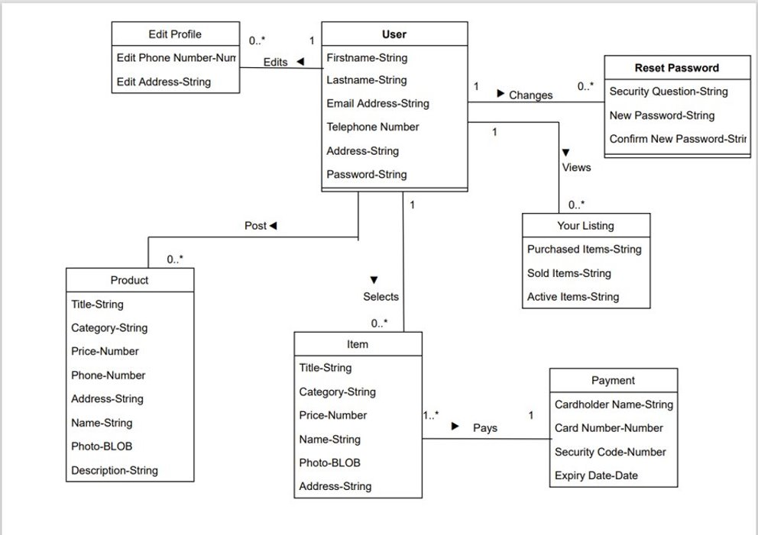
Domain Diagram

Slide 10
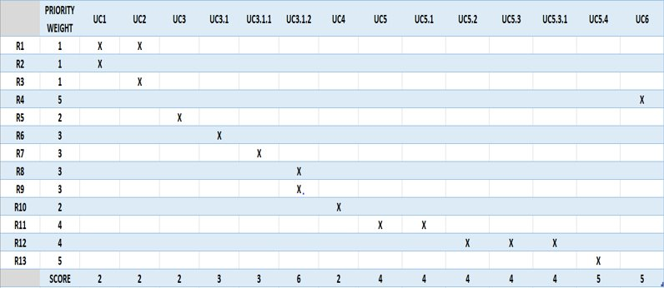
Requirement To Use Case Traceability Matrix
NOTE : Priority weight 1 is the highest priority​

Slide 11
Increment Matrix
Use Case | Priority | Effort (Person - weeks) | Depends On | Iteration 1 (03/10/2021) | Iteration 2 (04/05/2021) | Iteration 3 (05/03/2021)
UC1 | 2 | 3 | NONE | 3
UC2 | 2 | 3 | UC1 | 3
UC3 | 2 | 2 | UC2 |  | 2
UC3.1 | 3 | 5 | UC3 |  |  | 5
UC3.1.1 | 3 | 1 | UC3.1 |  |  | 1
UC3.1.2 | 6 | 2 | UC3.1.1 |  |  | 2
UC4 | 2 | 4 | UC2 |  |  | 4
UC5 | 4 | 6 | UC2 |  |  | 6
UC5.1 | 4 | 1 | UC5 |  |  | 1
UC5.2 | 4 | 2 | UC5 |  |  | 2
UC5.3 | 4 | 2 | UC5 |  |  | 2
UC5.3.1 | 4 | 1 | UC5 |  |  | 1
UC5.4 | 5 | 2 | UC5.4 |  |  | 2
UC6 | 5 | 2 | NONE | 2
Total Effort |  | 36 |  | 8 | 2 | 26
1 PW = 5 Hrs |  |  |  | 40 | 10 | 130
Total PW = 180

Slide 12
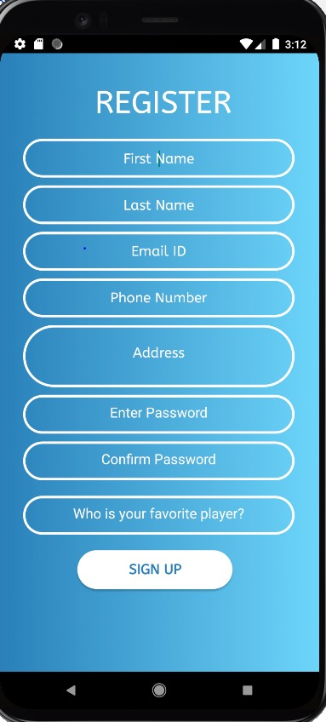
Expanded Use Cases
EUC1: Register
Precondition: This use case assumes user is on the main page and wants to register for the application
Actor: User | System: MavShop
1. TUCBW the user selects the ‘Register’ button on the App. ​ 3. User enter all his details and click on register button. 5. TUCEW user is redirected to the ‘Login’ page and is prompted to login. | 0. System displays the main page. 2. User is redirected to Register page. *4. System validates all the data entered by user and create a new entry into the database if no error is found and redirected to “login” page.
Postcondition: User is registered for application and can login.

Slide 13
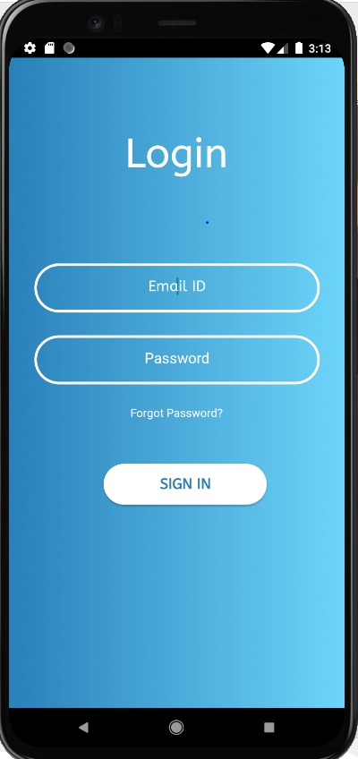
Expanded Use Cases
EUC2: Login
Precondition: User must be registered into MavShop
Actor: User | System: MavShop
1. TUCBW user enters their credentials and clicks on ‘Sign in’ button. 5. TUCEW user is redirected to the ‘Categories’ page. | 0. System displays the login page. *2. System will validate user input and display the following: If the login credentials don’t match, user will be showed “User not found! Please Register” message. If the user puts any email id other than UTA email address he will be displayed with message saying “Invalid email id. Please use UTA email address”. If the login credentials match system, then user will be redirected to app homepage. If user forgets the password, he will be asked to reset password.
Postcondition: User must be provided with the Categories page which displays various product categories.

Slide 14
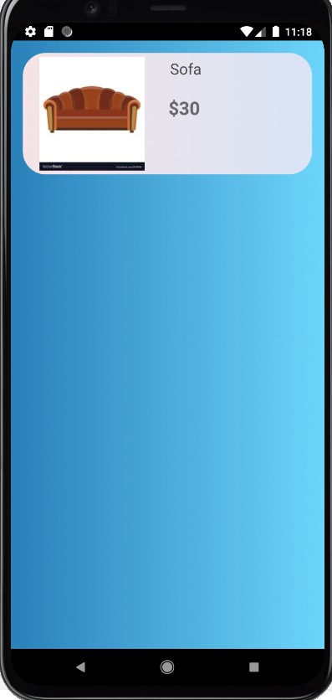
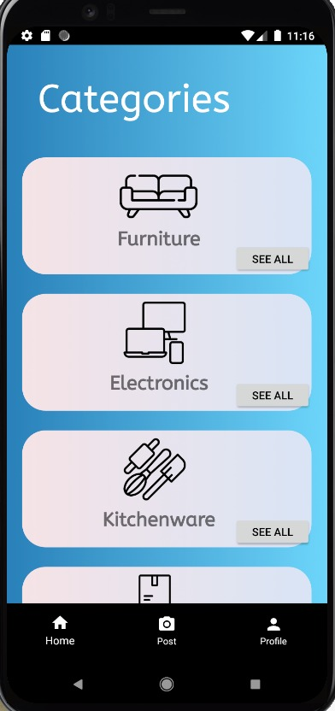
Expanded Use Cases (Contd.)
EUC3.1: View and Select Item to Purchase from the Listing
Precondition: Use case assumes that the user is on Categories Page
Actor: User | System: MavShop
1. TUCBW buyer clicks on the product of their interest. 3. TUCEW buyer is redirected to ‘Product Information’ page of the selected product. | 0. System displays the product categories. *2. System should fetch the products of the selected category from the database.
Postcondition: User should be able to select any product which he wants to buy.

Slide 15
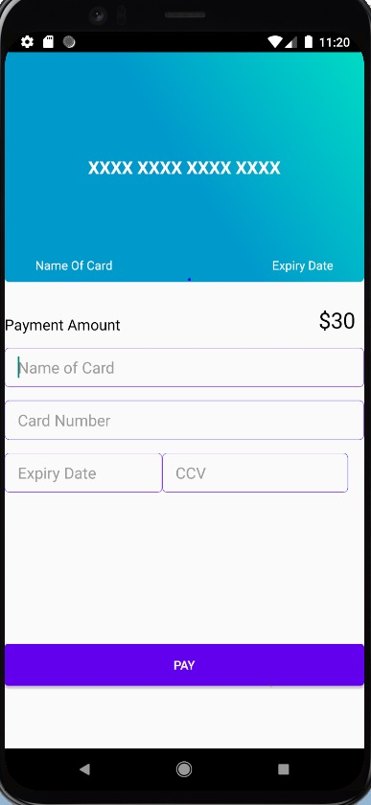
Expanded Use Cases (Contd.)
EUC3.1.2: Enter Payment Information and Pay
Precondition: Use case assumes that the user has selected the product he wants to buy.
Actor: User | System: MavShop
1. TUCBW buyer clicks on the ‘Buy Now’ button on the ‘Product Information’ page. 3. User enters the payment details and clicks on submit button. 5. TUCEW buyer clicks on ‘Submit Payment’ and sees ‘Categories’ page. | * 0. System displays the product information to the product he wants to buy. 2. System displays the form to enter payment details of the user. *4. System will validate the user card credentials and display the following: If the card details entered are correct, user will be shown “Payment Successful” message. If the card number is not 16-digit, user will be shown “Invalid Card Number” message. If the card CVV number is not three-digit, user will be shown “Invalid CVV” message.
Postcondition: Product should be disabled from the product list.

Slide 16
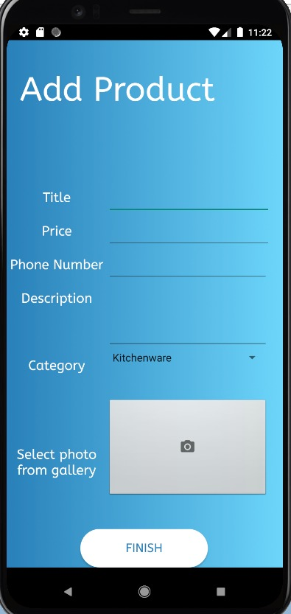
Expanded Use Cases (Contd.)
EUC4: Enter Product Details
Precondition: This use case assumes user is on MavShop and wants to sell a product.
Actor: User | System: MavShop
1. TUCBW seller clicks on the ‘Post’ button on the bottom navigation bar.​ 3. The user enters all the necessary details of the product and clicks the “submit” button. 5. TUCEW seller clicks on the ‘Finish’ button and sees the ‘Categories’ page. | 0. System displays the app pages with bottom navigation bar. 2. System displays a page where user should fill up product details. *4. System validates all the mandatory field information and details are inserted into database.
Postcondition: User must see the product he added in the product listing.

Slide 17
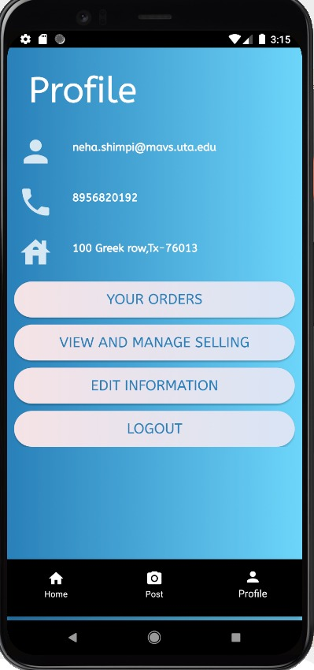
Expanded Use Cases (Contd.)
EUC5: View User Profile
Precondition: This use case assumes user wants to view Profile Page
Actor: User | System: MavShop
1. TUCBW user clicks on the ‘Profile’ button on the bottom navigation bar. 3. TUCEW user completes viewing personal information and may visit any other page such as ‘Categories’. ​ | 0. System displays the app pages with bottom navigation bar. *2. System displays the profile page where user’s personal details, order history and selling information are displayed.
Postcondition: User must see the edited fields in the personal details.

Slide 18
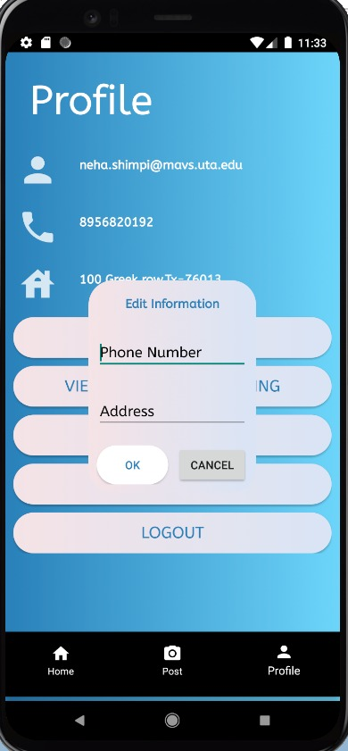
Expanded Use Cases (Contd.)
EUC5.1: Edit User Details
Precondition: This use case assumes user is on Profile Page
Actor: User | System: MavShop
1. TUCBW user clicks on the ‘edit information’ button provided on the ‘Profile’ page. 3. TUCEW user clicks on ‘Done’ and sees the ‘Profile’ page. | 0. System displays the user personal details. *2. System validates the values and inserts the new values to the database.
Postcondition: User must see the updated information on the Profile Page.

Slide 19
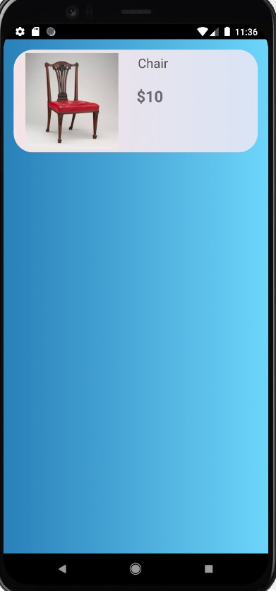
Expanded Use Cases (Contd.)
EUC5.2: View Purchase History
Precondition: This use case assumes user is on Profile Page
Actor: User | System: MavShop
1. TUCBW user clicks on ‘Your Orders’ button in the ‘Profile’ page. 3. TUCEW user completes viewing and sees ‘Profile’ page. | 0. System displays the user personal details. *2. System checks all the purchase history of that particular user from the database and return it to “purchase history” page.
Postcondition: User has seen his purchase history up to date.

Slide 20
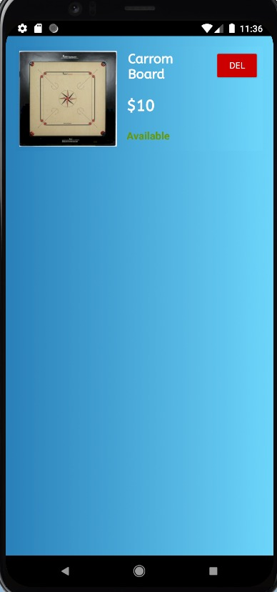
Expanded Use Cases (Contd.)
EUC5.3: View and Manage Selling
Precondition: This use case assumes user is on Profile Page and wants to view Manage selling tab.
Actor: User | System: MavShop
1. TUCBW user clicks on ‘View and Manage Selling’ button in the ‘Profile’ page. 3. TUCEW user completes viewing and sees the ‘Profile’ page. | 0. System displays the Profile Page. *2. System displays a page where all the products previously sold by the user and his active listings are displayed.
Postcondition: User has seen his Selling history and active listings up to date

Slide 21
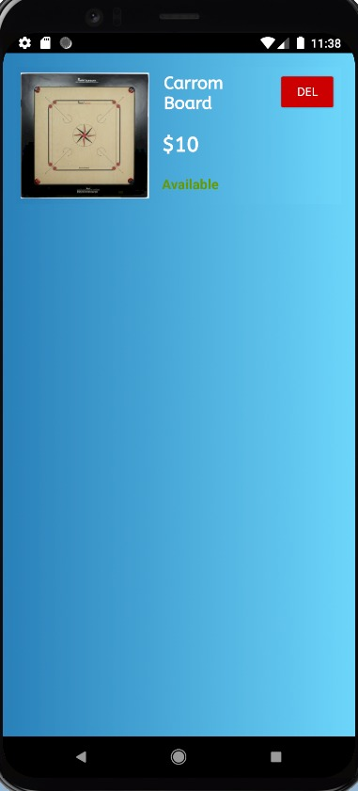
Expanded Use Cases (Contd.)
EUC5.3.1: Delete Item from Listing
Precondition: This use case assumes user is on View and Manage Selling Page
Actor: User | System: MavShop
1. TUCBW user clicks on the ‘Delete’ icon provided next to a product listed in the ‘View and Manage Selling’ page. 3. TUCEW user confirms the deletion of the listing and sees the ‘View and Manage Selling’ page. | 0. System displays the active products listing. *2. System deletes the entry of that product from the database.
Postcondition: User must not see the deleted product in the products listing.

Slide 22
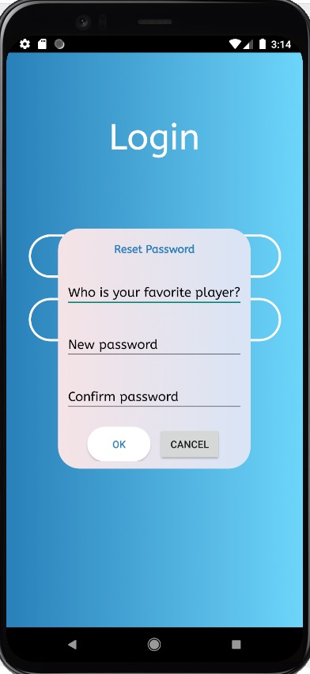
Expanded Use Cases (Contd.)
EUC6: Reset Forgotten Password
Precondition: This use case assumes user has forgotten the password and clicked on Forgot password link.
Actor: User | System: MavShop
1. TUCBW the user clicks on ‘Forgot Password’ provided on ‘Login’ page. 3. User enters the answer to security question and new password he wants to set and clicks on Submit 5. TUCEW user clicks on ‘Reset Password’ and is redirected to ‘Login’ screen. | 0. System displays the Login UI page. 2. System displays the Reset -Password Page. *4. New password is updated in the database.
Postcondition: User must sign in to application with the new password which he just changed.

Slide 23
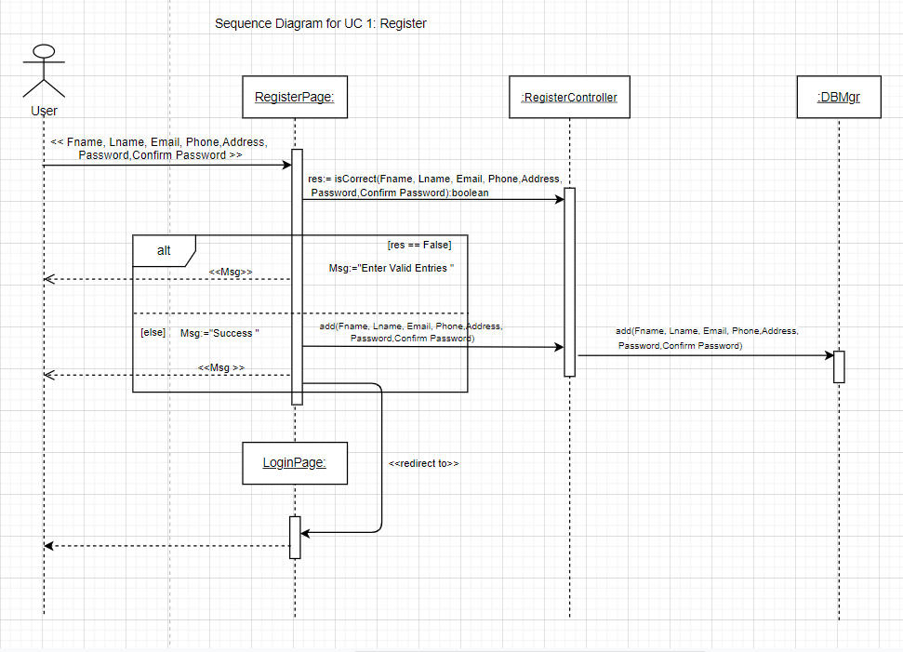
Sequence Diagram

Slide 24
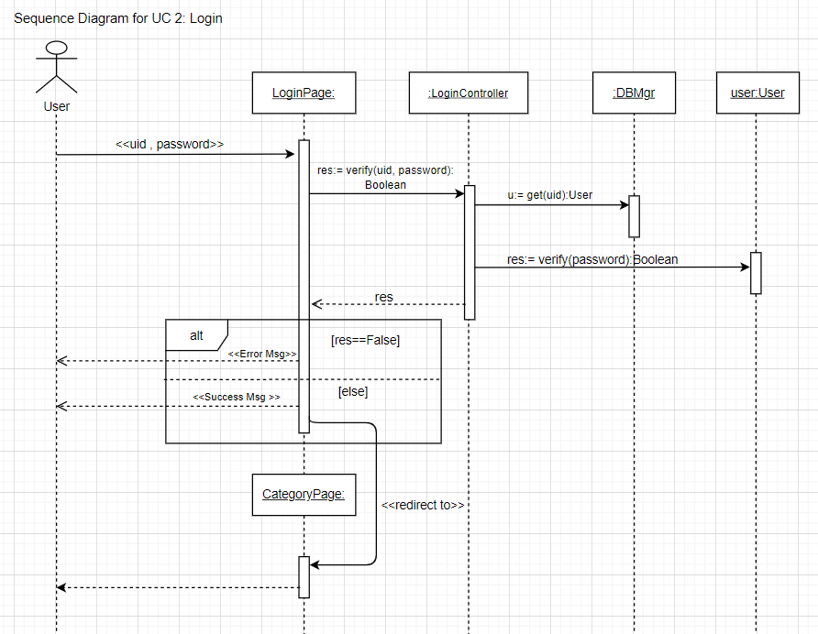

Slide 25
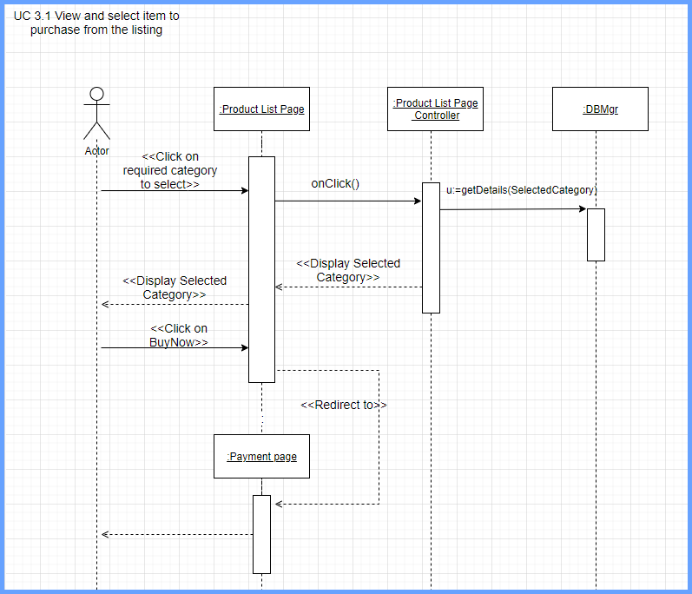

Slide 26
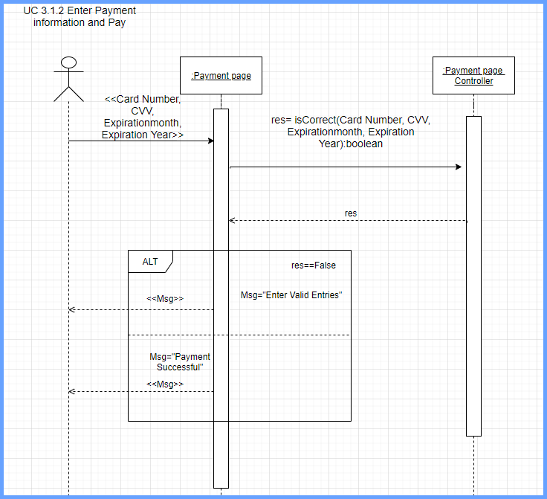

Slide 27
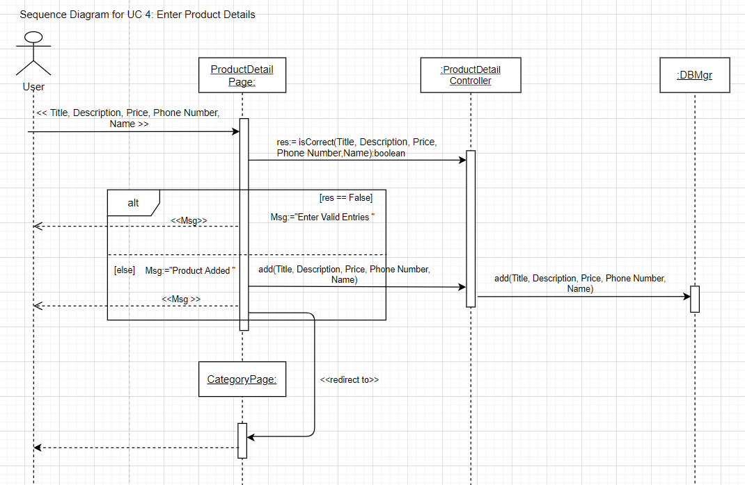

Slide 28
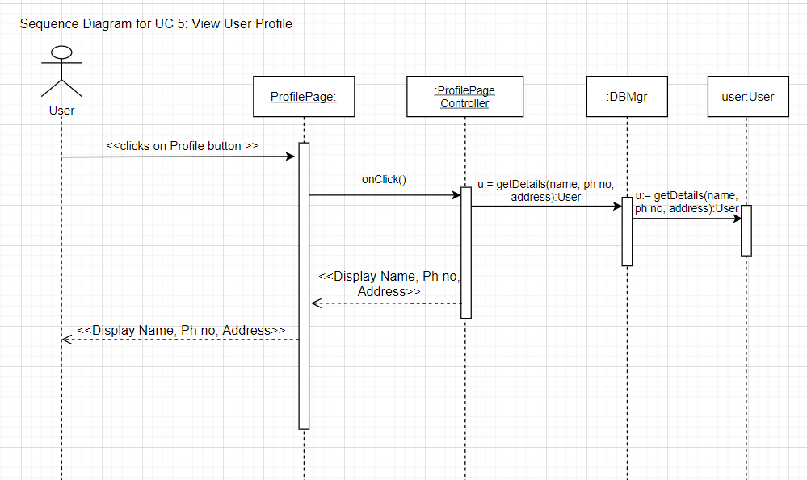

Slide 29
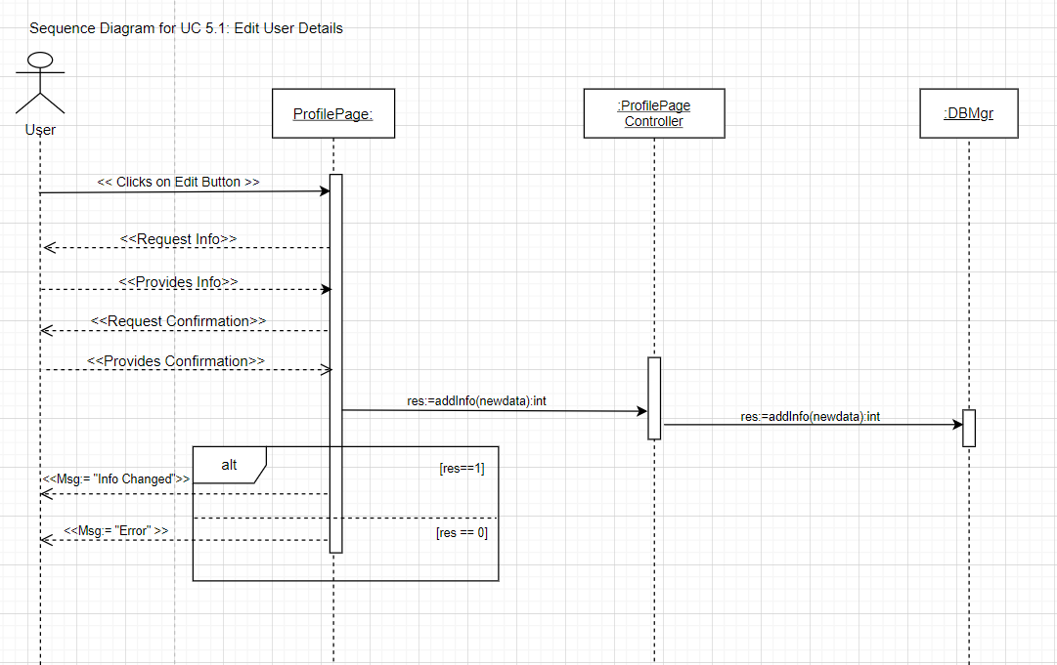

Slide 30
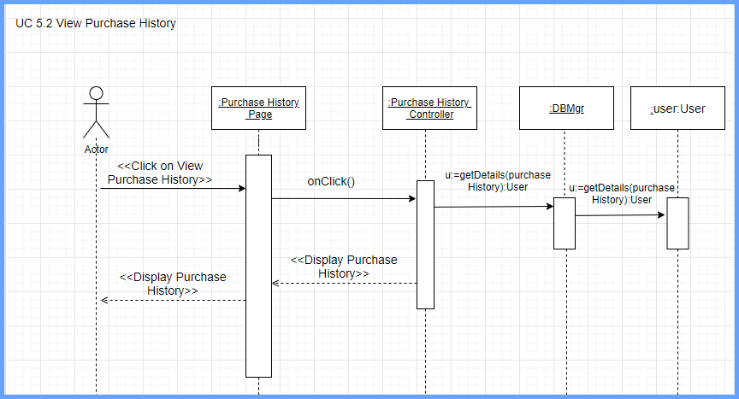

Slide 31
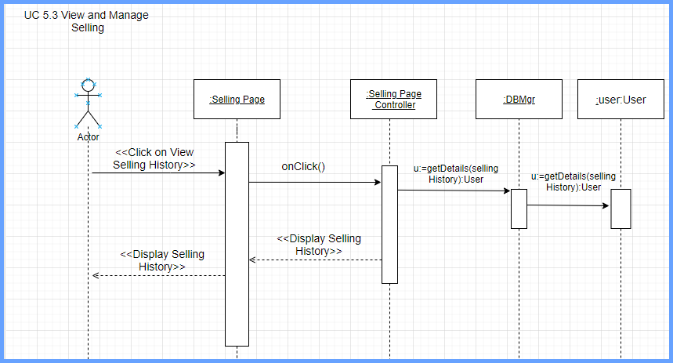

Slide 32
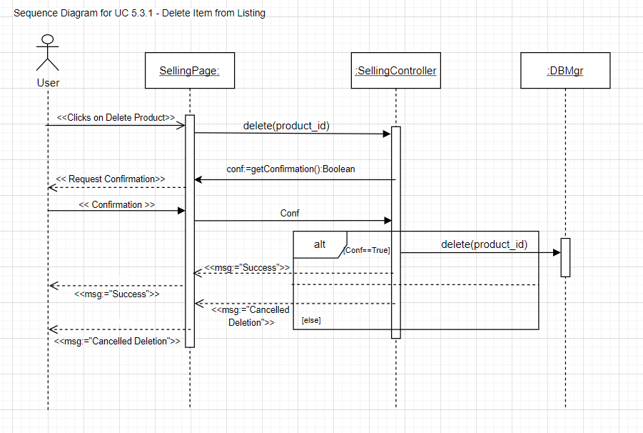

Slide 33
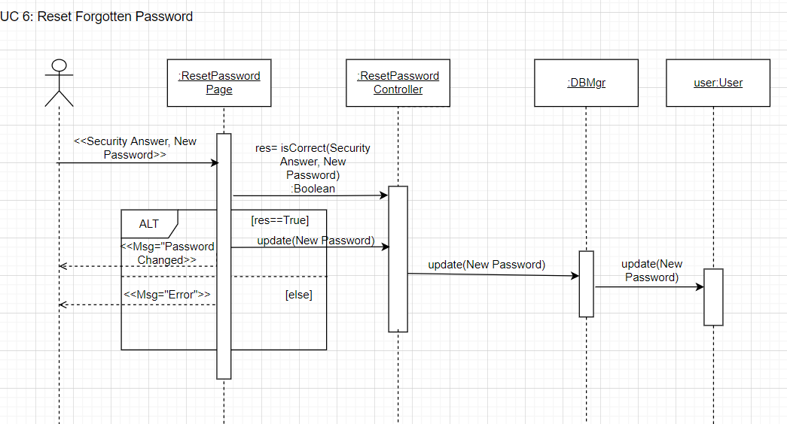

Slide 34
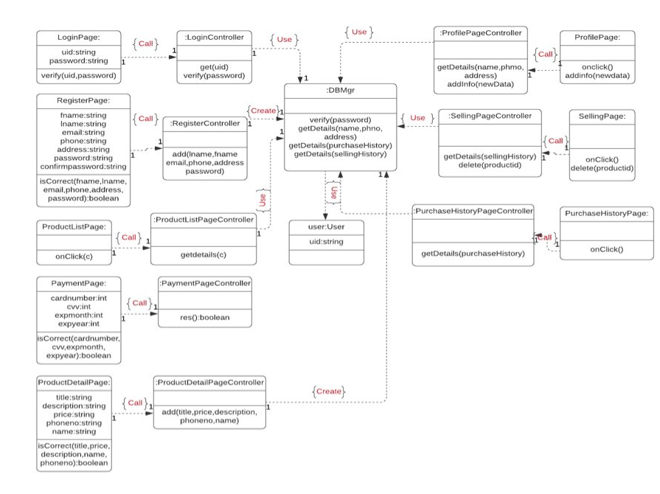
Domain Class Diagram

Slide 35
Demo

Slide 36
TASK LIST
Use Case # | Use Case Name | Team Member Assigned | Iteration(Due by)
UC1 | Register | Akshat | 03/10/2021
UC2 | Login | Akshat | 03/10/2021
UC3 | Select Item Category | Neha | 04/05/2021
UC3.1 | View and Select the item to purchase from the listing | Sucharitha | 05/03/2021
UC3.1.1 | View Seller Information | Sushmitha | 05/03/2021
UC3.1.2 | Enter Payment Information and Pay | Rupal | 05/03/2021
UC4 | Enter Product Details | Sucharitha | 05/03/2021
UC5 | View User Profile | Sravanthi | 05/03/2021
UC5.1 | Edit User Details | Sravanthi | 05/03/2021
UC5.2 | View Purchase History | Rupal | 05/03/2021
UC5.3 | View and Manage Selling | Sushmitha | 05/03/2021
UC5.3.1 | Delete Item from Listings | Neha | 05/03/2021
UC5.4 | Logout | Akshat | 05/03/2021
UC6 | Reset Forgotten Password | Akshat | 05/03/2021

Slide 37
SUMMARY:
Mav$hop is an android application which aims at buying and selling of product within UTA.
Iteration 3 helped to learn:
Design implementation of the rest of the project.
Detailed flow of events between components.
Hands-on coding of the functionality.
Completed the coding and testing phases of the project.

Slide 38
THANK YOU!

