Slide 1
CSE-5324 –Software Engineering Analysis and Design
MAV$HOP
TEAM-2-Smartinis
Group Members:
Neha Anil Shimpi (Team captain)
Sucharitha Cheenepalli
Akshat Ashwin Shah
Sushmitha Srinath Kenkare
Rupal Ravindra Godbole
Sai Sravanthi Podilli
Instructor: Dr. Michael F. Siok

Slide 2
Agenda
Project Description
Overall Technical Approach
Requirements
Use Cases
- High Level Use Case
- Use case Diagram
Requirements Use case Traceability Matrix
Increment Matrix
Domain Model Diagram
Task List

Slide 3
Project Description
Mav$hop is an app which will facilitate user within UTA to sell or buy items when moving in/moving out of the campus.
Mav$hop helps user to purchase and sell an item.
User who wishes to sell an item will post the product on the app with necessary details.
User who buys an item will have categories like furniture, kitchenware, electronic and more to select from and proceed for payment.

Slide 4
Overall Technical Approach
Requirement Analysis
Designing
Coding
Testing
Planning
Determining scope
Determining high level plan
Gathering business requirements
Performing detailed analysis.
Analyzing needs to ensure end systems meets expectation
Describe features and operations of the system.
Includes design documents
Actual code implementation.
Finding any issues in the end system.

Slide 5
Requirements
Req ID | Req Statement | Line Reference
R1 | The app shall allow the user to choose between login or register. | Derived
R2 | If the user wants to register, the app shall allow the user to enter details necessary for the registration. | 9,10,11
R3 | If the user selects to login, the app shall allow the users to login through authentication. | 12
R4 | The app shall provide a reset password function for registered users. | 13
R5 | The app shall provide the user with list of categories. | 15-17
R6 | The app shall allow the user to select an item from the list. | Derived
R7 | The app shall allow the user to buy the item which he has selected or contact the seller for more details. | 24,25
R8 | The app shall allow the user to enter payment details if willing to buy the item. | 27
R9 | The app should check the card details provided by user and process the payment. | Derived
R10 | The app shall allow the user to sell the item after entering contact details, required information and uploading appropriate images of the item. | 19-22
R11 | The app shall allow user to edit his personal details in the profile section. | Derived
R12 | The app shall provide user with his purchase and selling history. | Derived
R13 | The app shall provide user to logout from application. | Derived

Slide 6
Use-Cases
Use Case # | Use Case Name
*UC1 | Register -susmitha
*UC2 | Login -susmitha
UC3 | Select Item Category –not needed
*UC3.1 | View and Select the item to purchase from the listing - sucharitha
UC3.1.1 | View Seller Information –not needed
*UC3.1.2 | Enter Payment Information and Pay -sucharitha
*UC4 | Enter Product Details -rupal
UC5 | View User Profile -akshat
UC5.1 | Edit User Details -sravathi
*UC5.2 | View Purchase History - sravathi
UC5.3 | View and Manage Selling -rupal
UC5.3.1 | Delete Item from Listings -susmitha
*UC5.4 | Logout –not needed
UC6 | Reset Forgotten Password- akshat

Slide 7
High Level Use-Cases
UC 1: Register
TUCBW the user selects the ‘Register’ button on the App.
TUCEW user is redirected to the ‘Login’ page and is prompted to login.
UC 2: Login
TUCBW user enters their credentials and clicks on ‘Sign in’ button.
TUCEW user is redirected to the ‘Categories’ page.
UC 3: Select Item Category
TUCBW buyer selects a product category in the ‘Categories’ page.
TUCEW buyer is redirected to the page that contains product listings from the selected category.
UC 3.1: View and Select the item to purchase from the listing
TUCBW buyer clicks on the product of their interest.
TUCEW buyer is redirected to ‘Product Information’ page of the selected product.
UC 3.1.1: View Seller Information
TUCBW buyer clicks on product of their interest.
TUCEW buyer completes viewing the seller information and may proceed to ‘Payment’ page.
UC 3.1.2: Enter Payment Information and Pay
TUCBW buyer clicks on the ‘Buy Now’ button on the ‘Product Information’ page.
TUCEW buyer clicks on ‘Submit Payment’ and sees ‘Categories’ page.
UC 4: Enter Product Details
TUCBW seller clicks on the ‘Post’ button on the bottom navigation bar.
TUCEW seller clicks on the ‘Finish’ button and sees the ‘Categories’ page.

Slide 8
UC 5: View User Profile
TUCBW user clicks on the ‘Profile’ button on the bottom navigation bar.
TUCEW user completes viewing personal information and may visit any other page such as ‘Categories’.
UC 5.1: Edit User Details
TUCBW user clicks on the ‘Edit Information’ button provided int the 'Profile’ page.
TUCEW user clicks on ‘Done’ and sees the ‘Profile’ page.
UC 5.2: View Purchase History
TUCBW user clicks on ‘Your Orders’ button in the ‘Profile’ page.
TUCEW user completes viewing and sees ‘Profile’ page.
UC 5.3: View and Manage Selling
TUCBW user clicks on ‘View and Manage Selling’ button in the ‘Profile’ page.
TUCEW user completes viewing and sees the ‘Profile’ page.
UC 5.3.1: Delete Item from Listings
TUCBW user clicks on the ‘Delete’ icon provided next to a product listed in the 'View and Manage Selling’ page.
TUCEW user confirms the deletion of the listing and sees the ‘View and Manage Selling’ page.
UC 5.4: Logout
TUCBW user clicks on ‘Logout’ in the ‘Profile’ page.
TUCEW user is redirected to the ‘Login’ page.
UC 6: Reset Forgotten Password
TUCBW the user clicks on ‘Forgot Password’ provided on ‘Login’ page.
TUCEW user clicks on ‘Reset Password’ and is redirected to ‘Login’ screen.

Slide 9
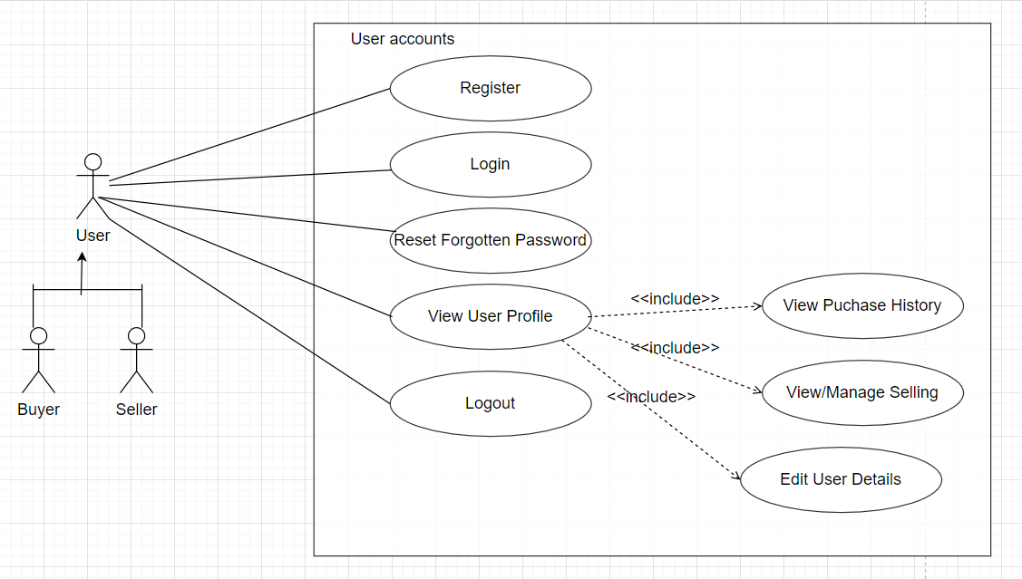
USE CASE DIAGRAM

Slide 10
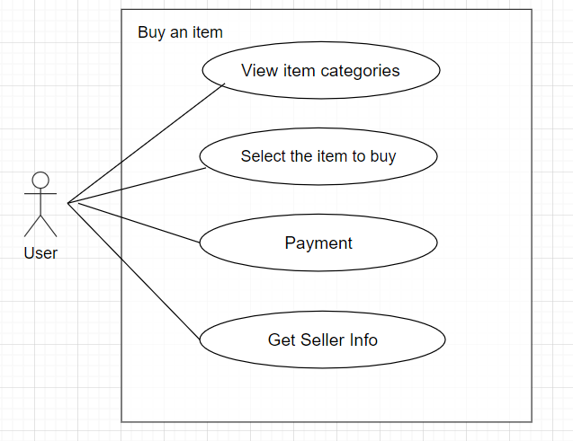
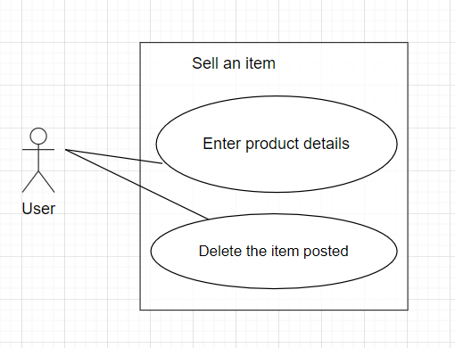
USE CASE DIAGRAM (CONT.)

Slide 11
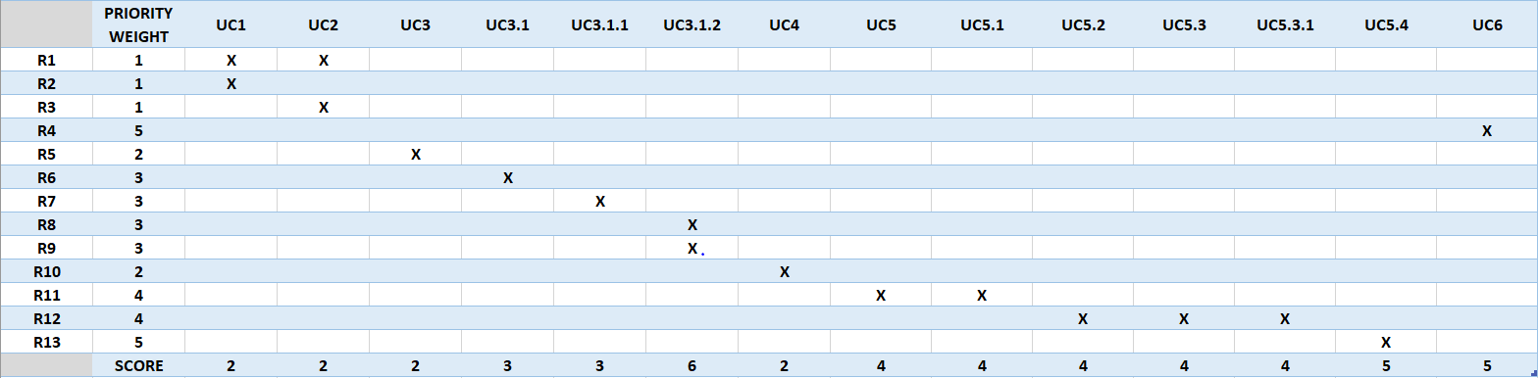
Requirement to Use-case Traceability Matrix
NOTE : Priority weight 1 is the highest priority

Slide 12
Increment Matrix
Use Case | Priority | Effort (Person - weeks) | Depends On | Iteration 1 (03/10/2021) | Iteration 2 (04/05/2021) | Iteration 3 (05/03/2021)
UC1 | 2 | 3 | NONE | 3
UC2 | 2 | 3 | UC1 | 3
UC3 | 2 | 2 | UC2 |  | 2
UC3.1 | 3 | 5 | UC3 |  | 3 | 2
UC3.1.1 | 3 | 1 | UC3.1 |  | 1
UC3.1.2 | 6 | 2 | UC3.1.1 |  | 1 | 1
UC4 | 2 | 4 | UC2 |  | 2 | 2
UC5 | 4 | 6 | UC2 |  | 3 | 3
UC5.1 | 4 | 1 | UC5 |  |  | 1
UC5.2 | 4 | 2 | UC5 |  |  | 2
UC5.3 | 4 | 2 | UC5 |  | 1 | 1
UC5.3.1 | 4 | 1 | UC5 |  | 1
UC5.4 | 5 | 2 | UC5.4 |  |  | 2
UC6 | 5 | 2 | NONE | 2
Total Effort |  | 36 |  | 8 | 14 | 14
1 PW = 5 Hrs |  |  |  | 40 | 70 | 70
Total PW = 180

Slide 13
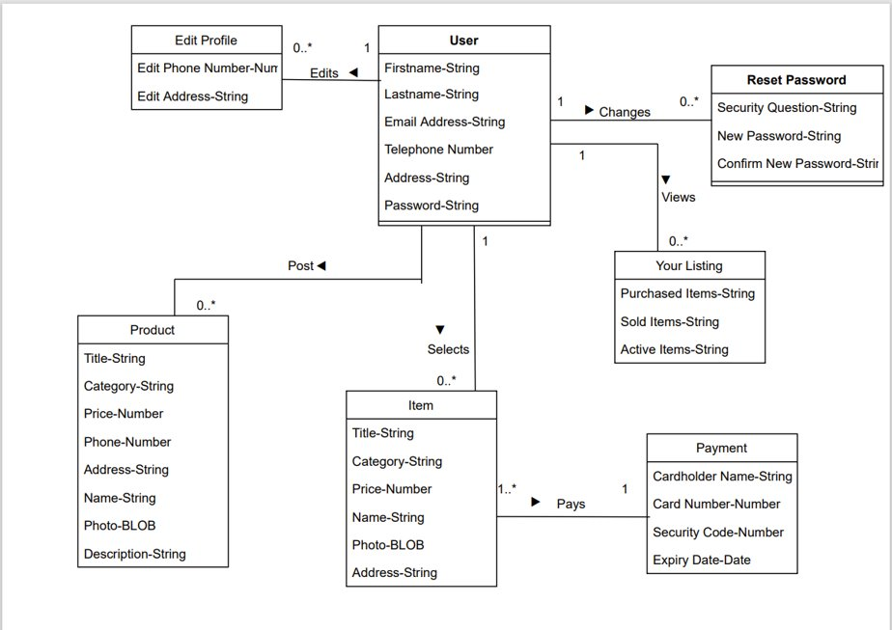
Domain Model Diagram

Slide 14
TASK LIST
Use Case # | Use Case Name | Team Member Assigned | Iteration(Due by)
UC1 | Register | Akshat | 03/10/2021
UC2 | Login | Akshat | 03/10/2021
UC3 | Select Item Category | Neha | 04/05/2021
UC3.1 | View and Select the item to purchase from the listing | Sucharitha | 05/03/2021
UC3.1.1 | View Seller Information | Sushmitha | 04/05/2021
UC3.1.2 | Enter Payment Information and Pay | Rupal | 05/03/2021
UC4 | Enter Product Details | Sucharitha | 05/03/2021
UC5 | View User Profile | Sravanthi | 05/03/2021
UC5.1 | Change Phone Number | Sravanthi | 05/03/2021
UC5.2 | Change Address | Sravanthi | 05/03/2021
UC5.3 | View Purchase History | Rupal | 05/03/2021
UC5.4 | View and Manage Selling | Sushmitha | 05/03/2021
UC5.4.1 | Delete Item from Listings | Neha | 04/05/2021
UC5.5 | Logout | Akshat | 05/03/2021
UC6 | Reset Forgotten Password | Akshat | 03/10/2021

Slide 15
SUMMARY:-
Mav$hop is the android application which aims at buying and selling of product within UTA.
Application ensures:- Easy access and
Iteration1 helped to learn:
Scope of the project
Detailed functional requirements of the project
Domain knowledge of the application.
Actors and their respective roles.
Completed the Planning and requirement Analysis Phase of the project.
Next Phases:- Design and Implementation

Slide 16
THANK YOU!

Slide 17
CSE-5324 –Software Engineering Analysis and Design
MAV$HOP
TEAM-2-Smartinis
Iteration-2
Group Members:-
Neha Anil Shimpi (Team captain)
Sucharitha Cheenepalli
Akshat Ashwin Shah
Sushmitha Srinath Kenkare
Rupal Ravindra Godbole
Sai Sravanthi Podilli
Instructor: Dr. Michael F. Siok

Slide 18
Agenda
Project Description
Overall Technical Approach
Expanded Use Cases
Sequence Diagram
Domain Class Diagram
App pages and Code Snippets
Increment matrix
Task List

Slide 19
Project Description
Mav$hop is an app which will facilitate user within UTA to sell or buy items when moving in/moving out of the campus.
Mav$hop helps user to purchase and sell an item.
User who wishes to sell an item will post the product on the app with necessary details.
User who buys an item will have categories like furniture, kitchenware, electronic and more to select from and proceed for payment.

Slide 20
Overall Technical Approach
Requirement Analysis
Designing
Coding
Testing
Planning
Determining scope
Determining high level plan
Gathering business requirements
Performing detailed analysis.
Analyzing needs to ensure end systems meets expectation
Describe features and operations of the system.
Includes design documents
Actual code implementation.
Finding any issues in the end system.

Slide 21
Expanded Use Cases
EUC1: Registration
EUC2: Login
Precondition: This use case assumes user is on the main page and wants to register for the application
Actor: User | System: MavShop
1. TUCBW user clicks on “Register” button in the main page. 3. User enter all his details and click on register button. 5. TUCEW user is redirected to login page and is prompted to login | 0. System displays the main page. 2. User is redirected to Register page. *4. System validates all the data entered by user and create a new entry into the database if no error is found and redirected to “login” page.
Postcondition: User is registered for application and can login.
Precondition: User must be registered into MavShop
Actor: User | System: MavShop
1. TUCBW user enters their credentials and clicks on ‘Sign in’ button. 3. TUCEW user is redirected to the ‘Home’ page. | 0. System displays the login page. *2. System will validate user input and display the following: If the login credentials don’t match, user will be showed “User not found! Please Register” message. If the user puts any email id other than UTA email address he will be displayed with message saying “Invalid email id. Please use UTA email address”. If the login credentials match system, then user will be redirected to app homepage. If user forgets the password, he will be asked to reset password.
Postcondition: User must be provided with the home page which displays various product categories.

Slide 22
Expanded Use Cases (Contd.)
EUC3.1: View and Select Item to Purchase from Listing
EUC3.1.2: Enter Payment Information and Pay
Precondition: Use case assumes that the user has selected the product he wants to buy.
Actor: User | System: MavShop
1. TUCBW buyer clicks on the ‘Buy Now’ button on the ‘Product Information’ page. 3. User enters the payment details and clicks on submit button. 5. TUCEW user payment is successful and information of the seller selling the product is displayed. | * 0. System displays the product information to the product he wants to buy. 2. System displays the form to enter payment details of the user. *4. System will validate the user card credentials and display the following: If the card details entered are correct, user will be shown “Payment Successful” message. If the card number is not 16-digit, user will be shown “Invalid Card Number” message. If the card CVV number is not three-digit, user will be shown “Invalid CVV” message.
Postcondition: Product should be disabled from the product list.
Precondition: Use case assumes that the user is on Home Page
Actor: User | System: MavShop
1. TUCBW user selects the product category 3. TUCEW user can see the list of products from that category | 0. System displays the product categories. 2. System should fetch the products of the selected category from the database.
Postcondition: User should be able to select any product which he wants to buy.

Slide 23
Expanded Use Cases (Contd.)
EUC4: Enter Product Details
EUC5: View User Profile
Precondition: This use case assumes user is on MavShop home page and wants to sell a product.
Actor: User | System: MavShop
1. TUCBW seller clicks on the ‘Post’ button on the ‘Home’ page 3. The user enters all the necessary details of the product and clicks the “submit” button. 5. TUCEW seller clicks on the ‘Finish’ button and sees the ‘Home’ page | 0. System displays the home page. 2. System displays a page where user can fill up product details. *4. System validates all the mandatory field information and details are inserted into database.
Postcondition: User must see the product he added in the product listing.
Precondition: This use case assumes user is on MavShop home page and wants to view Profile Page
Actor: User | System: MavShop
1. TUCBW user clicks on the ‘Profile’ button on the ‘Home’ page. 3. TUCEW user completes viewing personal information and may visit any other page such as ‘Home. | 0. System displays the Home Page. *2. System displays the profile page where user’s personal details, order history and selling information are displayed.
Postcondition: User must see the edited fields in the personal details.

Slide 24
Expanded Use Cases (Contd.)
EUC5.1: Edit User Details
EUC5.2: View Purchase History
Precondition: This use case assumes user is on Profile Page
Actor: User | System: MavShop
1. TUCBW user clicks on the ‘edit’ button provided next to the ‘Phone Number’ and ‘Address’ fields on the ‘Profile’ page. 3. TUCEW user clicks on ‘Done’ and sees the ‘Profile’ page | 0. System displays the user personal details. *2. System validates the values and inserts the new values to the database.
Postcondition: User must see the updated information on the Profile Page.
Precondition: This use case assumes user is on Profile Page
Actor: User | System: MavShop
1. TUCBW user clicks on “purchase history” button in the profile page. 3. TUCEW user clicks on ‘Done’ and sees the ‘Profile’ page | 0. System displays the user personal details. *2. System checks all the purchase history of that particular user from the database and return it to “purchase history” page.
Postcondition: User has seen his purchase history up to date.

Slide 25
Expanded Use Cases (Contd.)
EUC5.3: View and Manage Selling
EUC5.3.1: Delete Item from Listing
Precondition: This use case assumes user is on Profile Page and wants to view Manage selling tab.
Actor: User | System: MavShop
1. TUCBW user clicks on ‘Selling’ button in the ‘Profile’ page. 3. TUCEW user completes viewing and sees the ‘Profile’ page. | 0. System displays the Profile Page. *2. System displays a page where all the products previously sold by the user and his active listings are displayed.
Postcondition: User must not see the product listed in the products listing.
Precondition: This use case assumes user is on Selling Page
Actor: User | System: MavShop
1. TUCBW user clicks on the ‘Delete’ icon provided next to a product listed in the ‘Selling’ page. 3. TUCEW user confirms the deletion of the listing and sees the ‘Selling’ page. | 0. System displays the active products listing. *2. System deletes the entry of that product from the database.
Postcondition: User must not see the product listed in the products listing.

Slide 26
Expanded Use Cases (Contd.)
EUC6: Reset Password
Precondition: This use case assumes user has forgotten the password and clicked on reset password link.
Actor: User | System: Mav-Shop
1. TUCBW user clicks on ‘Reset password Link'. 3. User enters the new password he wants to set and clicks on Submit 5. TUCEW user will be shown "Password successfully changed" messsage | 0. System displays the Login UI page. 2. System displays the Reset -Password Page. *4. New password is updated in the database.
Postcondition: User must be signed-in to system with the new password which he just changed.

Slide 27
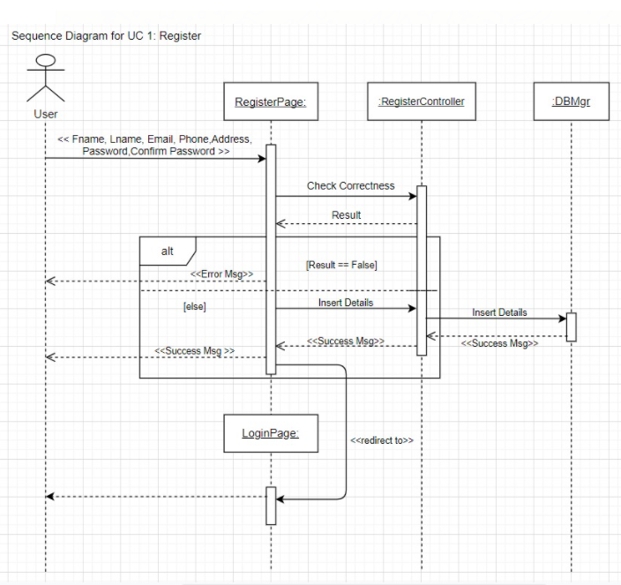
Sequence Diagram

Slide 28
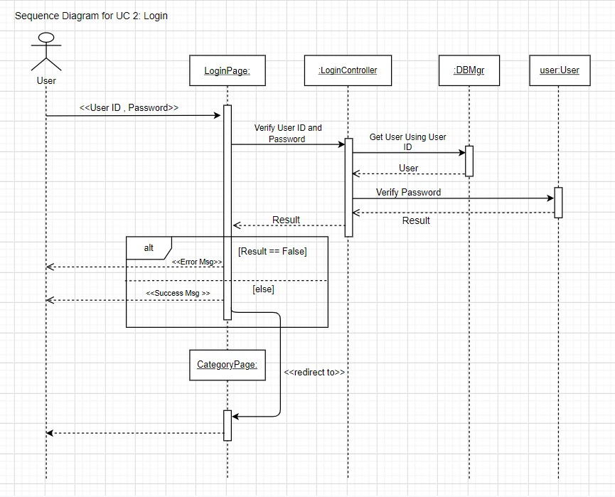

Slide 29
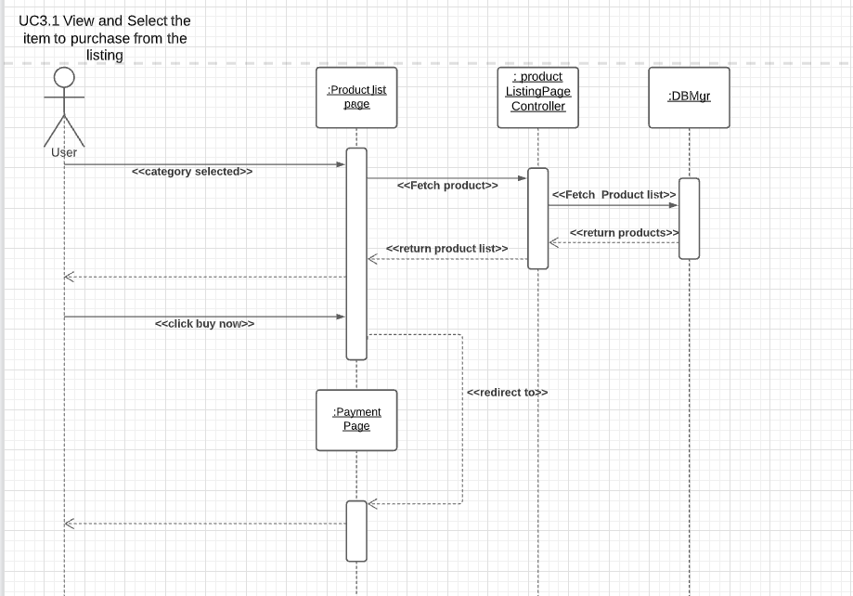

Slide 30
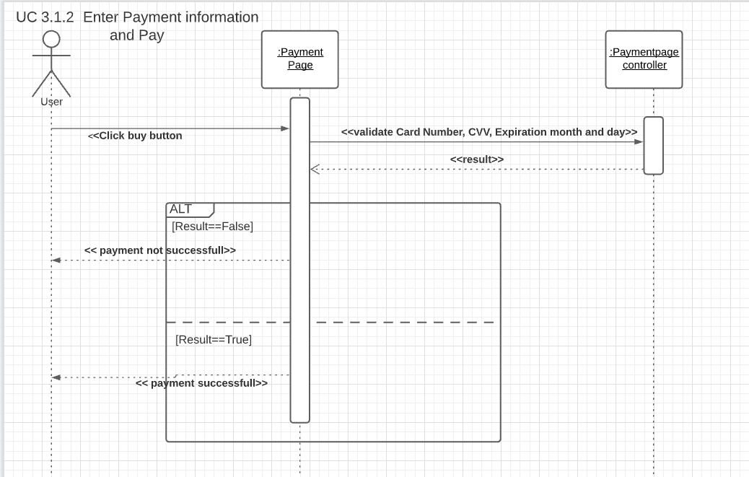

Slide 31
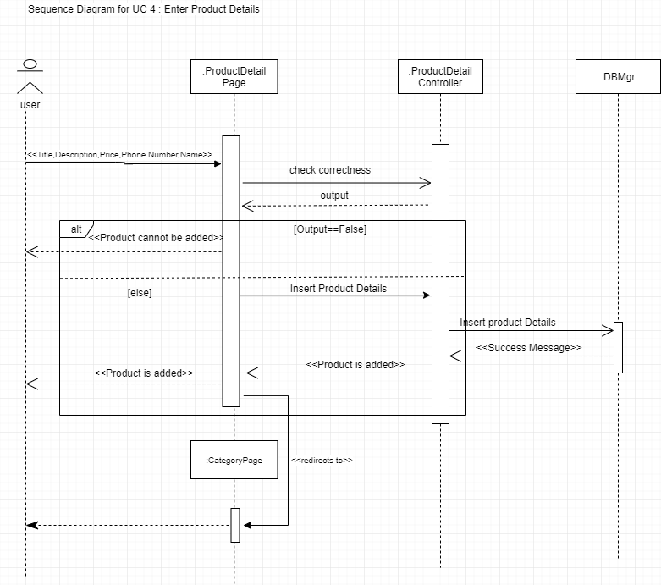

Slide 32
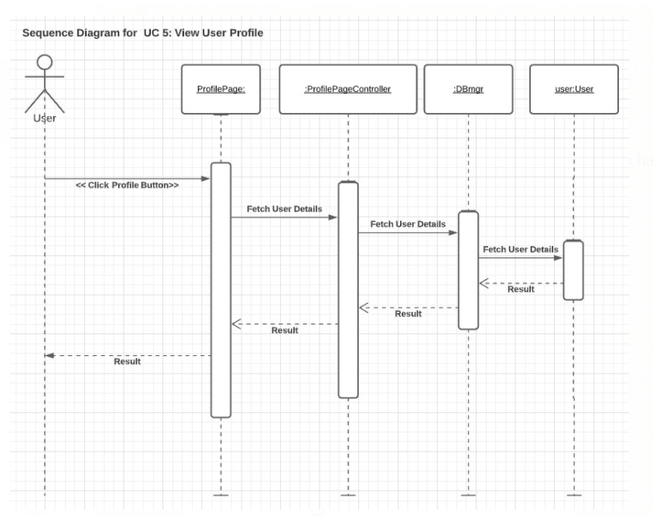

Slide 33
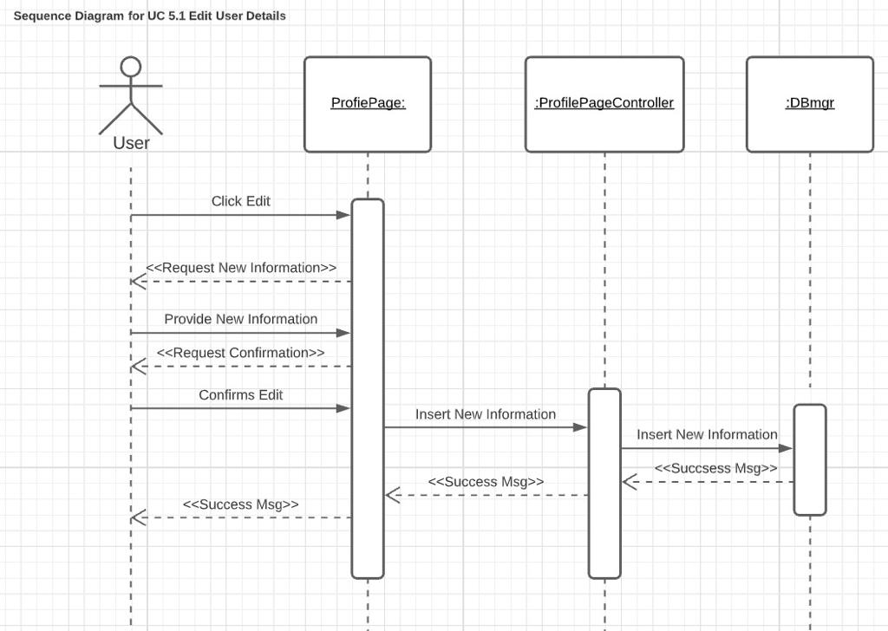

Slide 34
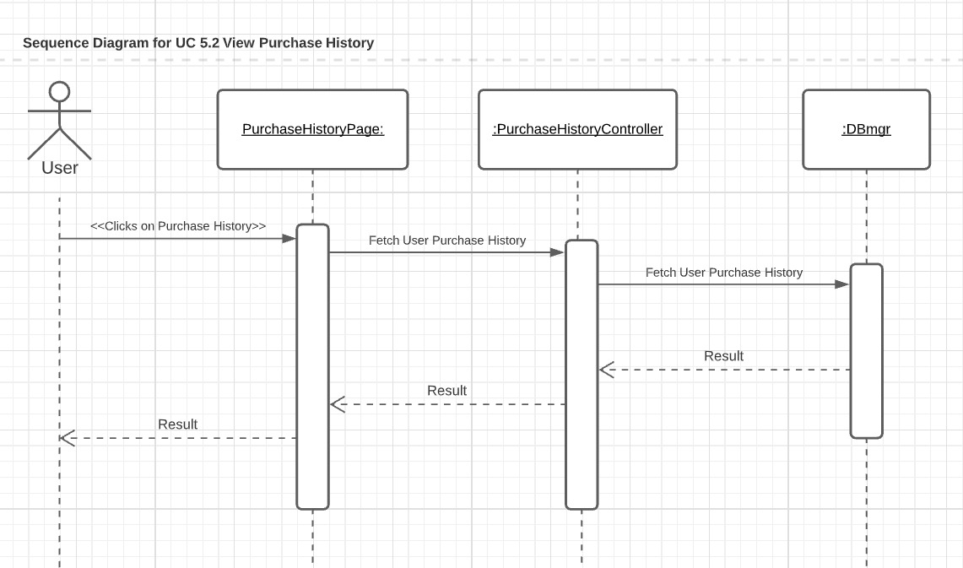

Slide 35
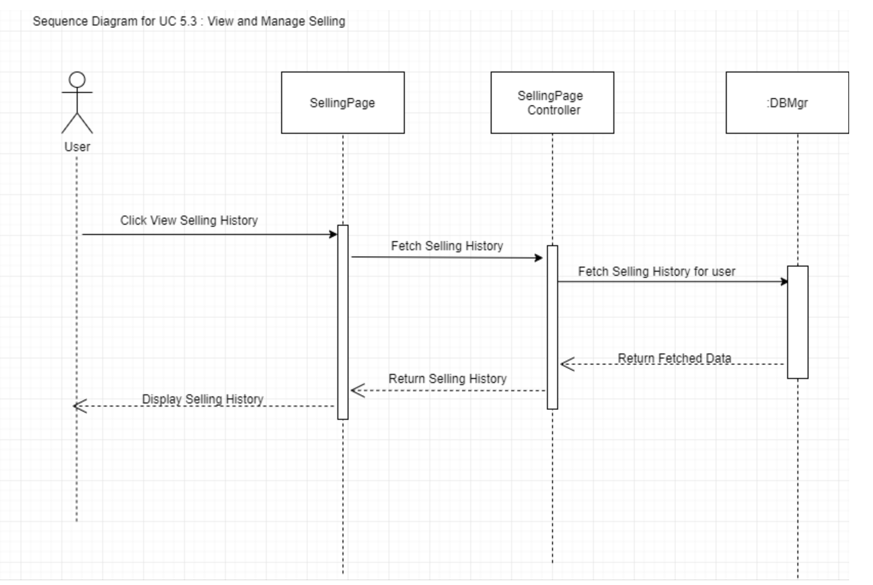

Slide 36
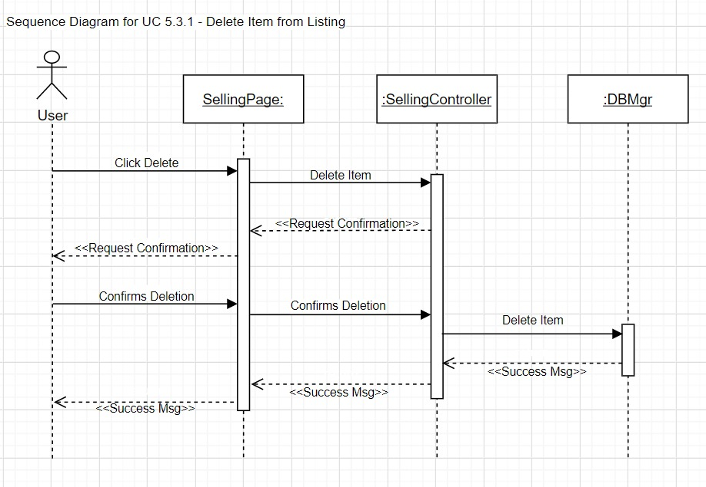

Slide 37
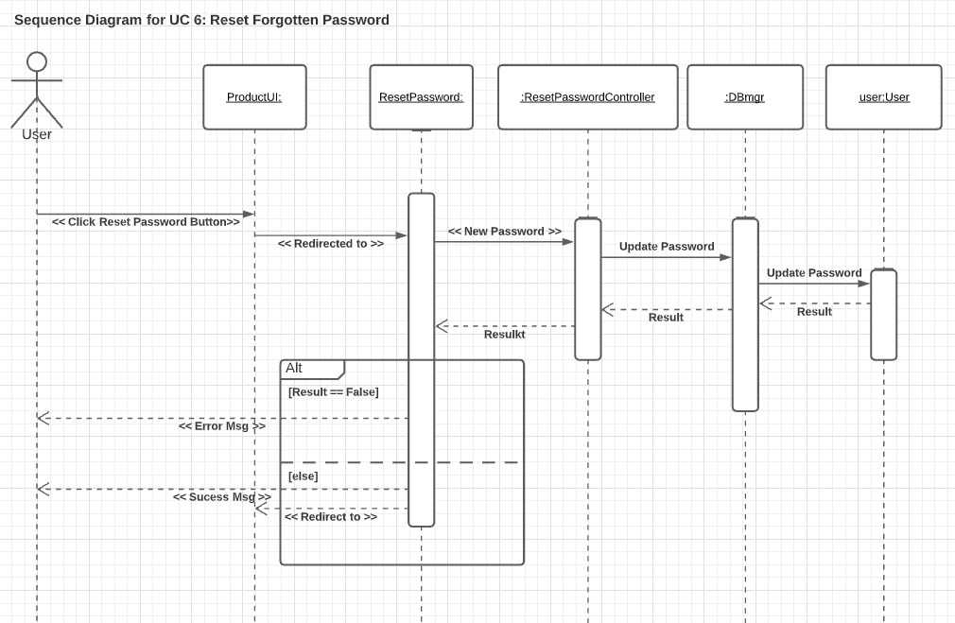

Slide 38
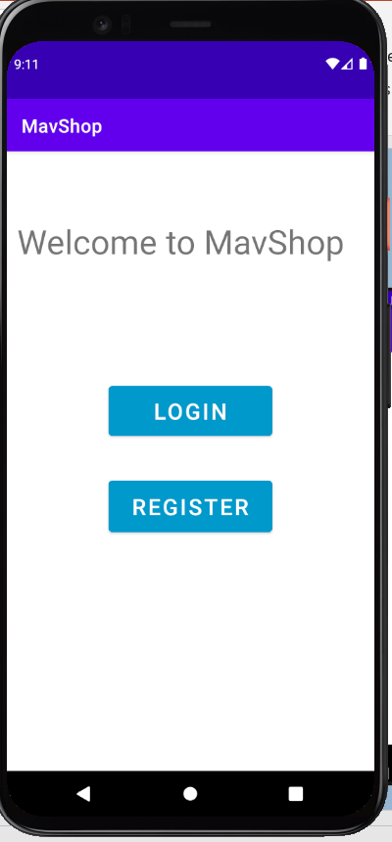
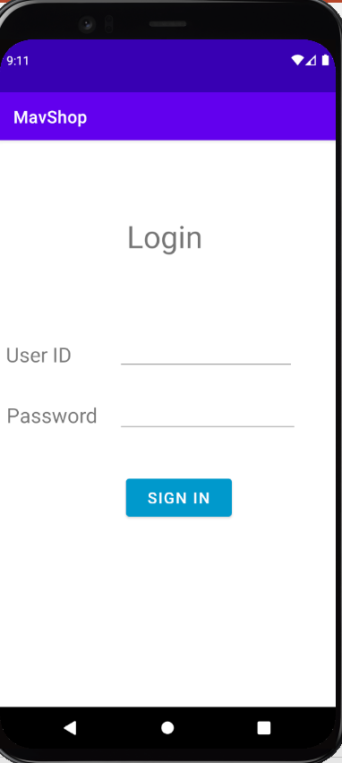
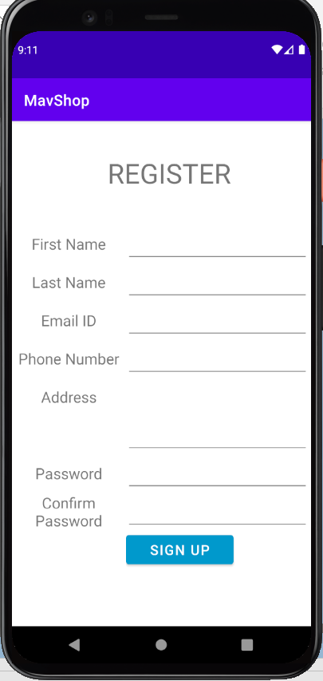
App pages
Main Page
Login Page
Register Page

Slide 39
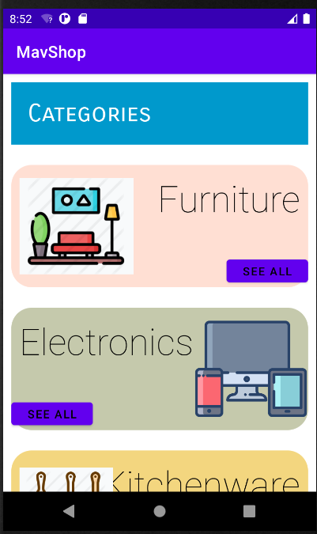
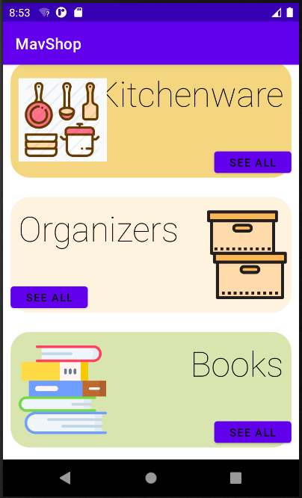
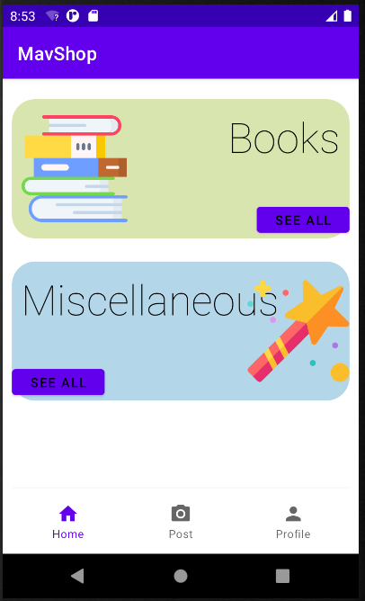
Categories Page

Slide 40
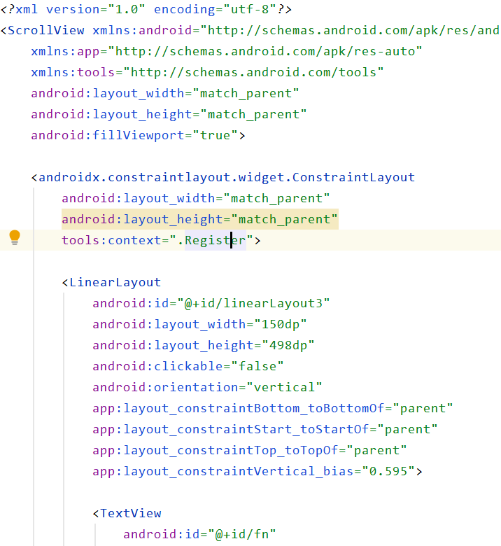
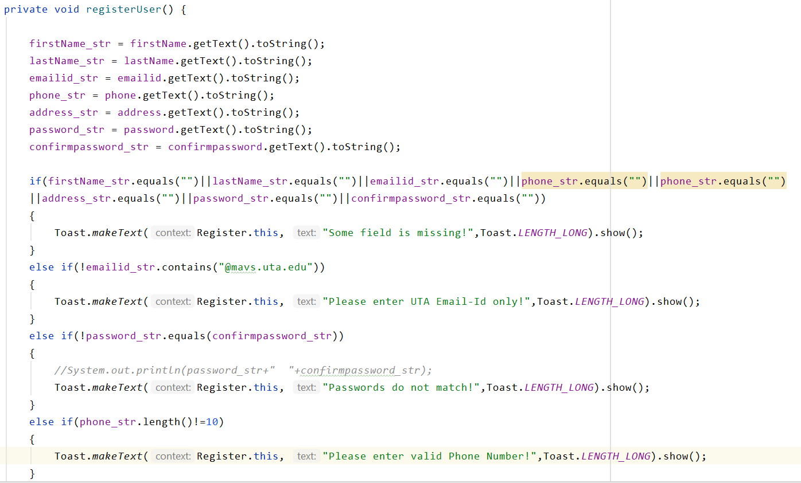
Code Snippet(Register Page)
XML
Java

Slide 41
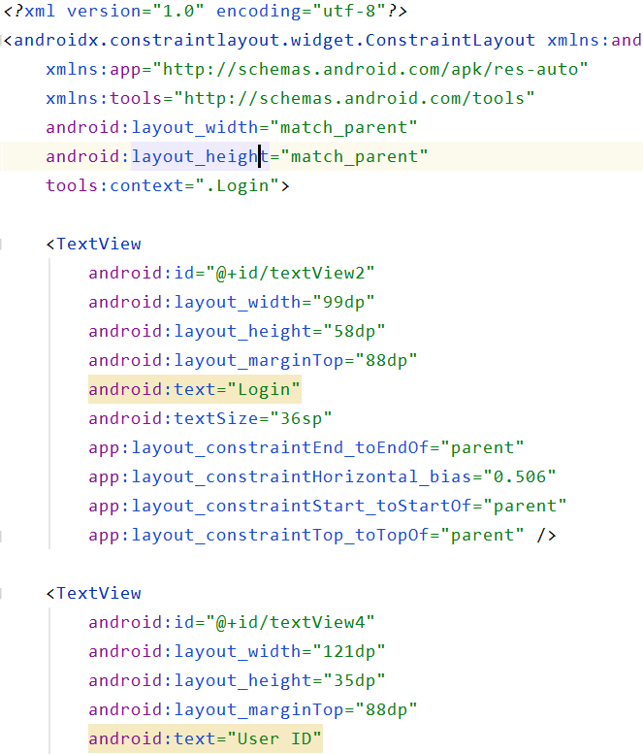
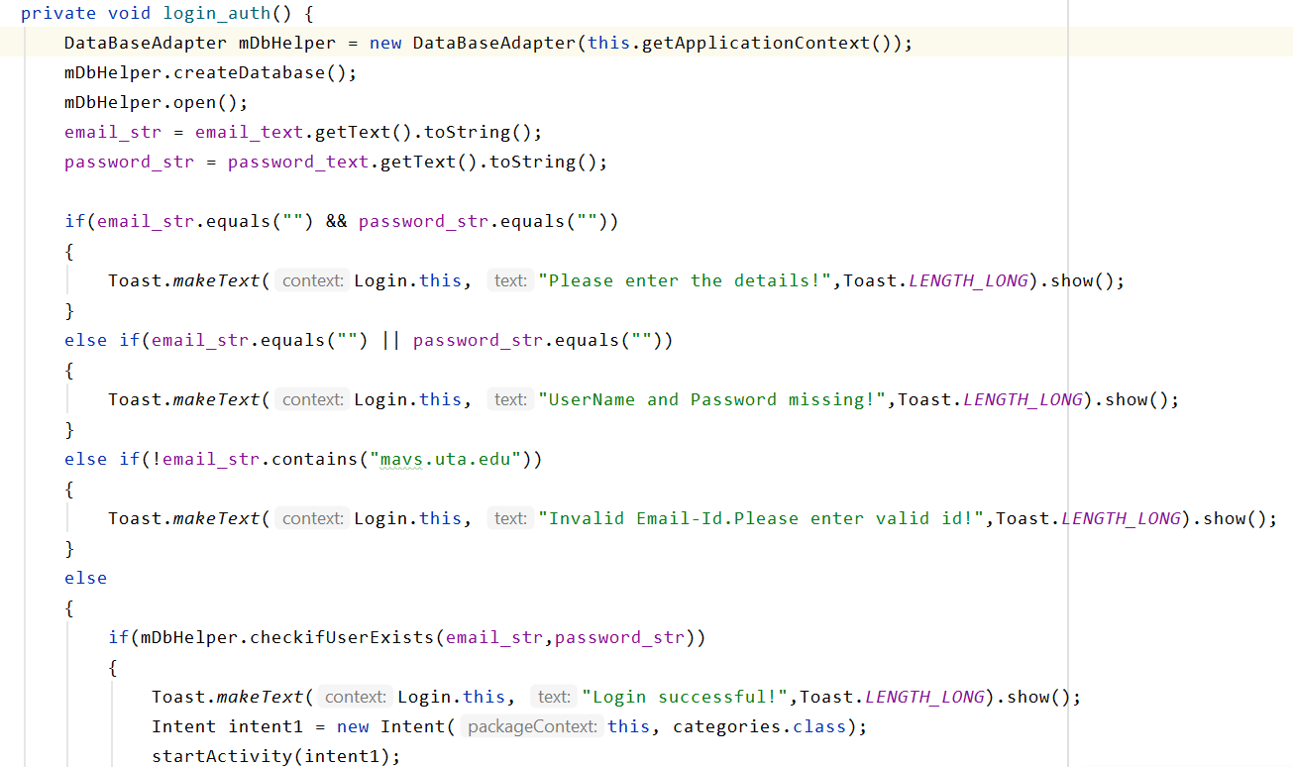
Code Snippet(Login Page)
XML
Java

Slide 42
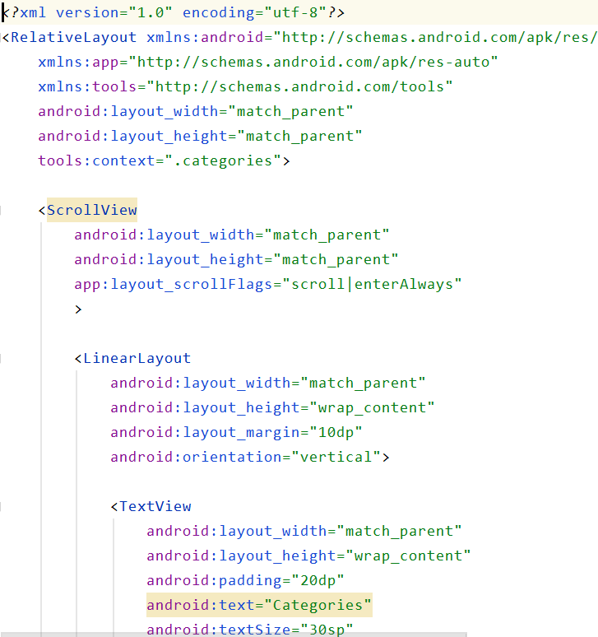
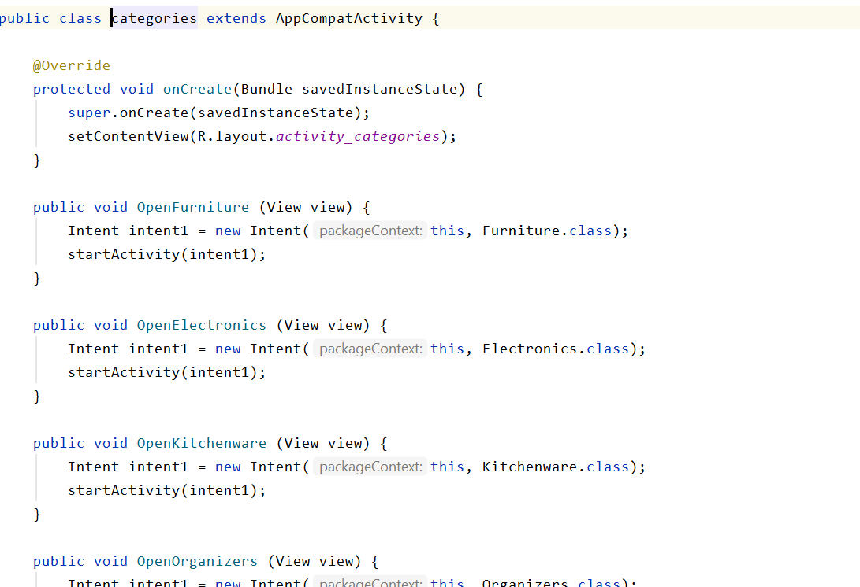
Code Snippet(Category Page)
XML
Java

Slide 43
Increment Matrix
Use Case | Priority | Effort (Person - weeks) | Depends On | Iteration 1 (03/10/2021) | Iteration 2 (04/05/2021) | Iteration 3 (05/03/2021)
UC1 | 2 | 3 | NONE | 3
UC2 | 2 | 3 | UC1 | 3
UC3 | 2 | 2 | UC2 |  | 2
UC3.1 | 3 | 5 | UC3 |  |  | 5
UC3.1.1 | 3 | 1 | UC3.1 |  |  | 1
UC3.1.2 | 6 | 2 | UC3.1.1 |  |  | 2
UC4 | 2 | 4 | UC2 |  |  | 4
UC5 | 4 | 6 | UC2 |  |  | 6
UC5.1 | 4 | 1 | UC5 |  |  | 1
UC5.2 | 4 | 2 | UC5 |  |  | 2
UC5.3 | 4 | 2 | UC5 |  |  | 2
UC5.3.1 | 4 | 1 | UC5 |  |  | 1
UC5.4 | 5 | 2 | UC5.4 |  |  | 2
UC6 | 5 | 2 | NONE | 2
Total Effort |  | 36 |  | 8 | 2 | 26
1 PW = 5 Hrs |  |  |  | 40 | 10 | 130
Total PW = 180

Slide 44
TASK LIST
Use Case # | Use Case Name | Team Member Assigned | Iteration(Due by)
UC1 | Register | Akshat | 03/10/2021
UC2 | Login | Akshat | 03/10/2021
UC3 | Select Item Category | Neha | 04/05/2021
UC3.1 | View and Select the item to purchase from the listing | Sucharitha | 05/03/2021
UC3.1.1 | View Seller Information | Sushmitha | 05/03/2021
UC3.1.2 | Enter Payment Information and Pay | Rupal | 05/03/2021
UC4 | Enter Product Details | Sucharitha | 05/03/2021
UC5 | View User Profile | Sravanthi | 05/03/2021
UC5.1 | Change Phone Number | Sravanthi | 05/03/2021
UC5.2 | Change Address | Sravanthi | 05/03/2021
UC5.3 | View Purchase History | Rupal | 05/03/2021
UC5.4 | View and Manage Selling | Sushmitha | 05/03/2021
UC5.4.1 | Delete Item from Listings | Neha | 05/03/2021
UC5.5 | Logout | Akshat | 05/03/2021
UC6 | Reset Forgotten Password | Akshat | 05/03/2021

Slide 45
SUMMARY:-
Mav$hop is the android application which aims at buying and selling of product within UTA.
Iteration2 helped to learn:
Design implementation of the project.
Detailed flow of events between components.
Actual hands-on coding of the functionality.
Completed the designing and started with coding phase of the project.
Next Phases:-Coding and Testing

Slide 46
THANK YOU!

