Slide 1
CSE-5324 –Software Engineering Analysis and Design
MAV$HOP
TEAM-2-Smartinis
Group Members:-
Neha Anil Shimpi(Team captain)
Sucharitha Chennepalli
Akshat Ashwin Shah
Sushmitha Srinath Kenkare
Rupal Ravindra Godbole
Sai Sravanthi Podilli
Instructor:-Dr.Michael F. Siok

Slide 2
Agenda
Project Description
Overall Technical Approach
Requirements
Use Cases
- High Level Use Case
- Use case Diagram
Requirements Use case Traceability Matrix
Increment Matrix
Domain Model Diagram
Task List

Slide 3
Project Description
Mav$hop is an app which will facilitate user within UTA to sell or buy items when moving in/moving out of the campus.
Mav$hop helps user to purchase and sell an item.
User who wishes to sell an item will post the product on the app with necessary details.
User who buys an item will have categories like furniture, kitchenware, electronic and more to select from and proceed for payment.

Slide 4
Overall Technical Approach
Requirement Analysis
Designing
Coding
Testing
Planning
Determining scope
Determining high level plan
Gathering business requirements
Performing detailed analysis.
Analyzing needs to ensure end systems meets expectation
Describe features and operations of the system.
Includes design documents
Actual code implementation.
Finding any issues in the end system.

Slide 5
Requirements
Req ID | Req Statement | Line Reference
R1 | The app shall allow the user to choose between login or register. | Derived
R2 | If the user wants to register, the app shall allow the user to enter details necessary for the registration. | 9,10,11
R3 | If the user selects to login, the app shall allow the users to login through authentication. | 12
R4 | The app shall provide a reset password function for registered users. | 13
R5 | The app shall provide the user with list of categories. | 15-17
R6 | The app shall allow the user to select an item from the list. | Derived
R7 | The app shall allow the user to buy the item which he has selected or contact the seller for more details. | 24,25
R8 | The app shall allow the user to enter payment details if willing to buy the item. | 27
R9 | The app should check the card details provided by user and process the payment. | Derived
R10 | The app shall allow the user to sell the item after entering contact details, required information and uploading appropriate images of the item. | 19-22
R11 | The app shall allow user to edit his personal details in the profile section. | Derived
R12 | The app shall provide user with his purchase and selling history. | Derived
R13 | The app shall provide user to logout from application. | Derived

Slide 6
Use-Cases
Use Case # | Use Case Name
UC1 | Register
UC2 | Login
UC3 | Select Item Category
UC3.1 | View and Select the item to purchase from the listing
UC3.1.1 | View Seller Information
UC3.1.2 | Enter Payment Information and Pay
UC4 | Enter Product Details
UC5 | View User Profile
UC5.1 | Edit User Details
UC5.2 | View Purchase History
UC5.3 | View and Manage Selling
UC5.3.1 | Delete Item from Listings
UC5.4 | Logout
UC6 | Reset Forgotten Password

Slide 7
High Level Use-Cases
UC 1: Register
TUCBW the user selects the ‘Register’ button on the App.
TUCEW user is redirected to the ‘Login’ page and is prompted to login.
UC 2: Login
TUCBW user enters their credentials and clicks on ‘Sign in’ button.
TUCEW user is redirected to the ‘Home’ page.
UC 3: Select Item Category
TUCBW buyer selects a product category in the ‘Home’ page.
TUCEW buyer is redirected to the page that contains product listings from the selected category.
UC 3.1: View and Select the item to purchase from the listing
TUCBW buyer clicks on the product of their interest.
TUCEW buyer is redirected to ‘Product Information’ page of the selected product.
UC 3.1.1: View Seller Information
TUCBW buyer clicks on ‘Contact Seller’ button on the ‘Product Information’ page.
TUCEW buyer completes viewing the seller information and sees the ‘Product Information’ page.
UC 3.1.2: Enter Payment Information and Pay
TUCBW buyer clicks on the ‘Buy Now’ button on the ‘Product Information’ page.
TUCEW buyer clicks on ‘Submit Payment’ and sees ‘Home’ page.
UC 4: Enter Product Details
TUCBW seller clicks on the ‘Post’ button on the ‘Home’ page.
TUCEW seller clicks on the ‘Finish’ button and sees the ‘Home’ page.

Slide 8
UC 5: View User Profile
TUCBW user clicks on the ‘Profile’ button on the ‘Home’ page.
TUCEW user completes viewing personal information and may visit any other page such as ‘Home’.
UC 5.1: Edit User Details
TUCBW user clicks on the ‘edit’ button provided next to the ‘Phone Number’ and ‘Address’ fields on the ‘Profile’ page.
TUCEW user clicks on ‘Done’ and sees the ‘Profile’ page.
UC 5.2: View Purchase History
TUCBW user clicks on ‘Purchase History’ button in the ‘Profile’ page.
TUCEW user completes viewing and sees ‘Profile’ page.
UC 5.3: View and Manage Selling
TUCBW user clicks on ‘Selling’ button in the ‘Profile’ page.
TUCEW user completes viewing and sees the ‘Profile’ page.
UC 5.3.1: Delete Item from Listings
TUCBW user clicks on the ‘Delete’ icon provided next to a product listed in the ‘Selling’ page.
TUCEW user confirms the deletion of the listing and sees the ‘Selling’ page.
UC 5.4: Logout
TUCBW user clicks on ‘Logout’ in the ‘Profile’ page.
TUCEW user is redirected to the ‘Login’ page.
UC 6: Reset Forgotten Password
TUCBW the user clicks on ‘Forgot Password’ provided on ‘Login’ page.
TUCEW user clicks on ‘Reset Password’ and is redirected to ‘Login’ screen.

Slide 9
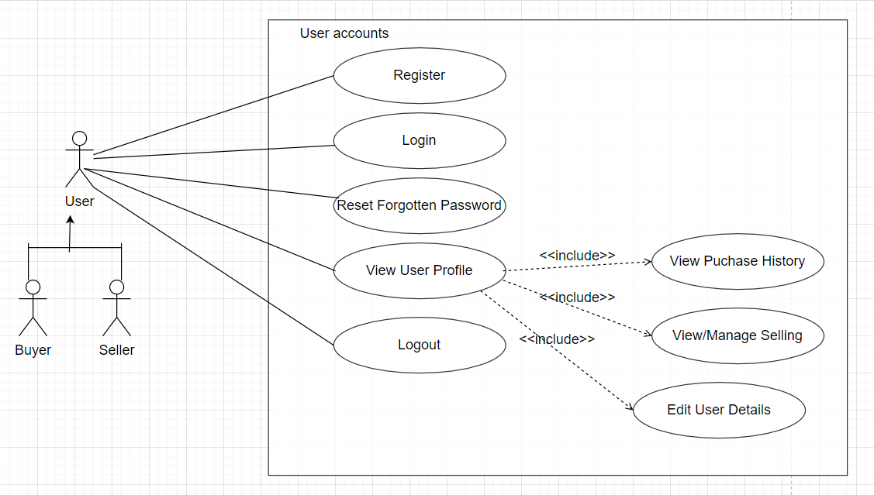
USE CASE DIAGRAM

Slide 10
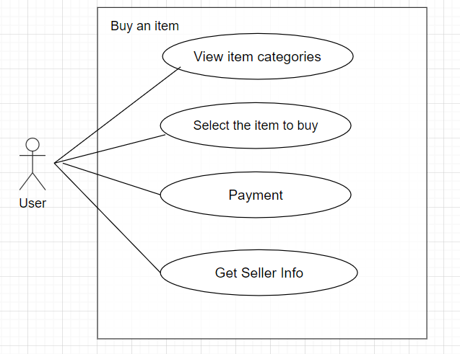
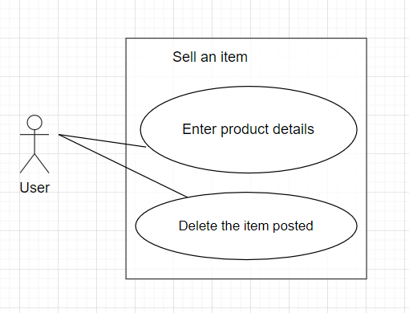
USE CASE DIAGRAM (CONT.)

Slide 11
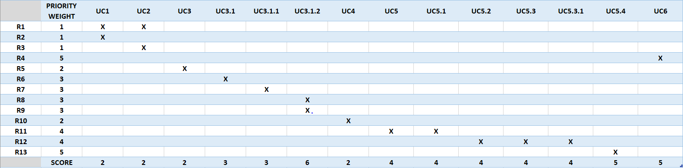
Requirement to Use-case Traceability Matrix
NOTE : Priority weight 1 is the highest priority

Slide 12
Increment Matrix
Use Case | Priority | Effort (Person - weeks) | Depends On | Iteration 1 (03/10/2021) | Iteration 2 (04/05/2021) | Iteration 3 (05/03/2021)
UC1 | 2 | 3 | NONE | 3
UC2 | 2 | 3 | UC1 | 3
UC3 | 2 | 2 | UC2 |  | 2
UC3.1 | 3 | 5 | UC3 |  | 3 | 2
UC3.1.1 | 3 | 1 | UC3.1 |  | 1
UC3.1.2 | 6 | 2 | UC3.1.1 |  | 1 | 1
UC4 | 2 | 4 | UC2 |  | 2 | 2
UC5 | 4 | 6 | UC2 |  | 3 | 3
UC5.1 | 4 | 1 | UC5 |  |  | 1
UC5.2 | 4 | 2 | UC5 |  |  | 2
UC5.3 | 4 | 2 | UC5 |  | 1 | 1
UC5.3.1 | 4 | 1 | UC5 |  | 1
UC5.4 | 5 | 2 | UC5.4 |  |  | 2
UC6 | 5 | 2 | NONE | 2
Total Effort |  | 36 |  | 8 | 14 | 14
1 PW = 5 Hrs |  |  |  | 40 | 70 | 70
Total PW = 180

Slide 13
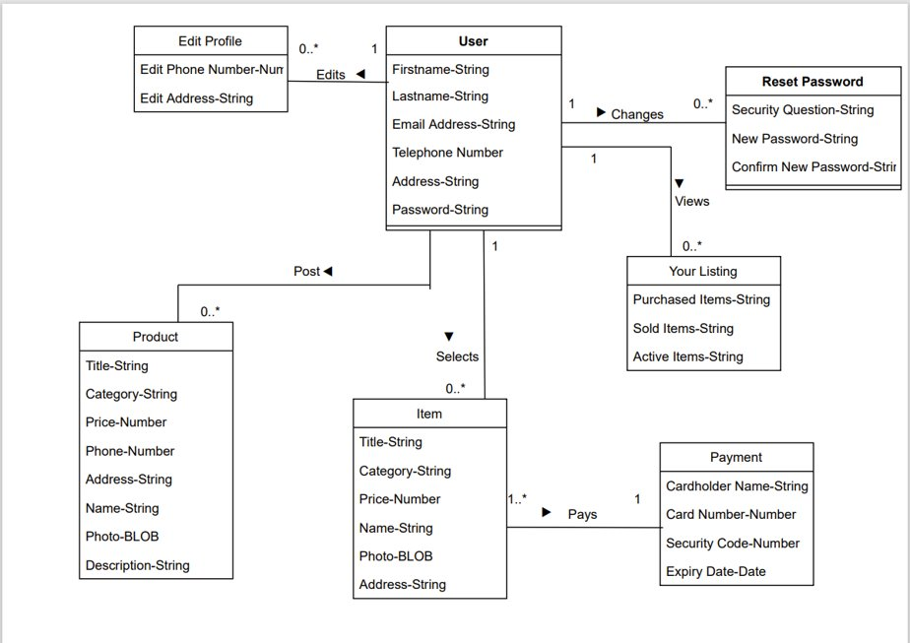
Domain Model Diagram

Slide 14
TASK LIST
Use Case # | Use Case Name | Team Member Assigned | Iteration(Due by)
UC1 | Register | Akshat | 03/10/2021
UC2 | Login | Akshat | 03/10/2021
UC3 | Select Item Category | Neha | 04/05/2021
UC3.1 | View and Select the item to purchase from the listing | Sucharitha | 05/03/2021
UC3.1.1 | View Seller Information | Sushmitha | 04/05/2021
UC3.1.2 | Enter Payment Information and Pay | Rupal | 05/03/2021
UC4 | Enter Product Details | Sucharitha | 05/03/2021
UC5 | View User Profile | Sravanthi | 05/03/2021
UC5.1 | Change Phone Number | Sravanthi | 05/03/2021
UC5.2 | Change Address | Sravanthi | 05/03/2021
UC5.3 | View Purchase History | Rupal | 05/03/2021
UC5.4 | View and Manage Selling | Sushmitha | 05/03/2021
UC5.4.1 | Delete Item from Listings | Neha | 04/05/2021
UC5.5 | Logout | Akshat | 05/03/2021
UC6 | Reset Forgotten Password | Akshat | 03/10/2021

Slide 15
SUMMARY:-
Mav$hop is the android application which aims at buying and selling of product within UTA.
Application ensures:- Easy access and
Iteration1 helped to learn:
Scope of the project
Detailed functional requirements of the project
Domain knowledge of the application.
Actors and their respective roles.
Completed the Planning and requirement Analysis Phase of the project.
Next Phases:- Design and Implementation

Slide 16
THANK YOU!

