Slide 1
LEAD SCORING CASE STUDY (LOGISTIC REGRESSION)
-POOJA AGRAWAL
NEHA SHUKLA

Slide 2
An Education Company Named X Education Sells Online Courses To Industry Professionals. On Any Given Day, Many Professionals Who Are Interested In The Courses Land On Their Website And Browse For Courses. The Company Markets Its Courses On Several Websites And Search Engines Like Google. Once These People Land On The Website, They Might Browse The Courses Or Fill Up A Form For The Course Or Watch Some Videos. When These People Fill Up A Form Providing Their Email Address Or Phone Number, They Are Classified To Be A Lead. Moreover, The Company Also Gets Leads Through Past Referrals. Once These Leads Are Acquired, Employees From The Sales Team Start Making Calls, Writing Emails, Etc. Through This Process, Some Of The Leads Get Converted While Most Do Not. The Typical Lead Conversion Rate At X Education Is Around 30%. Now, Although X Education Gets A Lot Of Leads, Its Lead Conversion Rate Is Very Poor. For Example, If, Say, They Acquire 100 Leads In A Day, Only About 30 Of Them Are Converted. To Make This Process More Efficient, The Company Wishes To Identify The Most Potential Leads, Also Known As ‘Hot Leads’. If They Successfully Identify This Set Of Leads, The Lead Conversion Rate Should Go Up As The Sales Team Will Now Be Focusing More On Communicating With The Potential Leads Rather Than Making Calls To Everyone. A Typical Lead Conversion Process Can Be Represented Using The Following Funnel: As You Can See, There Are A Lot Of Leads Generated In The Initial Stage (Top) But Only A Few Of Them Come Out As Paying Customers From The Bottom. In The Middle Stage, You Need To Nurture The Potential Leads Well (I.E. Educating The Leads About The Product, Constantly Communicating Etc. ) In Order To Get A Higher Lead Conversion. X Education Has Appointed Us To Help Them Select The Most Promising Leads, I.E. The Leads That Are Most Likely To Convert Into Paying Customers. The Company Requires Us To Build A Model Wherein We Need To Assign A Lead Score To Each Of The Leads Such That The Customers With Higher Lead Score Have A Higher Conversion Chance And The Customers With Lower Lead Score Have A Lower Conversion Chance. The CEO, In Particular, Has Given A Ballpark Of The Target Lead Conversion Rate To Be Around 80%.
PROBLEM STATEMENT

Slide 3
GOALS OF THE CASE STUDY:
Build a logistic regression model to assign a lead score between 0 and 100 to each of the leads which can be used by the company to target potential leads. A higher score would mean that the lead is hot, i.e. is most likely to convert whereas a lower score would mean that the lead is cold and will mostly not get converted.
The data provided (leads dataset) are from the past with around 9000 data points. The target variable, in this case, is the column ‘Converted’ which tells whether a past lead was converted or not wherein 1 means it was converted and 0 means it wasn’t converted.

Slide 4
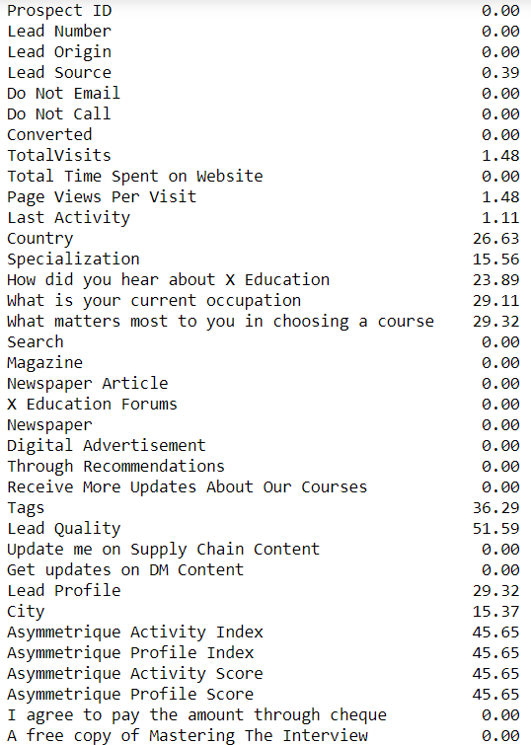
DATA INSPECTION & CLEANING
The dataset has 9240 records and 37 Variables
No duplicate values are available
There were many cells which had ‘Select’ as their values which meant the customer did not select any of the available choices. Hence those values were converted into NULL values.
Any column having missing value percentage above 70 % was removed. Eg. Lead Profile.
Rest of the columns which have missing value percentage more than 2 % were looked upon individually and the missing values were imputed.

Slide 5
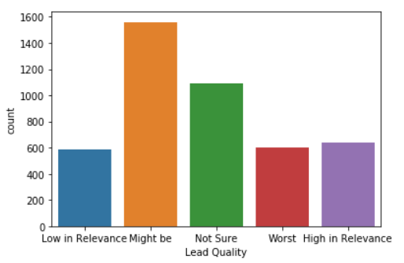
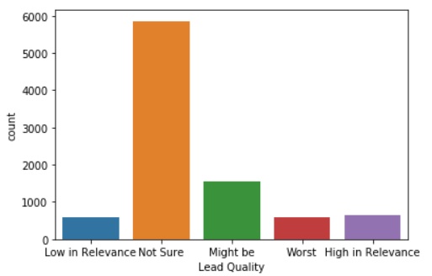
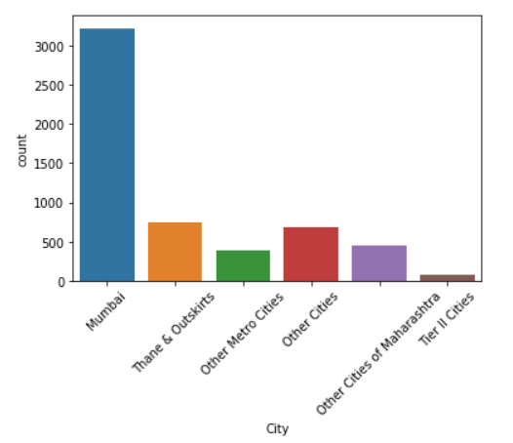
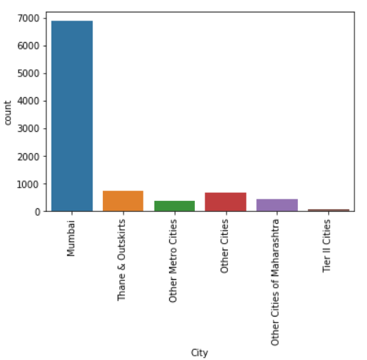
Missing Values Imputation
Lead quality is based on customer intuition. Imputed missing values with ‘Not Sure’
60% of the City column has Mumbai in it. Imputed the missing values to Mumbai

Slide 6
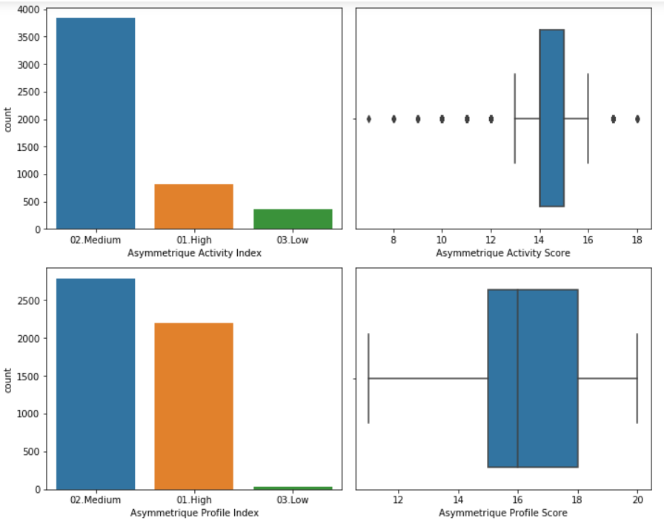
Asymmetrique Activity Index(45.65%) Asymmetrique Activity Score(45.65%) Asymmetrique Profile Index(45.65%) Asymmetrique Profile Score(45.65%)
There is too much variation in these parameters so its not reliable to impute any value in it. 45% null values means we need to drop these columns.

Slide 7
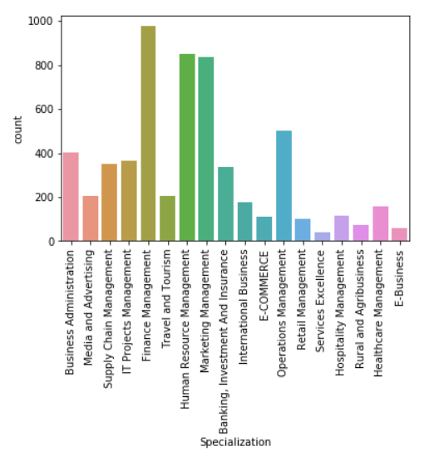
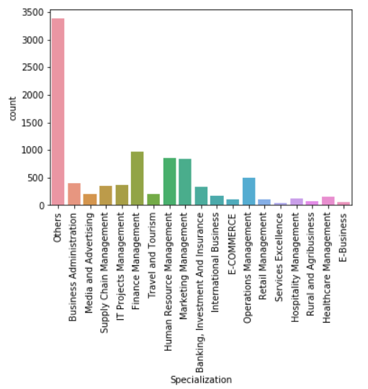
Specialization(36.58%)
It maybe the case that lead has not entered any specialization if their option is not available on the list, may not have any specialization or is a student. Hence we can make a category "Others" for missing values

Slide 8
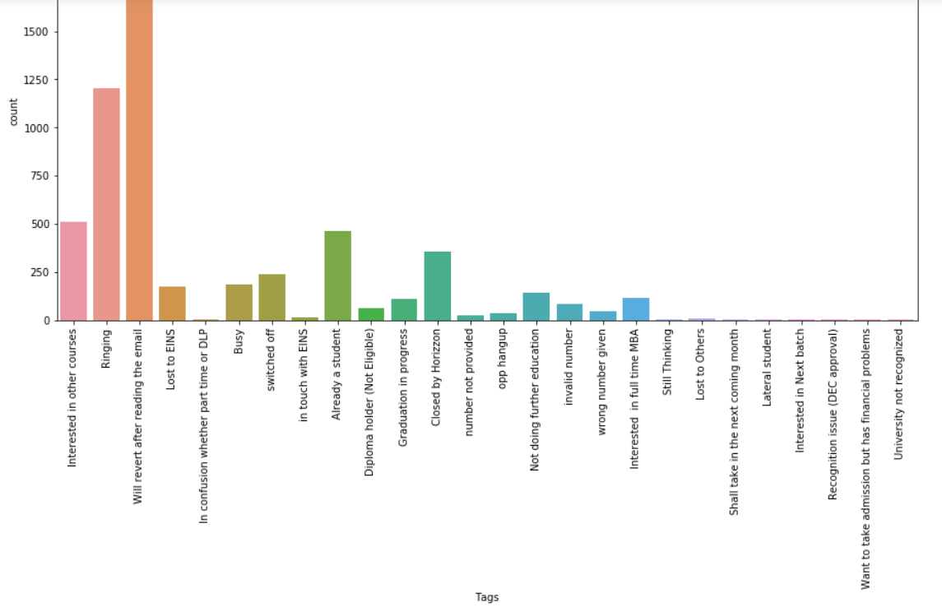
Tags(36.29%)
The missing values will be imputed by 'Will revert after reading the email'

Slide 9






'What is your current occupation’ (29 %)
Country(26.63%)
86% entries are unemployed. So, imputed missing value with “Unemployed”
For most values, country is India. So imputing the missing values with “India”
What matters most to you in choosing a course(29.32%)
Blanks in this column can be imputed by “Better Career Prospects”

Slide 10
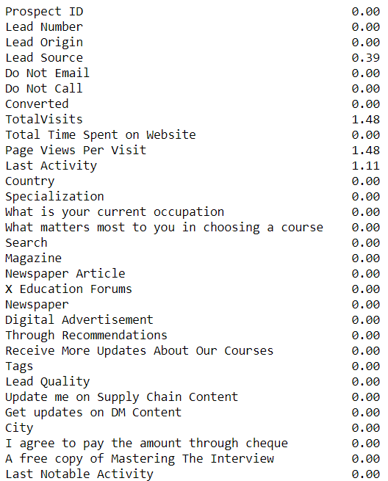
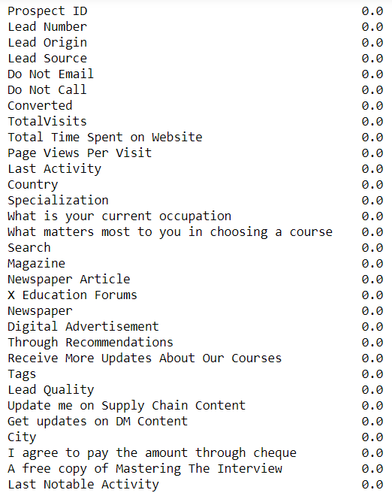
Rest missing values are under 2% so we have dropped these rows.

Slide 11
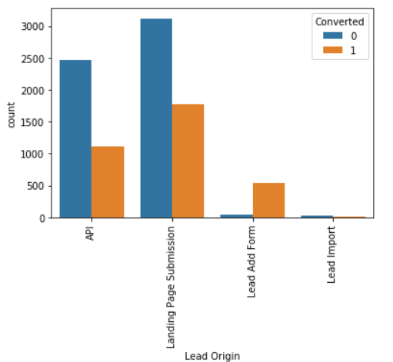
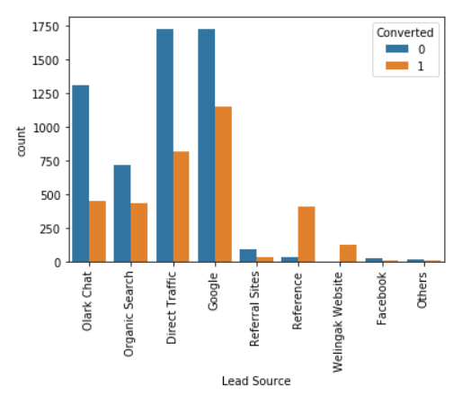
API and Landing Page Submission have 30-35% conversion rate but count of lead originated from them are considerable.
Lead Add Form has more than 90% conversion rate but count of lead are not very high.
Lead Import are very less in count.
To improve overall lead conversion rate, we need to focus more on improving lead conversion of API and Landing Page Submission origin and generate more leads from Lead Add Form.
Google and Direct traffic generates maximum number of leads.
Conversion Rate of reference leads and leads through welingak website is high.
To improve overall lead conversion rate, we should focus on improving lead conversion of Olark chat, organic search, direct traffic, and google leads and generate more leads from reference and welingak website.

Slide 12
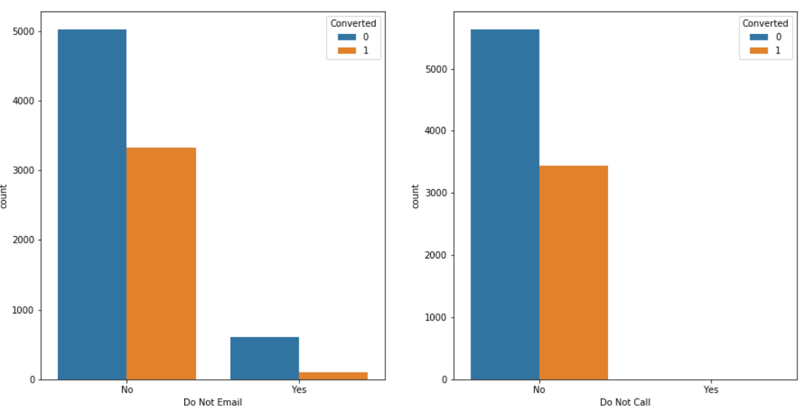
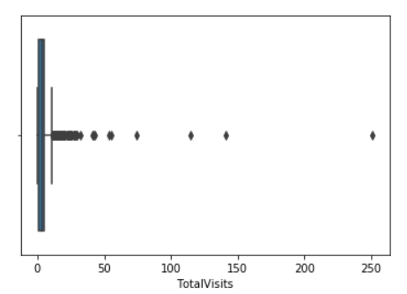
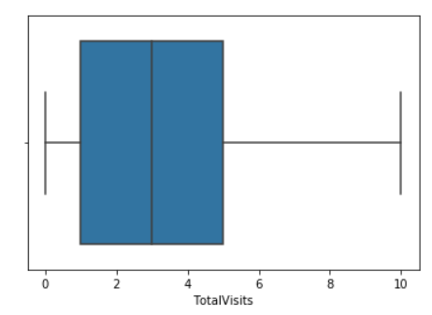
People who haven’t opted for these services have a high conversion rate
It's found that there are many outliers in the data. Therefore, we will cap the outliers to 95% value for analysis.

Slide 13
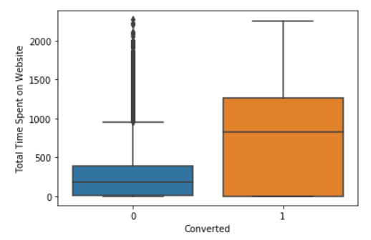
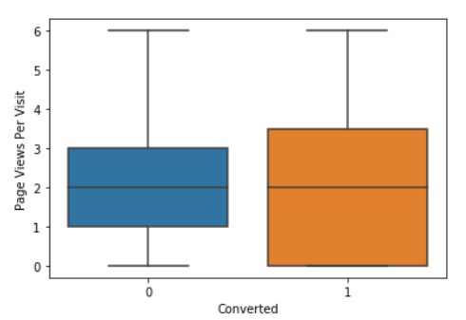
Leads spending more time on the website are more likely to be
converted.
Median for converted and unconverted leads is the same. Nothing can be said specifically for lead conversion from Page Views Per Visit

Slide 14
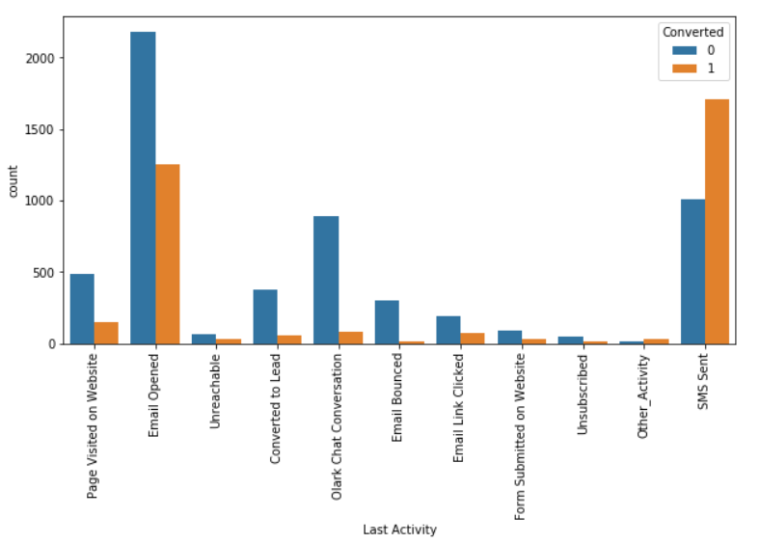
Most of the lead have their Email opened as their last activity.
Conversion rate for leads with last activity as SMS Sent is almost 60%.

Slide 15
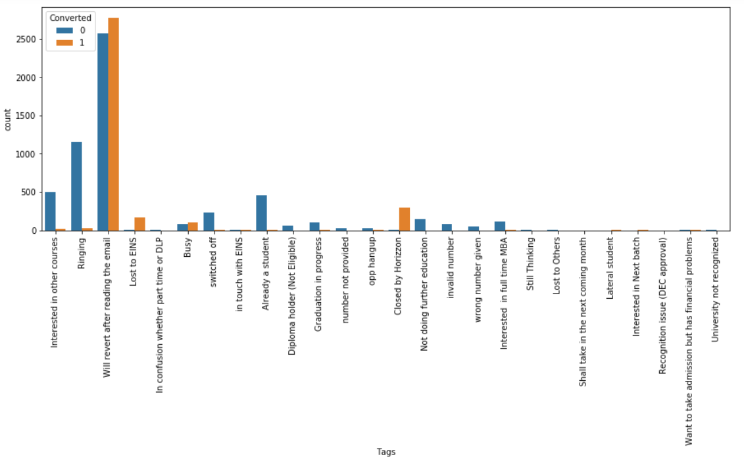
The Leads who revert after reading the email have the highest conversion rate

Slide 16
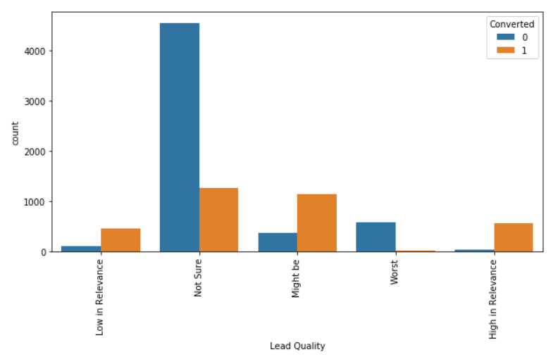
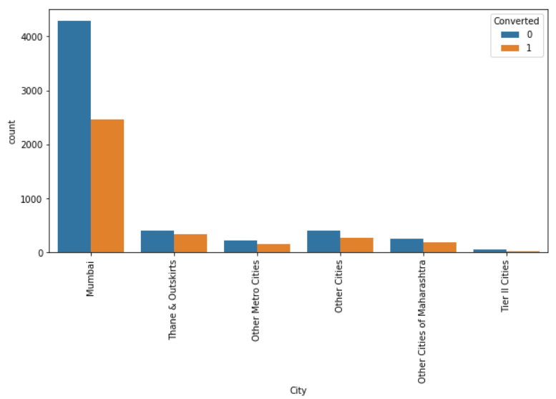
The conversion rate of “Might be” is highest
Most leads are from Mumbai with around 30% conversion rate

Slide 17
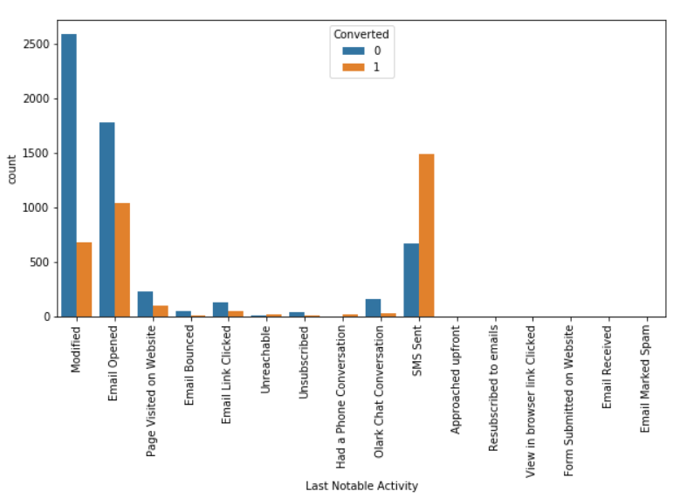
SMS Sent has the highest rate of conversion
it is observed that many columns(listed below) are not adding any information to the model. Therefore, we can drop them for further analysis
'Lead Number’, 'What matters most to you in choosing a course','Search','Magazine','Newspaper Article’, 'X Education Forums','Newspaper','Digital Advertisement',' Through Recommendations', 'Receive More Updates About Our Courses’, 'Update me on Supply Chain Content’, 'Get updates on DM Content’, 'I agree to pay the amount through cheque’, 'A free copy of Mastering The Interview’, 'Country'

Slide 18
Data Preparation
Test-Train Split
Feature Scaling
Converted some binary variables(Yes/No) to 1/0. For example, ‘Do Not Email’, ‘Do Not Call’ For categorical variables with multiple levels, created dummy features and dropped the respective original column The data set is left with 87 variables now
Test-Train split was performed on data set by putting feature variables to X and response variable(‘Converted’) to y
We performed feature scaling on train data The conversion rate is 38%

Slide 19
MODEL BUILDING

Slide 20

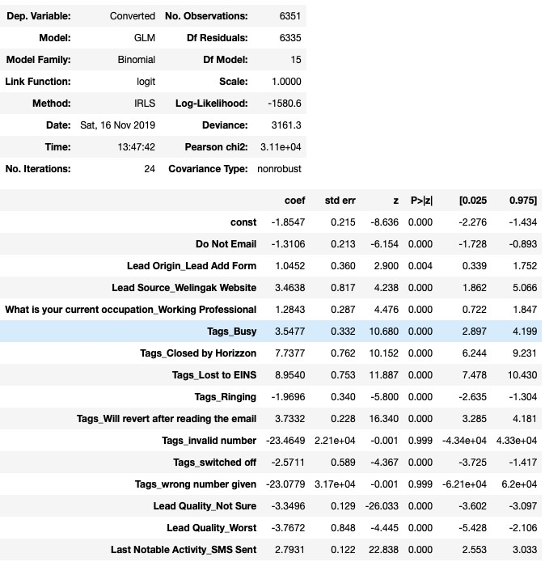
The Summary Report is as follows:

Slide 21

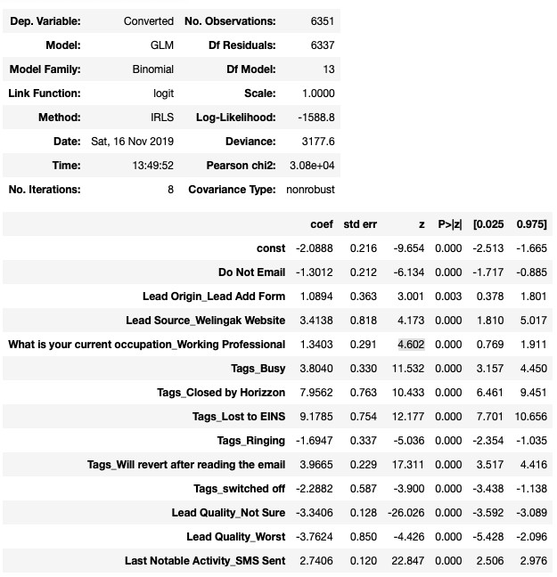
Dropping tags_invalid number and tags_wrong number given because of high p-value and rebuilding the MODEL

Slide 22
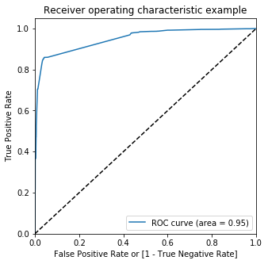
ROC CURVE
An ROC curve demonstrates several things:
It shows the tradeoff between sensitivity and specificity (any increase in sensitivity will be accompanied by a decrease in specificity).
The closer the curve follows the left-hand border and then the top border of the ROC space, the more accurate the test.
The closer the curve comes to the 45-degree diagonal of the ROC space, the less accurate the test
95% of the area is covered by the ROC

Slide 23
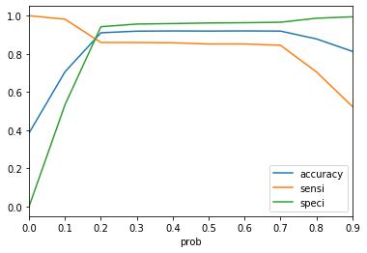
Plotting accuracy, sensitivity, and specificity for various probabilities
From the curve above, 0.2 is the optimum point to take it as a cutoff probability.

Slide 24
Metrics on Train Set
Confusion Matrix
Predicted → Actual ↓ | Not Churn | Churn
Not Churn | 3679 (TN) | 226 (FP)
Churn | 343 (FN) | 2103 (TP)
TP | True Positives
TN | True Negatives
FN | False Negatives
FP | False Positives
Accuracy | Sensitivity | Specificity | Precision | Recall | F1 Score
0.9104 | 0.8597 | 0.9421 | 0.9029 | 0.8597 | 0.8808
Precision
Recall

Slide 25
Metrics on Test Set
Confusion Matrix
Predicted → Actual ↓ | Not Churn | Churn
Not Churn | 1635 (TN) | 99 (FP)
Churn | 155 (FN) | 834 (TP)
TP | True Positives
TN | True Negatives
FN | False Negatives
FP | False Positives
Accuracy | Sensitivity | Specificity | Precision | Recall | F1 Score
0.9067 | 0.8432 | 0.9429 | 0.8938 | 0.8432 | 0.8678
84% of the values (actual converted) are predicted by the model
94% of the values (actual not converted) are predicted by the model
Recall

Slide 26
CONCLUSION
RERESCSULTS
The top three variables which contribute most towards the probability of a lead getting converted are :
Tags
Lead Source
Lead Quality.
The top 3 categorical/dummy variables which should be focused the most in order to increase the probability of lead conversion are:
Tags_Lost to EINS
Tags_Closed by Horizzon
Tags_Will revert after reading the email
Focus should be more on improving lead conversion of API and Landing Page Submission origin and generate more leads from Lead Add Form.
Focus should be on improving lead conversion of olark chat, organic search, direct traffic, and google leads and generate more leads from reference and welingak website.
Websites should be made engaging yet simple to attract customers to spend Time on it.

Slide 27
Thank You…

