Slide 1
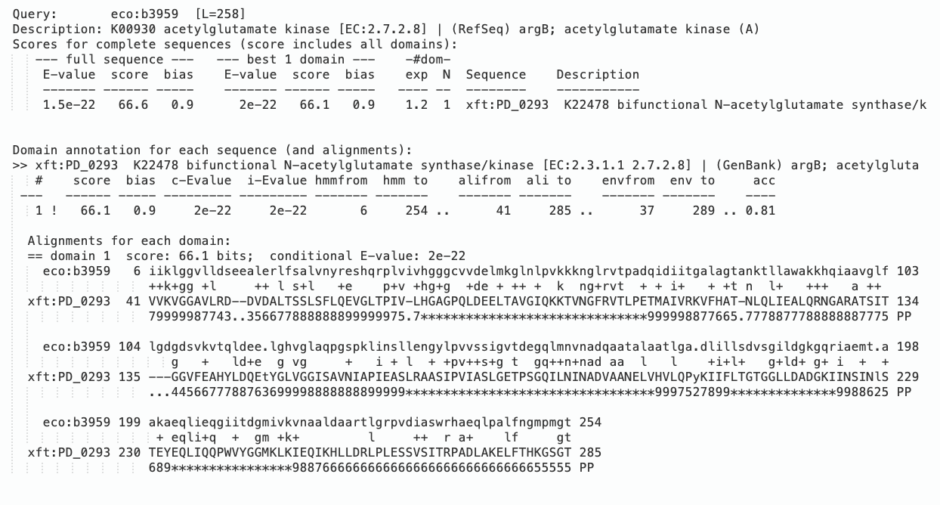
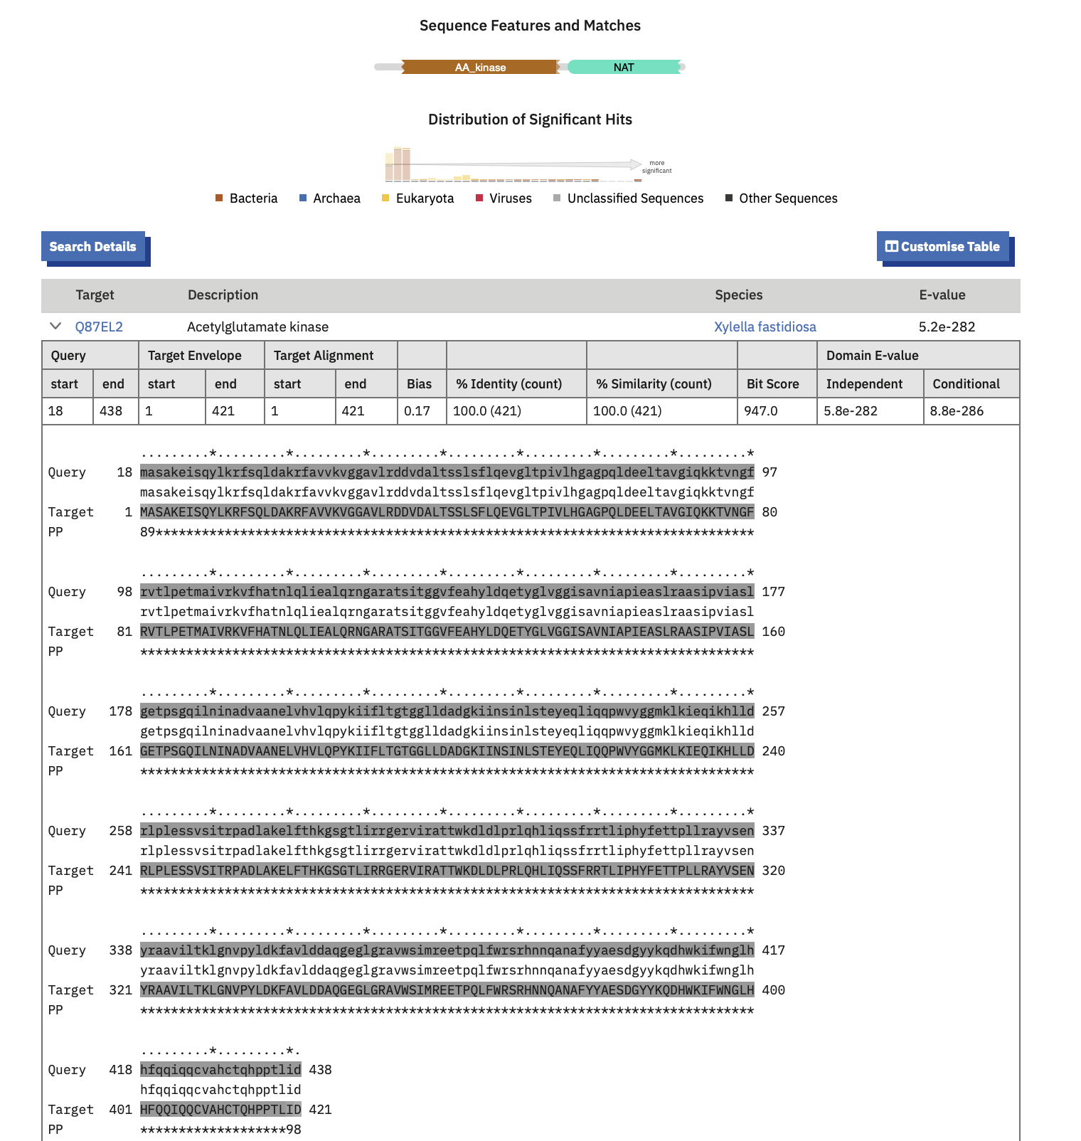
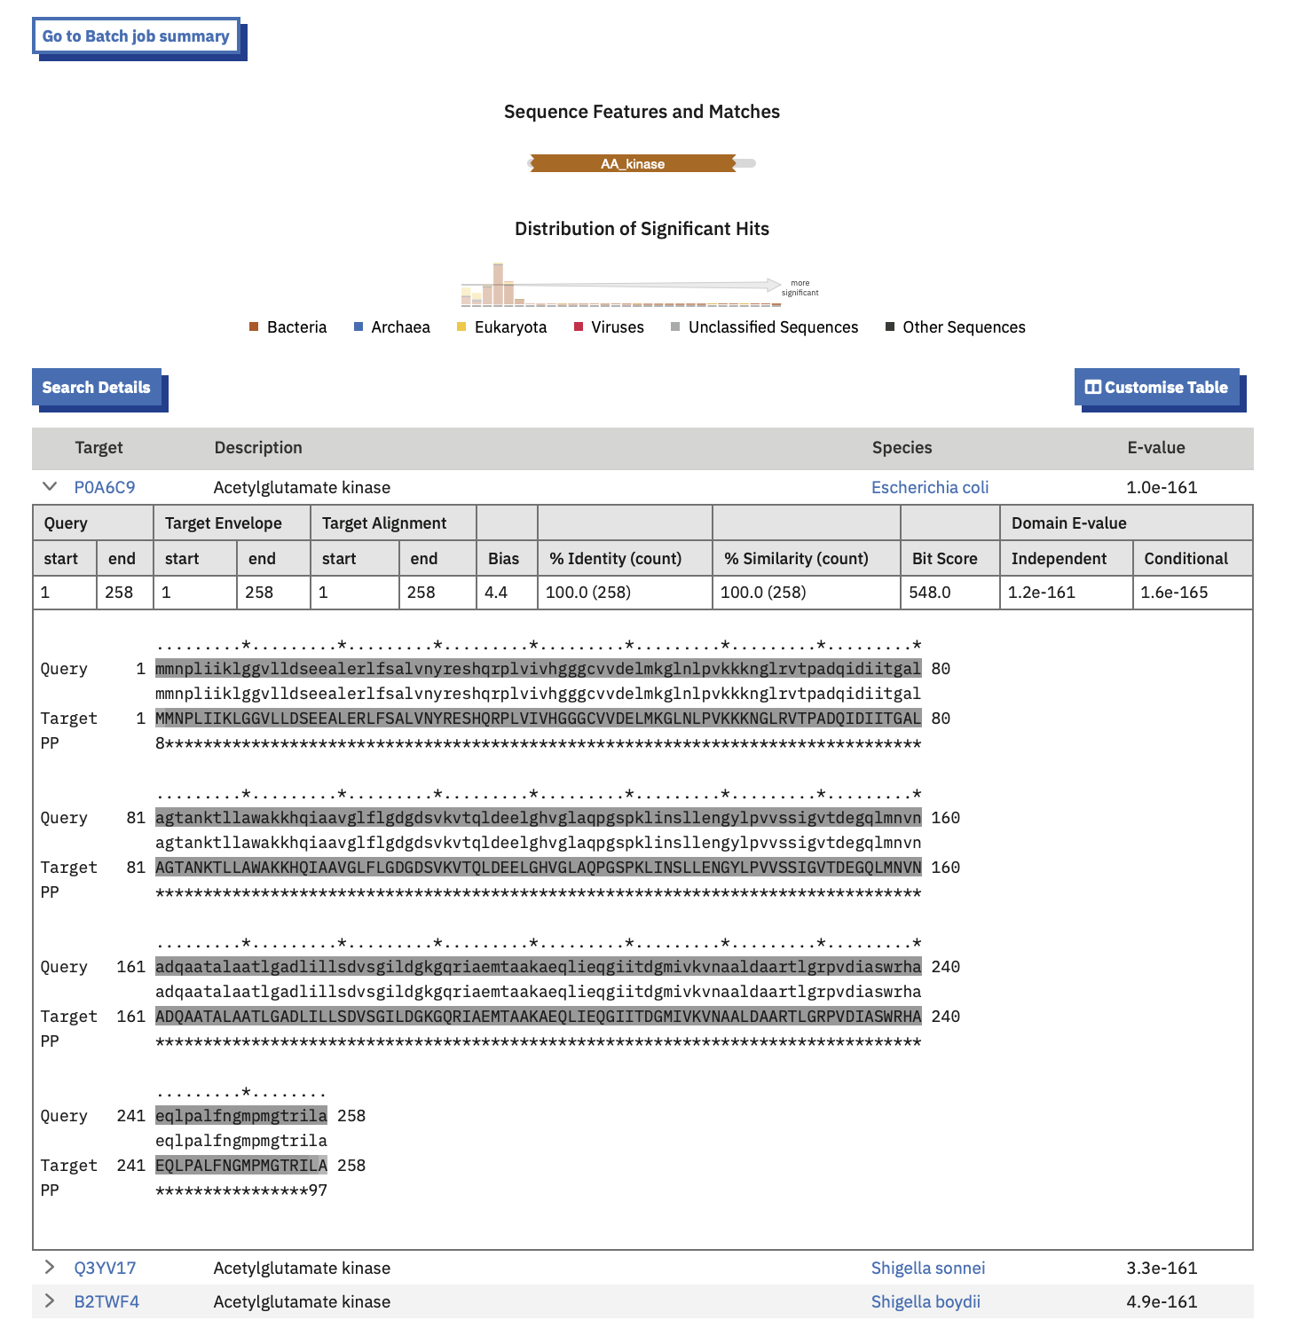
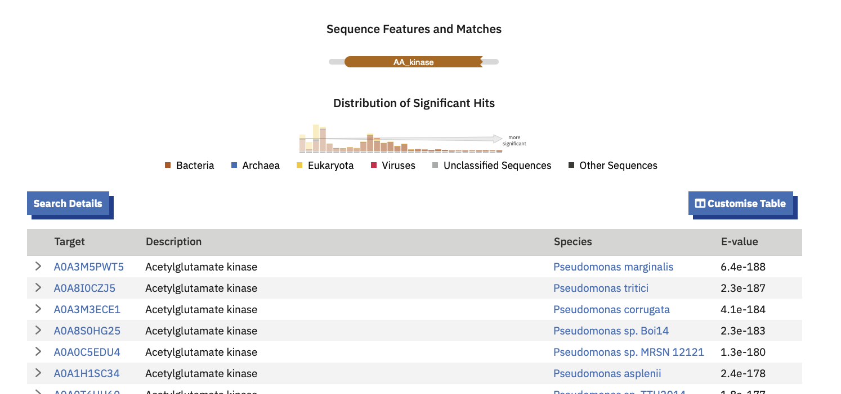
Alignment for K00930 and K22478 sequences
Domain search for K00930 sequence
Domain search for K22478 sequence
Domain search for NC_012660.1_5881 ORF sequence

Slide 2
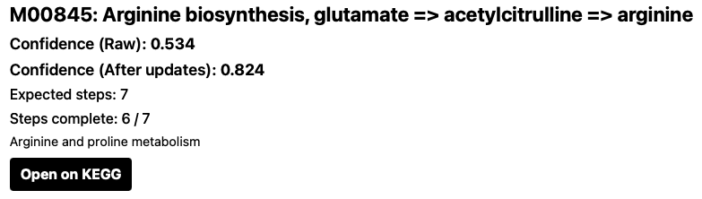
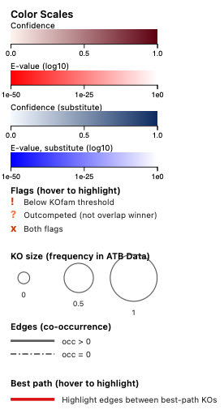
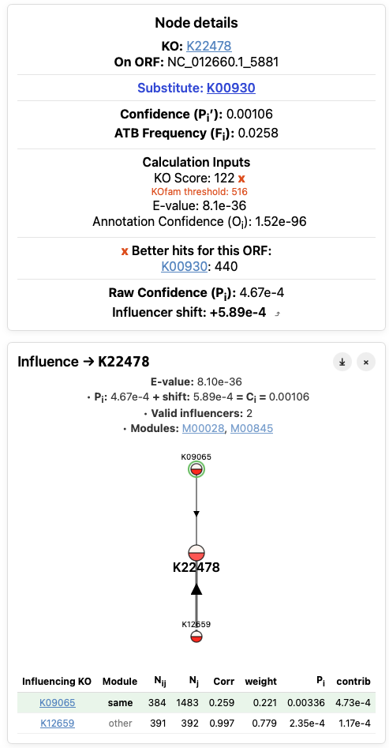
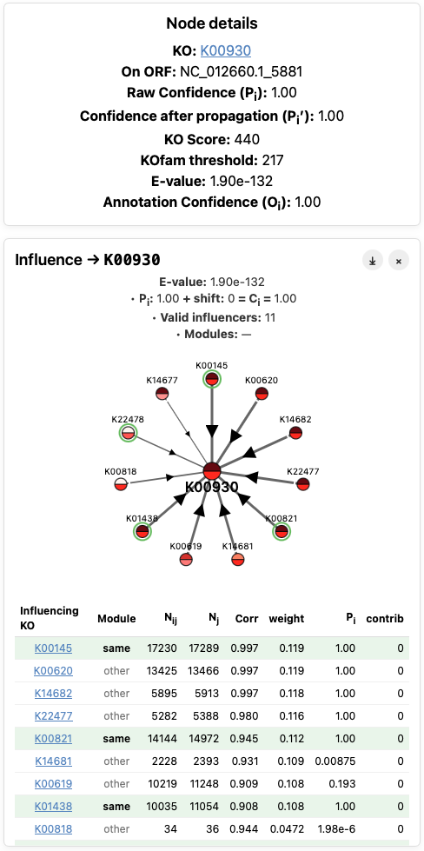
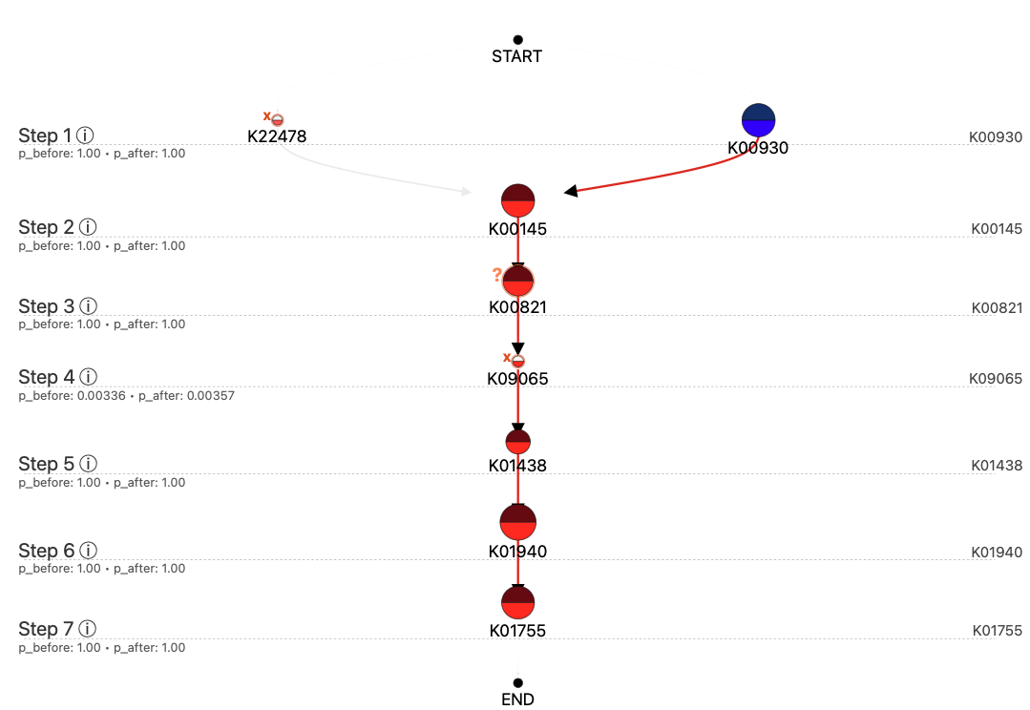
Module Graph for M000845 in SBW25
Node details for K22478 and K00930

Slide 3
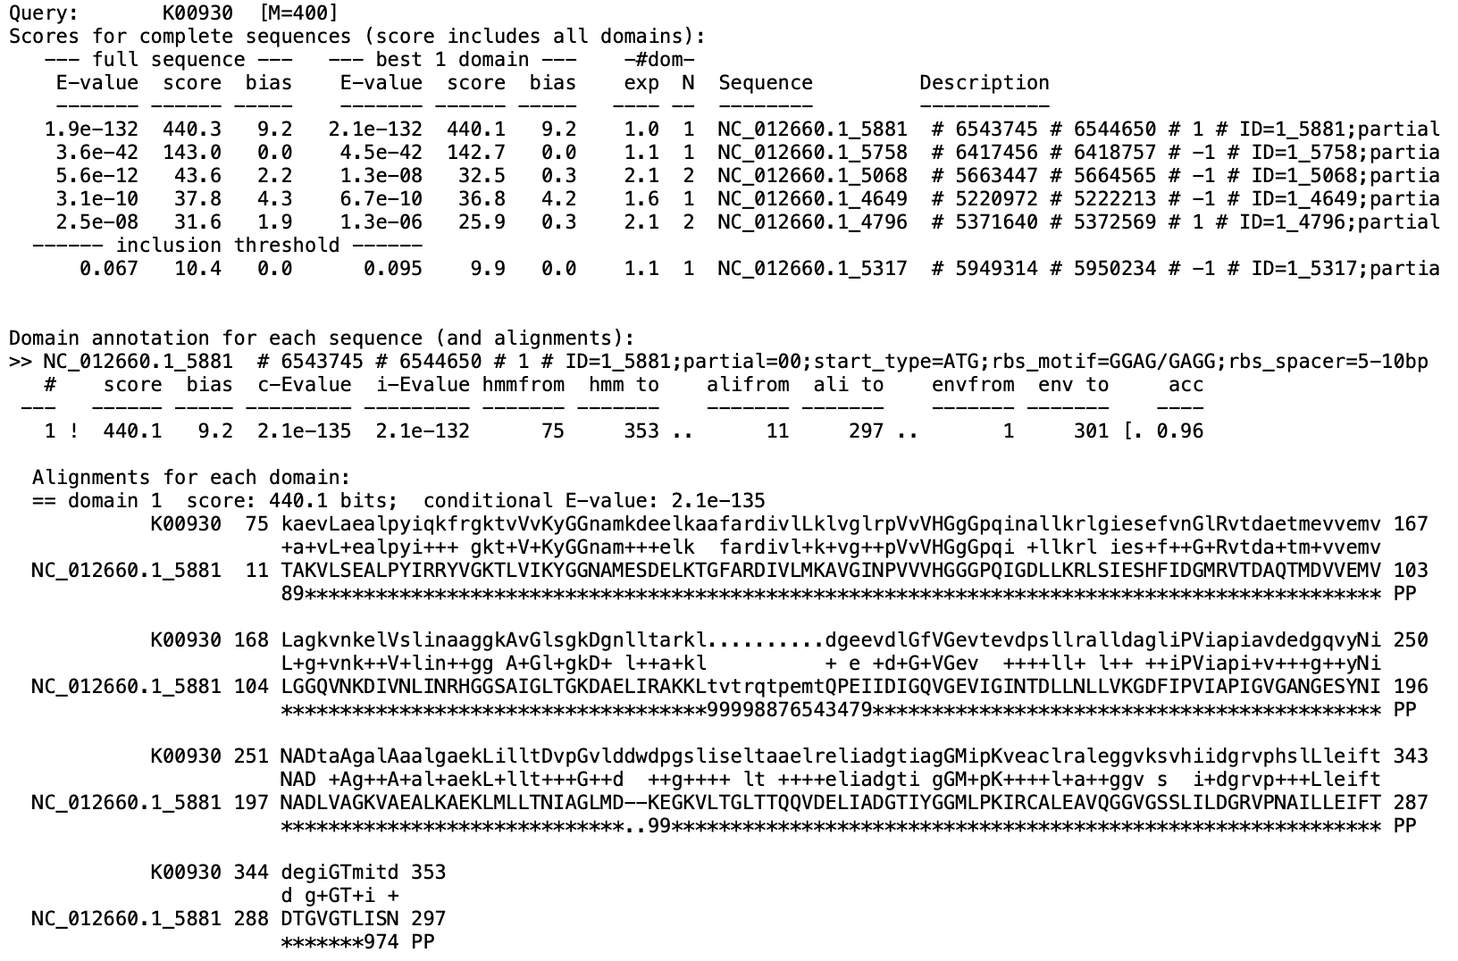
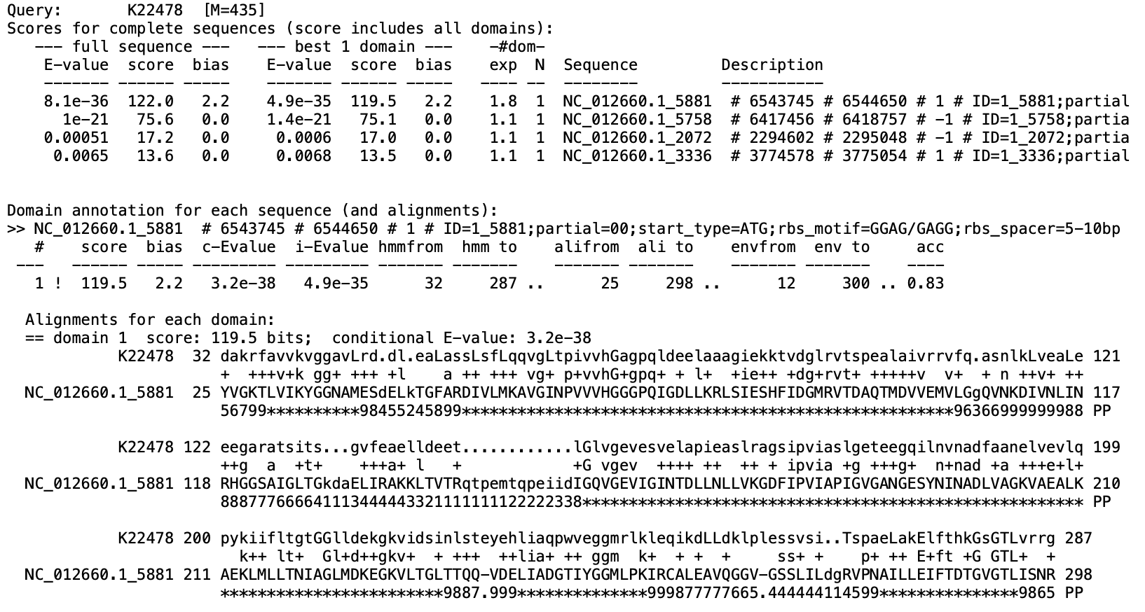
HMMSEARCH for K00930.hmm against ORF NC_012660.1_5881
HMMSEARCH for K22478.hmm against ORF NC_012660.1_5881

