Slide 1
ETL PROJECT
EXTRACT , TRANSFORM , LOAD ' BIG MART SALES ' DATA.
Copyright @ Neha Talwar Data Analytics bootcamp 2019

Slide 2
GOAL :
The goal is to extract the data from a reliable data source like Kaggle and bring it into the python environment with pandas as a csv and structure it into a pandas dataframe to begin the transformation phase of the data by cleaning the data, fixing the null and missing values , grouping by relevant variables to create visualizations and identify the outlets with maximum sales and the other trends and variables contributing to those sales. After the data is cleaned and fixed i will load the pandas dataframe into a local database such as postgreSQL and check for SQL tables with SQL commands.

Slide 3
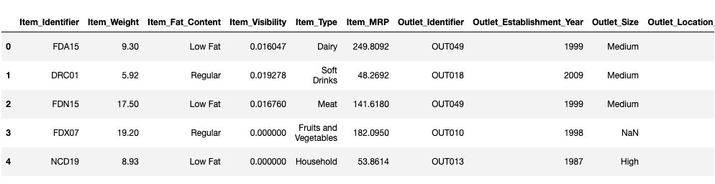
The pandas dataframe after extraction
DESCRIPTION OF THE DATA :-
This dataset describes the sales for BigMart which is a go-to grocery mart for all kinds of perishable and non-perishable food items. The data is divided into a train and test csv where the train csv has 8523 rows and 12 rows and test csv has 5681 rows and 11 columns. On merging both the csv’s the total row count sums upto 14204 rows .

Slide 4



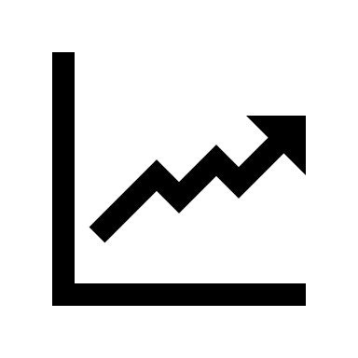
data cleaning or transformation required.
Exploratory data analysis
Impute missing , null values
Visualize the data with plots

Slide 5
The EDA gave the following pointers :-
After merging the data we have 14204 rows and 13 columns of which 8 are categorical and 5 are numerical columns .
The column ‘item weight’ has 2439 missing values and ‘outlet size’ has 4016 missing values .
Column ‘item visibility’ has zero value errors that needs to be fixed.
The code : -
Used the pivot table to aggregate column’s mean values after grouping by relevant columns.
Used apply function on the dataframe with lambda function to locate and fill the missing values with the calculated averages from the pivot table.
Plotted with seaborn library to deduce correlations between the columns.

Slide 6
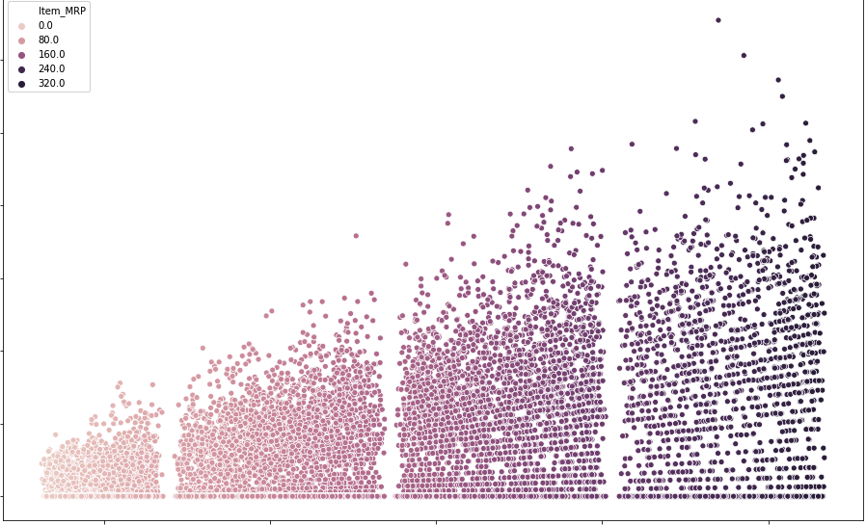
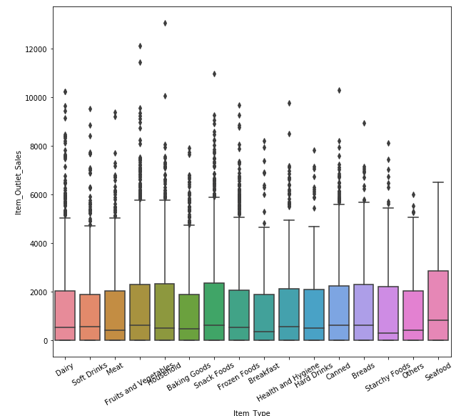
The boxplot shows that sales for meats , fruits and vegetables , dairy , snacks is high whereas seafood has the least sales.
The scatterplot depicts that the $50 -100 MRP items are the most sold and thus most dense after which $150-200 MRP items are comparatively less dense and the items above $200 MRP are the least dense or are slow-moving in nature.

Slide 7
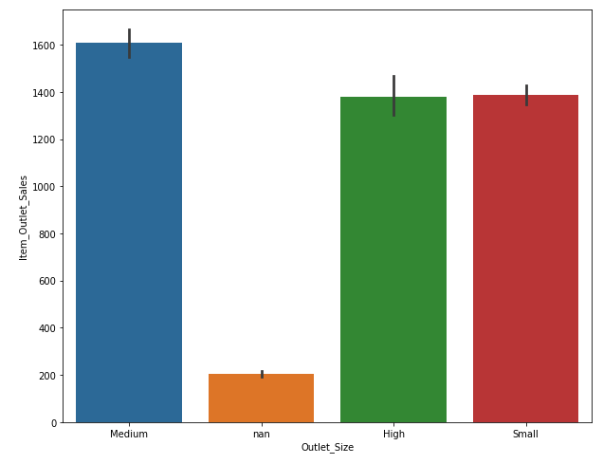
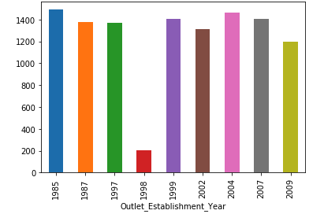
Medium sized outlets are doing the maximum sales followed by high and small at an even rate.
Sales look to be similar for all the establishments that started operations in different year's except for the year 1998 that has the least sales.

Slide 8
Loading the data into postgres database
Create a table in my local postgres database with a ‘CREATE TABLE’ query and import the csv into the table.
Import the create_engine function from sqlalchemy library.
Connect to the local database.
Confirm the data has been added by querying the table stored in postgres.
Make sql queries from the jpynb to perform C.R.U.D operations on the stored data.

Slide 9
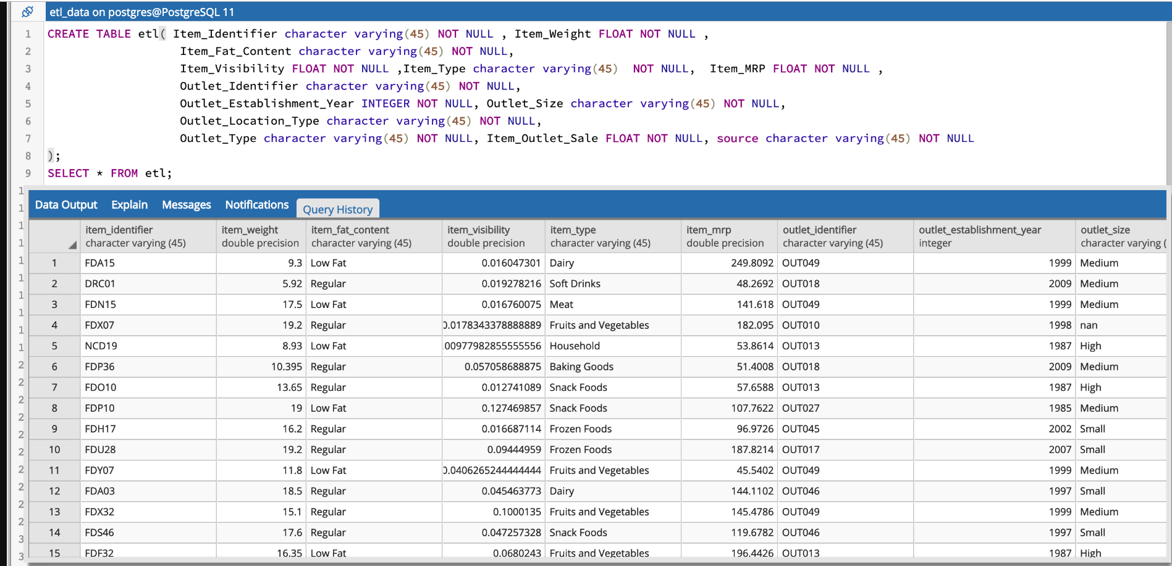
The Postgres table data.

