Slide 1




Predictive Modelling on Bank Marketing Data Using Data Mining
Presented by:
Prannoy Banerjee
Neha Chanchlani
Hitesh Gupta
Instructor:
- Patrice Seyed

Slide 2
Table of Content
Project Overview
Data Preparation
Exploratory Data Analysis
Implementation of Algorithms-
  Logistic Regression
  Decision Tree
  SVM
  Naïve Bayes
  Random Forest
Comparative Analysis :
  Decision tree, svm and logistic regression
  Naïve Bayes and Random Forest
Conclusion

Slide 3
Project Overview
Predictive modelling is a process used in predictive analysis to create a statistical model of future behaviour.
The data we chose is related with direct marketing campaigns of a Portuguese banking institution.
We are basically predicting whether a customer will subscribe to “Term Deposit Account” or not based on his characteristics.
Along with that we are also trying to predict the amount that bank will propose to the customer for the deposit.

Slide 4
Term Deposit Account
A term deposit is a deposit held at a financial institution that has a fixed term.
These are generally short-term with maturities ranging anywhere from a month to a few years.
When a term deposit is purchased, the lender (the customer) understands that the money can only be withdrawn after the term has ended or by giving a predetermined number of days’ notice.
So our aim is to identify whether a customer will subscribe to “Term Deposit” or not.

Slide 5
Data Preparation
The data we used for the project is Portugal based Telemarketing data.
URL for description of data: https://archive.ics.uci.edu/ml/datasets/
All the data used is in the public domain and does not require any additional license.
Actual dataset can be obtained from :
https://archive.ics.uci.edu/ml/datasets/Bank+Marketing#

Slide 6
Output/Predictor Variables
y - has the client subscribed a term deposit? (binary: 'yes','no')
Term Deposit Amount – the amount of term deposit (continuous)

Slide 7
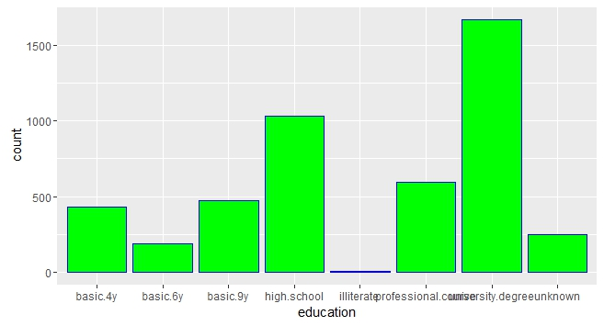
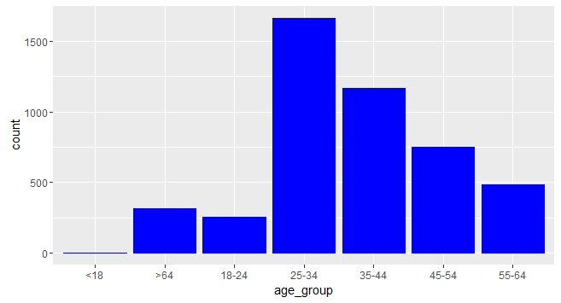
Exploratory Data Analysis
Education of users subscribed
to Term Deposit Account
Number of users based on age having TDA

Slide 8
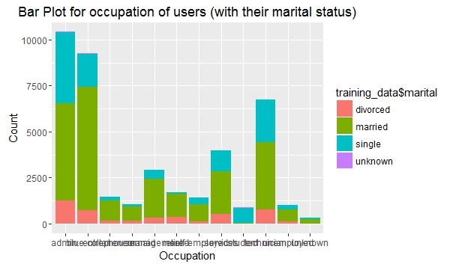
Exploratory Data Analysis
Occupation and Marital status of users subscribed to Term Deposit Account

Slide 9
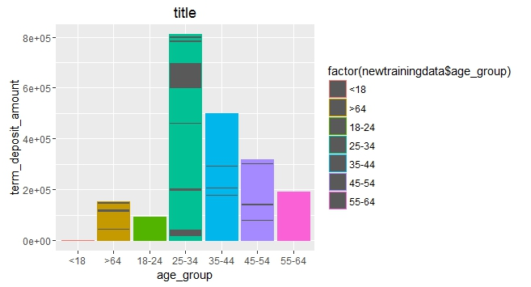
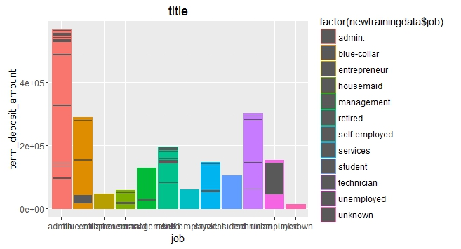
Exploratory Data Analysis
Plot of Term Deposit Amount based on age group
Plot of Term Deposit amount based on job

Slide 10
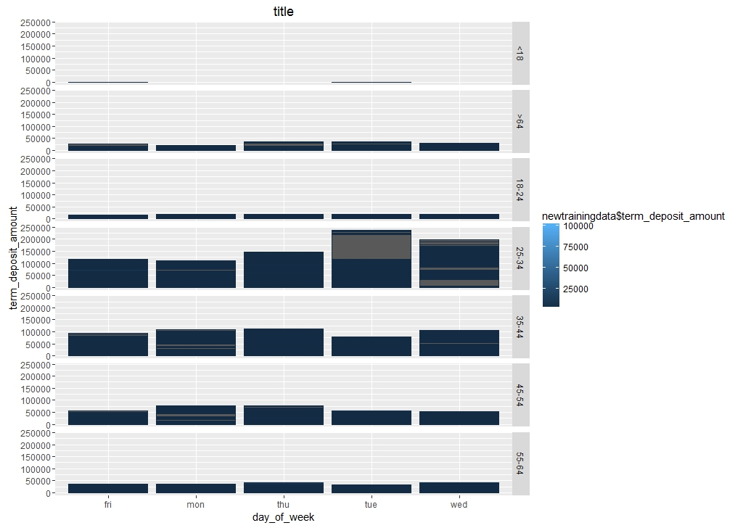
Exploratory Data Analysis
Distribution of Term Deposit over multiple days

Slide 11
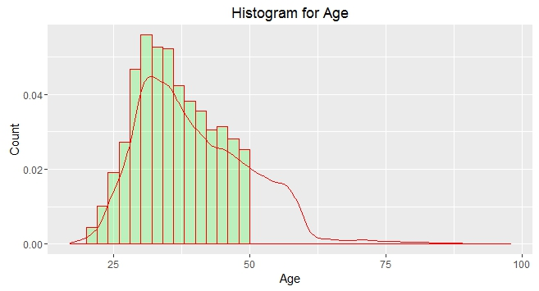
Exploratory Data Analysis
User Age Plot

Slide 12
Classification Algorithms
To predict whether a customer will subscribe for Term Deposit Account:
Logistic Regression
Decision Tree
SVM
To predict the amount to be proposed to the customer for Term Deposit:
Naïve Bayes
Random Forest

Slide 13
Logistic Regression
We considered following combination of features for the logistic regression model:
Feature Combination | Accuracy Percentage
job+education+balance | 0.739744848
job+education+balance+age_group+poutcome | 0.782335623
job+education+balance+housing | 0.733944848
job+education+balance+loan | 0.782562334
age+poutcome | 0.783022571
age+nr.employed | 0.738370952
duration+emp.var.rate | 0.769283611
duration+balance_group | 0.747791953
duration+ balance_group +poutcome | 0.79892051
So the feature combination of “duration+ balance_group +poutcome”
gave us maximum accuracy.

Slide 14
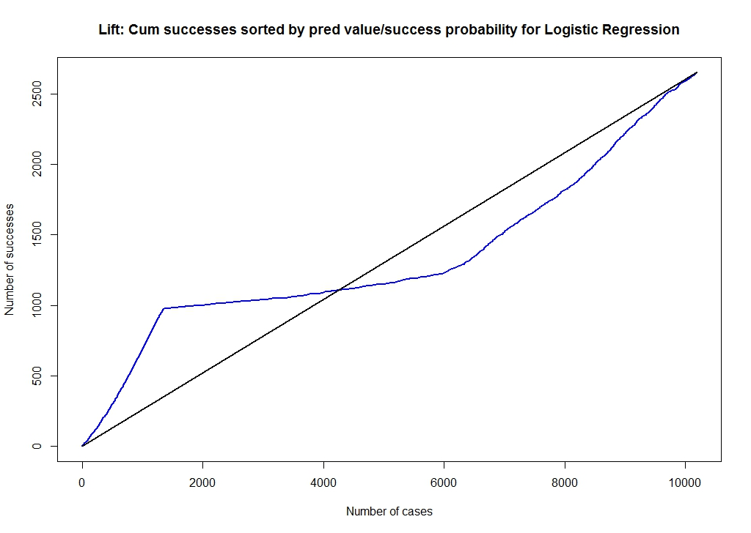
Lift Curve for this particular model:

Slide 15
Decision Tree
A decision tree is a decision support tool that uses a tree-like graph or model of decisions and their possible consequences, including chance event outcomes, resource costs, and utility. It is one way to display an algorithm.
Combination of features for the Decision Tree model:
Feature Combination | Accuracy Percentage
job+education+balance | 0.880037933
job+education+balance+age_group+poutcome | 0.88940256
job+education+balance+housing | 0.880037933
job+education+balance+loan | 0.880037933
age+poutcome | 0.88940256
age+nr.employed | 0.881104789
duration+emp.var.rate | 0.900426743
duration+balance_group | 0.890232338
duration+ balance_group +poutcome | 0.903034614
All Features | 0.912043623

Slide 16
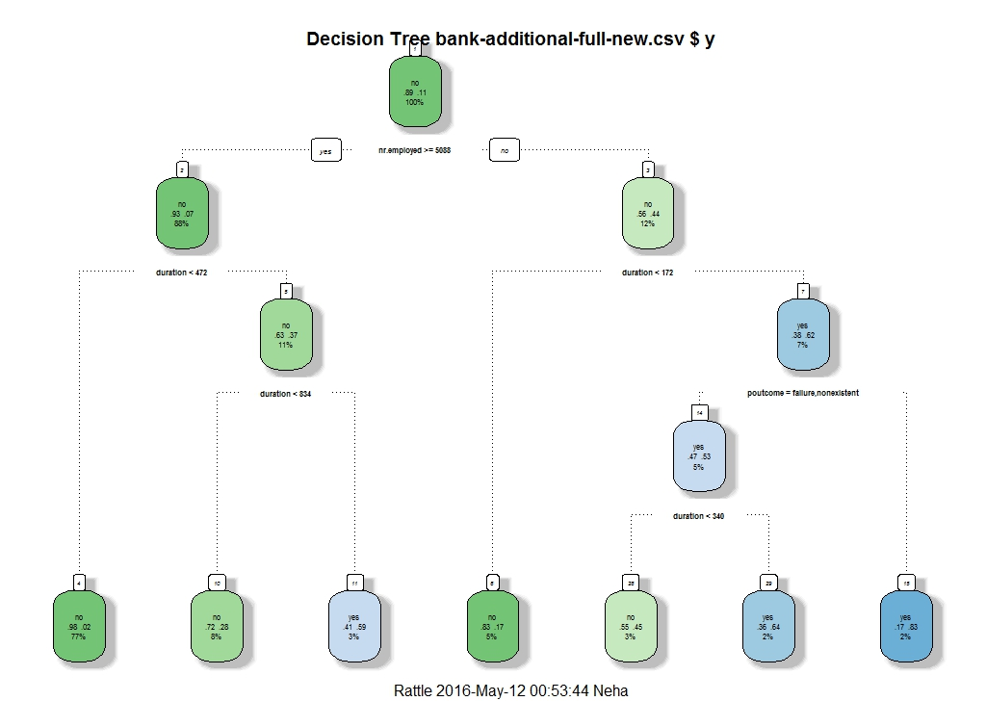
Decision Tree for the most accurate model

Slide 17
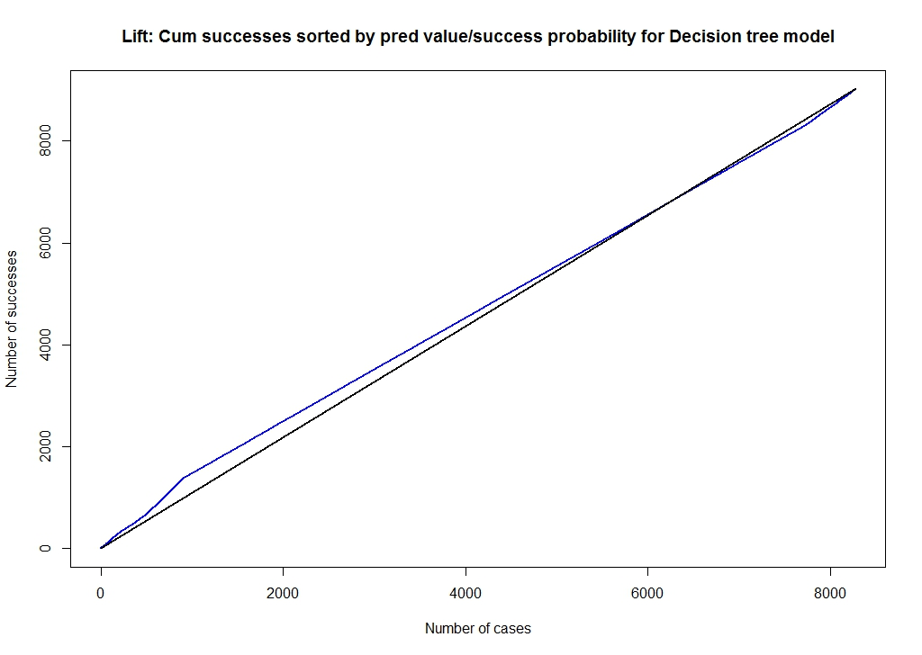
Lift Curve for the most accurate model

Slide 18
SVM
Support vector machines are supervised learning models with associated learning algorithms that analyze data used for classification and regression analysis.
Given a set of training examples, each marked for belonging to one of two categories, an SVM training algorithm builds a model that assigns new examples into one category or the other, making it a non-probabilistic binary linear classifier.

Slide 19
We considered following combination of features for the SVM model:
Feature Combination | Accuracy Percentage
job+education+balance | 0.7397448
job+education+balance+age_group+poutcome | 0.7829244
job+education+balance+housing | 0.7237448
job+education+balance+loan | 0.7459244
age+poutcome | 0.7830226
age+nr.employed | 0.7433759
duration+emp.var.rate | 0.7709519
duration+balance_group | 0.7504416
duration+ balance_group +poutcome | 0.7987242
So the feature combination formed by considering duration, balance_group and poutcome gave us maximum accuracy.

Slide 20
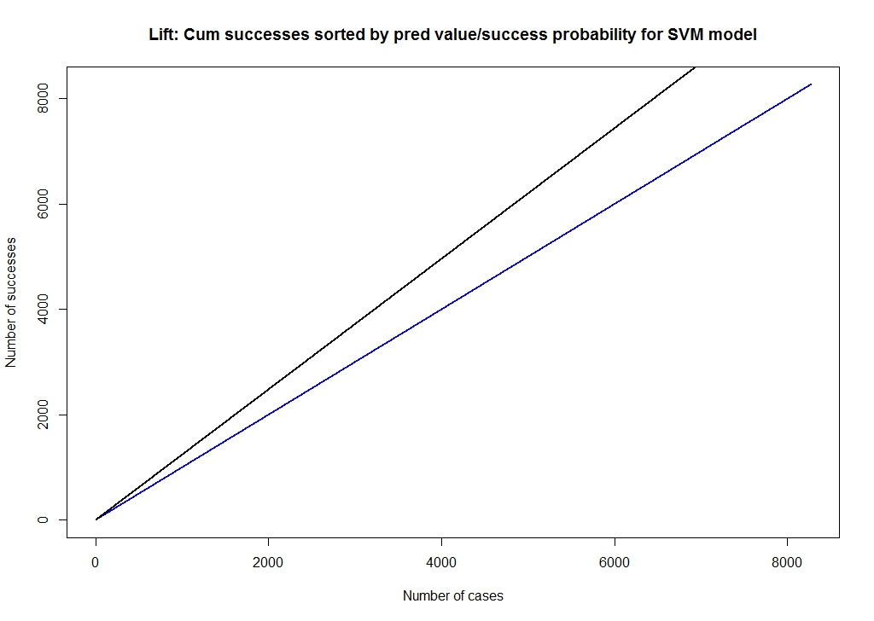
Lift Curve for the most successful model

Slide 21
7.1 Naïve Bayes Classifier
Naive Bayes classifiers are a family of simple probabilistic classifiers based on applying Bayes' theorem with strong (naive) independence assumptions between the features.
They can handle both continuous and discrete predictors; it assumes a distribution (can be chosen) for the continuous predictor.
In our case, the predictor variables are age_group (7 possibilities), balance_group (6 possibilities), housing (binary), loan (binary) and poutcome (binary).
These categorical predictor variables create (7)(6)(2)(2)(2) = 336 groups.
We score a case as success (y=1) if its probability is 0.5 or larger, and as failure (y=0), otherwise.

Slide 22
Observations
Among 14588 customers who have not subscribed for a term deposit account, the Naive Bayes classification approach predicts the term deposit amount correctly for 14351 (98.37%). But it fails to identify 237 out of 14588 predictions (1.62%) correctly.
Among 1880 customers who have subscribed for a term deposit account, the Naive Bayes classification approach predicts the term deposit amount correctly for 369 (19.63%). But it fails to identify 1511 out of 1880 predictions (80.37%) correctly.
The misclassification rate of Naive Bayes classification method is 0.1060937 i.e. 10.61 %.

Slide 23
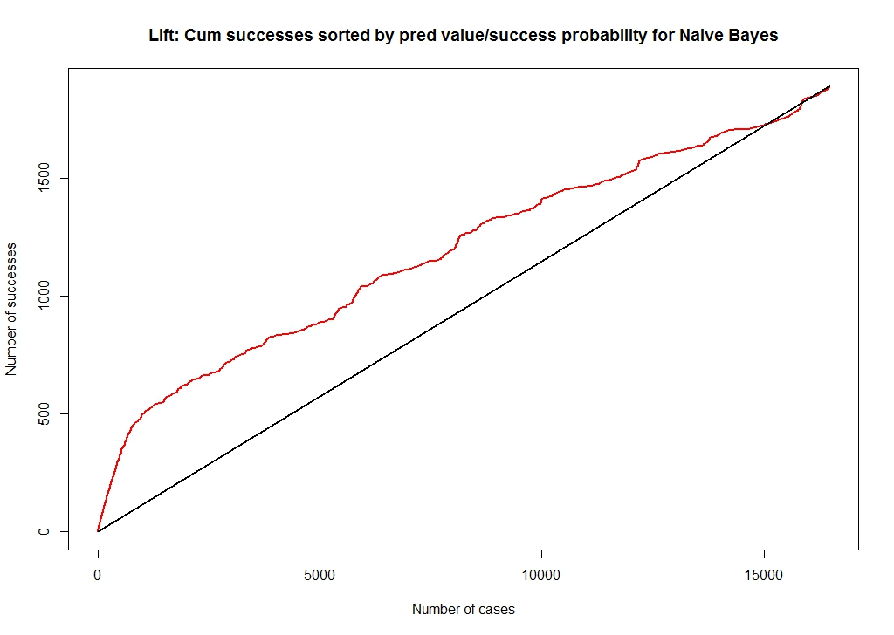
Lift Curve for Naïve Bayes

Slide 24
Random Forest Classifier
A Random Forest classifier uses a number of decision trees, in order to improve the classification rate.
Random forests are implemented in R in the randomForest package
Random forests is an ensemble learning method used for classification and regression.
Unlike single decision trees which can suffer from high variance or high bias, Random Forests use random sampling and averaging to find a natural balance between the two extremes.

Slide 25
Advantages of Random Forest
Superior performance
Robust against overfitting
Easy to use, little tuning
Low variance and low bias
Measures variable importance through permutation
Induces additional randomness which diversifies the trees, resulting in expanded search space and noise profile for better prediction
Multiple model with different subset of predictors
Using out-of-bag error as an estimate of the generalization error

Slide 26
Predicting Accuracy with feature combinations
The predictor variables are age_group (7 possibilities)
balance_group (6 possibilities), housing (binary), loan (binary) and poutcome (binary)
Here we have assumed a symmetric cost structure and the probability cutoff is 0.5. i.e. if its probability is 0.5 or greater, we score a case as success (y = 1), or failure (y = 0), otherwise.

Slide 27
Observations
Among 7282 customers who have not subscribed for a term deposit account, the Random Forest classification approach predicts the term deposit amount correctly for 7143 (98.09%). But it fails to identify 139 out of 7282 predictions (1.91%) correctly.
Among 956 customers who have subscribed for a term deposit account, the Random Forest classification approach predicts the term deposit amount correctly for 234 (24.48%). But it fails to identify 1511 out of 1880 predictions (75.52 %) correctly.
The misclassification rate of Random Forest classification method is 0.1045157 i.e. 10.45 %.

Slide 28
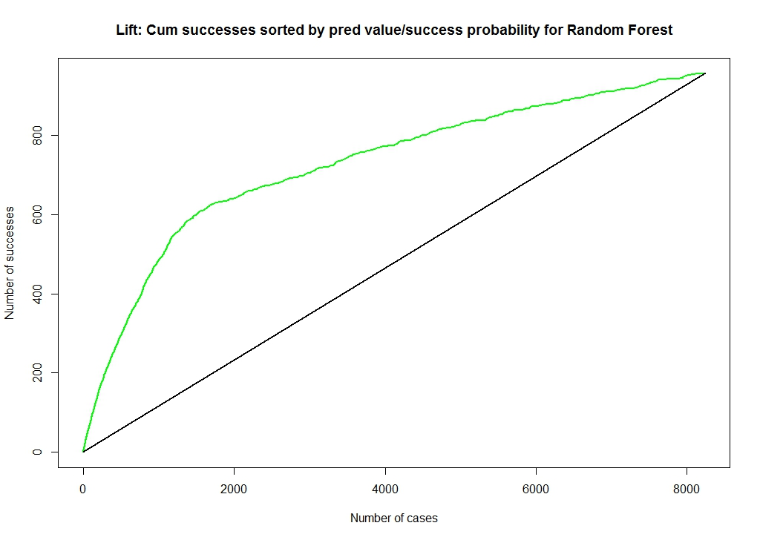
Lift curve for Random Forest Classification

Slide 29
Comparative analysis
  Decision tree, SVM and logistic regression
Feature Combination | Logistic Regression | Decision Tree | SVM
job+education+balance | 0.739744848 | 0.880037933 | 0.7397448
job+education+balance+age_group+poutcome | 0.782335623 | 0.88940256 | 0.7829244
job+education+balance+housing | 0.733944848 | 0.880037933 | 0.7237448
job+education+balance+loan | 0.782562334 | 0.880037933 | 0.7459244
age+poutcome | 0.783022571 | 0.88940256 | 0.7830226
age+nr.employed | 0.738370952 | 0.881104789 | 0.7433759
duration+emp.var.rate | 0.769283611 | 0.900426743 | 0.7709519
duration+balance_group | 0.747791953 | 0.890232338 | 0.7504416
duration+ balance_group +poutcome | 0.79892051 | 0.903034614 | 0.7987242

Slide 30
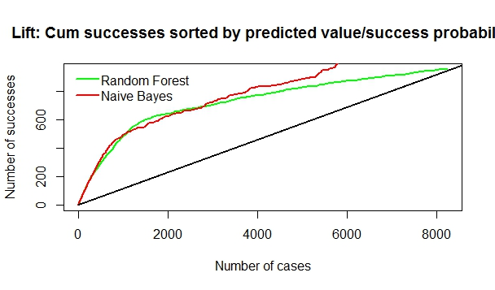
Comparative analysis
Naïve bayes and random forest
The misclassification rate for Naïve Bayes classification method is 0.1060937 (i.e., 10.61 %) whereas, the for Random Forest classification method it is 0.1045157 (i.e., 10.450%).
Random Forest method reduces the overall misclassification error in the holdout (evaluation/test) data set hence, this is an improvement over the Naïve rule.

Slide 31
Thank You!
Questions?

