Slide 1
TEAM MEMBERS
Final Year B.E. Project | CSE
Neha Vithob Nayak
AI-Powered
2SD22CS129
Pooja S Doddagoudar
2SD22CS130
Placement
Ambika Chavan
2SD23CS400
Preparation Platform
Smital Kaginkar
2SD23CS409
Prepare Smarter. Interview Better.
PROJECT GUIDE
Prof. Chaitali Chate
Dept. of CSE, SDMCET
SDG 4: Quality Education | SDG 8: Decent Work | SDG 9: Innovation
SDMCET, Dharwad | 2025–2026

Slide 2
PROBLEM STATEMENT
The Gap We're Solving
Students lack a unified, AI-driven platform for complete placement preparation
Fragmented Resources
No Personalized Learning
No AI Interview Analysis
Students juggle 5+ separate platforms for aptitude, coding, resume and interview practice
Generic content fails to adapt to individual skill gaps, performance or career goals
Zero real-time feedback on communication, confidence, tone or answer quality
No Performance Tracking
Isolated Existing Systems
Students cannot identify weak areas, set goals or measure improvement over time
Aptitude, coding, resume & interview data are never connected into one unified view
Research Gap → No single system unifies aptitude, coding, NLP resume analysis, AI mock interviews and analytics in one intelligent ecosystem

Slide 3




PROJECT OBJECTIVES
What We Set Out to Achieve
Four core objectives that drive the platform design and implementation
Adaptive Practice
Resume Evaluation
To provide adaptive aptitude and coding practice based on student performance and evolving placement trends.
To evaluate resumes using AI and Natural Language Processing techniques to provide structured improvement suggestions.
01
02
ELO-based difficulty adjustment
Aptitude: logical, quantitative & verbal
NLP keyword extraction & TF-IDF
ATS-based scoring across 5 dimensions
Coding: DSA, programming languages
AI tracks topic-wise weak areas
Missing skills & structure feedback
Aligned with industry job requirements
AI Mock Interviews
Performance Analytics
To conduct AI-based mock video interviews and provide structured performance feedback on communication, confidence, and technical responses.
To perform analysis of student skills, academic records, and career goals in order to derive comprehensive performance statistics and system-wide insights.
03
04
Whisper AI for speech-to-text
Communication & confidence analysis
Placement Readiness Score (PRS)
Weak area heatmaps & recommendations
Technical response quality scoring
Structured post-session feedback report
Role-based dashboards: Student, Faculty, TPO
Department-wide institutional analytics

Slide 4





PROPOSED SYSTEM
Our Solution — One Intelligent Ecosystem
A centralized, AI-driven platform for complete placement readiness
Adaptive Learning
Coding Practice
Resume Analyzer
AI adjusts difficulty in real-time using ELO scoring per student
DSA + programming problems with live code execution (Judge0)
NLP-powered ATS scoring, 5-dimension feedback & improvement tips
AI Mock Interviews
Readiness Score
Whisper AI transcription + speech & confidence evaluation
Weighted PRS from all 4 modules — personalized dashboard

Slide 5
LITERATURE SURVEY & RESEARCH GAP
Existing Systems vs. Our Approach
System / Study | Methodology | Limitation
Smart Resume Analyzer — Sharma et al. (IEEE 2021) | NLP keyword extraction | No personalized recommendations
AI Student Performance Prediction — Kumar et al. (Springer 2020) | ML classification models | Not placement-focused
Online Coding Evaluation — Rao et al. (IJCA 2019) | Automated test case execution | No analytics or AI guidance
Placement Management System — XYZ University (2022) | CRUD-based portal | No AI integration
Adaptive Learning System — MIT Research (2021) | Recommendation algorithm | Complex, not campus-specific
Our Proposed System | NLP + ML + Whisper AI + ELO Scoring | Fully Integrated Intelligent Ecosystem ✓
Research Gap →
None of the existing systems integrates resume analysis, adaptive testing, AI video interview evaluation, placement readiness scoring and institutional analytics into a single campus-specific ecosystem.

Slide 6
TECHNOLOGY STACK
Built With Modern, Industry-Standard Technologies
Frontend
Backend
Database
AI & ML
Auth & Dev
React.js
FastAPI (Python)
MongoDB
Whisper AI (Speech)
JWT Authentication
Tailwind CSS
REST APIs
Mongoose ODM
NLP / Scikit-learn
Git & GitHub
React Router
MediaPipe
Postman
Axios
Groq AI
VS Code
Security & Non-Functional Requirements
JWT + bcrypt — encrypted passwords & secure sessions
Role-based access — Student / Faculty / TPO isolation
Scalable MVC — modular design for easy future upgrades

Slide 7
SYSTEM ARCHITECTURE & METHODOLOGY
How the System Works
FRONTEND
API LAYER
AI ENGINE
DATABASE
ANALYTICS
React.js + Vite
FastAPI + JWT Auth
NLP + Whisper + ML
MongoDB
Dashboards + PRS
Student
Registration
Profile
Setup
Adaptive
Practice
Resume
Analysis
Mock
Interview
Implementation Methodology
MVC Architecture
RESTful APIs
JWT Authentication
Adaptive ELO Scoring
Clean separation of Model, View, Controller for maintainability
Standardized HTTP communication across all modules
Secure, stateless role-based session management
Dynamic difficulty adjustment per student performance

Slide 8
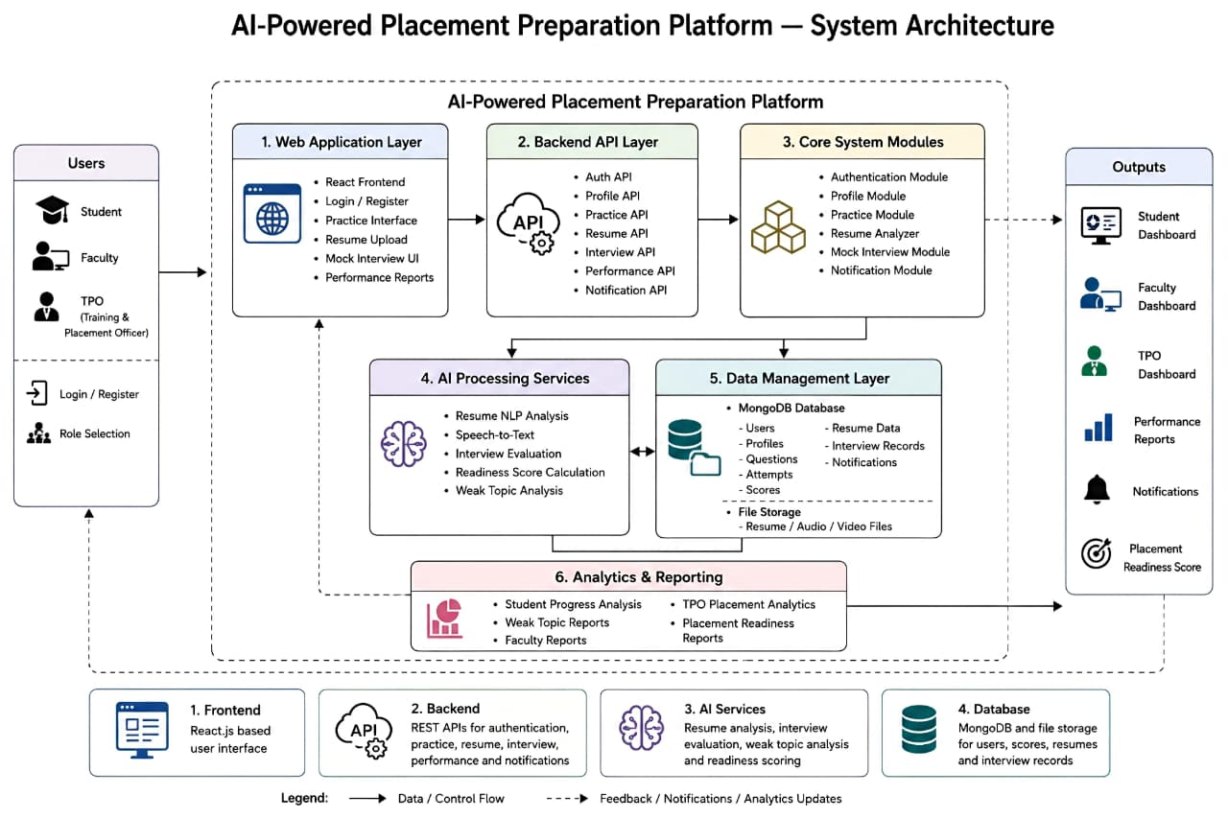
SYSTEM ARCHITECTURE

Slide 9
MODULE — RESUME ANALYZER
AI Resume Analyzer
ATS SCORING DIMENSIONS
NLP-Powered ATS Evaluation & Structured Feedback Engine
Technical Skills
1
Upload Resume
Matched against target role keywords
PDF / DOCX accepted via secure file storage
2
Text Extraction
Soft Skills
pdfplumber parses raw text from document
Leadership, teamwork, communication terms
3
NLP Cleaning
Action Verbs
NLTK: lowercase, stopwords removal, lemmatization
Built, led, deployed, designed, optimized
4
TF-IDF Vectorization
5000 feature vectors generated from cleaned text
Resume Length
Optimal 1–2 page structure check
5
Category Prediction
ML model predicts job role + confidence score
ATS Compatibility
6
ATS Resume Scoring
Formatting, keyword density & structure
5-dimension score generated with improvement tips
AI generates: Missing skills + formatting suggestions + keyword optimization tips

Slide 10



MODULE — AI MOCK INTERVIEW
AI Mock Interview System
Whisper AI + NLP + MediaPipe for Real-Time Speech & Behavioral Evaluation
Select Type
Record
Transcribe
Analyze
Feedback
Tech / HR
Video + Audio
Whisper STT
NLP + MediaPipe
AI Report
Communication
Technical Depth
Confidence
Eye Contact
Evaluated
Analyzed
Measured
Detected
Word clarity, fluency, filler words, grammar quality scored by NLP
Answer relevance, keyword accuracy and reasoning depth assessed
Voice energy, pitch variation and words-per-minute analyzed
Facial landmark tracking via MediaPipe in real-time session
Interview Types: Technical | HR & Behavioral
Generates structured feedback report post-session

Slide 11




MODULE — APTITUDE & CODING PRACTICE
Aptitude & Coding Test Module
Adaptive practice engine with ELO-based difficulty adjustment
APTITUDE PRACTICE
CODING PRACTICE
Logical Reasoning
DSA Problems
Puzzles, analogies, blood relations, pattern recognition
Arrays, Trees, Graphs, DP, Hashing — Beginner to Advanced
Quantitative Aptitude
Live Code Execution
Percentages, ratios, profit-loss, time & work, series
Write, run & test code in-browser using Judge0 API
Verbal Ability
Adaptive Difficulty
Reading comprehension, vocabulary, sentence correction
ELO-based engine adjusts problem level per performance
AI tracks topic-wise accuracy and recommends focus areas
Supports Java, Python, C++, JavaScript | Future: Built-in Compiler

Slide 12
MODULE — PLACEMENT READINESS SCORE (PRS)
How PRS is Calculated
A weighted composite score computed across all four platform modules
PRS = (Aptitude Score × 0.25) + (Coding Score × 0.30) + (Resume Score × 0.25) + (Interview Score × 0.20)
Aptitude Score
Coding Score
Resume Score
Interview Score
25%
30%
25%
20%
weightage
weightage
weightage
weightage
Topic-wise accuracy across logical, quantitative & verbal sections
DSA performance + test case pass rate + ELO difficulty rating
ATS rating from NLP: keywords, skills, formatting, action verbs
Communication + confidence + technical depth from AI analysis
Dynamic Score
Weak Area Identification
Role-based Visibility
PRS updates automatically after every completed module activity
AI flags subjects below threshold → recommends targeted practice
Student: own PRS | Faculty & TPO: department-wide analytics

Slide 13
ANALYTICS DASHBOARD
Multi-Role Analytics Dashboard
Real-time insights tailored for Students, Faculty and Training & Placement Officers
STUDENT DASHBOARD
FACULTY DASHBOARD
TPO DASHBOARD
✓
Placement Readiness Score (PRS) gauge
✓
Total students & active users count
✓
Institution-wide placement readiness
✓
Resume ATS score overview
✓
Subject-wise class accuracy rates
✓
Department-wise PRS comparison
✓
Interview performance summary
✓
Performance radar (5 dimensions)
✓
Send job alerts & notifications to students
✓
Weak topic heatmap + AI recommendations
✓
Student-wise leaderboard ranking
✓
Interview trends & mock session insights
All dashboards powered by real-time MongoDB queries via FastAPI — Role-based access enforced by JWT

Slide 14
RESEARCH PAPER CONTRIBUTION
Published Research Work
PAPER TITLE
AI-Powered Placement Preparation Platform for Student Career Readiness
Journal: Indian Journal of Science & Technology (IJST)
Manuscript ID: IJST-2026-700-R1 | Submitted: May 3, 2026 | Status:
Minor Revision ✓
Reviewer Feedback — Addressed
PAPER HIGHLIGHTS
Citation format — numerical [1],[2] ordering applied throughout
Unified AI platform — resume, coding, interview & analytics
DOI numbers added to all references in the paper
Whisper AI + MediaPipe for real-time interview evaluation
Figure callouts inserted in Results & Discussion section
NLP-based ATS scoring with 5-dimension structured feedback
Journal formatting guidelines (single column, line numbers) applied
This research validates the academic and practical contribution of our AI-powered placement preparation system.

Slide 15



FUTURE SCOPE & CONCLUSION
Future Scope
Conclusion
Built-in Compiler
Replace Judge0 API with native code execution engine
✓
Centralized AI ecosystem — one platform for all placement needs
Advanced AI Interview
✓
Adaptive testing, NLP resume scoring & Whisper AI interview analysis
Emotion detection, facial analysis, deeper NLP scoring
✓
PRS calculated from 4 weighted modules for actionable insight
Mobile Application
Native iOS & Android apps for on-the-go preparation
✓
Role-based dashboards for Students, Faculty & TPO
Company-Specific Prep
Bridges the academic-to-industry skill gap for campus placements
✓
Tailored modules for TCS, Infosys, Google, Amazon patterns
Predictive Analytics
✓
Research paper at IJST — peer reviewed, minor revision stage
ML-based placement outcome prediction & trend insights

Slide 16
Thank You
Questions & Discussion
SDMCET, Dharwad | Department of CSE | 2025–2026
Neha Nayak • Pooja Doddagoudar • Ambika Chavan • Smital Kaginkar
Guide: Prof. Chaitali Chate

