Slide 1
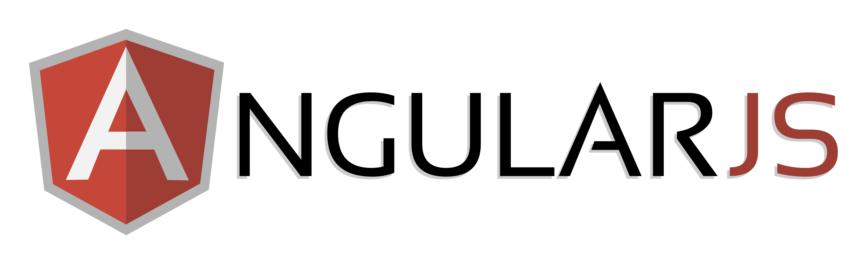

Slide 2
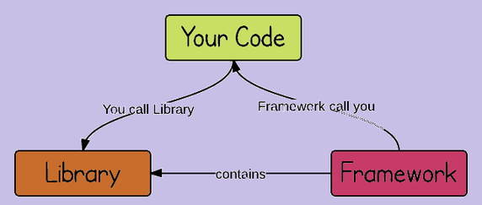
What is Framework?
Framework: This describes a given structure of "how" you should present your code. Pretty much like a code-template, along some helpers, constructors etc. to solve/simplify a specific problem or bring your architecture in "order".
Examples, “AngularJS", "Backbone", "requireJS", “ReactJS".
ARE YOU CONFUSED COMPARING IT TO LIBRARY ??
Library: A library provides a set of helper functions/objects/modules which your application code calls for specific functionality. Libraries typically focus on a narrow scope (e.g., strings, IO, sockets), so their API's also tend to be smaller and require fewer dependencies.it offers a lot of tools and neat stuff to work with, which in general, simplify your coding experience.
Examples "jQuery", "MooTools", "YUI"

Slide 3
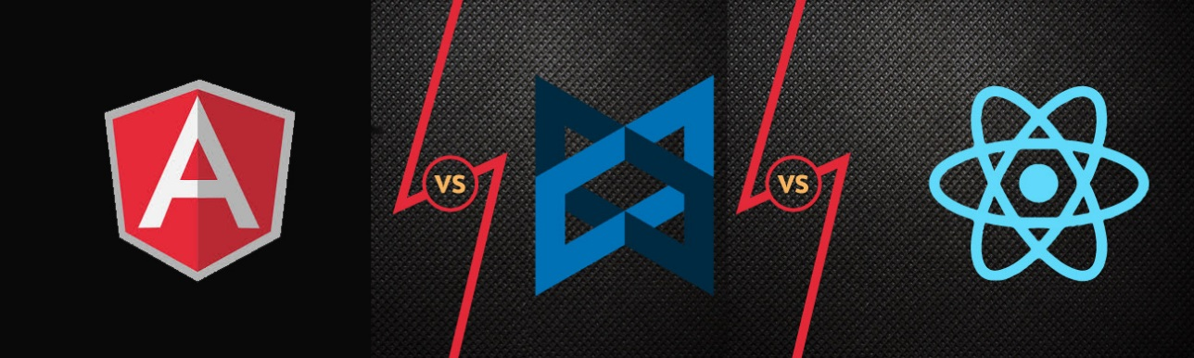
Lets Compare
AngularJS | ReactJS | BackboneJS
1) MVC Framework | 1) V in MVC | 1) MVC Framework
2) Angular supported by Google | 2) React by Facebook | 2) By Jeremy Ashkenas known for Coffee Script and Underscore.js.
3) Angular offers most everything you'd need to get a project off the ground. However, it does offer a number of ways to do "the same thing" that does lead it to be somewhat problematic in larger companies unless there is a hard-and-fast style guide to adhere to. | 3) React set out to tackle the problem of making highly efficient adjustments to the DOM. This is huge, because touching the DOM is a surprisingly expensive task made worse by inefficiencies in manipulation libraries like jQuery. | 3) It offers so little it is common for implementations to differ widely across projects - this lack of standardization can be difficult when trying to look for examples or trying to coordinate changes across a large team.
4) Well suited to Large & small companies | 4) Well suited to large & small companies. | 4) Well suited to solo developers or very small teams

Slide 4
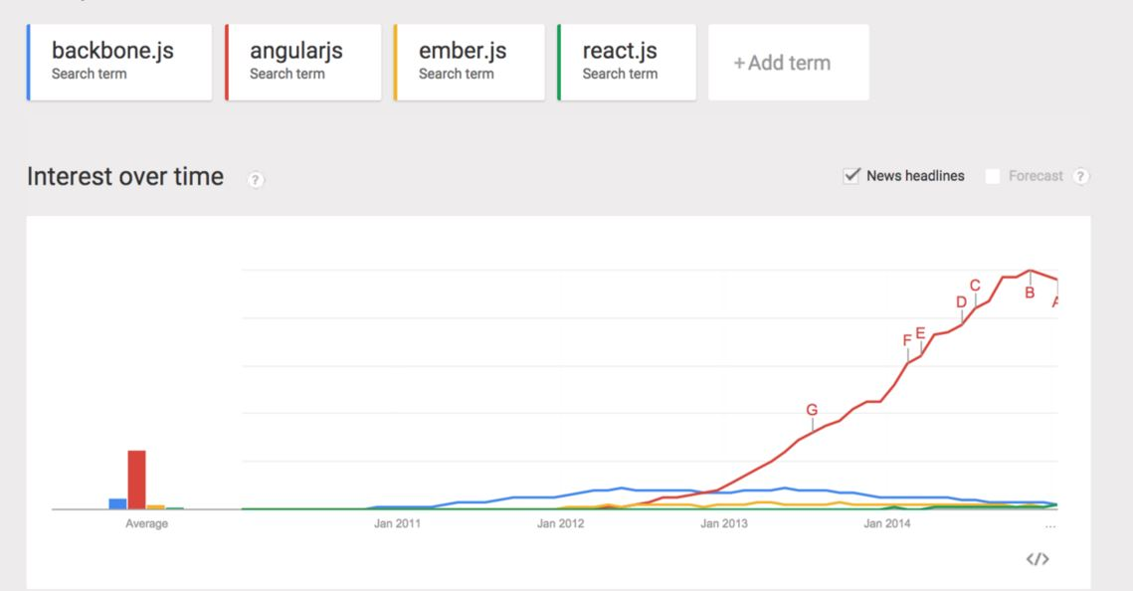
Popularity

Slide 5
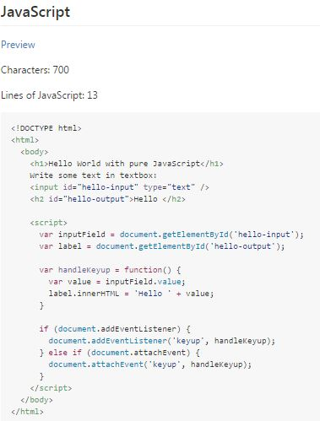
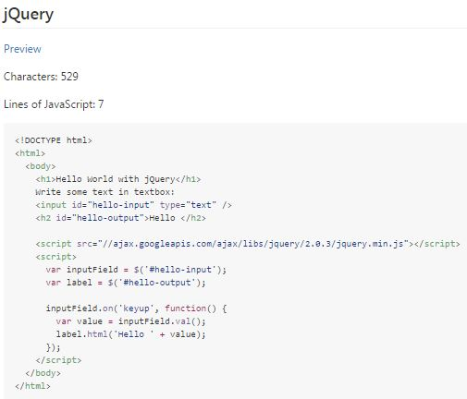
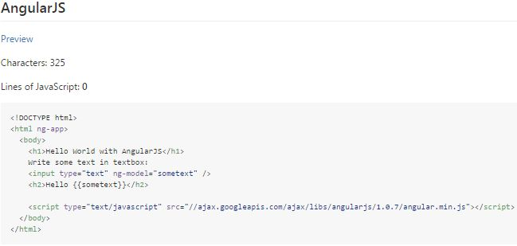
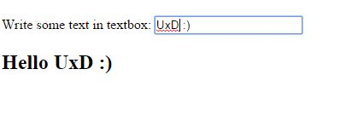

Slide 6
Setting up Environment
This may require :
Code Editor : Sublime, ATOM
Server : Tomcat, Apache, NodeJS (Install XAMPP for multiple servers)
Browsers: Chrome/Firefox
You can download library from the official angular site https://angularjs.org/ (1.2 version) or use cdn link.

Slide 7

MVC
?
Services
Scope
Directive
Linking
LOT OF TERMINOLOGIES AND QUITE HARD SO PLEASE PRACTICE ALONG ALL CONCEPTS
Notes:
I saw a lot of words that were confusing and after more research I started to get a little frustrated…kind of felt like this kid.

Slide 8
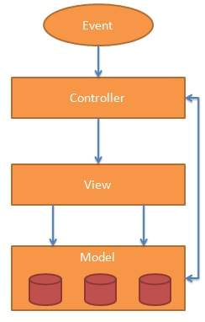
Model View Controller
Model View Controller or MVC as it is popularly called, is a software design pattern for developing web applications.
Model – It is the lowest level of the pattern responsible for maintaining data. The model is responsible for managing application data. It responds to the request from view and to the instructions from controller to update itself.
View – It is responsible for displaying all or a portion of the data to the user. A presentation of data in a particular format, triggered by the controller's decision to present the data. They are script-based template systems such as JSP, ASP PHP and very easy to integrate with AJAX technology.
Controller – It is a software Code that controls the interactions between the Model and View.
The controller responds to user input and performs interactions on the data model objects.
The controller receives input, validates it, and then performs business operations that modify the
state of the data model.
Notes:
How many people have heard of or know what the MVC is?
For the rest of us…
**
[ Read definitions ]
**
It is important to note that a MVC system can exist for the browser, the server, and even the database.
We’ll be talking about the MVC on the browser.

Slide 9
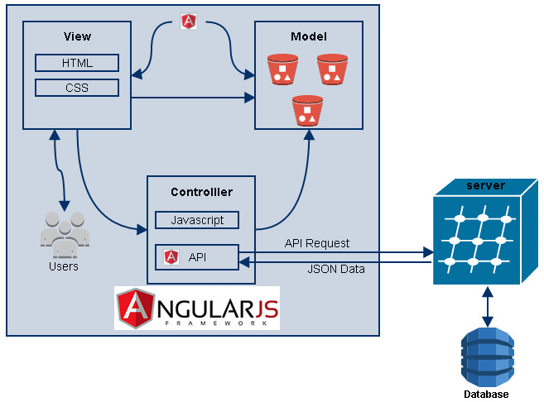

Slide 10
Single Page Application
Single-page application applies only to websites and webapps. It simply points to the fact that navigation between different screens of the website is achieved without loading a different webpage in the browser.
Classic example is GMail : when you click on a message in your inbox, browser stays on the same webpage, but JavaScript code hides the inbox and brings the message body on screen. Compare it to the webmail services of 2000-2003.
Examples: http://piratecode.ru/ , https://historyoficons.com/ , http://ilovethisfame.com/
Why SPA?
SPA is extremely good for very responsive sites
With SPA we don't need to use extra queries to the server to download pages.
SPA can use caching and local storage effectively. It is easy to scale, and it is easy to cache resources
SPA separates UI and data, SPA communicates with server only with JSON REST API (Send/Receive JSON using AJAX), this also allows both parts to be independently developed and tested.
SPA are easy to debug with chrome, as you can monitor network operations, investigate page elements and data associated with it.

Slide 11
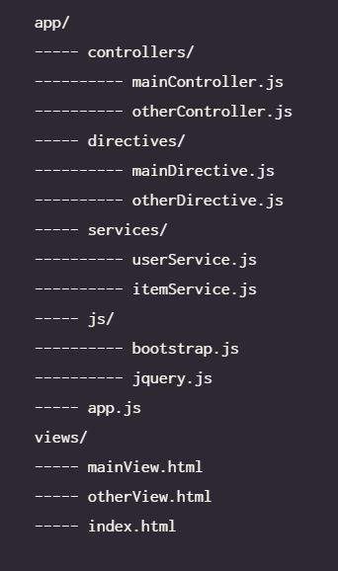
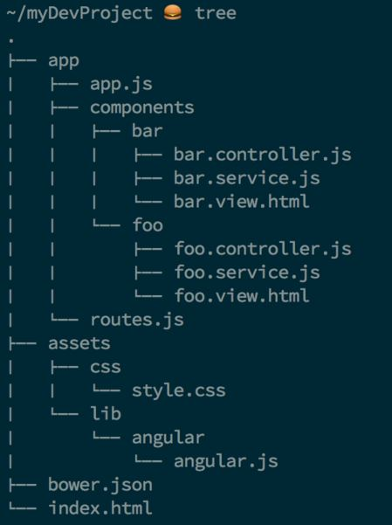
Sample Project structure
Small/Mid
Large

Slide 12
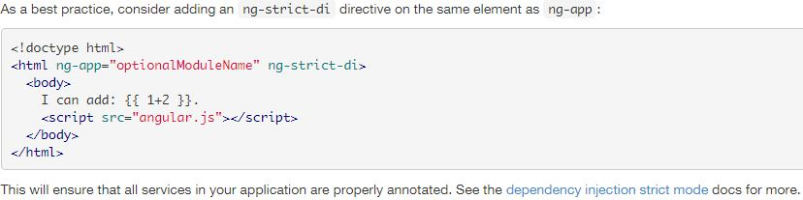
Bootstrap Application
Load framework: Place the script tag at the bottom of the page. Placing script tags at the end of the page improves app load time because the HTML loading is not blocked by loading of the angular.js script.
Choose: angular-[version].js for a human-readable file, suitable for development and debugging.
Choose: angular-[version].min.js for a compressed and obfuscated file, suitable for use in production.
Define AngularJS Application : Place ng-app to the root of your application, typically on the <html> tag if you want angular to auto-bootstrap your application.

Slide 13
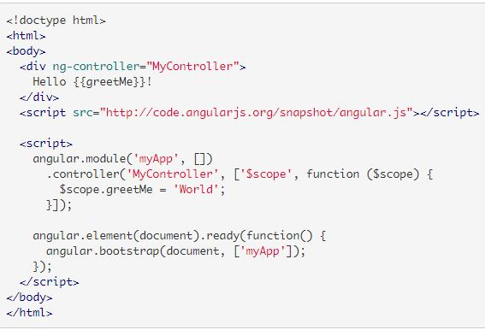
Manual Initialization
If you need to have more control over the initialization process, you can use a manual bootstrapping method instead. Examples of when you'd need to do this include using script loaders or the need to perform an operation before Angular compiles a page.
After the page and all of the code is loaded, find the root element of your AngularJS application, which is typically the root of the document.
Call angular.bootstrap to compile the element into an
executable, bi-directionally bound application.

Slide 14
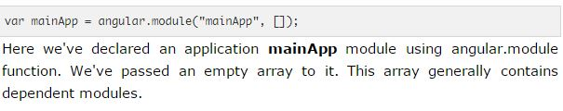
Module
A module is a collection of services, directives, controllers, filters, and configuration information. angular.module is used to configure the $injector.
AngularJS supports modular approach. Modules are used to separate logics say services, controllers, application etc. and keep the code clean.

Slide 15
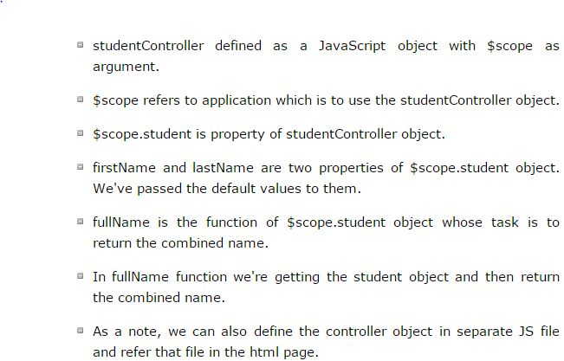

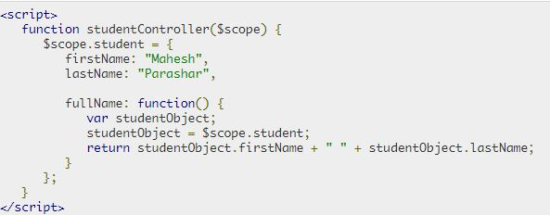
Controllers
AngularJS application mainly relies on controllers to control the flow of data in the application. A controller is defined using ng-controller directive.
A controller is a JavaScript object containing attributes/properties and functions. Each controller accepts $scope as a parameter which refers to the application/module that controller is to control.

