Slide 1


Survey on Virtual Machine Allocation in Cloud Infrastructure - Final Report
Ashwini Ukarde (026328001)
Neha Bhoi (026627560)
Saishree Jayakumar (026617056)

Slide 2
Table of content
Introduction
Algorithm
Interior Search Algorithm
A Novel Family Genetic Approach
K Means
Bin Packing with Variable Item Size Algorithm(VISBP)
Bin Packing - Reordering Grouping Genetic Algorithm
Hybrid Genetic Algorithm
Conclusion

Slide 3
Introduction
What is VM Allocation?
Why is it important?
What factors need to be considered?

Slide 4
Interior Search Algorithm
What it does?
Global optimization algorithm used to solve multi-dimensional optimization problems
Uses a stochastic random search
Need for ISA
High energy consumption
Results in increased infrastructure cost and intoxicating the surroundings with carbon emission
Solution - ISA
Objective function
Minimize the energy consumption
Maximize the available resource utilization
Goal is to find a global optimum

Slide 5
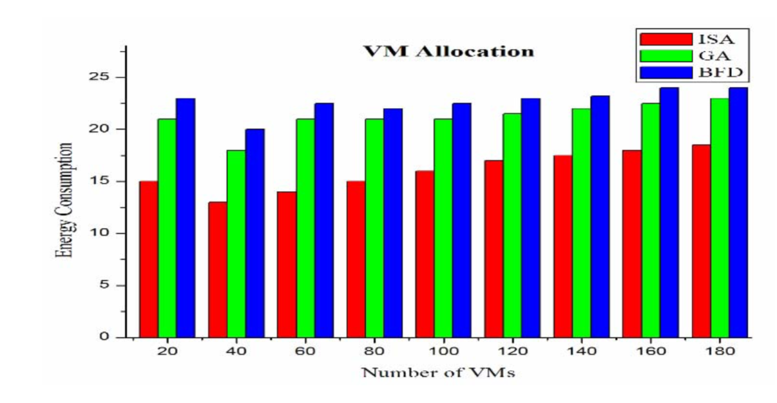
Challenge
Performance
Advantages
Excellent convergence
Energy consumption of Best Fit Decreasing (BFD) and Genetic Algorithm (GA) is around 90 – 95% whereas ISA uses only 65%
It has flexibility and efficiency to solve problems in NP-hard situations
Only one hyper parameter(α) which is ideal to tune
Takes multiple iterations to converge to a global optimum affecting the response time for VM creation
Possible Solution
Parallelize the stochastic random search
Saves around 30% of energy

Slide 6
State of the art Interior Search Algorithm
Based on: Stochastic random search
Resources Considered: Number of available Hosts, VMs and Users
Weakness: Response Time due to multiple iterations need to reach global optimum
Performance Better Than: Best Fit Decreasing and Genetic Algorithm
Strength: Energy Efficiency and Resource Utilization

Slide 7
Novel Family Genetic Approach for VM Allocation
Need for FGA
Solution - FGA
Multi objective constraint optimization problem
Traditional GA have many limitations including,
Premature convergence causing sub optimal result
High processing time
Optimizes for
CPU
Memory
Bandwidth

Slide 8
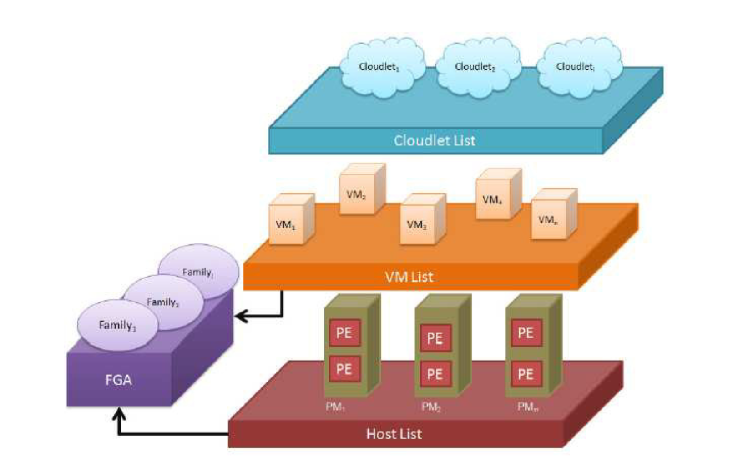
Family Genetic Approach
FGA is a promising variant of Genetic Algorithm with adaptive parameters
Divides the entire processing among the various families that run in parallel in the module
Uses self-adjusting mutation with Population Differentia
Performs crossover and mutation on each family to achieve a better individual
Uses fitness function (CPU, Memory and Bandwidth)

Slide 9
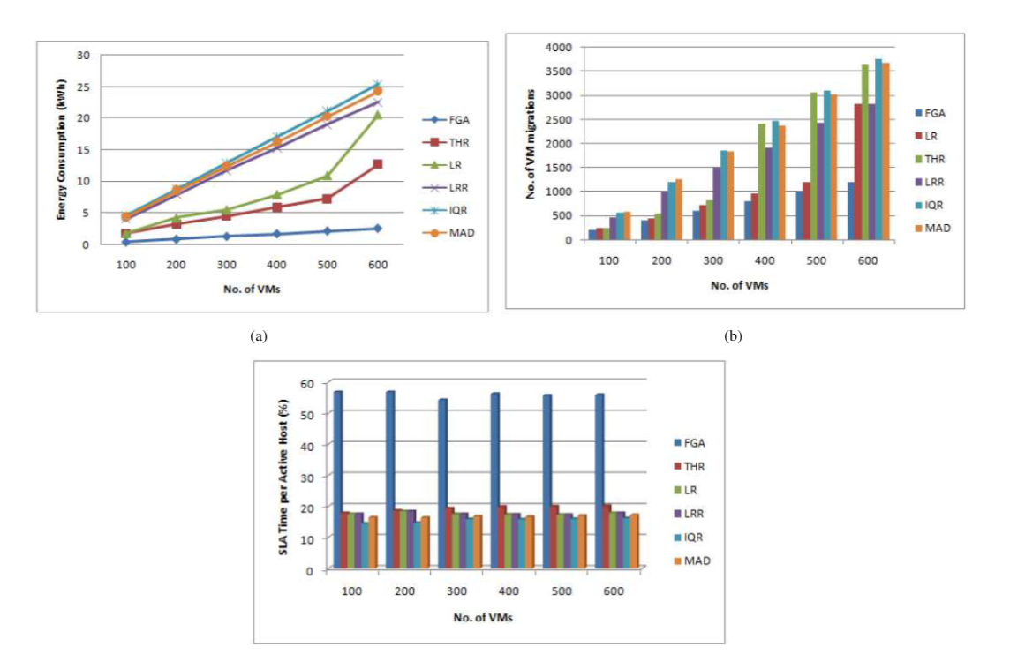
Experimental Results
Energy Consumption: 4 – 9 times better than all the other algorithms
VM Migrations: 3 – 5 times less migrations than other algorithms
SLA Time: At least 3 times faster than other algorithms

Slide 10
Novel Family Genetic Approach for VM Allocation
Advantages
Challenges
Multiple parameters to tune (k and w) and number of families to be constructed
Processing parallelized across families
Less VM Migrations
Less Energy Consumption
Less information about cross over and mutation
Better SLA time
Optimal VM Allocation
Possible Solution
Might be better to combine with other optimization methods(Hill Climbing)
Though an adaptive GA, FGA takes very small steps to converge during last few mutations

Slide 11
State of the art Novel Family Genetic Approach for VM Allocation
Based on: Genetic Algorithm
Performance Better Than: Traditional GA, Single factor regression algorithm(LR and LRR), IQR, MAD
Strength: Energy Efficiency, better SLA, less migration
Resources Considered: CPU, memory and bandwidth
Weakness: FGA takes very small steps to converge during last few mutations

Slide 12
K Means Algorithm
Time efficient algorithm
K-means algorithm uses clustering technique.
Result: -
- Idle time less compared to traditional FIFO
Clustering - Divide the large dataset into small groups having similar characteristics
Number of clusters determined dynamically according to number of data centers to number of hosts
Depending upon the number of hosts, number of K clusters in a datacenter are determined
- Better CPU Utilization

Slide 13
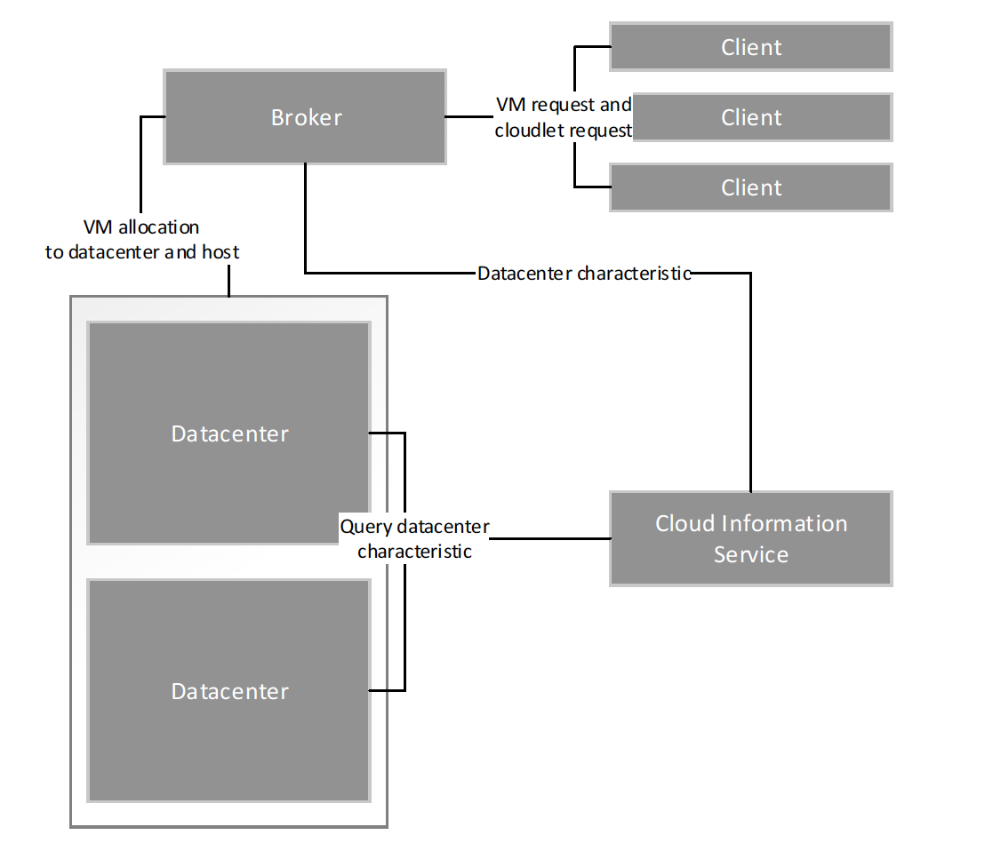
K-Means

Slide 14
State of the art: K-MEANS
Based on: K-Means Algorithm.
Resources Considered: CPU Utilization
Performance Better Than: FIFO algorithm
Strength: Time efficient

Slide 15
Bin Packing with Variable Item Size Algorithm(VISBP)
Energy efficient and load balancing algorithm
Capable of overload avoidance and green computing
Applies Live migration of resources

Slide 16
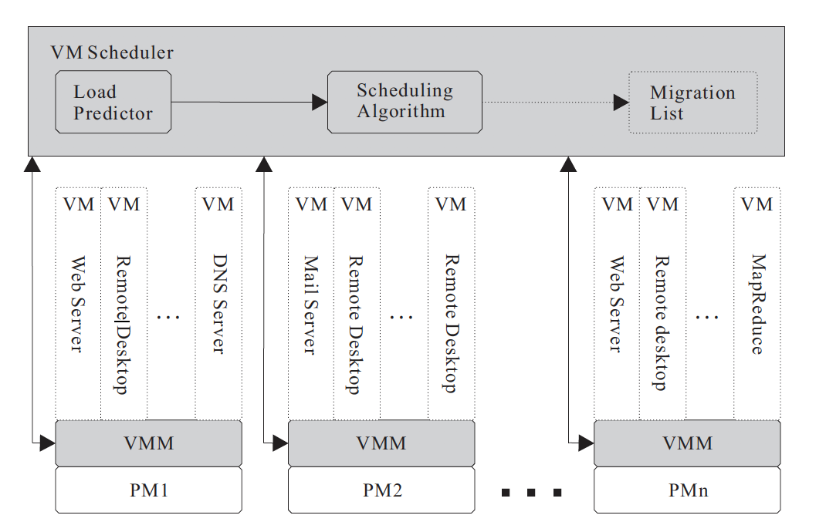
Bin Packing with Variable Item size Algorithm(VISBP)
Each Physical Machine runs a VMM
VMM collects the usage statistics of resources on corresponding PM such as CPU utilization, memory consumption, network sends and receives, etc..
Statistics are forwarded to a centralized VM scheduler, for load balance and green computing by adjusting the mapping of VMs to PMs.

Slide 17
Bin Packing with Variable Item Size Algorithm(VISBP)
The VM Scheduler has two modules:
The scheduling algorithm optimizes VM layout so that the resource demands are satisfied, and resource waste is minimized.
The load predictor estimates the resource demands in the near future.
Load distribution is better that BG and VectorDot algorithm
Results:

Slide 18
State of the art: VISBP
Based on: Bin Packing.
Resources Considered:CPU, Memory and Network
New Aspect: Change in Size of VM
Weakness: SLA Violation
Performance Better Than: VectorDot, Offline BP, Sandpiper
Strength: Hot-Spot mitigation, Load balancing

Slide 19
Reordering Grouping Genetic Algorithm
Energy efficient and optimized resource allocation algorithm
It is a genetic algorithm to solve the Multi-Capacity Bin Packing Problem (MCBPP)
It uses first fit ordering which naturally avoids generating infeasible solutions
RGGA uses 8.4% less energy than first fit and 6.84% less energy than worst fit

Slide 20
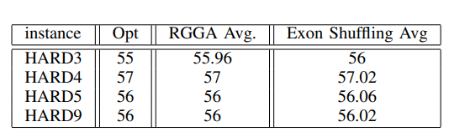
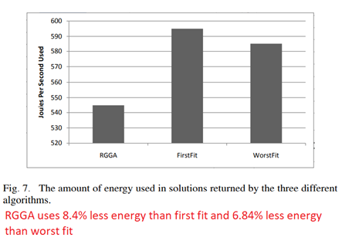
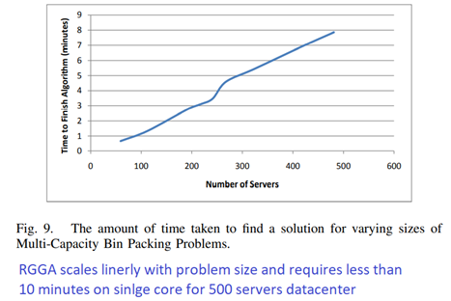
Experimental Result

Slide 21
Reordering Grouping Genetic Algorithm
Challenge: One challenge over here is that this algorithm considers workloads for VMs are deterministic. But in reality, these are non-deterministic loads
Possible Solution: Perform an experiment with simulation of non-deterministic loads and compare the results

Slide 22
State of the art: RGGA
Based on: Genetic Algorithm and Bin Packing.
Resources Considered: Processor Time and RAM Used.
Strength: Energy efficient, Optimal Solution, High throughput.
Weakness: Workloads for VMs are deterministic.
Performance Better Than: Exon shuffling GA, First Fit and Worst Fit

Slide 23
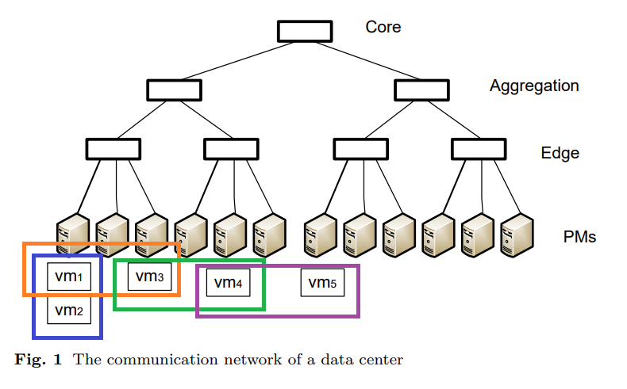
Hybrid Genetic Algorithm
Energy efficient and optimized resource allocation algorithm
It consider energy consumption in communication network along with energy consumption by physical machine.
It categorize the communication between a pair of VMs into four types.
It uses the repairing procedure to resolve all the constraint violations to convert the infeasible individual into a feasible one
It uses local optimization procedure for optimize solution (Heuristic Algorithm)

Slide 24
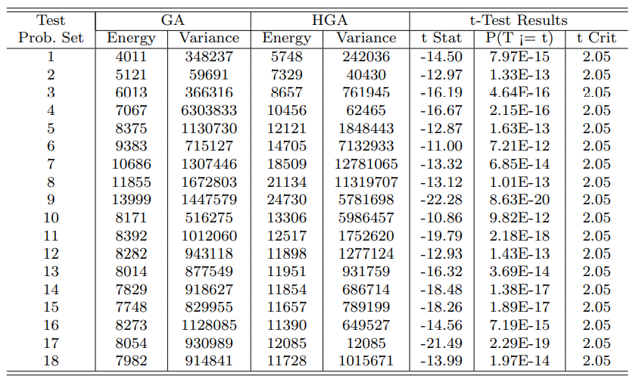
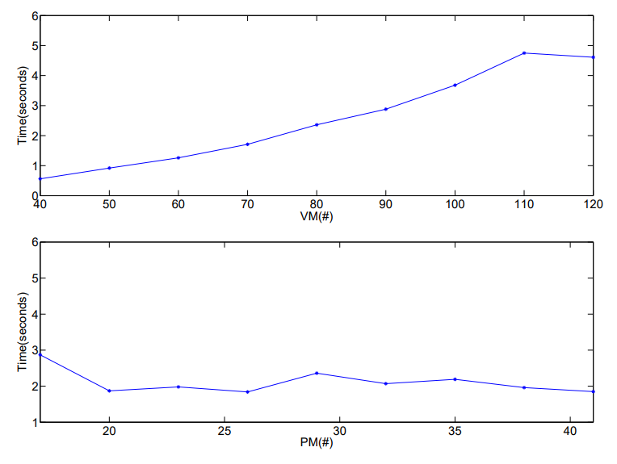
Experimental Results
Total energy consumption of the HGA is 27.36%-43.90% less than that of the original GA
Mean computation time of the HGA reduces by 73.30%-88.61%

Slide 25
Hybrid Genetic Algorithm
Problem : The incorporated repairing and local optimization procedure will result in the increase in the computation workload of the HGA
Solution: The HGA converges much quicker than the original GA in terms of the number of generations. Thus, the computation time of the HGA is shorter than that of the GA.

Slide 26
State of the art: HGA
Based on: Genetic Algorithm and Heuristic Algorithm.
Resources Considered: CPU, Memory and Network.
Strength: Energy efficiency of communication net-work and Optimal Solution.
Weakness: Needs a data structure to represent a placement of VMs. The incorporated repairing and local optimization procedure will result in the increase in the computation workload
Performance better than: Original Genetic Algorithm

Slide 27
Conclusion
K-Means : Time Efficient algorithm
VISBP: Hot-Spot mitigation, Load balancing
Novel Family Genetic Approach: Energy Efficient, better SLA, less VM migration
HGA: Energy efficient, optimized resource allocation
RGGA: Energy efficient, optimized resource allocation
Interior Search: Energy Efficient, optimized resource utilization

Slide 28
Future Work
From our analysis we realized that the algorithms have room for improvements. In the future scope we would try to prototype and experiment using the possible solutions we specified and analyze whether it gives better results

Slide 29
References
A Hybrid Genetic Algorithm for the Energy-efficient Virtual Machine Placement Problem in Data Centers by Maolin Tang and Shenchen Pan, 2014 Springer
D. Wilcox, A. McNabb and K. Seppi, "Solving virtual machine packing with a Reordering Grouping Genetic Algorithm," 2011 IEEE Congress of Evolutionary Computation (CEC), New Orleans, LA, 2011, pp. 362-369, doi: 10.1109/CEC.2011.5949641.
Mohammed Joda Usman, Abdul Samad, Ismail, Hassan Chizari and Ahmed Aliyu, "Energy-Efficient virtual machine allocation technique using interior search algorithm for cloud datacenter", 2017 6th ICT International Student Project Conference (ICT-ISPC)
Christina Terese Joseph, Chandrasekaran K, Robin Cyriac, " A Novel Family Genetic Approach for Virtual Machine Allocation", International Conference on Information and Communication Technologies (ICICT 2014)
B. Adrian and L. Heryawan, "Analysis of K-means algorithm for VM allocation in cloud computing," 2015 International Conference on Data and Software Engineering (ICoDSE), Yogyakarta, 2015, pp. 48-53, doi: 10.1109/ICODSE.2015.7436970.
W. Song, Z. Xiao, Q. Chen and H. Luo, "Adaptive Resource Provisioning for the Cloud Using Online Bin Packing," in IEEE Transactions on Computers, vol. 63, no. 11, pp. 2647-2660, Nov. 2014, doi: 10.1109/TC.2013.148.

Slide 30

Thank You!

