Slide 1
petOnly
INFO 5100 Application Engineering and Development Project
Neha Ghate
NUID : 001617639 | ghate.n@husky.neu.edu

Slide 2
Problem Statement:
Building a connect between Pet Owners and different independent organizations providing services to the Pets.

Slide 3

Problem solution:
A connection that bridges the gap between the pet owners and the independent organizations providing services to Pets.

Slide 4
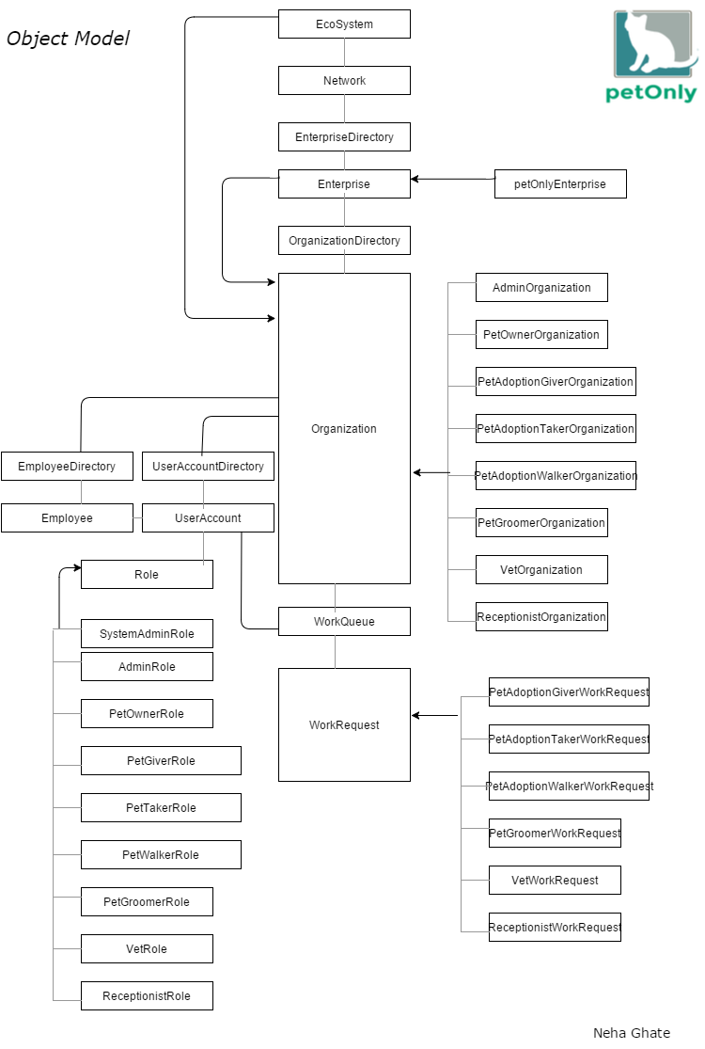
Object Model :

Slide 5

Key Roles:
petOnly Admin Role
Pet Owner
Pet Adoption Roles
Pet Groomer Role
Veterinarian Role

Slide 6
Key Features:
Internet Of things with Sensors
Ecosystem Model
Db40 Implementation
Extra Features:
Loggers
Email Integration
Image Upload
Charts using Jfreecharts
External Date and Time Picker
Google Maps Integration using jxBrowser
Scheduling for IoT automation
SMS integration using TROPO

Slide 7
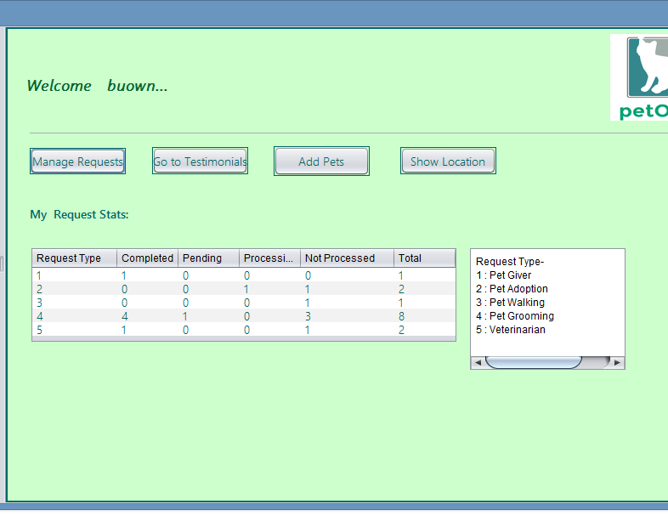
Pet owner dashboard
Statistics about owners various requests.

Slide 8
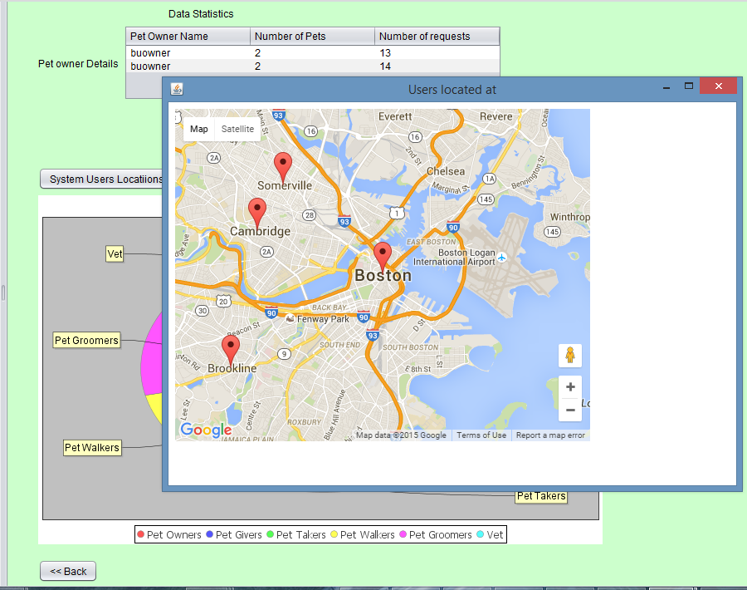
Admin Work Panel
Maps showing user locations.

Slide 9
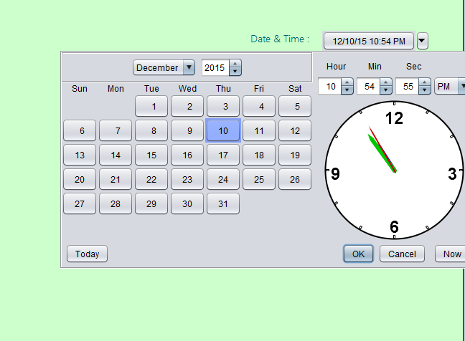
Date Time picker using ext jar
New functionalities :
Buttons like Now and Today.
Time Picker.

Slide 10
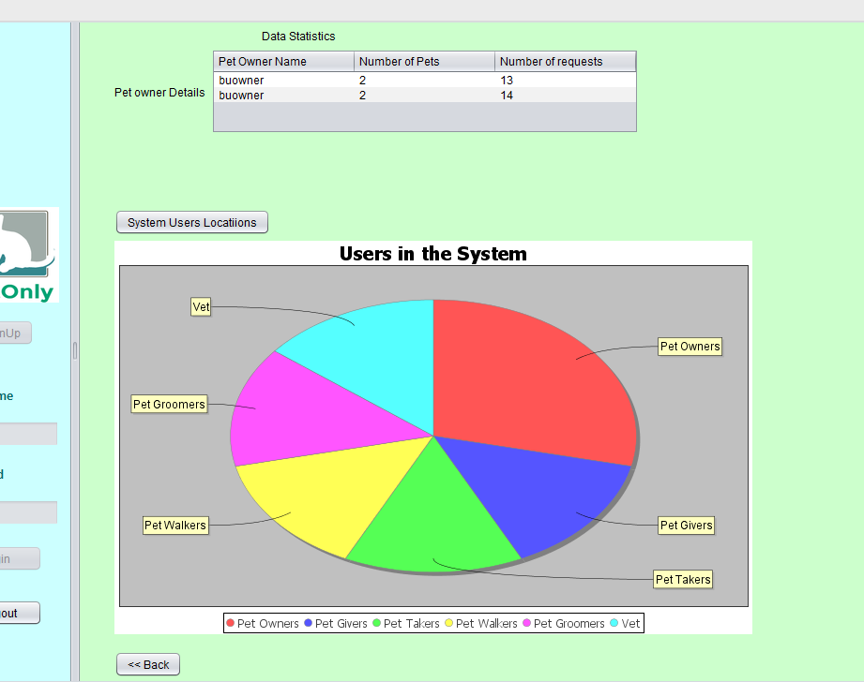
Admin Data Stats
Details about users in the system
Detailed info about pet owners under that enterprise.

Slide 11
Thank you!

