Slide 1
Canadian Real Estate Market Trends Capstone Project
Neha Tararr

Slide 2
Agenda
Overview – Canada's Real Estate Overview
Average Household Income Change Rate vs. Average Mortgage Payments Change Rate
Buyers vs. Renters
Indicators Impacting Canada's Real Estate

Slide 3
Project Overview/ Introduction.
The first Part of Project shows an overview of Canada's Real Estate Market, where a Comparison between Average Household Income and Average Monthly Mortgage Payments is showing. It also discusses the trend between Buyers and Renters. Then it is followed by the Real Estate Market indicators.

Slide 4
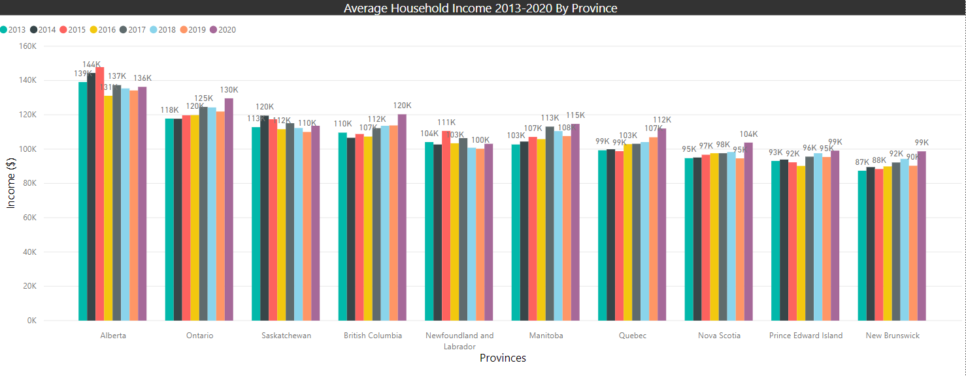
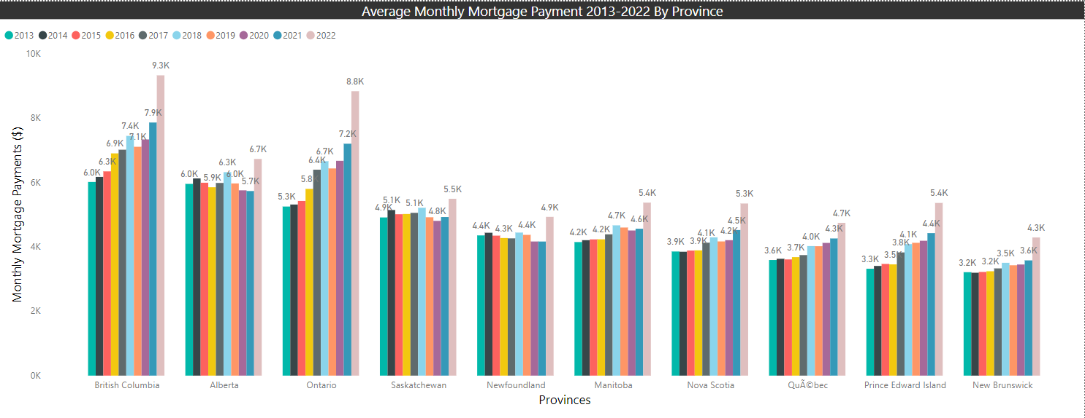
Business Imperative: Is Mortgage Becoming More Expensive For Canadians By The Day?
Income vs. Mortgage - How much household incomes have been changing comparative to mortgage payments?
Income and Mortgage comparison by Provinces
PowerBI data cleaning
Change Rates between Income vs. Mortgage by Provinces
Python Coding

Slide 5
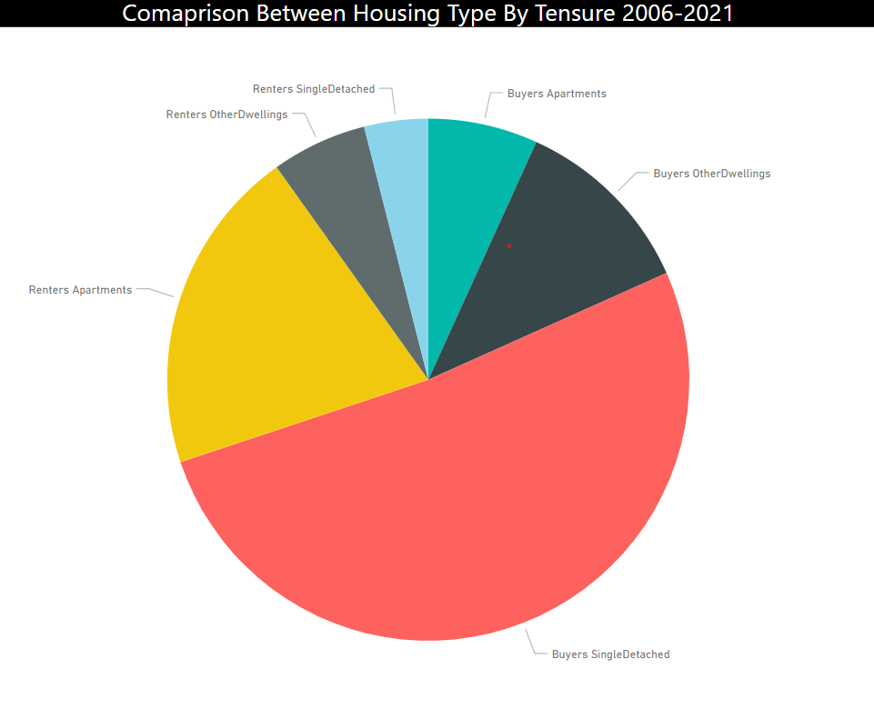
Business Imperative: Do Canadians Buy More Real Estate Or Rent More Real Estate? Which One Is Better For Investing?
Analysis of Buyers vs. Renters in Canadian Real Estate
Which type of House is getting sold more often?
How many people bought the houses by their type and how many people rented the houses by their type from 2006 - 2021.
PowerBI Data Cleaning

Slide 6
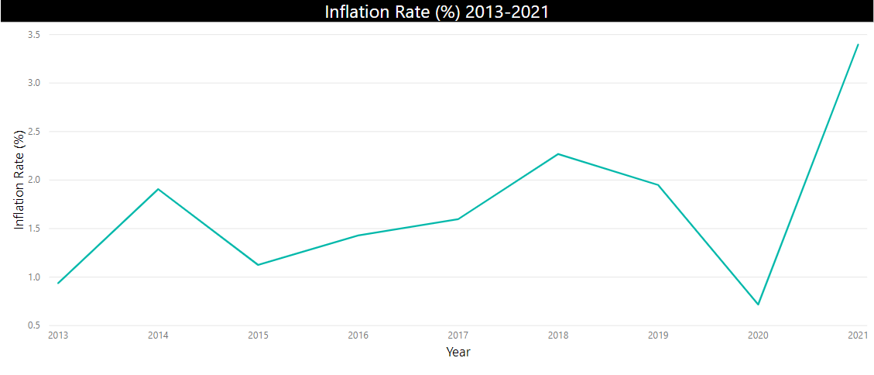
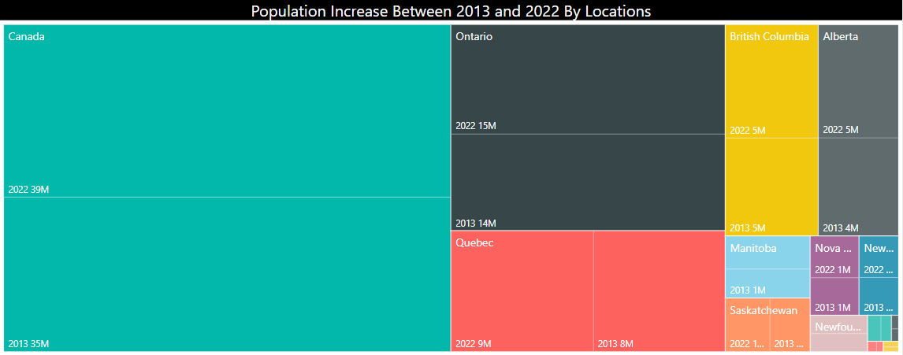
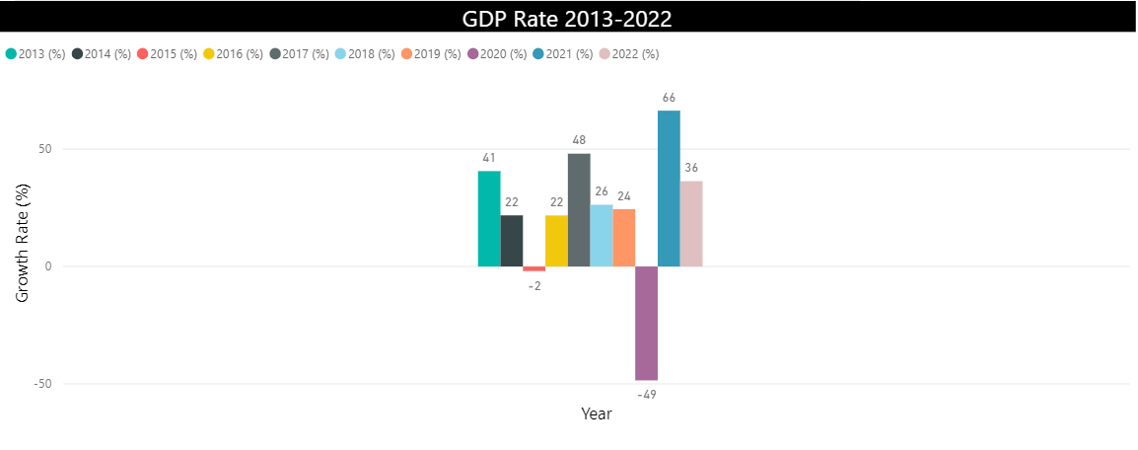
Business Imperative: Are There Any Indicators Driving The Change/Trend In Canadian Real Estate Market?
Change in Inflation Rates
Change in Interest Rates
GDP (Gross Domestic Product)
Change in Population
Change in Unemployment Rate

Slide 7

Overview of Requirements?
Is Mortgage Becoming More Expensive For Canadians By The Day?
Housing Affordability
Analyze the relationship between monthly mortgage payments and monthly household income to assess housing affordability in Canada.
Calculate the debt-to-income ratio to determine the proportion of income allocated to mortgage payments.
Compare the affordability of housing across different provinces or major cities in Canada.
Discuss trends in housing affordability over time and their implications for homeownership and rental markets.
Do Canadians Buy More Real Estate Or Rent More Real Estate? Which One Is Better For Investing?
Examine the reasons behind the choice of buying or renting, such as financial considerations, lifestyle preferences, or housing market conditions.
Explore the role of real estate investment in building wealth and diversifying investment portfolios.
Are There Any Indicators Driving The Change/Trend In Canadian Real Estate Market?
Inflation rate, Interest rate, GDP, Population, Unemployment rate

Slide 8
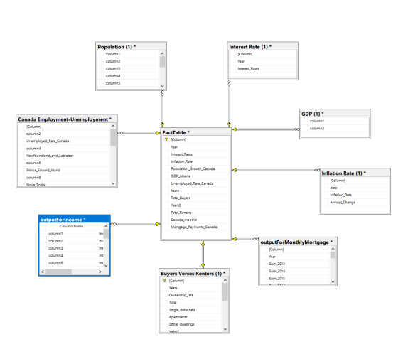
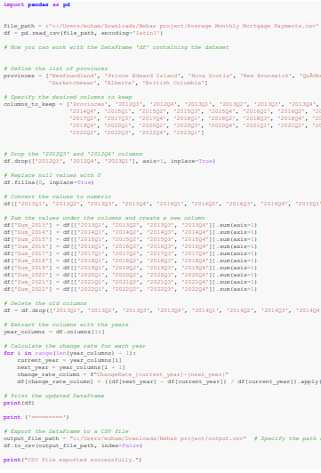
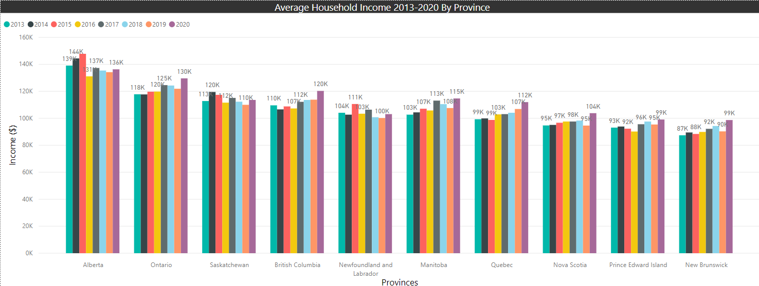
Overview of Internal system structures Canada's Real Estate
Python (Feature Engineering)
Calculations, aggregations, filtering, merging, adding columns using libraries like Panda.
Data Loading and Exploration.
Data Cleaning and Preprocessing.
PowerBI (Data Exploration And Visuals)
Preparing, renaming, clearing, and Organizing Data for visuals.
Adding aggregated columns and grouping by taking an average.
Filtering columns, Replacing null columns, and changing data types.
Microsoft SQL (Dimensional Modeling)
Creating Dimensional Model
Creating Fact Tables and Dimensional Tables
Creating Relationships
Creating Star Schema
Notes:
Microsoft Sql (dimensioanl modeling), python (panda), powerbi,

Slide 9
Technical Problems And Solutions – Canada's Real Estate
Dataset Issues | Dataset Solutions
Variations in formats, null values, and timeframes. | Defined consistent formats, data types, deleted empty values, and timeframes for better data organization and analysis.
Multiple values for each year without showing annual rates. | Summed and averaged these values to derive annual rates for accurate analysis.
The table was segmented into quarterly data. | Focused on quarter 4 as it provided the most recent and representative population figures, rendering quarters 1, 2, and 3 irrelevant for the analysis.
Change rate was not identified. | Created a change rate metric to assess and analyze the rate of change within the dataset.

Slide 10
Technical Problems And Solutions – Canada's Real Estate
Python Issues | Python Solutions
Connectivity issues between Pandas and the device. | Utilized PowerShell to successfully display the coding results when Pandas connectivity was problematic.
Challenges regarding the clarity of their interrelation. | Converted the data type into percentage values to enhance understanding.
Data was not easy to read due to extra information, null values, wrong data types, lack of change rate, and quarterly data distribution instead of annual. | Removed unnecessary data, limited the timeframe to selected years, aggregated quarterly data to calculate annual values, replaced missing values with zero, and added a new column to display the rate of change.

Slide 11
Technical Problems And Solutions – Canada's Real Estate
SQL Issues | SQL Solutions
The tables lacked relationships. | Introduced virtual keys to establish connections and enable the creation of a relational diagram to visualize the relationships. Ensured uniqueness within the model.
Lack of commonality between tables, absence of Primary and Foreign keys. | Added a Primary key to the Fact Table and assigned Foreign keys to the dimensional tables to establish proper relationships.
Absence of a fact table. | Manually created a Fact Table to serve as the central table for the dimensional model.

Slide 12
Technical Problems And Solutions – Canada's Real Estate
PowerBI Issues | PowerBI Solutions
Values inserted in certain columns were not being displayed in visualization but appeared in the data table. | Duplicate columns were created to ensure the visibility of the column values in the visualization.
A challenge arose in comparing values between buyers and renters. | Relationship management and the establishment of a relation between the two groups were implemented to enable effective comparison.
Outdated columns existed. | New custom columns were generated, and outdated tables were removed from the Power Query Editor to ensure data accuracy and relevance.
Columns needed to be renamed, and empty columns needed addressing. | Columns were renamed, and remaining null values were replaced with zero to maintain data completeness and consistency.

Slide 13
Technical Problems And Solutions – Canada's Real Estate
PowerBI Issues | PowerBI Solutions
Different aggregated functions were required based on data types and specific questions. | Newly created custom columns were introduced, presenting aggregated values such as sums, averages, and other relevant metrics based on the nature of the table and data.
Data types were distorted. | Data types were adjusted to align with their respective values to ensure accurate analysis.
Column headers were not defined. | Header definitions were assigned to each column to enhance clarity and facilitate better understanding of the data.

Slide 14

System Demonstration - Canada's Real Estate
Notes:
PowerBI, visualizations: CanadaRealEstateVisuals - Power BI

Slide 15
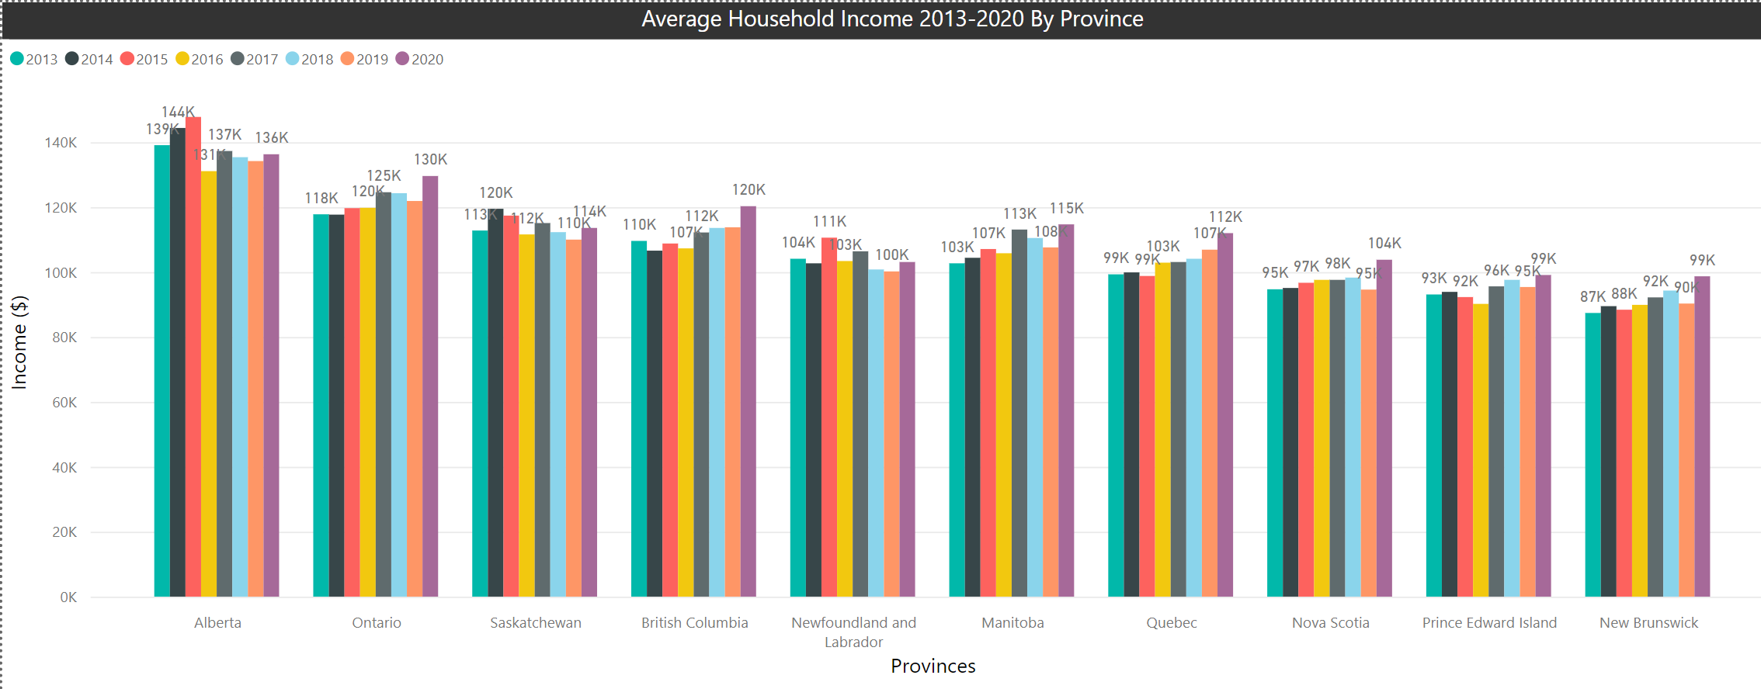
Notes:
Comparison between provinces, Alberta has the highest Household Income. Alberta went down in Average Household Income from 139K in 2013 to 136K in 2020. Average Household Income is growing at a slower pace for all provinces.

Slide 16
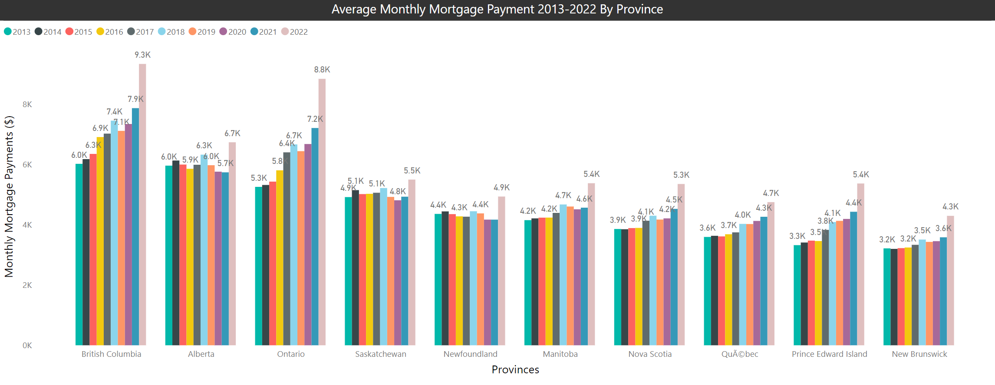
Notes:
Comparison between provinces, even though Alberta is affordable in comparison to other provinces (in terms of taxes, highest average household income, etc.) it still has quite expensive mortgage payments. As you can see, yes Ontario is high for most of them, however, Alberta is following right behind.

Slide 17
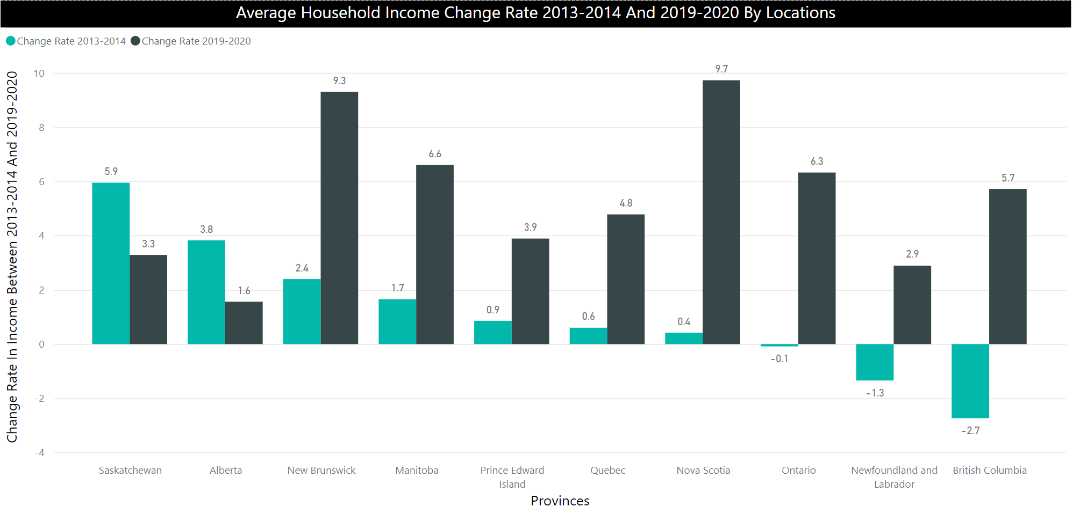
Notes:
Shows how much Average Household income has changed based on the change rate from 2014 to 2020. Did the Average Household Income change rate increased or decreased by each Province?
British Columbia really improved in their average household income change rate, from -2.7 in 2014 to 5.7 in 2020, which means their average household income decreased in 2014, and increased in 2020. Aberta's average household income decreased from 3.8 (2014) to 1.6 (2020), has the least household income change rate in 2020.
Nova Scotia from previous year 2019, change rate income has seen the highet increase $94600 (2019) - $103800 (2020). Population might also impact this as shown in later slide, Nova Scotia's population has been one of the lowest number in overall Canada.

Slide 18
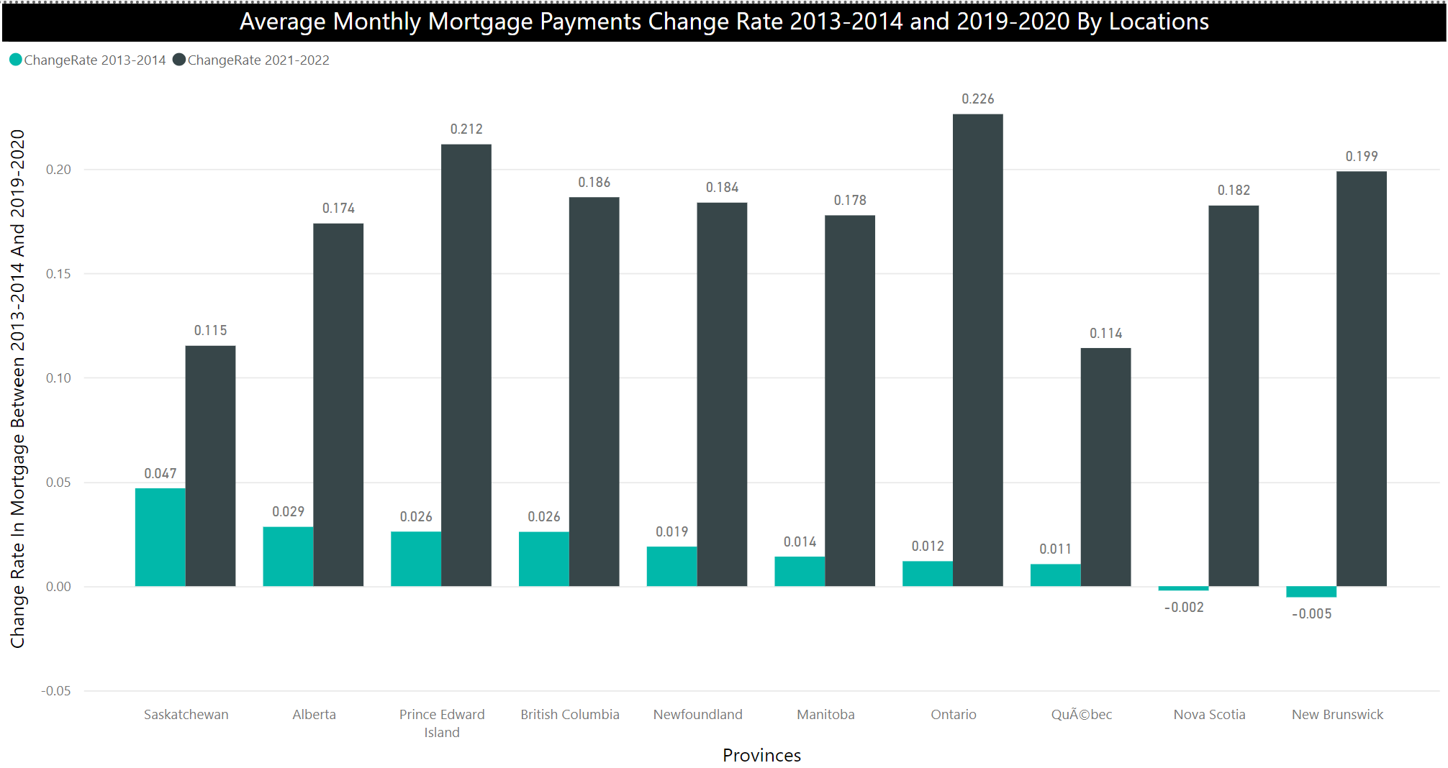
Notes:
Shows how much Average Mortgage Payments changed from 2014 to 2020. Did the Average Monthly Mortgage Payments change rate increase or decrease by each Province?
All time high Average Monthly Mortgage payment is Ontario from 2021-2022. Which means Ontario whose Average Mortgage Payment was $7206 in 2021 jumped all the way to $8837 in 2022, they have seen the highest increase in their mortgage.
The lowest change rate beween 2021 and 2022 Mortgage Payments is Quebec and Saskatchewan.

Slide 19
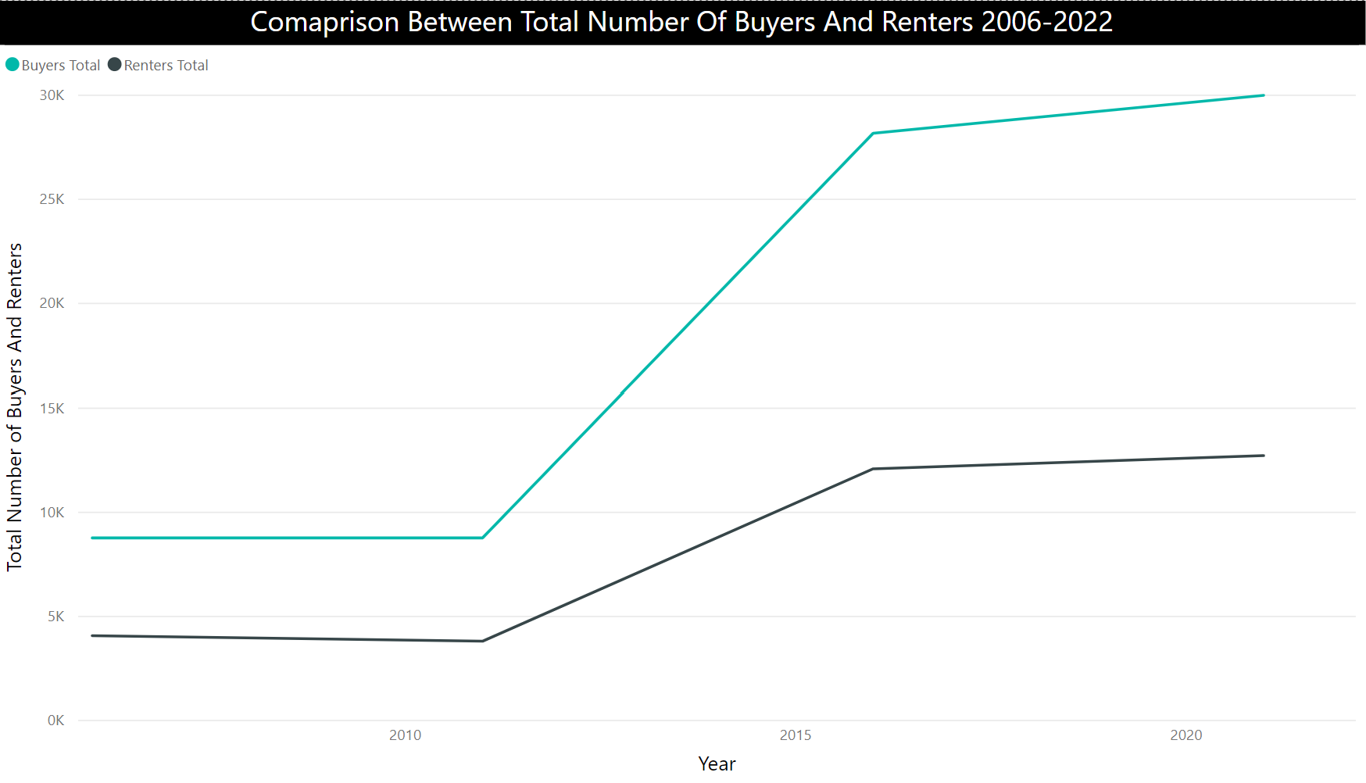
Notes:
Buyers are way higher in numbers than Renters. Which means people are buying houses way more often than renting Real Estate in Canada since 2006 all the way upto 2022.
Buyers being always more in number than renters shows that Canadians like to spend their money in buying Real estate.
Good point of view from investing prospect, in case someone is buying real estate investing property in Canada, building it with keeping in mind that it gets sold more often than rent, can put the investors in right direction.

Slide 20
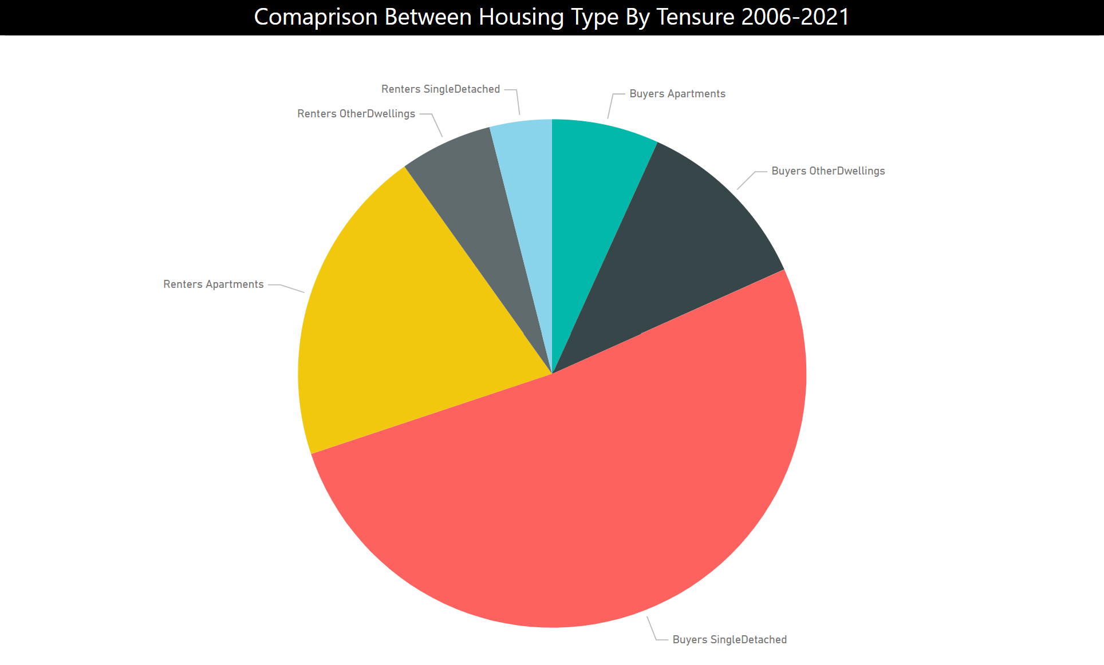
Notes:
How many people bought the houses by their type and how many people rented the houses by their type from 2006 - 2021. As you can see, slightly, more than half of Tensures have bought Single Detached houses.
Also a good point of view from investing perspective, since the consumers are buying more single detached homes, it would be benefitial to look into buying Single Detached homes for investing.
Single Detached have the highest buyers where Single Detached has the lowest renters. Apartments are good for renting.

Slide 21
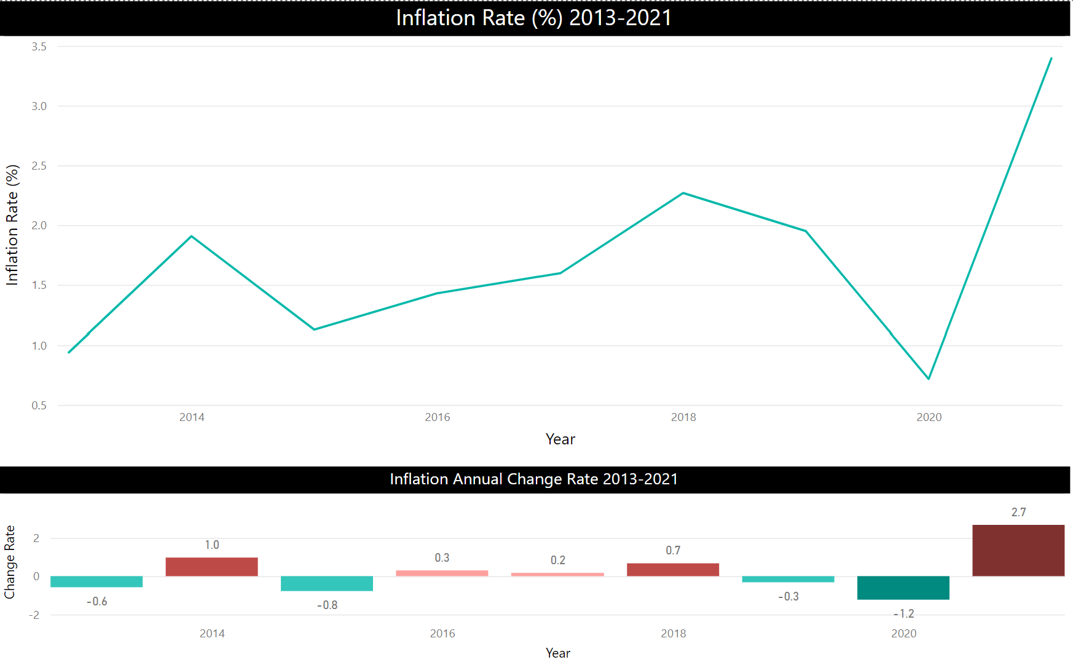
Notes:
First indicator is Inflation Rate, it has increased drastically in past year.
As you can see in 2020 the inflation was -1.2 and it jumped to all way to 2.7 in 2021.
Not just that, this is the highest amount of inflation rate we have seen since 2013.
Which makes sense because our interest rates are also going up, which is a big indicator for our insanely high mortgage prices. (Interest rates showing in next slide)

Slide 22
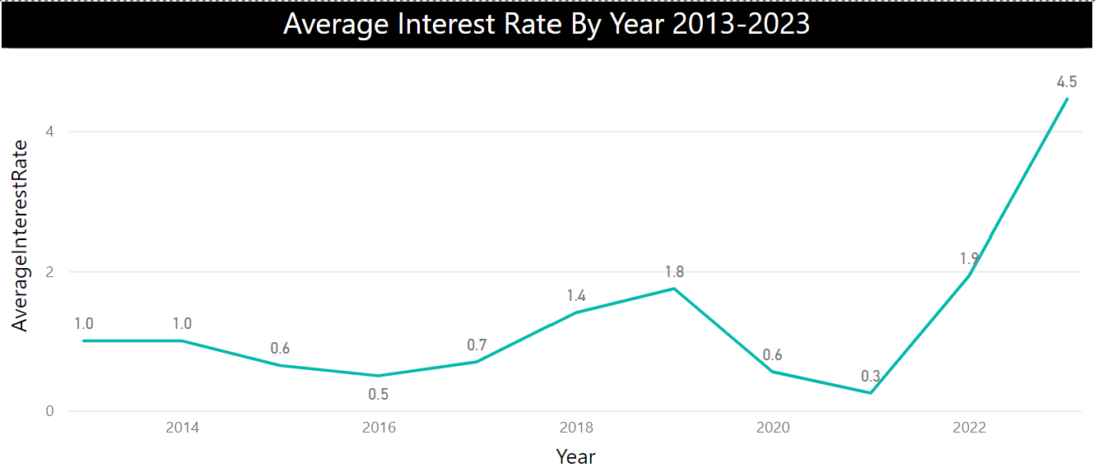
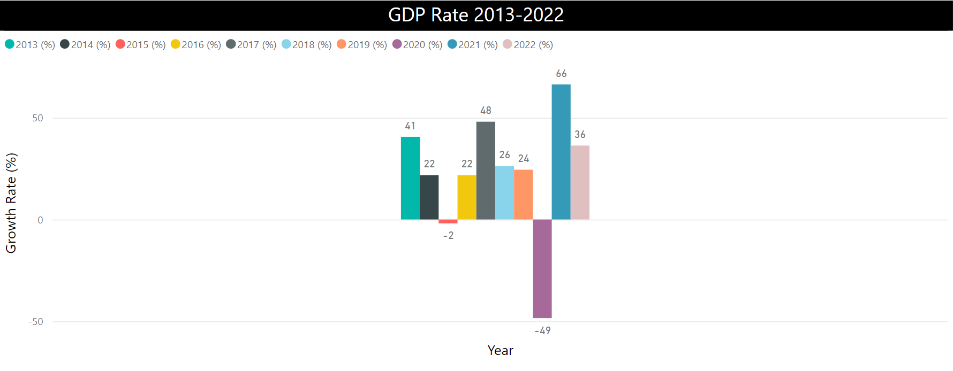
Notes:
GDP is also going down, which can be an indication for economy's suffering.
As mentioned in previous slide, interest rates spiked from 0.25 in 2021 to all the way to 4.46 in 2023.
This can be a direct impact on Mortgage Payments. Real estate is getting more expensive.

Slide 23
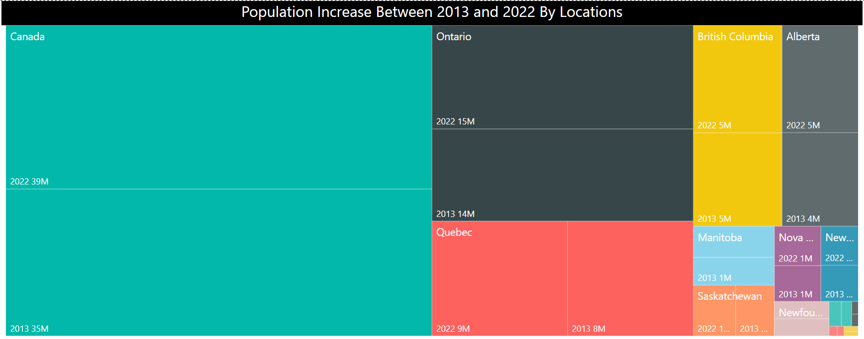

Slide 24
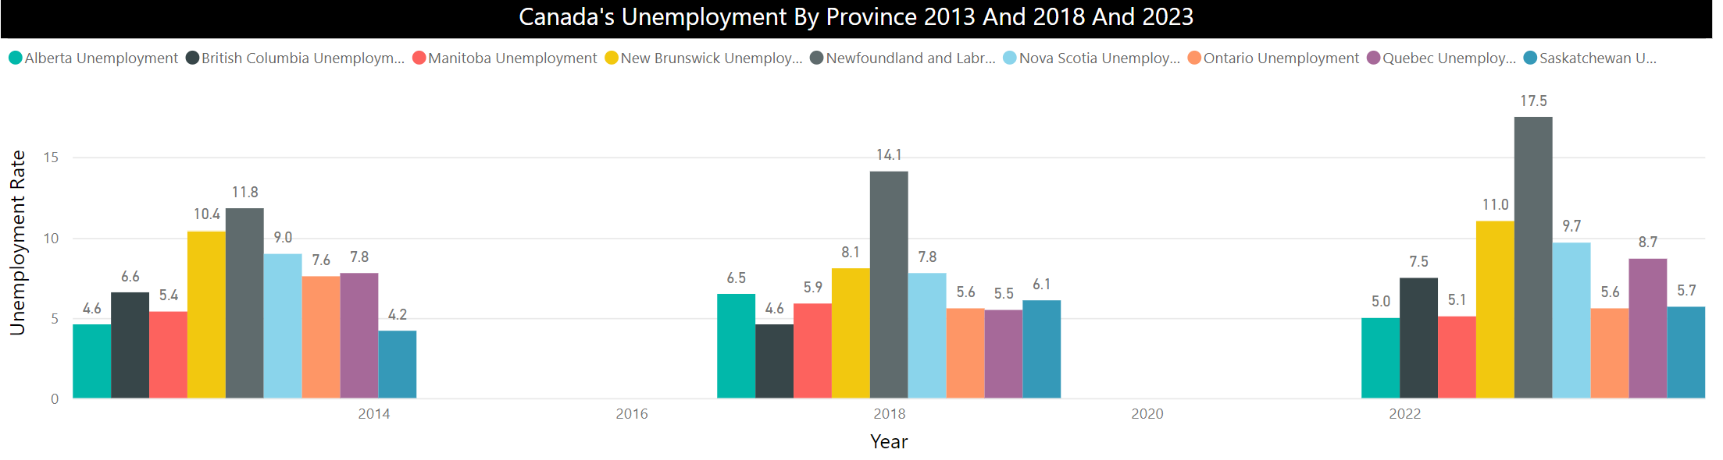
Notes:
Even though population has not increased much, unemployment rate keeps going up. Which is another indicator why Average Household income has growing at a slower pace.
Newfoundland has the highest unemployment rate, whereas, Alberta has the lowest unemployment rate in 2022.
Even though population did not increase that much, we were not prepared for it as our unemployment rate also went up. Alberta from 4.6 (2013) to 5.0 (2022).
Alberta's Household income also went down because of increase in unemploymnet rate.

