Slide 1

Computer Engineering Department
A.P. Shah Institute of Technology
G.B.Road,Kasarvadavali, Thane(W), Mumbai-400615
UNIVERSITY OF MUMBAI
Academic Year 2020-2021

Slide 2
A Project Report on
HANDWRITING CHARACTER RECOGNITION Submitted in partial fulfillment of the degree of
Bachelor of Engineering(Sem-7)
in
Computer Engineering
By
Shweta Chauhan (17102009)
Nehal Barot (17102060)
Anjali Solanki (18202003)
Yash Awasthi (15202013)
Under the Guidance of
Prof. Amol Kalugade

Slide 3
1.Project Conception and Initiation

Slide 4
1.1 Abstract
Handwriting character recognition remains largely unsolved problems due to the presence of many handwritten characters present around the world.
The handwriting character recognition will be done by using Keras, Convolutional Neural Network and Tensor Flow.
Automatic identification of handwritten script facilitates many important applications such as automatic transcription of multilingual documents and search for documents on the Web containing different particular scripts.
The increase in usage of handheld devices which accept handwritten input has created a growing demand for algorithms that can efficiently analyze and retrieve handwritten data. T
his project is aimed at developing software which is helpful to recognize English characters.
Neural network is used for solving problems such as the recognition of patterns, classifying the patterns into groups, data mining etc.
Here the pattern information could be an image and handwritten data. Neural network attempts to determine the handwritten characters or image that the neural network has learned.

Slide 5
1.2 Objectives
The main objective is to recognize online handwritten documents, which includes characters, words, lines, paragraphs etc.
Our approach is to recognize handwriting by using images.
The HTR system has an objective to transform a document image into text data.
dealing with handwritten English characters is that characters written by different persons representing the same character are not identical but can vary in both size and shape.
To handle formatting, perform correct segmentation into characters and finds the most plausible words.

Slide 6
1.3 Literature Review
Neural Networks For Handwritten English Alphabet Recognition The paper makes use of Neural Networks to recognize the English handwritten alphabets.
Direction Based Feature Extraction Paper presents a feature extraction method referred as the direction feature to recognize the handwritten characters.
Diagonal Based Feature Extraction System Using Neural Network The characters in this paper are recognized using a new technique called the diagonal feature extraction technique.
Recognition of Handwritten Textual Annotations using Tesseract Open Source OCR Engine for information Just In Time
(Link https://arxiv.org/ftp/arxiv/papers/1003/1003.5893.pdf)

Slide 7
1.4 Problem Definition
During the past thirty years, substantial research efforts have been devoted to character recognition that is used to translate human readable characters to machine-readable codes.
Immense effort has been made on character recognition, as it provides a solution for processing large volumes of data automatically in a large variety of scientific and business applications.
The main problem encountered when dealing with handwritten English characters is that characters written by different persons representing the same character are not identical but can vary in both size and shape.
The fast variation in personal writing styles and differences in one person’s writing style depending on the context is another problem encountered when trying to recognize English handwritten characters.

Slide 8
1.5 Scope
We can develop an android application which will directly use the camera to take picture of documents instead of taking the images from other sources.
This can be further developed into a system which will recognize devnagri scripts.
Handwritten Notes to Digital Notes
Converting old scriptures to digital library
House Number Recognition through Google street images
Physical written regional language to other
Quick digitization of printed hand-filled forms
Postal address to digital texts.

Slide 9
1.6 Technology stack
Tensorflow
Keras
Python OpenCV
Numpy, Pandas, matplotlib
Google Colab

Slide 10
1.7 Benefits for environment & Society
Handwriting recognition software allows user to translate all those signature and notes into electronic words in a text document format.
The advantage of this electronic storage is that this data only requires far less physical space than the storage of the physical copies.
recognition can be done at any time after the document has been written, even years later.
Ancient literature can be converted and stored digitally.

Slide 11
2. Project Design

Slide 12
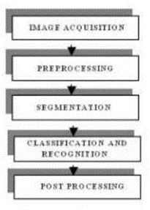
2.1 Proposed System
A typical handwriting recognition system consists of pre-processing, segmentation, classification and post processing stages.

Slide 13
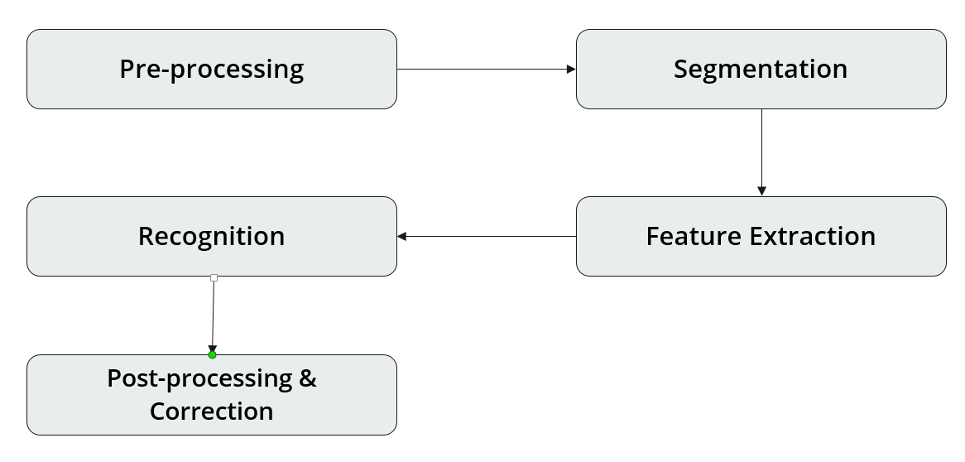
2.2 Design(Flow Of Modules)

Slide 14
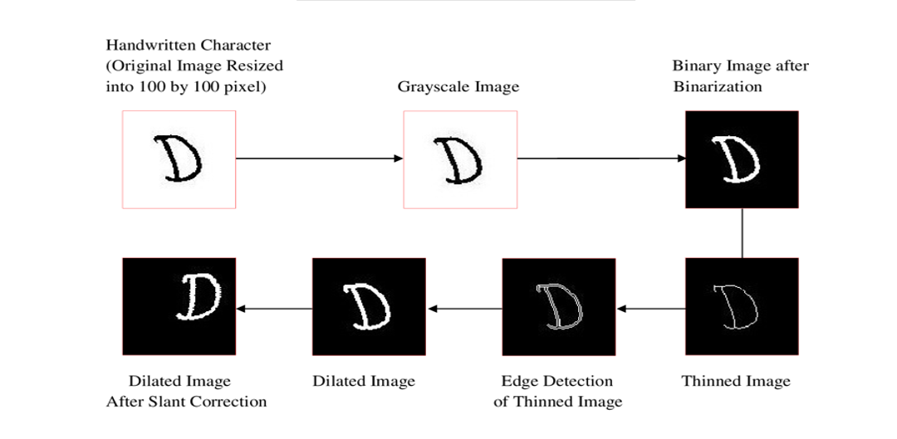
2.5 Pre-Processing

Slide 15
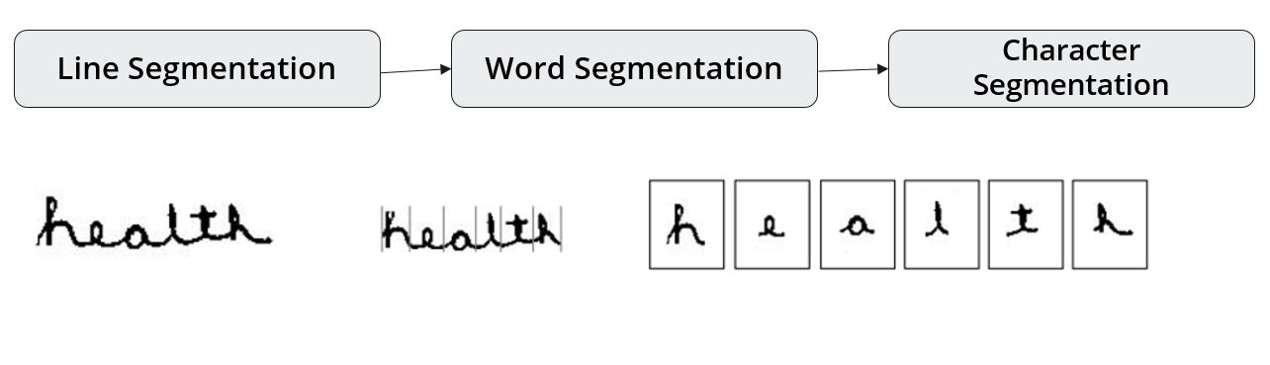
2.5 Segmentation

Slide 16
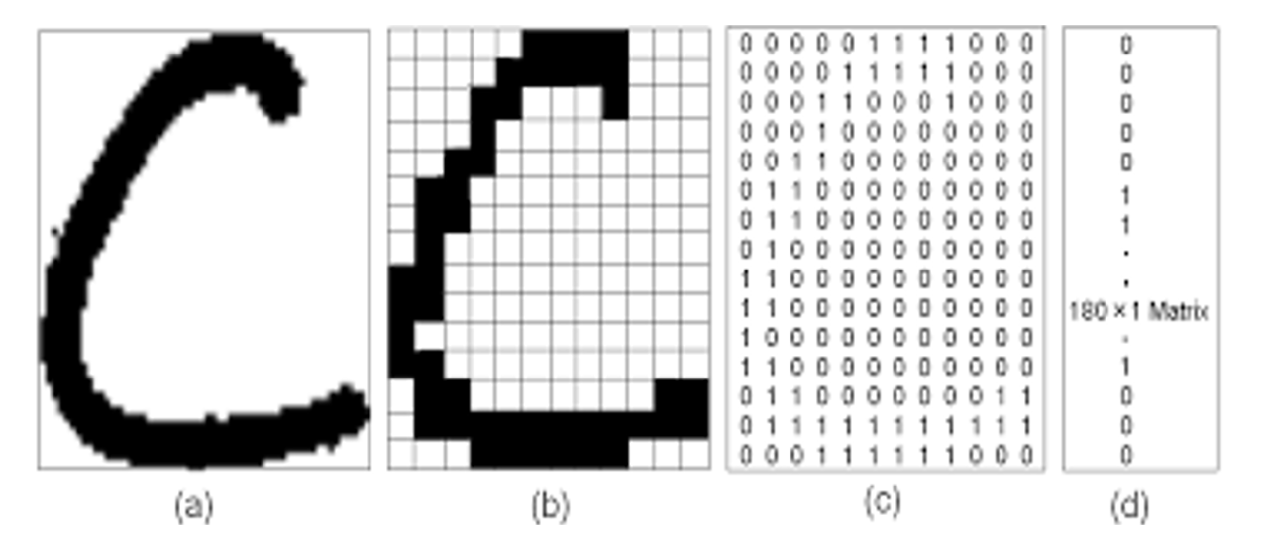
Feature Extraction

Slide 17
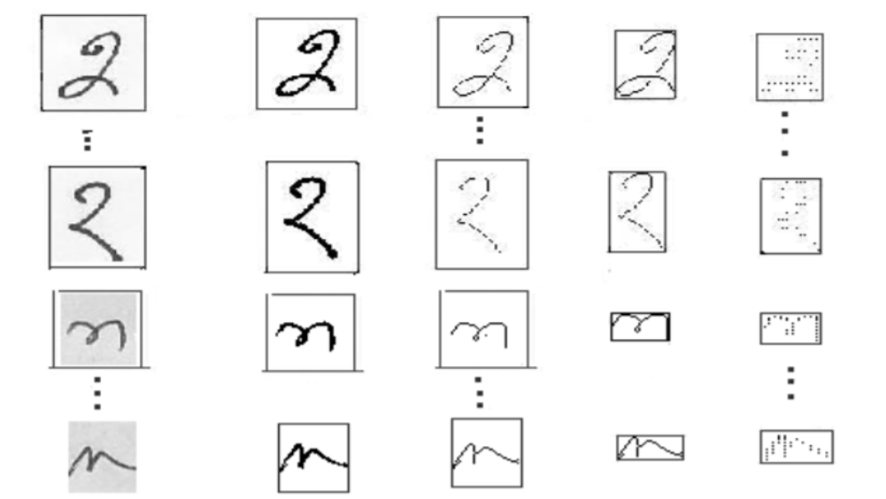
Recognition

Slide 18
3.Implementation

Slide 19
3.1.2 algorithms
A Convolutional Neural Network (ConvNet/CNN) is a Deep Learning algorithm which can take in an input image, assign importance (learnable weights and biases) to various aspects/objects in the image and be able to differentiate one from the other. The pre-processing required in a ConvNet is much lower as compared to other classification algorithms. While in primitive methods filters are hand-engineered, with enough training, ConvNets have the ability to learn these filters/characteristics.
We use a NN for our task. It consists of convolutional NN (CNN) layers, recurrent NN (RNN) layers and a final Connectionist Temporal Classification (CTC) layer.

Slide 20
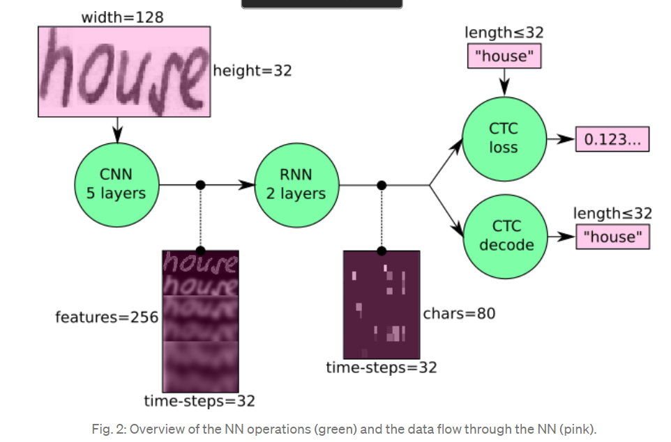
CNN-RNN-CTC

Slide 21
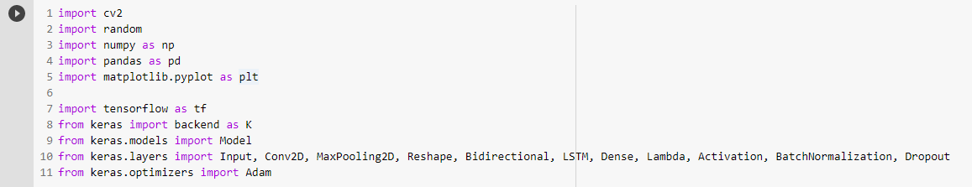
3.1.3 pseudo code

Slide 22
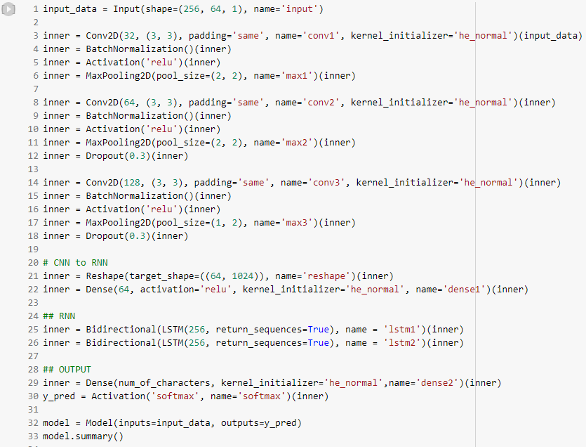
3.1.3 pseudo code

Slide 23
3.1.4 platforms for execution
Windows OS
Google Colab
Jupyter notebook

Slide 24
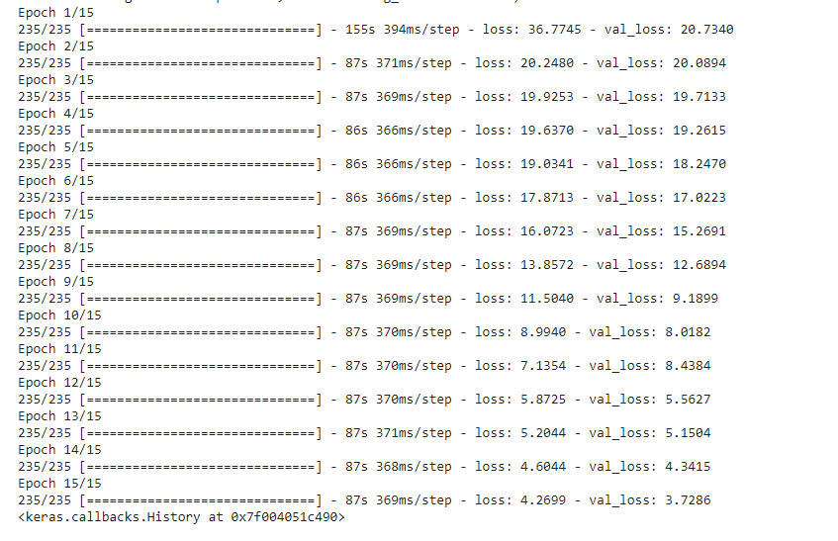
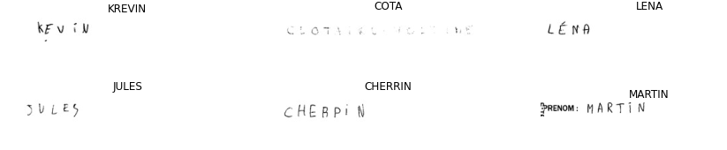
4. Results

Slide 25
5.Conclusion
Our project has produced good results for image containing handwritten text in different styles, different size and alignment with varying background. The method of training neural network with extracted features from sample images of each character has detection accuracy to greater extent. Users can have a varying handwritten text that can be of different sizes, styles, fonts etc. sometimes it may be possible that their alignment can be different with a varying background. Our project focuses on producing the best results from all by providing a better image to users. Also we have tried to increase the efficiency of the English character recognition and conversion to its digital form using our trained neural network model. There is a great extent in the detection accuracy for methods of training the neural network having features that are extracted from the images of a particular character.

Slide 26
6. References
[1] L. Spitz 'Shape-based word recognition' in International Journal on Document Analysis and recognition October 1998, pages 178-190Optical Character Recognition by Line Eikvil,Issue December 1993
[2] Steps Involved in Text Recognition and Recent Research in OCR ;A Study K.Karthick, K.B.Ravindrakumar, R.Francis, S.Ilankannan - International Journal of Recent Technology and Engineering (IJRTE) ISSN: 2277-3878, Volume-8, Issue-1, May 2019
[3] Srikanta Pal Nallapareddy Priyanka and Ranju Manda. Article:line and word segmentation approach for printed documents. IJCA,Special Issue on RTIPPR, pages 30–36, 2010.

Slide 27
7.Bibliography
[4] Mohamad MA Hassan, H Nasien D & Haron H 2015 ‘A Review on feature extraction and feature selection for handwritten character recognition’ International Journal of Advanced Computer Science and Applications, vol. 6, no. 2, pp. 204-212
[5] Recognition of Handwritten Textual Annotations using Tesseract Open Source OCR Engine for information Just In Time
(Link https://arxiv.org/ftp/arxiv/papers/1003/1003.5893.pdf)
[6] ‘An overview of character recognition focused on off-line handwriting’ IEEE Transactions on Systems, Man, and Cybernetics, Part C (Applications and Reviews), vol. 31, no. 2, pp. 216- 233

Slide 28
Thank You

