Slide 1
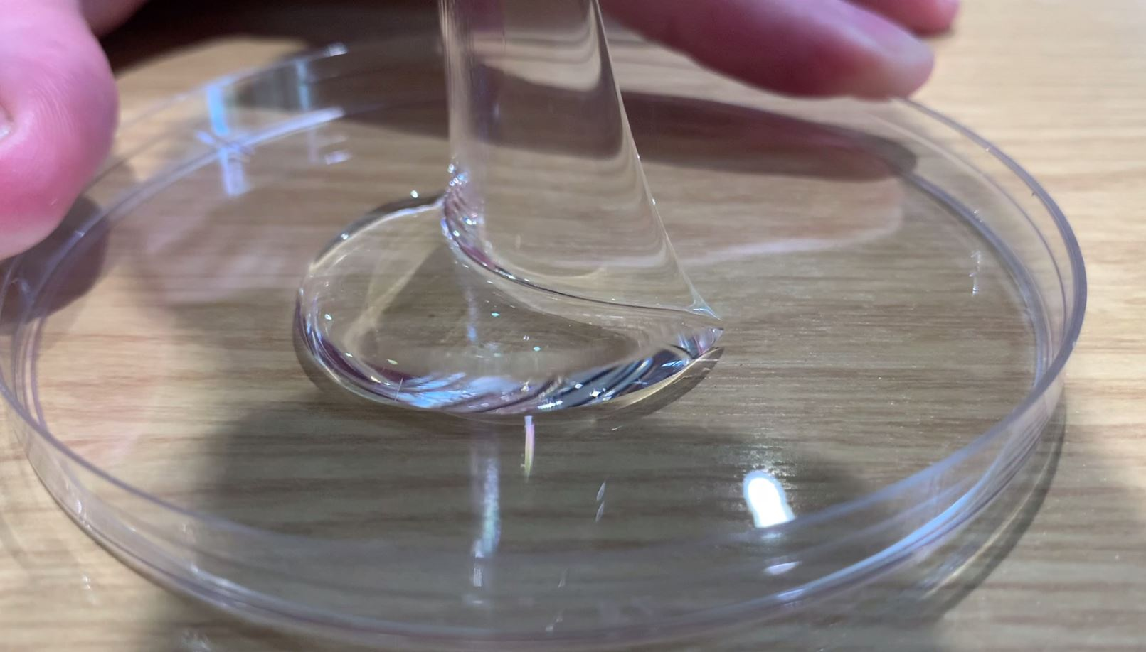
DEPARTMENT OF BIOMEDICAL ENGINEERING · HITEC UNIVERSITY, TAXILA
Fabrication and Characterization of a
Self-Healing PVA-Chitosan Hydrogel
Crosslinked with Borax
for Soft-Tissue-Mimetic Hydrogel Applications
PRESENTED BY
RA
Raina Amer
23-BME-016
TA
Tayyeba Ahmed
23-BME-015
NH
Nehal Hassan
23-BME-001
AH
Anum Hajra Asif
22-BME-001

Slide 2
INTRODUCTION
Why Self-Healing Hydrogels Matter
1
Soft, tissue-like materials
2
The core problem
Hydrogels are water-rich networks used in wound dressings, drug-delivery patches, soft robots, and flexible sensors that must bend and stay in contact with the body.
Ordinary hydrogels tear or crack under repeated stress, and once damaged, they usually stay damaged — shortening device life.
3
The fix: self-healing
4
Autonomous is the goal
A self-healing hydrogel repairs its own cracks, extending working life and improving safety for anything worn on or placed inside the body.
Healing that needs heat or pressure is hard to use clinically. A gel that closes a cut at room temperature, from contact alone, behaves far more like real tissue.
2 / 10

Slide 3
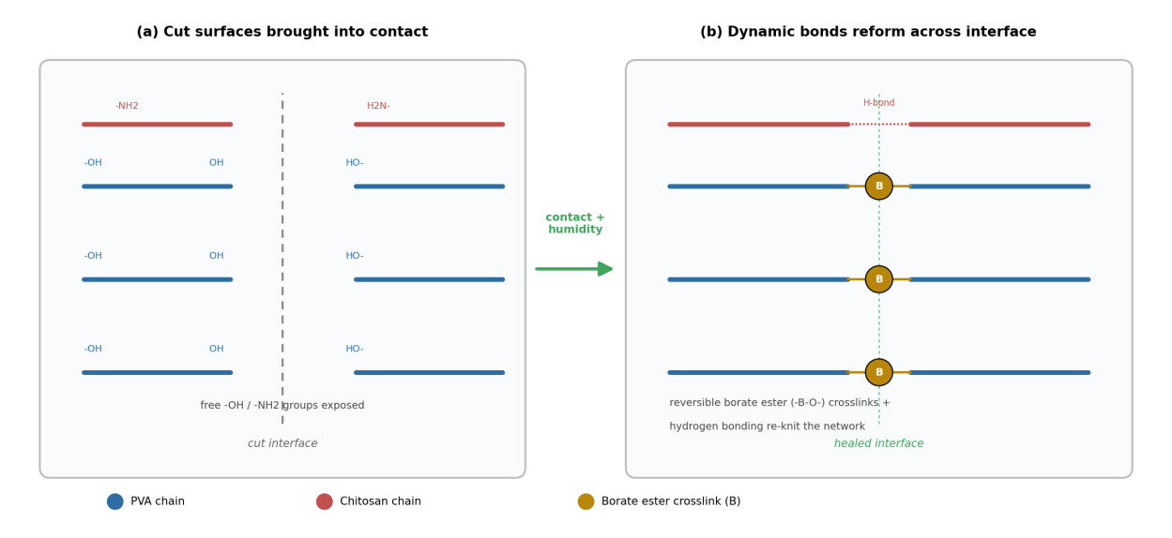
MECHANISM
How Self-Healing Works in This System
Borate ester bonds:
Borate ions react with -OH groups on PVA chains. These bonds are reversible — they break under stress and reform when surfaces touch again, letting a cut rejoin.
Chitosan hydrogen bonding:
Amine (-NH2) and hydroxyl groups on chitosan form hydrogen bonds across the cut interface, holding the two halves together while borate ester bonds reform.
Both mechanisms run with no heat or pressure required — this makes the healing fully autonomous, the highest level of self-healing.
Fig. 2 — Self-healing mechanism: cut surfaces reconnect via reversible borate ester bonds and chitosan hydrogen bonding.
3 / 10

Slide 4
OBJECTIVE
Project Objective & CEP Pass Targets
Fabricate a PVA-chitosan hydrogel, crosslinked with borax, that behaves like soft tissue and heals itself after being cut — soft, stretchable, mold-stable, and able to recover its shape after deformation.
ELASTIC RECOVERY TARGET
HEALING EFFICIENCY TARGET
> 80%
≥ 45%
Gel must spring back almost completely after compressive loading is released.
A healed, cut-and-rejoined sample must recover at least 45% of original strength.
Success was measured by casting specimens, testing them under compression on the ME 8236 apparatus, and comparing fresh vs. healed samples against these two targets.
4 / 10

Slide 5
MATERIALS & METHODS
Hydrogel Formulation
Component | Conc. | Amount / 50 mL batch | Role in the Network
PVA (Polyvinyl Alcohol) | 4% w/v | 2.0 g in 50 mL water | Primary polymer backbone; forms the elastic network
Chitosan | 1% w/v | 0.5 g in 50 mL of 1% acetic acid | Reinforces network; adds biocompatibility & H-bonding sites
Borax (Sodium Tetraborate) | 4% of PVA vol. | 0.8 g in 20 mL water | Crosslinker; forms reversible borate ester bonds
PVA range
Borax range
Chitosan level
Below ~3% the gel is too weak to hold a mold; above ~6% it turns stiff and loses skin-like stretch. 4% sits in the soft-tissue modulus range (10-50 kPa).
Under ~2% the gel barely crosslinks and flows; over ~6% it becomes brittle and self-healing fails. 4% gives fast gelation and reliable healing.
Kept at 1% — higher amounts tend to precipitate in the borax mixture, while 1% dissolves cleanly and blends without disturbing crosslinking.
5 / 10

Slide 6
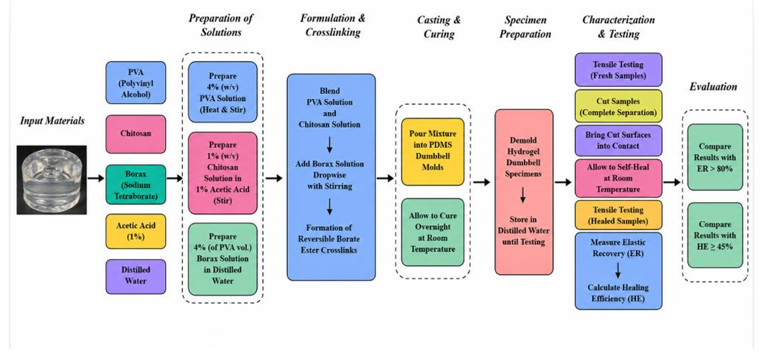
MATERIALS & METHODS
Methodology Pipeline
6 / 10

Slide 7
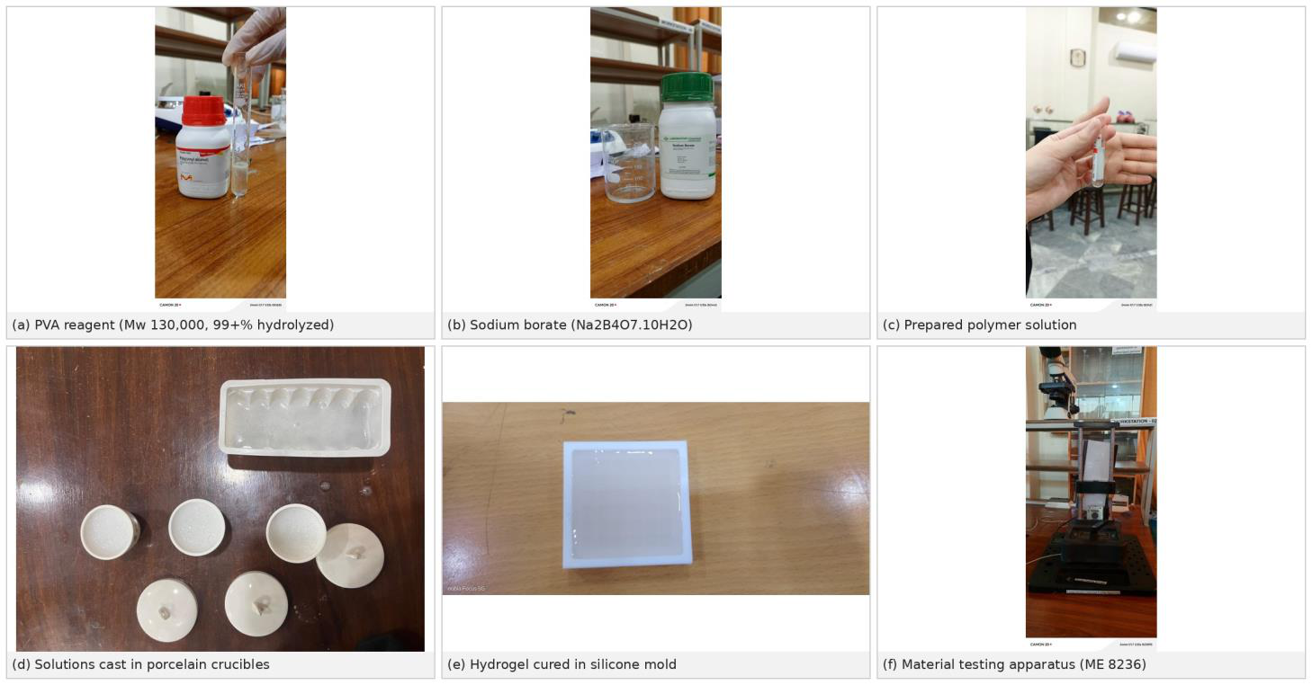
MATERIALS & METHODS

Slide 8
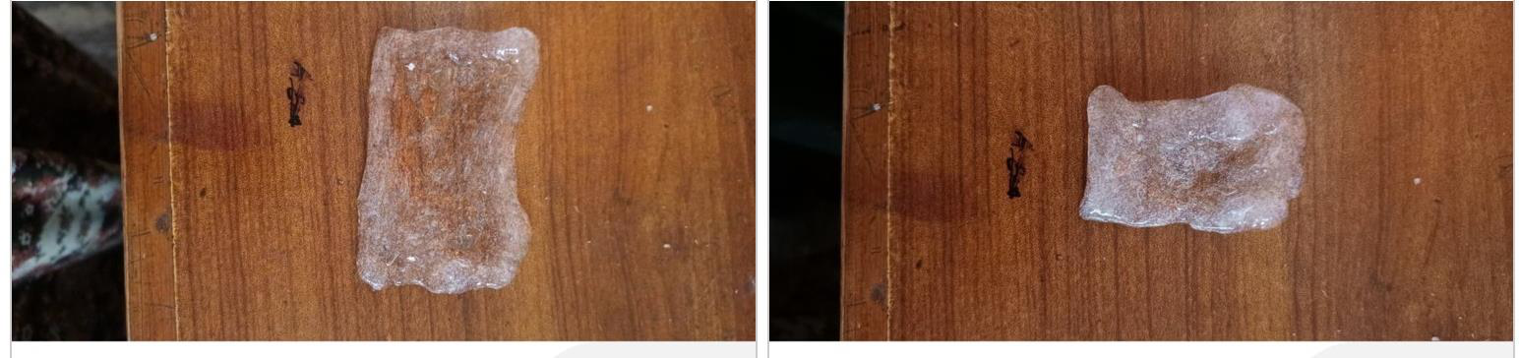
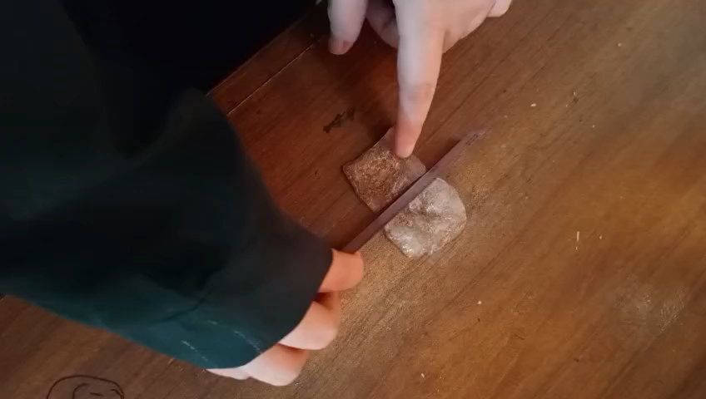
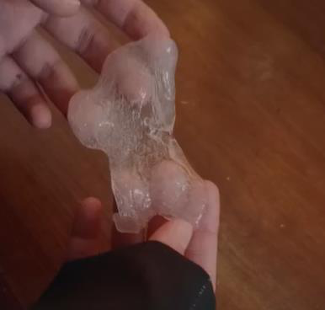
RESULTS
Self-Healing Demonstration
Cut & rejoin:
Two cured samples were cut completely in half with a clean scalpel, then the faces were brought into gentle contact — no clamping, no pressing.
Healing window:
Rejoined samples sat in a slightly humid container for 24-48 hours at room temperature, with no heat or pressure applied.
Within about 24 hours the cut surfaces bonded well enough to be lifted and handled as a single piece — confirming the healing is autonomous.
Fig. 4 — Demolded self-healing sheet showing the rejoined region (top), and the healed specimen handled by hand as one piece (bottom).
7 / 10

Slide 9
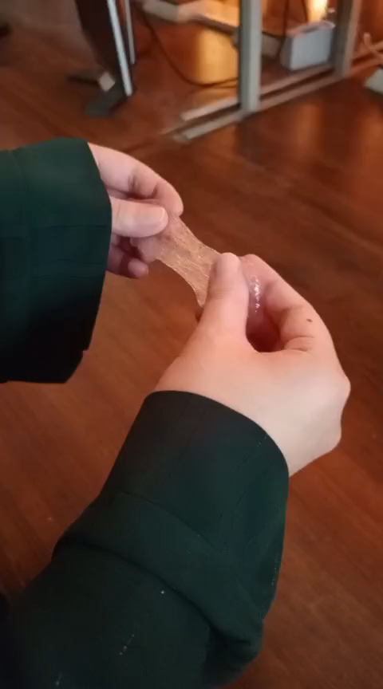
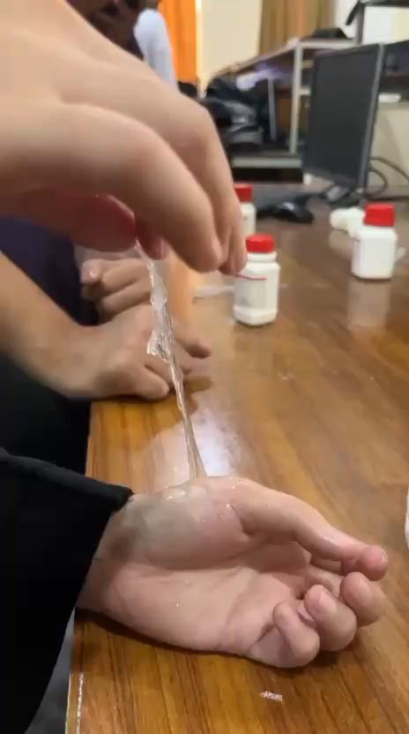

Slide 10
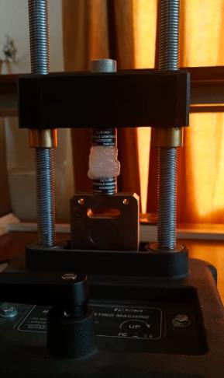
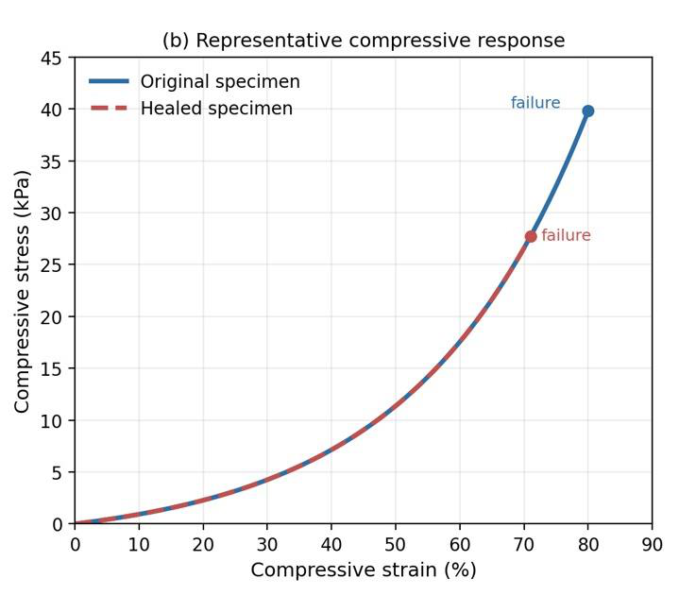
RESULTS
Mechanical Test Results
Specimen | Compressive Strength σ (kPa) | Strain at Failure ε (%) | Compressive Modulus E (kPa)
Original (uncut) | 40 | 80 | 22
Healed (cut + rejoined) | 28 | 71 | 21
The healed specimen recovered most of its stiffness (21 vs. 22 kPa modulus) but failed earlier than the original — pointing to the rejoined interface, not the bulk gel, as the weak point.
(a) ME 8236 compression apparatus
Driving factors:
Borax crosslink density, healing contact time, and how clean and well-aligned the cut surfaces were.
(b) Representative compressive stress-strain curves — original vs. healed specimen
8 / 10

Slide 11
RESULTS
Performance vs Pass Specifications
Property | Required | Result | Pass?
Elastic recovery (ER) | > 80% | 88% | Yes
Healing eff. (σ) | ≥ 45% | 70% | Yes
Healing eff. (ε) | ≥ 45% | 89% | Yes
Healing eff. (U) | Bonus | 66% | —
All three required metrics pass, with elastic recovery and strain-based healing efficiency clearing their targets by a wide margin.
9 / 10

Slide 12
CONCLUSION
Conclusion & Future Work
A simple, single-day, borax-crosslinked PVA-chitosan system delivers autonomous self-healing at room temperature — meeting both CEP targets with an elastic recovery of ~88% and a healing efficiency of ~70% in compressive strength.
FUTURE WORK
Finer-tuned borax concentration to balance strength against healing
Map healing efficiency across multiple contact times, not one point
Swelling, degradation, and cytotoxicity / cell-viability testing
More specimens per group for statistically reliable error bars
Key takeaway: the main route to better performance is finer control of crosslink density and healing conditions — not a more complex material.
10 / 10

Slide 13





Thank You

