Slide 1



CUSTOMER SEGMENTATION
DATA SCIENCE PROJECT
Group 2

Slide 2

OUR TEAM
Mentor : Saigeethika Ma’am
Team Members’ Names :
Sharmila M
Nehal Kakade
Rhucha Dhawale
Santhosh Chinnandi
Kaveeshvar S
Shridhar
Muhammed Afnas

Slide 3
PROJECT OBJECTIVE
Perform customer segmentation Identify different customer groups based on behavior
Help business:
Target the right customers
Improve marketing strategies
Increase sales efficiency

Slide 4

DATASET DETAILS
Dataset: Marketing Campaign Dataset
Contains customer information such as:
Demographics (Age, Income, Education)
Spending behavior (Wine, Fruits, Meat, etc.)
Purchase channels (Web, Store, Catalog)
Campaign responses
Target:
Perform clustering to identify customer segments

Slide 5





FEATURES USED
People
Products
Age
Income
Education
Marital Status
Spending
Promotion
Place
Campaign responses
Purchase channels

Slide 6
DATA PREPROCESSING
Handled missing values (Income → median)
Removed unnecessary columns
Converted datatypes
Feature engineering:
Age
Customer Tenure
Total Spending
Children count

Slide 7
FEATURE ENGINEERING
Created:
Total_Spending
Customer_Tenure
Age
Encoded categorical variables
Dropped irrelevant features

Slide 8
EDA SECTION
Income Distribution
Spending Analysis
Right-skewed distribution
Presence of high-income outliers
Total spending varies significantly
Wine & meat products dominate spending
Age Distribution
Purchase Behavior
Most customers fall in mid-age group
Wide age spread observed
Purchases via:
Web
Store
Catalog
Store purchases slightly higher

Slide 9
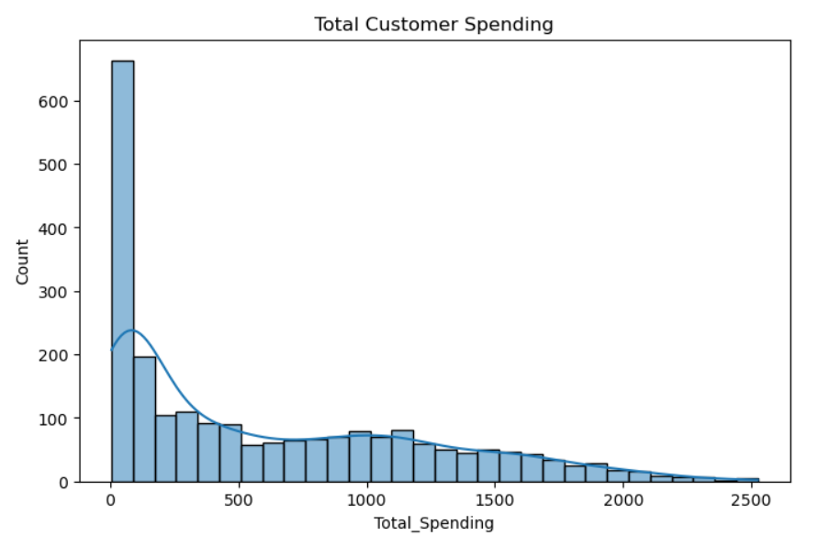
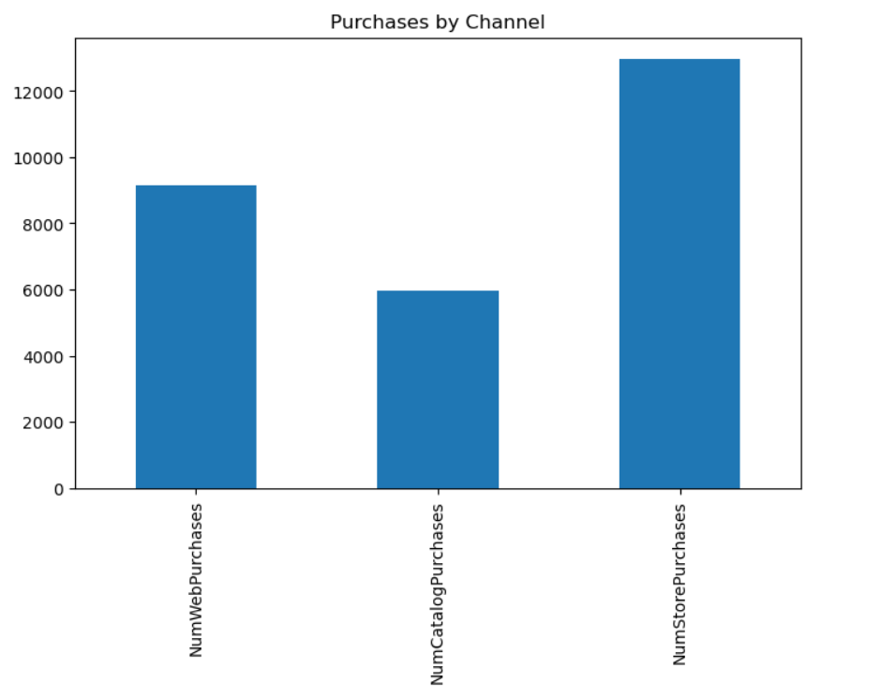
EDA SECTION

Slide 10
EDA SECTION
Correlation Heatmap
Strong relationships between:
Income & Spending
Different product purchases
Outlier Handling
Detected using boxplots
Handled using IQR method
Recency vs Spending
Weak correlation
Justifies need for clustering

Slide 11
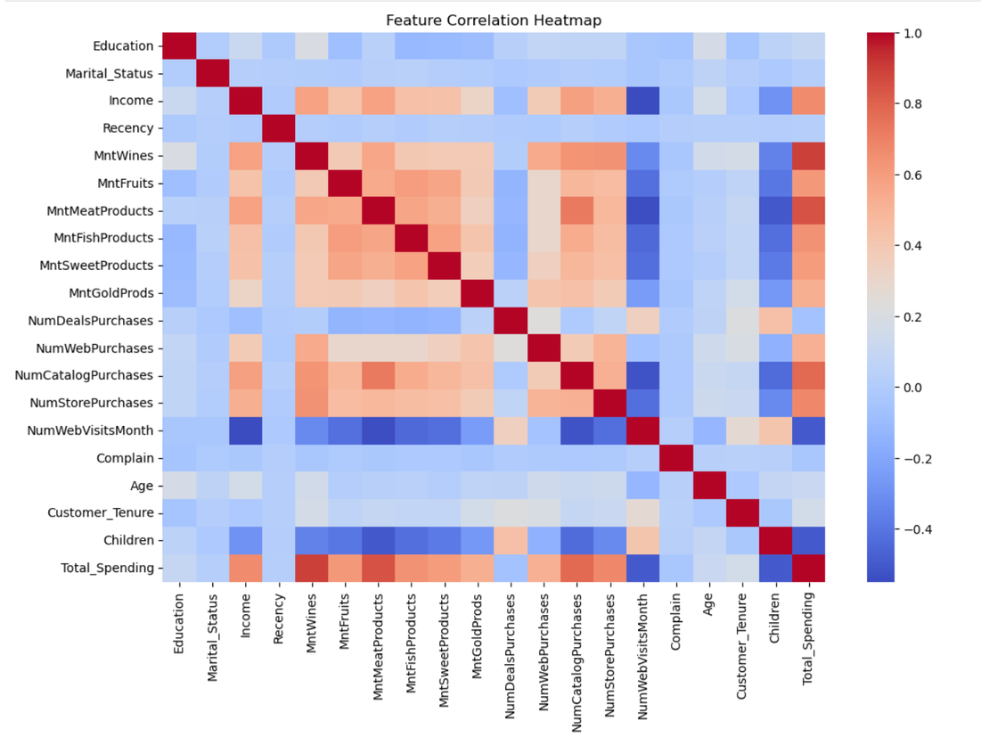
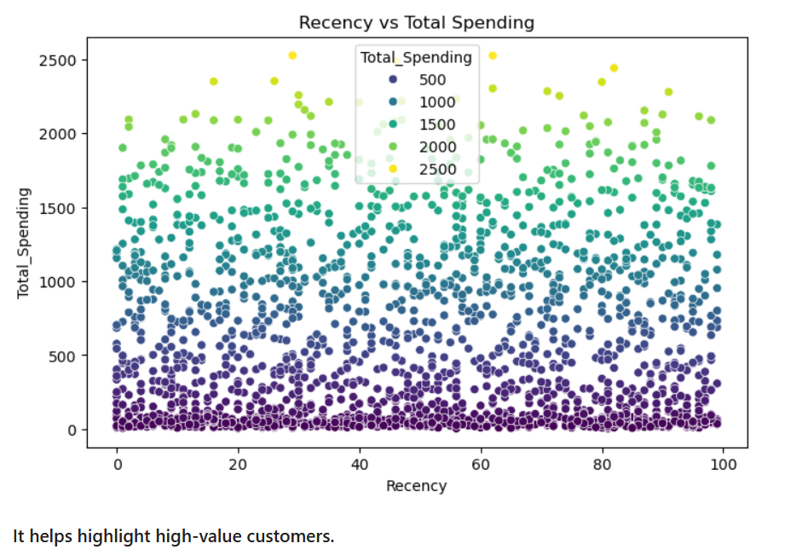
EDA SECTION

Slide 12
MODEL BUILDING SECTION
Clustering Approach
Elbow Method
Used multiple algorithms:
KMeans
Agglomerative
DBSCAN
Gaussian Mixture
Used to find optimal clusters
Optimal K ≈ 4
Final Model
Silhouette Score
Selected: KMeans (K=4)
Reason:
Better interpretability
Good silhouette score
Compared clustering performance.
KMeans showed good separation

Slide 13
MODEL BUILDING SECTION
Model Evaluation
PCA Visualization
Metrics used:
Silhouette Score
Davies-Bouldin Index
Result:
Moderate cluster separation
Reduced data to 2D
Visualized cluster separation
Clear grouping observed
Cluster Insights
Cluster Profiling
Compared clusters using:
Income
Spending
Recency
Used heatmaps & radar charts
High spenders
Low spenders
Frequent buyers
Occasional customers

Slide 14
CLASSIFICATION MODELS
Classification Models
Model Comparison
Random Forest
Logistic Regression
Decision Tree
Random Forest → Best accuracy
Used for prediction deployment

Slide 15
DEPLOYMENT
Saved model using joblib
Exported processed dataset
Ready for integration into app
Dynamic application with static as well as dynamic graphs
The user has to enter details like income, recency and more inputs in order to know what category of customer he/she belongs.

Slide 16
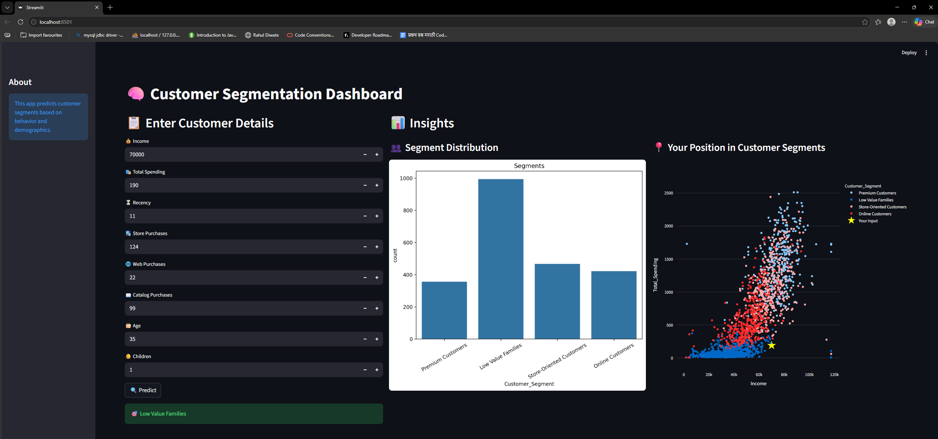
APP SCREENSHOT

Slide 17


CHALLENGES FACED
Handling missing values
Choosing optimal clusters
Interpreting clusters meaningfully
Outlier impact on clustering

Slide 18
CHALLENGES HANDLED
Handling missing values - Used median imputation for numerical features to avoid data loss.
Choosing optimal clusters - Used the Elbow Method to find the optimal number of clusters by plotting WCSS.
Interpreting clusters meaningfully - Labeled clusters based on characteristics such as premium customers, low value families ,store oriented and online customers.
Outlier impact on clustering - Detected outliers using boxplots and IQR method. Capped extreme values to improve clustering performance.

Slide 19

KEY LEARNINGS
Importance of feature engineering
Clustering evaluation techniques
Real-world business interpretation

Slide 20
THANK YOU

