Slide 1




P. R. Pote (Patil) College of Engineering & Mgmt., Amravati
Department of Computer Science & Engineering
Seminar Topic
“Real Time Face Recognition”
Name of Guide
Prof. Aditya Sontakke
Name of Project Members
Mr. Aditya Kadam
Mr. Nehal Meskar
Mr. Suraj Ingole
Mr.
Notes:
qqqq

Slide 2
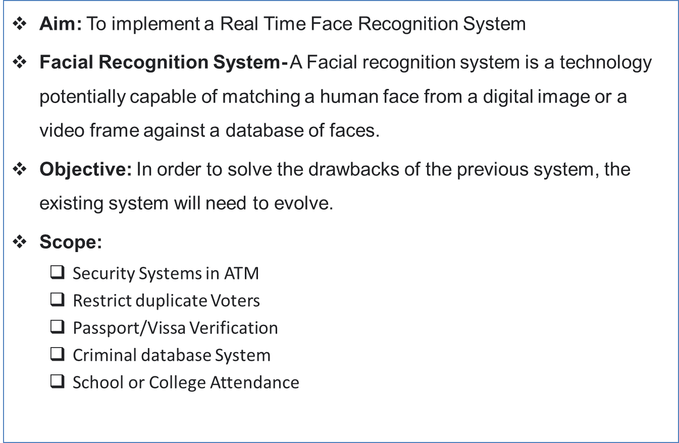

Introduction
PRPCEM, MCA Department
2

Slide 3
Literature Survey
Year | Author Name | Topic | Technology Used | Conclusion
2020 | Rachid Aliradi , Naima Bouzera | Detection of facial components based on SVM Classification. | Support vector machines (SVM) has been adapted. | SVM doesn’t perform well when we have large data set because the required training time is higher.
2017 | Liton Chandra Paul | Face recognition using principal component analysis method | Principal Component Analysis (PCA) | There’s lot of loss of information and also he major components are difficult to comprehend.
2019 | Kunihiko Fukushima | Comparison of Three Free face recognition. | Deep learning and CNN. | CNN needed a lot of data & compute resource to work for large image
PRPCEM, MCA Department
Notes:
qqqq

Slide 4
Proposed System
Technology Used:
  Python
  OpenCV
Algorithm Used:
  Haar Feature
  Cascade Classifier
  Local Binary Pattern Histogram (LBPH)
PRPCEM, MCA Department

Slide 5
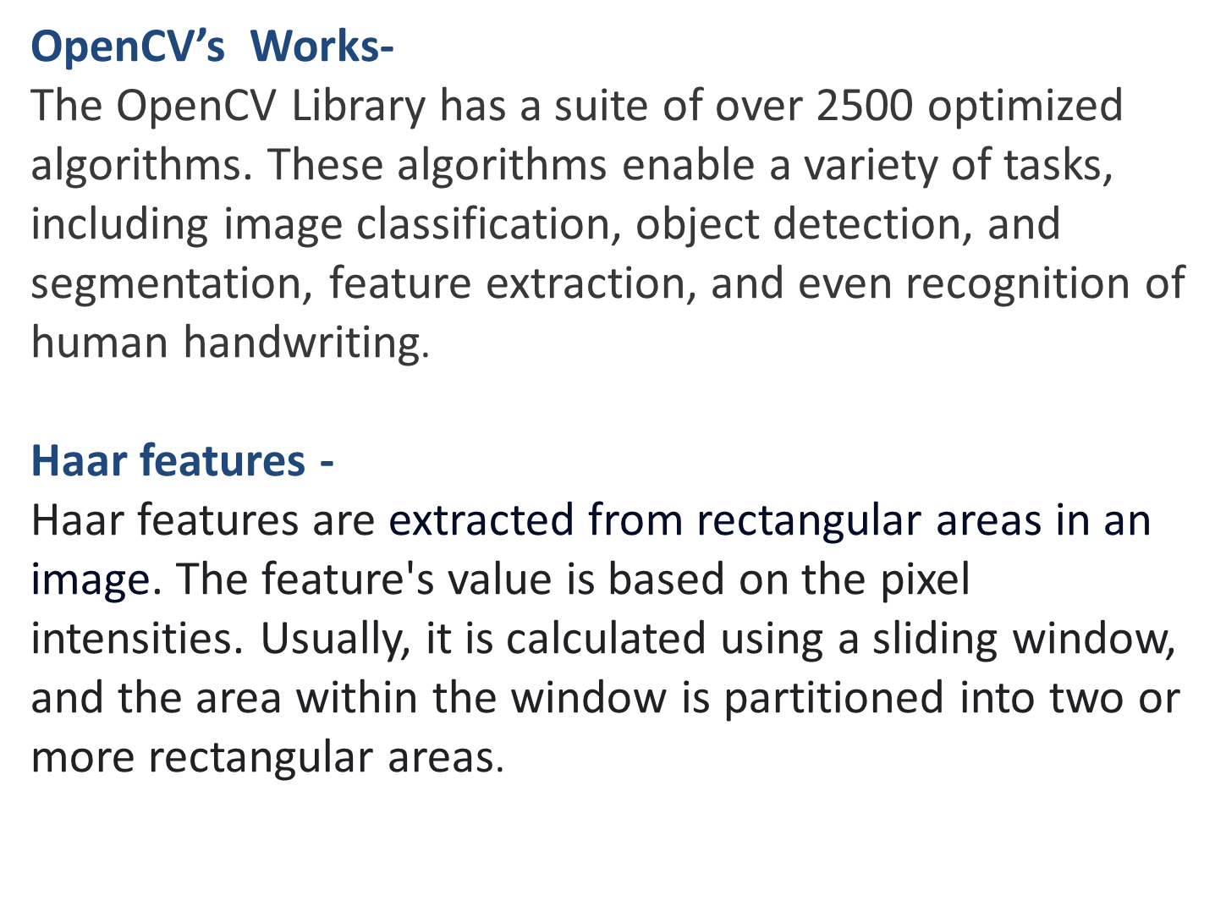
PRPCEM, MCA Department

Slide 6
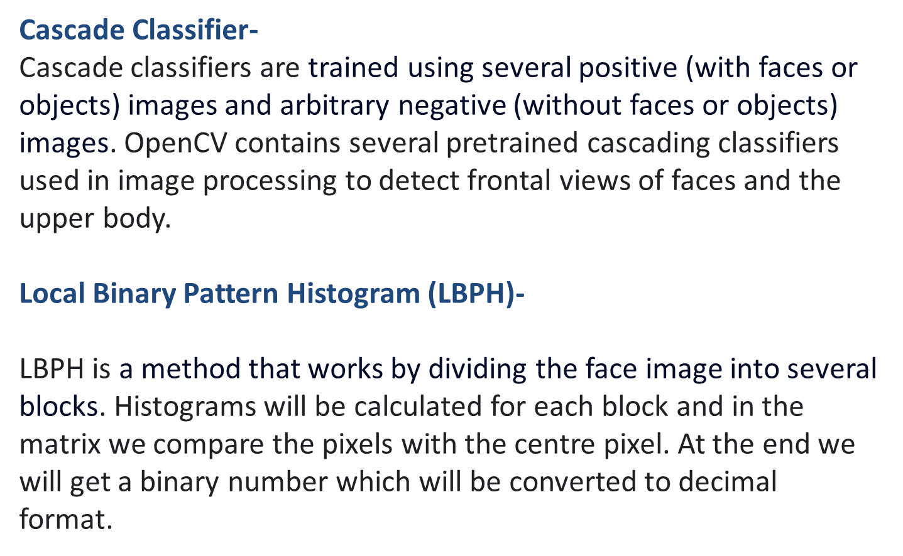
PRPCEM, MCA Department

Slide 7
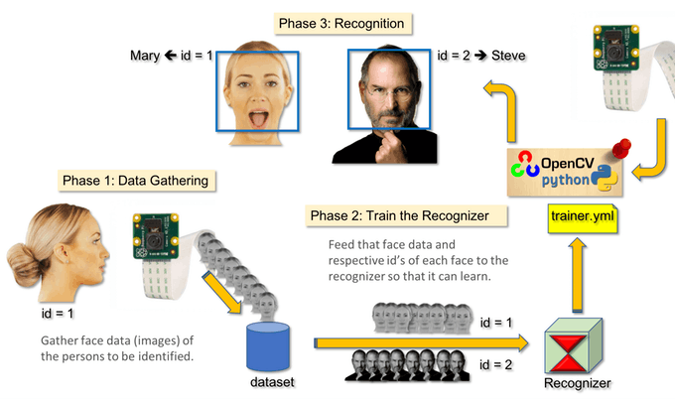
PRPCEM, MCA Department

Slide 8
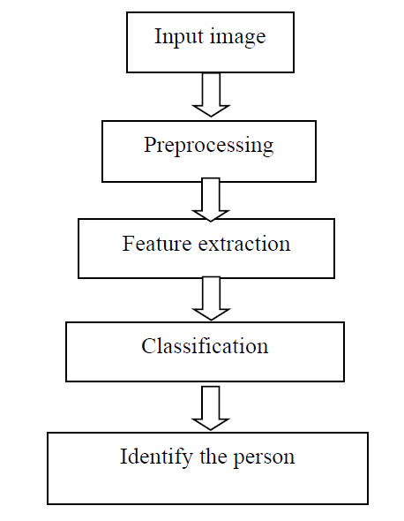
Methodology
Fig. 1. Block diagram of Proposed System
PRPCEM, MCA Department
6

Slide 9
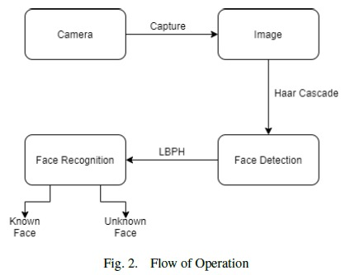
PRPCEM, MCA Department

Slide 10

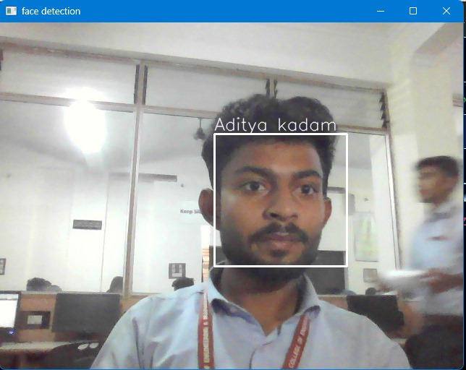
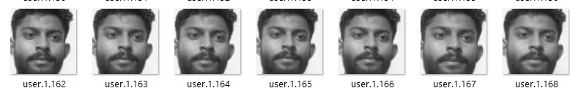
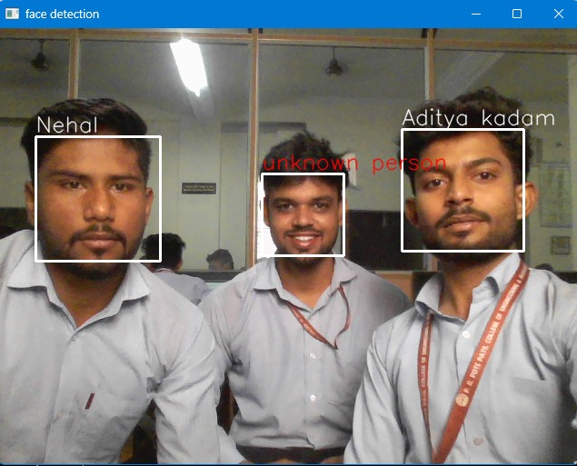
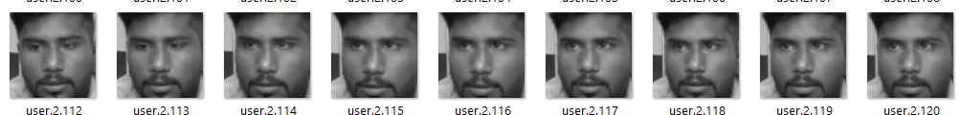
PRPCEM,MCA Department

Slide 11
Thank You
PRPCEM, MCA Department

