Slide 1

Reflection
Object Oriented Programming
Nehal Patel
Research Scholar, VNSGU

Slide 2
Definition
In object-oriented programming languages such as Java, reflection allows inspection of classes, interfaces, fields and methods at runtime without knowing the names of the interfaces, fields, methods at compile time. It also allows instantiation of new objects and invocation of methods.
Reflection is an API that is used to examine or modify the behavior of methods, classes, and interfaces at runtime. The required classes for reflection are provided under java.lang.reflect package which is essential in order to understand reflection.

Slide 3
Demo

Slide 4
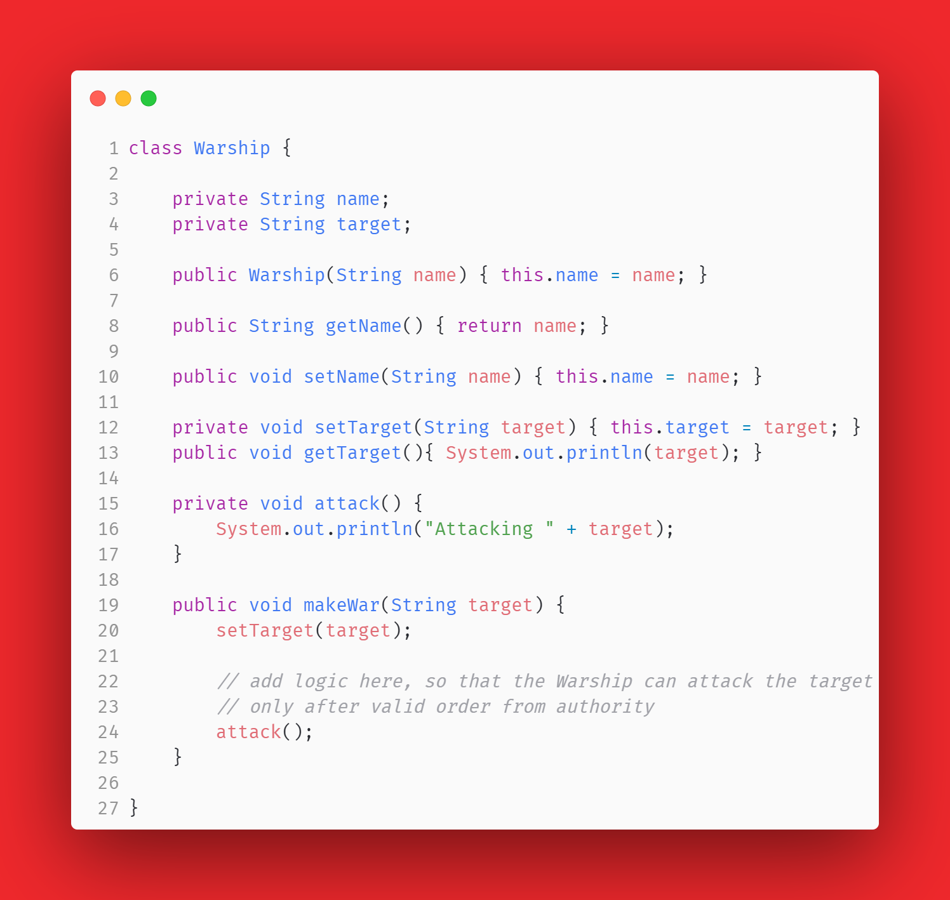

Slide 5
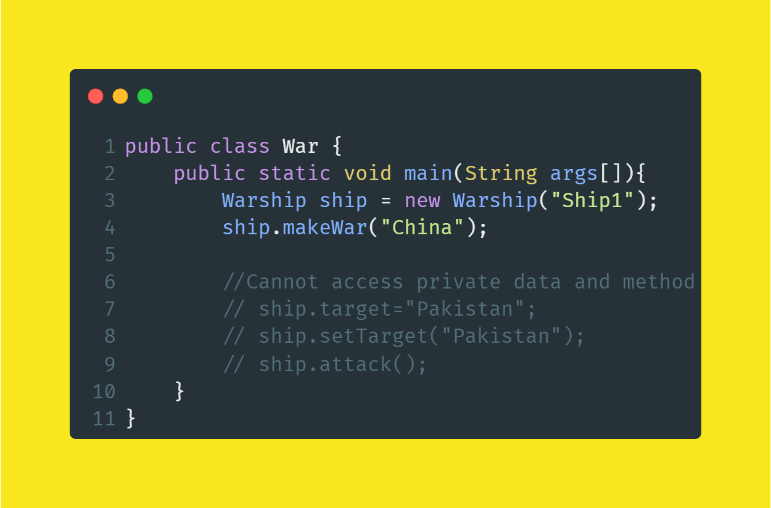

Slide 6
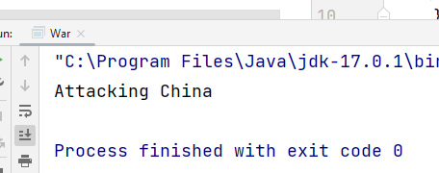
Output

Slide 7

OK, We can’t access private members outside the class.
So, does Access Specifiers provide security?

Slide 8

Reflection in Action

Slide 9
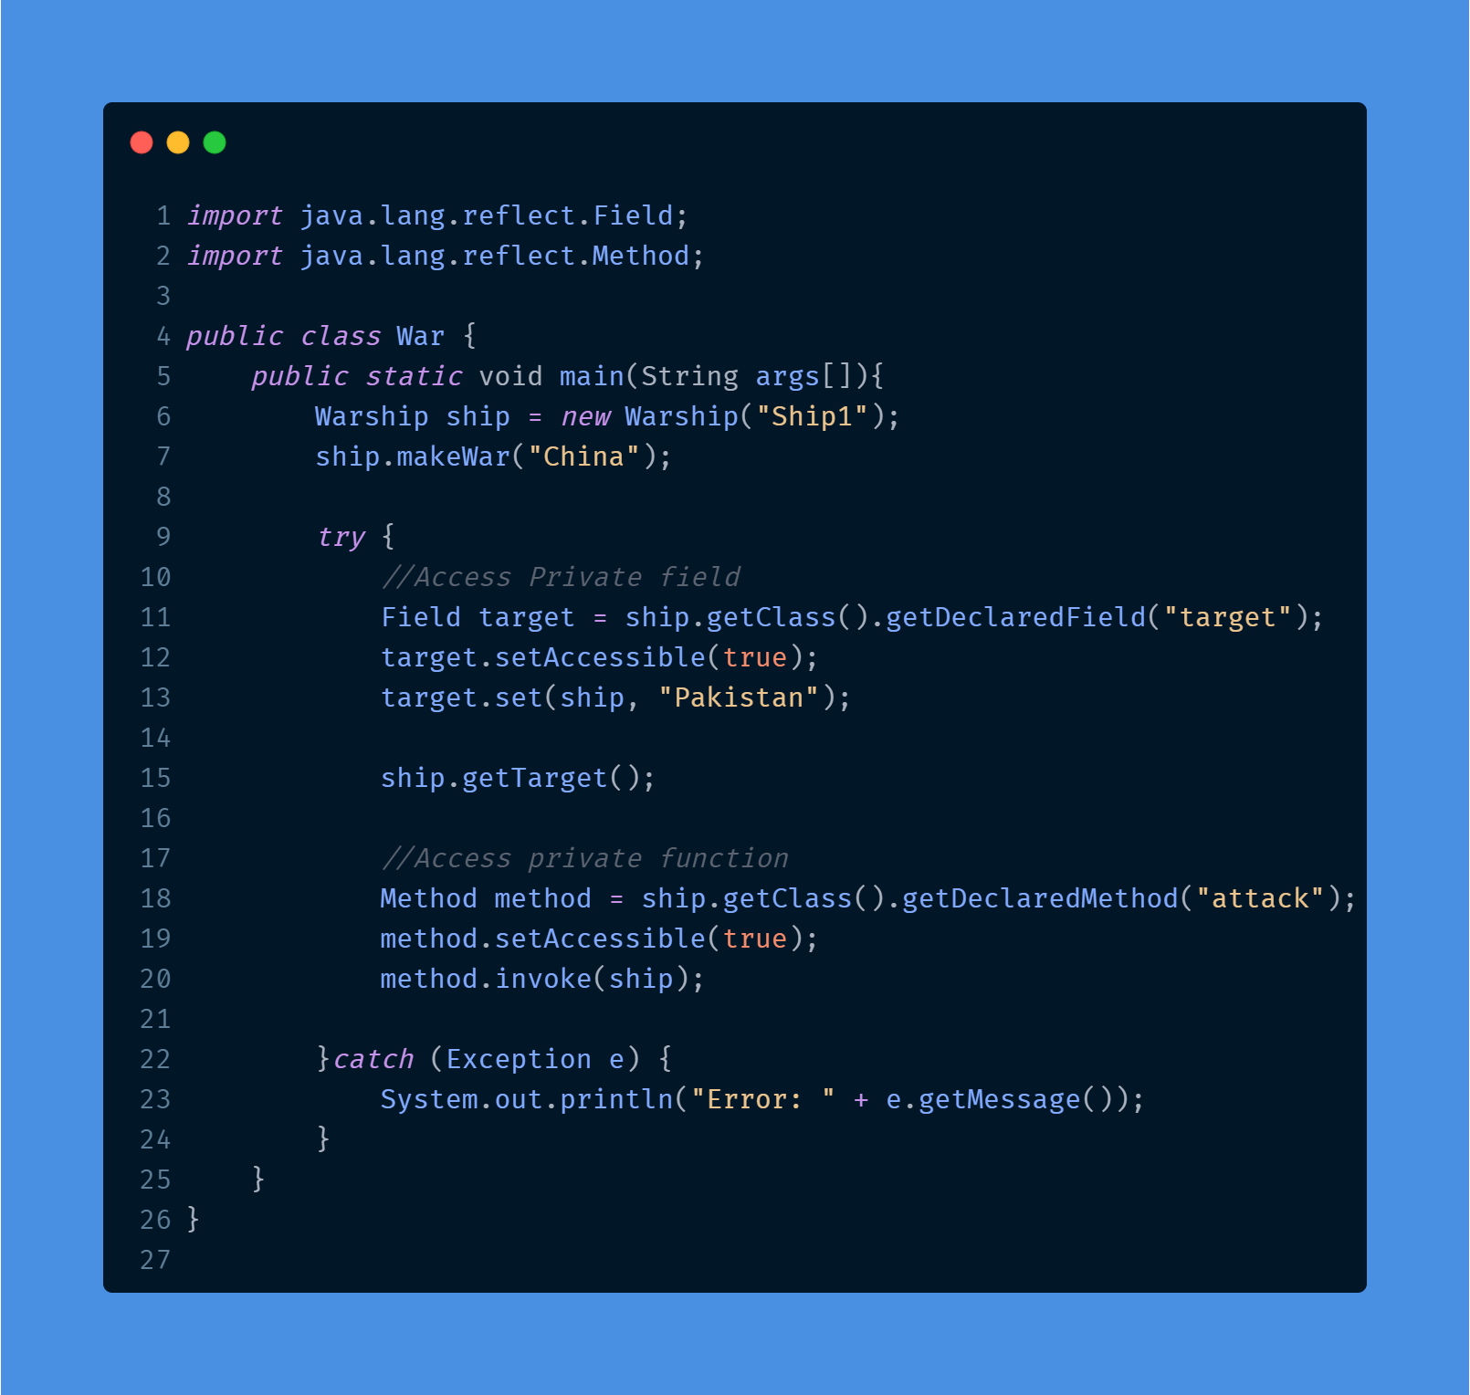

Slide 10
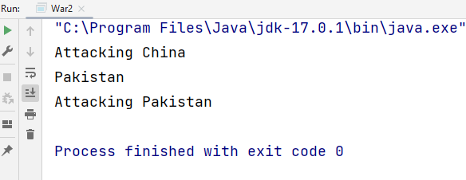
Output

Slide 11
OK, We can’t access private members outside the class.
So, does Access Specifiers provide security?
No, access modifiers don't offer security protection. They are merely there for developer convenience.
e.g. they help to enforce good coding practices and help with programming patterns

Slide 12
The Object class is the parent class of all the classes in java by default. In other words, it is the topmost class of java.
public final Class getClass()
The java.lang.Class class instance represent classes and interfaces in a running Java application.It has no public constructor.
public final class Class<T> extends Object implements Serializable, GenericDeclaration, Type, AnnotatedElement

Slide 13
java.lang.Class
Constructor<?>[] getConstructors()
Constructor<?>[] getDeclaredConstructors()
Field[] getDeclaredFields()
Class<?>[] getInterfaces()
Method[] getDeclaredMethods()
Method[] getMethods()
String getName()
…

Slide 14
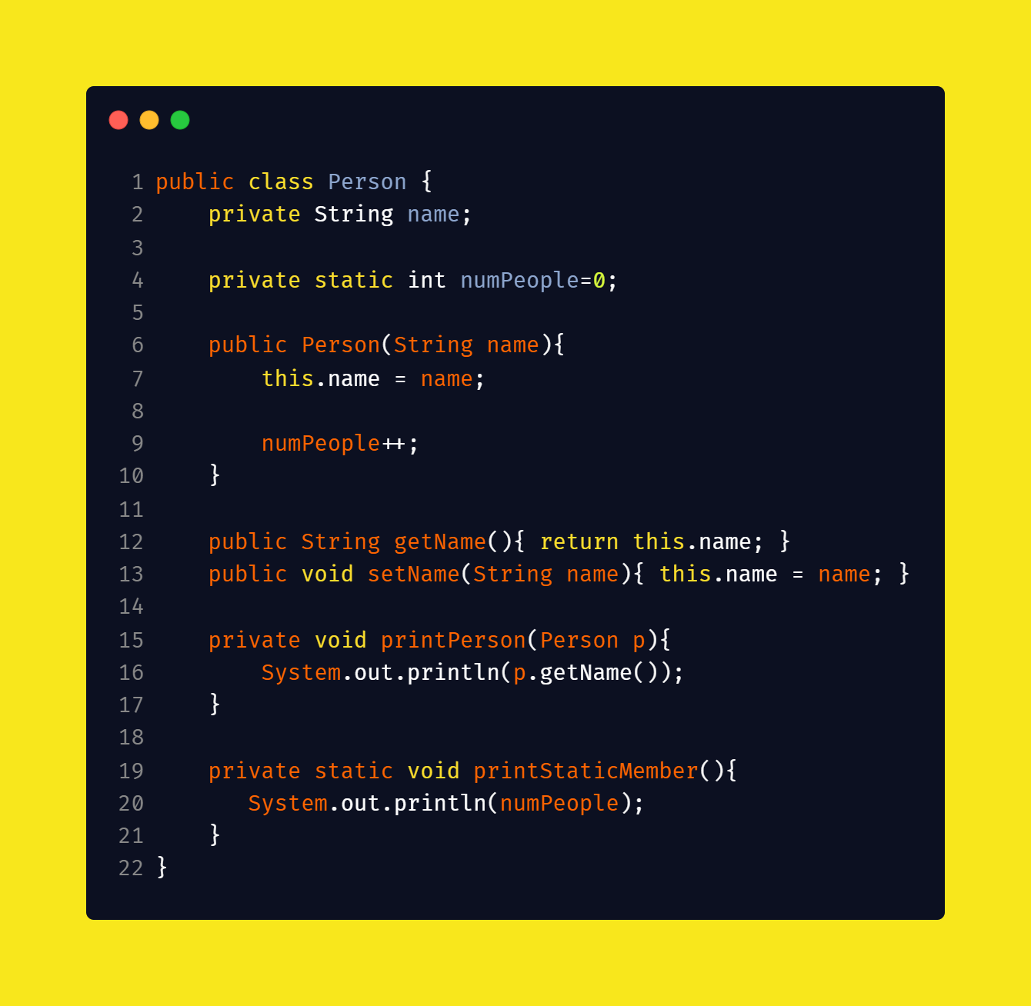

Slide 15
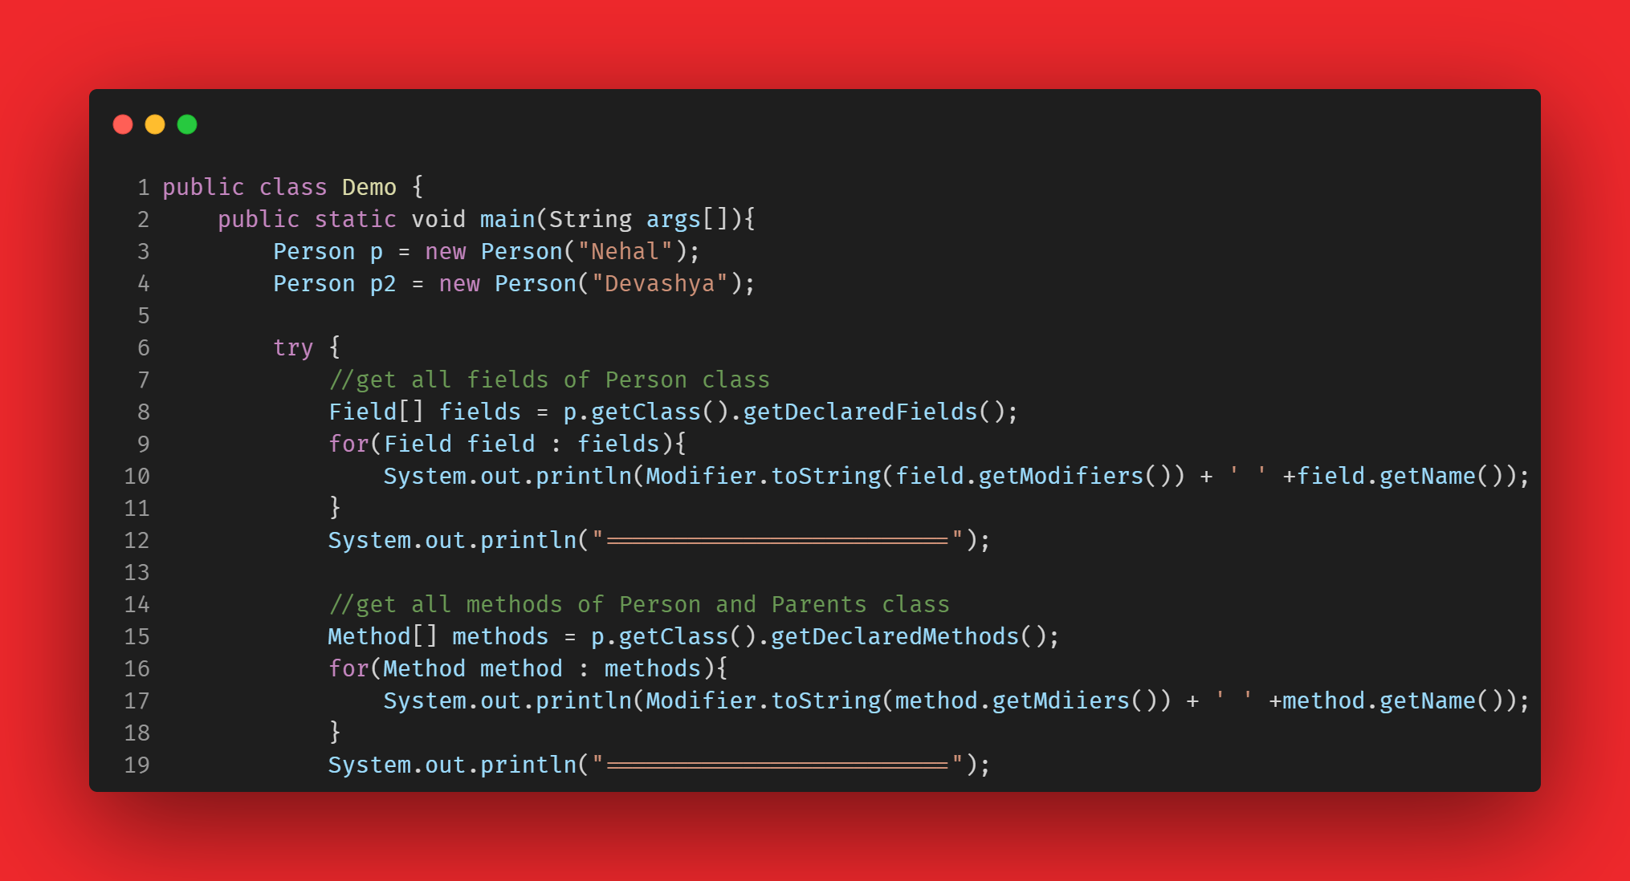

Slide 16
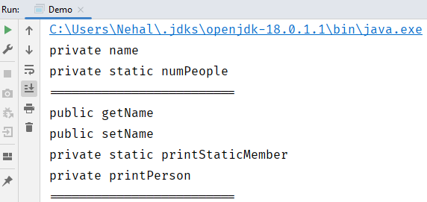

Slide 17
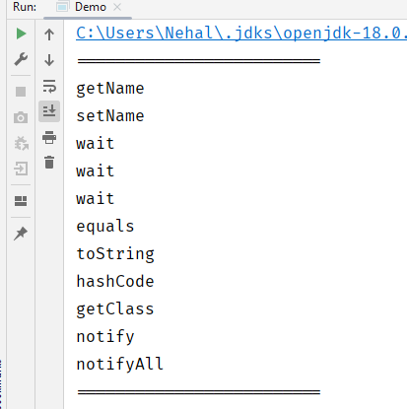
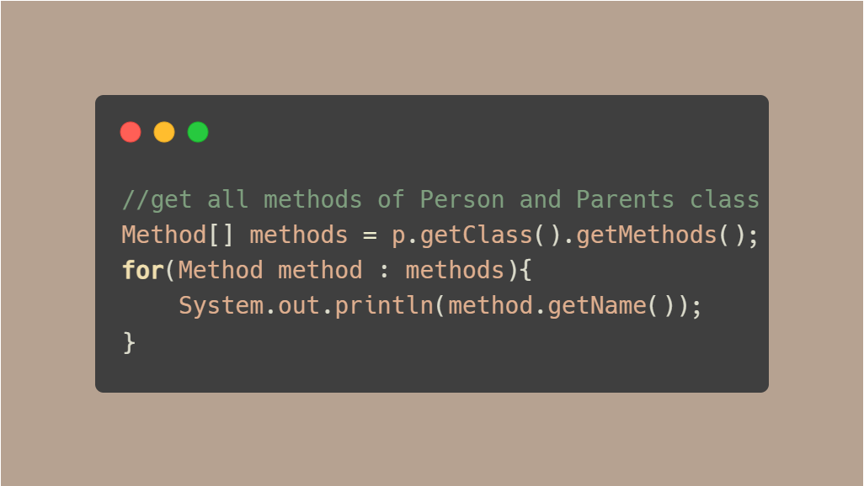
Get all methods

Slide 18
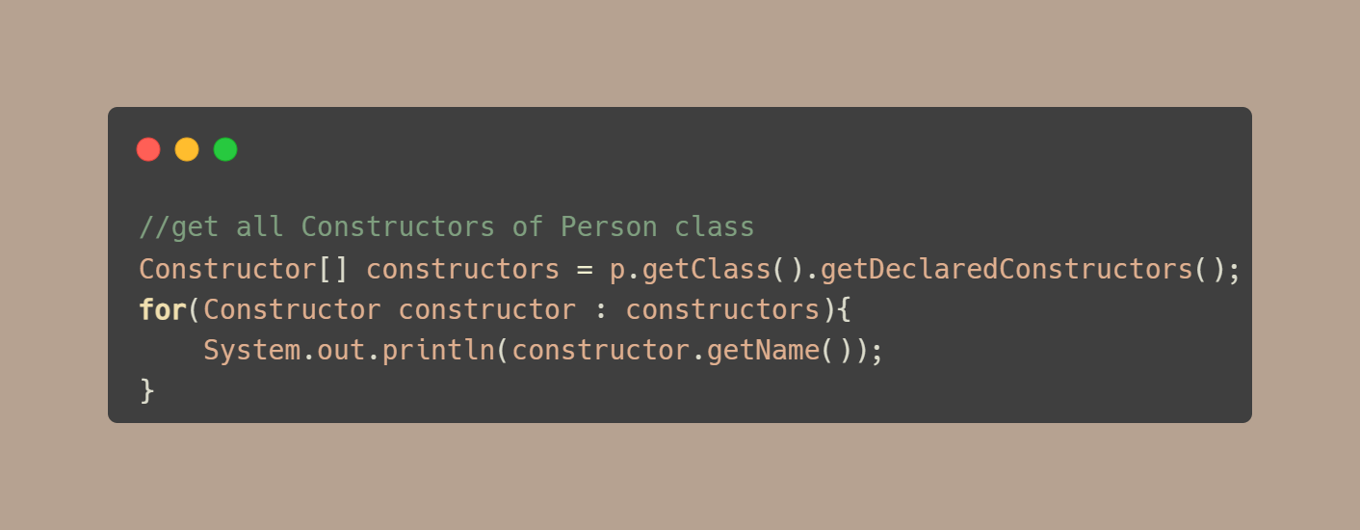

Get Constructors

Slide 19
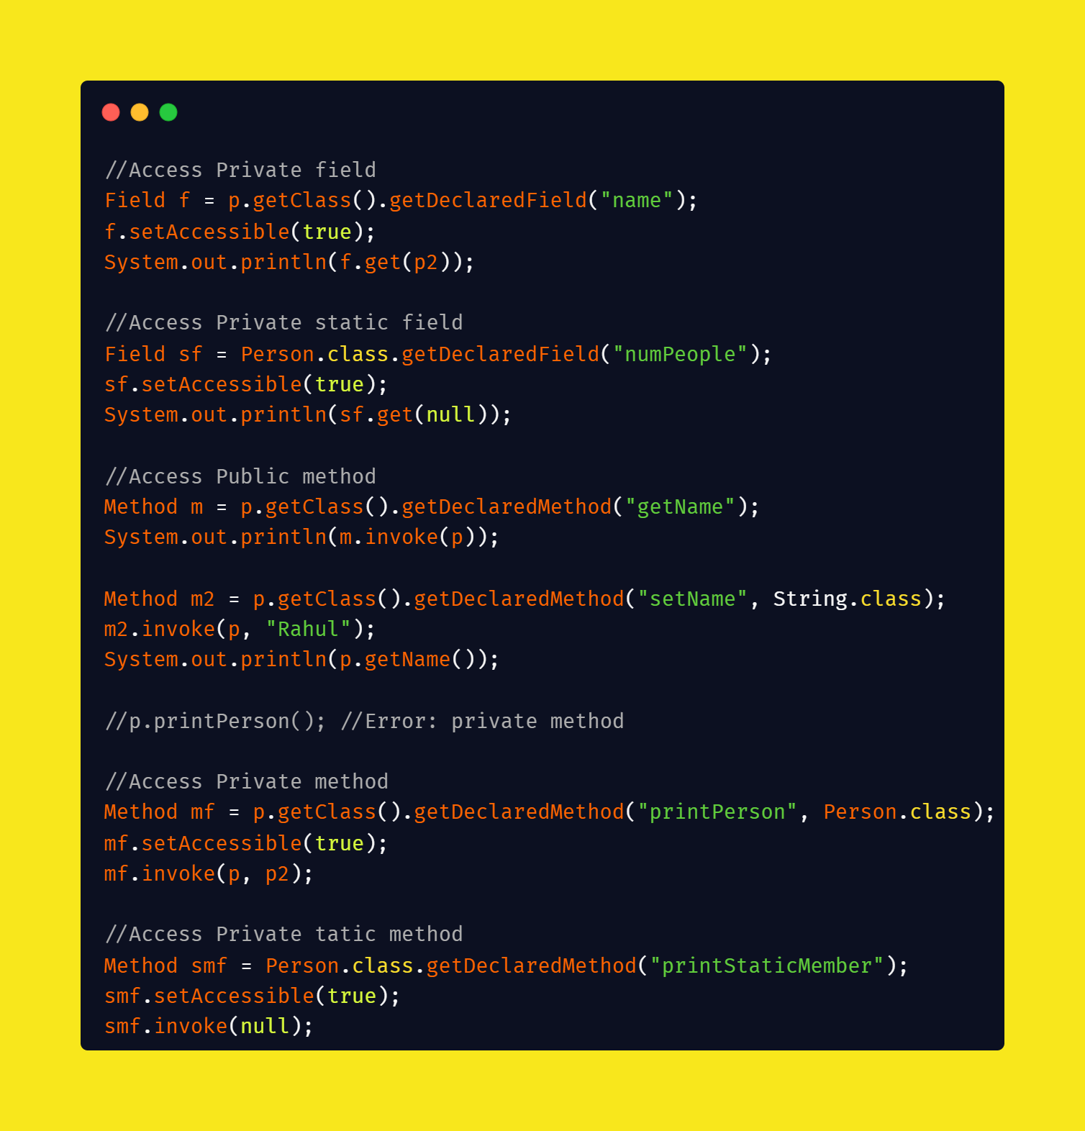

Slide 20
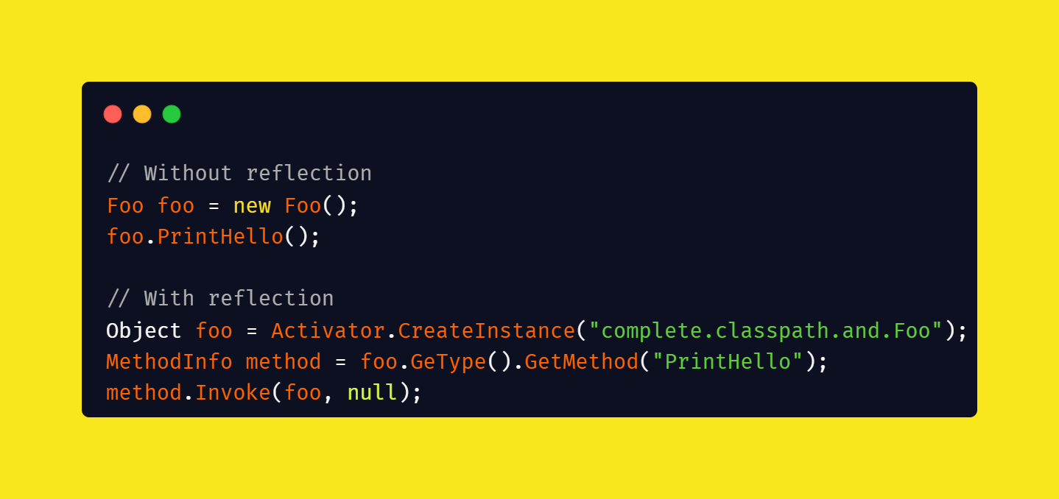
Reflection in C#

Slide 21

Use of Reflection
Make generic software libraries
Serialization or Deserialization
Metaprogramming
Debugging
Documentation
Software Testing
For the runtime creation/instantiation of mock objects.
Unit Testing
Code Coverage

Slide 22
Thanks

