Slide 1

Reflection
Object Oriented Programming
Nehal Patel

Slide 2
Definition
Reflection allows inspection of classes, interfaces, fields and methods at runtime without knowing the names of the interfaces, fields, methods at compile time. It also allows instantiation of new objects and invocation of methods.

Slide 3
Demo

Slide 4
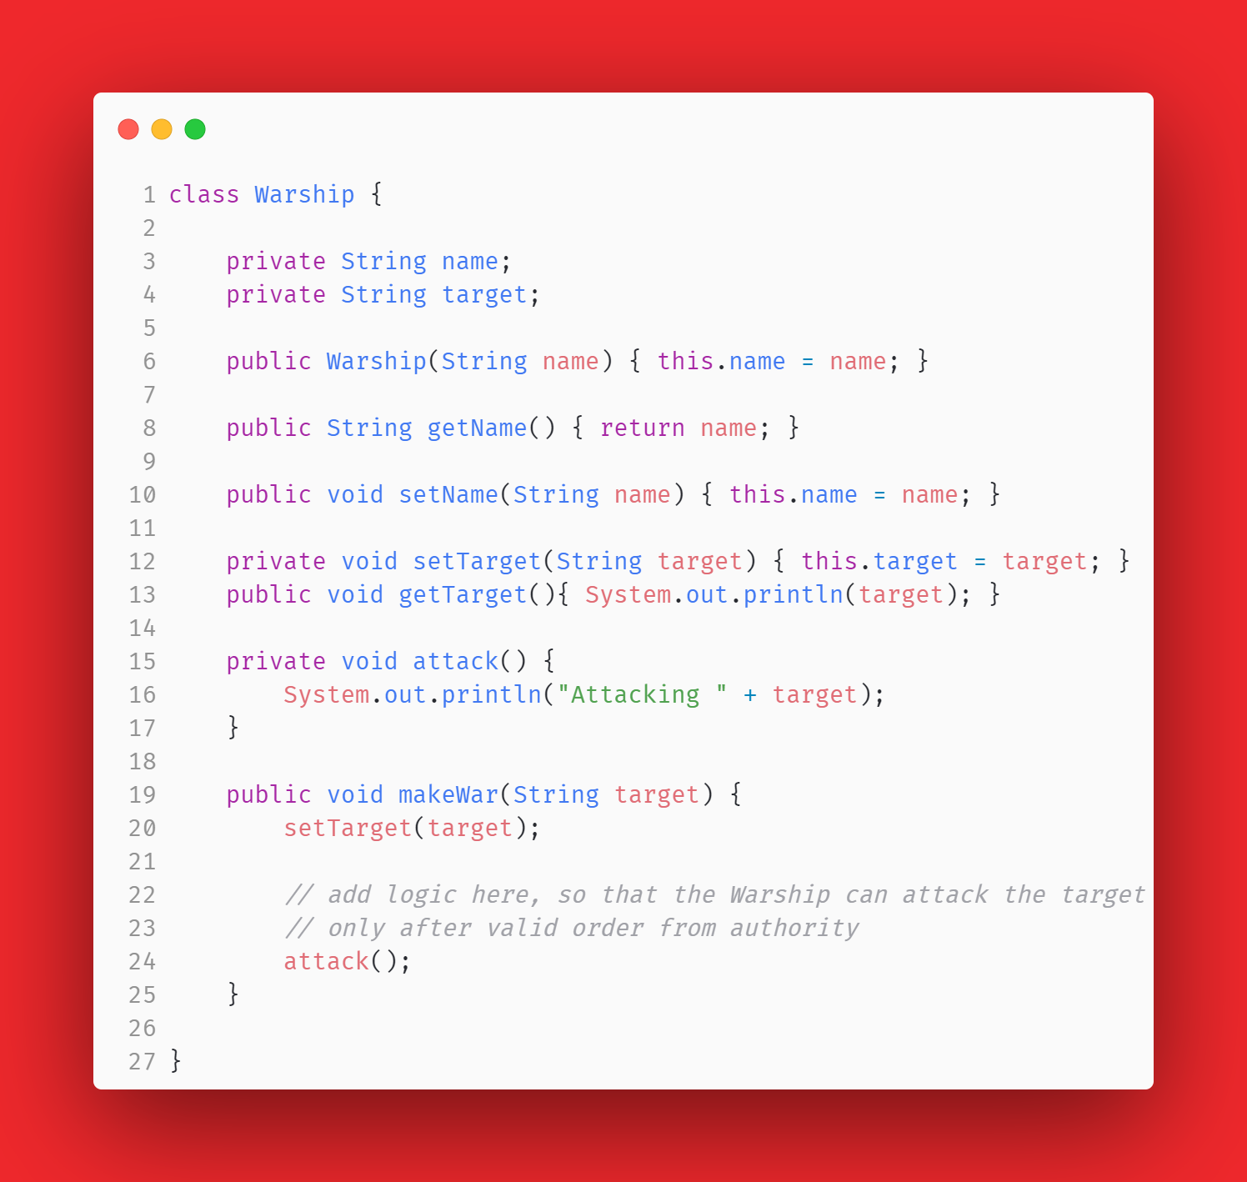

Slide 5
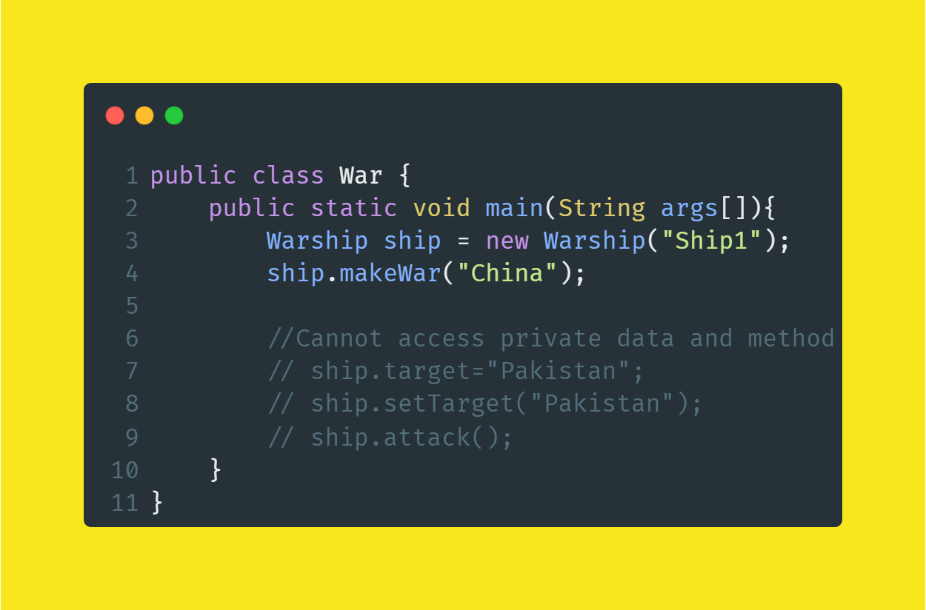

Slide 6
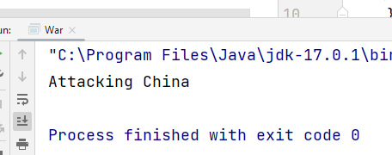
Output

Slide 7

OK, We can’t access private members outside the class.
So, does Access Specifies provide security?
No, access modifiers don't offer security protection. They are merely there for developer convenience, e.g. they help to enforce good coding practices and help with programming patterns

Slide 8

Reflection in Action

Slide 9
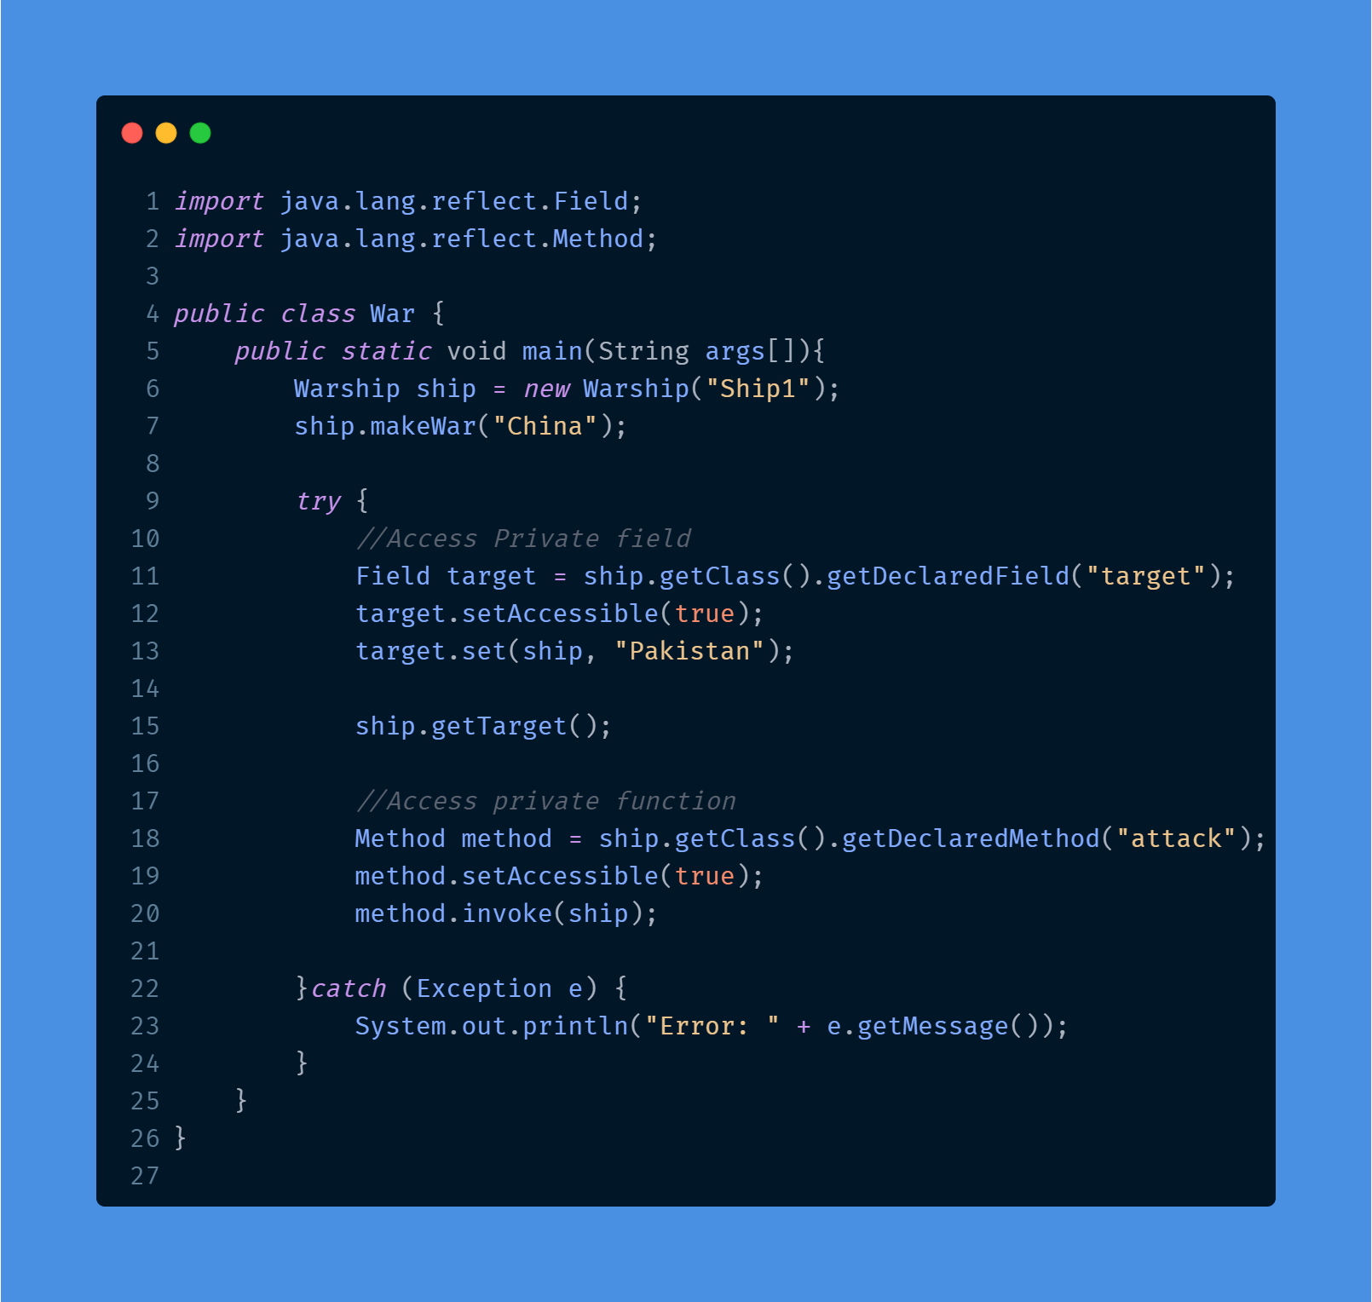

Slide 10
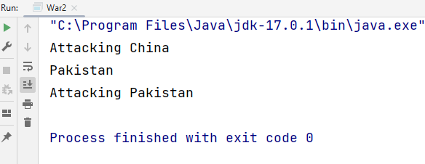
Output

