Slide 1
Lecture 1 What is AI?
CSE 473
Artificial Intelligence
Oren Etzioni
Notes:
What are the fundamental Scientific Questions?
How did the Universe start?
Genome
AI
Theory for each, except AI..
GO OVER SYLLABUS
HAND OUT SEATING CHART

Slide 2
AI as Science
What are the most fundamental scientific questions?
Notes:
Where did the physical universe come from? And what laws guide its dynamics?
How did biological life evolve? And how do living organisms function?
What is the nature of intelligent thought?

Slide 3
Goals of this Course
To teach you the main ideas of AI.
Give you AI “color”
To introduce you to a set of key techniques and algorithms from AI
To introduce you to the applicability and limitations of these methods (problem sets)

Slide 4
What is Intelligence?
Notes:
Ability to interact with world
Ability to PERCEIVE and ACT
Reasoning, Planning
Make decisions
Websters: “Capacity to learn and Understand Problems”
LEARNING and ADAPTATION: also major thrust at Microsoft Research!

Slide 5
What is Artificial Intelligence?
Notes:
Model HUMAN COGNITION
Psychological level – errors and all
Neural level
Optimize PERFORMANCE on specific tasks – examples
Games
Expert systems – manufacturing
Speech understanding, ETC
The turing test…

Slide 6
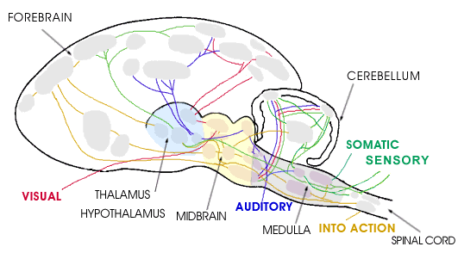
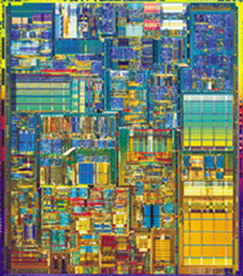
Hardware
10¹¹ neurons 10¹⁴ synapses cycle time: 10⁻³ sec
10⁷ transistors 10¹⁰ bits of RAM cycle time: 10⁻⁹ sec
Notes:
Far fewer interconnections!
Much faster update!

Slide 7
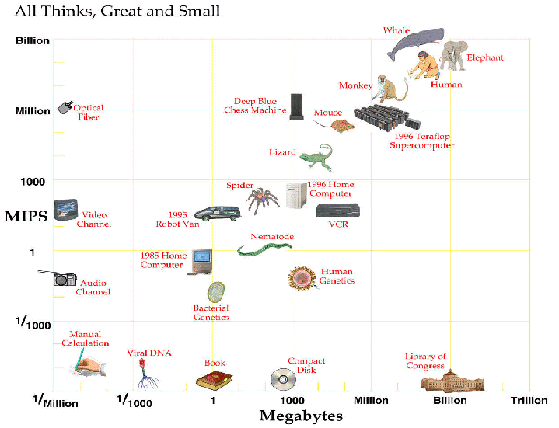
Computer vs. Brain

Slide 8
Conclusion
In near future we can have computers with as many processing elements as our brain, but:
far fewer interconnections (wires or synapses)
much faster updates.
Fundamentally different hardware may
require fundamentally different algorithms!
Very much an open question.
Neural net research.

Slide 9
What Level of Abstraction?
Hardware (build brains)
“network” (neural networks?)
Algorithm + representation
Intermediate Behavior (cognitive modeling)
Task Performance (Deep Blue, Turing Test)
Task Competence (Idealized view)

Slide 10

Classical AI
The principles of intelligence are separate from any hardware / software / wetware implementation
Look for these principles by studying how to perform tasks that require intelligence
Can we rely on simple tasks? (e.g., 8-puzzle, tic tac toe)

Slide 11
Success Story: Medical Expert Systems
Mycin (1980)
Expert level performance in diagnosis of blood infections
Today: 1,000’s of systems
Everything from diagnosing cancer to designing dentures
Often outperform doctors in clinical trials
Major hurdle today – non-expert part – doctor/machine interaction

Slide 12
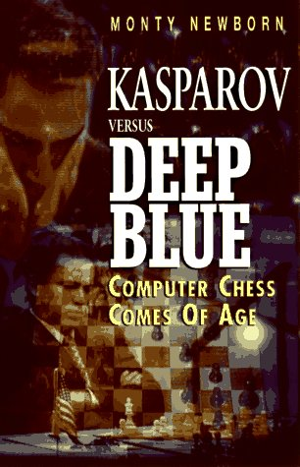
Success Story: Chess
I could feel – I could smell – a new kind of intelligence across the table - Kasparov
Examines 5 billion positions / second
Intelligent behavior emerges from brute-force search

Slide 13
Autonomous Systems
In the 1990’s there was a growing concern that work in classical AI ignored crucial scientific questions:
How do we integrate the components of intelligence (e.g. learning & planning)?
How does perception interact with reasoning?
How does the demand for real-time performance in a complex, changing environment affect the architecture of intelligence?

Slide 14

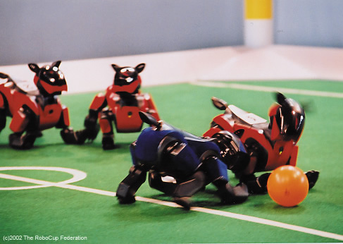
Provide a standard problem where a wide range of technologies can be integrated and examined
By 2050, develop a team of fully autonomous humanoid robots that can win against the human world champion team in soccer.

Slide 15
Software Robots (softbots)
Softbots: ‘intelligent’ program that uses software tools on a person’s behalf.
Sensors = LS, Google, etc.
Effectors = RM, ftp, Amazon.com
Software: not physical but not simulated.
Active: not a help system (softbot safety!)

Slide 16
Key Hard Problem for AI
Today’s successful AI systems
operate in well-defined domains
employ narrow, specialize knowledge
Commonsense Knowledge
needed to operate in messy, complex, open-ended worlds
Your kitchen vs. GM factory floor
understand unconstrained Natural Language

Slide 17
Role of Knowledge in Natural Language Understanding
Speech Recognition
“word spotting” feasible today
continuous speech – rapid progress
turns out that “low level” signal not as ambiguous as we once thought
Translation / Understanding
very limited progress
The spirit is willing but the flesh is weak. (English)
The vodka is good but the meat is rotten. (Russian)
Notes:
automatic translation only really successful in
very limited domains – eg weather reports
as a tool for human editors to extensively revise

Slide 18
Syntactic, Semantic, Analogical Knowledge
Time flies like an arrow.
Fruit flies like a banana.
Fruit flies like a rock.
Notes:
What are different PARSES (groupings)?
What kinds of knowledge needed to understand each?
Syntactic – “fruit flies” could be a phrase, probably not “time flies”
Semantics – rocks are not edible, bananas are
Analogical – “time flies” makes “sense” because of our rich body of SPATIAL analogies
Statistical – “flies like a rock” common phrase

Slide 19
How to Get Commonsense?
CYC Project (Doug Lenat, Cycorp)
Encoding 1,000,000 commonsense facts about the world by hand
Coverage still too spotty for use!
Alternatives?
Open Mind
KnowItAll
Notes:
Machine learning – bootstrapping?
Data mining the web?
Reinforcement learning -

Slide 20
Historical Perspective
(4th C BC+) Aristotle, George Boole, Gottlob Frege, Alfred Tarski
formalizing the laws of human thought
(16th C+) Gerolamo Cardano, Pierre Femat, James Bernoulli, Thomas Bayes
formalizing probabilistic reasoning
(1950+) Alan Turing, John von Neumann, Claude Shannon
thinking as computation
(1956) John McCarthy, Marvin Minsky, Herbert Simon, Allen Newell
start of the field of AI

Slide 21
Recurrent Themes
Neural nets vs AI
McCulloch & Pitts 1943
Died out in 1960’s, revived in 1980’s
Neural nets vastly simplified model of real neurons, but still useful & practical – massive parallelism
particular family of learning and representation techniques
Logic vs Probability
In 1950’s logic seemed more computationally & expressively attractive (McCarthy, Newell)
attempts to extend logic “just a little” to deal with the fact that the world is uncertain!
1988 – Judea Pearl’s work on Bayes nets
provided efficient computational framework
Today – no longer rivals
hot topic: combining probability & first-order logic

Slide 22
Recurrent Themes, cont.
Weak vs Strong Methods
Weak – general search methods
A* search, constraint propagation, ...
Rise of “knowledge intensive” approach
expert systems
more knowledge, less computation
Today: resurgence of weak methods
desktop supercomputers
in highly competitive domains (Chess) exceptions to the general rules are most important!
How to combine weak and strong methods seamlessly?

Slide 23
(Re-)Current Themes
Combinatorial Explosion
Micro-world successes don’t scale up.
How to Organize and accumulate large amounts of knowledge?
How to translate from informal, ill-structured statements to formal reasoning (e.g., understand a story)?
What are reasonable simplifying assumptions?

