Slide 1
finding & analyzing scholarly research publications
mon, sept 14, 2015

Slide 2
reminders
On Wednesday we will focus on the Data to Story Project – GSS dataset, access to SPSS software, and talk about forming groups
SPSS workshop next Monday – Odum Institute, Davis Library 219

Slide 3
exploratory
explanatory
descriptive
little is known
WHAT?
outcome: general ideas and research questions
document the phenomenon
WHO?
WHEN?
HOW?
outcome: details & descriptions
test for causes and/or predictions
WHY?
outcome: test a theory
recap from last class:

Slide 4
 | purpose | stage in learning process | question | main audience | outcome
exploratory | learn about something new | earliest | what? | varies; usually a researcher | general ideas and research questions
descriptive | provide details on something known | middle | who? when? how? | varies | factual details and descriptions
explanatory | build a new model or test existing explanation | late | why? | professional researchers | test a theory; compare explanations
evaluation | determine effectiveness of program/policy | late | does it work? | practitioners and policy makers | practical recommendation
Neuman, W.L. (2009). Understanding research. Boston, MA: Pearson/Allyn and Bacon

Slide 5
rationale for today’s discussion
Intent is to expand/strengthen your tools for analyzing information
Process of science
Process of scholarly communication
Products of scholarly communication

Slide 6
rationale for today’s discussion
Intent is to expand/strengthen your tools for analyzing information
Process of science
Process of scholarly communication
Products of scholarly communication
evaluating scholarly journal articles

Slide 7
The classical ideal of science
Theories
Hypotheses
Observation
Generalizations
Induction
Deduction
Method and Measurement
Operationalization
Wallace, W.L. (1969). Sociological Theory: An Introduction. New York: Aldine de Gruyter.
Notes:
Traditional social science has been dominated by an approach to theory and research modeled on the experimental natural sciences. Traditional social science methods are based on a fourfold approach: 1) developing questions, 2) forming hypotheses, 3) testing the hypotheses, and 4) formulating theory.
Assumes that complex phenomena are best understood in terms of fine analysis of parts. It also assumes that social life consists of cause-effect relations.
Hypothesis testing is a painstakingly slow process in which theories are developed and fine-tuned by numerous tests. The fourfold process is thus repeated to generate new questions and improved hypotheses in an incremental building-block process.
Based on five major concepts: hypothesis, operationalism, control and manipulation, covering laws and prediction.
Hypothesis: well-formed guess about a relationship between variables. It is based on intuition, personal experience, or most desirably, previous research and theory. An hypothesis must be testable; in other words, the variables brought together must be carefully defined so that any trained researcher can observe them in precisely the same way.
Operationism states that all variables in a hypothesis should be stated in ways that provide means of observation. How do you know when you see what you’re seeking? Operational definitions are the most precise possible definitions because they tell you how the concept is to be seen. An operational definition of intelligence, for example, is the Stanford-Binet intelligence test. Operationism relies on measurement, in which precise, usually numerical, indices of observations are made.
Measurement is evaluated in terms of two criteria: validity and reliability. Validity is the degree to which an observation meausures what it is intended to measure. Reliability is the degree to which the construct is meaured accurately, and reliability is most often estimated by consistency. If your bathroom scale gives you a different wweight each day, eve though you have not gained or lost, it is unreliable.
Control and manipulation in observation

Slide 8

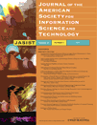
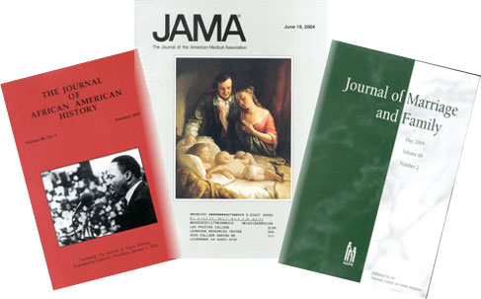
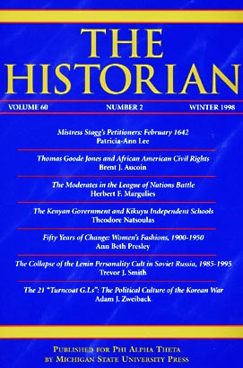
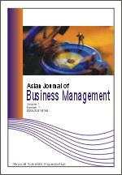

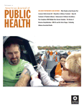

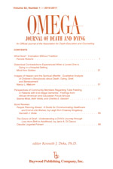
[handout: types of periodicals]
The scholarly journal
vs
The popular publication

Slide 9
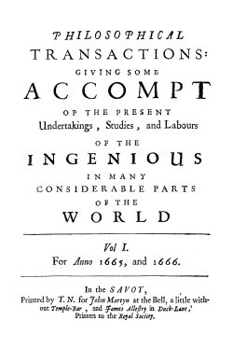
Royal Society of London for Improving Natural Knowledge

Slide 10
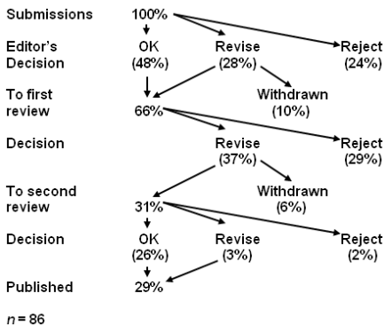

Slide 11
3 types of peer review
BLIND REVIEW | DOUBLE BLIND REVIEW | OPEN REVIEW
The names of the reviewers are hidden from the author | Both the reviewer and the author remain anonymous | Reviewer and author are known to each other

Slide 12
3 types of peer review
BLIND REVIEW | DOUBLE BLIND REVIEW | OPEN REVIEW
Advantages | Advantages | Advantages
Reviewer anonymity allows for impartial decisions free from influence by the author | Author anonymity prevents any reviewer bias based on, for example, an author's country of origin or previous controversial work. Articles written by 'prestigious' or renowned authors are considered on the basis of the content of their papers, rather than on the author's reputation | Some scientists feel this is the best way to prevent malicious comments, stop plagiarism, prevent reviewers from drawing upon their own 'agenda' and encourage open, honest reviewing.

Slide 13
3 types of peer review
BLIND REVIEW | DOUBLE BLIND REVIEW | OPEN REVIEW
Disadvantages | Disadvantages | Disadvantages
Reviewers may use their anonymity as justification for being unnecessarily critical or harsh when commenting on the author's work. | It is uncertain whether a paper can ever truly be 'blind' – especially in specialty 'niche' areas. Reviewers can often identify the author through the paper's style, subject matter or self-citation. | Some see open review as a less honest process in which politeness or fear of retribution may cause a reviewer to withhold or tone down criticism. For example, junior reviewers may hesitate to criticize more esteemed authors for fear of damaging their prospects.

Slide 14
Let’s look at the instructions for authors from three scholarly / peer-reviewed journals…

Slide 15
article submission & review process
Nature publication guidelines:
http://www.nature.com/nature/authors/get_published/
Science publication guidelines:
http://www.sciencemag.org/site/feature/contribinfo/prep/gen_info.xhtml
Health Affairs publication guidelines:
http://www.healthaffairs.org/1410i_for_authors_prep_and_review.php
Type of review
Rigor / acceptance rate
Process & criteria

Slide 16
Submissions judged on criteria such as…
Is the subject appropriate to the editorial aims and scope of the journal?
Originality: does the article say something original, does it add to the body of knowledge, etc.? If a case study, is this its first use?
Research methodology: most journals are concerned about this, as would be expected for an academic publisher. Is the research design, methodology, theoretical approach, critical review, etc. sound? Are the results well presented, do they correlate to the theory, and have they been correctly interpreted? Is the analysis sufficiently rigorous?
Is the paper set in the context of the wider literature, are there sufficient relevant citings, are these well referenced and are other people's views credited?
Is the paper accurate, is any information missing or wrong?
Is the structure logical, is the sequence of the material appropriate, is there a good introduction and are the summary and conclusions adequate?
Does the title of the article accurately reflect its content?
How useful would the article be to a practitioner, is it a useful example of "good practice"?
Could the study be replicated with similar results?
Is the material clearly presented, readable? Are graphs and tables used to good effect? Is the level of detail appropriate? Is the use of terminology appropriate to the readership?
Is the perspective appropriate for an international audience?
Questions of format: are the abstract, keywords etc. appropriate?
Is it an appropriate length (note: many journals will stipulate length requirements in their author guidelines)?
[Handout: analyzing research articles]

Slide 17
Let’s look at a few articles from scholarly (peer-reviewed) publications…and get a jump on an upcoming assignment…

Slide 18
Identify a research study on a topic of interest to you…
http://library.unc.edu/
E-research by discipline
Academic Search Premier
Limit to Scholarly (Peer Reviewed) Journals
Look at the article and work through the evaluation criteria from the handout…

Slide 19
The author mentioned several types of material we could use to finish a literature review. I tend to classify them by the length, so there are articles and books. It is obvious that reading books is time-consuming.
Yet, there also exists a certain type of scholarly journal article---book reviews. So I am wondering is reading book reviews a better way than reading the whole book?
-Yunhan

Slide 20
Journals are being published in an accelerating rate. Some authors of these peer-reviewed journals crave influence in academia, and hence the major goal of doing research becomes getting published in a journal with high impact factor.
What do you think of this tendency? How can we deal with academic fraud involved such as plagiarism and falsification of data?
Add to another class lecture
-Yunhan

Slide 21
Does knuckle cracking lead to arthritis of the fingers?
During the author’s childhood, various renowned authorities (his mother, several aunts, and, later, his mother-in law [personal communication]) informed him that cracking his knuckles would lead to arthritis of the fingers. To test the accuracy of this hypothesis, the following study was undertaken.
For 50 years, the author cracked the knuckles of his left hand at least twice a day, leaving those on the right as a control. Thus, the knuckles on the left were cracked at least 36,500 times, while those on the right cracked rarely and spontaneously. At the end of the 50 years, the hands were compared for the presence of arthritis. There was no arthritis in either hand, and no apparent differences between the two hands.
Knuckle cracking did not lead to arthritis after a 50-year controlled study by the one participant. While a larger group would be necessary to confirm this result, this preliminary investigation suggests a lack of correlation between knuckle cracking and the development of arthritis of the fingers. A search of the literature revealed only one previous paper on this subject, and the authors came to the same conclusion (Swezey RL. Swezey SE. The consequences of habitual knuckle cracking. West J Med 1973;122:377-9.).
This result calls into question whether other parental beliefs, e.g., the importance of eating spinach, are also flawed. Further investigation is likely warranted.
In conclusion, there is no apparent relationship between knuckle cracking and the subsequent development of arthritis of the fingers. This study was done entirely at the author’s expense, with no grants from any governmental or pharmaceutical source.
Donald L. Unger, MD, Thousand Oaks, CA

