Slide 1

What can computer science learn from fine arts approach to teaching?
Lecia Barker and Kathy Garvin-Doxas University of Colorado
Eric Roberts
Stanford University
Bridging knowledge gaps • Advocating for change • Educating everyone
Notes:
Information Technology – all forms of technology used to create, store, exchange, and use information in its various forms, and, the design and use of computers and communications to improve the way we live, learn, work and play.

Slide 2
Overview of talk
Eric Roberts
Why are we here?
The importance of interdisciplinarity
What does CS need to learn about social science?
Kathy Garvin-Doxas
A tale of two cultures
Research methodology
Findings: climate issues, collaboration, pedagogy
What does social science need to learn about CS?

Slide 3
Why are we here?
The persistent challenge of attracting a broad audience to computer science
The influence of “CS culture” on recruitment and retention
A recognition that pedagogy helps to frame cultural perceptions
The importance of finding synergies between domain knowledge and social science knowledge
Notes:
Usual caveats about counting – all statistics depend upon that which you include in the definition of “information technology” degrees, jobs, etc. Distinguish between literacy and fluency – we’re not talking about usage here, we’re talking about innovation.
In 2003, girls represented 15% of AP Computer Science A; 9% of CS AB. Combined, that is only 13%. Perspective: girls represented 49% of all AP calculus test takers in 2003; 59% of statistics; 37% of Physics. It looks like a decrease over time, though I don’t have the figures for the prior years.
Re: % of women CS bachelors: this, in spite of the facts that more women than men earn associates, bachelors, and masters degrees and the number of women receiving all types of degrees is increasing at a faster rate than for men (source: National Center for Ed Statistics, 2004 annual report)
[1] National Science Foundation, 2000, [2] National Center for Education Statistics, 2000, [3] New York Times, “3 women and 3 paths, 10 years later”, 8/21/03, Katie Hafner, [4] White House Council of Economic Advisors, 2000., [5] “Leadership Careers in Hi-tech: Wired for Success,” Catalyst, 2001
[6] J Cohoon data below

Slide 4
Low participation of women in computer science
18% of all CS doctoral degrees
28% of all CS bachelors degrees
13% of CS “Advanced Placement” test takers in 2003
Participation by targeted minorities is even lower.

Slide 5
The importance of interdisciplinarity
In the last ten years, I’ve had the opportunity to teach collaboratively with colleagues from several Stanford departments
In each case, the experience has been enriching, not only for its own sake, but also because of its effect on my CS teaching
Integrating a range of fields makes CS seem accessible to a wider range of students
Notes:
Usual caveats about counting – all statistics depend upon that which you include in the definition of “information technology” degrees, jobs, etc. Distinguish between literacy and fluency – we’re not talking about usage here, we’re talking about innovation.
In 2003, girls represented 15% of AP Computer Science A; 9% of CS AB. Combined, that is only 13%. Perspective: girls represented 49% of all AP calculus test takers in 2003; 59% of statistics; 37% of Physics. It looks like a decrease over time, though I don’t have the figures for the prior years.
Re: % of women CS bachelors: this, in spite of the facts that more women than men earn associates, bachelors, and masters degrees and the number of women receiving all types of degrees is increasing at a faster rate than for men (source: National Center for Ed Statistics, 2004 annual report)
[1] National Science Foundation, 2000, [2] National Center for Education Statistics, 2000, [3] New York Times, “3 women and 3 paths, 10 years later”, 8/21/03, Katie Hafner, [4] White House Council of Economic Advisors, 2000., [5] “Leadership Careers in Hi-tech: Wired for Success,” Catalyst, 2001
[6] J Cohoon data below

Slide 6
What does CS need to learn about social science?
Our community has tried many strategies over the years to increase diversity
While some of those strategies have been successful, others are counterproductive
Most of us have no tools or training to assess the effectiveness of our initiatives
One of the great strengths of the NCWIT is the pairing of a social science network with the industry and academic alliances
Notes:
Usual caveats about counting – all statistics depend upon that which you include in the definition of “information technology” degrees, jobs, etc. Distinguish between literacy and fluency – we’re not talking about usage here, we’re talking about innovation.
In 2003, girls represented 15% of AP Computer Science A; 9% of CS AB. Combined, that is only 13%. Perspective: girls represented 49% of all AP calculus test takers in 2003; 59% of statistics; 37% of Physics. It looks like a decrease over time, though I don’t have the figures for the prior years.
Re: % of women CS bachelors: this, in spite of the facts that more women than men earn associates, bachelors, and masters degrees and the number of women receiving all types of degrees is increasing at a faster rate than for men (source: National Center for Ed Statistics, 2004 annual report)
[1] National Science Foundation, 2000, [2] National Center for Education Statistics, 2000, [3] New York Times, “3 women and 3 paths, 10 years later”, 8/21/03, Katie Hafner, [4] White House Council of Economic Advisors, 2000., [5] “Leadership Careers in Hi-tech: Wired for Success,” Catalyst, 2001
[6] J Cohoon data below

Slide 7
Research Methods

Slide 8
“Triangulated” research method
Document review (e.g., syllabus)
Records review (e.g., grades)
Ethnographic observation
Informal and formal interviews

Slide 9
Ethnographic data collection
Deep understanding of social setting
Observe what people say and do
Interpret what these actions mean
Ask questions to find out if interpretations are accurate
Write “field notes”
Observations and interpretations, hunches
Conduct Interviews with members of the setting

Slide 10
Content analysis of field notes & interviews
Read through, search for patterns
Identify themes recurring across courses, observers
Code data to understand
frequency of occurrence
importance in the social context
Ask insiders if interpretations are accurate

Slide 11
Data collected
>600 hours classroom observation in introductory, mid-level, and project classes
Formal interviews with >170 students
Many informal interviews

Slide 12
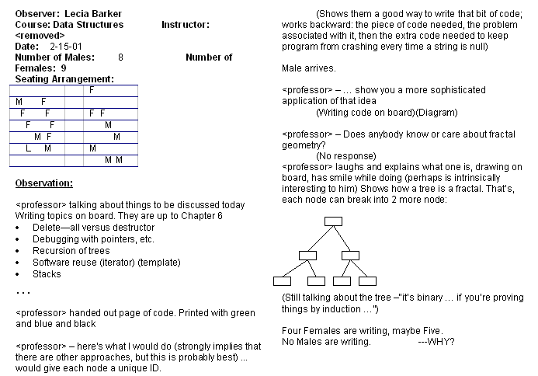

Slide 13
Findings

Slide 14
Key areas of difference
Knowledge sharing
Assessment techniques

Slide 15
Knowledge sharing
Interviewer: Are you more inclined to talk to the other students in recitation?
Student: A little bit.
Another student: Yeah, I've, I've talked to people in recitations. I talk to NO ONE in the class. I only talk to a couple of people in the recitation.
CS professor: I called a student by his name and he asked me, ‘why do you know my name?’.

Slide 16
Interviews: Belief that group work is prohibited
“[We are] strictly forbidden from working with other students on projects. The cheating policy that [the professor] distributed first day of class said that, pretty much, ‘If we catch any duplication of code, anything that even resembles somebody else's code closely, you will both receive an immediate F in the class and be dropped’. So, yeah we're not allowed to work with the other students at all.”

Slide 17
Interviews: Fear of asking questions
“A lot of times the males liked to throw big words around (which intimated me at first), but later I realized it was all just talk to impress other students.”
“I was initially [willing to ask questions], and then, I don’t ask questions anymore. [sigh] I just feel like, I must know so little compared to everyone else there that I’m embarrassed. I don’t want to ask…There’s five people who are already expert programmers and already know everything.”

Slide 18
Assessment
Computer grading
Focus on programming
Does it compile?

Slide 19
Implications for students
Less experienced students (most women) quickly lose confidence
inability to gauge own progress in relation to peers
Students learn little from each other
fear of being seen as stupid or not belonging
Students come to believe that learning in CS should be private, individual
senior projects courses seen as burdensome; students end up “dividing and conquering”

Slide 20
Patterned practices observed in TAM classrooms
Lecture and lab combined: less one-way communication, more interactive environment
students constantly call on each other and the professor for help
Students sometimes taught professors
it is okay to not know something
Learning often by trial and error
Public critique of assignments prior to individualized grading

Slide 21
Interviews: Learning with each other
…I got a chance to get to know more of the people in there because we help each other with technical stuff, and when one person doesn’t know, the next does. So we just help each other out and that’s how we get to know each other.
It’s okay to ask somebody questions. You know that they’re on the same page and ask dumb questions to each other that you wouldn’t normally ask.

Slide 22
Interviews: A mutually supportive environment
Well it’s kind of just a community environment…you learn as a community. It’s where you can count on each other. It’s just very neighborly.
I could see it starting to be a little community because part of it is collaborating and getting ideas. So if you have familiar students, it was very comfortable to see familiar faces.

Slide 23
Interviews: Expectation for collaboration in the classroom
I couldn’t believe these students demanding class time for more time to work together. I told some colleagues and they were shocked. I mean, this is just unheard of in engineering. It’s not the way we teach. – Computer science professor teaching TAM students

Slide 24
Assessment
I think it’s important that the class is coming together and critiquing and reviewing each other’s work. I mean, I was really nervous the first time. There were these incredibly talented people looking at my work. But really it’s good to just have the people there because they provide feedback and can help you with ideas.
Everybody had to be on display, though, so as the semester went on, I got used to it. And it was kind of cool, because even I had ideas to share with other students sometimes.

Slide 25
Implications for students
Learning is a collaborative accomplishment
Sets the expectation that one will work with others
Public assessment permits students to gauge their own skills in comparison to their peers
In such a classroom, students have great access to hearing each other speak, not just hearing their professors’ specialized jargon

Slide 26
What does that have to do with diversity?
Research shows women tend to prefer collaborative learning environments
Women come into CS with less experience
Lose confidence easily because they cannot accurately judge their progress (in addition to the more difficult environment)
Though they perform as well as their male peers
Fail to develop an identity of “computer scientist”
Change of pedagogy/learning environment may both attract and retain women

Slide 27
Collaborative environments are better for both males and females
In educational research, it is well established that all students learn more when
they are engaged in two-way communication with the instructor
collaborate with other students
hear their peers articulate what they are learning

Slide 28
So can CS professors adapt this pedagogy?
Find ways of ensuring that students hear each other articulate what they are learning
E.g., student pairs might work out an algorithm in class
Find a way for students to display solutions to the rest of the class

