Slide 1
Seven Lectures on Statistical Parsing
Christopher Manning
LSA Linguistic Institute 2007
LSA 354
Lecture 1

Slide 2
Course logistics in brief
Instructor: Christopher Manning
manning@cs.stanford.edu
Office hours: Thu 10–12
Course time: Tu/Fr 8:00–9:45 [ugh!]
7 classes
Work required for credit:
Writing a treebank parser
Programming language: Java 1.5
Or other agreed project
See the webpage for other information:
http://nlp.stanford.edu/courses/lsa354/

Slide 3
This class
Assumes you come with some background…
Some probability, and statistics; knowledge of algorithms and their complexity, decent programming skills (if doing the course for credit)
Assumes you’ve seen some (Statistical) NLP before
Teaches key theory and methods for parsing and statistical parsing
The centroid of the course is generative models for treebank parsing
We extend out to related syntactic tasks and parsing methods, including discriminative parsing, nonlocal dependencies, treebank structure.

Slide 4
Course goals
To learn the main theoretical approaches behind modern statistical parsers
To learn techniques and tools which can be used to develop practical, robust parsers
To gain insight into many of the open research problems in natural language processing

Slide 5
Parsing in the early 1990s
The parsers produced detailed, linguistically rich representations
Parsers had uneven and usually rather poor coverage
E.g., 30% of sentences received no analysis
Even quite simple sentences had many possible analyses
Parsers either had no method to choose between them or a very ad hoc treatment of parse preferences
Parsers could not be learned from data
Parser performance usually wasn’t or couldn’t be assessed quantitatively and the performance of different parsers was often incommensurable

Slide 6
Statistical parsing
Over the last 12 years statistical parsing has succeeded wonderfully!
NLP researchers have produced a range of (often free, open source) statistical parsers, which can parse any sentence and often get most of it correct
These parsers are now a commodity component
The parsers are still improving year-on-year.

Slide 7
Statistical parsing applications
High precision question answering systems (Pasca and Harabagiu SIGIR 2001)
Improving biological named entity extraction (Finkel et al. JNLPBA 2004):
Syntactically based sentence compression (Lin and Wilbur Inf. Retr. 2007)
Extracting people’s opinions about products (Bloom et al. NAACL 2007)
Improved interaction in computer games (Gorniak and Roy, AAAI 2005)
Helping linguists find data (Resnik et al. BLS 2005)

Slide 8
Why NLP is difficult: Newspaper headlines
Ban on Nude Dancing on Governor's Desk
Iraqi Head Seeks Arms
Juvenile Court to Try Shooting Defendant
Teacher Strikes Idle Kids
Stolen Painting Found by Tree
Local High School Dropouts Cut in Half
Red Tape Holds Up New Bridges
Clinton Wins on Budget, but More Lies Ahead
Hospitals Are Sued by 7 Foot Doctors
Kids Make Nutritious Snacks

Slide 9

May 2007 example…

Slide 10
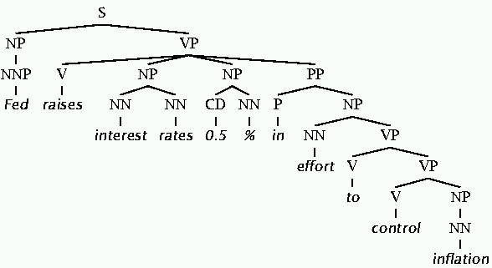
Why is NLU difficult? The hidden structure of language is hugely ambiguous
Tree for: Fed raises interest rates 0.5% in effort to control inflation (NYT headline 5/17/00)

Slide 11
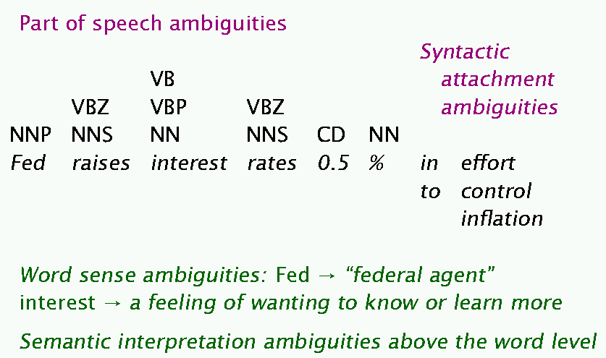
Where are the ambiguities?

Slide 12
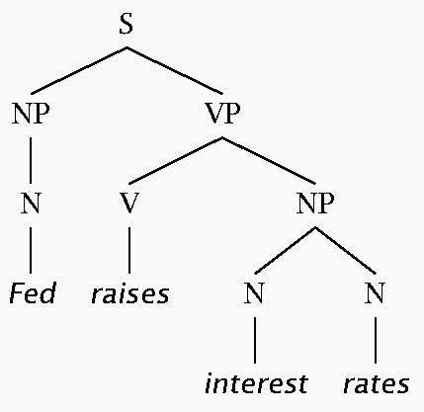
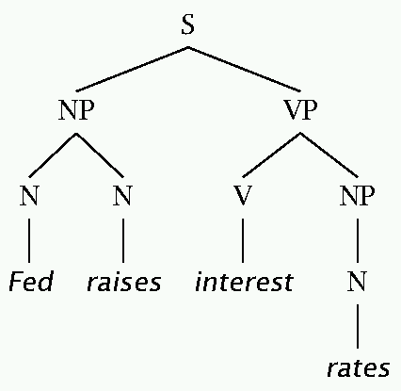
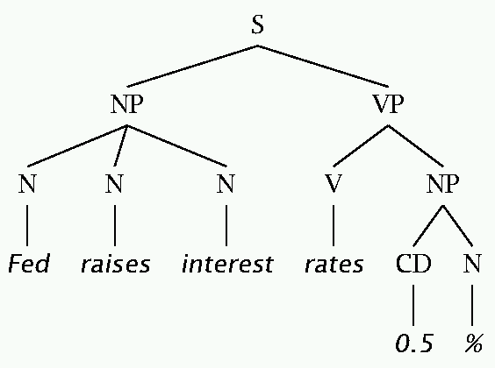
The bad effects of V/N ambiguities

Slide 13
Ambiguity: natural languages vs. programming languages
Programming languages have only local ambiguities, which a parser can resolve with lookahead (and conventions)
Natural languages have global ambiguities
I saw that gasoline can explode
“Construe an else statement with which if makes most sense.”

Slide 14
Classical NLP Parsing
Wrote symbolic grammar and lexicon
S → NP VP NN → interest
NP → (DT) NN NNS → rates
NP → NN NNS NNS → raises
NP → NNP VBP → interest
VP → V NP VBZ → rates
…
Used proof systems to prove parses from words
This scaled very badly and didn’t give coverage
Minimal grammar on “Fed raises” sentence: 36 parses
Simple 10 rule grammar: 592 parses
Real-size broad-coverage grammar: millions of parses

Slide 15
Classical NLP Parsing: The problem and its solution
Very constrained grammars attempt to limit unlikely/weird parses for sentences
But the attempt make the grammars not robust: many sentences have no parse
A less constrained grammar can parse more sentences
But simple sentences end up with ever more parses
Solution: We need mechanisms that allow us to find the most likely parse(s)
Statistical parsing lets us work with very loose grammars that admit millions of parses for sentences but to still quickly find the best parse(s)

Slide 16
The rise of annotated data: The Penn Treebank
( (S
(NP-SBJ (DT The) (NN move))
(VP (VBD followed)
(NP
(NP (DT a) (NN round))
(PP (IN of)
(NP
(NP (JJ similar) (NNS increases))
(PP (IN by)
(NP (JJ other) (NNS lenders)))
(PP (IN against)
(NP (NNP Arizona) (JJ real) (NN estate) (NNS loans))))))
(, ,)
(S-ADV
(NP-SBJ (-NONE- *))
(VP (VBG reflecting)
(NP
(NP (DT a) (VBG continuing) (NN decline))
(PP-LOC (IN in)
(NP (DT that) (NN market)))))))
(. .)))

Slide 17
The rise of annotated data
Going into it, building a treebank seems a lot slower and less useful than building a grammar
But a treebank gives us many things
Reusability of the labor
Broad coverage
Frequencies and distributional information
A way to evaluate systems

Slide 18
Two views of linguistic structure: 1. Constituency (phrase structure)
Phrase structure organizes words into nested constituents.
How do we know what is a constituent? (Not that linguists don't argue about some cases.)
Distribution: a constituent behaves as a unit that can appear in different places:
John talked [to the children] [about drugs].
John talked [about drugs] [to the children].
*John talked drugs to the children about
Substitution/expansion/pro-forms:
I sat [on the box/right on top of the box/there].
Coordination, regular internal structure, no intrusion, fragments, semantics, …

Slide 19
Two views of linguistic structure: 2. Dependency structure
Dependency structure shows which words depend on (modify or are arguments of) which other words.
put
boy
tortoise
on
The
the
rug
The
boy
put
the
tortoise
on
the
rug
the

Slide 20
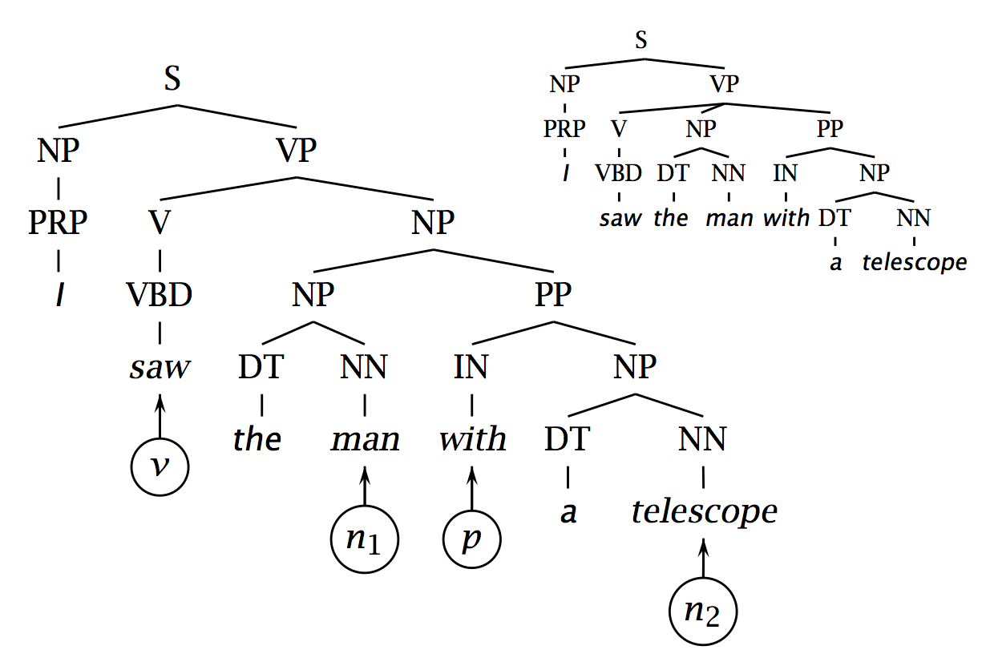
Attachment ambiguities: Two possible PP attachments

Slide 21
Attachment ambiguities
The key parsing decision: How do we ‘attach’ various kinds of constituents – PPs, adverbial or participial phrases, coordinations, etc.
Prepositional phrase attachment:
I saw the man with a telescope
What does with a telescope modify?
The verb saw?
The noun man?
Is the problem ‘AI complete’? Yes, but …

Slide 22
Attachment ambiguities
Proposed simple structural factors
Right association (Kimball 1973) = ‘low’ or ‘near’ attachment = ‘early closure’ (of NP)
Minimal attachment (Frazier 1978). Effects depend on grammar, but gave ‘high’ or ‘distant’ attachment = ‘late closure’ (of NP) under the assumed model
Which is right?
Such simple structural factors dominated in early psycholinguistics (and are still widely invoked).
In the V NP PP context, right attachment usually gets right 55–67% of cases.
But that means it gets wrong 33–45% of cases.

Slide 23
Attachment ambiguities
Words are good predictors of attachment (even absent understanding)
The children ate the cake with a spoon
The children ate the cake with frosting
Moscow sent more than 100,000 soldiers into Afghanistan …
Sydney Water breached an agreement with NSW Health …

Slide 24
The importance of lexical factors
Ford, Bresnan, and Kaplan (1982) [promoting ‘lexicalist’ linguistic theories] argued:
Order of grammatical rule processing [by a person] determines closure effects
Ordering is jointly determined by strengths of alternative lexical forms, strengths of alternative syntactic rewrite rules, and the sequences of hypotheses in the parsing process.
“It is quite evident, then, that the closure effects in these sentences are induced in some way by the choice of the lexical items.” (Psycholinguistic studies show that this is true independent of discourse context.)

Slide 25
A simple prediction
Use a likelihood ratio:
E.g.,
P(with|agreement) = 0.15
P(with|breach) = 0.02
LR(breach, agreement, with) = 0.13
→ Choose noun attachment

Slide 26
A problematic example
Chrysler confirmed that it would end its troubled venture with Maserati.
Should be a noun attachment but get wrong answer:
w C(w) C(w, with)
end 5156 607
venture 1442 155

Slide 27
A problematic example
What might be wrong here?
If you see a V NP PP sequence, then for the PP to attach to the V, then it must also be the case that the NP doesn’t have a PP (or other postmodifier)
Since, except in extraposition cases, such dependencies can’t cross
Parsing allows us to factor in and integrate such constraints.

Slide 28
A better predictor would use n₂ as well as v, n₁, p

Slide 29
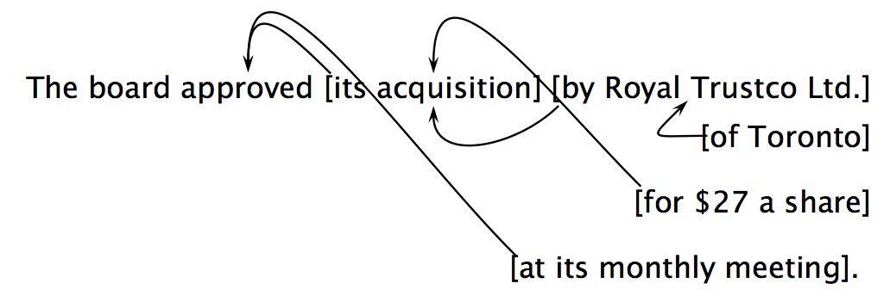
Attachment ambiguities in a real sentence
Catalan numbers
C_{n} = (2n)!/[(n+1)!n!]
An exponentially growing series, which arises in many tree-like contexts:
E.g., the number of possible triangulations of a polygon with n+2 sides
Notes:
1, 2, 5, 14, 42, 132, 429, 1430

Slide 30
What is parsing?
We want to run a grammar backwards to find possible structures for a sentence
Parsing can be viewed as a search problem
Parsing is a hidden data problem
For the moment, we want to examine all structures for a string of words
We can do this bottom-up or top-down
This distinction is independent of depth-first or breadth-first search – we can do either both ways
We search by building a search tree which his distinct from the parse tree

Slide 31
Human parsing
Humans often do ambiguity maintenance
Have the police … eaten their supper?
come in and look around.
taken out and shot.
But humans also commit early and are “garden pathed”:
The man who hunts ducks out on weekends.
The cotton shirts are made from grows in Mississippi.
The horse raced past the barn fell.

Slide 32
A phrase structure grammar
S → NP VP N → cats
VP → V NP N → claws
VP → V NP PP N → people
NP → NP PP N → scratch
NP → N V → scratch
NP → e P → with
NP → N N
PP → P NP
By convention, S is the start symbol, but in the PTB, we have an extra node at the top (ROOT, TOP)
Notes:
Cats scratch people with people with cats with claws.

Slide 33
Phrase structure grammars = context-free grammars
G = (T, N, S, R)
T is set of terminals
N is set of nonterminals
For NLP, we usually distinguish out a set P ⊂ N of preterminals, which always rewrite as terminals
S is the start symbol (one of the nonterminals)
R is rules/productions of the form X → γ, where X is a nonterminal and γ is a sequence of terminals and nonterminals (possibly an empty sequence)
A grammar G generates a language L.

Slide 34
Probabilistic or stochastic context-free grammars (PCFGs)
G = (T, N, S, R, P)
T is set of terminals
N is set of nonterminals
For NLP, we usually distinguish out a set P ⊂ N of preterminals, which always rewrite as terminals
S is the start symbol (one of the nonterminals)
R is rules/productions of the form X → γ, where X is a nonterminal and γ is a sequence of terminals and nonterminals (possibly an empty sequence)
P(R) gives the probability of each rule.
A grammar G generates a language model L.

Slide 35
Soundness and completeness
A parser is sound if every parse it returns is valid/correct
A parser terminates if it is guaranteed to not go off into an infinite loop
A parser is complete if for any given grammar and sentence, it is sound, produces every valid parse for that sentence, and terminates
(For many purposes, we settle for sound but incomplete parsers: e.g., probabilistic parsers that return a k-best list.)

Slide 36
Top-down parsing
Top-down parsing is goal directed
A top-down parser starts with a list of constituents to be built. The top-down parser rewrites the goals in the goal list by matching one against the LHS of the grammar rules, and expanding it with the RHS, attempting to match the sentence to be derived.
If a goal can be rewritten in several ways, then there is a choice of which rule to apply (search problem)
Can use depth-first or breadth-first search, and goal ordering.

Slide 37
Bottom-up parsing
Bottom-up parsing is data directed
The initial goal list of a bottom-up parser is the string to be parsed. If a sequence in the goal list matches the RHS of a rule, then this sequence may be replaced by the LHS of the rule.
Parsing is finished when the goal list contains just the start category.
If the RHS of several rules match the goal list, then there is a choice of which rule to apply (search problem)
Can use depth-first or breadth-first search, and goal ordering.
The standard presentation is as shift-reduce parsing.

Slide 38
Problems with top-down parsing
Left recursive rules
A top-down parser will do badly if there are many different rules for the same LHS. Consider if there are 600 rules for S, 599 of which start with NP, but one of which starts with V, and the sentence starts with V.
Useless work: expands things that are possible top-down but not there
Top-down parsers do well if there is useful grammar-driven control: search is directed by the grammar
Top-down is hopeless for rewriting parts of speech (preterminals) with words (terminals). In practice that is always done bottom-up as lexical lookup.
Repeated work: anywhere there is common substructure

Slide 39
Problems with bottom-up parsing
Unable to deal with empty categories: termination problem, unless rewriting empties as constituents is somehow restricted (but then it's generally incomplete)
Useless work: locally possible, but globally impossible.
Inefficient when there is great lexical ambiguity (grammar-driven control might help here)
Conversely, it is data-directed: it attempts to parse the words that are there.
Repeated work: anywhere there is common substructure

Slide 40
Principles for success: take 1
If you are going to do parsing-as-search with a grammar as is:
Left recursive structures must be found, not predicted
Empty categories must be predicted, not found
Doing these things doesn't fix the repeated work problem:
Both TD (LL) and BU (LR) parsers can (and frequently do) do work exponential in the sentence length on NLP problems.

Slide 41
Principles for success: take 2
Grammar transformations can fix both left-recursion and epsilon productions
Then you parse the same language but with different trees
Linguists tend to hate you
But this is a misconception: they shouldn't
You can fix the trees post hoc:
The transform-parse-detransform paradigm

Slide 42
Principles for success: take 3
Rather than doing parsing-as-search, we do parsing as dynamic programming
This is the most standard way to do things
Q.v. CKY parsing, next time
It solves the problem of doing repeated work
But there are also other ways of solving the problem of doing repeated work
Memoization (remembering solved subproblems)
Also, next time
Doing graph-search rather than tree-search.

