Slide 1
CIS 5371 Cryptography
Introduction
Based on: Jonathan Katz & Yehuda Lindel Introduction to Modern Cryptography

Slide 2
Prerequisites for this course
Basic Mathematics, in particular Number Theory
Basic Probability Theory
Problem solving skills
Programming skills (for projects)

Slide 3
Goals for the Introduction
Discuss the challenges of teaching a course in cryptography.
Discuss the effectiveness & practicality of cryptography.
Discuss Shannon’s encryption model.
Discuss classical ciphers
Discuss the foundations of cryptography.
Establish a mindset for developing crypto- graphy systems for Information Assurance.

Slide 4
Challenges for teaching a cryptography course
Education problem: the gap between state-of the-art research in cryptography and standard applications.
Two aspects of cryptanalysis: breaking systems vs proving robustness.
The evolutionary aspect of cryptography.

Slide 5
Classical vs Modern Cryptography
Pre 1940: The art of writing
the code (e.g., hieroglyph) was the secret of the scribes
secret codes we required for diplomacy, for individual privacy or during wars
Post 1940: The science/technology of developing techniques for securing
digital information
digital transactions and
distributed computations
Usage:
Pre 1970: mainly intelligence (military, diplomatic)
Post 1970: everybody

Slide 6
Modern Cryptography
Message Encryption
Message authentication, digital signatures
Secret key exchange/distribution
Secure access (access control)
e-commerce, e-government, e-auctions, e-voting and other e-applications.
Digital cash (Bitcoin)
Blockchain (chain-of-custody)
Support system security
. . . and more

Slide 7
Some key words
Cipher: enables the expression of a public code by a secret code by making the relevant information confidential.
Cryptographic system: cryptographic algorithms (e.g. a cipher).
Plaintext: information encoded by using a public code.
Ciphertext: information encoded by using a cipher.
Encryption, decryption: actions that transform a plaintext to a ciphertext, and a ciphertext to a plaintext.

Slide 8
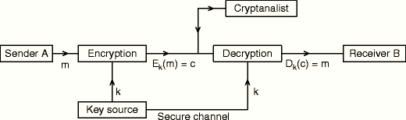
The setting for private key encryption Shannon encryption model

Slide 9
The syntax of a cipher
A cipher (Gen,Enc,Dec) is defined by: a plaintext source (with a distribution), a secret key distribution, a ciphertext space, with
Gen: a key generation algorithm
that is probabilistic an outputs a key k according to some distribution.
Enc: an encryption algorithm
That takes as input key k and a plaintext m and outputs a ciphertext c: c = Enc_{k}(m).
Dec: a decryption algorithm
That takes as input a key k and a ciphertext c and outputs a plaintext m’: m’ = Dec_{k}(c).
Must have m’ = m.

Slide 10
Kerckhoffs’ principle
“The cipher method must not be required to be secret, and it must be able to fall into the hands of the enemy without inconvenience.’’
[In French: Il faut qu’il n’exige pas le secret, et qu’il puisse sans inconvénient tomber entre les mains de l’ennemi.]
Todays understanding
Security should not rely on the secrecy of the algorithms being used---indeed these algorithms should be public.
Open crypto design vs “security by obscurity”.

Slide 11
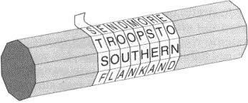
Classical ciphers transpositions & substitutions
Scytale cipher: Spartan warriors used it to encrypt messages. A leather belt was wrapped around a baton (cylinder): = σκυτάλη in greek. Encryption was performed by writing the message along the axis, and then unwrapping the belt.
Decryption involved wrapping the belt around a scytale of the same diameter and reading along the axis.
This encryption consists of a secret permutation of the characters of the message, called a transposition.

Slide 12
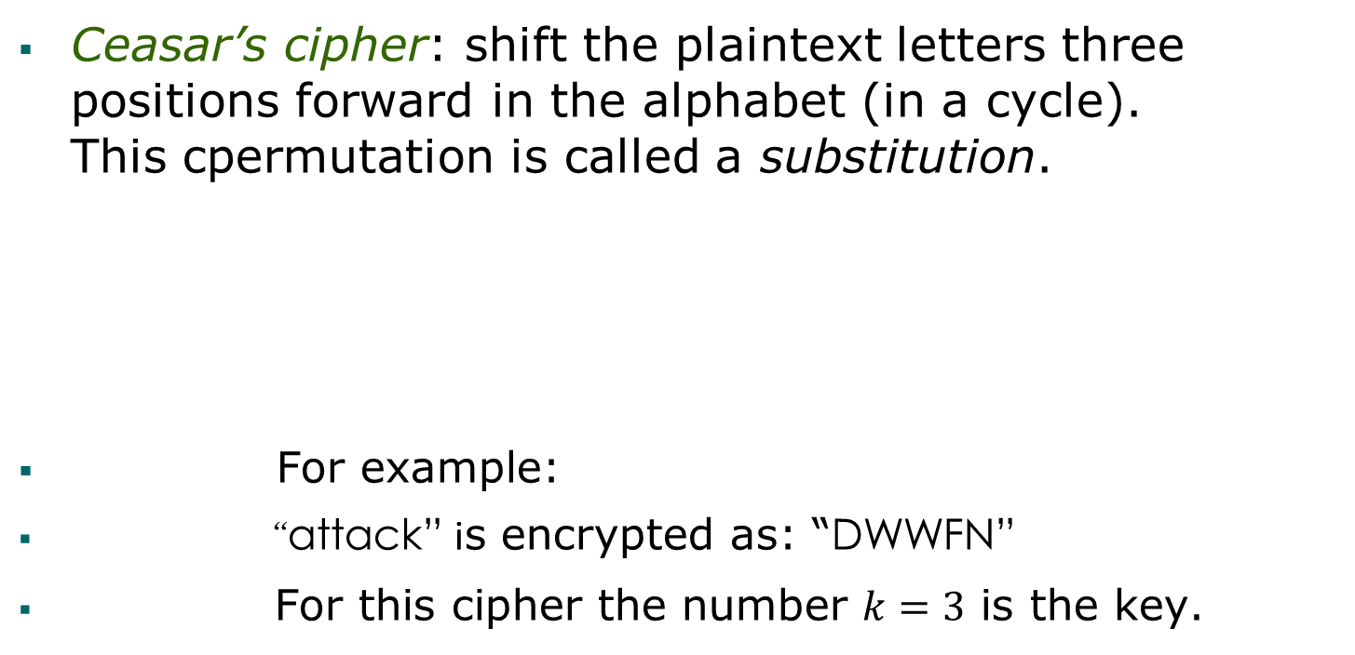
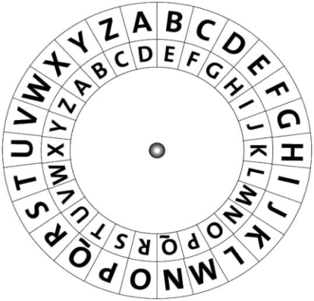
Classical ciphers transpositions and substitutions
a | b | c | d | e | f | g | h | i | j | k | l | m | n | o | p | q | r | s | t | u | v | w | x | y | z
D | E | F | G | H | I | J | K | L | M | N | O | P | Q | R | S | T | U | V | W | X | Y | Z | A | B | C
Ceasar wheel

Slide 13
Classical ciphers transpositions and substitutions
Ceasar’s cipher is a mono-alphabetic substitution: it uses the permutation of one alphabet.
Vigenere’s poly-alphabetic cipher
Multiple alphabetic substitutions are used
Example: Keyword RELATIONS
[R=17, t=19, K=10; E=4, o=14 , S=18, …]
Keyword | R | E | L | A | T | I | O | N | S | R | E | L | A
Plaintext | t | o | b | e | o | r | n | o | t | t | O | b | e
Cipertext | K | S | M | E | H | Z | B | B | L | K | S | M | E

Slide 14
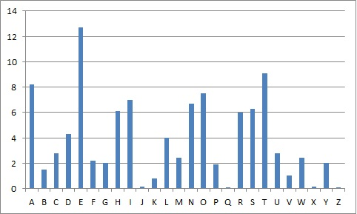
Classical Ciphers cryptanalysis
Cryptanalysis based on
statistical pattern of the English language: the frequency of letters, digrams etc.
Relative letter frequency

Slide 15
Classical Ciphers, Cryptanalysis
Cryptanalysis based on Statistical pattern of the English language: the frequency of digrams, trigrams etc.
10 most popular digrams:
TH, HE, IN, ER, AN, RE, ED, ON, ES, ST
10 most popular trigrams:
THE, ING, AND, HER, ERE, ENT, THA, NTH, WAS, ETH

Slide 16
Basic principles of modern cryptography
Principle 1 – Formal definitions
Importance of design
Importance of usage
Importance of study

Slide 17
Basic Principles of Modern Cryptography
Examples for Principal 1: Formal Definitions
An encryption scheme is secure if no adversary can find the secret key when given a ciphertext.
An encryption scheme is secure if no adversary can find the plaintext that corresponds to a given ciphertext.
An encryption scheme is secure if no adversary can determine any character of the plaintext that corresponds to a given ciphertext.
Although these capture many important aspects of privacy, they do not capture general information that the ciphertext may leak, which is not part of the plaintext itself, taking into account any information the attacker already has.

Slide 18
Basic Principles of Modern Cryptography
Final answer
An encryption scheme is secure if no adversary can determine any meaningful information about the plaintext from the ciphertext.
What is considered to be a break?
What is assumed to be the power of the adversary?
A first definition of security:
A cryptographic scheme for a given task is secure if no adversary of a specified power (e.g., an “efficient adversary”) can achieve a specific break.

Slide 19
Attack Scenarios Specific Breaks
Ciphertext-only attack (passive): the adversary observes one or more ciphertext(s) and attempts to deduce information about the corresponding plaintext(s).
Known-plaintext attacks (passive): the adversary is additionally able to learn one or more ciphertext/plaintext pairs using some key, and must deduce information about the plaintext of some other ciphertext produced using the same key
Chosen-plaintext attack (active-adaptive): the adversary is additionally able to obtain plaintext/ ciphertexts pairs of its choice.

Slide 20
Attack Scenarios Specific Breaks
Chosen-ciphertext attack (active-adaptive): the adversary is additionally able to obtain some information about the decryption of ciphertexts of its choice, other than the one it must decrypt (or obtain information about its plaintext).
Different applications of encryption may require the encryption scheme to be resilient to different types of attack.

Slide 21
Basic principles of Modern Cryptography
Principal 2 – Precise Assumptions
Validation of the assumption
By there very nature assumptions/statements are not proven but conjectured . . .
Comparison of schemes
If one scheme makes a weaker assumption than another then the first is to be preferred . . .
Facilitation of proofs of security
If the security of a scheme cannot be proven unconditionally and must rely on an assumption then a mathematical proof that the construction is secure requires a precise definition of the statement.

Slide 22
Basic principles of Modern Cryptography
Principal 3 – Proofs of Security
Rigorous vs Ad Hoc Approaches to Security (take-away: solutions that rely on definitions, assumptions and proofs are better than off-the-cuff solutions).
Provable Security and Real-World Security (take-away: provable security does not imply security in the real-world: it is only as good as the assumptions made)

Slide 23
Basic principles of Modern Cryptography
Mathematics and the real world --- models
If a definition does not model appropriately the real world problem then the definition may be useless, e.g.
the adversarial power may be to week, or
the break may not be foreseen.
Our arguments
Appeal to intuition
Proof of equivalence
Examples

Slide 24
Basic principles of Modern Cryptography
Rigorous Proofs of security
Reductionist approach:
“Given assumption X is true, construction Y is secure according to the given definitions.”

