Slide 1
EE 2204 - Data Structures and Algorithms
N Radhakrishnan
Assistant Professor
Anna University, Chennai

Slide 2
Topics
Introduction
Definitions
Classification of Data Structures
Arrays and Linked Lists
Abstract Data Types [ADT]
The List ADT
Array-based Implementation
Linked List Implementation
Cursor-based Implementation
Doubly Linked Lists

Slide 3
Data Structure [Wikipedia]
Data Structure is a particular way of storing and organizing data in a computer so that it can be used efficiently.
Different kinds of data structures are suited to different kinds of applications.
Storing and retrieving can be carried out on data stored in both main memory and in secondary memory.

Slide 4
Merriam-Webster's Definition
Way in which data are stored for efficient search and retrieval.
The simplest data structure is the one-dimensional (linear) array.
Data items stored non-consecutively in memory may be linked by pointers.
Many algorithms have been developed for storing data efficiently

Slide 5
Algorithms [Wikipedia]
An algorithm is a step-by-step procedure for calculations.
An algorithm is an effective method expressed as a finite list of well-defined instructions for calculating a function.
The transition from one state to the next is not necessarily deterministic; some algorithms incorporate random input.

Slide 6
Merriam-Webster's Definition
Procedure that produces the answer to a question or the solution to a problem in a finite number of steps.
An algorithm that produces a yes or no answer is called a decision procedure; one that leads to a solution is a computation procedure.
Example: A mathematical formula and the instructions in a computer program

Slide 7
Data Structure Classification
Primitive / Non-primitive
Basic Data Structures available / Derived from Primitive Data Structures
Homogeneous / Heterogeneous
Elements are of the same type / Different types
Static / Dynamic
memory is allocated at the time of compilation / run-time
Linear / Non-linear
Maintain a Linear relationship between element

Slide 8
ADT - General Concept
Problem solving with a computer means processing data
To process data, we need to define the data type and the operation to be performed on the data
The definition of the data type and the definition of the operation to be applied to the data is part of the idea behind an Abstract Data Type (ADT)

Slide 9
ADT - General Concept
The user of an ADT needs only to know that a set of operations are available for the data type, but does not need to know how they are applied
Several simple ADTs, such as integer, real, character, pointer and so on, have been implemented and are available for use in most languages

Slide 10
Data Types
A data type is characterized by:
A set of values
A data representation, which is common to all these values, and
A set of operations, which can be applied uniformly to all these values

Slide 11
Primitive Data Types
Languages like ‘C’ provides the following primitive data types:
boolean
char, byte, int
float, double
Each primitive type has:
A set of values
A data representation
A set of operations
These are “set in stone”.

Slide 12
ADT Definition [Wikipedia]
In computer science, an abstract data type (ADT) is a mathematical model for a certain class of data structures that have similar behavior.
An abstract data type is defined indirectly, only by the operations that may be performed on it and by mathematical constraints on the effects (and possibly cost) of those operations.

Slide 13
ADT Definition [Wikipedia]
An ADT may be implemented by specific data types or data structures, in many ways and in many programming languages; or described in a formal specification language.
example, an abstract stack could be defined by three operations:
push, that inserts some data item onto the structure,
pop, that extracts an item from it, and
peek, that allows data on top of the structure to be examined without removal.

Slide 14
Definition from techforum4you
Abstract data types or ADTs are a mathematical specification of a set of data and the set of operations that can be performed on the data.
They are abstract in the sense that the focus is on the definitions and the various operations with their arguments.
The actual implementation is not defined, and does not affect the use of the ADT.

Slide 15
ADT in Simple Words
Definition:
Is a set of operation
Mathematical abstraction
No implementation detail
Example:
Lists, sets, graphs, stacks are examples of ADT along with their operations

Slide 16
Why ADT?
Modularity
divide program into small functions
easy to debug and maintain
easy to modify
group work
Reuse
do some operations only once
Easy to change the implementation
transparent to the program

Slide 17
Implementing an ADT
To implement an ADT, you need to choose:
A data representation
must be able to represent all necessary values of the ADT
should be private
An algorithm for each of the necessary operation:
must be consistent with the chosen representation
all auxiliary (helper) operations that are not in the contract should be private
Remember: Once other people are using it
It’s easy to add functionality

Slide 18
The List ADT
The List is an
Ordered sequence of data items called elements
A₁, A₂, A₃, …,A_{N} is a list of size N
size of an empty list is 0
A_{i+1} succeeds A_{i}
A_{i-1} preceeds A_{i}
Position of A_{i} is i
First element is A₁ called “head”
Last element is A_{N} called “tail”

Slide 19
Operations on Lists
MakeEmpty
PrintList
Find
FindKth
Insert
Delete
Next
Previous

Slide 20
List – An Example
The elements of a list are 34, 12, 52, 16, 12
Find (52) -> 3
Insert (20, 4) -> 34, 12, 52, 20, 16, 12
Delete (52) -> 34, 12, 20, 16, 12
FindKth (3) -> 20

Slide 21
List - Implementation
Lists can be implemented using:
Arrays
Linked List
Cursor [Linked List using Arrays]

Slide 22
Arrays
Array is a static data structure that represents a collection of fixed number of homogeneous data items or
A fixed-size indexed sequence of elements, all of the same type.
The individual elements are typically stored in consecutive memory locations.
The length of the array is determined when the array is created, and cannot be changed.

Slide 23
Arrays
Any component of the array can be inspected or updated by using its index.
This is an efficient operation
O(1) = constant time
The array indices may be integers (C, Java) or other discrete data types (Pascal, Ada).
The lower bound may be zero (C, Java), one (Fortran), or chosen by the programmer (Pascal, Ada)

Slide 24
Different Types of Arrays
One-dimensional array: only one index is used
Multi-dimensional array: array involving more than one index
Static array: the compiler determines how memory will be allocated for the array
Dynamic array: memory allocation takes place during execution

Slide 25
One Dimensional Static Array
Syntax:
ElementType arrayName [CAPACITY];
ElementType arrayName [CAPACITY] = { initializer_list };
Example in C++:
int b [5];
int b [5] = {19, 68, 12, 45, 72};

Slide 26
Array Output Function
void display(int array[],int num_values)
{
for (int I = 0; i<num_values; i++)
cout<< array[i] << “ ”;
}

Slide 27
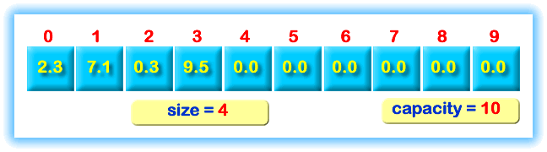
List Implemented Using Array

Slide 28
Operations On Lists
We’ll consider only few operations and not all operations on Lists
Let us consider Insert
There are two possibilities:
Ordered List
Unordered List

Slide 29
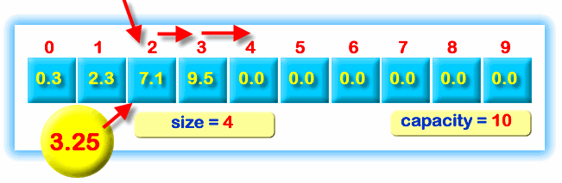
Insertion into an Ordered List

Slide 30
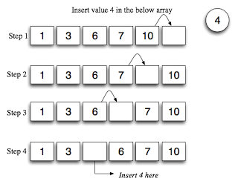
Insertion in Detail

Slide 31
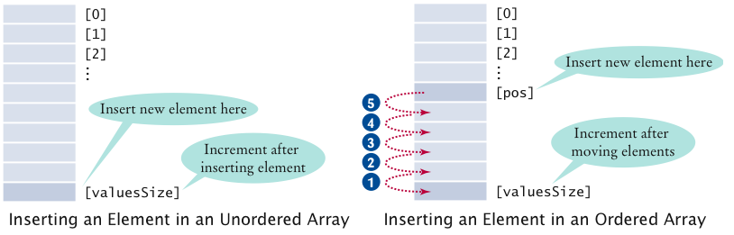
Insertion

Slide 32
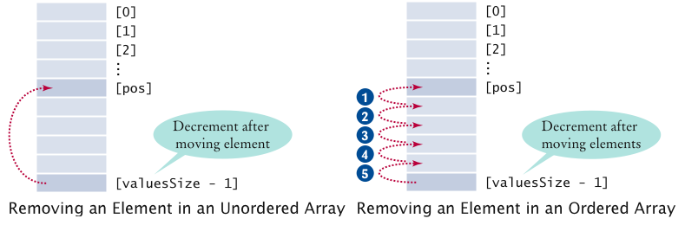
Deletion

Slide 33
Find / Search
Searching is the process of looking for a specific element in an array
For example, discovering whether a certain score is included in a list of scores.
Searching, like sorting, is a common task in computer programming.
There are many algorithms and data structures devoted to searching.
The most common one is the linear search.

Slide 34
Linear Search
The linear search approach compares the given value with each element in the array.
The method continues to do so until the given value matches an element in the list or the list is exhausted without a match being found.
If a match is made, the linear search returns the index of the element in the array that matches the key.
If no match is found, the search returns -1.

Slide 35
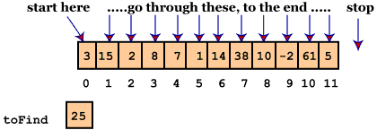
Linear Search

Slide 36
Linear Search Function
int LinearSearch (int a[], int n, int key)
{
int i;
for(i=0; i<n; i++)
{
if (a[i] == key)
return i;
}
return -1;
}

Slide 37
Using the Function
LinearSearch (a,n,item,loc)
Here "a" is an array of the size n.
This algorithm finds the location of the element "item" in the array "a".
If search item is found, it sets loc to the index of the element; otherwise, it sets loc to -1
index=linearsearch(array, num, key)

Slide 38
PrintList Operation
int myArray [5] = {19,68,12,45,72};
/* To print all the elements of the array
for (int i=0;i<5;i++)
{
printf("%d", myArray[i]);
}

Slide 39
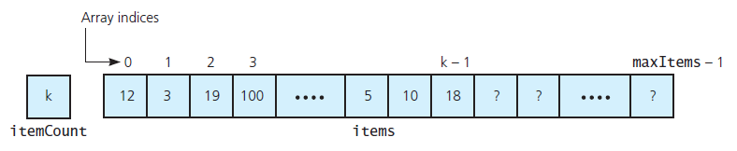
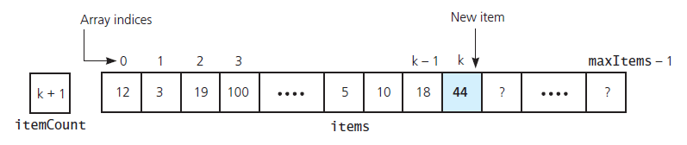

Slide 40
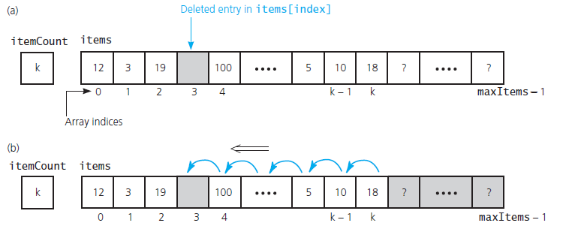
Implementing Deletion

Slide 41
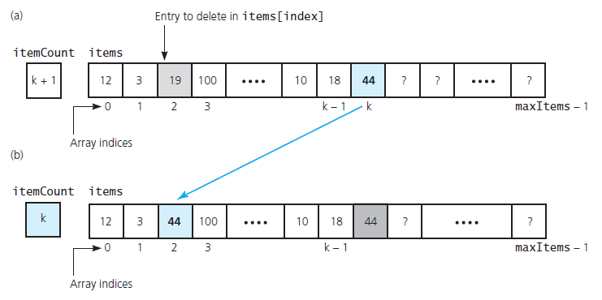
Deletion - Another Method

Slide 42
Operations Running Times
PrintList O(N)
Find
Insert O(N) (on avarage half
Delete needs to be moved)
FindKth
Next O(1)
Previous

Slide 43
Disadvantages of Using Arrays
Need to define a size for array
High overestimate (waste of space)
insertion and deletion is very slow
need to move elements of the list
redundant memory space
it is difficult to estimate the size of array

Slide 44
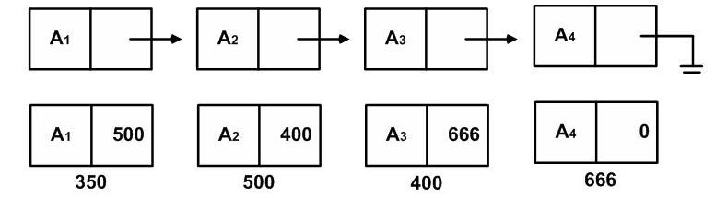
Linked List
Series of nodes
not adjacent in memory
contain the element and a pointer to a node containing its succesor
Avoids the linear cost of insertion and deletion!

Slide 45
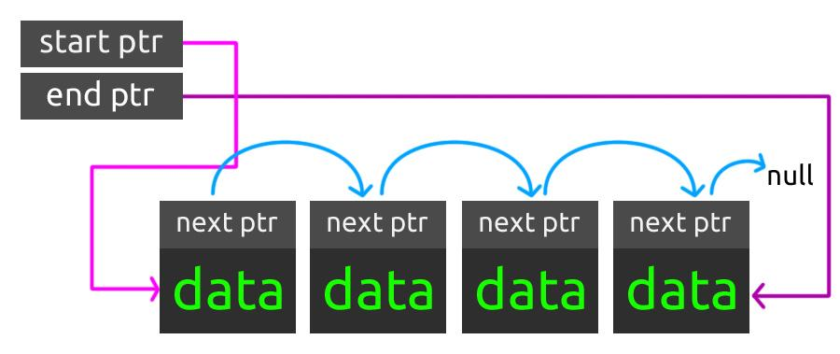
Singly Linked List

Slide 46
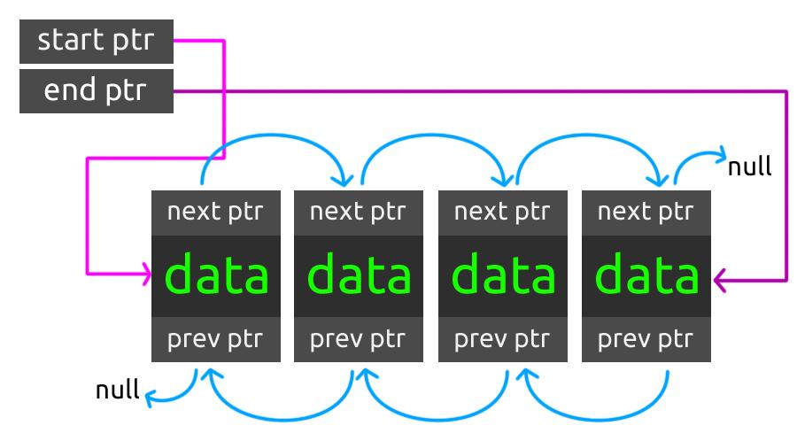
Doubly Linked List

Slide 47
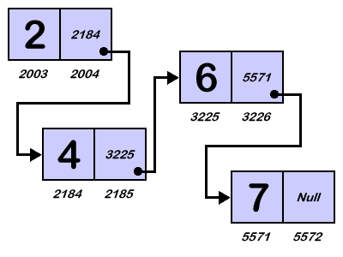
Singly Linked List

Slide 48
Singly-linked List - Addition
Insertion into a singly-linked list has two special cases.
It's insertion a new node before the head (to the very beginning of the list) and after the tail (to the very end of the list).
In any other case, new node is inserted in the middle of the list and so, has a predecessor and successor in the list.

Slide 49
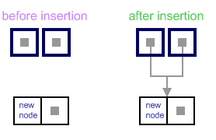
Empty list case
When list is empty, which is indicated by (head == NULL) condition, the insertion is quite simple.
Algorithm sets both head and tail to point to the new node.

Slide 50
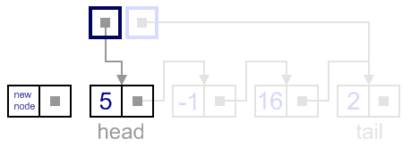
Add first
In this case, new node is inserted right before the current head node.

Slide 51
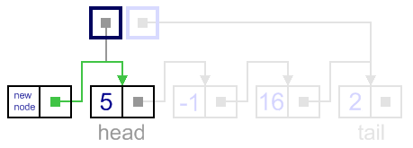
Add First - Step 1
It can be done in two steps:
Update the next link of the new node, to point to the current head node.

Slide 52
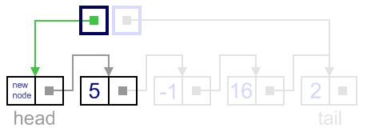
Add First - Step 2
Update head link to point to the new node.

Slide 54
Add last
In this case, new node is inserted right after the current tail node.
It can be done in two steps:
Update the next link of the current tail node, to point to the new node.
Update tail link to point to the new node.

Slide 55
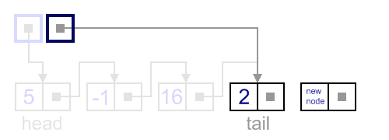
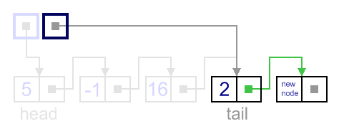

Slide 56
Insert - General Case
In general case, new node is always inserted between two nodes, which are already in the list. Head and tail links are not updated in this case.
We need to know two nodes "Previous" and "Next", between which we want to insert the new node.
This also can be done in two steps:
Update link of the "previous" node, to point to the new node.
Update link of the new node, to point to the "next" node.

Slide 57
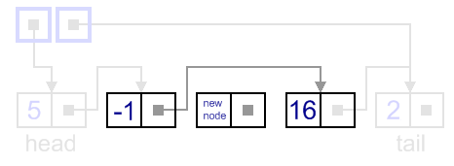
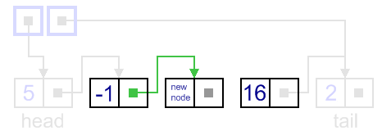
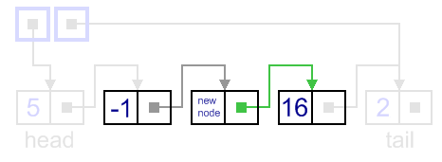

Slide 58
Singly-linked List - Deletion
There are four cases, which can occur while removing the node.
We have the same four situations, but the order of algorithm actions is opposite.
Notice, that removal algorithm includes the disposal of the deleted node - unnecessary in languages with automatic garbage collection (Java).

Slide 59
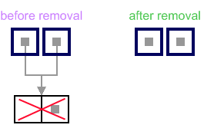
List has only one node
When list has only one node, that the head points to the same node as the tail, the removal is quite simple.
Algorithm disposes the node, pointed by head (or tail) and sets both head and tail to NULL.

Slide 60
Remove First
In this case, first node (current head node) is removed from the list.
It can be done in two steps:
Update head link to point to the node, next to the head.
Dispose removed node.

Slide 61
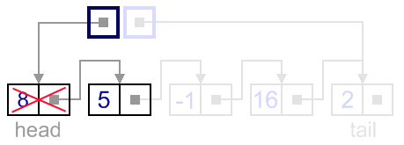
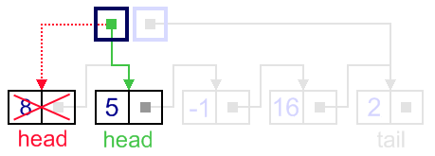
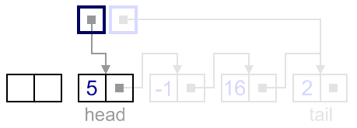

Slide 62
Remove Last
In this case, last node (current tail node) is removed from the list. This operation is a bit more tricky, than removing the first node, because algorithm should find a node, which is previous to the tail first.
It can be done in three steps:
Update tail link to point to the node, before the tail. In order to find it, list should be traversed first, beginning from the head.
Set next link of the new tail to NULL.
Dispose removed node.

Slide 63
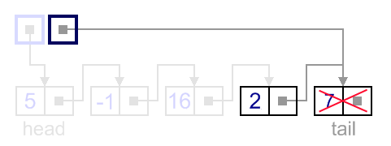
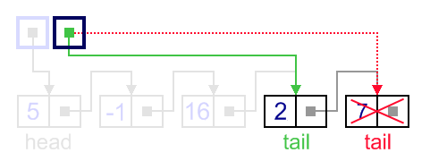
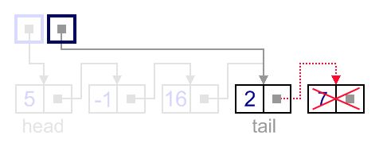
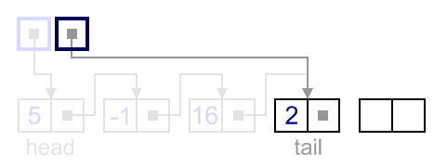

Slide 64
Remove - General Case
In general case, node to be removed is always located between two list nodes. Head and tail links are not updated in this case.
We need to know two nodes "Previous" and "Next", of the node which we want to delete.
Such a removal can be done in two steps:
Update next link of the previous node, to point to the next node, relative to the removed node.
Dispose removed node.

Slide 65
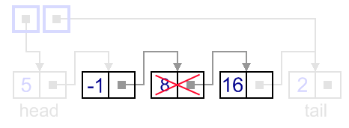
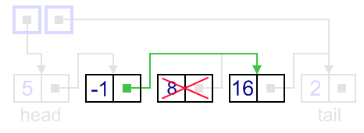
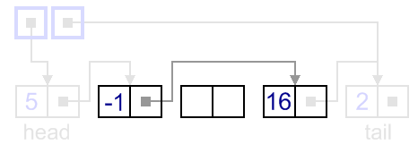

Slide 66
Advantages of Using Linked Lists
Need to know where the first node is
the rest of the nodes can be accessed
No need to move the elements in the list for insertion and deletion operations
No memory waste

Slide 67
Cursor Implementation
Problems with linked list implementation:
Same language do not support pointers!
Then how can you use linked lists ?
new and free operations are slow
Actually not constant time
SOLUTION: Implement linked list on an array - called CURSOR

Slide 68
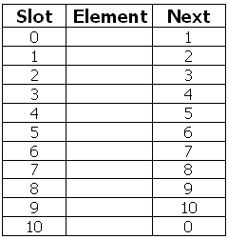
Cursor Implementation - Diagram

Slide 69
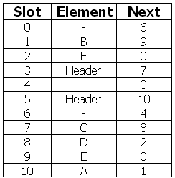
Cursor Implementation
If L = 5, then L represents list (A, B, E)
If M = 3, then M represents list (C, D, F)

Slide 70
Arrays - Pros and Cons
Pros
Directly supported by C
Provides random access
Cons
Size determined at compile time
Inserting and deleting elements is time consuming

Slide 71
Linked Lists - Pros and Cons
Pros
Size determined during runtime
Inserting and deleting elements is quick
Cons
No random access
User must provide programming support

Slide 72
Application of Lists
Lists can be used
To store the records sequentially
For creation of stacks and queues
For polynomial handling
To maintain the sequence of operations for do / undo in software
To keep track of the history of web sites visited

Slide 73
Why Doubly Linked List ?
given only the pointer location, we cannot access its predecessor in the list.
Another task that is difficult to perform on a linear linked list is traversing the list in reverse.
Doubly linked list A linked list in which each node is linked to both its successor and its predecessor
In such a case, where we need to access the node that precedes a given node, a doubly linked list is useful.

Slide 74
Doubly Linked List
In a doubly linked list, the nodes are linked in both directions. Each node of a doubly linked list contains three parts:
Info: the data stored in the node
Next: the pointer to the following node
Back: the pointer to the preceding node

Slide 75
Operations on Doubly Linked Lists
The algorithms for the insertion and deletion operations on a doubly linked list are somewhat more complicated than the corresponding operations on a singly linked list.
The reason is clear: There are more pointers to keep track of in a doubly linked list.

Slide 76
Inserting Item
As an example, consider the Inserting an item.
To link the new node, after a given node, in a singly linked list, we need to change two pointers:
newNode->next and
location->next.
The same operation on a doubly linked list requires four pointer changes.

Slide 77
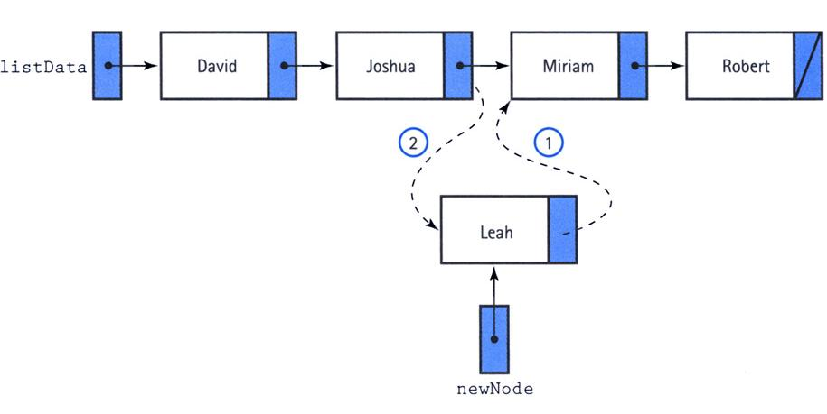
Singly Linked List Insertion

Slide 78
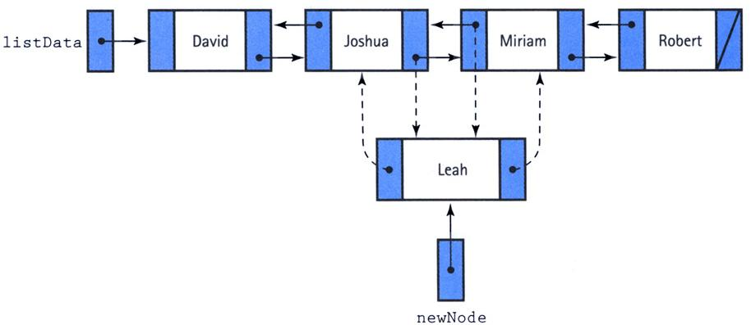
Doubly Linked List Insertion

Slide 79
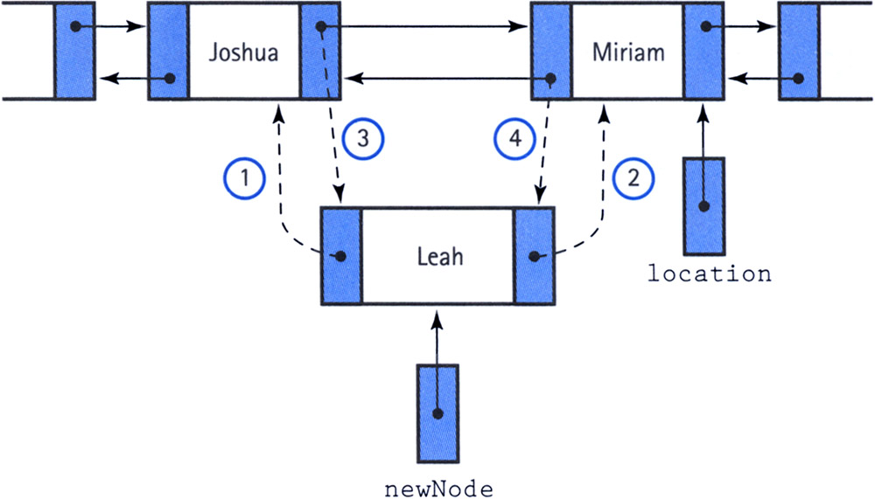
The Order is Important

Slide 80
Doubly Linked List - Deletion
One useful feature of a doubly linked list is its elimination of the need for a pointer to a node's predecessor to delete the node.
Through the back member, we can alter the next member of the preceding node to make it jump over the unwanted node.
Then we make the back pointer of the succeeding node point to the preceding node.

Slide 81
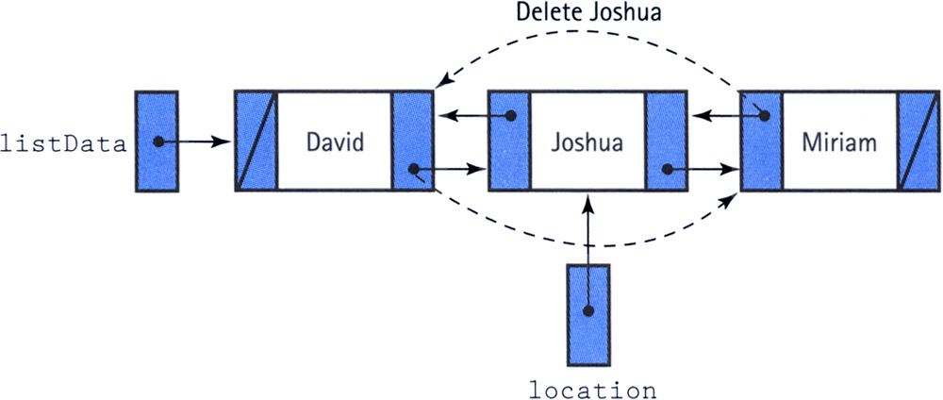
Doubly Linked List - Deletion

Slide 82
Special Cases of Deletion
We do, however, have to be careful about the end cases:
If location->back is NULL, we are deleting the first node
if location->next is NULL, we are deleting the last node.
If both location->back and location->next are NULL, we are deleting the only node.

Slide 83

Interaction

