Slide 1
Intorduction to Artificial Intelligence
Rina Dechter
CS 171
Fall 2006

Slide 2
Robotic links
Robocup Video
Soccer Robocupf
Darpa Challenge
Darpa’s-challenge-video
http://www.darpa.mil/grandchallenge05/TechPapers/Stanford.pdf

Slide 3
CS171
Course home page: http://www.ics.uci.edu/~dechter/ics-171/fall-06/
schedule, lecture notes, tutorials, assignment, grading, office hours, etc.
Textbook: S. Russell and P. Norvig Artificial Intelligence: A Modern Approach Prentice Hall, 2003, Second Edition
Grading: Homeworks and projects (30-40%)
Midterm and final (60-70%)

Slide 4
Course overview
Introduction and Agents (chapters 1,2)
Search (chapters 3,4)
Games (chapter 5)
Constraints processing (chapter 6)
Representation and Reasoning with Logic (chapters 7,8,9)
Learning (chapters 18,20)
Planning (chapter 11)
Uncertainty (chapters 13,14)
Natural Language Processing (chapter 22,23)

Slide 5
Course Outline
Resources on the Internet
AI on the Web: A very comprehensive list of Web resources about AI from the Russell and Norvig textbook.
Essays and Papers
What is AI, John McCarthy
Computing Machinery and Intelligence, A.M. Turing
Rethinking Artificial Intelligence, Patrick H.Winston

Slide 6
Today’s class
What is Artificial Intelligence?
A brief History
Intelligent agents
State of the art

Slide 7
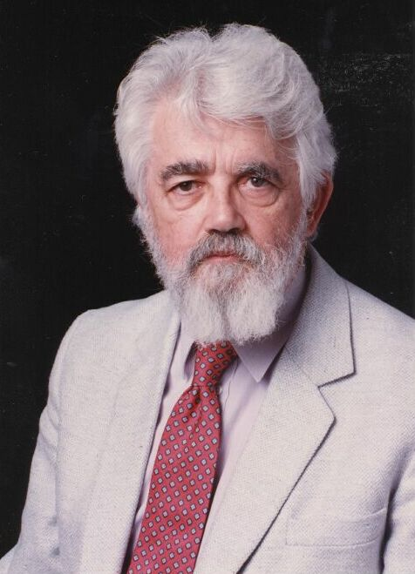
What is Artificial Intelligence (John McCarthy , Basic Questions)
What is artificial intelligence?
It is the science and engineering of making intelligent machines, especially intelligent computer programs. It is related to the similar task of using computers to understand human intelligence, but AI does not have to confine itself to methods that are biologically observable.
Yes, but what is intelligence?
Intelligence is the computational part of the ability to achieve goals in the world. Varying kinds and degrees of intelligence occur in people, many animals and some machines.
Isn't there a solid definition of intelligence that doesn't depend on relating it to human intelligence?
Not yet. The problem is that we cannot yet characterize in general what kinds of computational procedures we want to call intelligent. We understand some of the mechanisms of intelligence and not others.
More in: http://www-formal.stanford.edu/jmc/whatisai/node1.html

Slide 8
What is AI?
Views of AI fall into four categories:
Thinking humanly Thinking rationally
Acting humanly Acting rationally
The textbook advocates "acting rationally“
List of AI-topics

Slide 9
What is Artificial Intelligence?
Human-like (“How to simulate humans intellect and behavior on by a machine.)
Mathematical problems (puzzles, games, theorems)
Common-sense reasoning (if there is parking-space, probably illegal to park)
Expert knowledge: lawyers, medicine, diagnosis
Social behavior
Rational-like:
achieve goals, have performance measure

Slide 10
What is Artificial Intelligence
Thought processes
“The exciting new effort to make computers think .. Machines with minds, in the full and literal sense” (Haugeland, 1985)
Behavior
“The study of how to make computers do things at which, at the moment, people are better.” (Rich, and Knight, 1991)
The automation of activities that we associate with human thinking, activities such as decision-making, problem solving, learning… (Bellman)

Slide 11

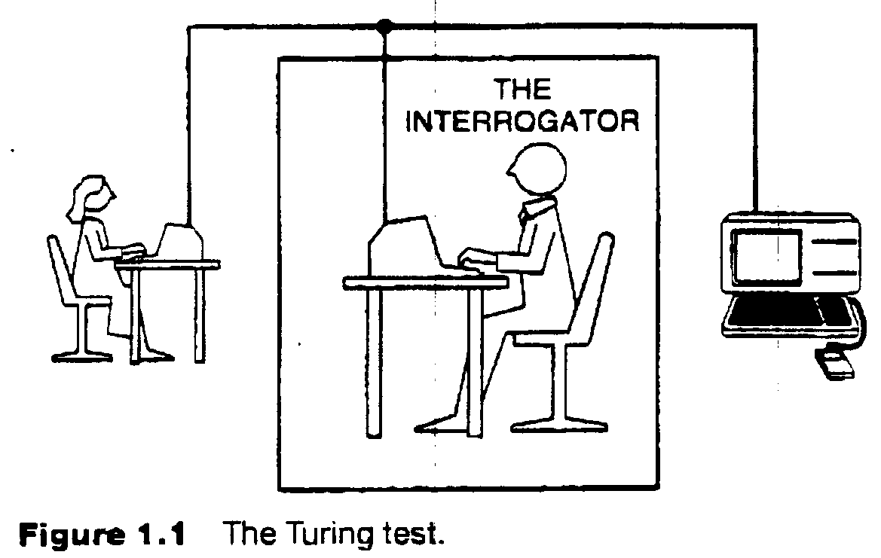
The Turing Test (Can Machine think? A. M. Turing, 1950)
Requires
Natural language
Knowledge representation
Automated reasoning
Machine learning
(vision, robotics) for full test

Slide 12
What is AI?
Turing test (1950)
Requires:
Natural language
Knowledge representation
automated reasoning
machine learning
(vision, robotics.) for full test
Thinking humanly:
Introspection, the general problem solver (Newell and Simon 1961)
Cognitive sciences
Thinking rationally:
Logic
Problems: how to represent and reason in a domain
Acting rationally:
Agents: Perceive and act

Slide 13
AI examples
Common sense reasoning
Tweety
Yale Shooting problem
Update vs revise knowledge
The OR gate example: A or B -→ C
Observe C=0, vs Do C=0
Chaining theories of actions
Looks-like(P) → is(P)
Make-looks-like(P) → Looks-like(P)
----------------------------------------
Makes-looks-like(P) ---is(P) ???
Garage-door example: garage door not included.
Planning benchmarks
8-puzzle, 8-queen, block world, grid-space world
Abduction: cambridge parking example

Slide 14
History of AI
McCulloch and Pitts (1943)
Neural networks that learn
Minsky (1951)
Built a neural net computer
Darmouth conference (1956):
McCarthy, Minsky, Newell, Simon met,
Logic theorist (LT)- proves a theorem in Principia Mathematica-Russel.
The name “Artficial Intelligence” was coined.
1952-1969
GPS- Newell and Simon
Geometry theorem prover - Gelernter (1959)
Samuel Checkers that learns (1952)
McCarthy - Lisp (1958), Advice Taker, Robinson’s resolution
Microworlds: Integration, block-worlds.
1962- the perceptron convergence (Rosenblatt)

Slide 15
The Birthplace of “Artificial Intelligence”, 1956
Darmouth workshop, 1956: historical meeting of the precieved founders of AI met: John McCarthy, Marvin Minsky, Alan Newell, and Herbert Simon.
A Proposal for the Dartmouth Summer Research Project on Artificial Intelligence. J. McCarthy, M. L. Minsky, N. Rochester, and C.E. Shannon. August 31, 1955. "We propose that a 2 month, 10 man study of artificial intelligence be carried out during the summer of 1956 at Dartmouth College in Hanover, New Hampshire. The study is to proceed on the basis of the conjecture that every aspect of learning or any other feature of intelligence can in principle be so precisely described that a machine can be made to simulate it." And this marks the debut of the term "artificial intelligence.“
50 anniversery of Darmouth workshop
Notes:
A Proposal for the Dartmouth Summer Research Project on Artificial Intelligence. J. McCarthy, M. L. Minsky, N. Rochester, and C.E. Shannon. August 31, 1955. "We propose that a 2 month, 10 man study of artificial intelligence be carried out during the summer of 1956 at Dartmouth College in Hanover, New Hampshire. The study is to proceed on the basis of the conjecture that every aspect of learning or any other feature of intelligence can in principle be so precisely described that a machine can be made to simulate it." And this marks the debut of the term "artificial intelligence.“

Slide 16
History, continued
1966-1974 a dose of reality
Problems with computation
1969-1979 Knowledge-based systems
Weak vs. strong methods
Expert systems:
Dendral:Inferring molecular structures
Mycin: diagnosing blood infections
Prospector: recomending exploratory drilling (Duda).
Roger Shank: no syntax only semantics
1980-1988: AI becomes an industry
R1: Mcdermott, 1982, order configurations of computer systems
1981: Fifth generation
1986-present: return to neural networks
Recent event:
AI becomes a science: HMMs, planning, belief network

Slide 17
Abridged history of AI
1943 McCulloch & Pitts: Boolean circuit model of brain
1950 Turing's "Computing Machinery and Intelligence"
1956 Dartmouth meeting: "Artificial Intelligence" adopted
1952—69 Look, Ma, no hands!
1950s Early AI programs, including Samuel's checkers program, Newell & Simon's Logic Theorist, Gelernter's Geometry Engine
1965 Robinson's complete algorithm for logical reasoning
1966—73 AI discovers computational complexity Neural network research almost disappears
1969—79 Early development of knowledge-based systems
1980-- AI becomes an industry
1986-- Neural networks return to popularity
1987-- AI becomes a science
1995-- The emergence of intelligent agents

Slide 18
State of the art
Deep Blue defeated the reigning world chess champion Garry Kasparov in 1997
Proved a mathematical conjecture (Robbins conjecture) unsolved for decades
No hands across America (driving autonomously 98% of the time from Pittsburgh to San Diego)
During the 1991 Gulf War, US forces deployed an AI logistics planning and scheduling program that involved up to 50,000 vehicles, cargo, and people
NASA's on-board autonomous planning program controlled the scheduling of operations for a spacecraft
Proverb solves crossword puzzles better than most humans
DARPA grand challenge 2003-2005, Robocup

Slide 19
Robotic links
Robocup Video
Soccer Robocupf
Darpa Challenge
Darpa’s-challenge-video
http://www.darpa.mil/grandchallenge05/TechPapers/Stanford.pdf

Slide 20
Agents (chapter 2)
Agents and environments
Rationality
PEAS (Performance measure, Environment, Actuators, Sensors)
Environment types
Agent types

Slide 21
Agents
An agent is anything that can be viewed as perceiving its environment through sensors and acting upon that environment through actuators
Human agent: eyes, ears, and other organs for sensors; hands,
legs, mouth, and other body parts for actuators
Robotic agent: cameras and infrared range finders for sensors;
various motors for actuators

Slide 22
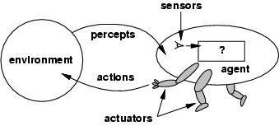
Agents and environments
The agent function maps from percept histories to actions:
[f: P* → A]
The agent program runs on the physical architecture to produce f
agent = architecture + program

Slide 23
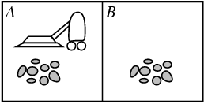
Vacuum-cleaner world
Percepts: location and contents, e.g., [A,Dirty]
Actions: Left, Right, Suck, NoOp

Slide 24
Rational agents
An agent should strive to "do the right thing", based on what it can perceive and the actions it can perform. The right action is the one that will cause the agent to be most successful
Performance measure: An objective criterion for success of an agent's behavior
E.g., performance measure of a vacuum-cleaner agent could be amount of dirt cleaned up, amount of time taken, amount of electricity consumed, amount of noise generated, etc.

Slide 25
Rational agents
Rational Agent: For each possible percept sequence, a rational agent should select an action that is expected to maximize its performance measure, given the evidence provided by the percept sequence and whatever built-in knowledge the agent has.

Slide 26
What’s involved in Intelligence? Intelligent agents
Ability to interact with the real world
to perceive, understand, and act
e.g., speech recognition and understanding and synthesis
e.g., image understanding
e.g., ability to take actions, have an effect
Knowledge Representation, Reasoning and Planning
modeling the external world, given input
solving new problems, planning and making decisions
ability to deal with unexpected problems, uncertainties
Learning and Adaptation
we are continuously learning and adapting
our internal models are always being “updated”
e.g. a baby learning to categorize and recognize animals

Slide 27
Implementing agents
Table look-ups
Autonomy
All actions are completely specified
no need in sensing, no autonomy
example: Monkey and the banana
Structure of an agent
agent = architecture + program
Agent types
medical diagnosis
Satellite image analysis system
part-picking robot
Interactive English tutor
cooking agent
taxi driver

Slide 28
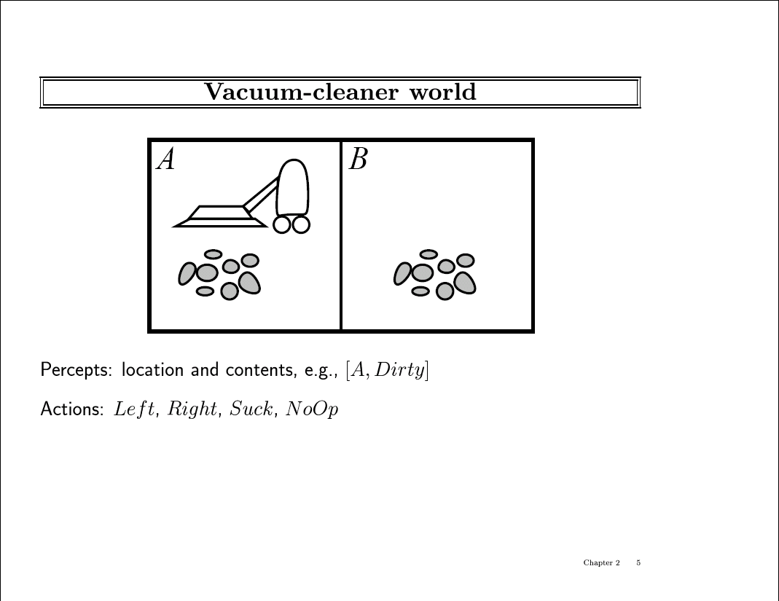

Slide 29
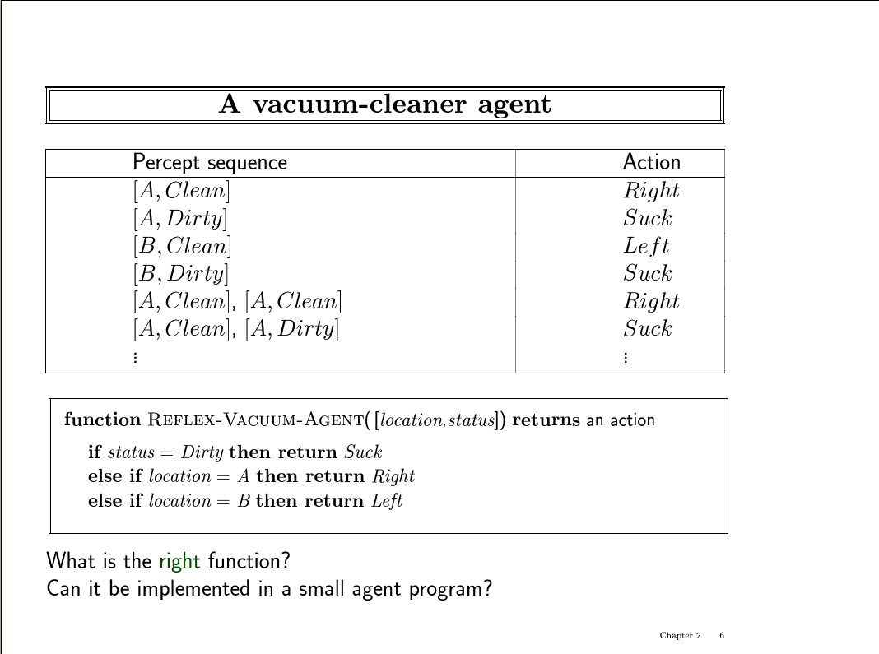

Slide 30
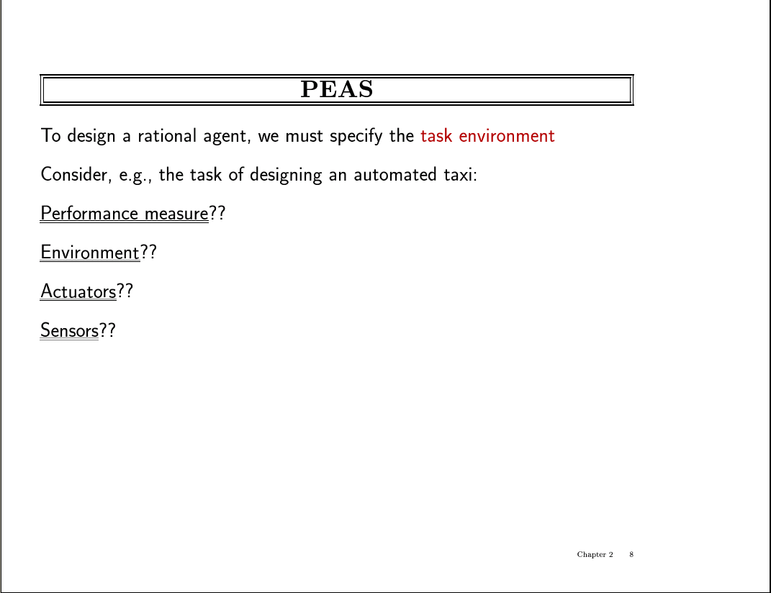

Slide 31
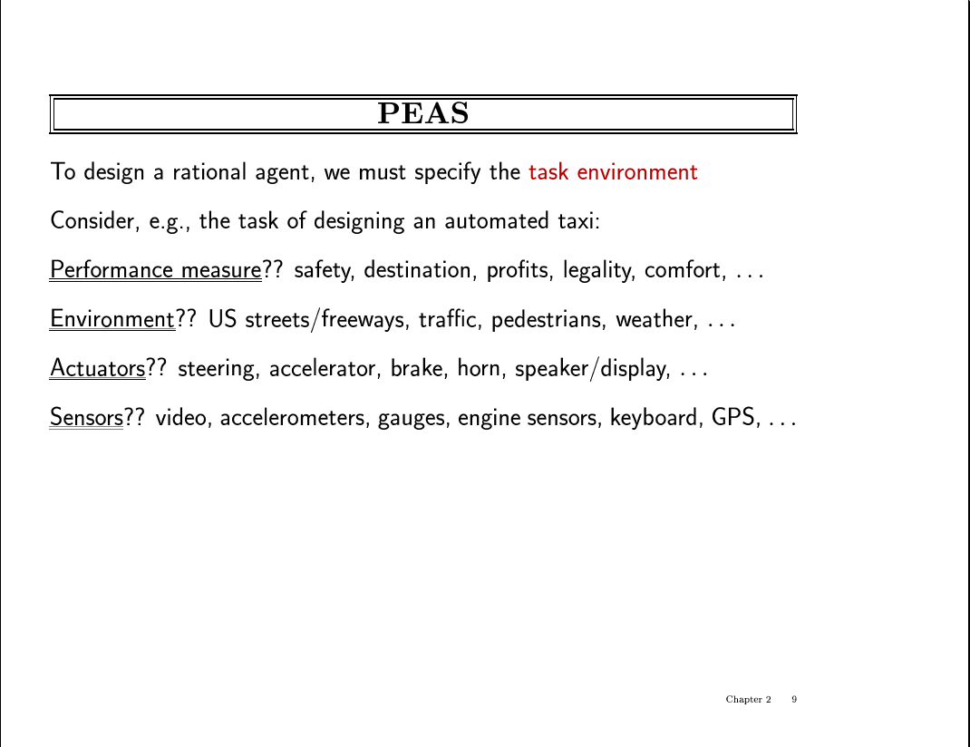

Slide 32
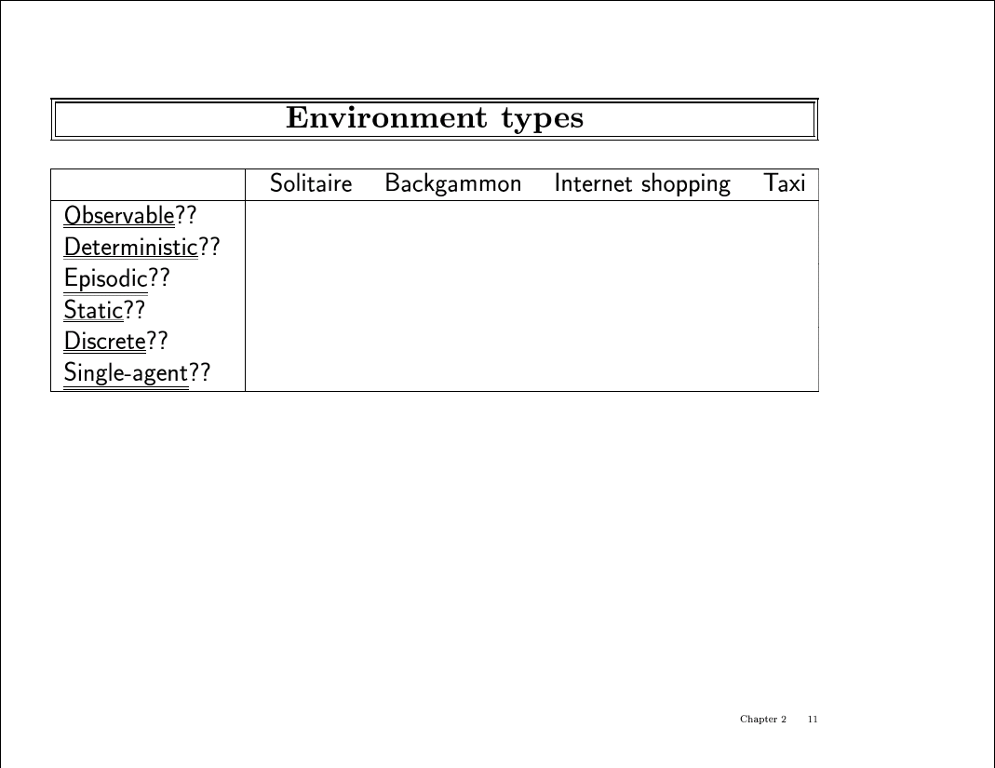

Slide 33
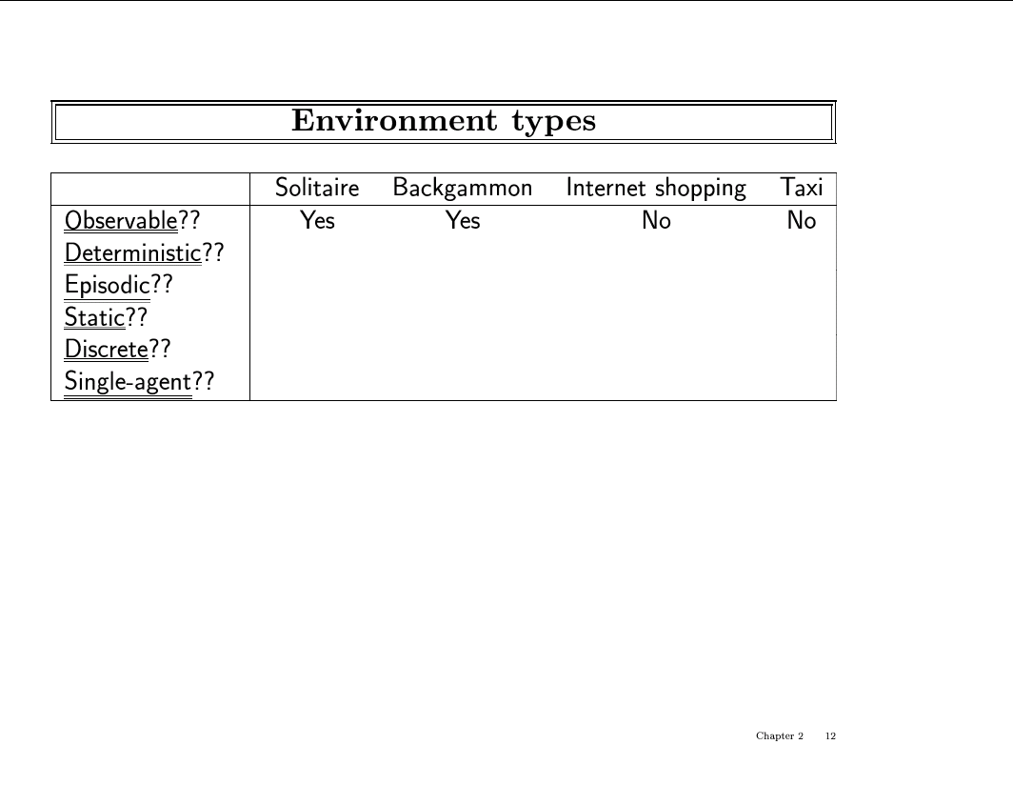

Slide 34
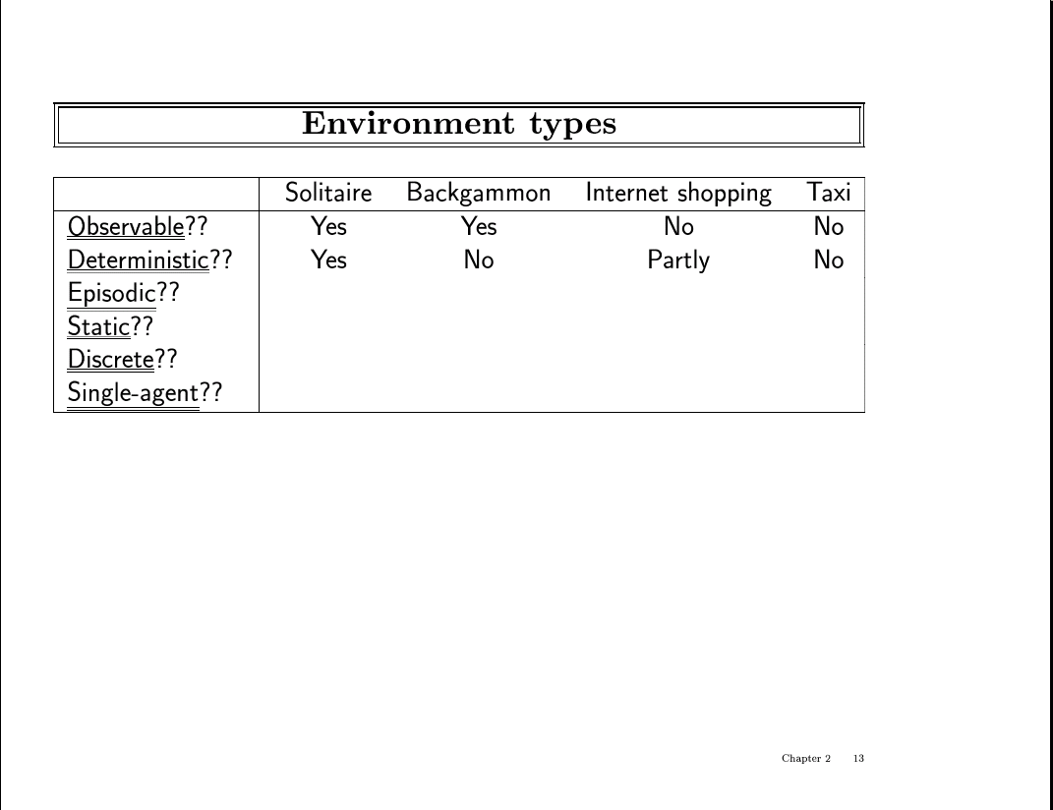

Slide 35
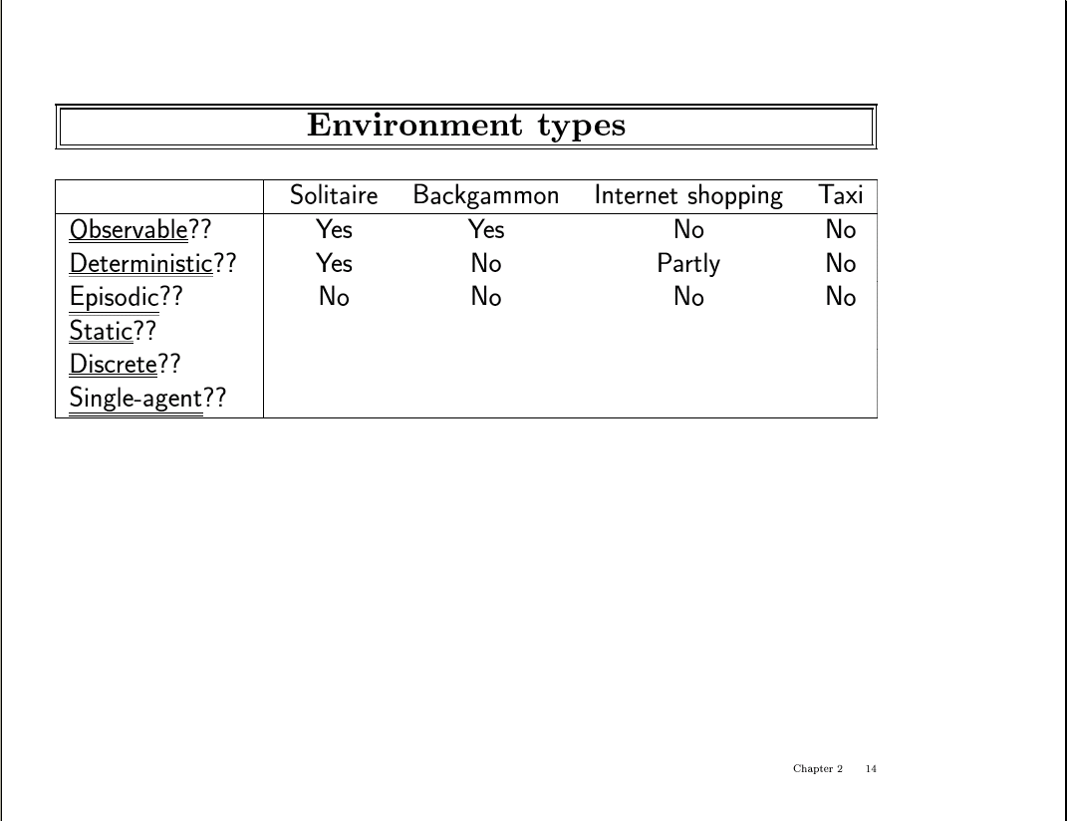

Slide 36
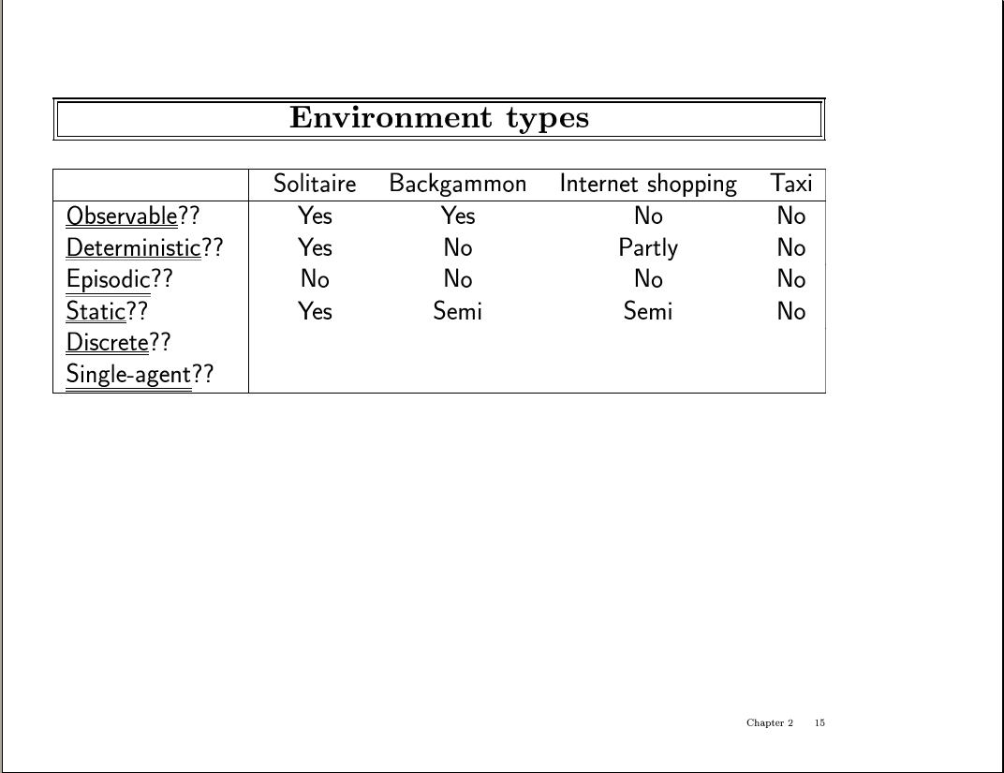

Slide 37
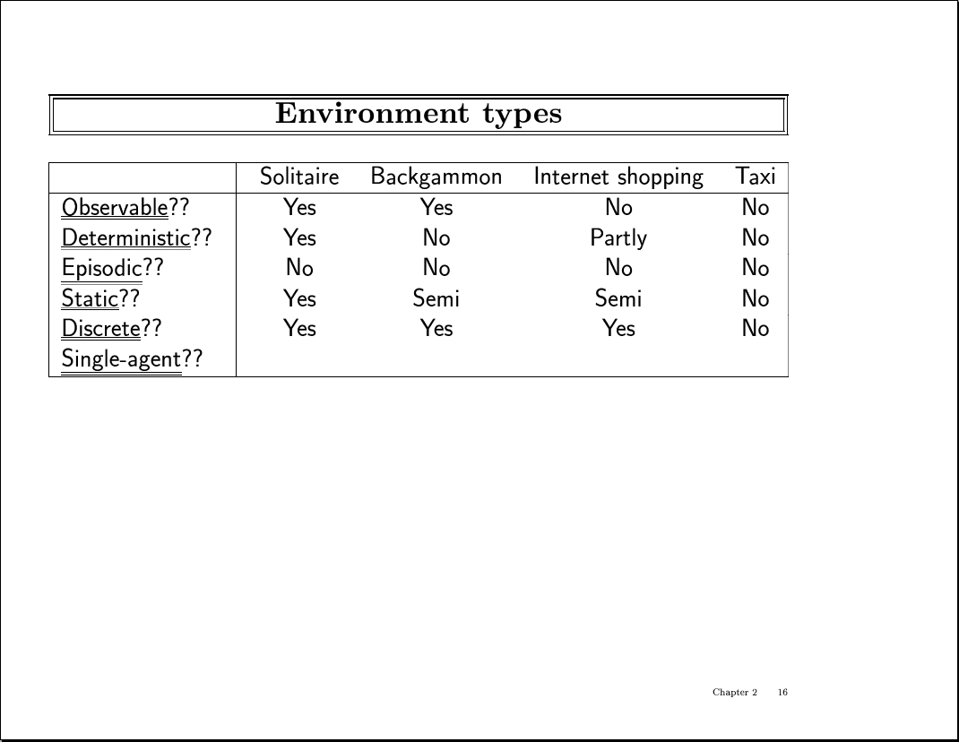

Slide 38
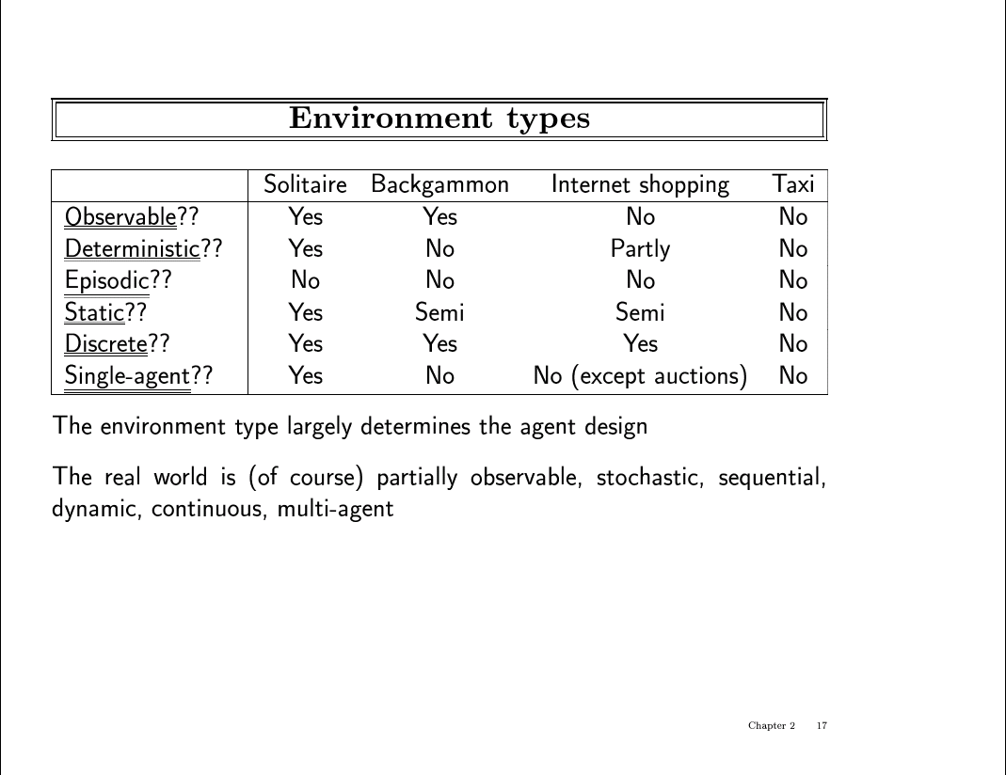

Slide 39
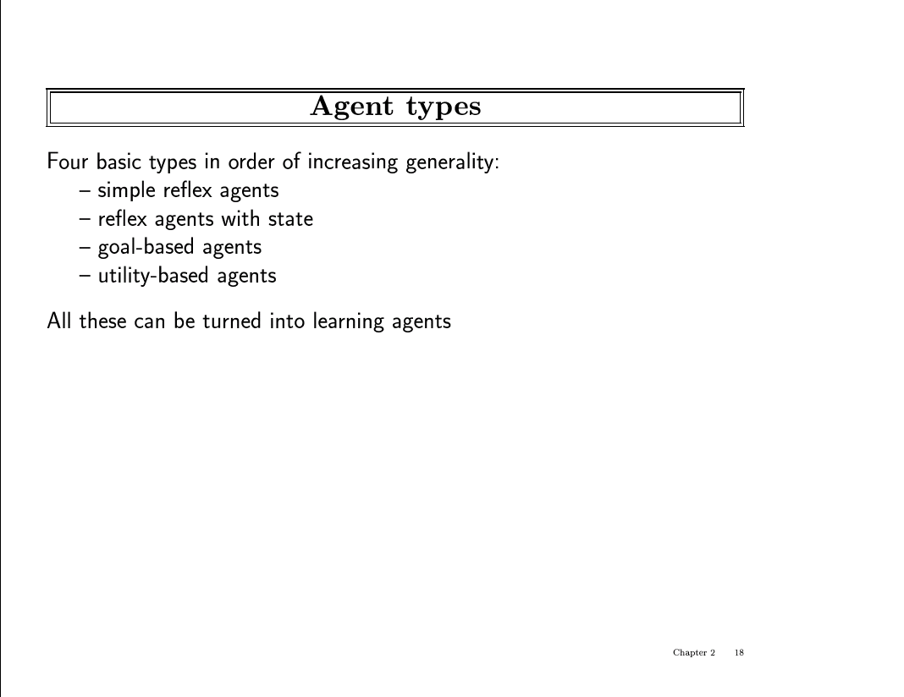

Slide 40
Agent types
Example: Taxi driver
Simple reflex
If car-in-front-is-breaking then initiate-breaking
Agents that keep track of the world
If car-in-front-is-breaking and on fwy then initiate-breaking
needs internal state
goal-based
If car-in-front-is-breaking and needs to get to hospital then go to adjacent lane and plan
search and planning
utility-based
If car-in-front-is-breaking and on fwy and needs to get to hospital alive then search of a way to get to the hospital that will make your passengers happy.
Needs utility function that map a state to a real function (am I happy?)

Slide 41
Summary
What is Artificial Intelligence?
modeling humans thinking, acting, should think, should act.
History of AI
Intelligent agents
We want to build agents that act rationally
Real-World Applications of AI
AI is alive and well in various “every day” applications
many products, systems, have AI components
Assigned Reading
Chapters 1 and 2 in the text R&N

