Slide 1
CSCI 5832 Natural Language Processing
Lecture 5
Jim Martin

Slide 2
Today 1/29
Review
FSTs/Composing cascades
Break
FST Examples
Porter Stemmer
Soundex
Segmentation
Edit distance

Slide 3
FST Review
FSTs allow us to take an input and deliver a structure based on it
Or… take a structure and create a surface form
Or take a structure and create another structure

Slide 4
FST Review
What does the transition table for an FSA consist of?
How does that change with an FST?

Slide 5
Review
In many applications it’s convenient to decompose the problem into a set of cascaded transducers where
The output of one feeds into the input of the next.
We’ll see this scheme again for deeper semantic processing.

Slide 6
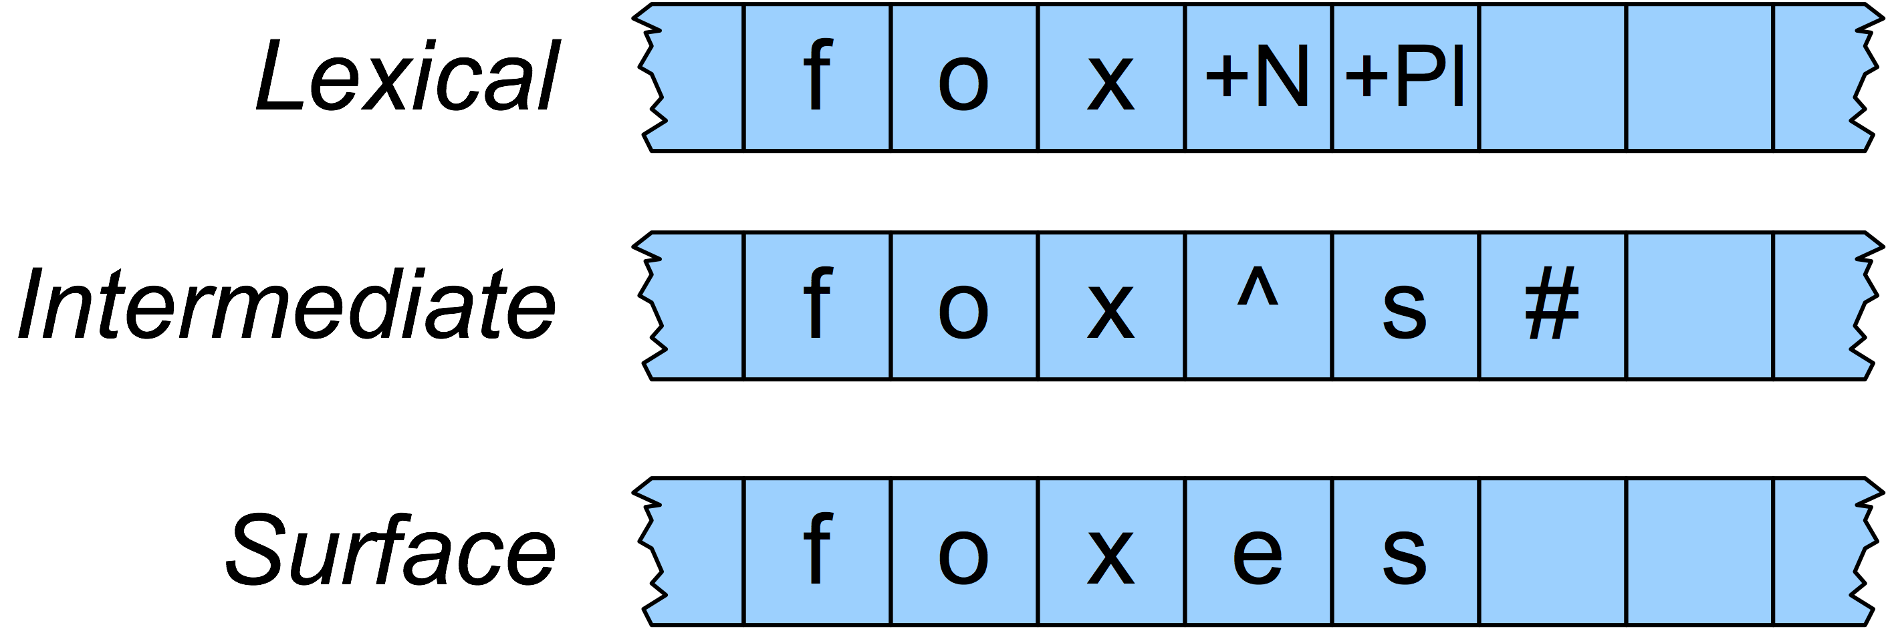
English Spelling Changes
We use one machine to transduce between the lexical and the intermediate level, and another to handle the spelling changes to the surface tape

Slide 7
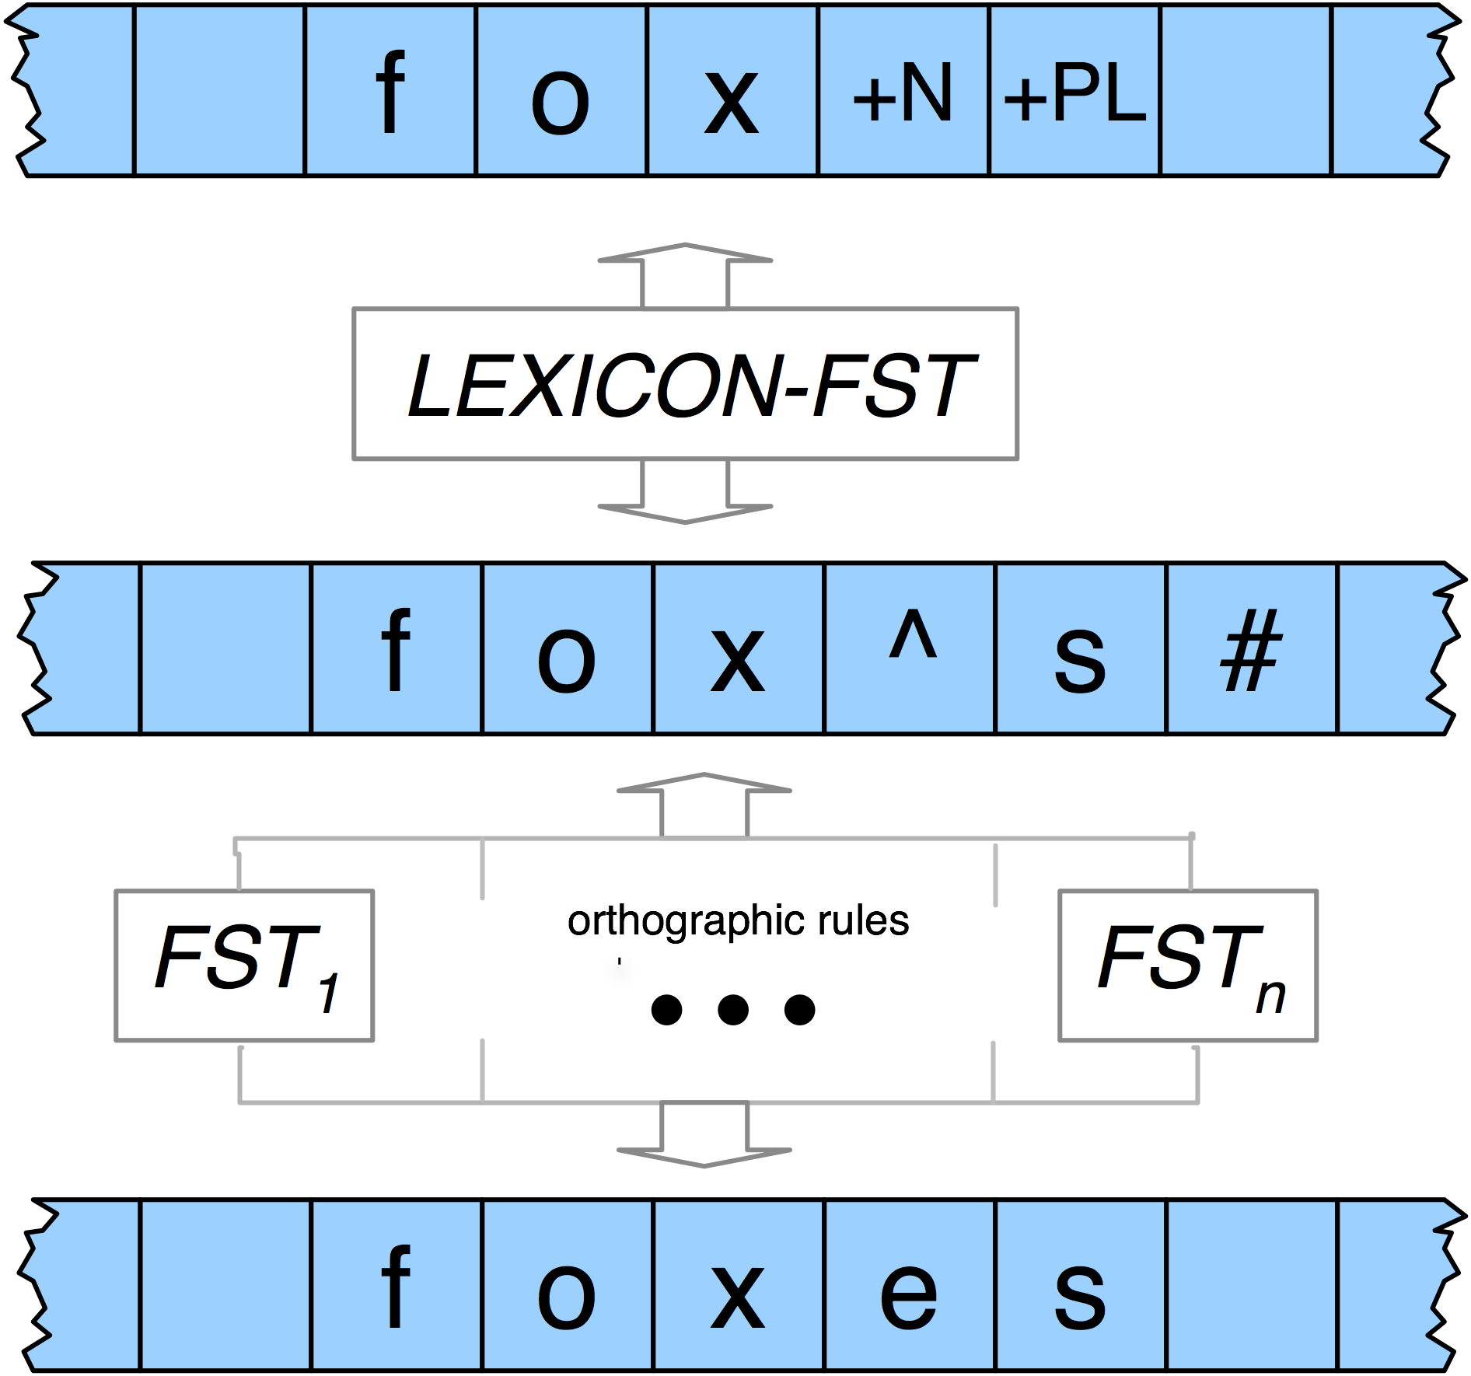
Overall Plan

Slide 8
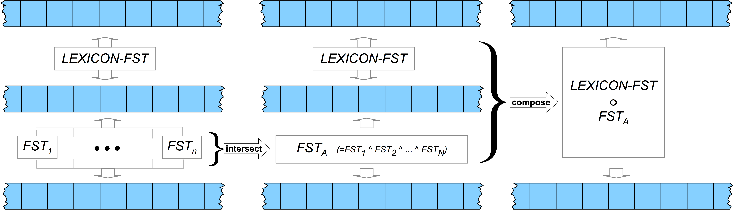
Final Scheme

Slide 9
Composition
Create a set of new states that correspond to each pair of states from the original machines (New states are called (x,y), where x is a state from M1, and y is a state from M2)
Create a new FST transition table for the new machine according to the following intuition…

Slide 10
Composition
There should be a transition between two states in the new machine if it’s the case that the output for a transition from a state from M1, is the same as the input to a transition from M2 or…

Slide 11
Composition
δ₃((x_{a},y_{a}), i:o) = (x_{b},y_{b}) iff
There exists c such that
δ₁(x_{a}, i:c) = x_{b} AND
δ₂(y_{a}, c:o) = y_{b}

Slide 12
Light Weight Morphology
Sometimes you just need to know the stem of a word and you don’t care about the structure.
In fact you may not even care if you get the right stem, as long as you get a consistent string.
This is stemming… it most often shows up in IR applications

Slide 13
Stemming for Information Retrieval
Run a stemmer on the documents to be indexed
Run a stemmer on users’ queries
Match
This is basically a form of hashing, where you want collisions.

Slide 14
Porter
No lexicon needed
Basically a set of staged sets of rewrite rules that strip suffixes
Handles both inflectional and derivational suffixes
Doesn’t guarantee that the resulting stem is really a stem (see first bullet)
Lack of guarantee doesn’t matter for IR

Slide 15
Porter Example
Computerization
ization -> -ize computerize
ize -> ε computer

Slide 16
Porter
The original exposition of the Porter stemmer did not describe it as a transducer but…
Each stage is separate transducer
The stages can be composed to get one big transducer
http://tartarus.org/martin/PorterStemmer/

Slide 17
Next HW
Part 1: Alter your code to take newswire text and segment it into paragraphs, sentences and words. As in…
<p>
<s> The quick brown fox. </s>
<s> This is sentence two. </s>
</p>

Slide 18
Readings/Quiz
First quiz is 2/12 (2 weeks from today)
It will cover Chapters 2,3,4,5 and parts of 6
Lectures are based on the assumption that you’ve read the text before class.
Quizzes are based on the contents of the lectures and the readings.

Slide 19
Segmentation
A significant part of the morphological analysis we’ve been doing involves segmentation
Sometimes getting the segments is all we want
Morpheme boundaries, words, sentences, paragraphs

Slide 20
Segmentation
Segmenting words in running text
Segmenting sentences in running text
Why not just periods and white-space?
Mr. Sherwood said reaction to Sea Containers’ proposal has been "very positive." In New York Stock Exchange composite trading yesterday, Sea Containers closed at $62.625, up 62.5 cents.
“I said, ‘what’re you? Crazy?’ “ said Sadowsky. “I can’t afford to do that.’’
Words like:
cents. said, positive.” Crazy?

Slide 21
Can’t Just Segment on Punctuation
Word-internal punctuation
M.p.h
Ph.D.
AT&T
01/02/06
Google.com
555,500.50
Expanding clitics
What’re -> what are
I’m -> I am
Multi-token words
New York
Rock ‘n’ roll

Slide 22
Sentence Segmentation
!, ? relatively unambiguous
Period “.” is quite ambiguous
Sentence boundary
Abbreviations like Inc. or Dr.
General idea:
Build a binary classifier:
Looks at a “.”
Decides EndOfSentence/NotEOS
Could be hand-written rules, or machine-learning

Slide 23
Word Segmentation in Chinese
Some languages don’t have spaces
Chinese, Japanese, Thai, Khmer
Chinese:
Words composed of characters
Characters are generally 1 syllable and 1 morpheme.
Average word is 2.4 characters long.
Standard segmentation algorithm:
Maximum Matching (also called Greedy)

Slide 24
Maximum Matching Word Segmentation
Given a wordlist of Chinese, and a string.
Start a pointer at the beginning of the string
Find the longest word in dictionary that matches the string starting at pointer
Move the pointer over the word in string
Go to 2

Slide 25
English example (Palmer 00)
the table down there
thetabledownthere
Theta bled own there
Works astonishingly well in Chinese
Far better than this English example suggests
Modern algorithms better still:
Probabilistic segmentation

Slide 26
Spelling Correction and Edit Distance
Non-word error detection:
detecting “graffe”
Non-word error correction:
figuring out that “graffe” should be “giraffe”
Context-dependent error detection and correction:
Figuring out that “war and piece” should be peace

Slide 27
Non-Word Error Detection
Any word not in a dictionary is a spelling error
Need a big dictionary!
What to use?
FST dictionary!!

Slide 28
Isolated Word Error Correction
How do I fix “graffe”?
Search through all words:
graf
craft
grail
giraffe
Pick the one that’s closest to graffe
What does “closest” mean?
We need a distance metric.
The simplest one: edit distance
I.e. Unix diff
(More sophisticated probabilistic ones: noisy channel)

Slide 29
Edit Distance
The minimum edit distance between two strings is the minimum number of editing operations
Insertion
Deletion
Substitution
Needed to transform one string into the other

Slide 30
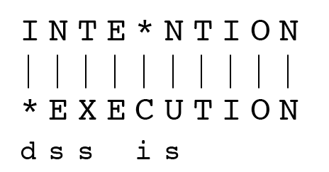
Minimum Edit Distance
If each operation has cost of 1
Distance between these is 5
If substitutions cost 2 (Levenshtein)
Distance between these is 8

Slide 31
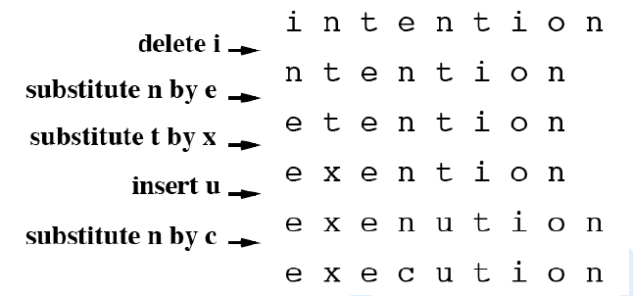
Min Edit Example

Slide 32
Min Edit As Search
But that generates a huge search space
Initial state is the word we’re transforming
Operators are insert, delete, substitute
Goal state is the word we’re trying to get to
Path cost is what we’re trying to minimize
Navigating that space in a naïve backtracking fashion would be incredibly wasteful
Why?
Lots of paths wind up at the same states. But there’s no need to keep track of the them all. We only care about the shortest path to each of those revisited states.

Slide 33
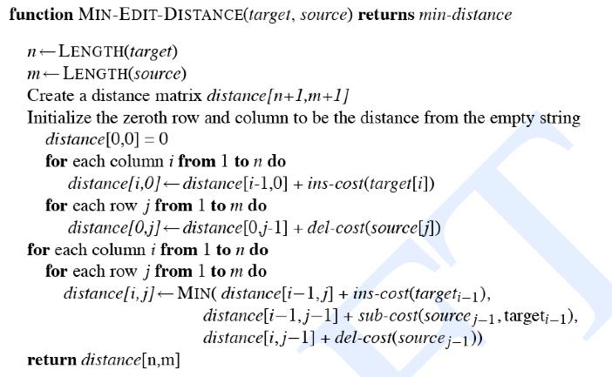
Min Edit Distance

Slide 34
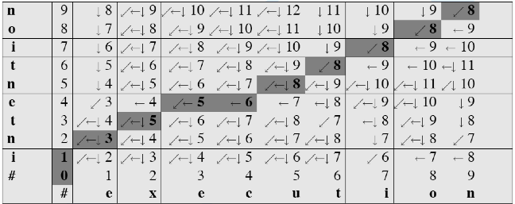
Min Edit Example

Slide 35
Summary
Minimum Edit Distance
A “dynamic programming” algorithm
We will see a probabilistic version of this called “Viterbi”

Slide 36
Summary
Finite State Automata
Deterministic Recognition of FSAs
Non-Determinism (NFSAs)
Recognition of NFSAs
FSAs, FSTs and Morphology
Very brief sketch: Tokenization
Minimum Edit Distance

Slide 37
Next Time
On to Chapter 4 (N-grams) for Thursday

