Slide 1


Social Media vs. News Platforms: A Cross-analysis for Fake News
Detection Using Web Scraping and NLP
Contacts:
Dr. Nasheen Nur, nurn@fit.edu
Dr. Siddhartha Bhattacharyya, sbhattacharyya@fit.edu
Candice Normalee Chambers, chambersc2017@my.fit.edu
Florida Institute of Technology
This Photo by Unknown author is licensed under CC BY.

Slide 2
News distribution in the 21st Century
The ease of gaining news through social media has been ever more convenient than reliable. Because humans value the convenience of distributed information, these news aren’t verified or challenged. Resulting, in people acting on fake news and further repeat this cycle of misinformation as they continue to spread false information.

Slide 3
Why we believe misinformation/fake news
Hot Topics/Issues
Covid-19 [6]
Trump vs Hilary Clinton/Biden Campaign [3]
Russia vs Ukraine War
Concepts that are important to specific populations or topics of interest
Political views
Religious views
Uninformed on how to verifying sources
Notes:
Focus on ongoing hot issues
Covid-19, in 2020 the unknowns of the virus allowed people speculate and spread false information
Trump vs Hilary Clinton/Biden Campaign, these two political races were trending topics and easy target to falsify information for political gain
Russia vs Ukraine War
Focus on concepts that are important to specific populations or topics of interest
Political views, humans tend to believe point of views they align with for example if someone aligns with the Republicans they tend to believe there representatives vs a Democratic representative
Religious views, similarly to political views humans will believe information they have faith in, for example the text from the Bible, Quran, etc.
Lack of education or training on verifying sources, if people aren't informed to verify and practice verifying they will never validate information they receive

Slide 4
Goal is to develop a false information detection pipeline
Incorporating different political views
Two reliable news sources: Fox News and CNN
Not depending on the pre-specified dataset for queries
Cross-examining shorter chunks of texts which improves accuracy
Overall, we want to develop a browser extension which will catch the fake news based on the NLP- based tool we will implement

Slide 5
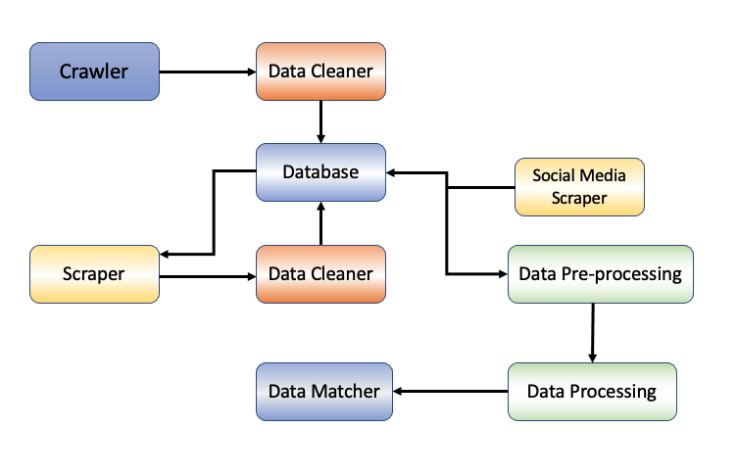
Overall Workflow
Check out our recent paper on fake news analysis. I am not going into details of the process we used for the time constraint.
Alsuliman, Fahad, Siddhartha Bhattacharyya, Khaled Slhoub, Nasheen Nur, and Candice Normalee Chambers.
"Social Media vs. News Platforms: A Cross-analysis for Fake News Detection Using Web Scraping and NLP."
In Proceedings of the 15th International Conference on PErvasive Technologies Related to Assistive Environments,
pp. 190-196. 2022.

Slide 6
Milestones/Deliverables for the project
We want to meet every two weeks
Creating a repository of existing literature and ongoing research and submitting a short survey on that [3-4 pages]
Due by the last week of October 2022
Progressing on the system design or a prototype for the browser extension [we already have some codes implemented and documents]
Report Due by the week of final, December 2022
Being involved with the implementation team(our research group) directly and contributing to a small significant portion
Codes and Report Due by the 2nd week of March 2023

Slide 7
References
Iftikhar Ahmad, Muhammad Yousaf, Suhail Yousaf, and Muhammad Ovais Ahmad. 2020. Fake news detection using machine learning ensemble methods. Complexity 2020 (2020).
Bashar Al Asaad and Madalina Erascu. 2018. A tool for fake news detection. In 2018 20th International Symposium on Symbolic and Numeric Algorithms for Scientific Computing (SYNASC). IEEE, 379–386.
Alessandro Bessi and Emilio Ferrara. 2016. Social bots distort the 2016 US Presidential election online discussion. First monday 21, 11-7 (2016).
William Ferreira and Andreas Vlachos. 2016. Emergent: a novel data-set for stance classification. In Proceedings of the 2016 conference of the North American chapter of the association for computational linguistics: Human language technologies. ACL.
Mayank Kumar Jain, Dinesh Gopalani, Yogesh Kumar Meena, and Rajesh Kumar. 2020. Machine Learning based Fake News Detection using linguistic features and word vector features. In 2020 IEEE 7th Uttar Pradesh Section International Conference on Electrical, Electronics and Computer Engineering (UPCON). IEEE, 1–6.
Wasim Ahmed Joseph Downing. 2020. COVID-19 and the 5G Conspiracy Theory: Social Network Analysis of Twitter Data. J Med Internet Res (2020).
Hannah Rashkin, Eunsol Choi, Jin Yea Jang, Svitlana Volkova, and Yejin Choi. 2017. Truth of varying shades: Analyzing language in fake news and political fact-checking. In Proceedings of the 2017 conference on empirical methods in natural language processing. 2931–2937.

Slide 8
Thank you
Questions?

