Slide 1
PRDA – 04 Customer Data Analysis
Istanbul Retail Sales and Customers Analysis 2021-2023

Slide 2
Project Overview
This project focuses on analysing customer shopping behaviour using transaction data collected from 10 different shopping malls in Istanbul between 2021 and 2023.
The dataset includes information about customers' age, gender, product categories, quantity purchased, product prices, payment methods, invoice dates, and shopping mall locations.
The main purpose of this project is to understand customer shopping patterns, identify which gender and age groups purchase more products and generate higher revenue, analyse popular product categories, and understand customer payment preferences.
Using Excel, SQL, and Power BI, the project aims to analyse the data, create meaningful visualisations, derive business insights, and provide suggestions to help the company improve its sales and customer experience.

Slide 3
Project Objectives
To analyse customer shopping distribution based on gender.
To identify which gender purchases more products and generates higher revenue.
To analyse customer shopping behaviour across different age groups.
To identify which age group purchases more products and generates higher revenue.
To analyse product category preferences and understand payment method patterns among customers.
To create visualisations using Power BI, derive meaningful business insights, and provide suggestions to improve sales and customer experience.

Slide 4
Dataset Description
Total Records: 99,457
Total Columns: 10
Dataset Type: Customer Shopping Transaction Data
Data Period: 2021–2023
Location: 10 different shopping malls in Istanbul, Turkey

Slide 5
Important Dataset Fields
invoice_no: Unique invoice number for each transaction.
customer_id: Unique customer identification number.
gender: Gender of the customer (Male/Female).
age: Age of the customer.
category: Product category purchased.
quantity: Number of products purchased.
price: Price per product in Turkish Lira (TL).
payment_method: Payment method (Cash, Credit Card, Debit Card).
invoice_date: Date of the shopping transaction.
shopping_mall: Name of the shopping mall.

Slide 6
Dataset Purpose
The dataset is used to analyse customer shopping behaviour, purchasing patterns, revenue generation, product category preferences, and payment methods.
Note: Revenue can be calculated using:
Revenue ={Quantity} *{Price}

Slide 7
Tools and Methodology
1. Microsoft Excel – Data Cleaning and Initial Analysis
Imported the customer shopping dataset into Excel.
Checked the dataset for missing values and duplicate records.
Reviewed data types and checked important columns such as age, quantity and price.
Used formulas and PivotTables to summarise customer shopping data.
Performed initial analysis based on gender, age group and product category.

Slide 8
SQL – Data Querying and Analysis
Used SQL to retrieve and analyse customer transaction data.
Applied SELECT, WHERE, GROUP BY and ORDER BY queries.
Used aggregate functions such as COUNT(), SUM() and AVG().
Analysed sales, revenue, product categories, gender and payment methods.

Slide 9
Power BI – Data Visualisation and Dashboard
Imported the customer dataset into Power BI.
Created charts and visualisations to understand customer shopping behaviour.
Compared shopping patterns by gender and age group.
Analysed revenue by gender, age group and product category.
Created a dashboard to present key findings and business insights.

Slide 10
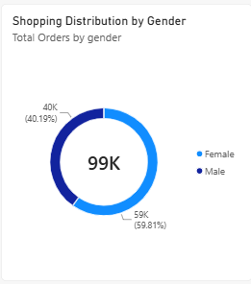
Shopping Distribution by Gender
This chart shows the distribution of customer shopping transactions based on gender.
It compares shopping activity between male and female customers.
It helps identify which gender has a higher number of shopping transactions.
This analysis helps the business understand customer shopping patterns and plan targeted marketing strategies.

Slide 11
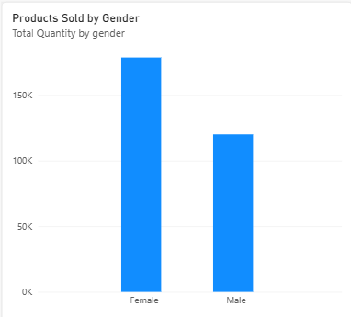
Shopping Distribution by Age Group
This chart shows the distribution of customer shopping transactions across different age groups.
It compares shopping activity among different age groups.
It helps identify which age group has the highest number of shopping transactions.
It helps the business understand the shopping behaviour of different age groups.
The findings can help the company plan age-based marketing campaigns.

Slide 12
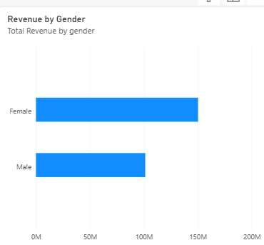
Revenue by Gender
This chart compares the total revenue generated by male and female customers.
It helps identify which gender contributes more to the company's revenue.
It compares the revenue contribution of male and female customers.
This analysis helps the business understand customer spending patterns and plan targeted marketing strategies.

Slide 13
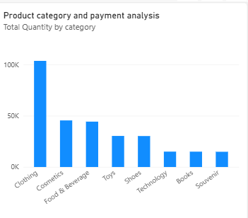
Purchase Category by Gender
his chart shows the product category preferences of male and female customers.
It compares the purchasing preferences of both genders across different product categories.
It helps identify which product categories are popular among male and female customers.
This analysis helps the business plan targeted promotions and improve product availability.

Slide 14
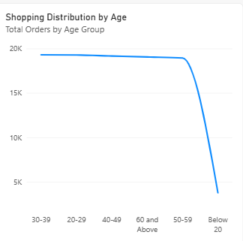
Payment Method Distribution
This chart shows the distribution of customer transactions across different payment methods.
It compares the usage of Cash, Credit Card and Debit Card.
It helps identify the most commonly used payment method.
It helps the business understand customer payment preferences.
The findings can help improve payment facilities and customer convenience.

Slide 15
Key Findings and Business Recommendations
Key Findings
Gender Analysis: Female customers contribute a higher share of shopping transactions and revenue than male customers.
Age Group Analysis: Customers in the 36–45 age group show the highest shopping activity and revenue contribution.
Revenue Analysis: Revenue contribution differs across gender and age groups, helping identify important customer segments.
Product Category Analysis: Clothing generates the highest revenue, followed by Shoes and Technology.
Products Sold: Product demand varies across different age groups and customer segments.
Payment Method Analysis: Cash is the most frequently used payment method among customers.

Slide 16
Business Recommendations
Targeted Marketing: Create targeted marketing campaigns for customer groups that contribute more sales and revenue.
Age-Based Promotions: Offer suitable discounts and promotions to attract customers from different age groups.
Inventory Management: Maintain sufficient stock of popular product categories such as Clothing, Shoes and Technology.
Customer Engagement: Develop marketing strategies to increase shopping activity among customer segments with lower sales.
Payment Facilities: Continue supporting popular payment methods and provide convenient digital payment options.
Sales Improvement: Regularly monitor sales trends and customer preferences to improve business performance.

Slide 17
Conclusion
The analysis helps the business understand customer shopping behaviour, identify important customer segments, recognise popular product categories and understand payment preferences. These insights can support better marketing, inventory planning and business decisions.

Slide 18
Thank you

