Slide 1
Java Database Connectivity

Slide 2
Data Persistence
For Future Use
Large Volume
File Handling
Database Management System

Slide 3
Introduction
An API to connect and execute query with the database
Can save, update, delete and fetch data
Uses JDBC Drivers

Slide 4
JDBC Driver
Four types of drivers:
JDBC-ODBC bridge driver
Native-API driver (partially java driver)
Network Protocol driver (fully java driver)
Thin driver (fully java driver)
Data
Java App
JDBC Driver

Slide 5
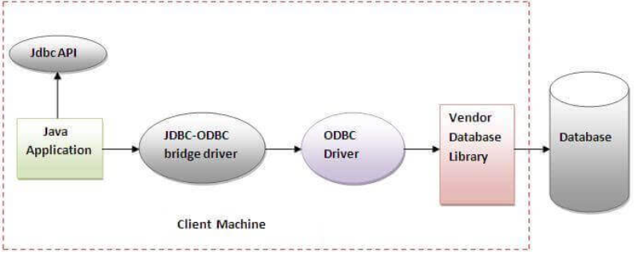
JDBC-ODBC Bridge
Uses ODBC Driver
Converts JDBC method calls into the ODBC function calls
Performance degraded because of conversion
Can be easily connected to any database

Slide 6
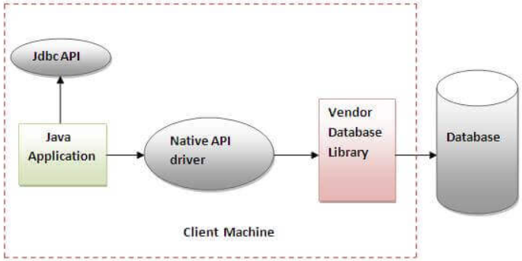
Native-API Driver
The Native API driver uses the client-side libraries of the database.

Slide 7
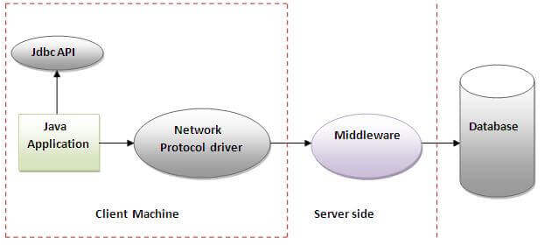
Network Protocol Driver
Uses middleware (application server) that converts JDBC calls directly or indirectly into the vendor-specific database protocol

Slide 8
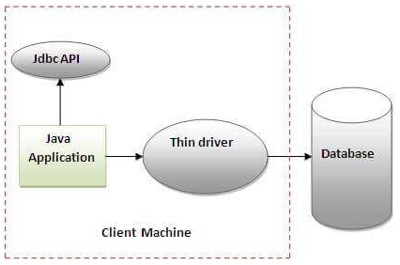
Thin Driver
The thin driver converts JDBC calls directly into the vendor-specific database protocol.
Drivers depend on the Database.

Slide 9
Java.sql package
Interfaces:
Driver interface
Connection interface
Statement interface
PreparedStatement interface
CallableStatement interface
ResultSet interface
ResultSetMetaData interface
DatabaseMetaData interface
RowSet interface
Classes
DriverManager class
Blob class
Clob class
Types class

Slide 10
Java Database Connectivity
Register the Driver class (Class)
public static void forName(String className)throws ClassNotFoundException
Create connection(DriverManager)
public static Connection getConnection(String url)throws SQLException
public static Connection getConnection(String url,String name,
String password) throws SQLException
Create statement (Connection)
public Statement createStatement()throws SQLException
Execute queries
public ResultSet executeQuery(String sql)throws SQLException
Close connection
public void close()throws SQLException

Slide 11
Example (Oracle 10g)
Driver class: The driver class for the oracle database is oracle.jdbc.driver.OracleDriver.
Connection URL: The connection URL for the oracle10G database is jdbc:oracle:thin:@localhost:1521:xe where jdbc is the API, oracle is the database, thin is the driver, localhost is the server name on which oracle is running, we may also use IP address, 1521 is the port number and XE is the Oracle service name. You may get all these information from the tnsnames.ora file.
Username: The default username for the oracle database is system.
Password: It is the password given by the user at the time of installing the oracle database.

Slide 12
Example
import java.sql.*;
class OracleCon{
public static void main(String args[]){
try{
//step1 load the driver class
Class.forName("oracle.jdbc.driver.OracleDriver");
//step2 create the connection object
Connection con=DriverManager.getConnection(“jdbc:oracle:thin:@localhost:1521:xe","system","oracle“;
//step3 create the statement object
Statement stmt=con.createStatement();
//step4 execute query
ResultSet rs=stmt.executeQuery("select * from emp");
while(rs.next())
System.out.println(rs.getInt(1)+" "+rs.getString(2)+" "+rs.getString(3));
//step5 close the connection object
con.close();
}catch(Exception e){ System.out.println(e);}
}
}

Slide 13
PreparedStatement
Use the SQL statements many times
Accepts input parameters at run time
Use of setXXX(int position, XXX value) method to set the value of parameter markers ?
PreparedStatement pstmt = null;
try {
String SQL = "Update Employees SET age = ? WHERE id = ?";
pstmt = conn.prepareStatement(SQL);
} catch (SQLException e) { . . . }

