Slide 1
Programming the I/O Hardware
Reference:
  textbook: Tanenbaum ch.5.1
  http://www.cs.umb.edu/ulab/UsingCforHardwareRegs.html
  “Linux Assembly Language Programming” by Bob Neveln

Slide 2
Types of I/O Devices
Block devices(e.g. disk)
  store information in fixed-size blocks
  each one has its own address
Character devices (e.g. serial I/O)
  accept or deliver a stream of characters
  not addressable
Others (e.g. clocks)
  generate interrupts at fixed intervals

Slide 3
Programming the I/O
CPU reads/writes into control registers and data buffers of the hardware to transfer data
CPU communicates with registers via:
  1) I/O Port number
    use special I/O instructions (e.g. in REG, PORT)
  2) Memory-mapped I/O
    map control registers to memory locations
    use the same instruction to access memory to access registers
  3) Hybrid
    memory-mapped I/O data buffers and I/O ports for control registers.

Slide 4
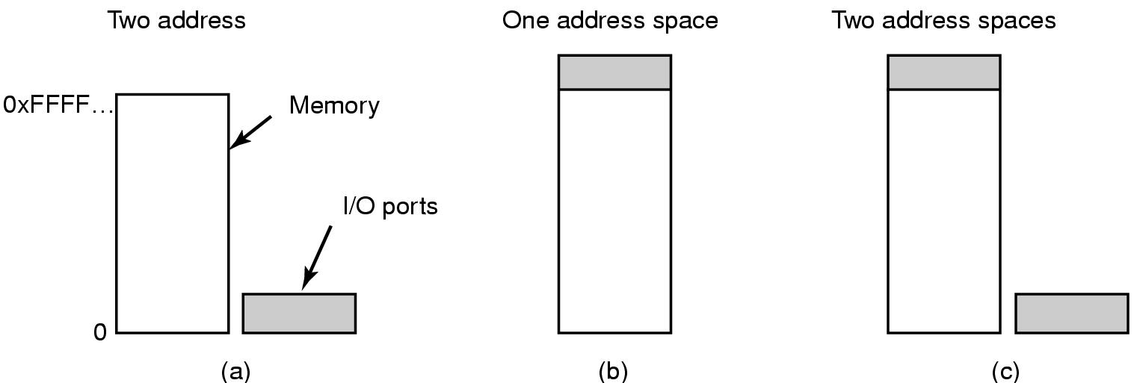
Memory-mapped I/O
Separate memory
and I/O space
Memory-mapped
I/O
Hybrid

Slide 5
80386Processor - Registers
Processor
%ax
%
eax
%ah
%al
Memory
%
bx
Memory
Address
%
ebx
%
bh
%
bl
0x00000000
%
cx
%
ecx
%
ch
%
cl
M/IO#
%
dx
%
edx
%dh
%dl
W/R#
%
esp
%sp
A-Bus
(32 bits)
%
ebp
%
bp
D-Bus
%
esi
%
si
(32 bits)
%
edi
%
di
0xFFFFFFFF
Neveln
, Figure 3-14 (Adapted)

Slide 6
Additional x86 Processor Registers
Additional status and control registers not shown
in Neveln Fig. 3-14
–
Instruction Pointer/Extended Instruction Pointer
%
eip
–
Extended Flags
%
eflags
Bit definitions of the eflags register is shown in
http://en.wikipedia.org/wiki/FLAGS_register_(computing)

Slide 7
x86 Processor Architecture
Uses the hybrid approach
I/O port: 0 - 64K
  e.g. COM1: base address 0x3f8
  COM2: base address 0x2f8
Device data buffers: 640K - 1M
To read data, CPU puts out the address on the bus’ address lines and assert the READ signal. A separate port/memory line is used to select I/O ports or memory.

Slide 8
x86 I/O Instructions
8-bit I/O instructions in assembly language
outb %a1, %dx /* output 8-bit data from %a1
/* I/O port number in %dx
inb %dx, %a1 /* input 8-bit data to %a1
/* I/O port number in %dx

Slide 9
Use Tutor to do input/output port
From CS341 lecture:
http://www.cs.umb.edu/ulab/UsingCforHardwareRegs.html
Tutor > ps 2f8 41 -- ps for port set
ATutor>
Tutor > pd 2f8 -- pd for port display
02f8 0d 00 c1 03…..

Slide 10
Serial Port I/O Programming Using C
Don’t use hard coded numbers!
Look at $pcinc/serial.h for symbolic constants
#define COM1_BASE 0x3f8
#define COM2_BASE 0x2f8
#define COM3_BASE 0x3e8
#define COM4_BASE 0x2e8
#define UART_TX 0 /* send data */
#define UART_RX 0 /* recv data */
. . .
#define UART_IER 1 /* interrupt enable*/
#define UART_LCR 3 /* line control */
#define UART_MCR 4 /* modem control */
#define UART_LSR 5 /* line status */
#define UART_MSR 6 /* modem status */

Slide 11
Serial Port I/O Programming Using C
(cont’d)
/* These are the bit definitions for the Line Status Register */
#define UART_LSR_TEMT 0x40 /* Transmitter empty */
#define UART_LSR_THRE 0x20 /* Transmit-hold-register empty */
#define UART_LSR_BI 0x10 /* Break interrupt indicator */
#define UART_LSR_FE 0x08 /* Frame error indicator */
#define UART_LSR_PE 0x04 /* Parity error indicator */
#define UART_LSR_OE 0x02 /* Overrun error indicator */
#define UART_LSR_DR 0x01 /* Receiver data ready */
/* These are the bit definitions for the Interrupt Enable Register */
#define UART_IER_MSI 0x08 /* Enable Modem status interrupt */
#define UART_IER_RLSI 0x04 /* Enable receiver line status interrupt */
#define UART_IER_THRI 0x02 /* Enable Transmitter holding register int. */
#define UART_IER_RDI 0x01 /* Enable receiver data interrupt */

Slide 12
Serial Port I/O Programming Using C (cont’d)
unsigned char status;
outpt(COM1_BASE + UART_TX, ‘A’);
status = inpt(COM1_BASE + UART_LSR);
Use literal values
Use offset values

Slide 13
Serial Port I/O Program: $pcex/echo.c
/* echo.c: use low-level i/o to echo console input */
/* build with makefile in $pcex: make C=echo */
#include <stdio.h>
#include <serial.h>
void main(){
int console = sys_get_console_dev(); /* find out current sys console */
int conport; int c = 0;
switch (console) {
case COM1: conport = COM1_BASE; break;
case COM2: conport = COM2_BASE; break;
default: printf("Expected serial port for console, exiting\n");
return;
}
while (c != 'q') { /* "poll" the DR (data-ready) bit until it goes on */
while ((inpt(conport+UART_LSR)&UART_LSR_DR)==0) ; /* busy-wait for char */
c = inpt(conport+UART_RX);
outpt(conport+UART_TX, c); /* should be ready */
}
}

Slide 14
Different Ways to Perform I/O
Programmed I/O
  CPU does all the work
  CPU does polling or busy waiting until I/O is free
Interrupt-Driven I/O
  allows the CPU to do something else while waiting for the I/O to be free
I/O using DMA
  DMA controller feeds the data to the I/O without bothering the CPU

Slide 15
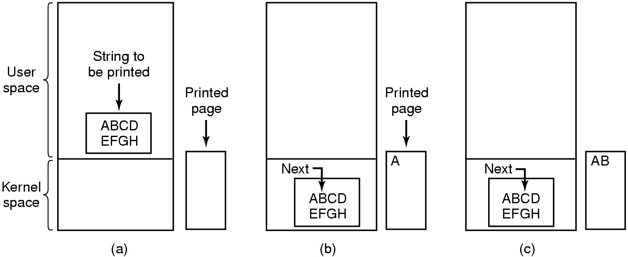
Example of Programmed I/O
Steps in printing a string
Assembles the string
in a buffer in user space.
Wait for printer to be
available.
When printer is available,
copy string to kernel space.
Wait for printer before writing
“A” to printer’s data register
Wait for printer to be ready
again before writing “B”

Slide 16
C code for the printing example
Copy_from_user(buffer, p, count);
for(i=0; i <count; i++) {
while (*printer_status_reg !=READY);
*printer_data_register = p[i];
}
return_to_user();

