Slide 1
Process Models, Creation and Termination
Reference
  text: Tanenbaum ch. 2.1

Slide 2
Definitions
Programs
  Algorithms embodied in machine code
  usually stored in an executable file
Processes
  Programs in execution
  Includes CPU and memory usage
  Sequential process uses a single program counter showing where the CPU is in the code

Slide 3
fork Example revisited
int main()
{
if (fork())
printf(“hello from parent\n”);
else printf(“hello from child\n”);
/* other program statements */
}
2 processes running the same program

Slide 4

Multiprogramming
~50 ms
a) Multiprogramming of 4 programs
b) Conceptual model of 4 independent processes
c) Only 1 program is active at once

Slide 5
Process Creation
Four events cause processes to be created(fork, CreateProcess):
  1. System initialization
    At system bootup time, the kernel is started.
  2. Execution of a process-create system call
    A running process can issue system calls
  3. A user request to create a process
    Clicking an icon or typing command can start a process
  4. Initiation of a batch job
    Mainframe computers create a new process when starting each batch job

Slide 6
Process Termination
Terminate new processes due to:
  1. Normal exit(voluntary)
    terminate at work completion(exit, ExitProcess)
  2. Error exit(voluntary)
    terminate when process discovers a fatal error
  3. Fatal error(involuntary)
    terminate when an error caused by the process(e.g. divide by zero)
  4. Killed by another process(involuntary)
    terminate by another process executing a system call(kill, TerminateProcess)

Slide 7
Process State Codes
Show Process State Codes using man ps :
Here are the different values that the s, stat and state output specifiers (header "STAT"
or "S") will display to describe the state of a process:
D uninterruptible sleep (usually IO)
R running or runnable (on run queue)
S interruptible sleep (waiting for an event to complete)
T stopped, either by a job control signal or because it is being traced
W paging (not valid since the 2.6.xx kernel)
X dead (should never be seen)
Z defunct ("zombie") process, terminated but not reaped by its parent
For BSD formats and when the stat keyword is used, additional characters may be displayed:
< high-priority (not nice to other users)
N low-priority (nice to other users)
L has pages locked into memory (for real-time and custom IO)
s is a session leader
l is multi-threaded (using CLONE_THREAD, like NPTL pthreads do)
+ is in the foreground process group

Slide 8
Zombies
If a process exits in UNIX and its parent does not pick up its exit status.
Not using resources
Show up with “Z” in the process state “S” column when using a “ps -ux” command
Stay in system until reboot
To avoid zombies, make the parent process do a wait or waitpd to pick up the status.

Slide 9
Process Hierarchies
In UNIX, a parent process and all its children and further descendants form a process group
A user signal is delivered to all members of a process group where each process handles accordingly
No process hierarchy in Windows, but one process can control another via its process handle
Special Control-C handling for console apps

Slide 10
mtip Example
shell
Wait for child termination
User issues control-C
SIGINT
Mtip doing keymon
Wait for read from user
SIGINT
Mtip doing linemon
Wait for read from line to SAPC

Slide 11
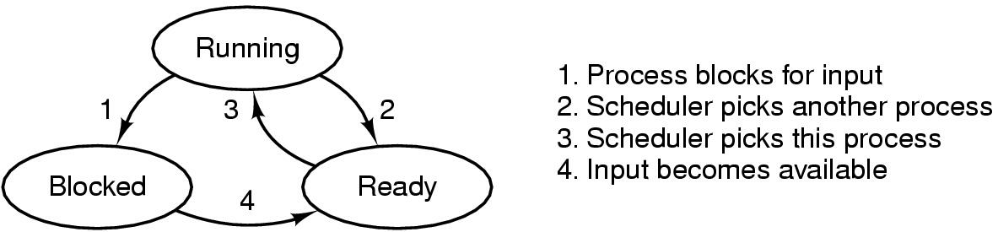
Process States
Possible process states:
  Running
  Blocked
  Ready
Transition between states

Slide 12
Example of Changing Process States
Process A: CPU-bound the whole time
Process B: about to read from user, block, eventually unblock
Process C: about to write a large file to disk, block on output, eventually unblock

Slide 13
Changing Process States (cont’d)
Key: running
ready
blocked
ch input
int
disk
int
ch input
int
disk
int
Process A
Process B
running
Process C
a
b
c
d
e
f
g
h
i
j
k
a: preempt A, schedule B f: int for disk write, not done
b: block B, schedule A g: int for char input, done
c: preempt A, schedule C h: preempt A, schedule B
d: block C, schedule A i: block B, schedule A
e: int for char input, not done j: int for disk write done, C ready
k: preempt A, schedule C

Slide 14
Changing Process States (cont’d)
Interrupts ride on the currently-running process
Interrupt handler execution between two instructions of the currently-running process
The interrupt handler is kernel code and uses only kernel data, and purposely ignores data in the current process.
  When process A is running, process A’s data is loaded in the user memory.
  Process A is interrupted when a char for process B is received. The interrupt handler processes the incoming data using kernel data.
  This is typical
    - each process is bombarded with interrupts for other processes’ data,
    - process is usually blocked during the time when interrupts for its own data come in.

