Slide 1
Process Tables; Threads
Reference on process tables
  text: Tanenbaum ch. 2.1
Reference on Threads
  text: Tanenbaum ch. 2.2

Slide 2
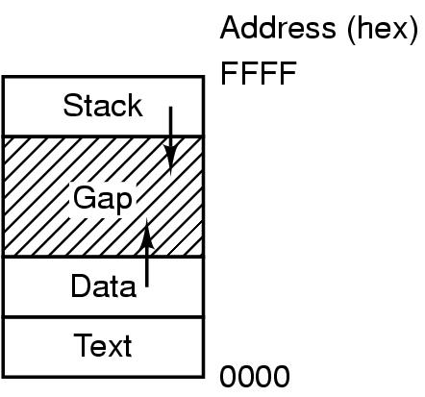
Memory Segments of a UNIX Process
FFFFFFFF
Variables
Program
00000000

Slide 3
Implementation of Process
Operating system maintains a process table
one entry per process
contains info such as program counter, stack pointer, memory allocation, status of open files, registers before state change, etc

Slide 4
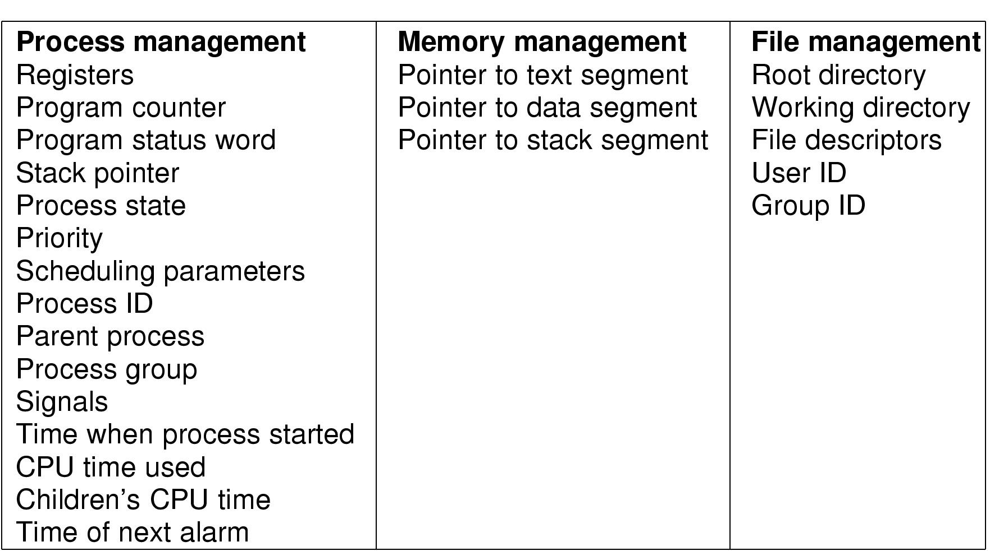
Fields of a Process Table Entry

Slide 5
Process Management Field
Registers (Saved registers)
  contains copies of CPU registers at the moment the process is blocked or being preempted
  the values are copied back into the CPU when the process is scheduled to run
Stack pointer
  stores pointer to the process stack

Slide 6
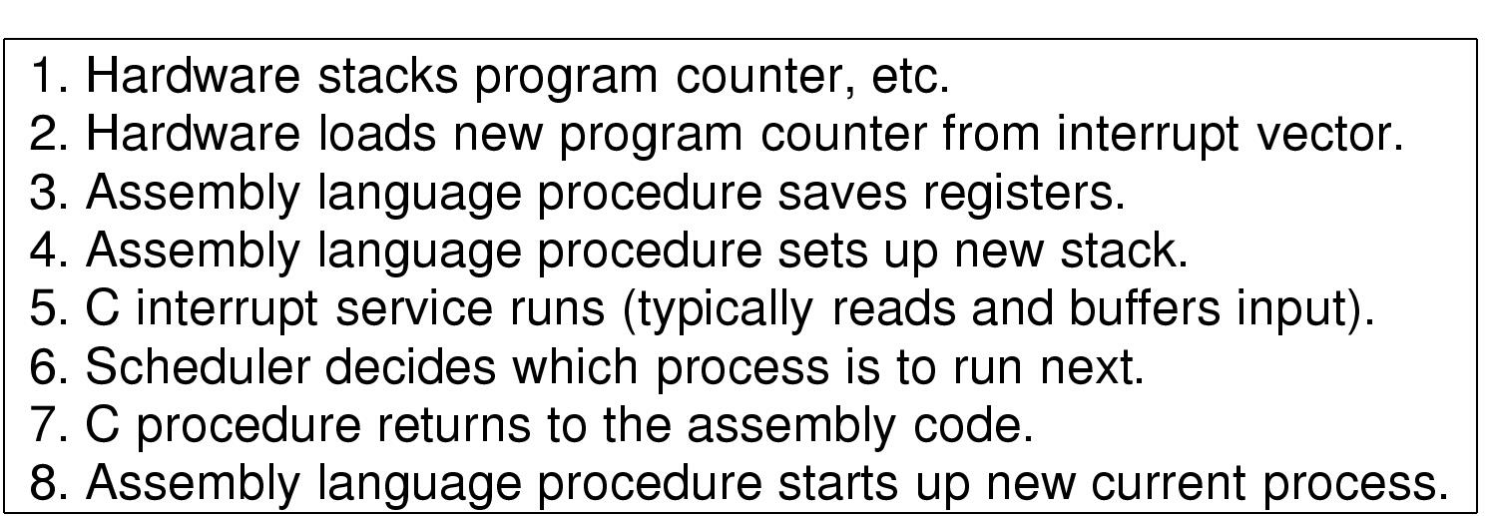
Lowest Level of OS operations when an Interrupt Occurs

Slide 7
Interrupt
Diagram
Proc #3
Proc #4
Stack
Stack
Data
Data
iret
Code
Code
User
#1
Kernel
Kernel Stack Proc #3
#3
PC
#9
PSW
etc
ISR
Process Table
Save registers on stack;
Set up new temporary stack ;
Call C routine to service interrupts;
Scheduler to decide which process to run next;
Save registers, PSW, PC, stack for Proc #3;
Load registers; Load PSW, PC, etc;
Run Proc #4;
Load registers,PSW,PC,stack for Proc #3;
iret
TempStack
#4
Proc #3
Proc #4
Proc …

Slide 8
Interrupt Processing Steps
Steps 1 and 2
  A part of CPU Interrupt cycle
  CPU switches to kernel stack before pushing items on the stack
Steps 3-8 interrupt handler
Step 4
  optional, many OS kernel allows interrupt handler to execute on the kernel stack
Step 6
  Scheduler loops through process table entries, looking for the highest priority ready process
Step 8
  Real process switch: CPU state and address space get switched
Add a Step 9
  iret will get delayed if a process switch occurs

Slide 9
Kernel Stack for Processes
Each process needs its own kernel stack to execute in the kernel(e.g. making a syscall for read)
If CPU gets blocked, whole execution environment held on stack and CPU state has to be saved before process switch
Another process can also do a syscall and it needs a kernel stack as well.
Implementation of process table and kernel stack varies from OS to OS

Slide 10
Kernel Stack and Interrupt Handlers
Interrupt can occur during running of kernel code.
Interrupt is doing work for another process that is blocked(e.g. ttyread and irqinthand in hw2).
Borrow the current process’s kernel stack to execute interrupt handler.
Kernel stack will be back to previous stack when handler finishes.

Slide 11
Threads
Definition
  execution flow of the process
A thread has:
  PC: keep track of which instruction to execute next
  Registers: holds current working variables
  Stack: execution history
  State: running, blocked, ready or terminated
Multithreading allows multiple execution to take place in the same process environment
Achieves higher performance by avoiding address space switching between processes

Slide 12

The Thread Model
(a) Three Processes
  3 different address space and 3 threads(single thread)
(b) One Process
  1 address space and 3 threads (multithreading)

Slide 13
Operations of Multithreading
Share the same address space (e.g. global variables), same resources( e.g. open files,, alarms and signals), same child processes etc.
Owned by a single user
Designed to work co-operatively. Use mutex in critical sections to make this happen.

Slide 14

A Multithreaded Web Server
/*** dispatcher thread ***/ /*** worker thread ***/
while (TRUE){ while(TRUE){
get_next_request(&buf); wait_for_work(&buf);
handoff_work(&buf); look_for_page_in_cache(&buf, &page);
} if(page_not_in_cache(&page))
read_page_from_disk(&buf,&page);
return_page(&page);
}

Slide 15
Simplified POSIX Thread APIs
void thread_create(thread, func, arg)
  Create a new thread
  Concurrent with the calling thread, thread executes func with argument arg
void thread_yield()
  Calling thread voluntarily gives up the processor to let some other thread run
  The schedule can resume running the calling thread later
int thread_join(thread)
  Wait for thread to finish; then return the value passed by thread_exit
void thread_exit(ret)
  Finish the current thread
  Store the return value in the current thread’s data structure

Slide 16
A Simple Multi-Thread Program
/* threadHello.c -- Simple multi-threaded program built with
gcc -g -Wall -Werror -D_POSIX_THREAD_SEMANTICS threadHello.c -c -o threadHello.o
gcc -g -Wall -Werror -D_POSIX_THREAD_SEMANTICS thread.c -c -o thread.o
gcc threadHello.o thread.o -o threadHello –lpthread */
#include <stdio.h>
#include "thread.h"
static void go(int n);
#define NTHREADS 10
static thread_t threads[NTHREADS];
int main(int argc, char **argv) {
int i;
long exitValue;
for (i = 0; i < NTHREADS; i++){
thread_create(&(threads[i]), &go, i);
}
for (i = 0; i < NTHREADS; i++){
exitValue = thread_join(threads[i]);
printf("Thread %d returned with %ld\n",
i, exitValue);
}
printf("Main thread done.\n");
return 0; }
void go(int n) {
printf("Hello from thread %d\n", n);
thread_exit(100 + n);
// Not reached
}

Slide 17
Running threadHello.c
$ ./threadHello
Hello from thread 1
Hello from thread 6
Hello from thread 0
Hello from thread 7
Hello from thread 4
Hello from thread 5
Hello from thread 2
Hello from thread 3
Hello from thread 8
Hello from thread 9
Thread 0 returned with 100
Thread 1 returned with 101
Thread 2 returned with 102
Thread 3 returned with 103
Thread 4 returned with 104
Thread 5 returned with 105
Thread 6 returned with 106
Thread 7 returned with 107
Thread 8 returned with 108
Thread 9 returned with 109
Main thread done.

