Slide 1
Thread Implementations; MUTEX
Reference on thread implementation
  text: Tanenbaum ch. 2.2
Reference on mutual exclusion (MUTEX)
  text: Tanenbaum ch. 2.3.3

Slide 2
Non-Blocking I/O
A competing method for doing multi-activity programming
Use extensively in data base server code doing writes
I/O system calls return immediately. They just drop off an I/O request with the OS.
App checks later on the status or get notified by signals.
In the mean time, the app can serve another request.

Slide 3
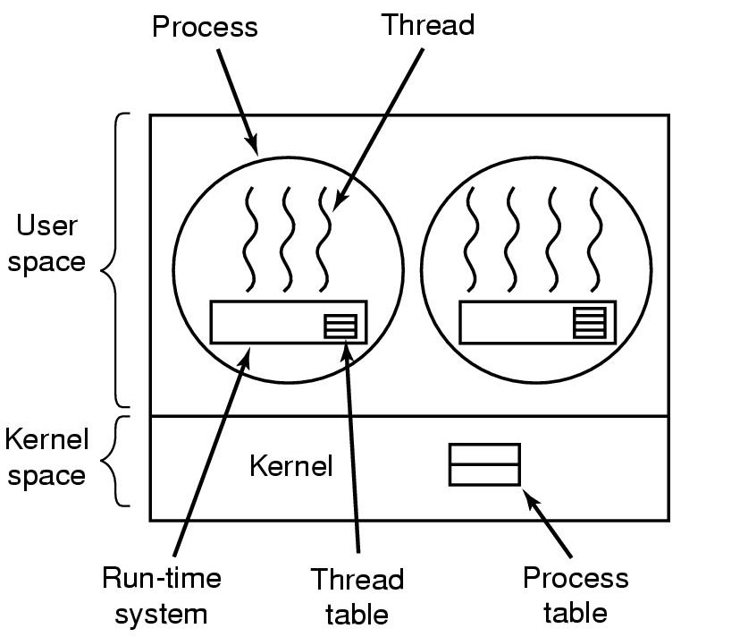
Implement Threads in User Space
Implement the entire threads package in user space without the kernel knowing about them
writing a user level scheduler inside one thread to implement multithreading
When 1 thread gets blocked by a system call, all user level threads get blocked

Slide 4
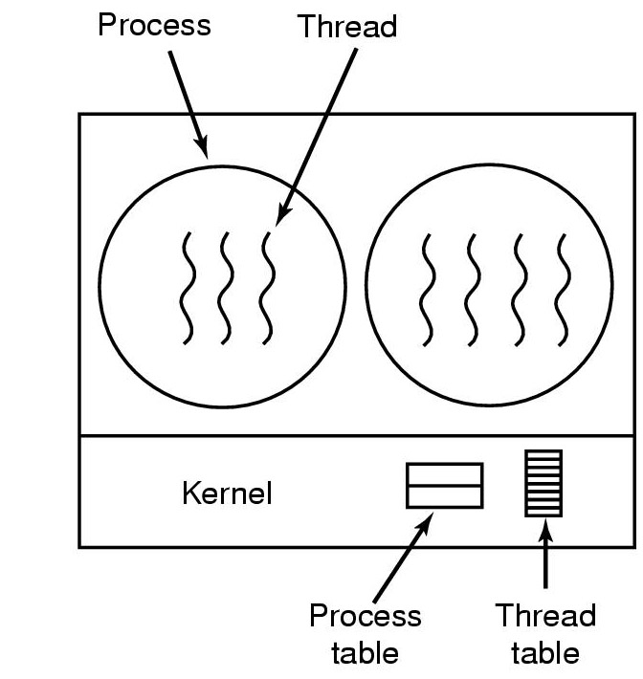
Implement Threads in the Kernel
Kernel manages the threads
Use system calls to create a new or destroy an old thread
When a thread is blocked, the kernel can run other threads
More costly to make system calls than calls into a user mode run-time system

Slide 5
Thread Safe Libraries
Multi-threading coding is tricky: shared variables cause race conditions
Libraries can cause thread-related problems
Most of the common C lib calls are thread safe,
e.g. printf, strcpy,malloc, etc
Examples of non-thread safe C lib calls(there are only 10):
e.g. ctime, rand, strtok etc.
Thread safe version: ctime_r, rand_r, strtok_r etc.

Slide 6
Difference between ctime and ctime_r
“man ctime” shows both versions:
char *ctime(const time_t *clock);
char *ctime_r(const time_t *clock,char *buf, int buflen);
Where is the memory buffer holding the return string? - in C library’s static data
If 2 threads are using ctime, the internal buffer will get overwritten
With ctime_r, each thread passes its own string buffer. So there is no problem.

Slide 7
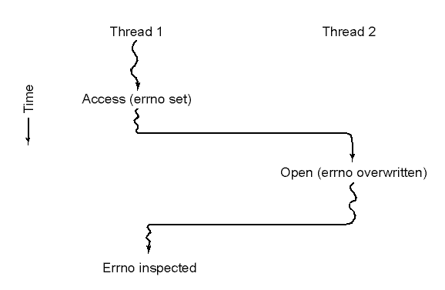
Making Single Thread Code Multithreaded
Problems with variables that are global to a thread but not the program
The errno example: error code is put in errno when a process (or thread) makes a system call that fails

Slide 8
Workaround for errno
On Solaris, define a macro in errno.h:
#ifdef xxx
#define errno (*(_errno())) /***thread safe way ***/
#else
extern int errno; /*** old single-thread way ***/
#endif
When you write: if(errno = = EINTR), you are really calling _errno function to get the errno for your thread
The underlying function _errno() returns a pointer to the thread -private cell for errno, not the value
The function has to determine the thread id (via a system call) and find the errno spot for that thread

Slide 9

Mutual Exclusion Using Critical Regions

Slide 10
Mutual Exclusion with Busy Waiting
Disabling Interrupts
Locked Variables
Test and Set Lock (TSL)
Strict Alternation
Peterson’s Solution

Slide 11
Disabling Interrupts
Each process disables interrupts just after entering its critical region and re-enables them just before leaving it
Not a good solution
  too dangerous to have a user program turn on/off interrupts
  in a multiprocessor environment, turning off interrupt only affects 1 processor
Useful mutual exclusion technique only for OS code

Slide 12
Locked Variables
Use a single shared(lock) variable. Test the lock before entering critical region
If the lock is 0, the process sets it to 1 and enters the critical region
If the lock is 1, the process waits until it becomes a 0
Code example:
while(lockforD = =1); /*** test the lock ***/
lockforD = 1; /*** set the lock ***/
Potential
problem

Slide 13
Test and Set Lock Problem
If the locked variable code is preempted just after lockforD go to 0, another process can run
The second process sees lockforD = 0, enters into critical region and set lockforD =1
When the first thread starts up again, it also enters into critical region because of the result of the test

Slide 14
TSL Instruction
Special atomic TSL instruction: Do Test and set lock in one instruction
Use “interlocked test-and-set” instruction to lock the bus between multiprocessors
Locks based on TSL are called spin locks
Example for x86 processor:
enter_region:
btsl $1, lockforD # atomic test-and-set bit 1
# lockforD -> CF, 1 ->lockforD
jc enter_region # test CF flag: If it is 1, try again
ret # If it is 0, access region
leave_region:
movl $0, lockforD # set to 0
ret

Slide 15
Spin Locks Details
How “btsl” works:
  1. Read bit 1 of lockforD into the CF bit of EFLAGS register
  2. Set bit 1 of lockforD to 1
  3. If CF=1, go back to enter_region and continue testing
  if CF=0, we have the lock and can go in critical region
Advantages
  no system calls; use special CPU capability
  can be used in kernel or user code
Disadvantages
  wastes CPU by spinning(use semaphores to block for longer waits)
  needs assembler coding

