Slide 1
Demand Paging
Reference
  text: Tanenbaum ch.4.3.3-4.4
Reference on UNIX memory management
  text: Tanenbaum ch. 10.4

Slide 2
Paging Overhead
4 MB page tables are kept in memory
To access VA 0x12345678, we need to do 3 memory references. A large burden!
  look up entry 0x48 in page directory
  look up entry 0x345 in page table
  look up address 0x678 in the page frame
Use hardware Translation Lookaside Buffers (TLB) to speed up the VA to PA mapping

Slide 3
Translation Lookaside Buffer (TLB)
Make use of the fact that most programs make a large number of memory references to a small number of pages
Construct a cache for PTEs from associative memory
Part of MMU hardware that stores a small table of selected PTEs
Hardware first checks the virtual page number against table entries. If there is a match, use the page frame number from TLB without looking up from the page table

Slide 4
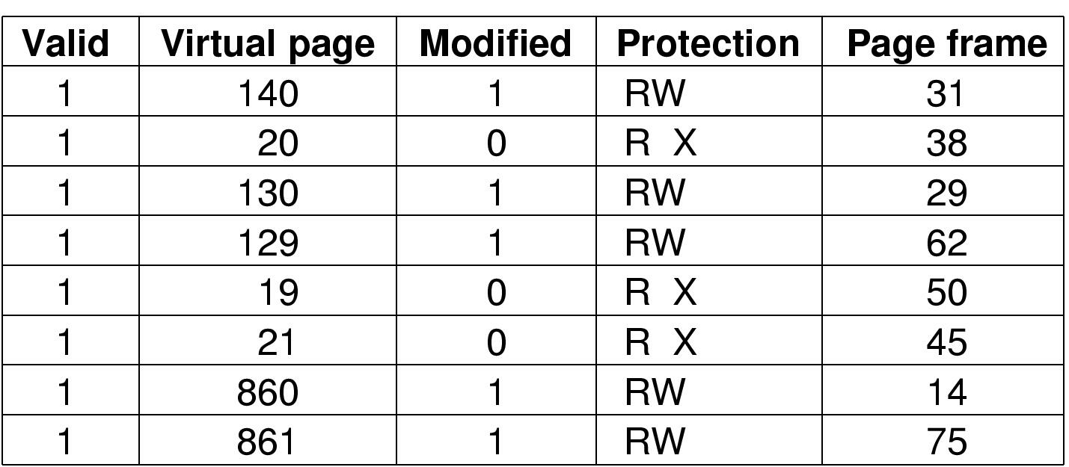
Example of TLB
Typical small table 4-64 entries
Pentium 4 has two128 entries TLBs (1 for instruction address and 1 for data address)

Slide 5
How TLB works
MMU first checks whether virtual page is present in the TLB
If it is, the page frame number is taken from the table
If it is not, MMU does a normal page table lookup. It evicts an entry from the table and replace it with the new one

Slide 6
Inverted Page Tables
Used by 64-bit computers to overcome the huge page table problem
With 2⁶⁴ address space and 4K page size, page table is 2⁵² entries. Huge storage required!
Instead of storing 1 virtual address per entry, the inverted table use 1 entry per page frame
With 256 MB physical memory and a page size of 4096 bytes, need a page table of 2¹⁶=65536 entries
Table contains info such as process, virtual page

Slide 7
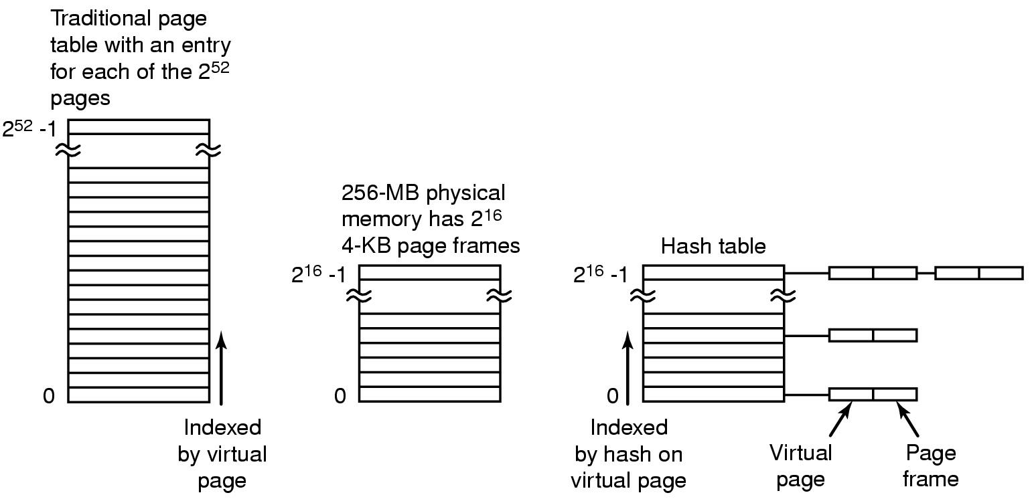
Inverted Page Table (cont’d)
Need to search the 64K table on every memory address
Use TLB for heavily used pages. Use hash tables to speed up search of virtual address to page frame for others.

Slide 8
Page Replacement Algorithms
Which page to throw out at page fault?
Optimal Page Replacement Algorithm
  Page that will not be used for a large number of instruction times from now will be removed
  But how does the OS know that in advance?
  Not a realizable algorithm

Slide 9
Not Recently Used(NRU) Page Replacement
Make use of the D bit and A bit to determine which page is used and which one is not
When a process is started up, both bits are cleared. Periodically(~20ms), the A bit is cleared to distinguish pages that have not been referenced recently from those that have been.
When a page fault occurs, the OS inspects all the pages and divides into 4 categories:
  class 0: not referenced, not modified
  class 1: not referenced, modified
  class 2: referenced, not modified
  class 3: referenced, modified
NRU algorithm removes a page at random from the lowest numbered non-empty class.

Slide 10
Not Frequently Used (NFU) Software Algorithm
Use a counter per page to keep track of A bits
At every clock tick(~20ms), the value of the A bit is added to the counter
Page with the lowest counter value gets replaced during page fault
Problem is that it never forgets anything.
  Heavily used pages during early passes can result in a high counter value at later passes
  highest counter value if the early pass execution time is the longest

Slide 11
First-In First-Out (FIFO) Page Replacement
OS maintains a list of all pages currently in memory
Arrange the list according to when the pages are put on the list
On a page fault, the oldest page is removed and the new one is put on the list
No idea if the page removed is frequently used or not

Slide 12
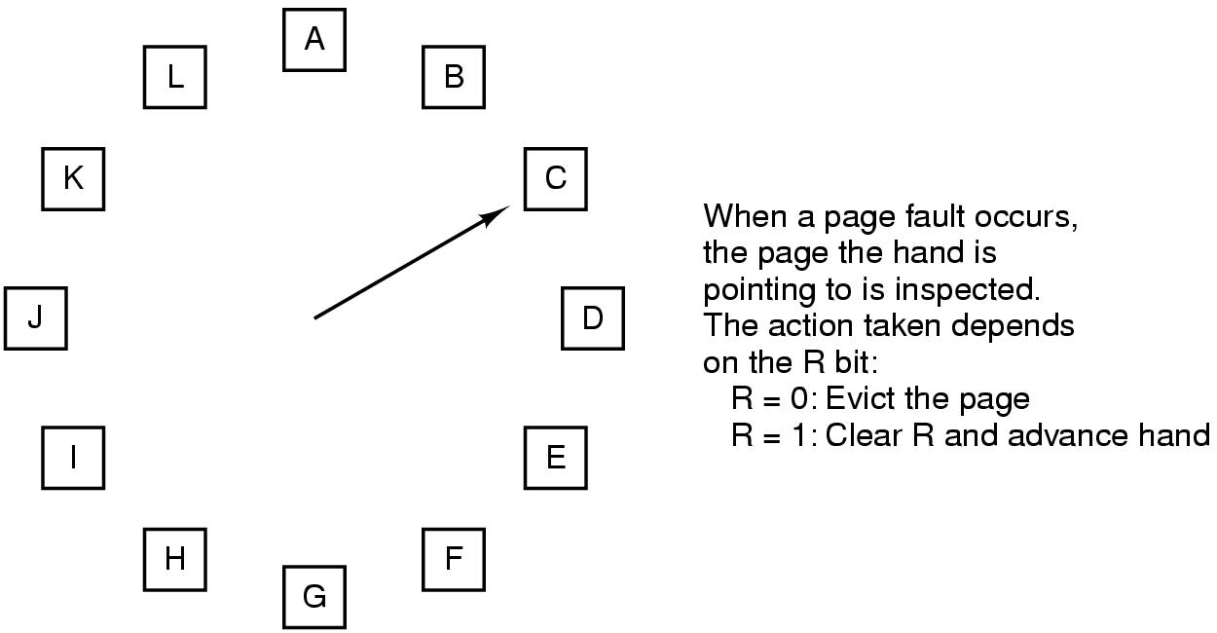
Clock Page Replacement
Page frames
A bit in x86
Process is repeated until a page is
found with R=0

Slide 13
Belady Anomaly
Page fault rate gives some info on how paging is doing
Compare page replacement algorithms by running the same workload and look at page fault rate using vmstat -s
The anomaly
  Adding more physical memory increases the number of page faults
  reason: the poor FIFO page replacement algorithm

Slide 14
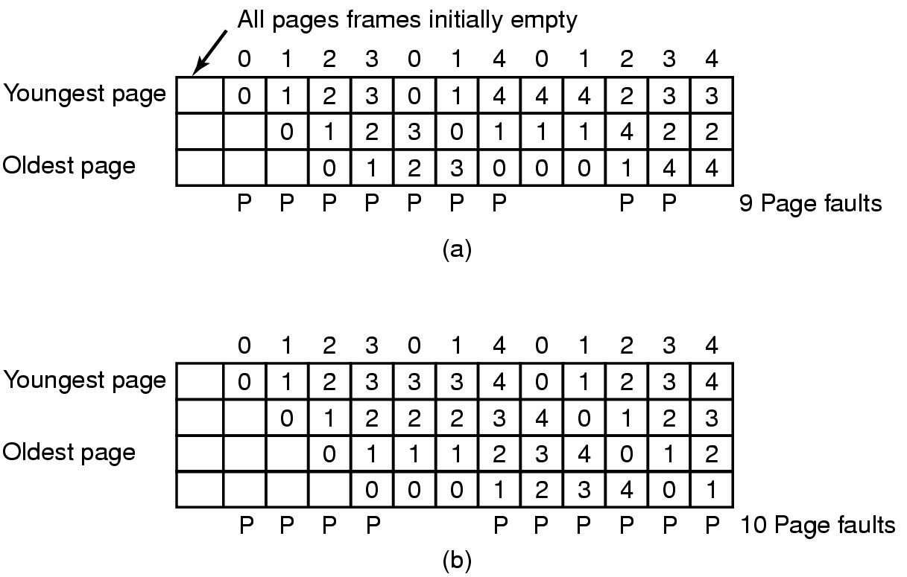
Illustration of the Belady Anomaly
FIFO with 3 page frames
FIFO with 4 page frames
Pages are referenced(the reference string):
0 1 2 3 0 1 4 0 1 2 3 4
P's show which page references show page faults

Slide 15
Least Recently Used (LRU) Page Replacement
Use the assumption that the heavily used pages in the last few instructions will be heavily used again in the next few.
When a page fault occurs, throw out the page that has been unused for the longest time
Expensive to maintain the linked list at every memory reference (finding the page, deleting, and moving it to the front)
Not used in OSes, but used by database servers in managing buffers

Slide 16
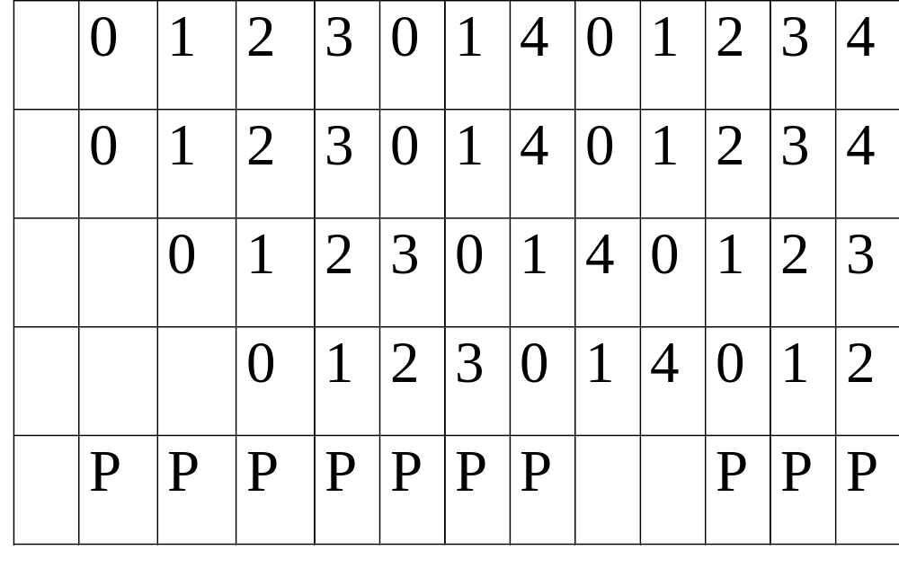
What is the LRU Algorithm?
Page Reference Order
Youngest
page
Oldest
page
10 PF’s compared to 9 with FIFO
FIFO keeps “4” in memory because it comes in last
Even a bad algorithm shines under the right circumstances

Slide 17
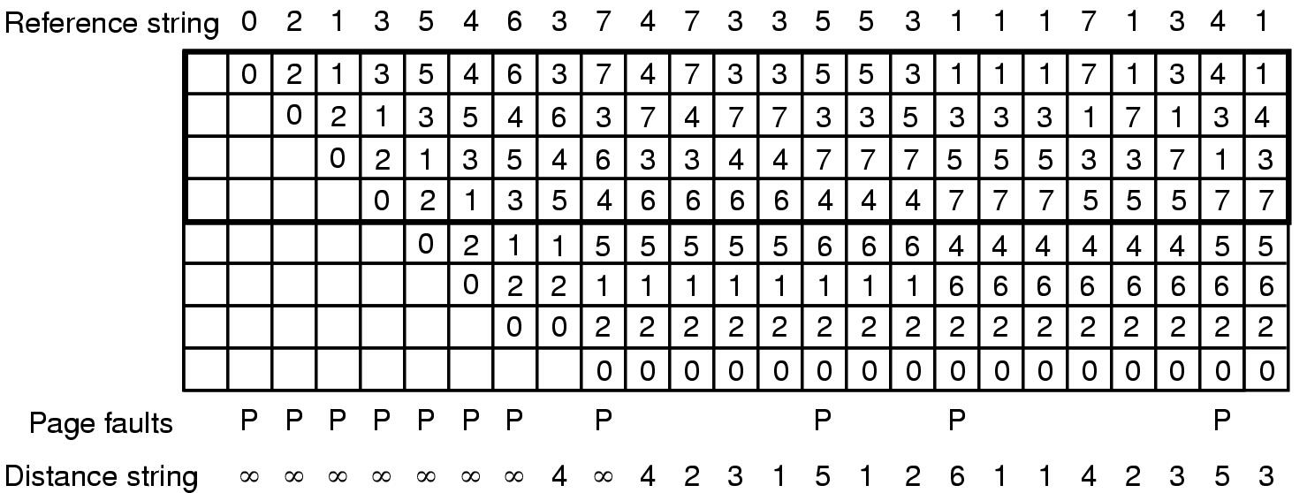
Stack Algorithms
A paging system is characterized by:
  the reference string
  the page replacement algorithm
  number of pages stored in memory(m)
A LRU Page Replacement example (page fault=11 for m=4)
Pages in memory (m)
Total # of virtual Pages (n)

Slide 18
Stack Algorithms (cont’d)
Properties of LRU algorithm
  the referenced page always move to the top entry of array M
  if the referenced page is in memory, all pages above it move down by one position
  pages below the referenced page are not moved
Belongs to a class of algorithms that M(m,r), the set of pages in memory at step r of a reference string, satisfies:
  M(m, r) ⊆ M(m+1, r)
  where m = pages in memory
  r = index to the reference string

Slide 19
Examples
Because M(m,r) is always a subset of M(m+1,r), one more page of physical memory can cause additional pages to be stored in memory, not drop any.
For the Belady sequence, M(3,7) ={0,1,4}, M(4,7) = {1,2,3,4}. FIFO is not a stack algorithm
For the LRU algorithm, M(4,14)={5,3,7,4}, M(5,14) = {5,3,7,4,6}. LRU is a stack algorithm. Page fault=9 for m =5
m=5

Slide 20
Distance Strings
Represent page reference by distance strings- distance from the top of the stack where the reference page was located
For example in LRU algorithm:
  distance for M(4, 8) =4
  distance for reference not on stack yet = ∞
  with m=3, all distances > 3 corresponds to page faults
  with m=4, all distances > 4 corresponds to page faults

Slide 21
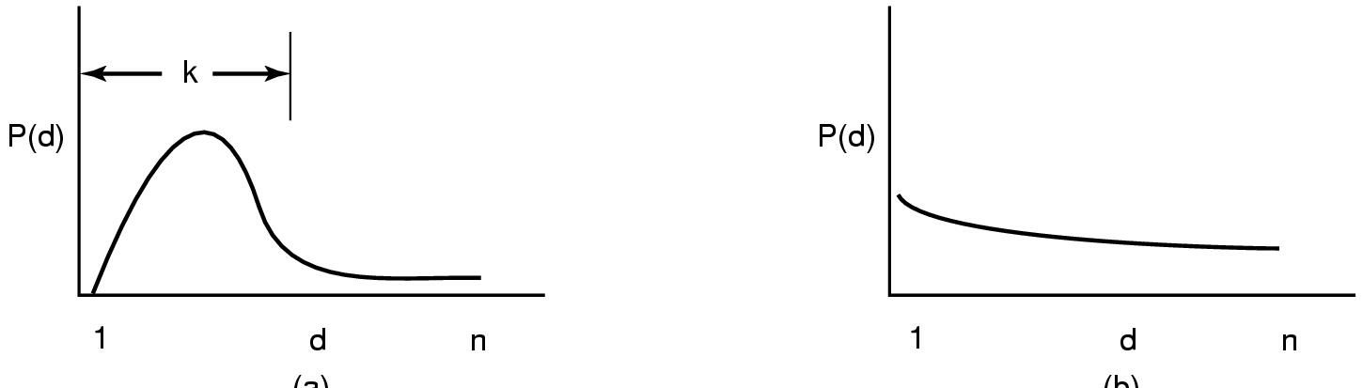
Probability density functions for distance strings
Statistical properties have a big impact on the page replacement algorithm performance
P(d) is the probability that the number of virtual page will be accessed
With a memory of k page frames, few page faults occur
Need a lot more page frames to avoid page faults

Slide 22
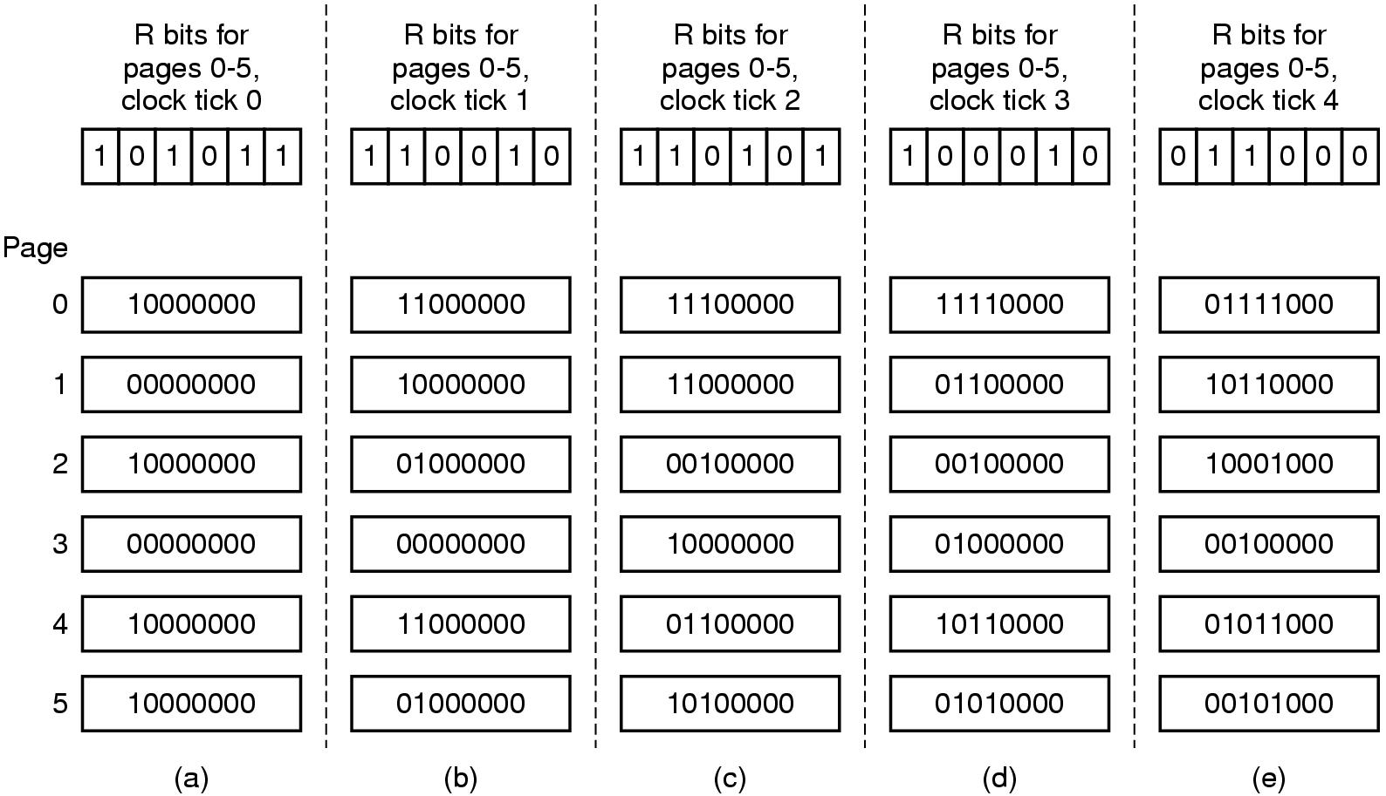
Simulation of LRU in Software
The aging algorithm simulates LRU in software
Note 6 pages for 5 clock ticks, (a) – (e)
Page 0
Page 5
00010000

Slide 23
Differences with the Aging and LRU Algorithm
For pages 3 and 5 at tick#4 (in figure e):
  Both had not been accessed at ticks #3 and #4
  Both had been access at tick #2, but we don’t know which one was referenced last
  Replace page 3 based on the fact that the page #5 was referenced at tick #1
  The counters have a finite of bits (e.g. 8). There is no reference history recorded at 8 tick time before. Page replacement is random if the pages have not been accessed for 160ms (@20ms per tick).

Slide 24
Working Set Page Replacement
Locality of Reference
  During any phase of execution, the process only references a relatively small fraction of its pages
Working Set
  set of pages that a process is currently using
If the entire working set is in memory, the process will run without page faults. If the available memory is too small, thrashing occurs.
Prepaging
  Many paging systems keep track of each process’ working set and make sure it is in memory before letting the process run

