Slide 1
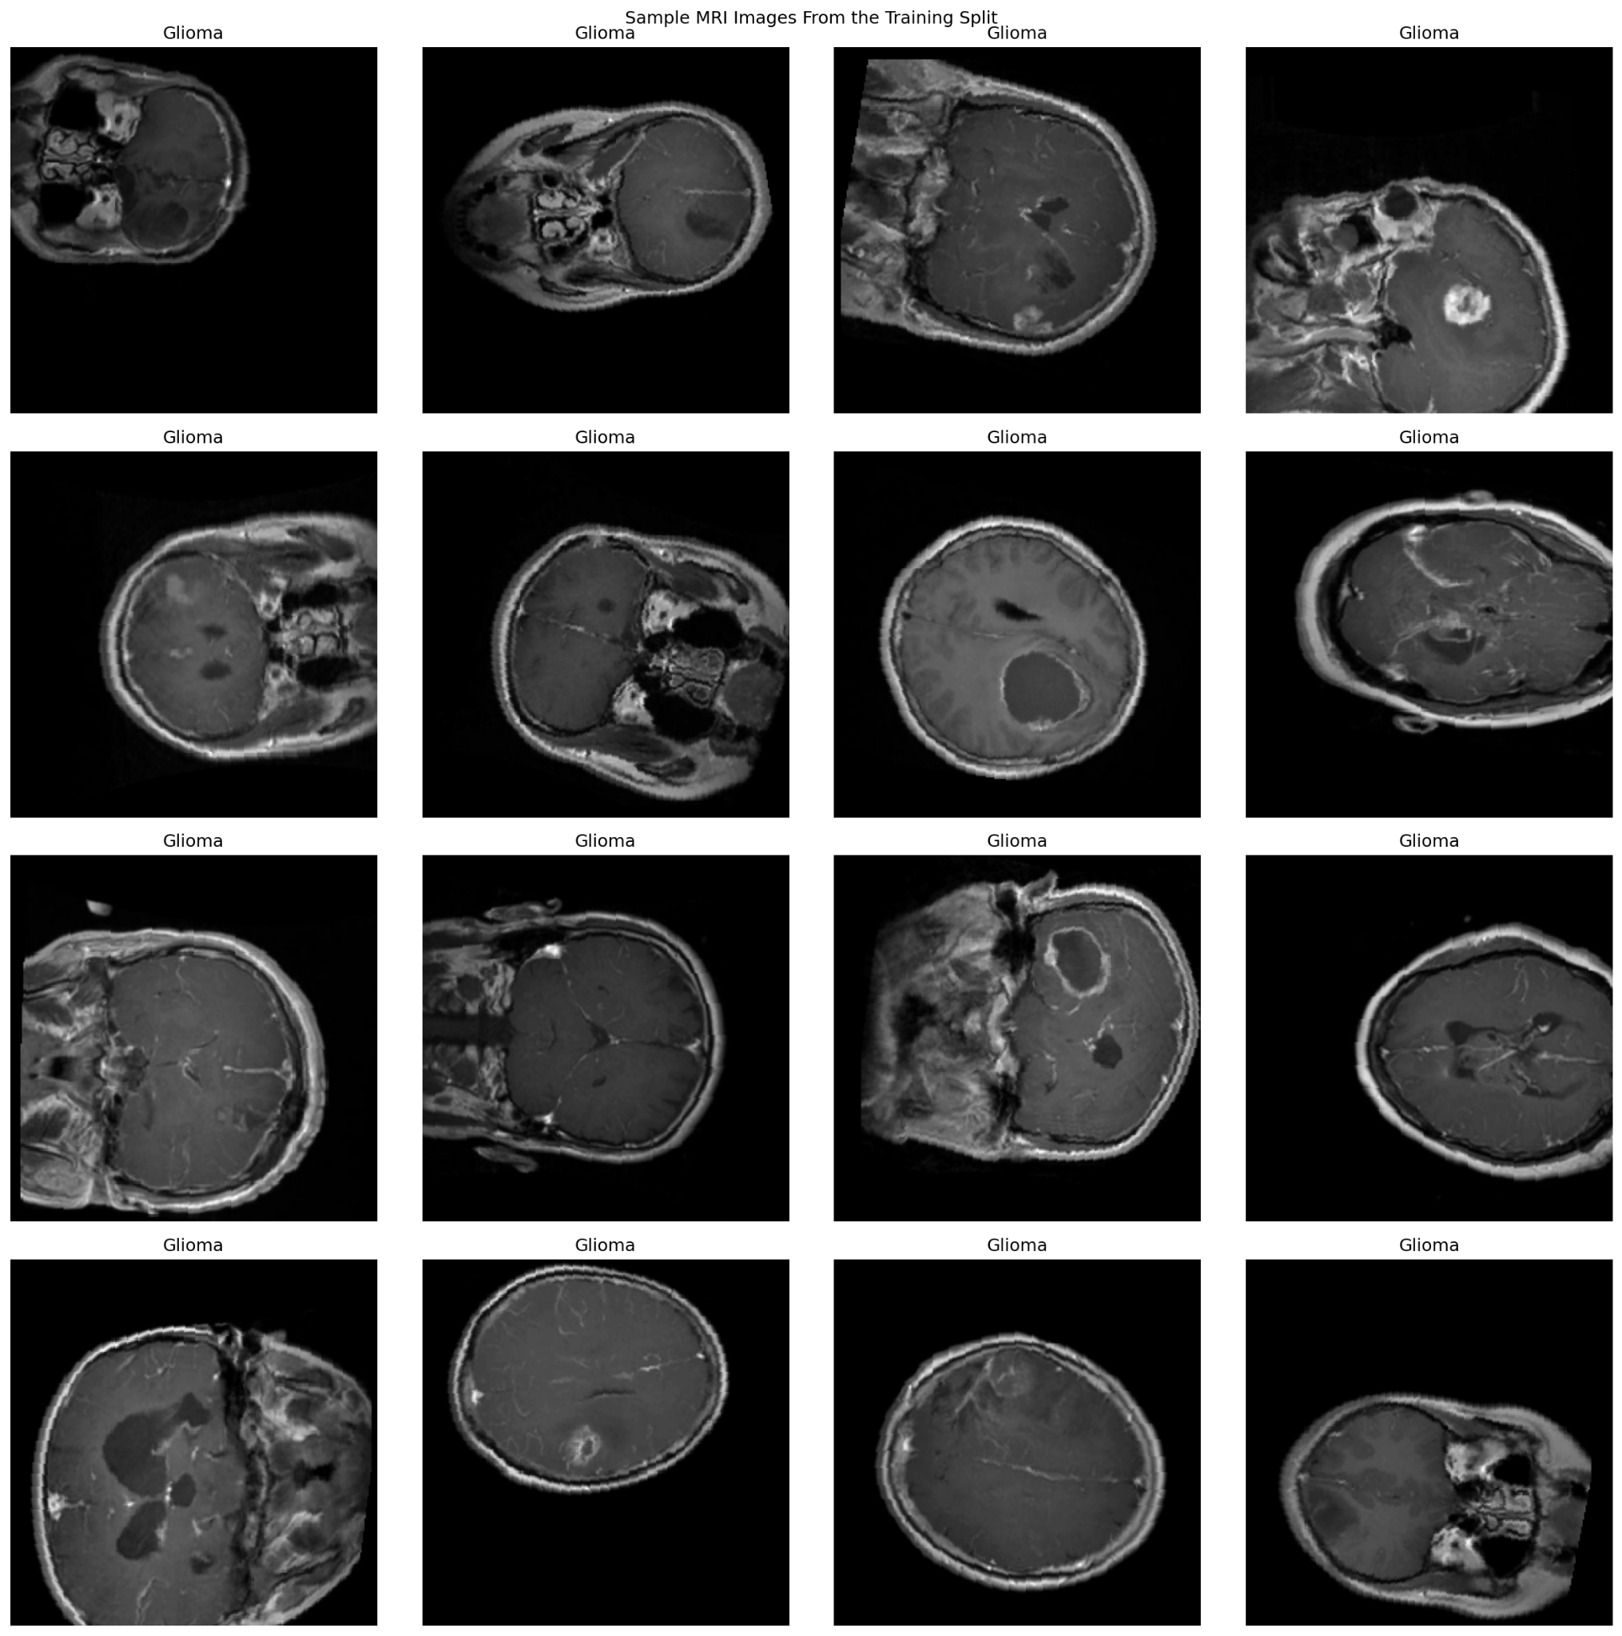
Brain Tumor MRI Classification Model
Final Project – MPHY 6120 AI in Medicine
Nehemyah Green, Ledi Anggara, Trent Levy
Apr 29, 2026
Notes:
Title slide. Introduce the model as a support tool for classifying brain tumor MRI slices into glioma, meningioma, and pituitary tumor. Emphasize this is a review board presentation, not a claim for autonomous diagnosis.
Final Project – MPHY 6120 AI in Medicine
Nehemyah Green, Ledi Anggara, Trent Levy

Slide 2
THE PROBLEM
The Clinical Need
The tool is designed to support image review, not replace clinical interpretation.
Clinical need
Glioma, meningioma, and pituitary tumors can require different clinical management.
MRI review depends on expert interpretation and can vary with image quality, slice selection, and reader experience.
A consistent AI second reader may help triage cases, support education, and provide an additional check during review.
Representative MRI slices from the training split
Section 1 of 5 | The Problem
Brain tumor MRI classifier | Review board presentation
Notes:
1 min
Problem slide. Keep it clinical. Explain that the issue is not only whether AI can classify images, but whether it can do it in a way that is consistent, transparent, and safe enough to be useful in workflow.
Clinical framing:
The safest intended use is decision support: the model can suggest a tumor class and show visual evidence, while the final decision remains with the clinician.

Slide 3
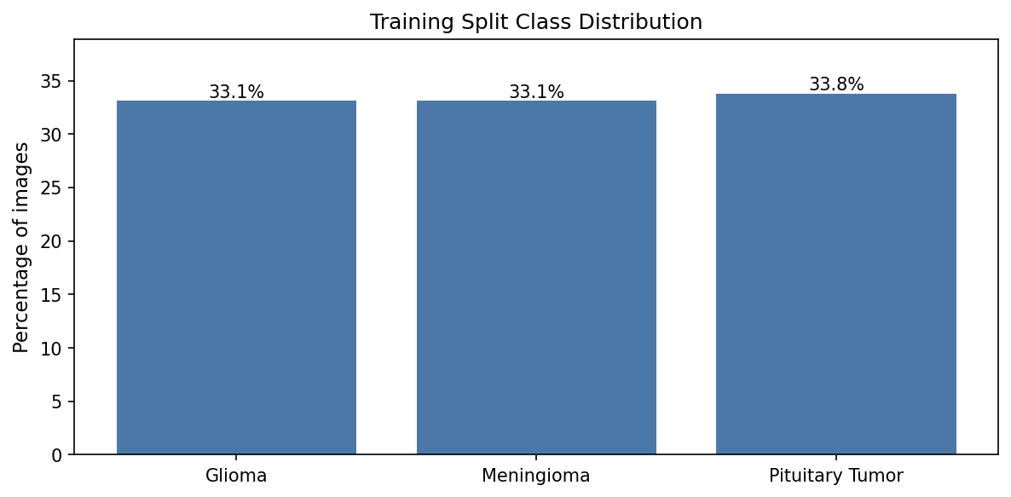
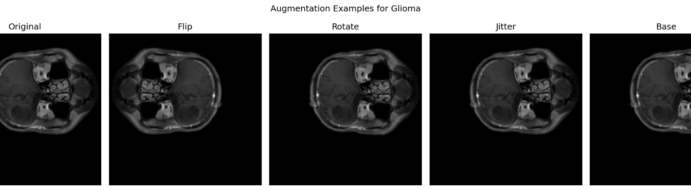
DATA & APPROACH
Dataset
Single 2D MRI slices were used to build and evaluate a three-class classifier.
4,239
908
909
3
training images
validation images
test images
classes
Data decisions
Training split class distribution
Classes: glioma, meningioma, and pituitary tumor.
Dataset was deduplicated.
Images were normalized and resized for model input.
Augmentation was used to reduce overfitting and teach the model to ignore small acquisition differences.
Evaluation was performed on a held-out test set.
Examples of augmentation applied to training images
Section 2 of 5 | Data & Approach
Brain tumor MRI classifier | Review board presentation
Notes:
1.5 MIN
Data slide. Mention that the dataset appears balanced across classes, which makes overall accuracy easier to interpret. Explain augmentation simply: small image changes used during training so the model does not memorize exact images.

Slide 4
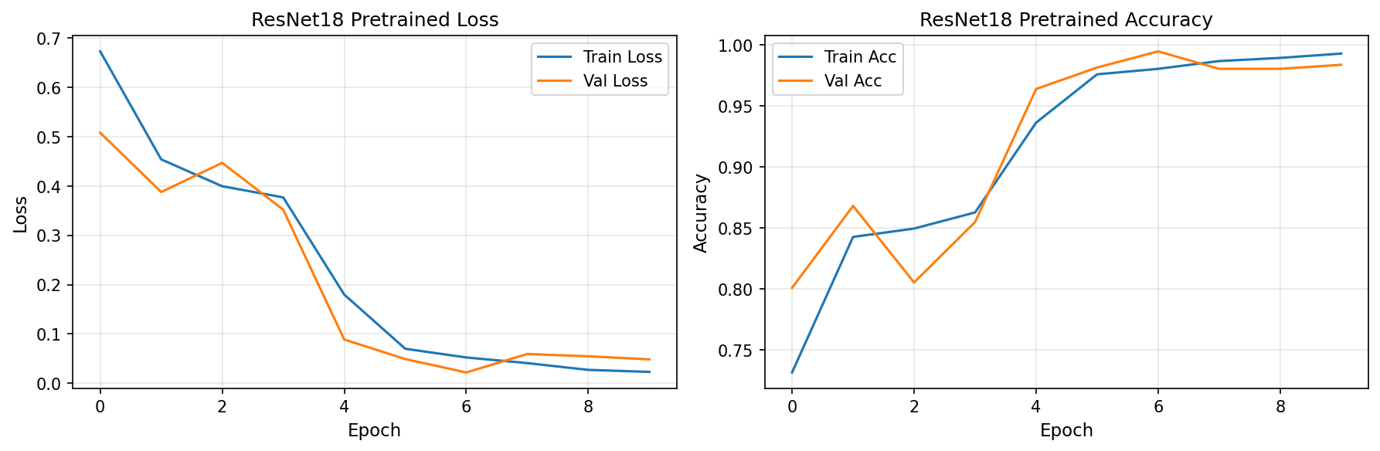
DATA & APPROACH
The Model - ResNet18 transfer learning classifier
Technical choices were kept practical: pretrained CNN, limited training time, and multiple explanation checks.
MRI slice
Preprocess + augment
ResNet18 pretrained
Class + confidence
Training and validation curves
Loss -Accuracy Curve for Train and Validation dataset for ResNEt18 Pretrained
Key technical decisions: transfer learning, class-balanced evaluation, confidence calibration review, and two interpretability methods.
Section 2 of 5 | Data & Approach
Brain tumor MRI classifier | Review board presentation
Notes:
1.5 min
Technical approach. Explain transfer learning in plain language: starting from a model that already knows general image patterns, then adapting it to brain MRI tumor classes. Point to training curves: loss decreases and accuracy increases without major divergence.

Slide 5
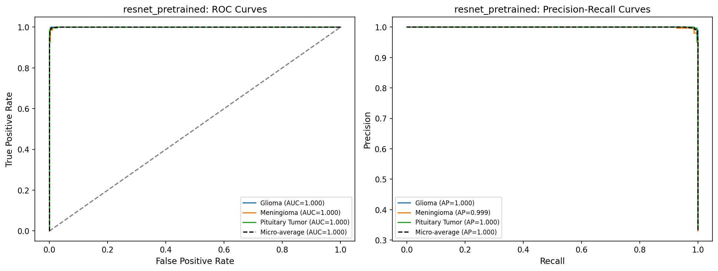
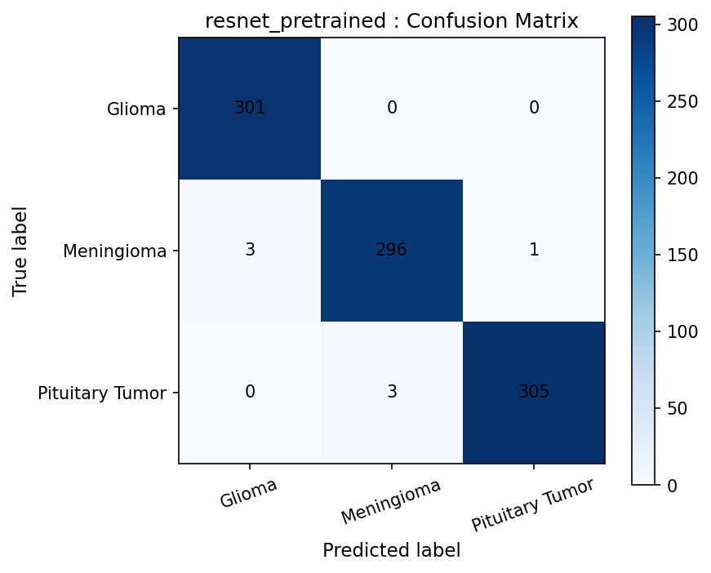
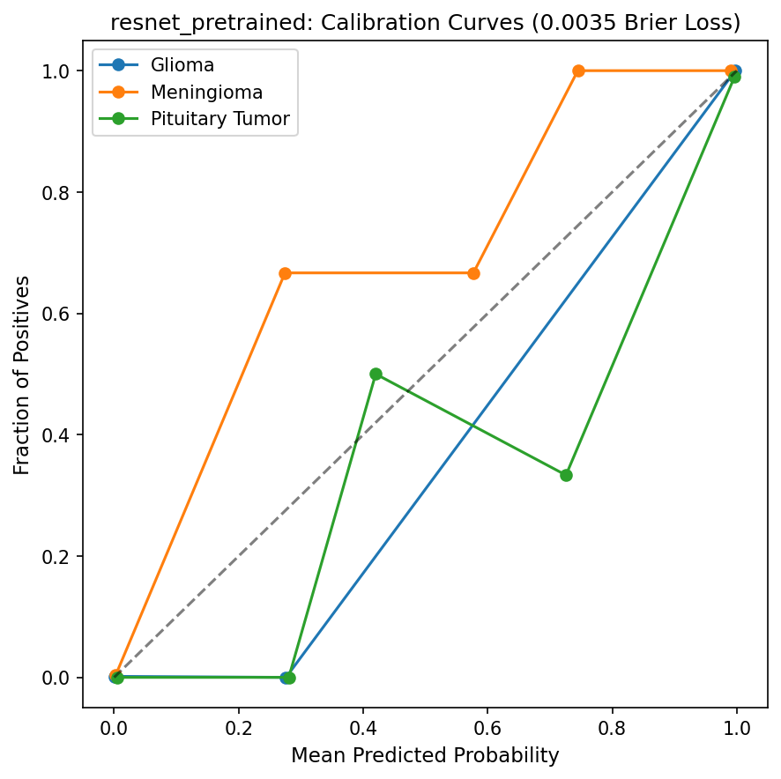
RESULTS
Test Performance
The model performed well on the internal test set, but errors cluster around meningioma cases.
0.99
1.000
0.0035
Macro Accuracy
ROC-AUC
all classes ≈ 1.00
Brier loss
lower is better
ROC and precision-recall curves
Assessment
Errors are rare but clinically meaningful.
Confidence is often very high, so calibration must be monitored.
External validation is still required.
Confusion matrix on held-out test set
Calibration curve
Section 3 of 5 | Results
Brain tumor MRI classifier | Review board presentation
Notes:
Results slide. State the key numbers clearly: 902 correct out of 909 on the test set. Do not oversell. Emphasize that excellent internal performance does not automatically mean the model is ready for independent clinical deployment.

Slide 6
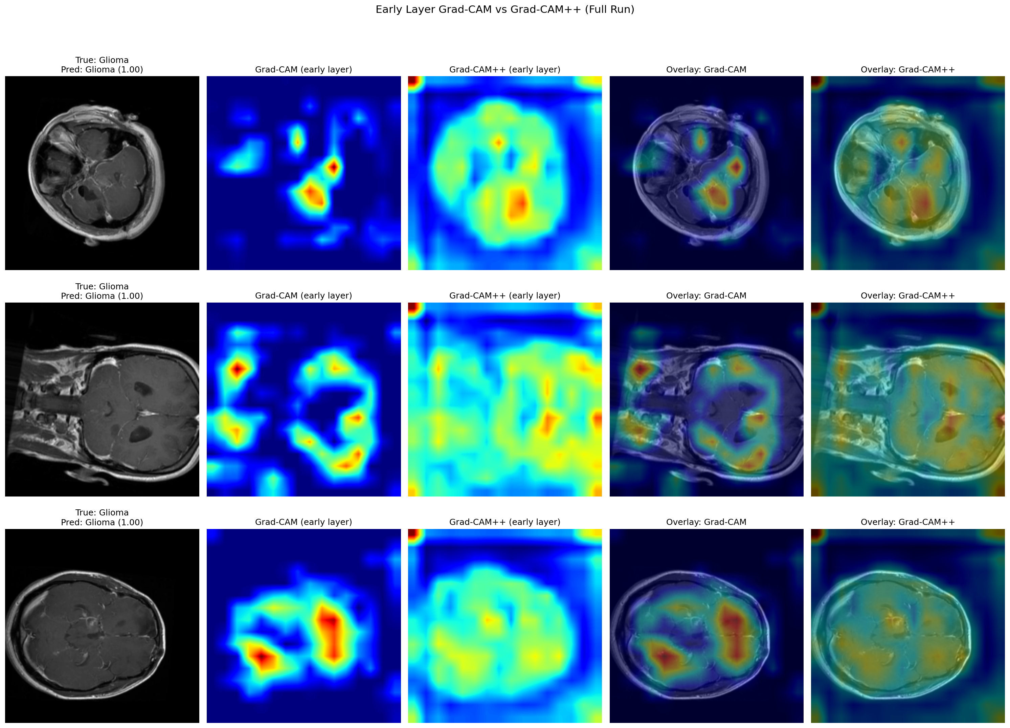
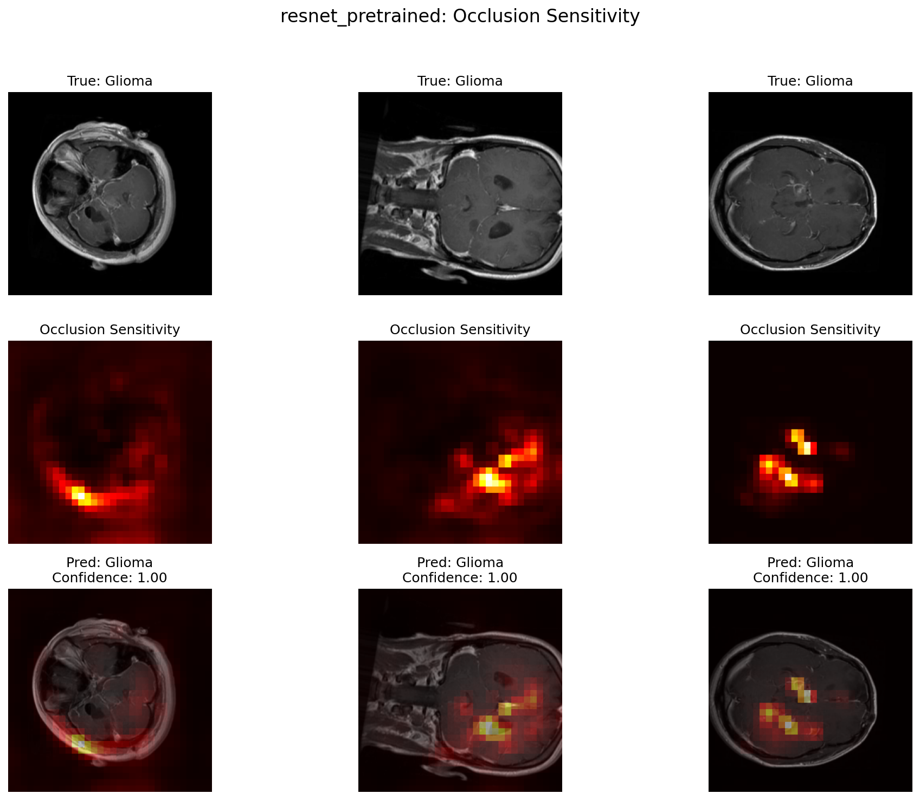
RESULTS
Interpretability
Grad-CAM and occlusion were used to test whether the model looked at clinically reasonable regions.
Occlusion sensitivity examples
Grad-CAM / Grad-CAM++ comparison
Grad-CAM on test dataset
Occlusion on test dataset
Section 3 of 5 | Results
Brain tumor MRI classifier | Review board presentation
Notes:
Interpretability slide. Explain that heatmaps are not proof that the model reasons like a physician. They are quality checks. The strongest limitation here is that there were no tumor masks, so localization could not be quantitatively verified.
What looks good: Occlusion maps often localize around tumor-relevant regions.
Multiple visual tools provide cross-checking.
What need caution:
Early-layer Grad-CAM can be diffuse and may include non-tumor anatomy.
No ground-truth masks were available, so Dice/IoU could not be validated.

Slide 7
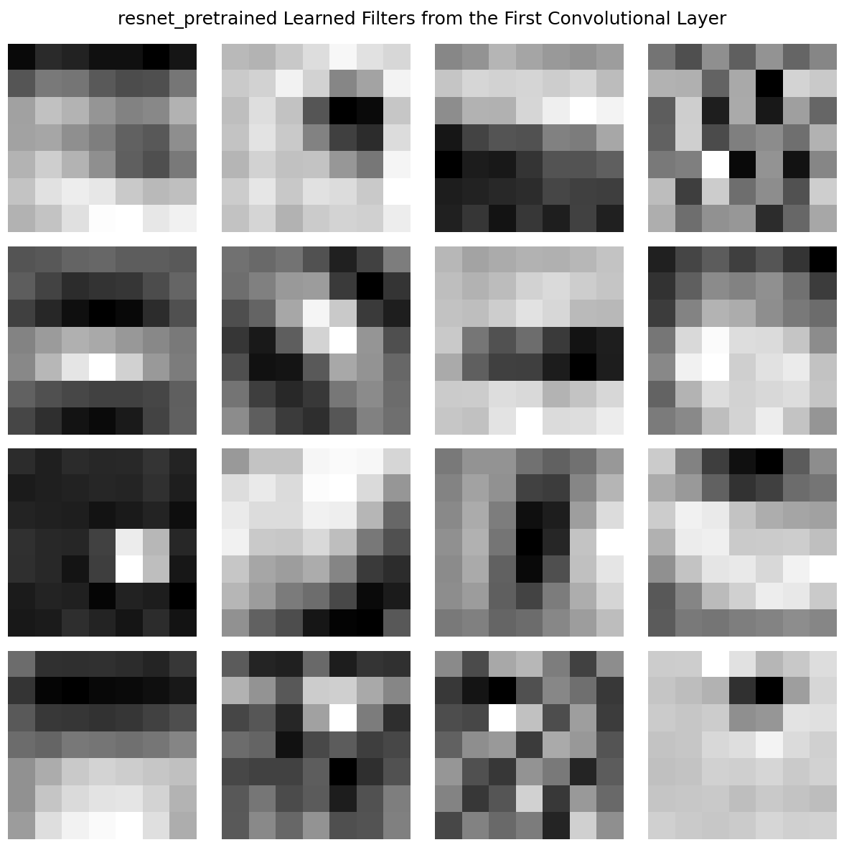
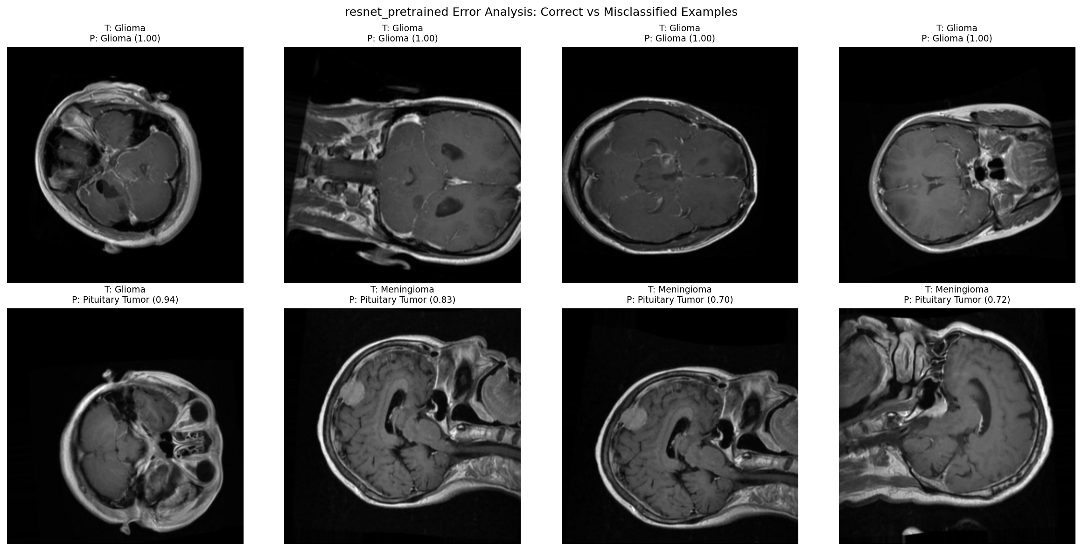
RESULTS
Interpretability
Grad-CAM and occlusion were used to test whether the model looked at clinically reasonable regions.
Filters
Correct vs misclassified examples
Section 3 of 5 | Results
Brain tumor MRI classifier | Review board presentation
Notes:
Interpretability slide. Explain that heatmaps are not proof that the model reasons like a physician. They are quality checks. The strongest limitation here is that there were no tumor masks, so localization could not be quantitatively verified.
What looks good: Occlusion maps often localize around tumor-relevant regions.
Multiple visual tools provide cross-checking.
What need caution:
Early-laer Grad-CAM can be diffuse and may include non-tumor anatomy.
No ground-truth masks were available, so Dice/IoU could not be validated.

Slide 8
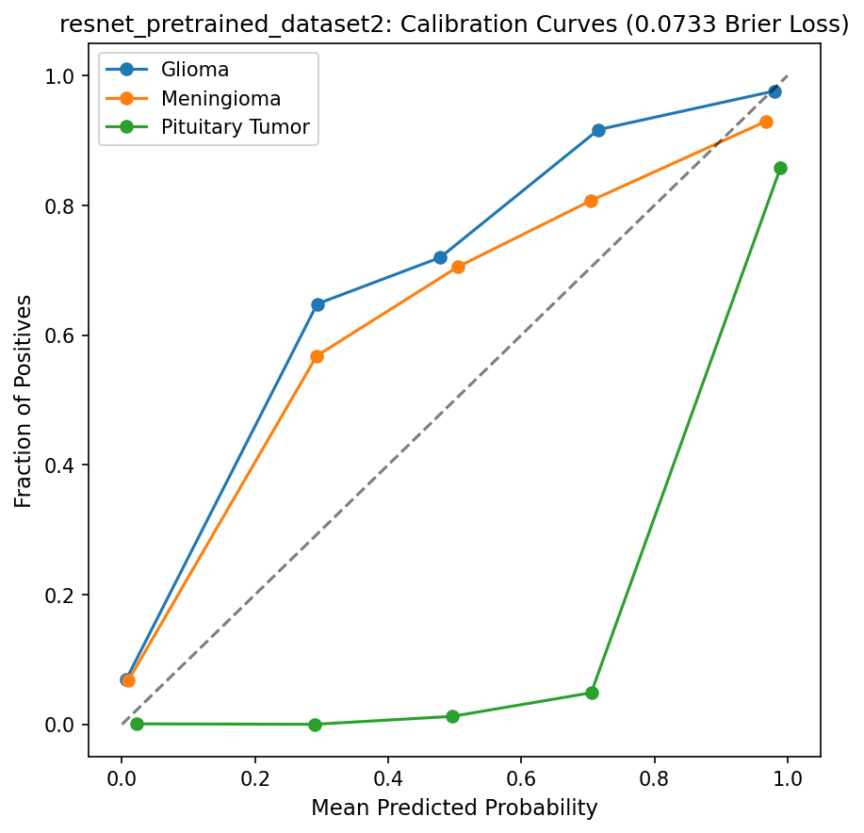
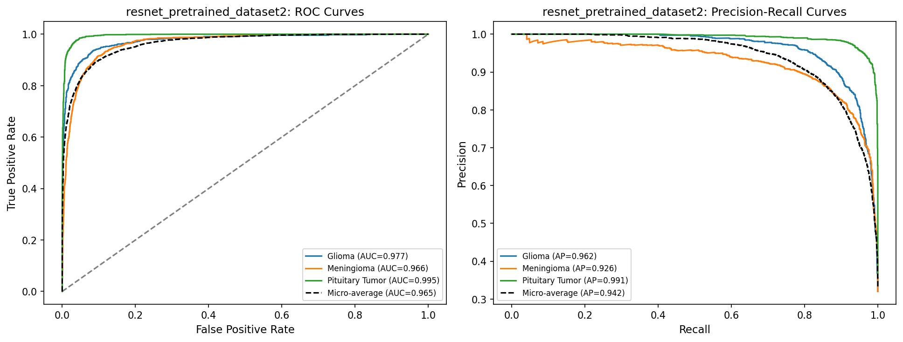
RESULTS
Test Performance – Additional Test Data (Glioma and Meningioma only)
The model performed well on the internal test set, but errors cluster around meningioma cases.
0.86
1.000
0.073
Macro Accuracy
ROC-AUC
all classes ≈ 1.00
Brier loss
lower is better
Calibration curve
ROC and precision-recall curves
Calibration curve
Section 3 of 5 | Results
Brain tumor MRI classifier | Review board presentation

Slide 9
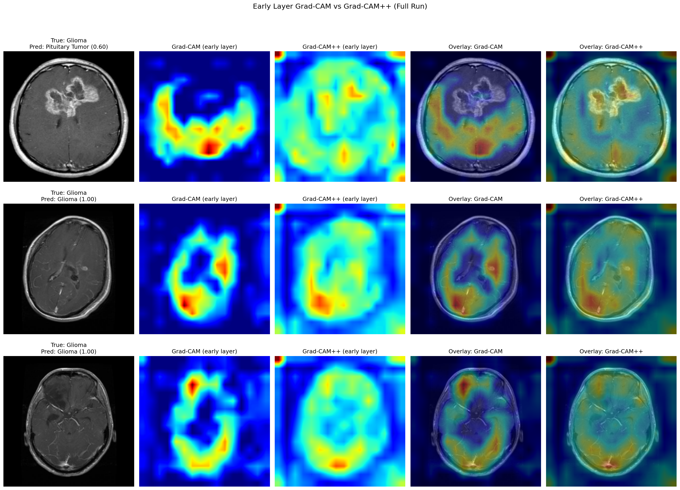
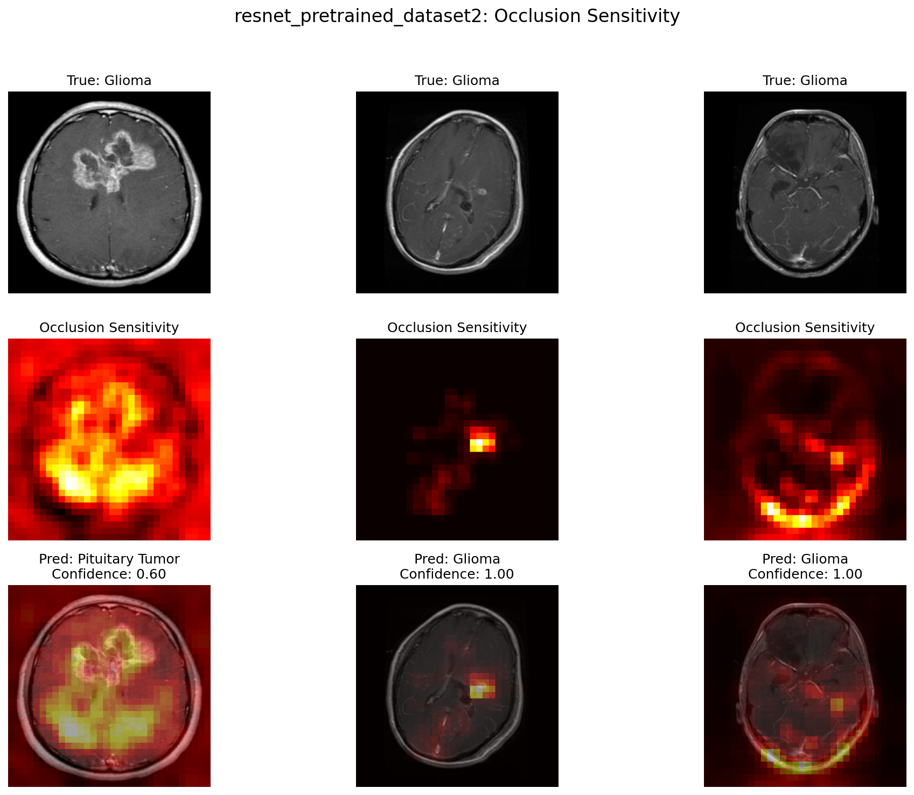
RESULTS
Interpretability
Grad-CAM and occlusion were used to test whether the model looked at clinically reasonable regions.
Occlusion sensitivity examples
Grad-CAM / Grad-CAM++ comparison
Grad-CAM on test dataset
Occlusion on test dataset
Section 3 of 5 | Results
Brain tumor MRI classifier | Review board presentation
Notes:
Interpretability slide. Explain that heatmaps are not proof that the model reasons like a physician. They are quality checks. The strongest limitation here is that there were no tumor masks, so localization could not be quantitatively verified.
What looks good: Occlusion maps often localize around tumor-relevant regions.
Multiple visual tools provide cross-checking.
What need caution:
Early-layer Grad-CAM can be diffuse and may include non-tumor anatomy.
No ground-truth masks were available, so Dice/IoU could not be validated.

Slide 10

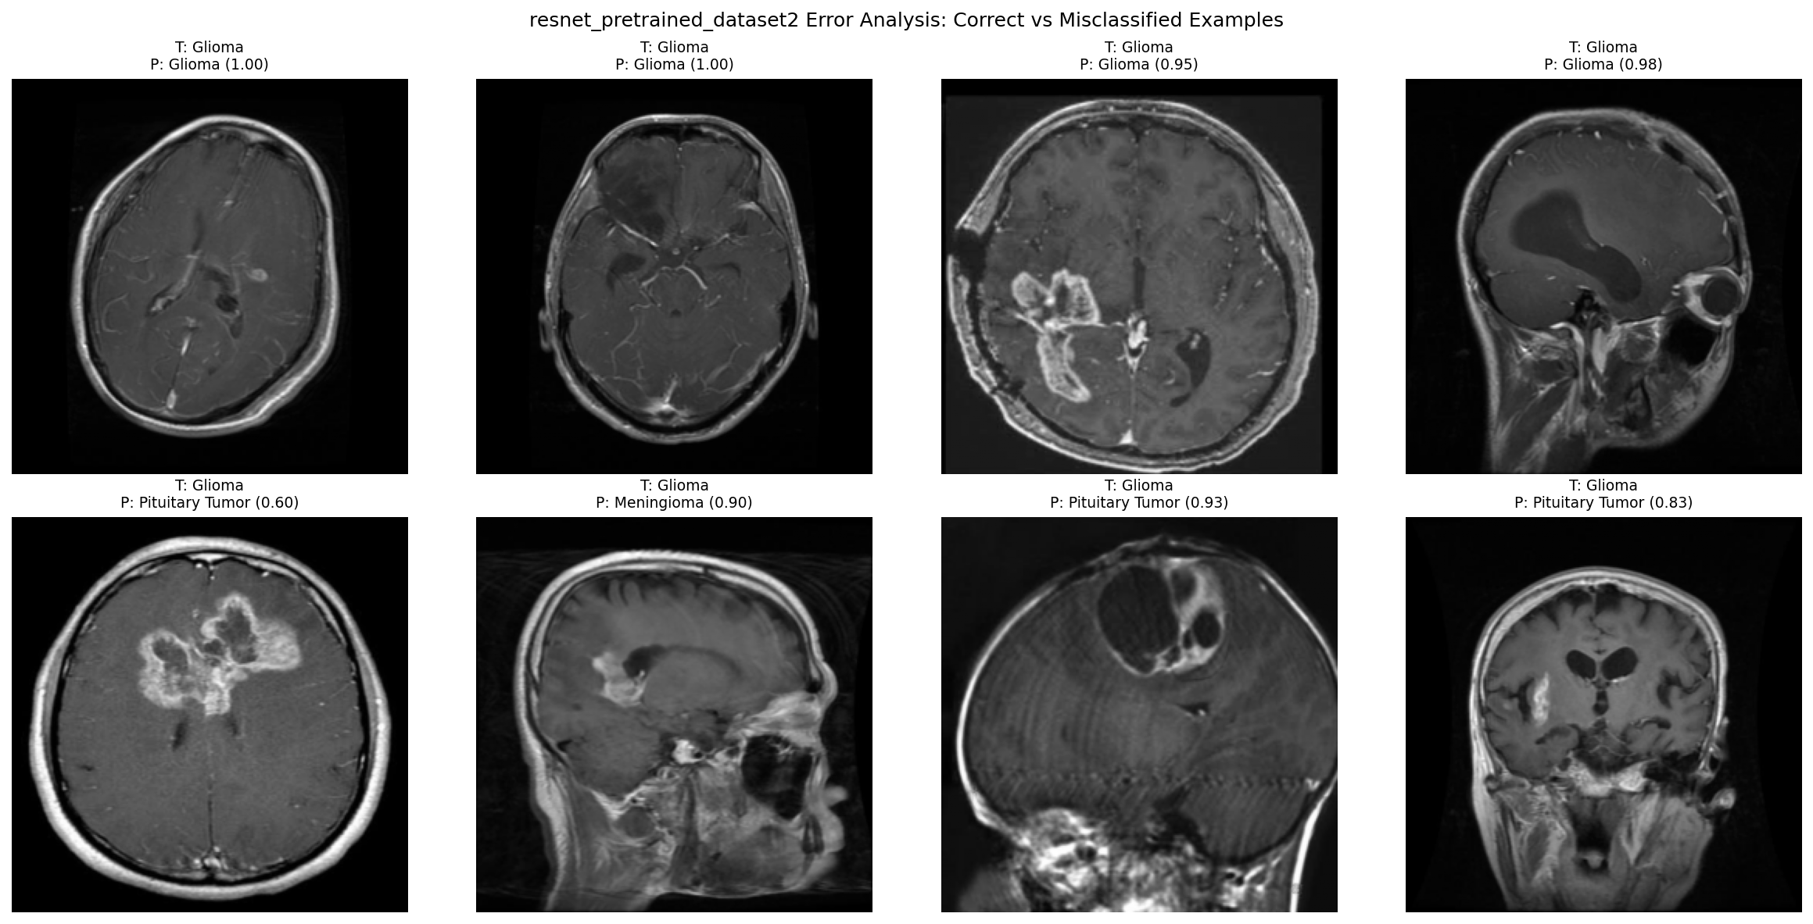
RESULTS
Interpretability
Grad-CAM and occlusion were used to test whether the model looked at clinically reasonable regions.
Filters
Correct vs misclassified examples
Section 3 of 5 | Results
Brain tumor MRI classifier | Review board presentation
Notes:
Interpretability slide. Explain that heatmaps are not proof that the model reasons like a physician. They are quality checks. The strongest limitation here is that there were no tumor masks, so localization could not be quantitatively verified.
What looks good: Occlusion maps often localize around tumor-relevant regions.
Multiple visual tools provide cross-checking.
What need caution:
Early-laer Grad-CAM can be diffuse and may include non-tumor anatomy.
No ground-truth masks were available, so Dice/IoU could not be validated.

Slide 11
FIELD GUIDE HIGHLIGHTS
The Governance
1
2
3
4
Acceptance testing
Routine monitoring
Escalation
Human review
Local validation before use
Target: no unexpected performance drop
Track accuracy, confidence, class mix, and failure patterns
Cadence: weekly early, monthly after stable
Pause if accuracy drops >5%, confidence shifts, or heatmaps behave unexpectedly
Clinician confirms, overrides, and documents final decision
Section 4 of 5 | Field Guide Highlights
Brain tumor MRI classifier | Review board presentation
Notes:
1 min
Field guide slide. Focus on governance. A strong model still needs acceptance testing at a new site because scanner protocols, image preprocessing, and patient mix can change. The review board will likely care about when to pause the model.

Slide 12
FIELD GUIDE HIGHLIGHTS
Limitations define safe boundaries for use
The model should be used only within its validated scope.
Known limitations
Where performance may degrade
Should NOT be used for
Single 2D slice input only.
No clinical history or multi-sequence MRI information.
Internal test performance only; external validation required.
No segmentation masks available for quantitative heatmap validation.
Different scanner vendors or protocols.
Low-quality, cropped, or rotated images.
Uncommon tumor subtypes or postsurgical changes.
Patient populations not represented in training data.
Standalone diagnosis.
Replacing radiology review or pathology.
Treatment planning decisions.
Automated triage without human confirmation.
Section 4 of 5 | Field Guide Highlights
Brain tumor MRI classifier | Review board presentation
Notes:
1 min
Limitations slide. Be direct. This model is not ready to be an autonomous diagnostic tool. The most important limitations are single-slice input, missing clinical context, missing external validation, and missing segmentation masks for localization validation.

Slide 13
Conclusion
Conclusion
The most useful lessons came from calibration, error review, and interpretability checks.
Lesson learned
What should do differently
Transfer learning is very effective for small-to-moderate medical imaging datasets.
Calibration and error examples are needed because high accuracy can hide overconfidence.
Grad-CAM is helpful but should not be treated as ground truth.
Governance is part of the model, not an afterthought.
Use full 3D MRI volumes or multiple slices instead of a single slice.
Add clinical metadata and multi-sequence MRI if available.
Collect expert tumor masks for localization validation.
Run external validation on data from a different institution before any clinical pilot.
Section 5 of 5 | Conclusion
Brain tumor MRI classifier | Review board presentation
Notes:
Lessons learned slide. This is your closing argument. The model performs very well, but the mature conclusion is not simply that it works. The conclusion is that the model is promising and that safe implementation depends on validation, monitoring, and clinician oversight.
Close: promising decision-support model, but deployment should be limited to a monitored, human-in-the-loop workflow.

Slide 14
Thank you
Questions and feedback are welcome.
Notes:
Q and A slide. Invite feedback. You can ask the board which deployment setting they would consider safest and what validation evidence they would require.

