Slide 1
ICU Mortality Risk Prediction
Using Routine ICU Data to Estimate Hospital Mortality
Kaggle MIMIC-Inspired ICU Dataset · Logistic Regression & XGBoost · n = 15,000
AI in Medicine Course Project
Notes:
SLIDE 1 — Title Welcome the audience and frame the project in one sentence: can routinely collected ICU data tell us which patients are most at risk of dying? Key points to mention: - Dataset: 15,000 ICU patient records sourced from Kaggle - Two models were built and compared: Logistic Regression (interpretable) and XGBoost (flexible) - The end product is a clinical SUPPORT tool — it flags risk, it does not make decisions - This work sits at the intersection of machine learning and clinical safety, which is exactly what the AI in Medicine course is about Tone: confident but grounded — there are real limitations here and we will be honest about them throughout.SLIDE 1 — Title Welcome the audience and frame the project in one sentence: can routinely collected ICU data tell us which patients are most at risk of dying? Key points: - Dataset: 15,000 ICU patient records sourced from Kaggle - Two models were built and compared: Logistic Regression (interpretable) and XGBoost (flexible) - The end product is a clinical SUPPORT tool — it flags risk, it does not make decisions - This work sits at the intersection of machine learning and clinical safety Tone: confident but grounded — there are real limitations here and we will be honest about them throughout.

Slide 2
Project Overview
01
02
03
Objective
Dataset
Approach
Build a mortality risk prediction tool using routinely collected ICU data to help clinical teams identify patients who may need closer monitoring or earlier escalation.
15,000 ICU patient records from Kaggle. Features include age, comorbidity scores, vital signs, oxygenation, sepsis status, ventilation, and vasopressor use. Mortality rate: 22.8%.
Two models compared — Logistic Regression (interpretable) and XGBoost (flexible). Decision thresholds were optimised for clinical utility (F1-score). The tool is a clinical support aid, not a decision-maker.
Notes:
SLIDE 2 — Project Overview Use this slide to orient the audience to the three pillars of the project. Objective card: The clinical motivation — ICU staff are overwhelmed and a risk score could prompt earlier escalation for patients who might otherwise be missed. The tool is designed to support rounds, handoffs, and admission reviews. Dataset card: 15,000 patients with features spanning demographics, comorbidities, vital signs (mean/min/max/std), lab values (lactate, glucose), oxygenation (SpO2), and organ support flags. Mortality rate of 22.8% creates a class imbalance challenge worth flagging. Approach card: Logistic Regression = clinical gold standard for risk scoring — explainable, calibrated, clinician-friendly. XGBoost = powerful gradient-boosted ensemble. We optimised thresholds using F1-score because catching deaths (recall) matters more than raw accuracy.

Slide 3
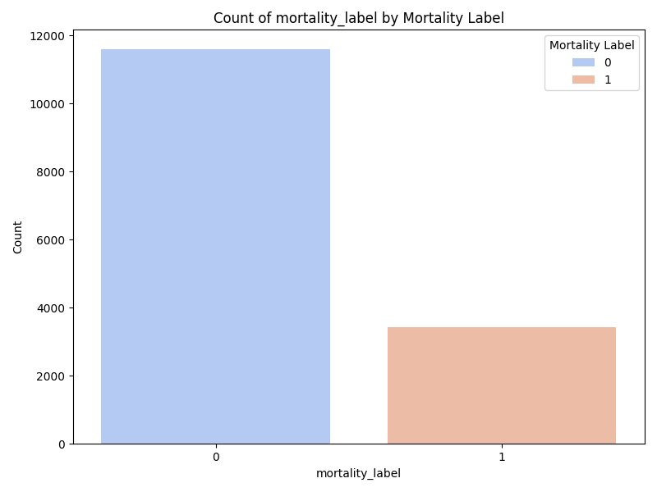
Dataset & Class Distribution
Key Dataset Stats
15,000
Total Patients
22.8%
Hospital Mortality
~11,600
Survivors (Label 0)
~3,400
Non-survivors (Label 1)
20+
Features
Notes:
SLIDE 3 — Dataset & Class Distribution Use this slide to set up the class imbalance problem — it is the root cause of most limitations. Key points: - 15,000 patients: ~11,600 survivors (Label 0) vs ~3,400 deaths (Label 1) — roughly a 3.4:1 ratio - The bar chart makes the imbalance visually obvious - A naive model that always predicts "survived" would be right 77% of the time but clinically useless — this is why accuracy is not our metric Transition: "With this imbalance in mind, let's look at which features actually differ between survivors and non-survivors."

Slide 4
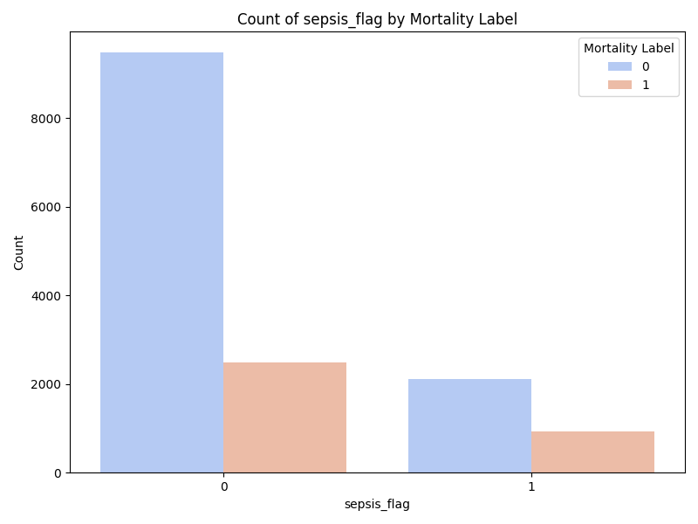
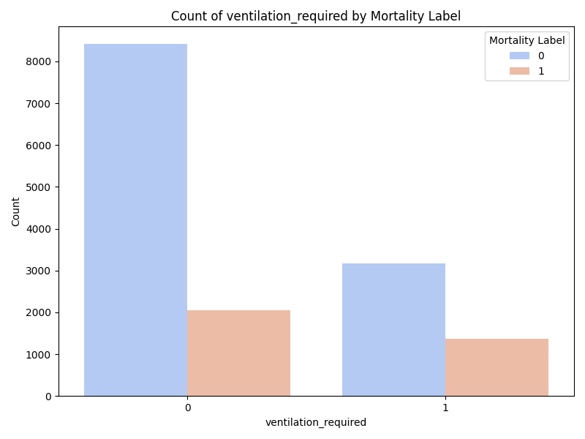
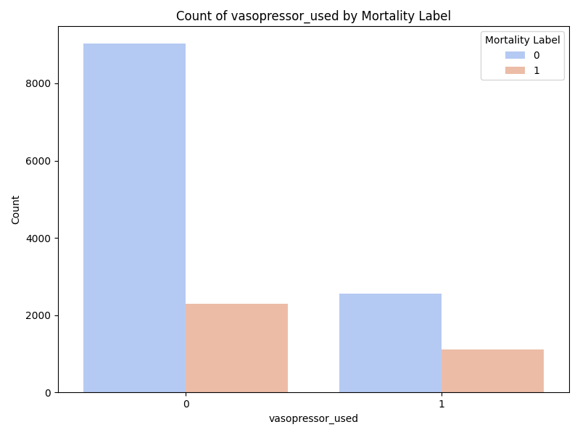
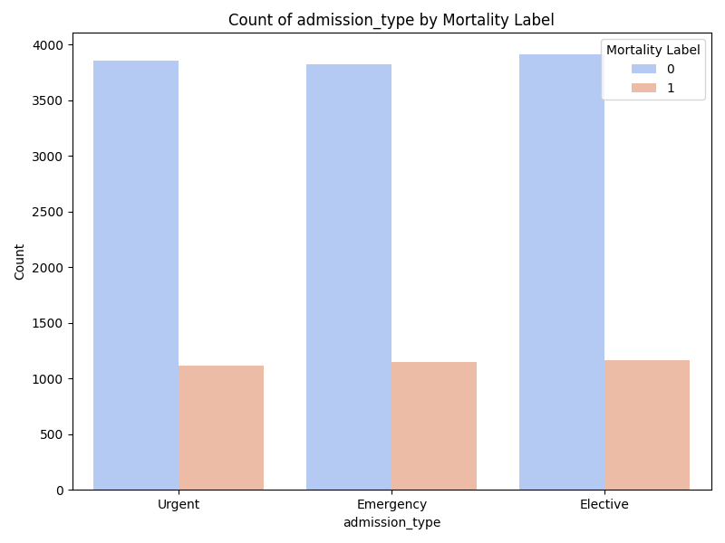
Exploratory Data Analysis: Clinical Risk Factors
Sepsis, ventilation, and vasopressor use show the strongest associations with ICU mortality
Notes:
SLIDE 4 — Exploratory Data Analysis: Clinical Risk Factors This slide focuses on the binary clinical flags that show the clearest separation between groups. Sepsis flag: Patients with sepsis have a noticeably higher proportion of mortality. Clinically expected — sepsis is a leading cause of ICU death. Becomes one of the strongest predictors in both models. Ventilation required: Patients requiring mechanical ventilation had higher mortality. Clinically intuitive — indicates severe respiratory failure. Vasopressor use: Similar pattern. Vasopressors indicate haemodynamic instability and shock — strongly associated with death. Admission type: Mortality is roughly EQUAL across Urgent, Emergency, and Elective. Admission type alone is NOT a strong discriminator — confirmed in the correlation matrix. Good sanity check on the data. Key takeaway: The binary support flags (ventilation + vasopressors, combined as "critical_support") and sepsis are the clearest clinical signals.

Slide 5
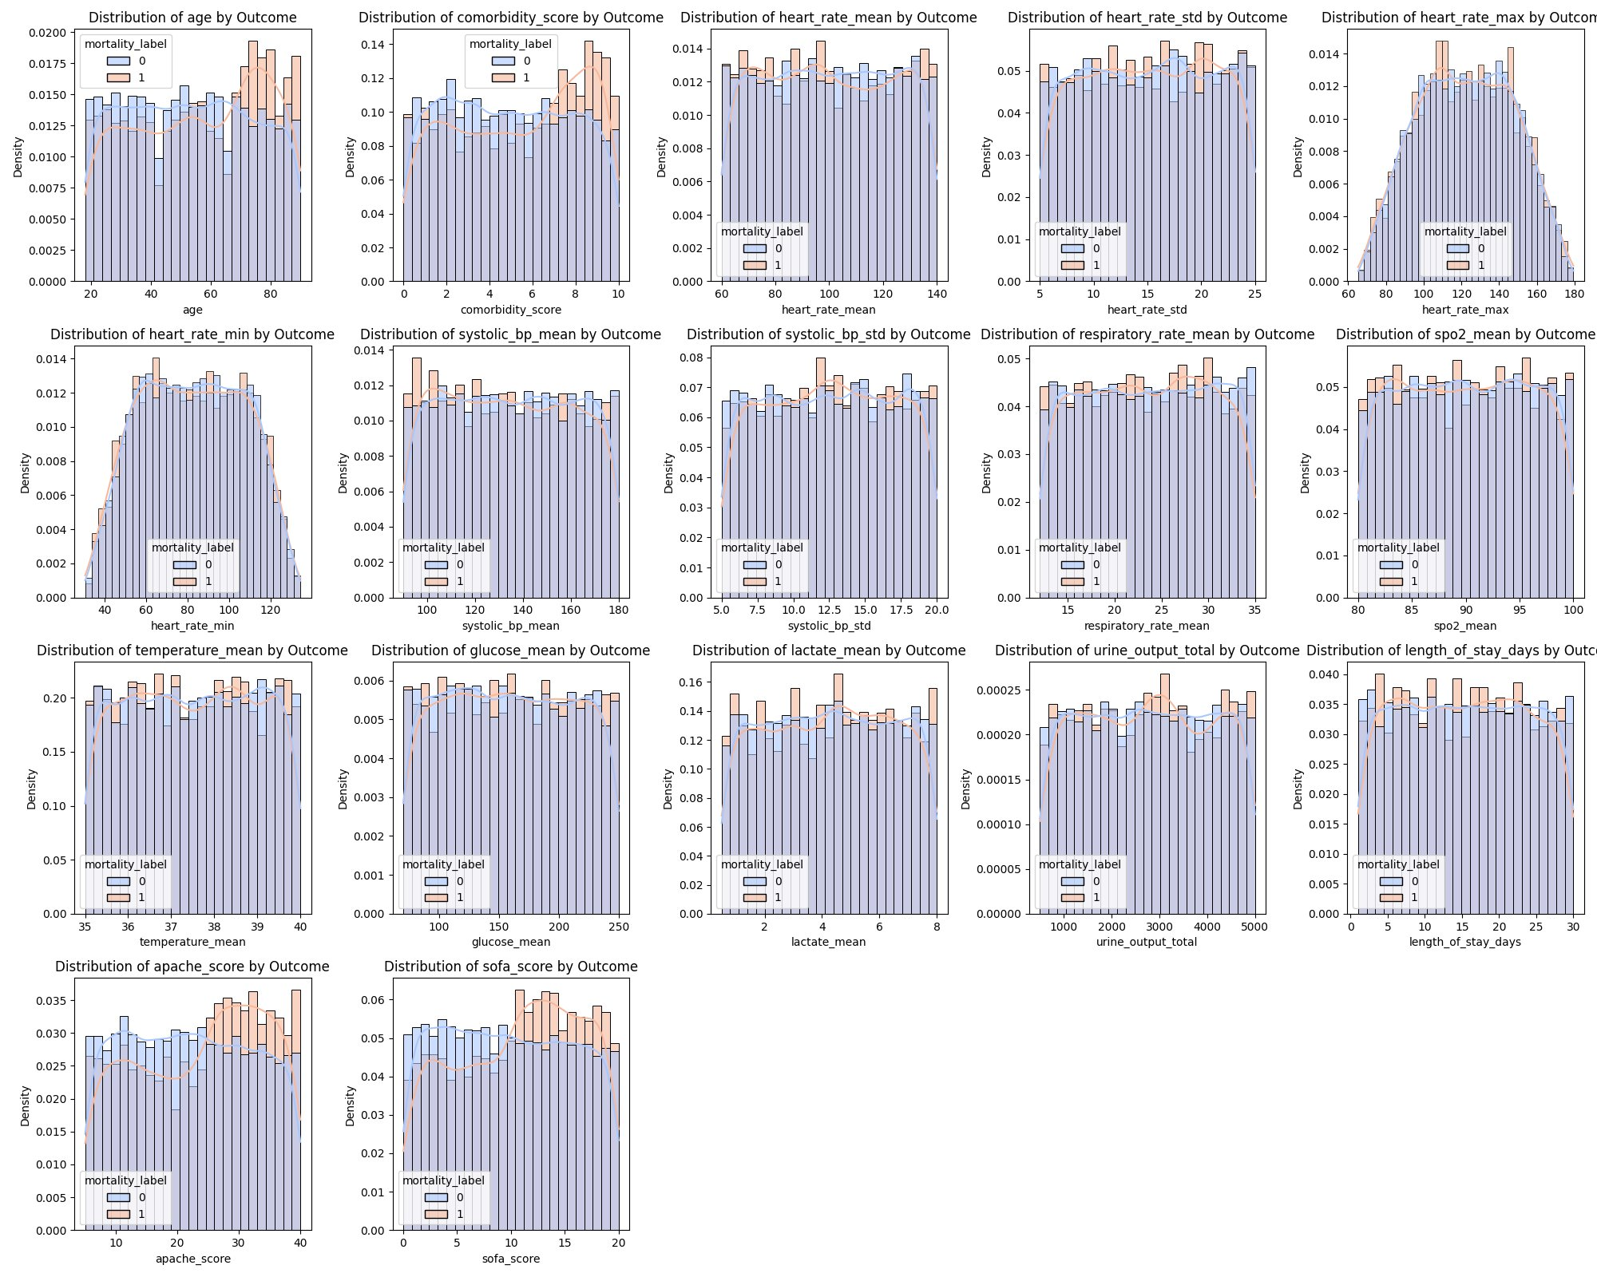
Feature Distributions by Outcome
Most continuous features show overlapping distributions between survivors and non-survivors — explaining the modest discriminative power of both models.
Notes:
SLIDE 5 — Feature Distributions by Outcome Critical finding — it directly explains why model performance is modest. Key point: Look at virtually any continuous feature — age, heart rate, systolic BP, SpO2, lactate, APACHE, SOFA — and the blue (survived) and orange (died) distributions OVERLAP almost completely. There is no single feature where the two groups separate cleanly. The survived and non-survived populations look remarkably similar across almost all clinical variables. Why this matters: Machine learning can only find signal that exists in the data. If distributions overlap this heavily, no model — no matter how complex — can achieve perfect separation. This is the fundamental reason both models land at AUROC ~0.61. It is not a failure of methods; it is a property of the dataset. Notable exception: Lactate and APACHE/SOFA show slightly more separation. These contribute most to model predictions.

Slide 6
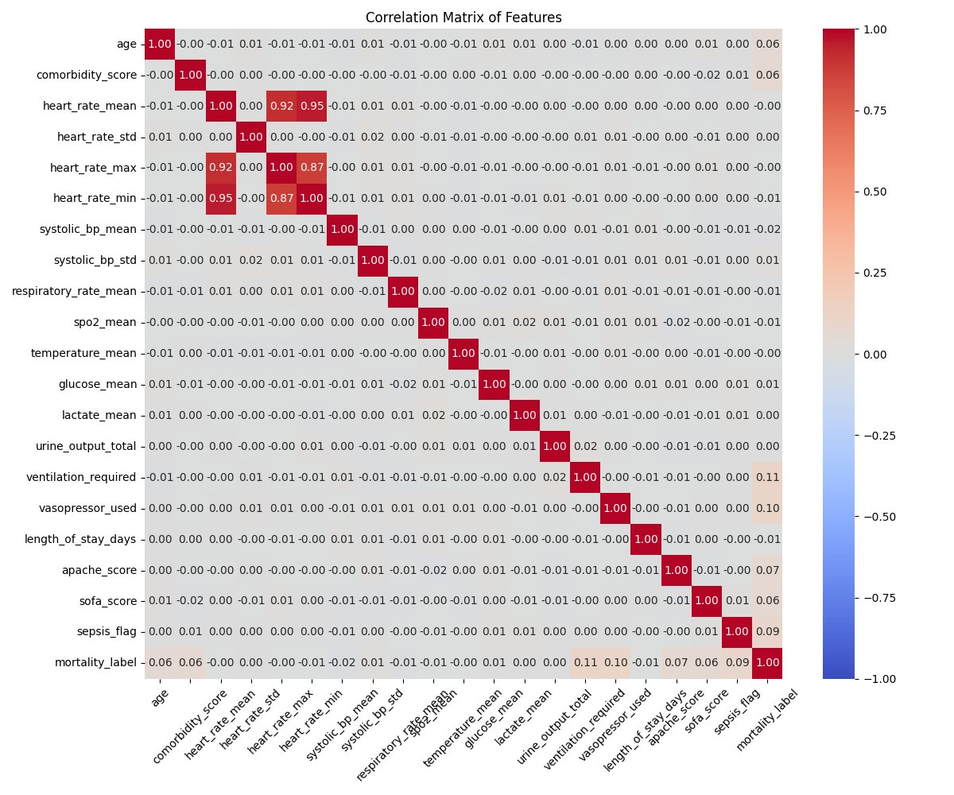
Feature Correlation Matrix
Weak signal overall
Most features show near-zero correlation with mortality_label, confirming limited predictive power in the dataset.
Heart rate cluster
heart_rate_mean, max, and min are highly inter-correlated (r ≥ 0.87) — expected from the same vital sign.
Strongest predictors
ventilation_required (0.11) and vasopressor_used (0.10) have the highest correlation with mortality, consistent with EDA findings.
Sepsis association
sepsis_flag correlates modestly with mortality (0.09) and with vasopressor use — as expected clinically.
Notes:
SLIDE 6 — Feature Correlation Matrix Quantitative confirmation of what we saw visually in the distributions. Key points: - The mortality_label row/column shows correlations close to zero for almost every feature (range: 0.00–0.06) - Strongest correlates: ventilation_required (0.11), vasopressor_used (0.10), sepsis_flag (0.09) - Age and comorbidity_score each correlate at ~0.06 — modest but clinically meaningful Internal correlations worth mentioning: - Heart rate mean, max, and min are highly inter-correlated (r >= 0.87) — same vital sign measured differently. We address this with the engineered heart_rate_range feature. - Most features are independent of each other — good for logistic regression Bottom line: Weak individual correlations are the core challenge. This is why we engineered composite features (critical_support, shock_index, age_comorbidity) to capture multi-feature patterns.

Slide 7
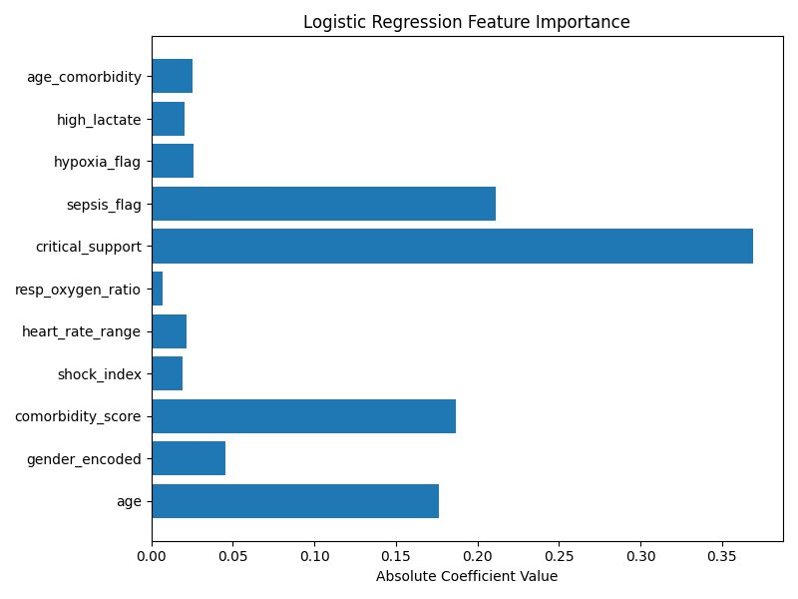
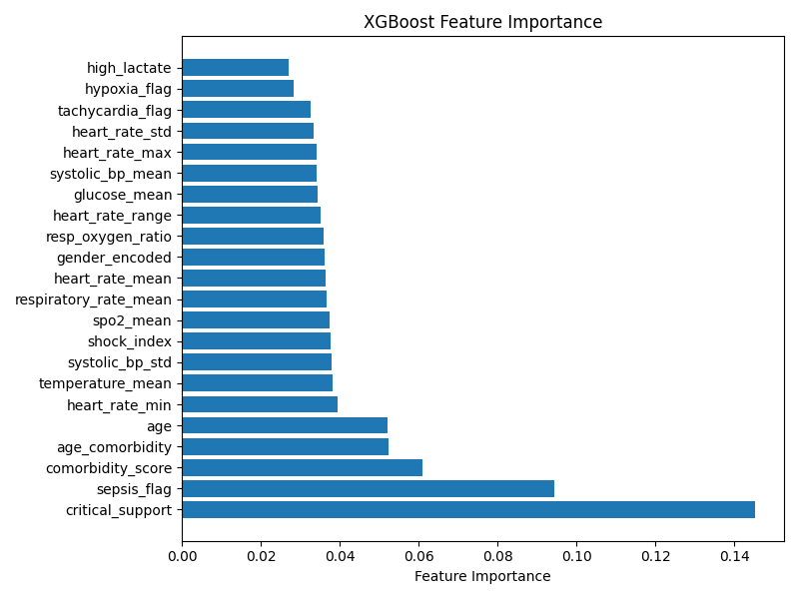
Feature Importance: What Drives Risk?
Logistic Regression
XGBoost
Both models agree: critical_support and sepsis_flag are the dominant predictors of ICU mortality.
Notes:
SLIDE 7 — Feature Importance: What Drives Risk? Both models tell a consistent and clinically meaningful story. Logistic Regression (left): - critical_support (ventilation + vasopressor combined) has the largest coefficient (~0.37) — strongest predictor - sepsis_flag is second (~0.21) - comorbidity_score and age also contribute strongly — sicker, older patients are at higher risk - Emphasize: because LR uses linear coefficients, clinicians can directly explain why a patient received a high score XGBoost (right): - critical_support and sepsis_flag dominate here too — consistent with logistic regression - XGBoost spreads importance across many more features with smaller individual contributions — typical of tree-based models, and makes individual predictions harder to explain at the bedside Key message: Both models agree on what matters most. Logistic Regression is more transparent about why, which is clinically essential.

Slide 8
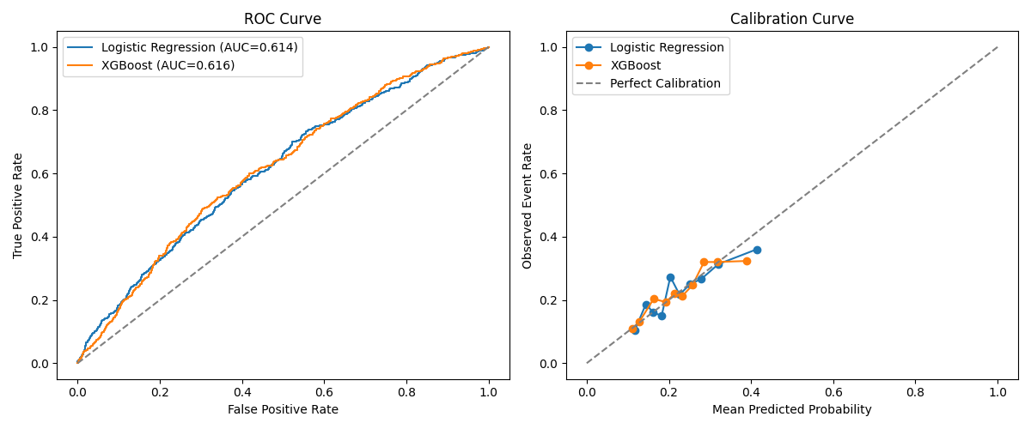
Model Performance Overview
Notes:
SLIDE 8 — Model Performance Overview Summary dashboard — use as a transition before diving into individual metrics. Left (ROC curves): Both curves nearly overlap at AUC ~0.61. The dashed diagonal is random chance (0.5). Being above the diagonal confirms both models learned something real — but the gap from perfect (1.0) is significant. Right (Calibration curves): This is where the models genuinely excel. Both track close to the perfect calibration diagonal. When the model says 30% mortality risk, roughly 30% of those patients actually died. Key message: "We have two models that are modestly discriminative but well-calibrated. They won't perfectly rank every patient, but when they give you a number, that number is trustworthy. That is meaningful for a clinical tool."

Slide 9
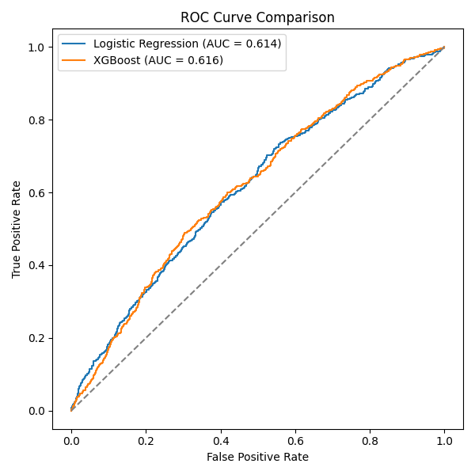
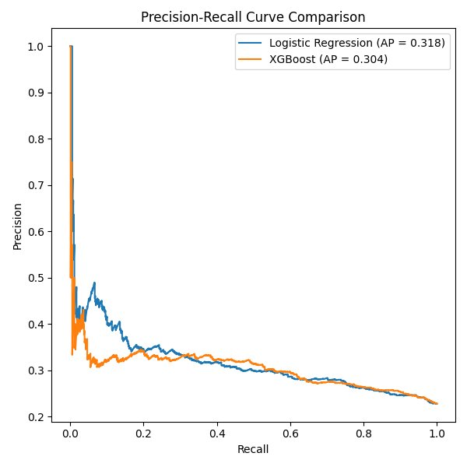
Discriminative Performance: ROC & Precision-Recall Curves
ROC Curve (AUC ~0.61)
Precision-Recall Curve (AP ~0.31)
Both models perform modestly above chance. The low PR-AUC reflects the challenge of the 22.8% minority class.
Notes:
SLIDE 9 — ROC & Precision-Recall Curves Two complementary views of the same models. ROC Curve (left): AUC ~0.61 for both. Bootstrapped confidence intervals overlap — no statistically significant difference between models. Curves diverge slightly at low false-positive-rate — this is where clinical use would operate (flagging a minority of patients, not everyone). Precision-Recall Curve (right): The harder test. Baseline AP for a no-skill model = 0.228 (the mortality rate). Both models achieve ~0.31 — meaningfully above baseline but showing rapid precision drop-off as recall increases. - High threshold = high precision but low recall (only catching the obvious cases) - Low threshold = high recall but low precision (many false alarms) Transition: "The threshold we chose prioritises recall — catching as many true deaths as possible. Let's see what that trade-off looks like in practice."

Slide 10
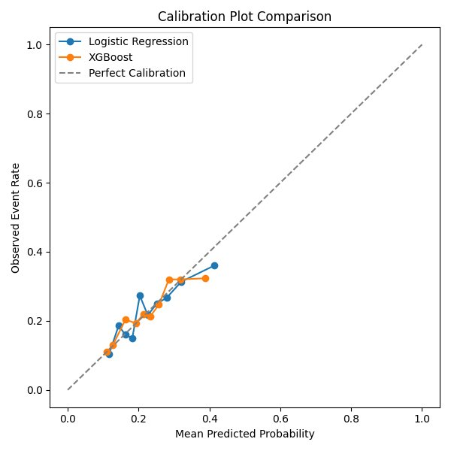
Probability Calibration
Brier Score
0.171
(Both models — lower is better)
What this means
A Brier score of 0.171 indicates excellent probability calibration. When the model predicts 35% mortality risk, approximately 35% of those patients truly die.
Why this matters clinically
Even if a model cannot perfectly rank patients, well-calibrated probabilities are directly usable — clinicians can trust the raw numbers as genuine risk estimates, not just relative rankings.
The key insight
Both models are mathematically trustworthy in their predicted probabilities, even when discriminative power is modest.
Notes:
SLIDE 10 — Probability Calibration One of the most underappreciated properties in clinical ML. What is calibration? A model is well-calibrated if its predicted probabilities match observed outcomes. If it says 40% risk, approximately 40% of those patients should die. The chart: Both models track close to the dashed diagonal. Predictions cluster between 0.10–0.45 — the models rarely predict very high probabilities because the underlying signal is weak. Brier Score = 0.171: - Perfect prediction = 0.0 - Naive model always predicting the mean mortality rate = ~0.228 - Our score of 0.171 beats the naive baseline — the models add real probabilistic value Clinical relevance: "When this model says a patient has a 35% mortality risk, that is a genuine, trustworthy probability estimate — not just a relative rank. This is what makes the tool usable in practice, even with modest discriminative performance."

Slide 11
The Clinical Trade-Off: Sensitivity vs. Alarm Fatigue
Metric
Logistic Regression
XGBoost
🕸️
AUROC
0.614
0.616
Wide Safety Net (High Recall ~75%)
PR-AUC
0.318
0.304
Models catch ~75% of patients who die. XGBoost is slightly more aggressive at 77%.
Precision
0.280
0.270
Recall
0.737
0.773
⚠️
Brier Score
0.171
0.171
False Alarm Cost (Low Precision ~27%)
Only ~27–28% of flagged patients actually die. In a busy ICU, this risks alarm fatigue.
✅
Logistic Regression Preferred
Equivalent performance — but far easier to interpret and explain at the bedside.
Notes:
SLIDE 11 — The Clinical Trade-Off This is one of the most important slides for a clinical audience — it translates numbers into real-world consequences. Metrics table walk-through: - AUROC and PR-AUC: nearly identical — no winner on discrimination - Brier Score: identical calibration — tied - Recall 0.737 vs 0.773: XGBoost catches slightly more deaths — the only meaningful difference - Precision 0.280 vs 0.270: to catch those extra deaths, XGBoost generates slightly more false alarms Safety net framing: - High recall = wide safety net: catches most deaths but also many survivors - Low precision (~27%) = roughly 3 out of 4 flagged "high risk" patients will actually survive The alarm fatigue problem: In a busy ICU, constant false alerts erode trust in the system. Clinical teams start ignoring alerts — a well-documented patient safety issue with alarm systems. This is a genuine operational risk. Why Logistic Regression wins: Same performance, but every prediction can be explained. Clinicians can ask "why is this patient flagged?" and get a meaningful answer. XGBoost cannot provide this transparency.

Slide 12
Interpreting the Risk Score
0–30%
Before Acting on Score
Do not assume the patient is safe. Compare with the bedside picture and recent trend.
Lower Risk
? Does the result match the patient's current condition?
30–70%
? Are the input data complete and accurate?
Use caution. Clinical judgment is especially important at this threshold.
Intermediate Risk
? Is the patient worsening despite a low score?
70–100%
Correlate with the clinical picture. Consider closer review and possible escalation if supported clinically.
? Is the patient stable despite a high score?
Higher Risk
The score supports — it does not replace — clinical judgment.
Notes:
SLIDE 12 — Interpreting the Risk Score Aimed at clinical users — use plain language. Risk tiers: - 0-30% (Lower Risk): Do NOT convey this as "safe." A 20% predicted mortality risk is clinically significant. Use as a prompt to cross-check against bedside findings, not as reassurance. - 30-70% (Intermediate Risk): The uncertainty zone. Clinical judgment is most critical here. Escalate based on clinical trajectory, not the score alone. - 70-100% (Higher Risk): A flag for closer attention — NOT automatic escalation. Cross-check with the bedside picture first. The four questions (right panel): Walk through each as a mental checklist a clinician should run before acting: 1. Does the score match what I'm seeing at the bedside? 2. Is the input data complete and reliable? 3. Is the patient getting worse despite a low score? 4. Is the patient stable despite a high score? Closing line to repeat clearly: "The score supports clinical judgment. It does not replace it."

Slide 13
Limitations & Failure Modes
🏥
📊
🚨
Single Dataset Only
Modest Discriminative Power
False Positives & Alarm Fatigue
Tested on one internal ICU dataset from Kaggle. Performance in other hospitals, health systems, or patient populations is unknown.
AUROC ~0.61 is only slightly better than chance. Both models should be understood as risk-awareness tools, not diagnostic instruments.
Precision ~27% means roughly 73% of high-risk flags are incorrect. In a high-acuity setting, this creates a meaningful alarm fatigue risk.
🔍
📋
⚙️
False Negatives & False Reassurance
No Subgroup Validation
Data Quality Dependency
Recall ~75% means ~25% of patients who die are not flagged. A low score must never be used to deprioritize a patient showing clinical decline.
Subgroup analyses (age, diagnosis, admission type) and comparison with clinician performance were not performed.
Performance degrades with missing, delayed, inaccurate, or non-representative input data.
Notes:
SLIDE 13 — Limitations & Failure Modes This slide demonstrates intellectual honesty — a key criterion for responsible AI in medicine. Single Dataset Only: Tested only on the training dataset. No idea how this performs at another hospital or with different data collection practices. External validation is required before any real deployment. Modest Discriminative Power: AUROC ~0.61 is not high. Frame it honestly as a risk-awareness aid, not a diagnostic tool. False Positives & Alarm Fatigue: Most operationally dangerous failure mode. 73% of high-risk flags are wrong. If clinical teams receive too many false alerts, they will stop acting on them — well-documented alarm fatigue. False Negatives & False Reassurance: 25% of patients who die will NOT be flagged. A low score should never lead a clinician to deprioritise a deteriorating patient. No Subgroup Validation: We did not check whether the model performs equally across age groups, diagnoses, or admission types. It may underperform in specific populations. A critical gap. Data Quality Dependency: The model was built on clean, complete data. Missing values, delayed labs, or data entry errors degrade performance in ways that are hard to detect at the bedside.

Slide 14
Human Override & Clinical Workflow
SITUATION
ACTION
High score, low clinical concern
Recheck data and reassess patient. Do not escalate on score alone.
SITUATION
ACTION
Low score, high clinical concern
Follow the bedside picture. Do not let a low score override concern about deterioration.
SITUATION
ACTION
Missing or unreliable data
Do not rely on the score until the data are verified.
SITUATION
ACTION
Patient outside validated population
Use extra caution. Treat result as supplemental information only.
SITUATION
ACTION
High-stakes decisions
Never use the score alone for major treatment or goals-of-care decisions.
The tool fits best into routine ICU care as an added risk-awareness step during admission, rounds, handoff, or changes in patient status.
Notes:
SLIDE 14 — Human Override & Clinical Workflow Operationalises the tool — tells clinical users exactly what to do in each scenario. Row by row: High score, low clinical concern: The model may be picking up a data pattern that does not match the patient in front of you. Recheck inputs, reassess, but do not escalate on the score alone. Bedside takes priority. Low score, high clinical concern: Never let a low score create false reassurance. If the patient looks sick, they are sick. The model missed it — this is a known failure mode. Missing or unreliable data: The model was built on complete, clean data. Missing or outdated inputs make the output unreliable. Verify before relying on the score. Patient outside validated population: Rare conditions, post-surgical patients, or very unusual presentations — treat the score with extra caution and as supplemental only. High-stakes decisions: Goals-of-care, treatment limitation, end-of-life decisions — these must NEVER be based on a model score. They require senior clinical judgment, family discussion, and ethical review. Bottom note: The tool fits best as a lightweight risk-awareness check during admission, handoff, or status changes — not as a decision engine.

Slide 15
Conclusions
01
Both Logistic Regression and XGBoost show modest but comparable discriminative performance (AUROC ~0.61), constrained by weak predictive signals in the dataset.
02
Threshold optimisation produced sensitive safety-net models (~75% recall) — but with meaningful false-positive rates (~73%) that risk alarm fatigue in the ICU.
03
Both models are well-calibrated (Brier ~0.171), meaning their predicted probabilities are genuinely trustworthy as risk estimates.
04
Logistic Regression is the preferred model: equivalent performance, superior interpretability, and easier to explain to clinical teams.
05
External validation, subgroup analysis, and prospective clinical testing are required before any real-world deployment.
Notes:
SLIDE 15 — Conclusions Bring everything together with an honest, confident summary. Point 01: Both models perform modestly (AUROC ~0.61). We are not overclaiming. Weak signal in the dataset — not the modelling approach — is the primary constraint. Point 02: Threshold optimisation gave us high-recall safety-net models (~75% recall). Catching deaths is the right clinical priority. But the 73% false-positive rate is a real operational problem requiring active management. Point 03: Brier score ~0.171 is a genuine win. Both models are well-calibrated — their predicted probabilities can be trusted as actual risk estimates, not just relative rankings. Point 04: Logistic Regression is the recommended model. Not because it outperformed XGBoost — it did not — but because equivalent performance with greater interpretability is always preferable in a clinical setting. Clinicians need to understand and trust their tools. Point 05: External validation on held-out hospital data, subgroup analysis, and a prospective clinical study are all required before real-world deployment. This is a proof-of-concept, not a production tool. Closing statement to deliver: "We built a well-calibrated, honest risk-awareness tool. It is imperfect — but it is transparent about its imperfections. That is exactly what responsible AI in medicine requires."

