Slide 1
Regression
By
Nehha S

Slide 2
What is Regression?
Regression analysis is a form of predictive modelling technique which investigates the relationship between a dependent and independent variable.

Slide 3
Height | Weight
73.84 | 241.89
74.11 | 212.74
71.73 | 220.04
69.88 | 206.34
67.06 | ??

Slide 4
examples
Prediction of rain using temperature and other factors
Determining Market trends
Prediction of road accidents due to rash driving

Slide 5
why regression is used?
Estimates the relationship between the target and the independent variable
Used to find the trends in data
Helps to predict real/continuous values

Slide 6
Terminologies related to regression analysis
Dependent Variable
Independent Variable
Outliers
Multicollinearity
Underfitting and Overfitting

Slide 7
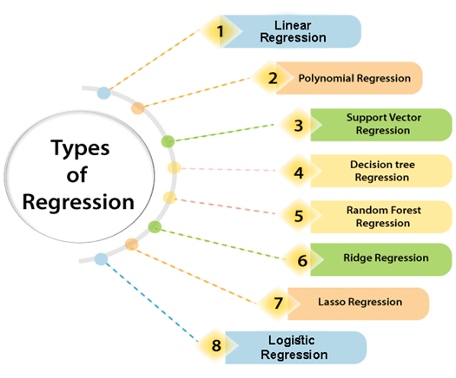
Types of regression

Slide 8
Linear regression
It is a statistical method that is used for predictive analysis.
Linear regression algorithm shows a linear relationship between a dependent (y) and one or more independent (x) variables, hence called as linear regression

Slide 9
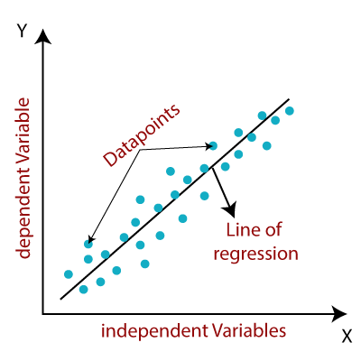


Y= Dependent Variable (Target Variable) X= Independent Variable (predictor Variable) a0= intercept of the line (Gives an additional degree of freedom) a1 = Linear regression coefficient (scale factor to each input value). ε = random error

Slide 10
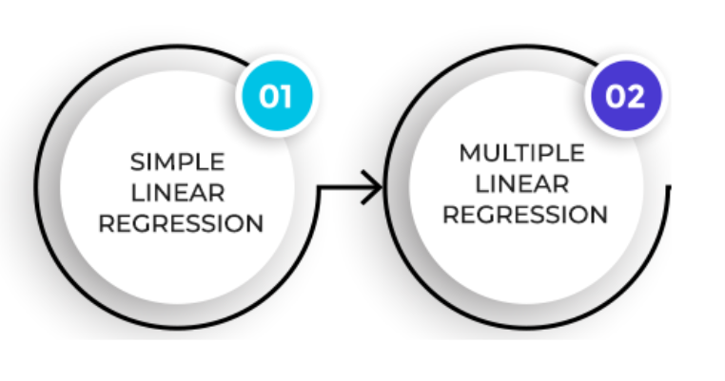
Types of Linear regression

Slide 11
Linear Regression Line

Slide 12
Positive Linear Regression Graph
Negative Linear Regression Graph

Slide 13


