Slide 1

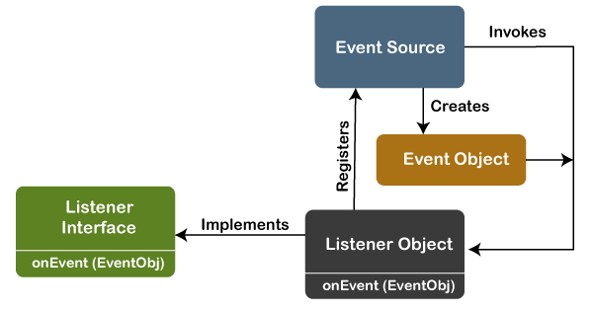
Shaheed Rajguru College of Applied Sciences for Women
Name: Neha kumari
Course:Bsc.Computer Science
Roll no.:2020331
Semester/Year: 1st
Topic of Presentation: Event Handling

Slide 2
EVENT HANDLING
Events | Source | Listeners | Interfaces
ACTION EVENT | Button, list item or menu item,Textfield. | Action Listener | void actionPerformed(ActionEvent ae)
ADJUSTMENT EVENT | Scroll bar | Adjustment Listener | void adjustmentValueChanged(AdjustementEvent ae)
COMPONENT EVENT | Components | Component Listener | void componentResized(ComponentEvent ce) void componentMoved(ComponentEvent ce) void componentShown(ComponentEvent ce) void componentHidden(ComponentEvent ce)
CONTAINER EVENT | Container’s components when added or removed | Container Listener | void componentAdded (ContainerEvent ce) void componentRemoved(ContainerEvent ce)
FOCUS EVENT | Component gains or loses input focus | Focus Listener | void focusGained(FocusEvent fe) void focusLost(FocusEvent fe)

Slide 3
Event | Source | Listener | Interface
ITEM EVENT | Checkbox, list item or menu item is selected or deselected | Item Listener | void itemStateChanged(ItemEvent te)
KEY EVENT | When input is received from keyboard | Key Listener | void keyPressed(KeyEvent ke) void keyReleased(KeyEvent ke) void keyTyped(KeyEvent ke)
MOUSE EVENT | Mouse | Mouse Listener MouseMotion Listener | void mouseClicked(MouseEvent me) void mouseEntered(MouseEvent me) void mouseExicted(MouseEvent me) void mousePressed(MouseEvent me) void mouseReleased(MouseEvent me) void mouseDragged(MouseEvent me) void mouseMoved(MouseEvent me)
MOUSEWHEEL EVENT | Mouse wheel | MouseWheel Listener | void mouseWheelMoved(MouseWheelEvent me)

Slide 4
Event | Source | Listener | Interface
TEXT EVENT | Text Components | Text Listener | void textValueChanged(TextEvent te)
WINDOW EVENT | Window | WindowListener WindowFocus Listener | void windowActivated(WindowEvent we) void windowClosed(WindowEvent we) void windowClosing(WindowEvent we) void windowDeactivated(WindowEvent we) void windowIconified(WindowEvent we) void windowDeiconifiedWindowEvent we) void windowOpened(WindowEvent we) void windowGainedFocus(WindowEvent we) void windowLostFocus(WindowEvent we)

Slide 5


