Slide 1

Deep Learning from Scratch in C++ Final Presentation
Malaria Detection
Nehil Danış
Technische Universität München
Master of Computer Science
31 July 2019

Slide 2
Context
The Structure of the Deep Learning Library
What is Malaria? Why did I work on this problem?
Data Preprocessiong
Dataset for Malaria Detection
Network Architectures Used
Results and Tests
Future Plans

Slide 3
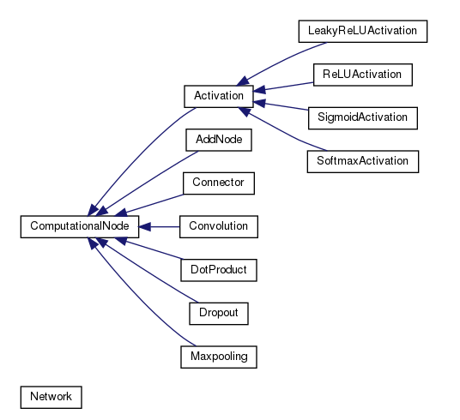
The Structure of the Deep Learning Library
*
1

Slide 4
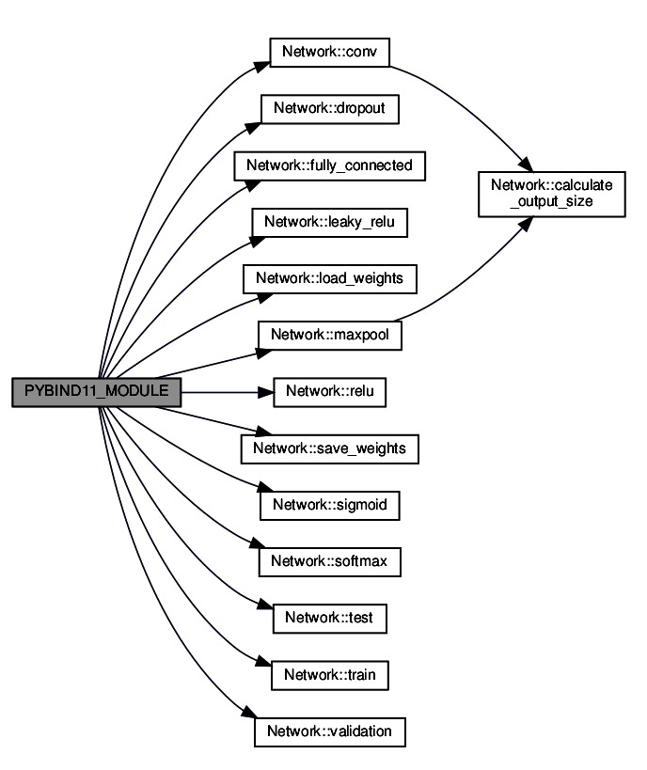
The Structure of the Deep Learning Library
The functions which are shown on the left side can be reach by the users via the python bindings.
These function are for the creation of the deep network architecture.
Later on user can use train, validation and test functions.

Slide 5
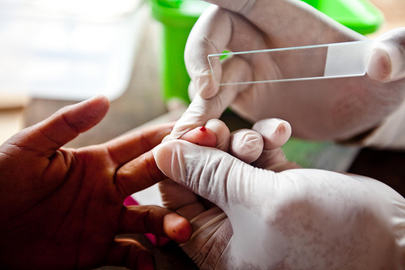
What is Malaria? Why did I work on this project?
Malaria is a life-threatening disease caused by parasites that are transmitted to people through the bites of infected female Anopheles mosquitoes. It is preventable and curable.
According to the World Health Organization(WHO) In 2017, there were an estimated 219 million cases of malaria in 87 countries. The estimated number of malaria deaths stood at 435 000 in 2017.
According to WHO protocol, diagnosis typically involves intensive examination of the blood smear at 100X magnification. Trained people manually count how many red blood cells contain parasites out of 5,000 cells. Thus, the detection of Malaria should be automized for the fast detection and treatment to prevent life losses.

Slide 6
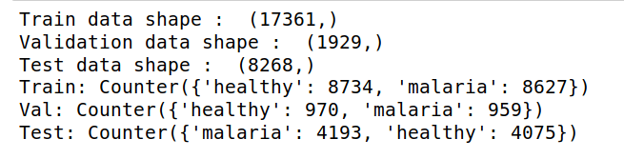
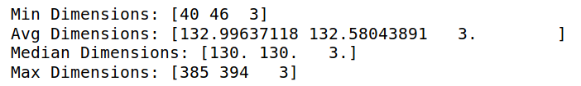
Data Preprocessing
The data divided into train, test and validation splits!
Since the image size changes in the dataset, the average image size of all images is found!

Slide 7
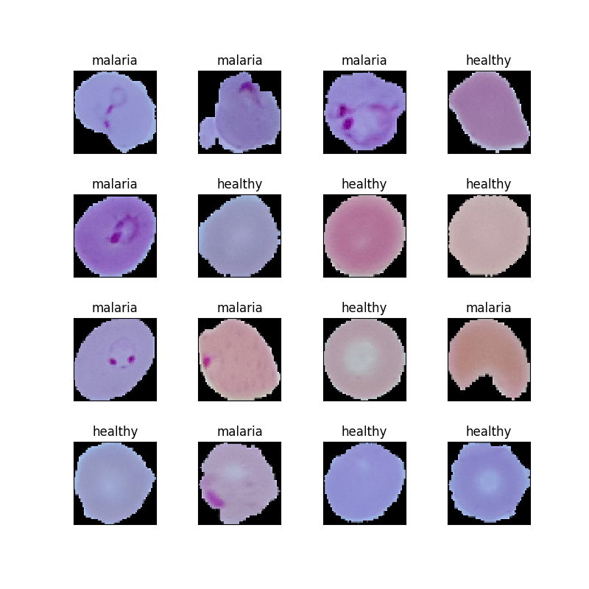
Dataset for Malaria Detection

Slide 8
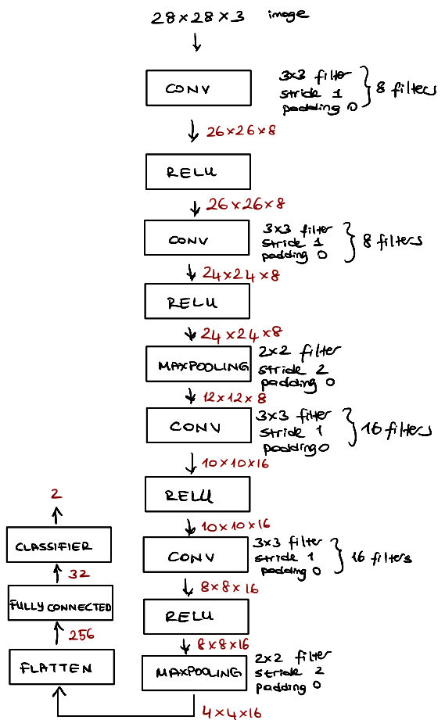
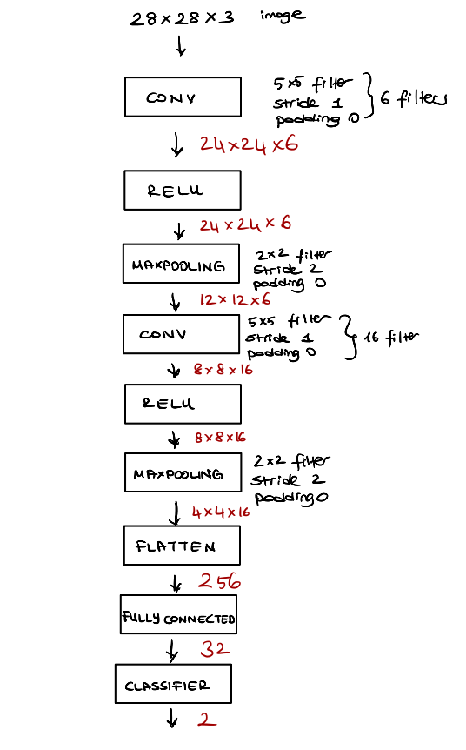
Network Architectures Used
LeNet
LeNet like Architecture

Slide 9
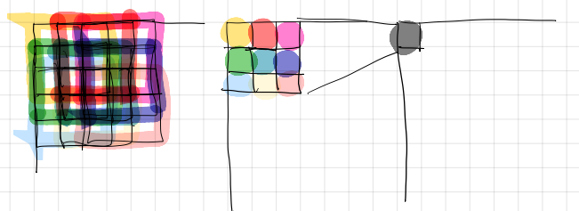
Network Architectures Used
Receptive Field, using 2 layer 3x3 filters is equal to using 1 layer 5x5 filter.

Slide 10
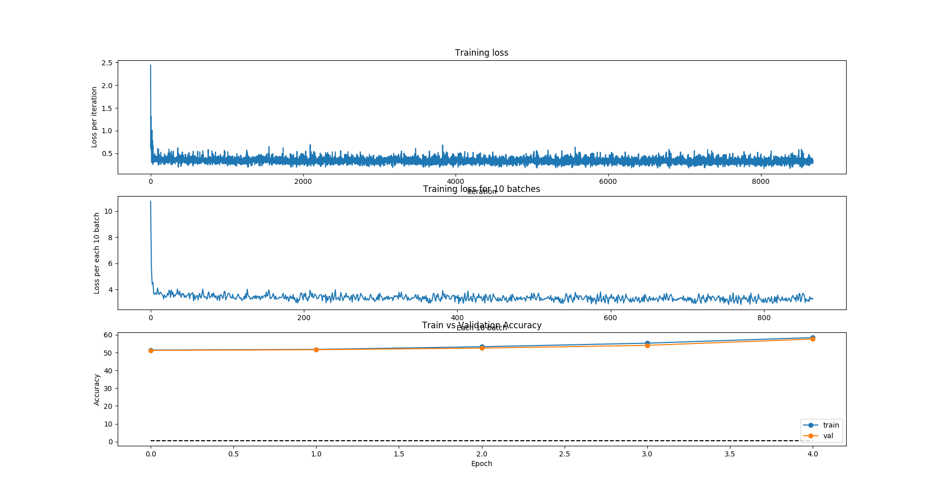
Results
By Using LeNet and SGD as a solver

Slide 11
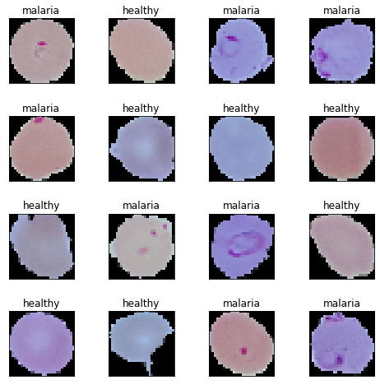

Test of LeNet with SGD by using 28x28x3 images
After 5 epochs the test accuracy is 0.56.
Ground Truth
Predictions
12 correct/16
Nehil Danış | Malaria Detection | Deep Learning from Scratch in C++

Slide 12
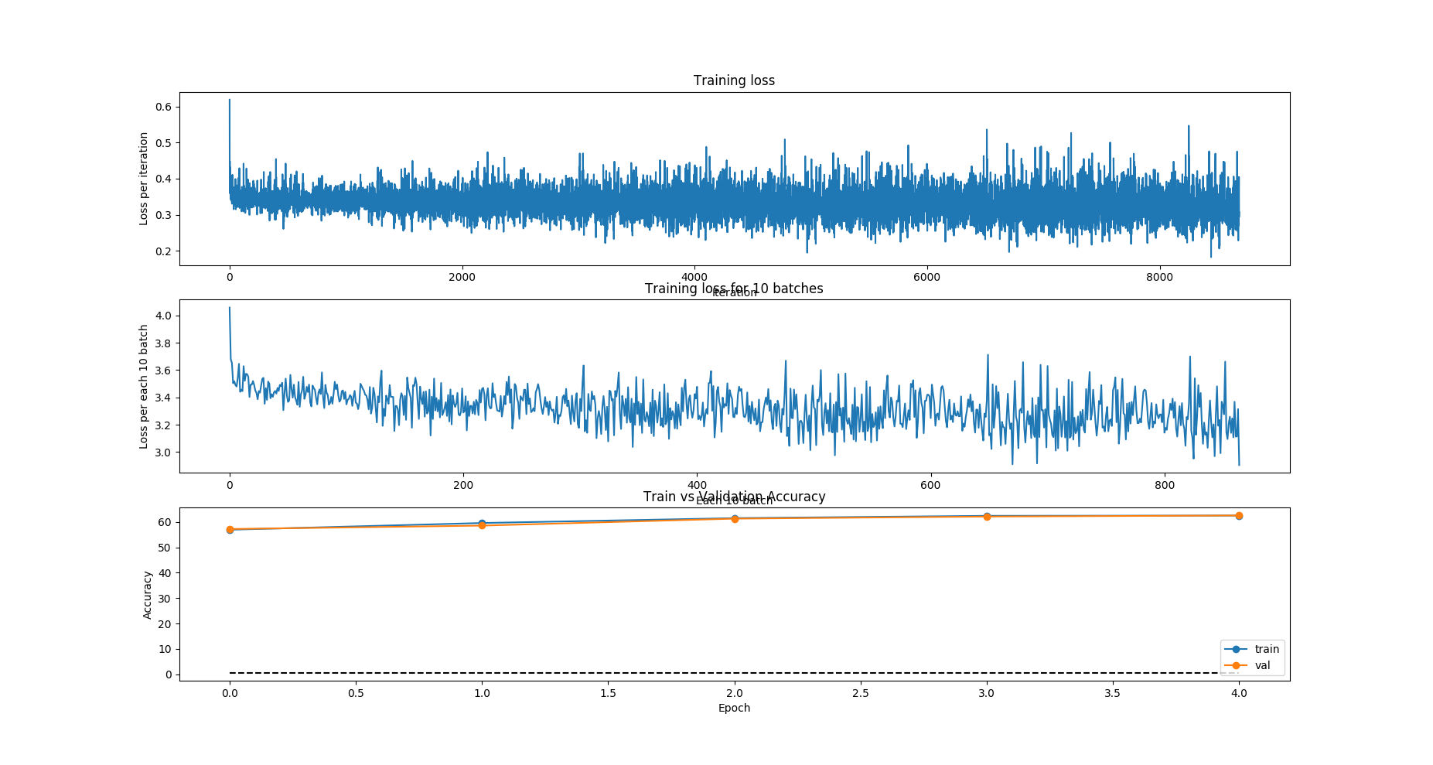
Results
Results with the LeNet like architecture by using SGD
Nehil Danış | Malaria Detection | Deep Learning from Scratch in C++

Slide 13

Test of LeNet which uses the Receptive Field
Property with SGD by using 28x28x3 Images
After training for 5 epoch, the test accuracy is 0.6236090953072085
Ground Truth
Predictions
8/16
Nehil Danış | Malaria Detection | Deep Learning from Scratch in C++

Slide 14
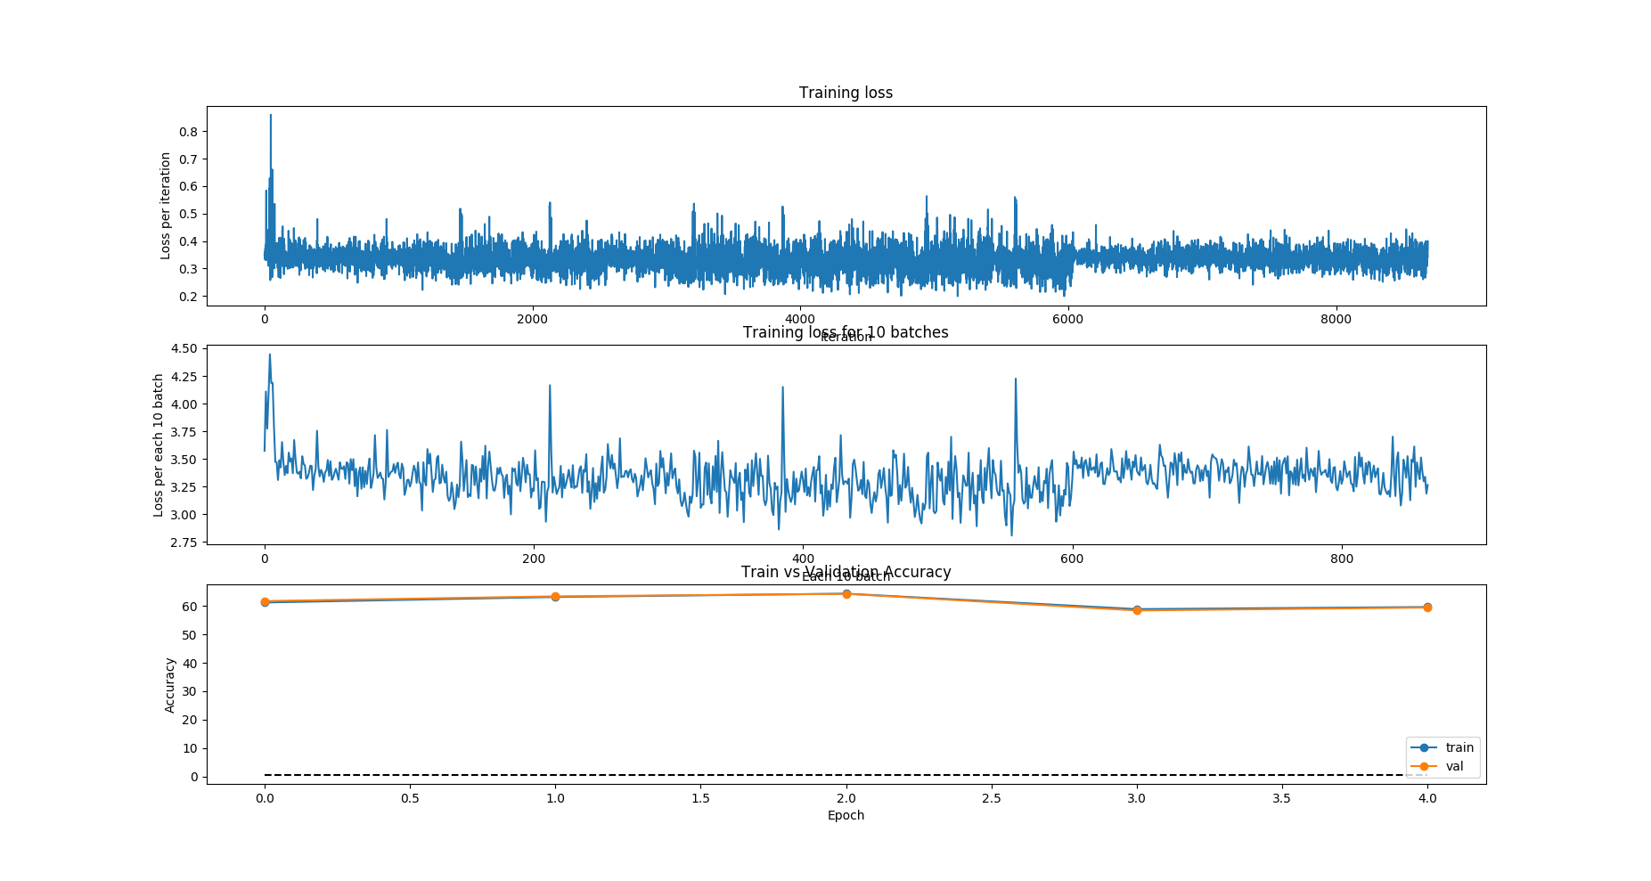
Results
By Using LeNet and momentum gradient descent as a solver

Slide 15

Test of LeNet with Momentum by using 28x28x3 images
By using the saved weights and biases after the third epoch, the test accuracy is 0.638.
Ground Truth
Predictions
10 correct/16
Nehil Danış | Malaria Detection | Deep Learning from Scratch in C++

Slide 16
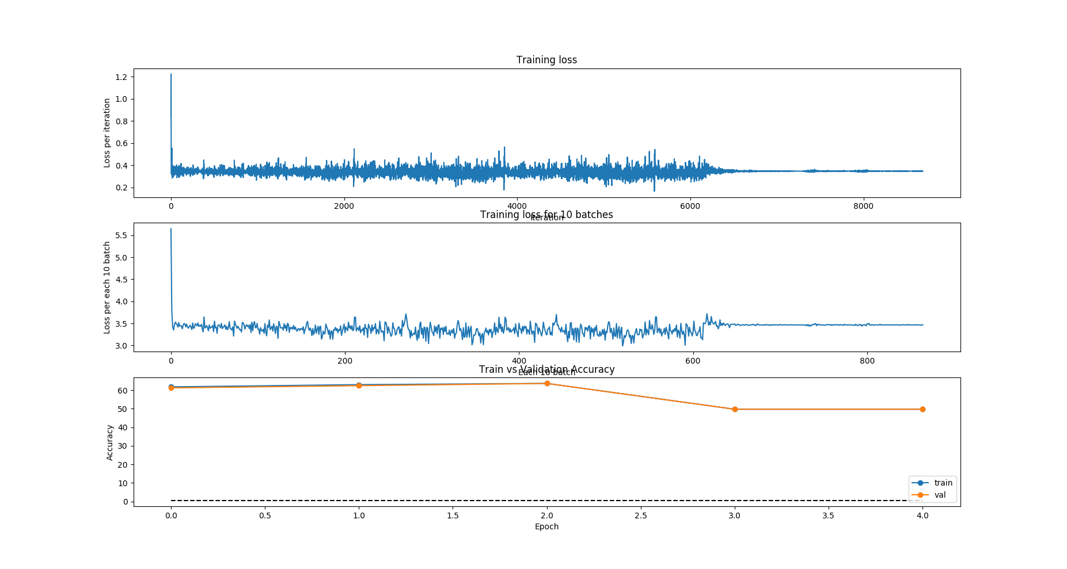
Results
By Using LeNet with the receptive field propertied and momentum gradient descent as a solver

Slide 17

Test of LeNet which uses the Receptive Field
Property with Momentum by using 28x28x3 Images
By using the saved weights and biases after the third epoch, the test accuracy is 0.630.
Ground Truth
Predictions
7 correct/16
Nehil Danış | Malaria Detection | Deep Learning from Scratch in C++

Slide 18
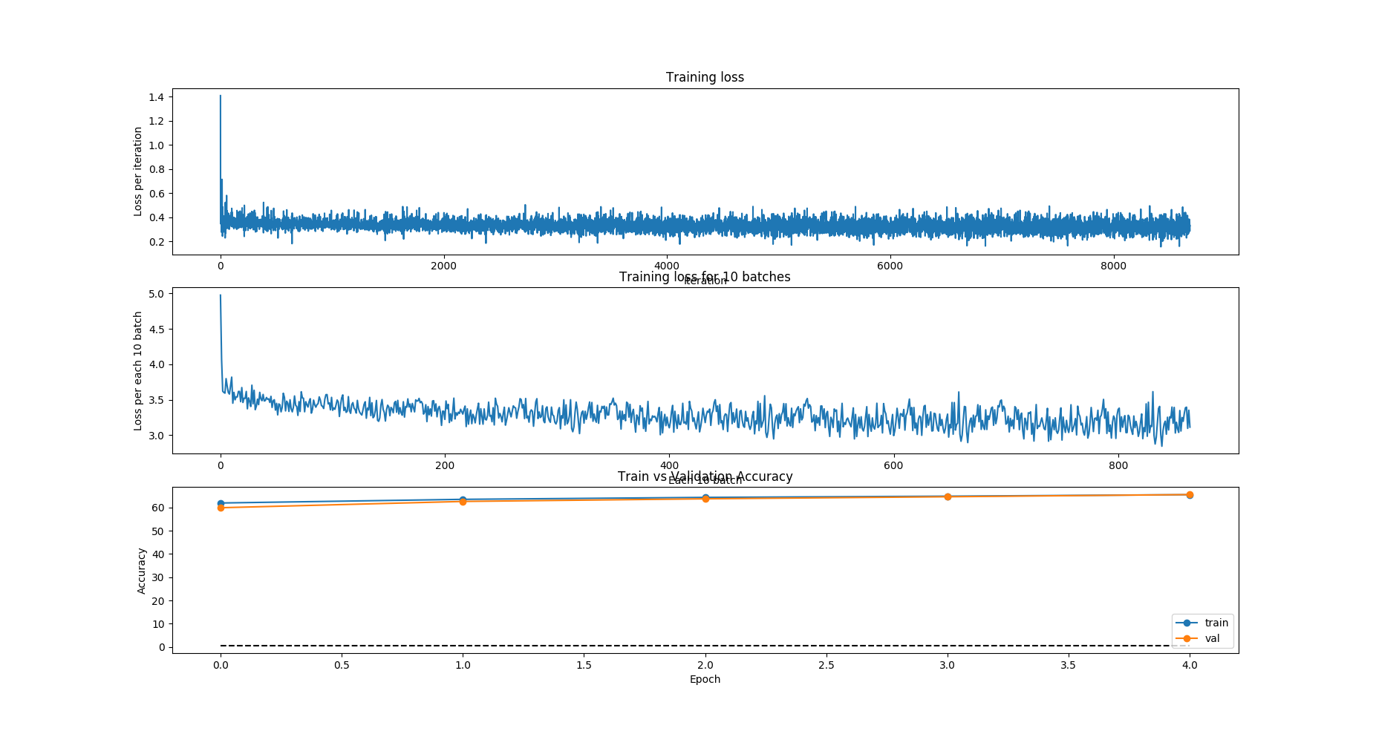
Results
By Using LeNet with SGD by using 64x64x3 images

Slide 19
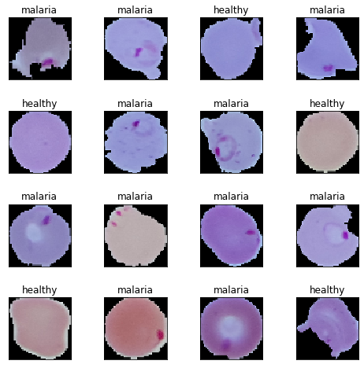

Test of LeNet with SGD by using 64x64x3 Images
After training the network for 5 epochs, the test accuracy is 0.647.
Ground Truth
Predictions
11 correct/16
Nehil Danış | Malaria Detection | Deep Learning from Scratch in C++

Slide 20
Future Plans
Deep learning library will be able to run the computations in parallel.
Transfer learning should be applied.
Hyperparameter search
A new architecture, eg. VGG16, GoogLeNet, ResNet. To build these networks new functionalities such as batch normalization, inception layer and residual connection should be added.
Nehil Danış | Malaria Detection | Deep Learning from Scratch in C++

