Slide 1
House Prices and Venues Data Analysis of Beijing

Slide 2
Introduction
The housing problem in Beijing is severe
Beijing was the most expensive city to rent an apartment in, with average monthly rent costing 1.2 times the average monthly salary
Creating the house price map is important

Slide 3
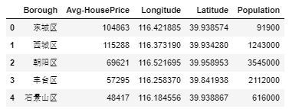
Data
Here is the master data containing the Borough, Average House Price, Latitude and Longitude and Population information of Beijing

Slide 4
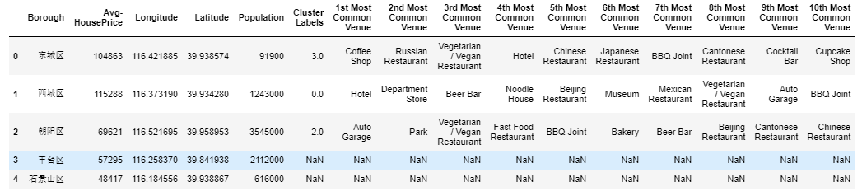
Methods
To cluster the boroughs, K-means algorithm was used
Here is the merged table with cluster labels for each borough.

Slide 5
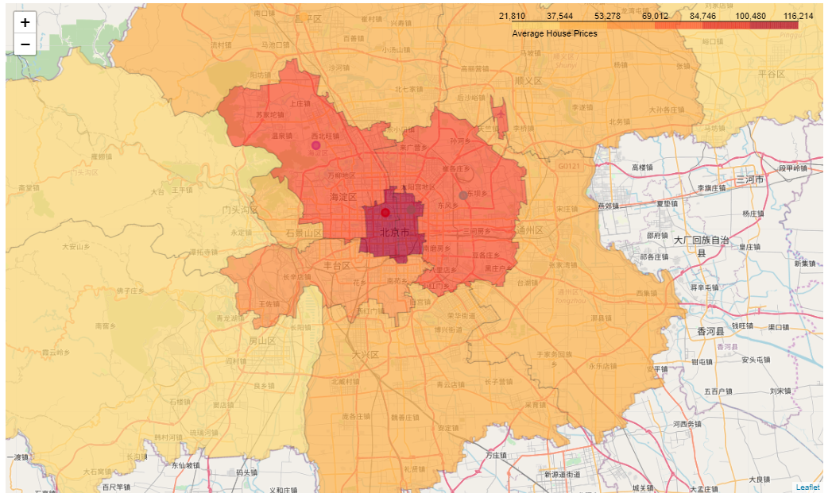
Results
Here is the choropleth map containing the following information for each borough: borough name, cluster name, house prices, and the top 3 number of venues.

Slide 6
Discussion
The house price in the center of Beijing is extremely high.
The business activities in these areas are prosperous.
If an investor wants to start his or her business in Beijing, it is better to choose these areas with higher population density and prosperous business activities though the house price is much higher.

