Slide 1

Detecting Criminal Wallets
STUDENTS
INSTRUCTOR
Nehoray Chalfon
Ofer Zevin
Ori Sinvani
Github repo
Harel Brener
Group 4

Slide 2
BITCOIN IN NUMBERS
$1.2T
25M
market capitalization
Active wallets on the blockchain
545K
$14.8B
transactions every single day
moved on-chain every 24 hours

Slide 3

THE PROBLEM
$154B
received by illicit crypto addresses in 2025 alone
Every Bitcoin transaction is public.
Yet criminal wallets hide among
hundreds of millions of look-alike addresses.
Real Hamas funding campaign via blockchain
Crime on the blockchain hides in plain sight.

Slide 4
GOAL & APPROACH
GOAL
Classify any Bitcoin wallet as criminal or benign from its on-chain behavior and graph neighborhood — served as a usable web tool.
0.42 BTC
2.10 BTC
?
0.07 BTC
1.30 BTC
DATA
5.80 BTC
0.95 BTC
REAL-CATS — 40,032 criminal + 90,176 benign labeled addresses
Elliptic++ — 822K addresses with transaction features
Wallets + transactions form a graph — each address is a node, payments are edges
benign
illicit
wallet under analysis

Slide 5

WHY OUR APPROACH IS DIFFERENT
EXISTING APPROACHES
OUR PROJECT
Manual blockchain forensics
Dataset variety
Chainalysis-style — accurate but slow, expensive, closed-source
REAL-CATS(2023), Elliptic(2016) combined
Feature-only ML
Graph structure + attention
XGBoost on hand-crafted features — blind to graph structure
GATv2 learns which neighbors are suspicious context
Prior academic work
End-to-end live system
Transaction-level labels on Elliptic(2016) — risk of being outdated
Any address → mempool.space → calibrated risk score in a web app

Slide 6
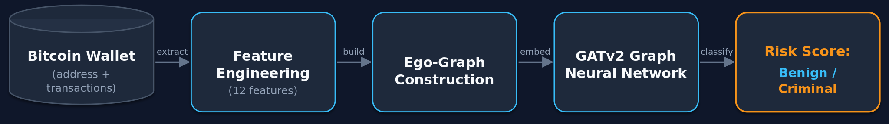
OUR SOLUTION — THE PIPELINE
Features
Ego-graphs
GATv2 GNN
Risk score
12 selected of 19 behavioral features per wallet
1-hop neighborhood graph built per wallet
Attention over neighbors → embedding → classifier
Temperature-calibrated probability served via API

Slide 7
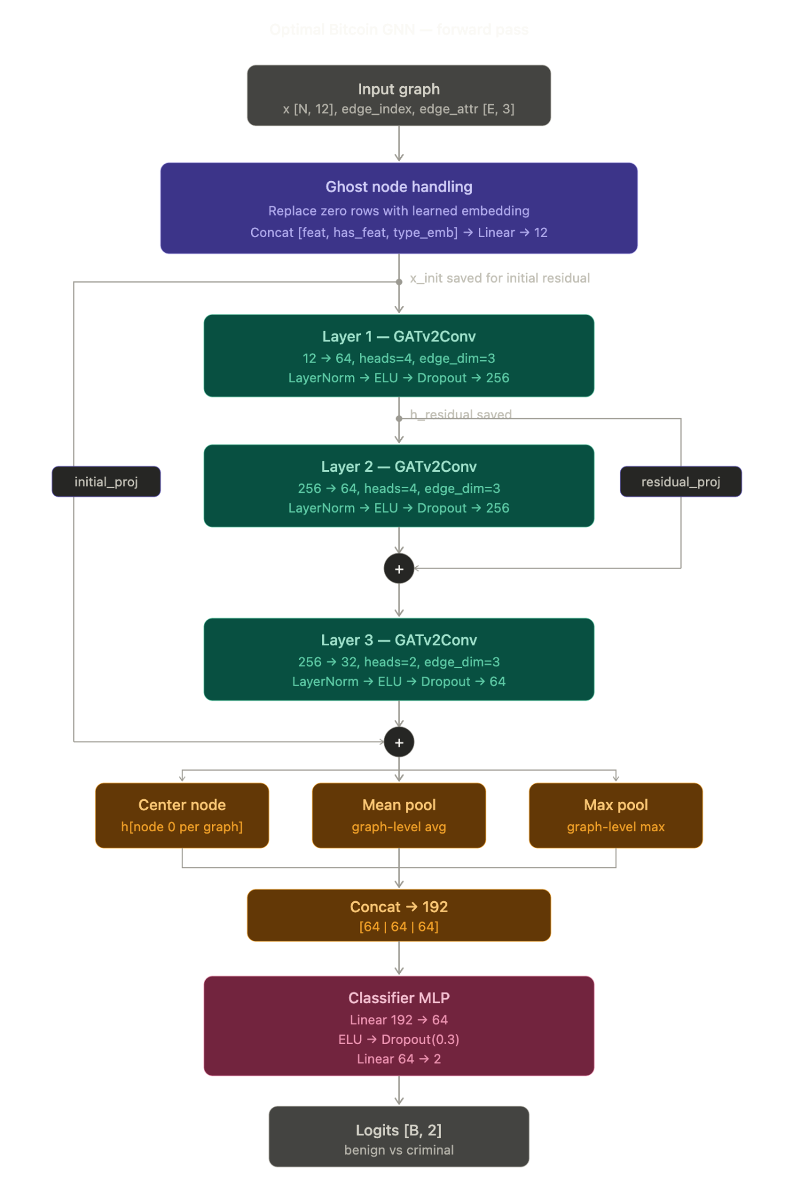
MODEL ARCHITECTURE
GATv2: 3-layer architecture with multi-head attention (4 → 4 → 2 heads).
Ghost-node: Learnable 12-d + node-type embeddings for featureless neighbors.
Regularization: DropEdge (p=0.1) implemented during training phase.
Dual Residuals: Layer-1→2 (gradient flow) and Input→Post-L3 (signal preservation).
Hybrid Readout: Center node + Mean/Max pooling → 192-d vector.
Post-hoc: MLP head (192→64→2) with Temperature Scaling (T=1.058).

Slide 8
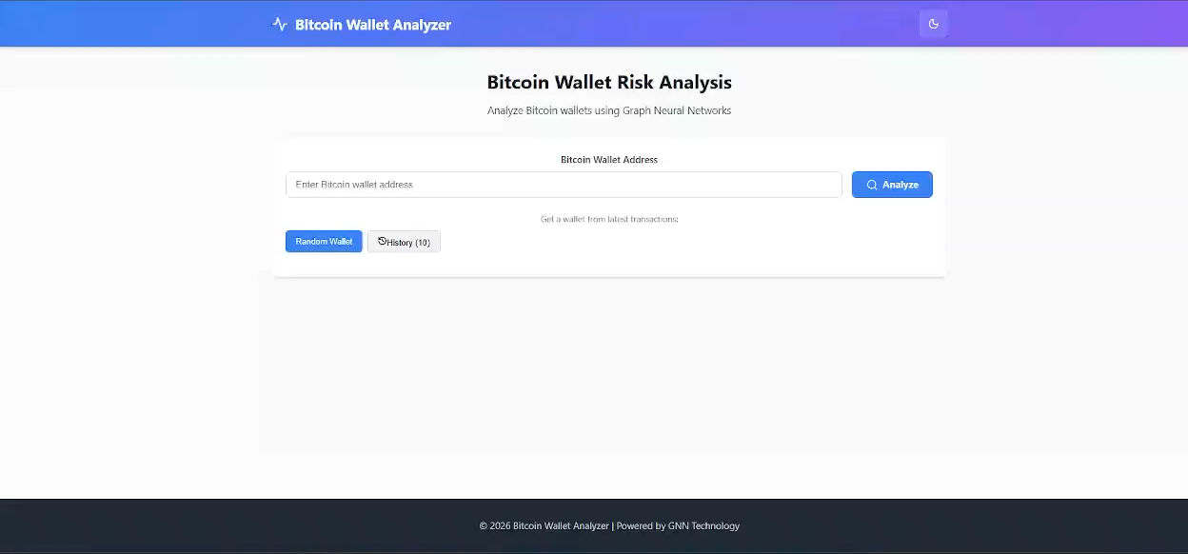
DEMO

Slide 9
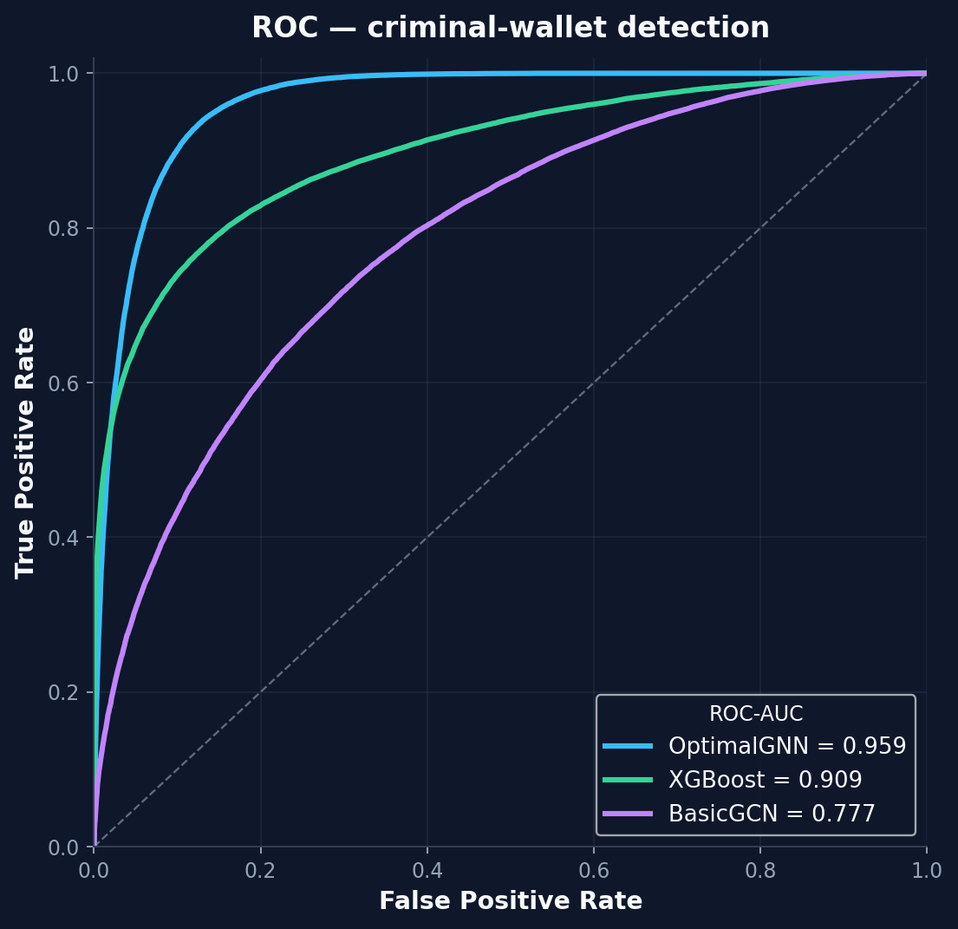
RESULTS — EVALUATION
11,880 held-out wallets · 4,740 criminal · never seen in training
89.4%
0.959
88.4%
0.87
Accuracy
ROC-AUC
Recall (criminal)
F1 (criminal)
CONFUSION MATRIX
 | Pred. Benign | Pred. Criminal
Actual Benign | 6,432 | 708
Actual Criminal | 550 | 4,190
Only 550 of 4,740 criminal wallets missed. Recall is what matters when screening for crime.

Slide 10

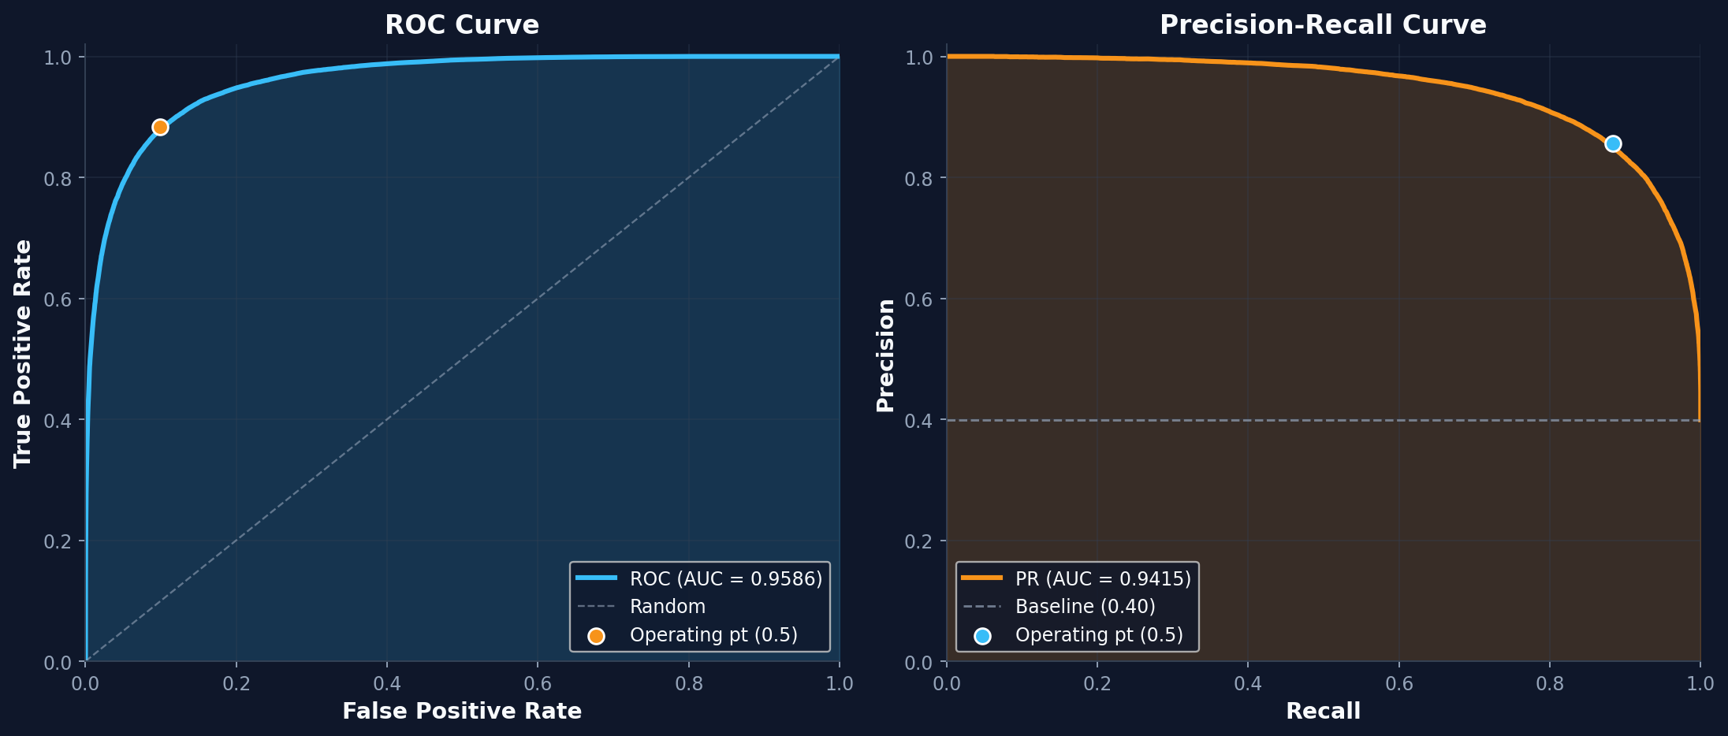
PERFORMANCE CURVE ANALYSIS
OptimalBitcoinGNN demonstrates exceptional discriminative power with high AUC scores across metrics.
Key Performance Metrics
01. ROC Curve Excellence
The ROC-AUC of 0.9586 indicates a very high true positive rate with minimal false positives, crucial for law enforcement.
02. Precision-Recall Stability
A PR-AUC of 0.9415 shows the model maintains high precision even at high recall levels, outperforming the 0.40 baseline.
03. Imbalance Robustness
The stability of the PR curve confirms that the model handles the inherent class imbalance of criminal vs. legitimate wallets effectively.

Slide 11
DOES GRAPH STRUCTURE MATTER?
Same 12 features, same test set — three models
Metric | OptimalGNN (Ours) | XGBoost | Basic GCN
Accuracy | 89.4% | 82.6% | 70.1%
Precision | 85.5% | 86.1% | 65.8%
Recall | 88.4% | 67.3% | 52.2%
F1-Score | 0.869 | 0.755 | 0.582
ROC-AUC | 0.959 | 0.909 | 0.777
+21 pts recall over XGBoost — the strongest feature-only baseline
Why? The criminals XGBoost misses are the ones hiding behind normal-looking features. Their neighborhood exposes them.

Slide 12
HOW WE COMPARE TO PRIOR WORK
Published GNN forensics tune a single transaction-level dataset — we generalize across datasets at the wallet level
Work | Method | Data · level | Reported result
Asiri et al. (2025) | Optimized GCN | Elliptic · transaction | 98.5% acc · 0.94 AUC
Zhang et al. (2024) | GAT-ResNet (attention + residual) | Elliptic · transaction | Illicit F1 0.72 · Recall 0.58
Alarab & Prakoonwit (2022) | GCN + LSTM (temporal) | Elliptic · transaction | Illicit F1 0.81 · Recall 0.71
Ours — OptimalBitcoinGNN | GATv2 ego-graph + attention | REAL-CATS + Elliptic++ · wallet | F1 0.87 · Recall 0.88 · 89.4% acc
The gap we fill: every prior model optimizes one mostly-2016 transaction-level dataset. Ours is the only one tested for cross-dataset generalization — trained on Elliptic++ (theft/Ponzi), validated on REAL-CATS (modern cybercrime & terror financing) — at the wallet level.

Slide 13


LIMITATIONS & FUTURE WORK
HONEST LIMITATIONS
FUTURE WORK
Labels are imperfect and dated — criminal behavior drifts over time
Temporal GNNs — model how wallet behavior evolves
Ego-graphs limited to 1 hop — long laundering chains can escape
Deeper / larger graphs with sampling for full-chain coverage
No formal user study of the web tool yet
Exchange integration: real-time screening at deposit time

Slide 14
SUMMARY
1
2
3
Graph structure is essential
Attention wins
It's a real tool
Connections catch criminals that features alone miss
GATv2: 89.4% accuracy, +21 pts recall over a strong XGBoost baseline
Live address → calibrated risk score, not just a notebook
The blockchain is public — we built the lens that makes crime on it visible.
Thank you · Questions?

