Slide 1
S
SkillSwap
Exchange Skills.
Grow Together.
A peer-to-peer skill barter platform — teach what you know,
learn what you need. No money, just credits.
DBMS Project
Peer Learning
Credit System

Slide 2
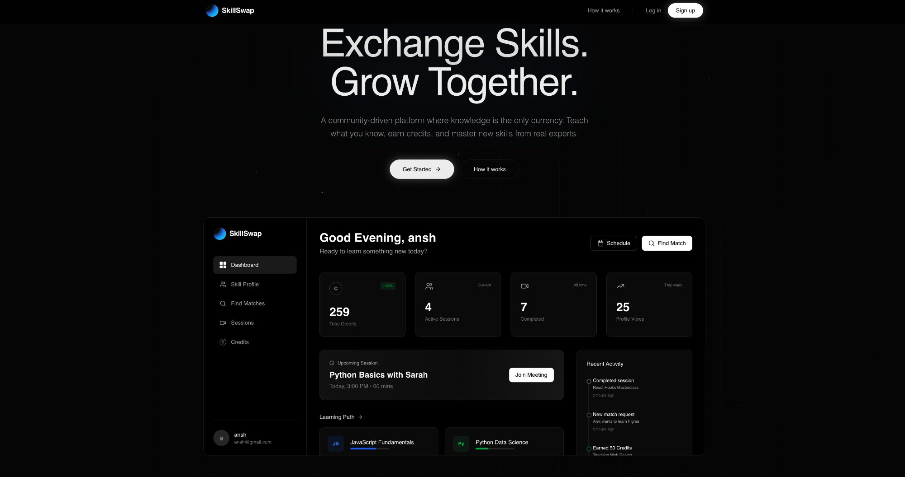
WHAT IS SKILLSWAP?
A Community-Driven Skill Barter Platform
Knowledge is the only currency
🎓
📚
🔄
Teach
Learn
Exchange
Share your skills
and earn credits
Spend credits to
learn from others
Credits transfer on
session completion
Live Platform

Slide 3
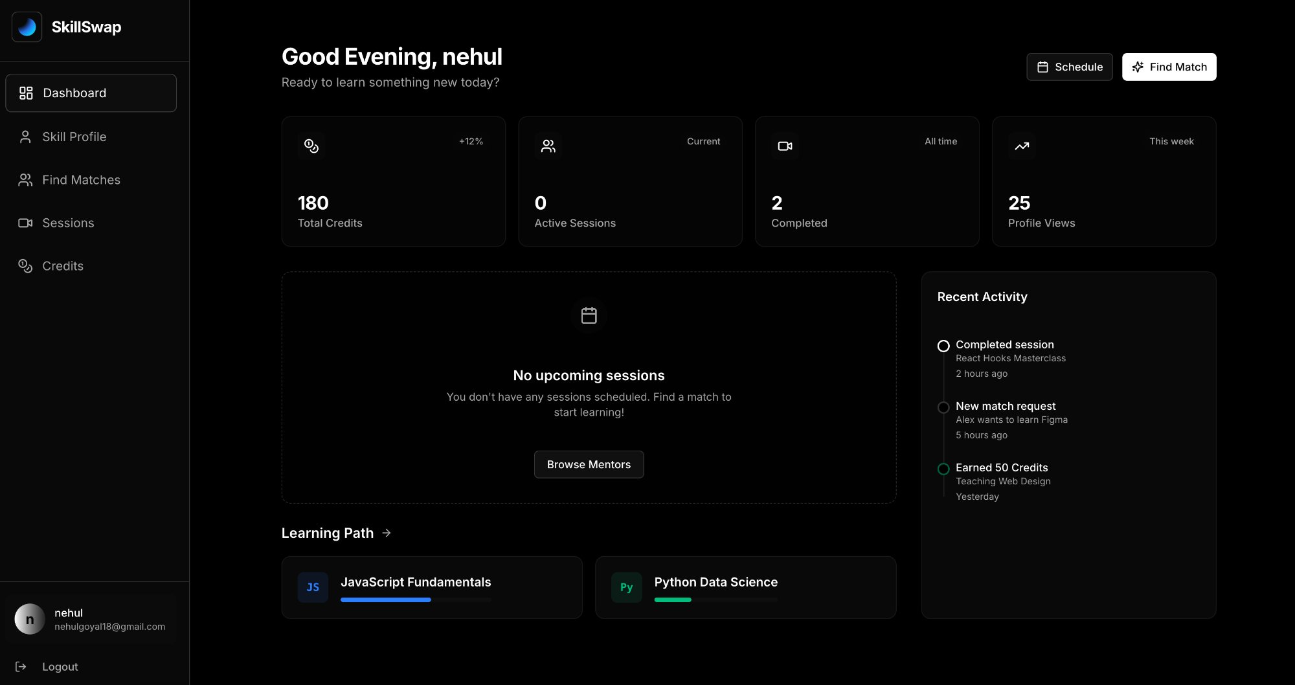
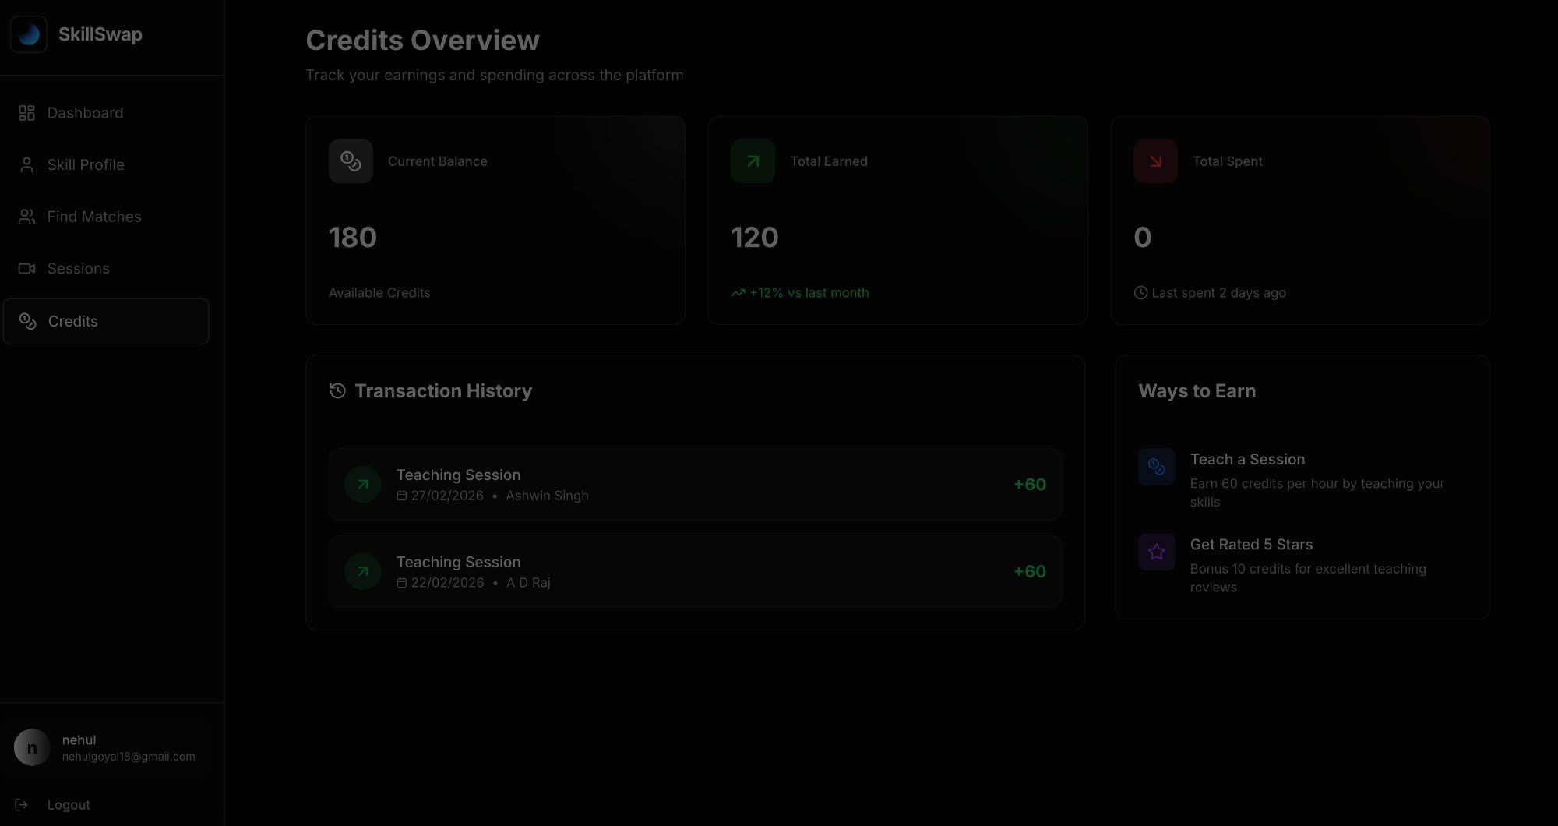
HOW IT WORKS
Simple 5-Step Process
1
2
3
4
5
Sign Up
Add Skills
Find Match
Session
Credits
Create account,
get starter credits
List what you teach
& want to learn
Search for tutors
by skill name
Schedule & conduct
the live meeting
Credits auto-transfer
on completion
Dashboard
Find Matches

Slide 4
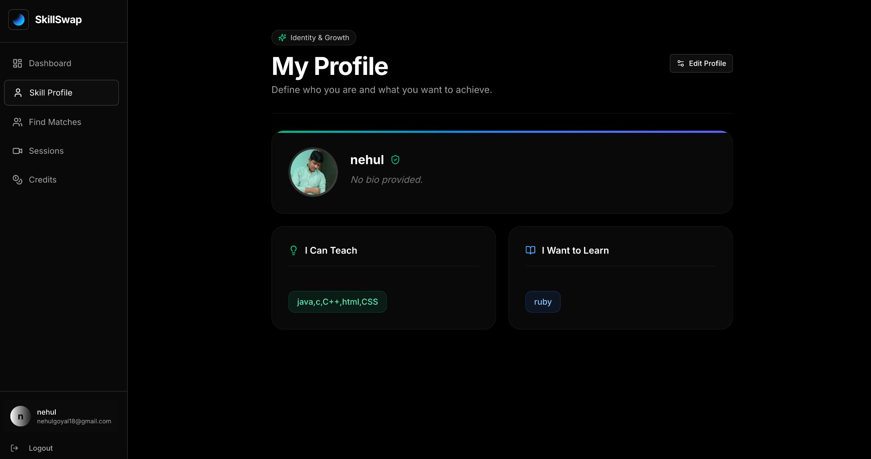
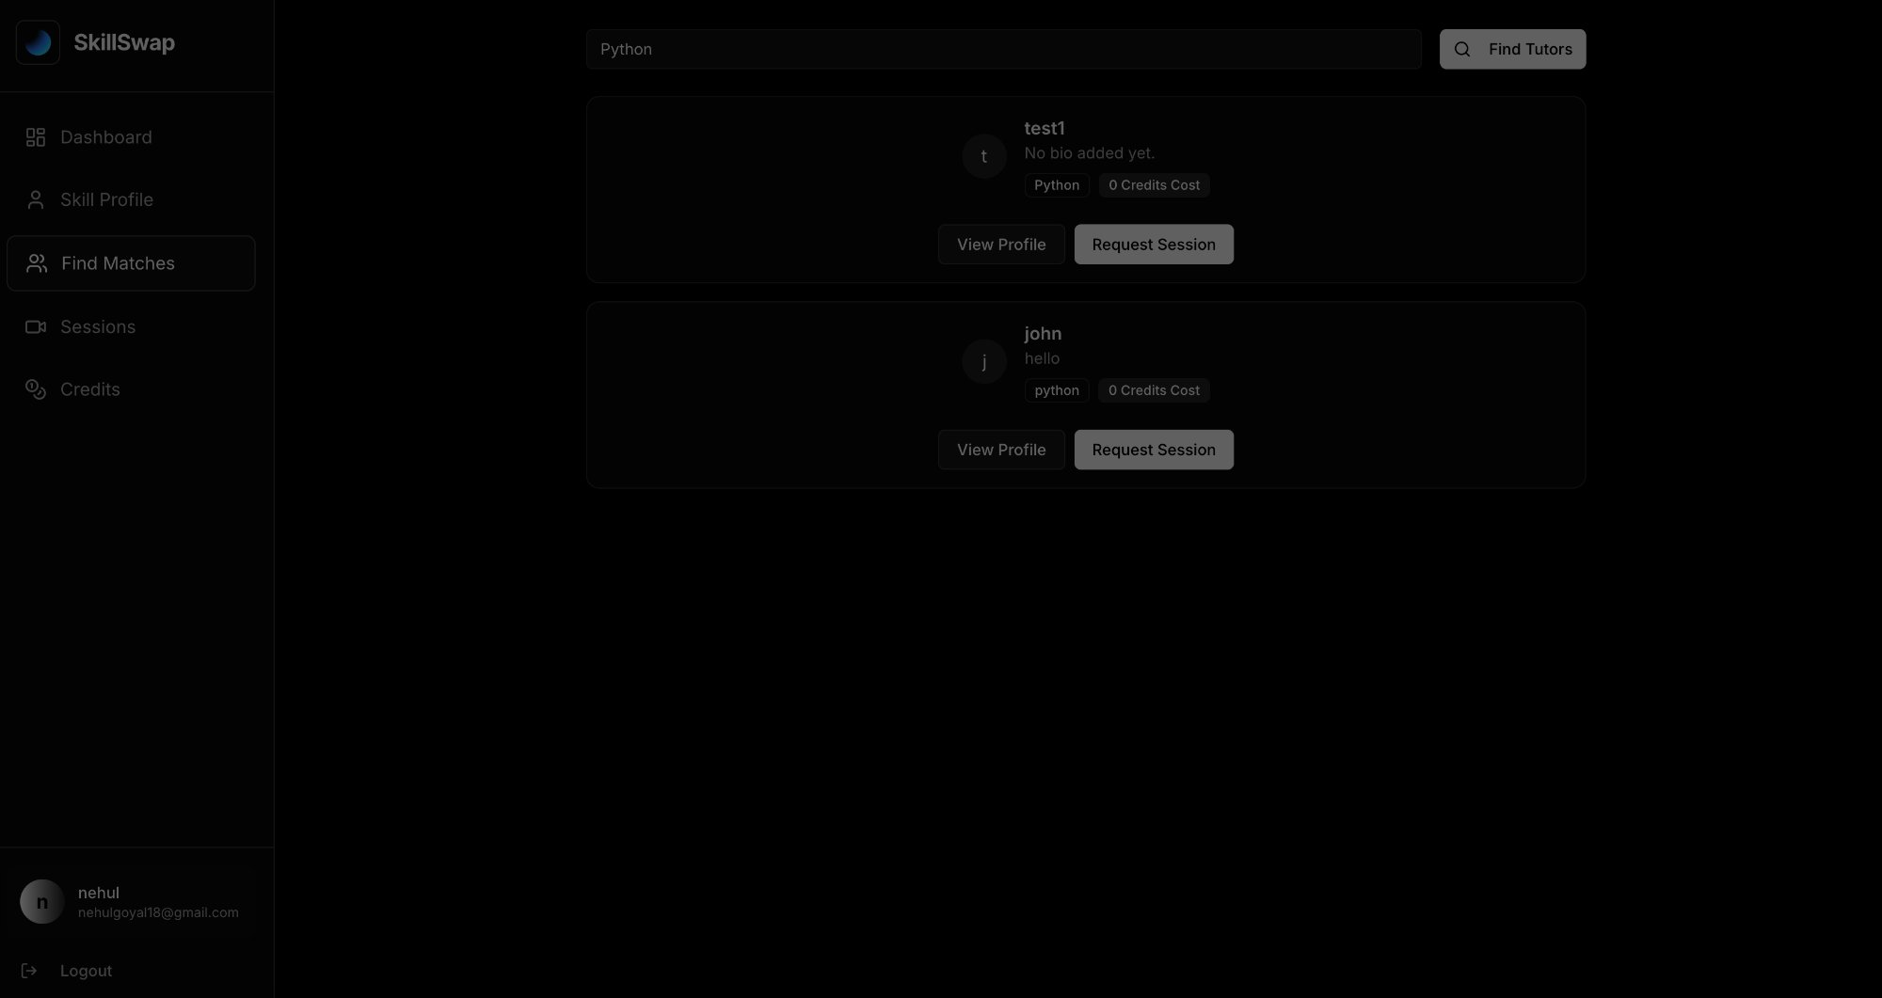
KEY FEATURES
Everything You Need to Teach & Learn
👤
Skill Profile
Skill Profile Page
Define skills you teach and want to learn
🔍
Smart Matching
Search tutors by skill name instantly
📅
Session Scheduling
Book and manage sessions with timezone support
💰
Credit Economy
60 credits per session, earn by teaching
Find Tutors
🖥️
Live Sessions
Real-time screen sharing during meetings

Slide 5
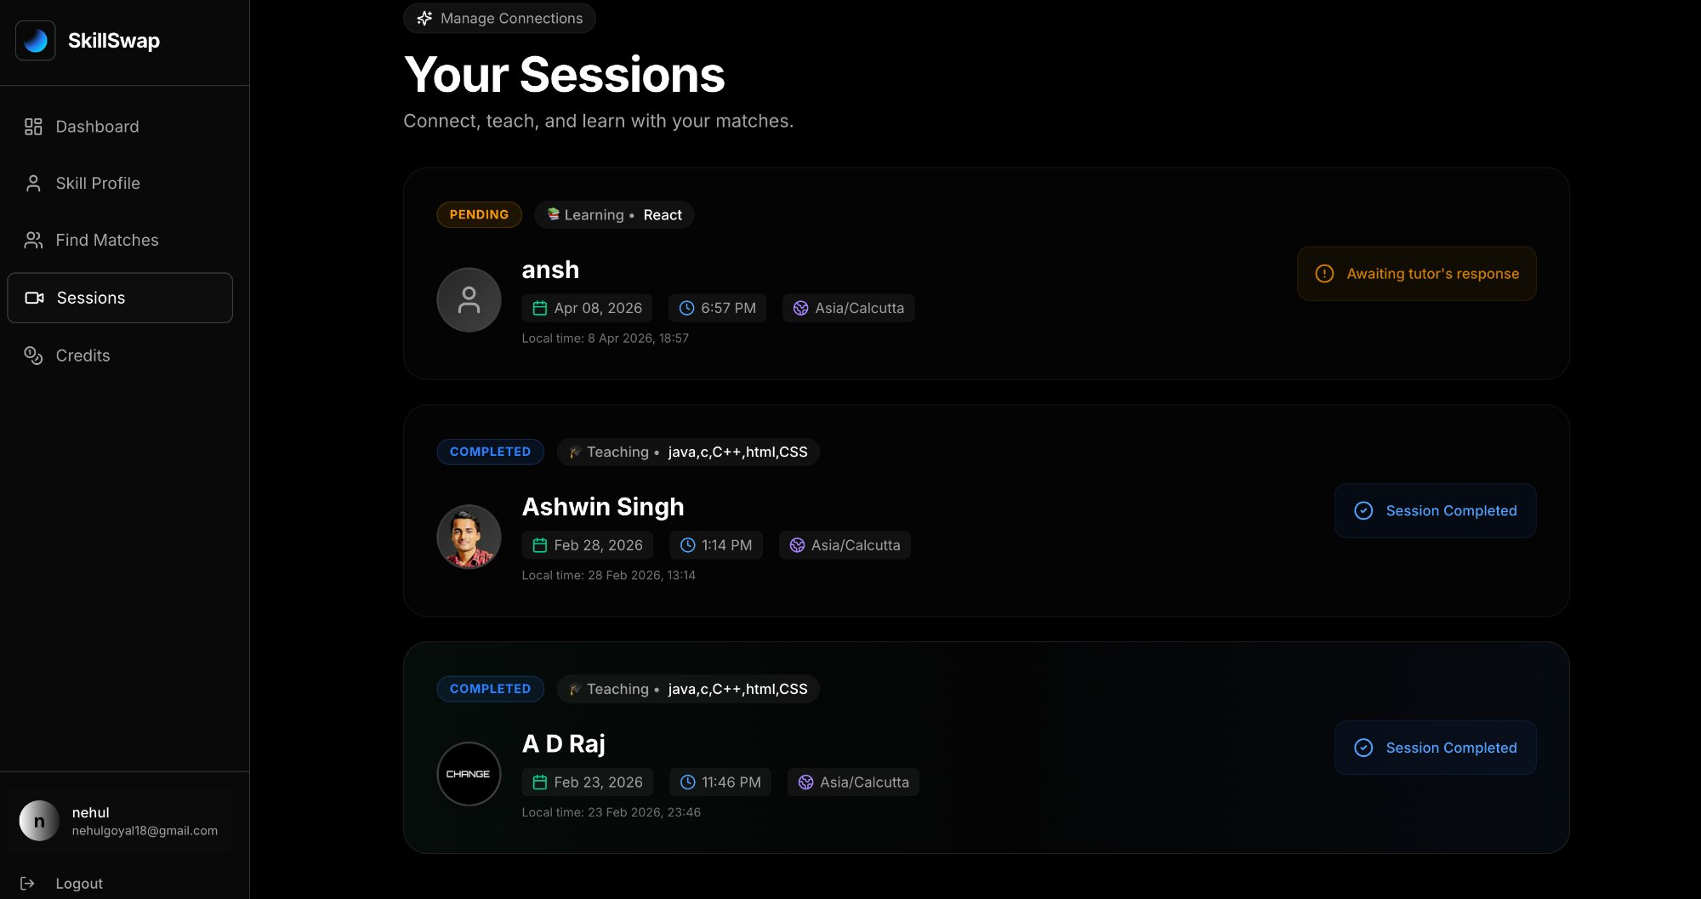
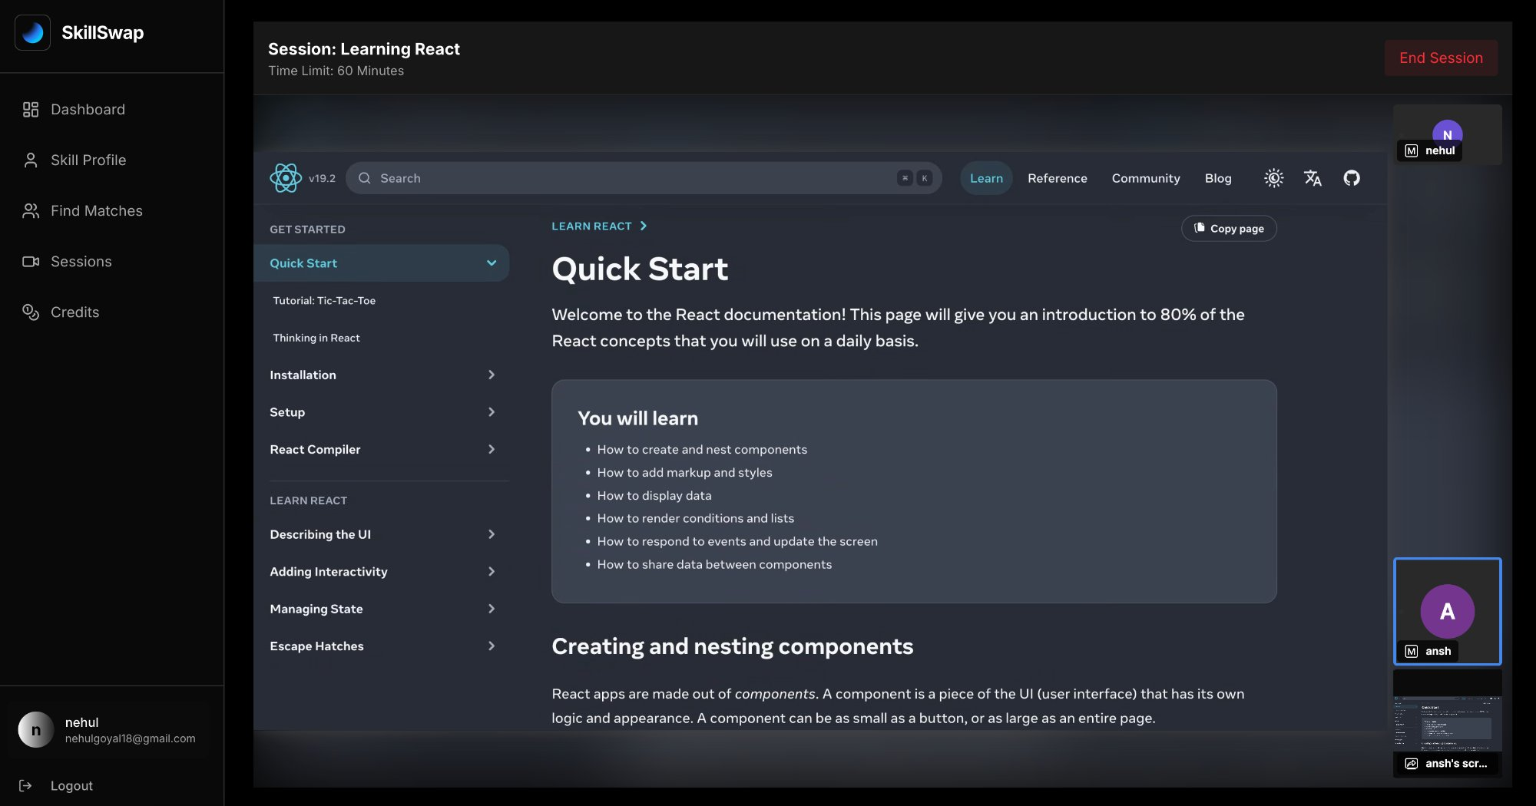
SESSIONS
Manage, Track & Conduct Learning Sessions
Your Sessions — Pending & Completed
Live Session with Screen Share
PENDING
COMPLETED
LIVE
Session statuses tracked in real-time

Slide 6
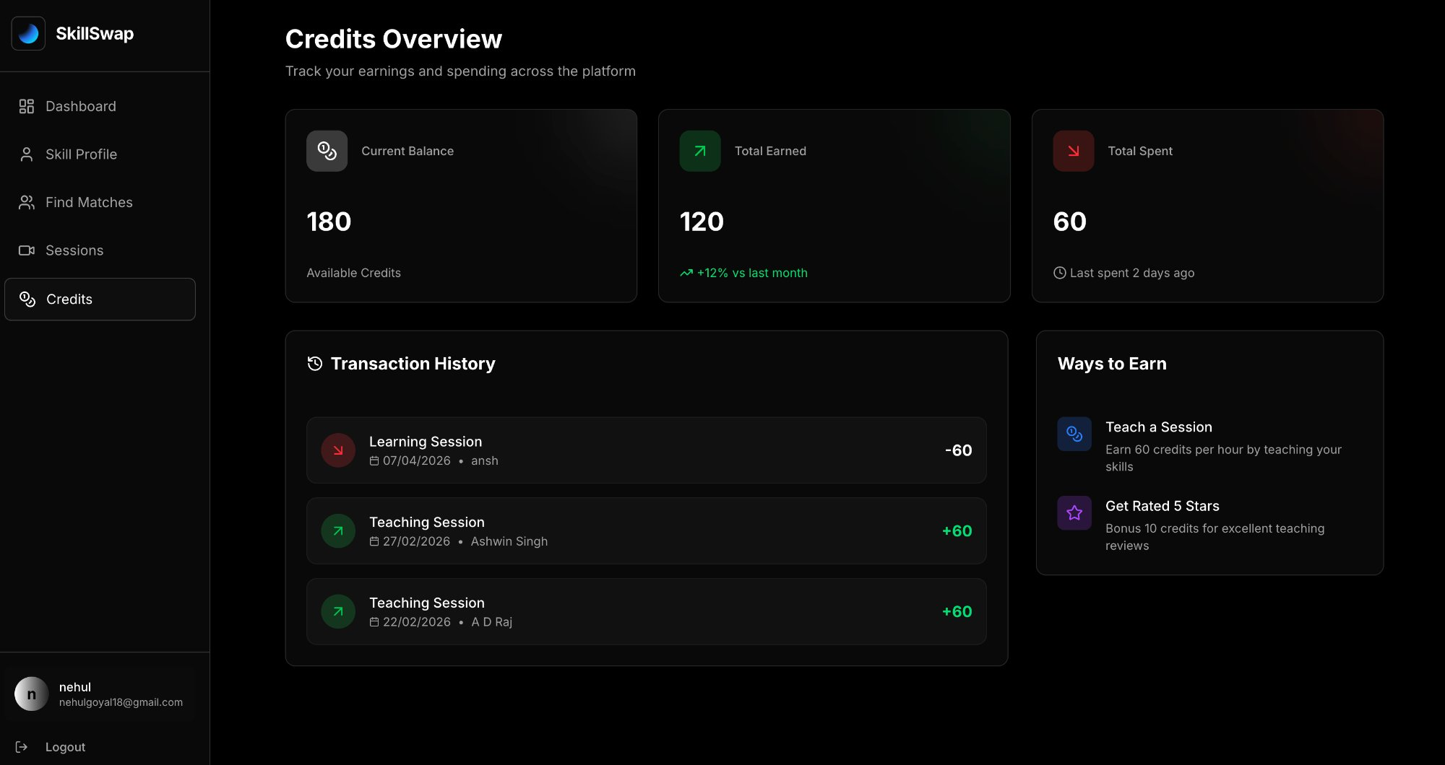
CREDIT SYSTEM
Knowledge as Currency
Credits Overview Page
180
Current Balance
+60
Per Session Taught
-60
Per Session Learned
+10
Bonus for 5-Star Rating
Full transaction history tracked in database

Slide 7
Technology Stack
Frontend:
Backend:
React.js, Tailwind CSS
Node.js, Express
Database:
Real-time:
PostgreSQL / MongoDB
WebRTC (Screen Share)
Thank You!
SkillSwap — Where Knowledge is Currency
DBMS Project • Skill Barter System
S
SkillSwap

