Slide 1
Narrative explanation of visualization encoding scheme
Wang, Qianwen

Slide 2
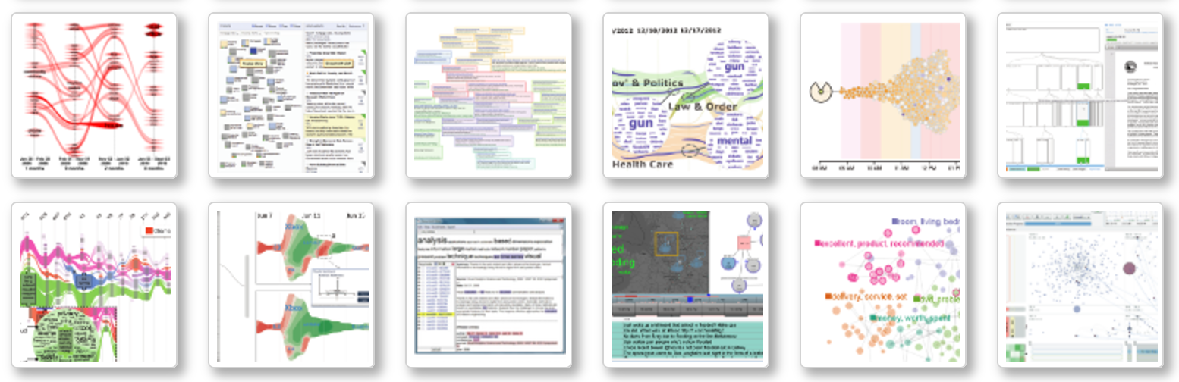
Motivation
Advanced visualization technology
Data with high dimension
Large datasets
Identify trends, similarities

Slide 3
Motivation
Advanced visualization technology
overwhelming information harm the understandability and memorability
Difficult to present, especially for novice
Little exposure outside visual community due to relatively long study period

Slide 4
Motivation
Narrative explanation can be a solution!
Specify the reading order
Bring information density down
Pre-defined narrative templates
Less study burden
Increase understandability and memorability
Guideline for presentation
time
Spatial order
Templar order

Slide 5
Contributions
An authoring tool to generate narrative slideshow for visualization explanation
General audience:
a tool to understand advanced visualization technology
People inside visualization community:
An authoring tool to generate narrative visualization.
A guideline: how to present a visualization
A notebook: record how themselves digest this paper, facilitating later share and communication
Future application:
Embedded in online visual analysis system

Slide 6
Related works
Narrative techniques: sequence & attention guidance
Authoring tools for narrative visualization
Tools for understanding visualization

Slide 7
Related Works
Narrative techniques
Paper | Useful Content | But…..

Slide 8
Related Works
Authoring tools for narrative visualization
Paper | Useful Content | But…..

Slide 9
Related Works
For a better understanding towards infovis
Paper | Useful Content | But…..
Learning Visualizations by Analogy: Promoting Visual Literacy through Visualization Morphing | Morphing from familiar vis to unfamiliar vis | A theory, not a tool

Slide 10
New problem or old problem?
Old problem:
better understand visualization
New method:
The first authoring tool aiming to explain advanced visualization designs in the form of narrative slideshow

Slide 11
Analysis target: Text Vis
Data attribute:
Time, geo, sentiment, correlation, size/frequency, cluster
Dataset type:
Table, network, geometry
Common mark:
Node: a topic, a document, etc
Line: correlation, transition
Area: stream over time
Common vis techniques:
Node-link, tree, word cloud, Sankey graph, scatter plot

Slide 12
Analysis target: Text Vis
Rectangular coordinate | x | y
Scatter plot
matrix
Sankey diagram
Polar coordinate | radius | theta
Radial tree map

Slide 13
Analysis target: Text Vis
mark | encode | channel | encode
node | A document, a topic, a keyword, etc | hue | Category Sentiment
 |  | shape | Category
 |  | Luminance /saturation | Ordered attribute
 |  | Position | X-Y:
 |  |  | R-Θ:
 |  |  | Others:
 |  | size | Frequency of a topic, volume of a file, importance of a user, etc

Slide 14
Analysis target: Text Vis
mark | form | channel | encode
keyword | Word cloud, Sentence tree | color
 |  | size
 |  | position

Slide 15
Analysis target: Text Vis
mark | encode | channel |  | encode
line |  | color
 |  | Dotted/dashed/solid
 |  | Dotted intensity
 |  | width
 |  | Straight line | Source/target
 |  | Transition line | Y-position/layer
 |  |  | Transition begin/end
 |  | Curve | Path (curve )

Slide 16
Analysis target: Text Vis
mark | encode | form | channel | encode
area |  | Theme river
 |  | Radar chart

Slide 17
Narrative Structure
Animated transition
Channel
X
Channel
X+ Y
Narrative sequence
mark A
mark B
mark C
Attention guidance

Slide 18

Animated transition
mark:
line
channel:
color, y-position,
dot intensity, width,
Channels might disturb each other!
If I use this figure to explain the encoding of color, people might also wonder the encoding of width, dot intensity, etc, and thus are less focused

Slide 19
Animated transition
1990 1995 2000 2005 2010 2015

Slide 20
Animated transition

Slide 21
Animated transition

Slide 22
Animated transition

Slide 23
Animated transition

Slide 24
Animated transition

Slide 25
Animated transition

Slide 26
Animated transition

Slide 27
Highlight for attention guidance
Overview → an individual mark
One mark → another mark
Blur
Flicker
Zoom-in
Annotation
Motion

Slide 28
Highlight for attention guidance
Overview → an individual mark
One mark → another mark
Blur
Flicker
Zoom-in
Annotation
Motion
Good for marks with occupied area/ share same area

Slide 29
Highlight for attention guidance
Overview → an individual mark
One mark → another mark
Blur
Flicker
Zoom-in
Annotation
Motion
Attractive Flicker: Guiding Attention in Dynamic Narrative Visualizations
Application????

Slide 30
Highlight for attention guidance
Overview → an individual mark
One mark → another mark
Blur
Flicker
Zoom-in
Annotation
Motion

Slide 31
Highlight for attention guidance
Overview → an individual mark
One mark → another mark
Blur
Flicker
Zoom-in
Annotation
Motion
Good for glyph

Slide 32
Highlight for attention guidance
Overview → an individual mark
One mark → another mark
Blur
Flicker
Zoom-in
Annotation
Motion
Good for an individual example

Slide 33
Narrative sequence
summarize from paper

Slide 34
Narrative sequence
summarize from video

Slide 35
Narrative sequence
Logical
Coordinate
Marks:
Node→ lines→ area
What about glyph and text?
If polar coordinate: middle to outsier
Channels:
Color→ Position→ Size

Slide 36
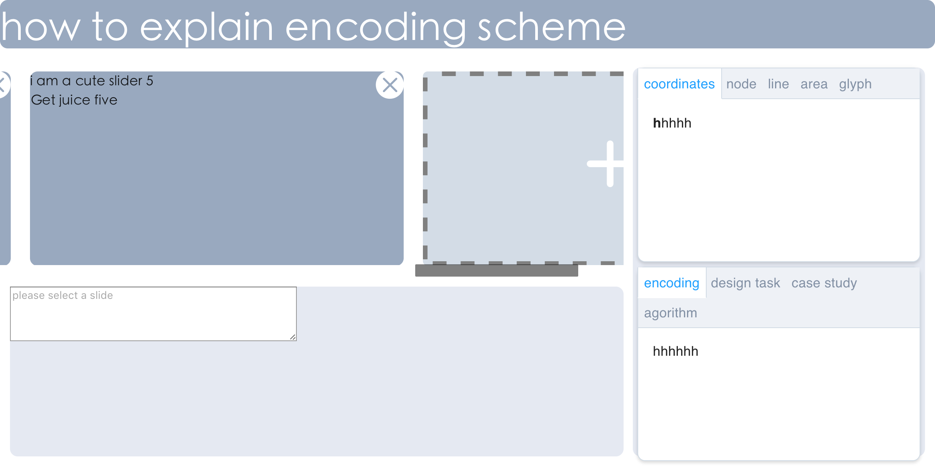
UI Design
Drag to add
Interactive slides:
Able to drag, delete, and add
Resource:
Extracted related elements from the text and the figure
Can be drag and drop on the interactive slides
Editor:
Edit selected slide
Add animation, edit annotation,

Slide 37
User study needed
Participants:
Insider VS outsider of visual community
Source:
Narrative slideshow of our system VS figures and text explanation
Metrics:
Understandability, memorability

Slide 38
Plan and milestone
date | idea | writing | coding | check
1.19 | Collect and read paper, videos about text visualization (start from theme river); | Survey related work;(wqw) | Finish decomposition of a png figure (LZ); Drag, add, delete of slides (WQW); | Code: ✓ Vis survey: Mainly focus on paper, need watch some video Related works: clarify categories, need to collect more next
1.26 | Summarize narrative templates; Show examples for feedback; | Related work collection | Collect all target visualization designs published in IEEE VIS, filter;(lz)
2.2 |  | Introduction and related work
2.9 | Refine the templates based on feedback; Continue survey and summarize; |  | Finish text and annotation extraction
2.16 |  | Narrative templates design | Online system: prototype
2.23 | User study design | Detection algorithm | Online system: interaction

Slide 39
Plan and milestone
date | idea | writing | coding | check
3.2 |  | 2 Case studies | Refine online system
3.9 | Experiment: user study
3.16 | Analyze user study data | User studies
3.23 |  | Conclusion and discussion
3.30 |  | Proof reading | Making video

