Slide 1
Marine Traffic Data Analysis
An Exploratory Study of Global Vessel Patterns

Slide 2
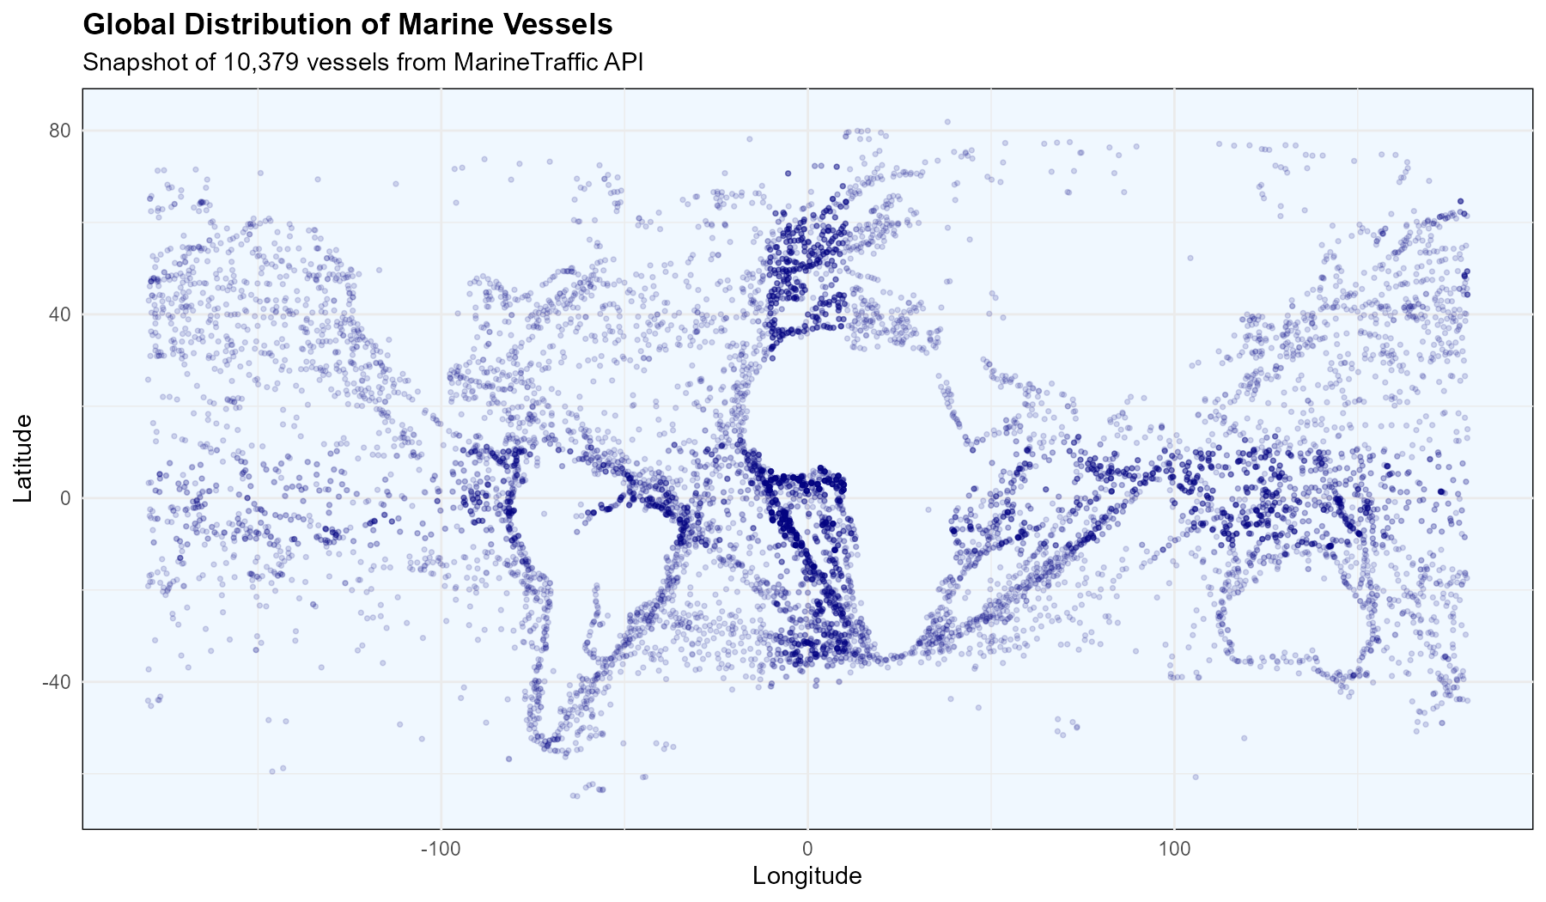
What does global maritime traffic look like?

Slide 3
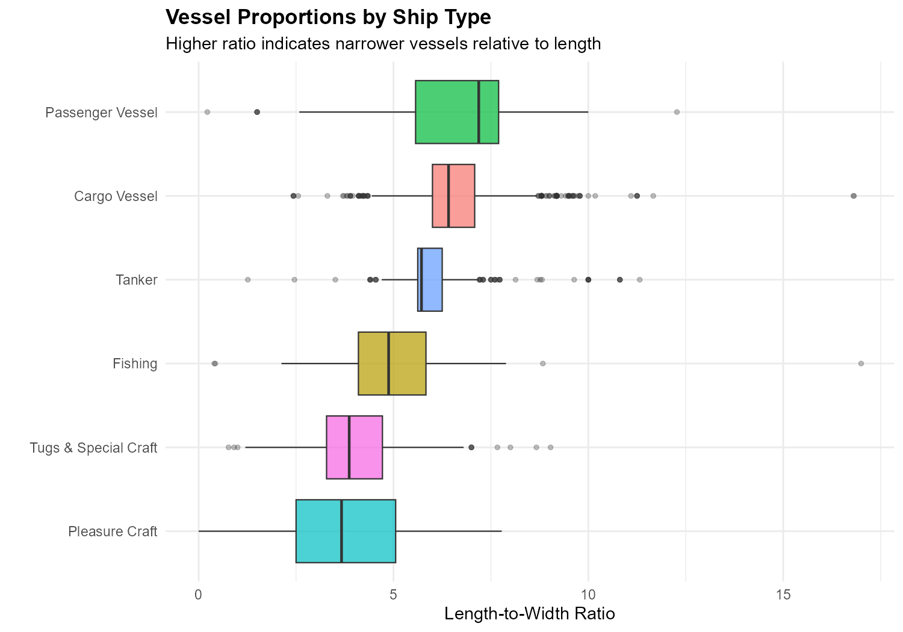
Do different vessel types have characteristic shapes?

Slide 4
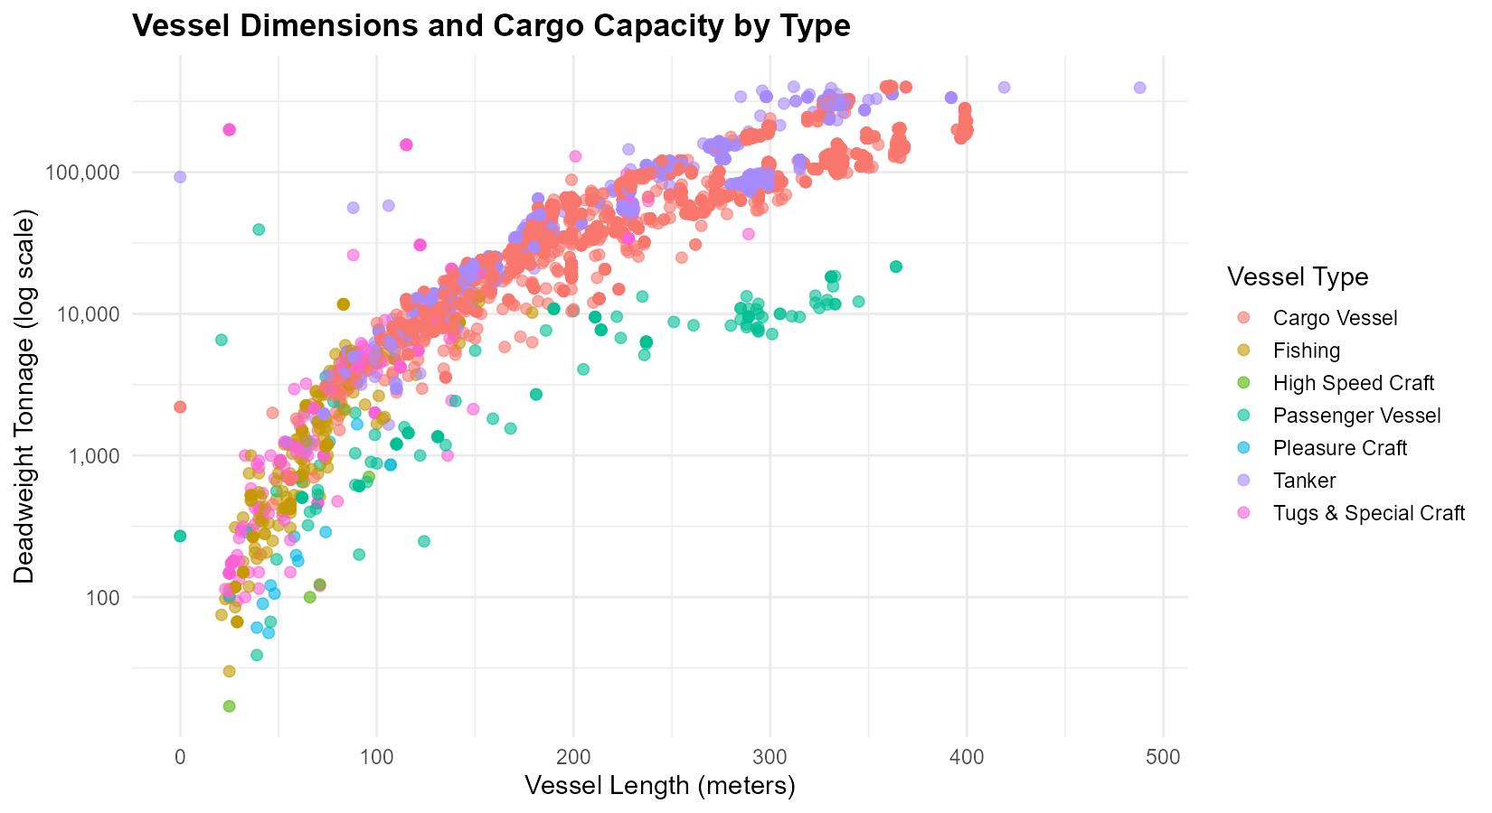
How does cargo capacity relate to vessel size?

Slide 5
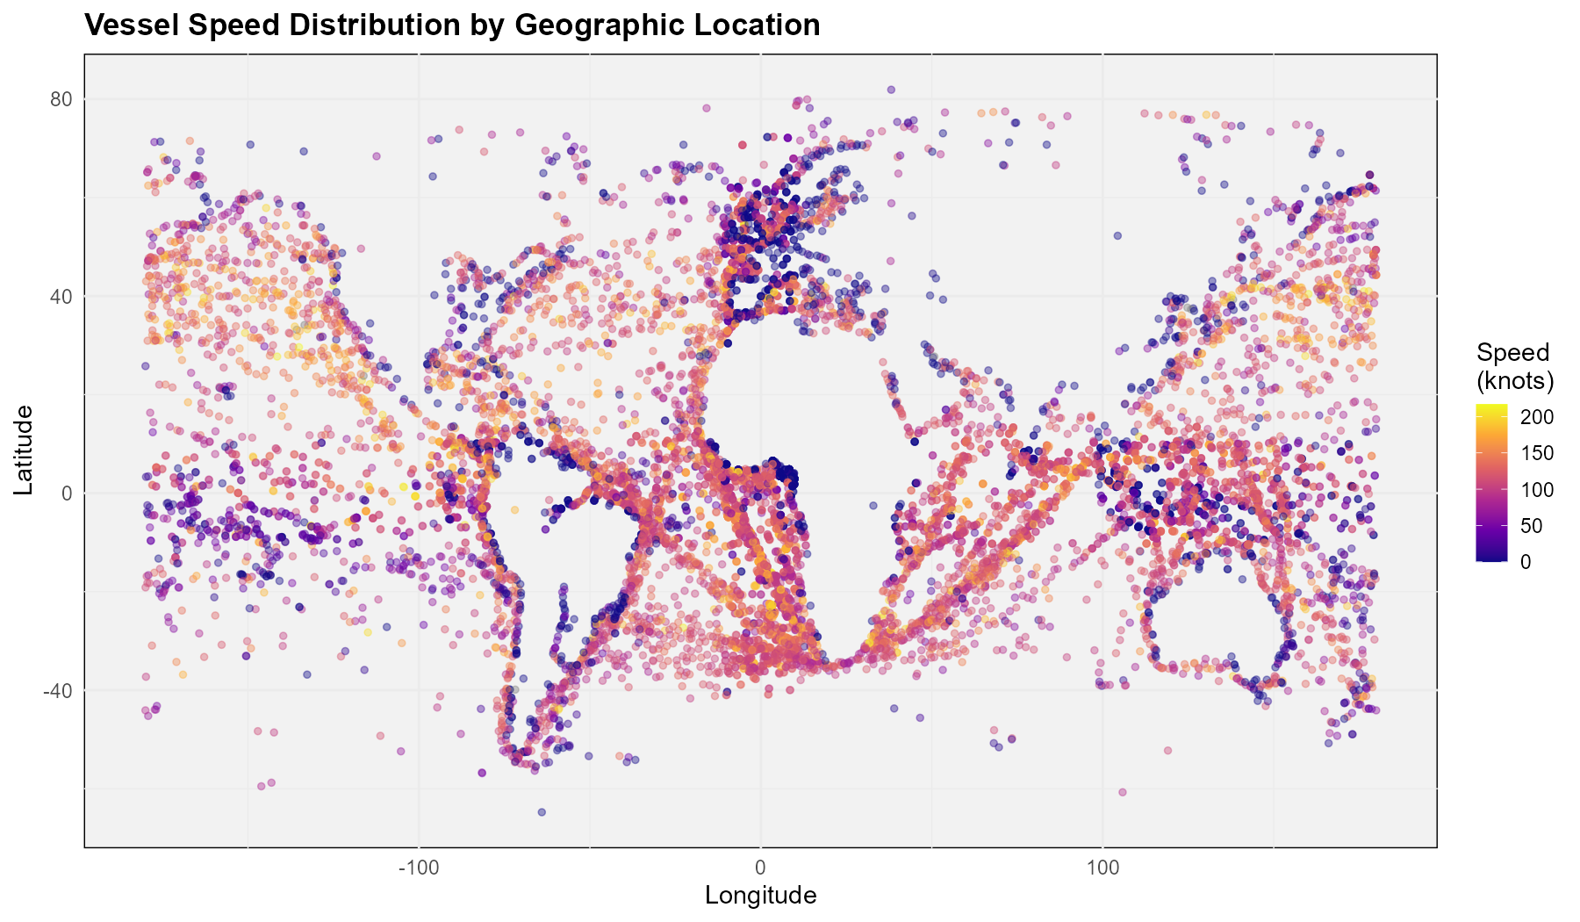
How does speed vary geographically?

Slide 6
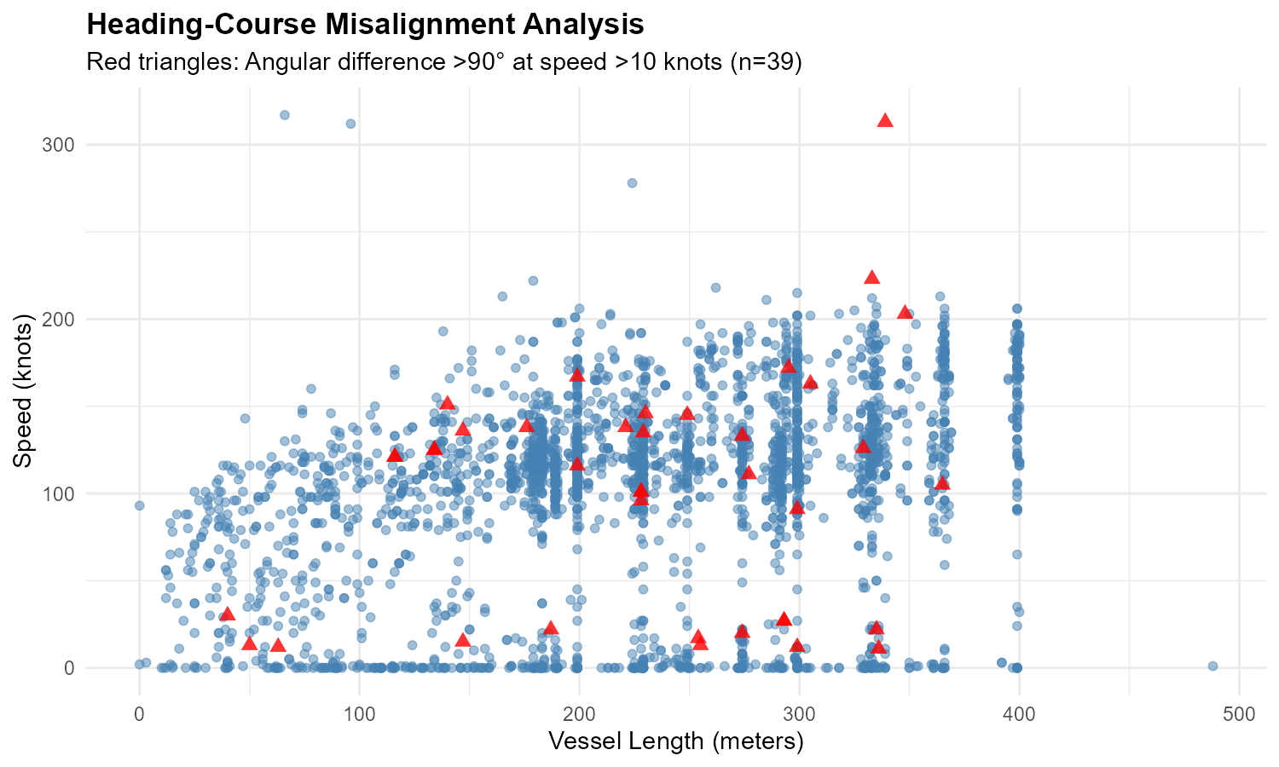
Can heading-course differences identify vessels in distress?

Slide 7
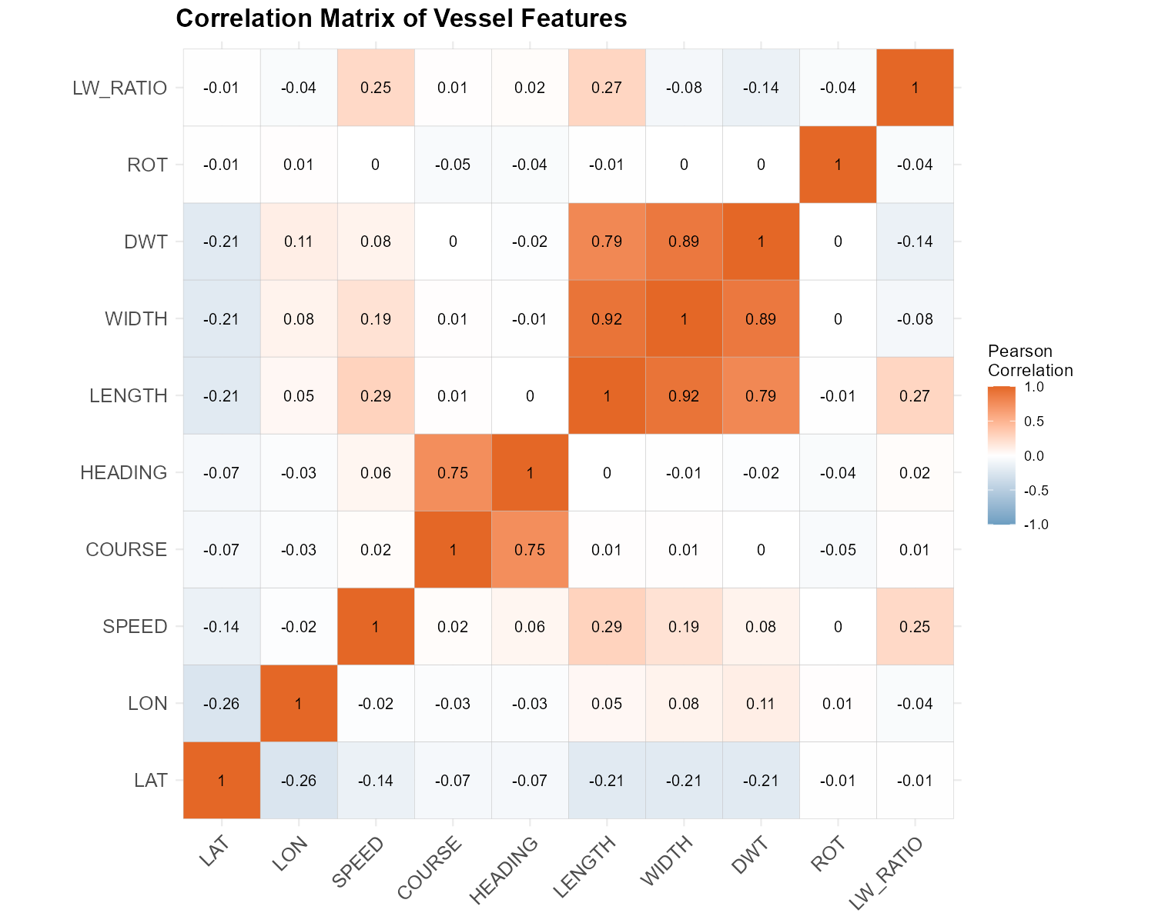
Which features show strong correlations?

Slide 8
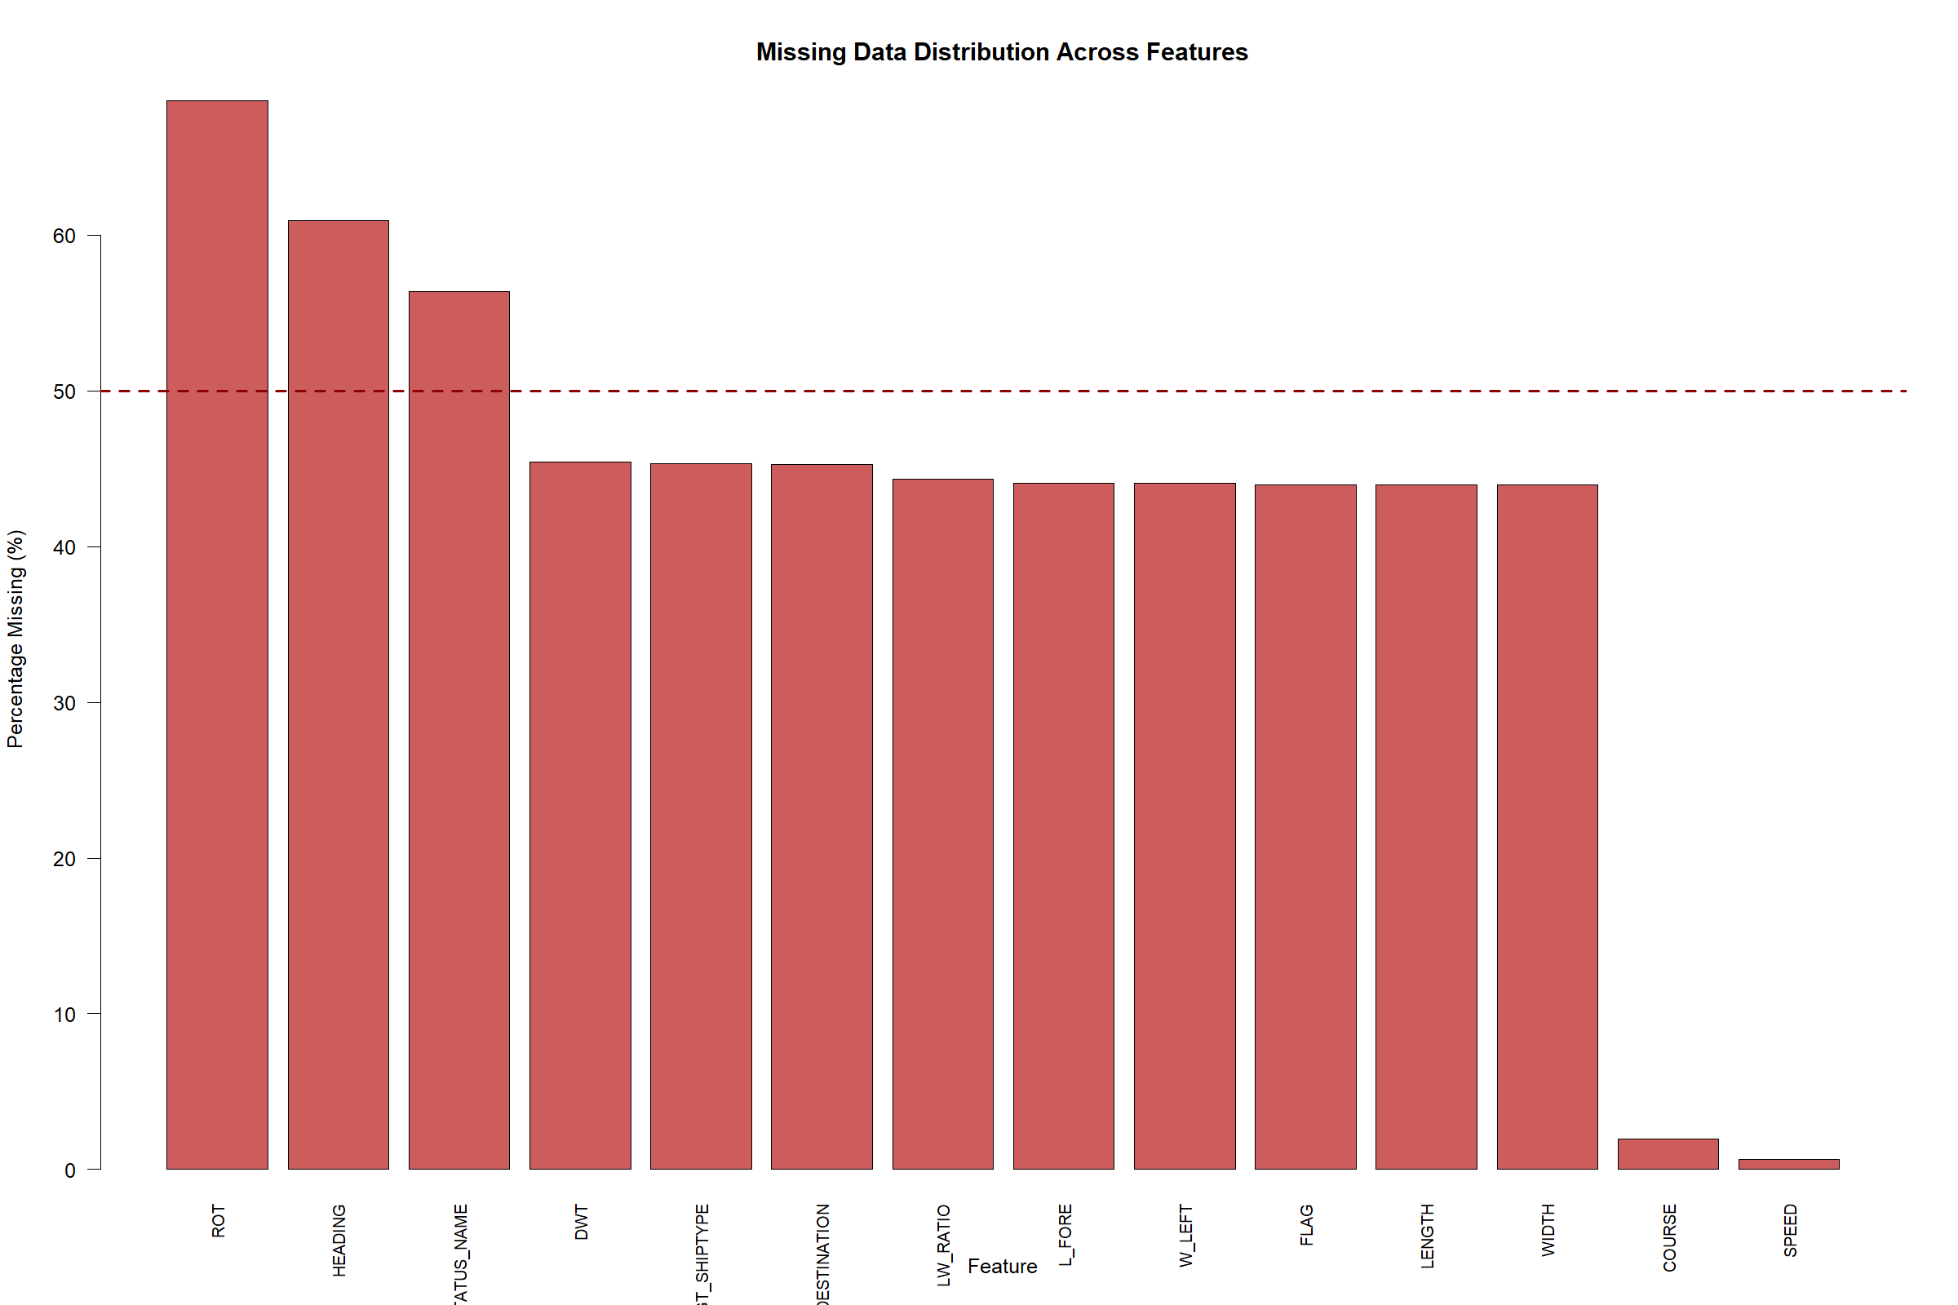
What's missing in our data?

Slide 9
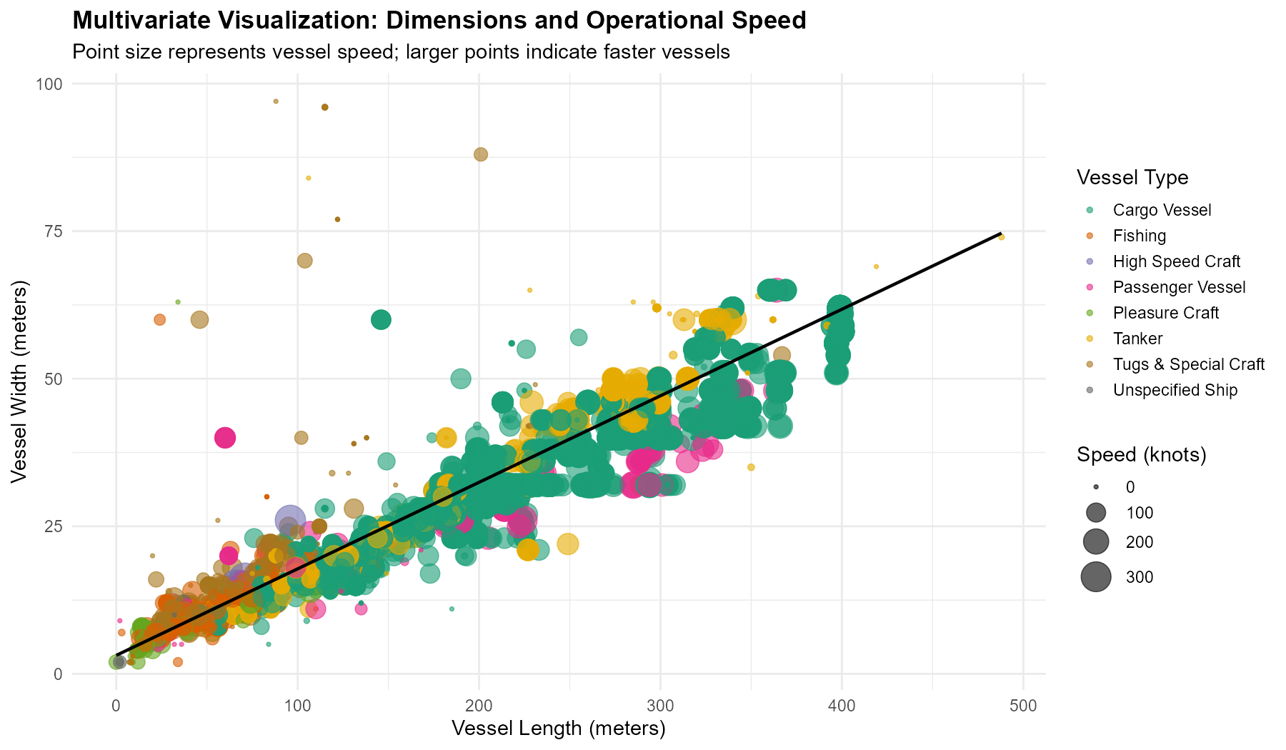
Can we model dimensional relationships?

Slide 10
Conclusion
We reverse-engineered the MarineTraffic API and scraped 10,379 vessels globally.
Through exploratory analysis, we discovered systematic relationships between vessel
characteristics, identified operational patterns, and built predictive models.
Simple linear regression explained 51.8% of dimensional variance—satisfying academic
requirements while revealing the need for advanced machine learning approaches.
This static snapshot establishes the foundation for real-time maritime surveillance,
anomaly detection, and predictive analytics.

