Slide 1
ML Based Demand Forecasting
A Summer Internship Project Report
Presented By: Neil Majumdar
Internship Organization: Jadson Technologies Pvt. Ltd.
Internship Duration: May 25th, 2026 to June 24th, 2026

Slide 2
Project Objectives
Analyze historical E-Commerce sales behavior
Identify seasonal demand patterns and shopping spikes
Perform forecasting diagnostics and volatility analysis
Build a Machine Learning Forecasting Model using Linear Regression
Predict future business sales trends and demand behavior

Slide 3
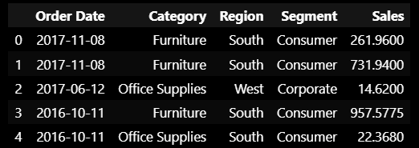
Dataset Overview
Superstore Sales Dataset was used for the analysis
Dataset contains e-commerce business transaction records
Includes sales, profit, customer, category, segment, and regional information
Historical sales data was used for forecasting and trend analysis
Dataset was analysed using Python, Pandas, Matplotlib, and Scikit-Learn

Slide 4
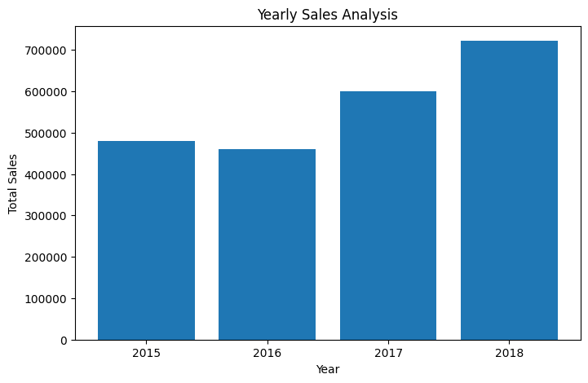
Yearly Sales Trend Analysis
The business demonstrated a consistent long-term upward sales trend across all observed years.

Slide 5
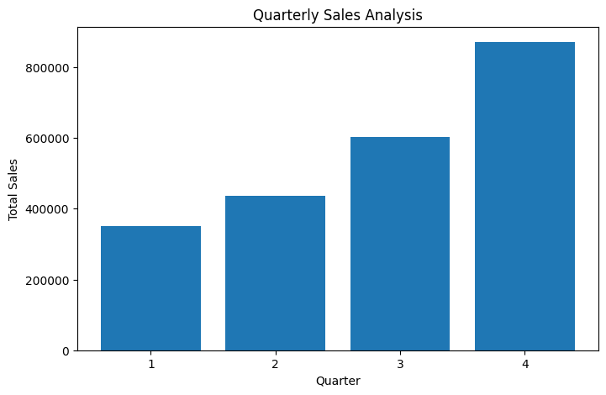
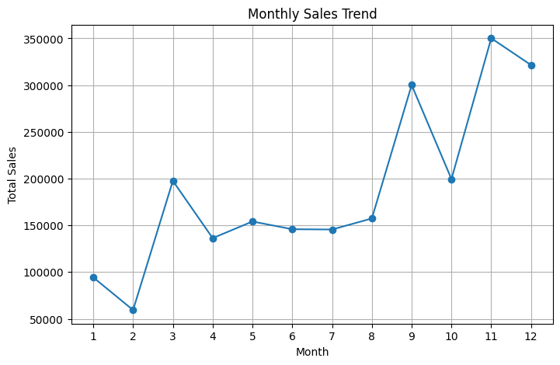
Monthly & Quarterly Sales Analysis
The business demonstrated noticeable monthly and quarterly fluctuations, with Q4 consistently generating the highest sales activity.

Slide 6
Volatility Analysis
• Major sales spikes were observed during Q4.
• Mid-year sales remained relatively stable.
• The business displayed strong non-linear volatility.

Slide 7
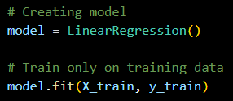

Forecasting Workflow
Workflow Diagram:
Historical Sales Data
• Historical sales records were used as the primary training dataset.
• Linear Regression was implemented to identify sales trends and patterns.
• The model was trained using time-based sales behavior.
• Future sales values were predicted using the trained forecasting model.
• The workflow enabled simple and efficient business demand prediction.
Linear Regression Model
Future Sales Prediction
Implementation Snippet:

Slide 8
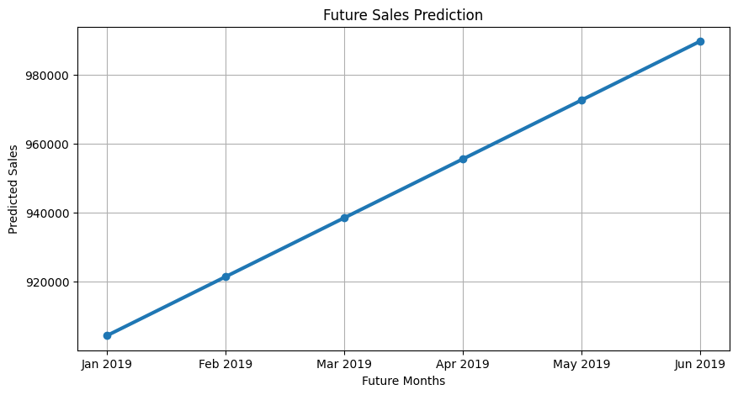
Future Sales Prediction
Predicted sales continue to show long-term business growth.
Forecast values follow consistent historical sales behavior.
Forecasting supports future inventory and demand planning.
Upward Trend
Stable Forecast
Business Utility

Slide 9
Business Insights & Interpretation
Key Insights
Business Impact
Sales demonstrated consistent long-term growth trends.
Q4 periods generated the highest sales activity.
Monthly sales patterns showed noticeable volatility.
Forecasting results indicated stable future demand growth.
The business can optimize inventory during peak seasons.
Forecasting reduces overstock and understock risks.
Trend analysis supports better strategic planning.
Data-driven forecasting improves operational efficiency.
"Forecasting enables smarter business planning and strategic decision-making."

Slide 10
Model Limitations and Future Improvements
⚠️ Model Limitations
🚀 Future Improvements
Linear Regression assumes a linear relationship in sales trends.
External business factors like seasonality and market demand were not included.
Prediction accuracy may vary with real-world fluctuations.
The model focused on basic forecasting implementation.
Advanced ML models like Random Forest or XGBoost can be implemented.
Seasonal and festival-based demand analysis can be added.
Real-time business data integration can improve predictions.
Larger datasets can improve forecasting reliability.

Slide 11
Tools & Technologies Used
Python
Used for data analysis
Also used for ML implementations
Supported forecasting model development
🐍 Programming Language
📚 Libraries & Frameworks
Pandas
NumPy
Matplotlib
Scikit-learn
💻 Development Tools
📊 Visualization Tools
Jupyter Notebook
VS Code
Google Colab
Used for coding and experimentation
Matplotlib
Microsoft Excel
PowerPoint
Used for charts, analysis, and reporting

Slide 12
Project Outcomes & Learning Experience
📈 Project Outcomes
🧠 Key Learnings
Successful analysis of historical sales data.
Identified monthly and quarterly sales trends.
Built a working sales forecasting model.
Generated future sales predictions using ML.
Improved understanding of business demand patterns.
Learned practical implementation of Linear Regression.
Improved Python and data analysis skills.
Understood real-world forecasting workflows.
Gained experience in data visualization and reporting.
Enhanced problem-solving and presentation abilities.
“Bridging data analysis with real-world business forecasting.”

Slide 13
Data Preparation Pipeline
Raw Dataset
Data Cleaning
Feature Engineering
Model-Ready Data

Slide 14
Data Preparation Details
🧹Data Cleaning
Feature Engineering
Verified dataset structure and consistency
Checked for missing or invalid values
Validated column data formats
Prepared dataset for analysis
Extracted Year from Order Date
Extracted Month from Order Date
Generated Time Index for forecasting
Prepared features for Linear Regression

Slide 15
Model Training & Development
Training Workflow
Model Development Process
Historical sales records were used as training data.
Time Index represented the sequence of sales over time.
Linear Regression identified underlying sales trends.
The model learned patterns from historical observations.
Forecasts were generated using the trained model.
Historical Sales Data
Time Index
Linear Regression
Trained Model

Slide 16
Model Evaluation & Performance
Average Forecasting Error
Forecast Accuracy Indicator
Mean Absolute Error (MAE)
32,200.46
Mean Absolute % Error (MAPE)
12.89%
Performance Interpretation
MAPE below 15% indicates good forecasting accuracy.
Forecasts closely followed historical sales trends.
The model successfully captured business growth patterns.
Suitable for demand forecasting and inventory planning.

Slide 17
Business Recommendations
📦 Inventory Planning
📈 Demand Forecasting
Maintain adequate stock levels during peak demand periods.
Use forecast trends to prevent stock shortages and overstocking.
Monitor future sales trends regularly.
Update forecasts periodically for improved accuracy.
💰 Resource Allocation
🎯 Strategic Decision Making
Allocate workforce and operational resources based on predicted demand.
Improve efficiency during high-sales periods.
Use forecast insights to support business planning.
Enable data-driven decision making across departments.

Slide 18
Future Scope & Enhancement Roadmap
Phase 1
Advanced
Models
Phase 2
Seasonal Intelligence
Phase 3
Real-Time Integration
Phase 4
Business Intelligence
Future improvements can enhance forecasting accuracy, automation, and business decision-making.

Slide 19
Project Summary
Project Objectives
Dataset
Forecast future sales using
historical business data.
Superstore Sales Dataset used for trend analysis and forecasting.
MAPE
12.89%
Model Used
Business Value
Linear Regression implemented for sales forecasting and trend prediction.
Supports inventory planning and data-driven decision making.

Slide 20
Thank You!

