Slide 1

ACEs: Integrated Impact Report — Enhanced
Comprehensive analysis of childhood experiences and outcomes
Notes:
---

Slide 2
Mechanism of Unconscious Momentum
Notes:
---
This slide references information from the following file: https://trioscollege-my.sharepoint.com/personal/neil_schwab_triosstudent_com/Documents/Microsoft%20Copilot%20Chat%20Files/Conscious%20Karma%20Human%20Evolution,%20and%20the%20Path%20to%20Therapeutic%20Resolution.pdf
Understanding Developmental Stack and Momentum

Slide 3

Understanding Developmental Stack and Momentum
Developmental Stack Layers
  Developmental stack includes genetics, early attachment, childhood schemas, and limbic system dominance influencing behavior.
Unconscious Momentum
  Patterns formed early persist unconsciously, causing repeated behaviors despite conscious insight.
Conscious Change Process
  Breaking unconscious momentum requires conscious practice, building new neural pathways and reducing shame.
Dual Reality in Transition
  Old patterns persist while new aligned actions build positive momentum needing patience and repetition.
Notes:
---
This slide references information from the following file: https://trioscollege-my.sharepoint.com/personal/neil_schwab_triosstudent_com/Documents/Microsoft%20Copilot%20Chat%20Files/Conscious%20Karma%20Human%20Evolution,%20and%20the%20Path%20to%20Therapeutic%20Resolution.pdf
Unconscious momentum refers to the persistence of patterns formed through early developmental experiences, even after gaining insight into them. The developmental stack begins with genetic inheritance, followed by early attachment experiences, schema formation during childhood, and limbic system dominance in response to trauma. These layers create automatic survival programs that continue to operate beneath conscious awareness. Even when individuals recognize these patterns, they often find themselves repeating them because of the accumulated neurological and behavioral momentum. This phenomenon explains why insight alone does not lead to immediate change. To overcome unconscious momentum, individuals must repeatedly engage in conscious practices that interrupt automatic responses and build new neural pathways. Depersonalizing patterns—understanding that these behaviors are installed mechanisms rather than core identity—is crucial for reducing shame and fostering change. The concept of dual reality during transition is also important: old patterns still express themselves while new, aligned actions gradually accumulate positive momentum. This process requires patience, repetition, and structured interventions that engage executive functioning and ethical intention, ultimately shifting the trajectory from fear-based survival to conscious, values-driven living.

Slide 4
Unconscious Decision Chain
Notes:
---
This slide references information from the following file: https://trioscollege-my.sharepoint.com/personal/neil_schwab_triosstudent_com/_layouts/15/Doc.aspx?sourcedoc=%7BDD964864-9EF5-46EF-8627-D2D0D756CC6C%7D&file=AW%20THESSIS%201.docx&action=default&mobileredirect=true
Addiction and Relational Compulsion Mechanisms

Slide 5

Addiction and Relational Compulsion Mechanisms
Unconscious Decision Chain
  Compulsive behaviors follow a cycle of triggers, automatic thoughts, emotional reactions, and temporary relief reinforcing themselves.
Role of Emotional Reactivity
  Emotions like fear or shame drive compulsive actions aimed at immediate relief but strengthen unhealthy patterns.
Conscious Interventions
  Techniques like Sacred Pause and grounding create space for mindful choices, breaking compulsive cycles.
Transformation through Awareness
  Understanding compulsions as attempts to manage distress empowers intentional change and healing.
Notes:
---
This slide references information from the following file: https://trioscollege-my.sharepoint.com/personal/neil_schwab_triosstudent_com/_layouts/15/Doc.aspx?sourcedoc=%7BDD964864-9EF5-46EF-8627-D2D0D756CC6C%7D&file=AW%20THESSIS%201.docx&action=default&mobileredirect=true
The unconscious decision chain illustrates how ACE-related trauma drives compulsive behaviors such as addiction and dysfunctional relationship patterns. This chain typically follows six predictable steps: trigger activation, automatic thinking, emotional reactivity, behavioral compulsion, temporary relief, and reinforcement cycle. Each step reinforces the previous one, creating a closed loop that perpetuates suffering. For example, a trigger—such as perceived rejection—activates conditioned thoughts rooted in childhood schemas, which then generate intense emotional states like fear or shame. These emotions drive compulsive behaviors aimed at immediate regulation, such as substance use or pursuit of an unavailable partner. Temporary relief from these behaviors reinforces the association between external solutions and internal regulation, strengthening the cycle. Breaking this chain requires inserting conscious interventions at key points, particularly between trigger and response. Techniques such as the Sacred Pause, present-moment grounding, and observer-awareness practices create space for conscious choice, allowing individuals to respond from adult resources rather than child survival strategies. This approach reframes addiction and relational compulsion not as moral failings but as unconscious attempts to manage distress, emphasizing the possibility of transformation through awareness and intentional action.

Slide 6
Five-Step Practice
Notes:
---
This slide references information from the following file: https://trioscollege-my.sharepoint.com/personal/neil_schwab_triosstudent_com/Documents/Microsoft%20Copilot%20Chat%20Files/Conscious%20Karma%20Human%20Evolution,%20and%20the%20Path%20to%20Therapeutic%20Resolution.pdf
Structured Intervention for Conscious Transformation

Slide 7
Structured Intervention for Conscious Transformation
Pause and Interrupt
  Stopping creates a mindful pause to break automatic, unconscious behavioral momentum.
Regulate and Breathe
  Controlled breathing regulates the nervous system and restores executive brain functions.
Connect and Listen
  Listening fosters connection to authentic values and present reality over fear responses.
Aligned Intention
  Finding motivations that serve others kindly and uphold ethical clarity and compassion.
Act with Boundaries
  Taking respectful action that maintains integrity and avoids harm to self and others.
Notes:
---
This slide references information from the following file: https://trioscollege-my.sharepoint.com/personal/neil_schwab_triosstudent_com/Documents/Microsoft%20Copilot%20Chat%20Files/Conscious%20Karma%20Human%20Evolution,%20and%20the%20Path%20to%20Therapeutic%20Resolution.pdf
The Five-Step Practice provides a practical framework for interrupting unconscious patterns and fostering conscious choice. Step one, STOP, involves creating a pause to disrupt automatic momentum. Step two, BREATHE, focuses on regulating the autonomic nervous system and restoring prefrontal cortex access, which is essential for executive functioning. Step three, LISTEN, encourages individuals to connect with their authentic values and present reality rather than reacting from conditioned fear. Step four, FIND ALIGNED INTENTION, requires identifying motivations that serve others kindly and align with ethical clarity, ensuring that actions are grounded in compassion rather than reactivity. Finally, step five, ACT WITH BOUNDARIES, emphasizes taking action that respects both self and others, avoiding harm while maintaining integrity. This practice works because it engages neurological mechanisms of change: interrupting limbic reactivity, activating conscious awareness, and reinforcing new patterns through repetition. Over time, these steps build positive momentum, weaken automatic schemas, and create sustainable transformation. The Five-Step Practice is versatile, applicable in addiction recovery, relational healing, and trauma integration, making it a cornerstone of ACE-informed therapeutic interventions.

Slide 8
Phased Care Pathway
Notes:
---
This slide references information from the following file: https://trioscollege-my.sharepoint.com/personal/neil_schwab_triosstudent_com/_layouts/15/Doc.aspx?sourcedoc=%7BDD964864-9EF5-46EF-8627-D2D0D756CC6C%7D&file=AW%20THESSIS%201.docx&action=default&mobileredirect=true
ACE-Informed Recovery Stages

Slide 9
ACE-Informed Recovery Stages
Safety and Stabilization
  Focus on nervous system regulation, environmental safety, and building therapeutic trust.
Recognition and Understanding
  Introduce psychoeducation on trauma’s effects, identify triggers without judgment, and promote observer consciousness.
Processing and Integration
  Work through trauma, develop emotional tolerance, and practice conscious choices during activation.
Meaning and Growth
  Recognize strengths, clarify values, and set authentic intentions to foster resilience.
Service and Integration
  Share healing journey, maintain recovery, and engage in long-term self-regulation.
Notes:
---
This slide references information from the following file: https://trioscollege-my.sharepoint.com/personal/neil_schwab_triosstudent_com/_layouts/15/Doc.aspx?sourcedoc=%7BDD964864-9EF5-46EF-8627-D2D0D756CC6C%7D&file=AW%20THESSIS%201.docx&action=default&mobileredirect=true
The Phased Care Pathway offers a structured approach to ACE-informed recovery, guiding individuals through five progressive stages. Phase 1, Safety and Stabilization, focuses on nervous system regulation, environmental adjustments, and establishing therapeutic trust. Phase 2, Recognition and Understanding, introduces psychoeducation about trauma’s impact on brain and body, identifies triggers without judgment, and teaches observer consciousness. Phase 3, Processing and Integration, involves working through specific traumatic experiences, developing tolerance for difficult emotions, and practicing conscious choice-making during activation. Phase 4, Meaning and Growth, emphasizes recognizing strengths, clarifying values, and setting authentic intentions, fostering resilience and purpose. Phase 5, Service and Integration, encourages individuals to share their healing journey appropriately, maintain recovery in real-world contexts, and engage in long-term maintenance based on internal regulation. This phased model acknowledges that recovery is non-linear and individualized, requiring flexibility and readiness assessment. It integrates trauma-informed principles with consciousness-based practices, ensuring that interventions address both physiological regulation and cognitive restructuring. By combining stabilization, insight, processing, and meaning-making, the pathway provides a comprehensive roadmap for transforming ACE-driven patterns into adaptive, values-aligned living.

Slide 10
Somatic Assessment Addendum
Notes:
---
This slide references information from the following file: https://trioscollege-my.sharepoint.com/personal/neil_schwab_triosstudent_com/_layouts/15/Doc.aspx?sourcedoc=%7BA032B395-E276-4C92-874C-C6377A749051%7D&file=somatic%20disorder%20assignment.docx&action=default&mobileredirect=true
Clinical Strategies for Somatic Symptom Recognition

Slide 11
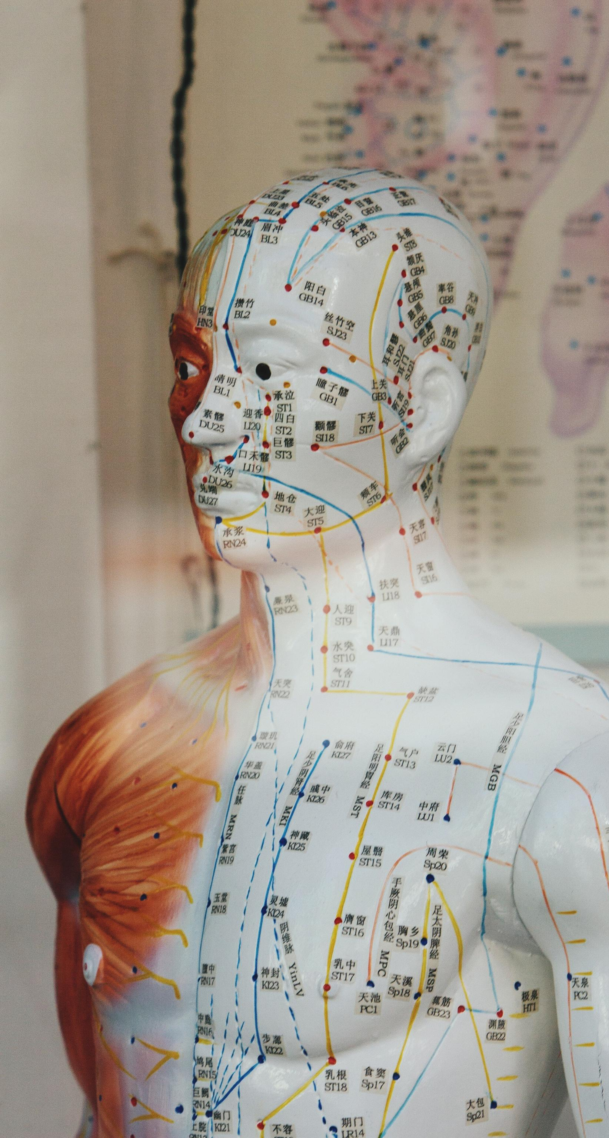
Clinical Strategies for Somatic Symptom Recognition
Unconscious Somatic Indicators
  Unconscious signs like micro-freezes, shallow breathing, and gaze aversion indicate autonomic nervous system dysregulation in trauma.
Conscious Symptom Recognition
  Conscious symptoms include reported pain, chronic fatigue, and sleep problems often linked to psychological distress, not organic causes.
Trauma-Informed Somatic Care
  Integrating grounding, safety planning, and psychoeducation supports clients in understanding the mind-body connection.
Holistic Clinical Approach
  Validating experiences and avoiding overmedicalization fosters compassionate, comprehensive treatment addressing body-mind healing.
Notes:
---
This slide references information from the following file: https://trioscollege-my.sharepoint.com/personal/neil_schwab_triosstudent_com/_layouts/15/Doc.aspx?sourcedoc=%7BA032B395-E276-4C92-874C-C6377A749051%7D&file=somatic%20disorder%20assignment.docx&action=default&mobileredirect=true
Somatic assessment is critical in ACE-informed care because trauma often manifests through physical symptoms that lack clear diagnostic markers. Clinicians must maintain an open, non-pathologizing stance, observing both unconscious and conscious signals. Unconscious indicators include micro-freezes, shallow breathing, gaze aversion, and gastrointestinal tension, which suggest autonomic dysregulation. Conscious signals may involve reported pain patterns, chronic fatigue, and sleep disturbances. These symptoms often reflect underlying psychological distress rather than organic pathology, making it essential to look beneath the surface for trauma-related mechanisms. Effective somatic assessment involves integrating body-first safety planning, grounding techniques, and psychoeducation to help clients understand the mind-body connection. Clinicians should avoid dismissing symptoms as imaginary while also refraining from unnecessary medicalization. Instead, they should validate the client’s experience, explore potential trauma links, and incorporate somatic regulation practices into treatment. This approach aligns with trauma-informed principles, emphasizing compassion, curiosity, and holistic care. By addressing somatic presentations alongside cognitive and emotional patterns, practitioners can create more comprehensive interventions that support nervous system regulation and overall healing.

