Slide 1
Covid-19 Contact Tracing Application
Neil Byrne
G00343624
Supervisor:
Mr. Gerard Harrison

Slide 2
Project Features
A mobile app containing the user’s contact details
RFID scan transfers information to RFID receiver
Geo-tag for user to easily identify when where they have been
Easy contact tracing for user and receiver
MEAN stack and IoT development
Why?
Breach of GDPR
Long-term solution
Learn more about IoT devices and MEAN stack

Slide 3

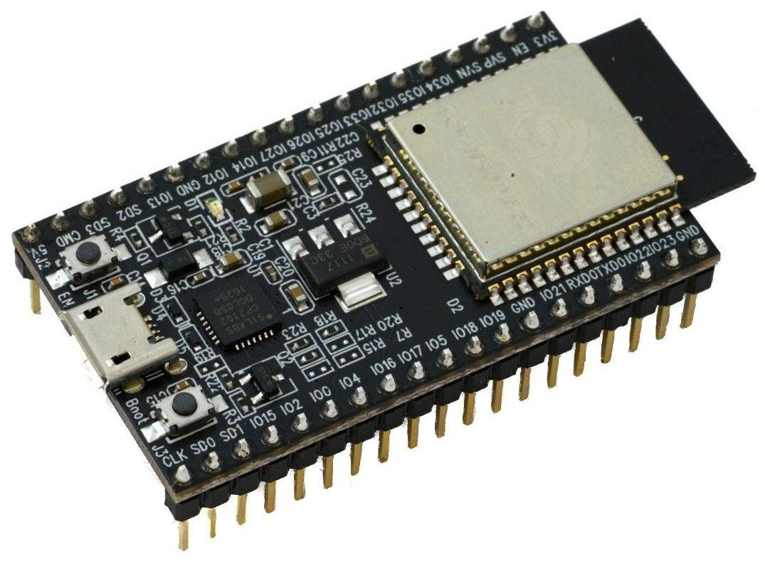
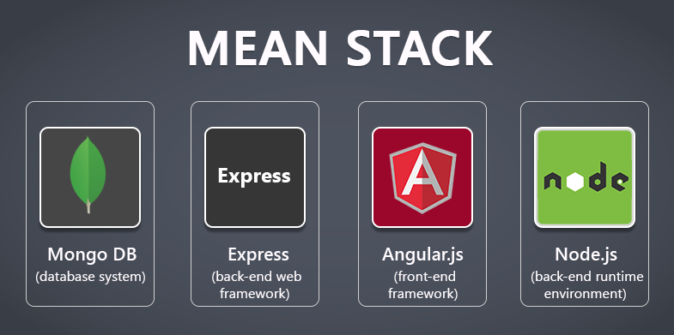
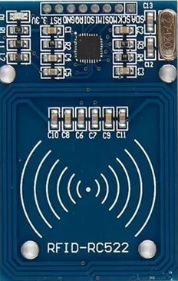

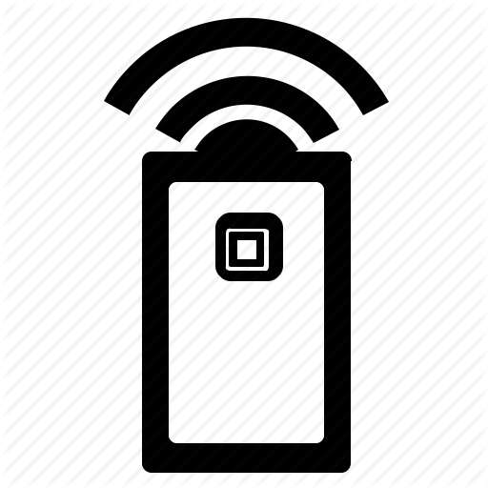
Architecture
Web App
NodeMCU 32 Board
Mongo DB
RFID Reader
Admin
Mobile App

Slide 4
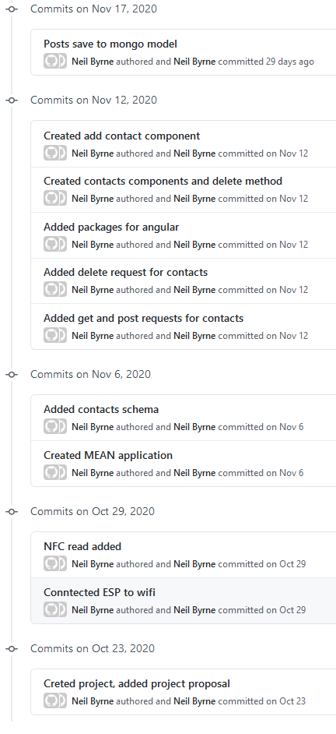
Development & Deployment
List any objectives that have already been implemented.
ESP32 RFID functional
Basic CRUD application

Slide 5
Work Plan
Show a Gantt Chart of the set of remaining activities.
Don’t forget to include your dissertation document and any other deliverables.

