Slide 1
NB Knight
Chong Sun

Slide 2
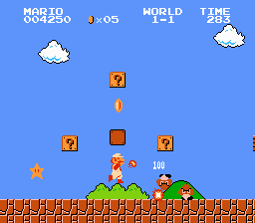
Introduction
A platform game like Super Mario Bro

Slide 3
Gameplay
Kill all enemies and avoid being attack by enemies’ bullets.

Slide 4
Controls
Move: A, D
Attack: J
Jump: SPACE

Slide 5
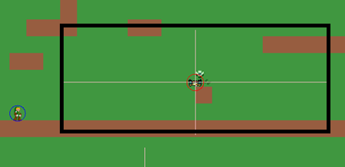
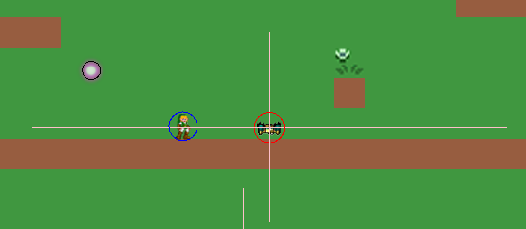
Enemy AI
Enemies can choose their target by themselves
Player not in alert range:
target=spawn point
Player in alert range:
target=player & attack
Player out of alert range:
target=spawn point & back to spawn point

Slide 6
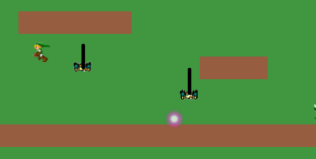
Enemy AI
Enemies can jump
Check distance to target on Y-axis
distance >= 32:
enemy jump

Slide 7
In the future
Add:
Improve:
Sound
Enemy animation
Pickups
Final boss
Animation
Enemy AI
Code design
Fix some hard code

